Slide 1
Digital Story telling
Dr. Indu Kumar,
Associate Professor
Department of ICT and Training
CIET, NCERT

Slide 2
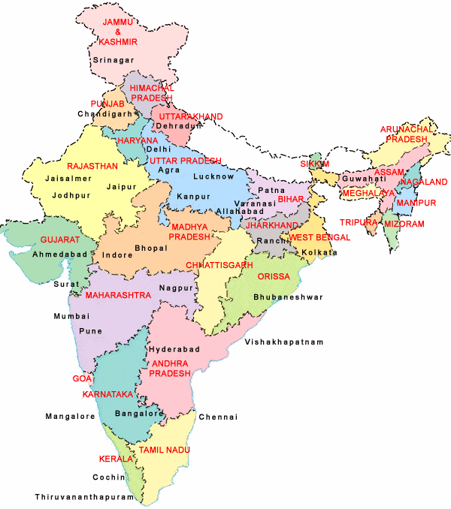
The Challenges we face
28 States 07 UTs
1.49 million schools
8.5 million teachers
48 School Boards
24,85,68,702 children in school
96,007 Secondary Schools under ICT@Schools Scheme

Slide 3
What is digital story?
Digital story is e text, video, audio/voice narration, music, sound effects, images and graphics; singly or in combination to create a fictional or non fictional media or multimedia narration.

Slide 4
Different Forms of Digital Stories
Mind Maps
Simulation
Audio
Video
Advertisement
Interactive media
Info graphics
Photographs
Animation
Cartoons as a digital Story
Slide shows,
Diagrams,
Charts,
Graphs,
Flow diagrams,

Slide 5
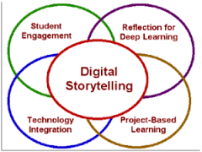
Role of digital stories in effective communication

Slide 6
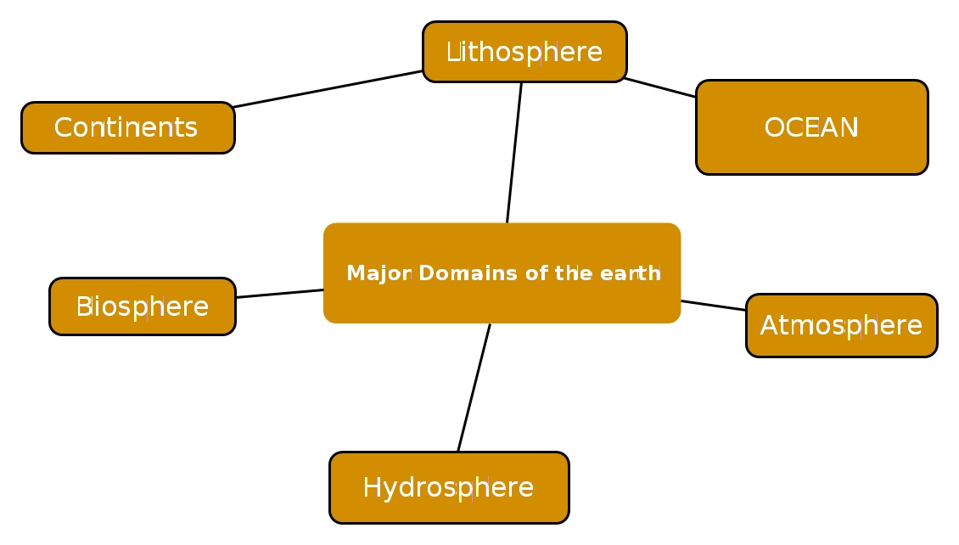
Digital stories :Example

Slide 7

Digital stories :Example

Slide 8
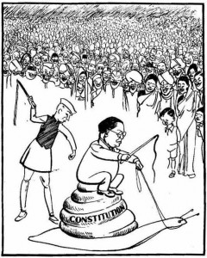
Digital stories :Example

Slide 9
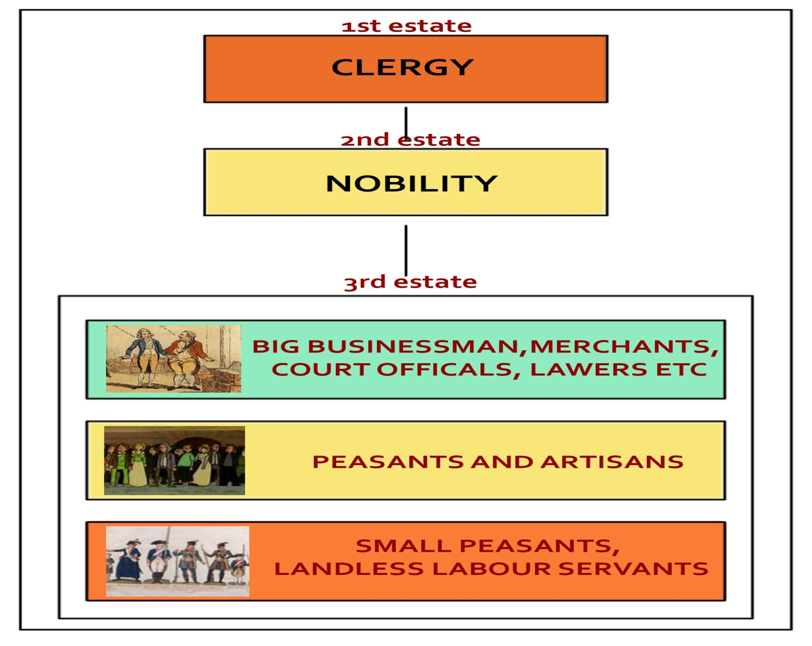
Digital stories :Example

Slide 10
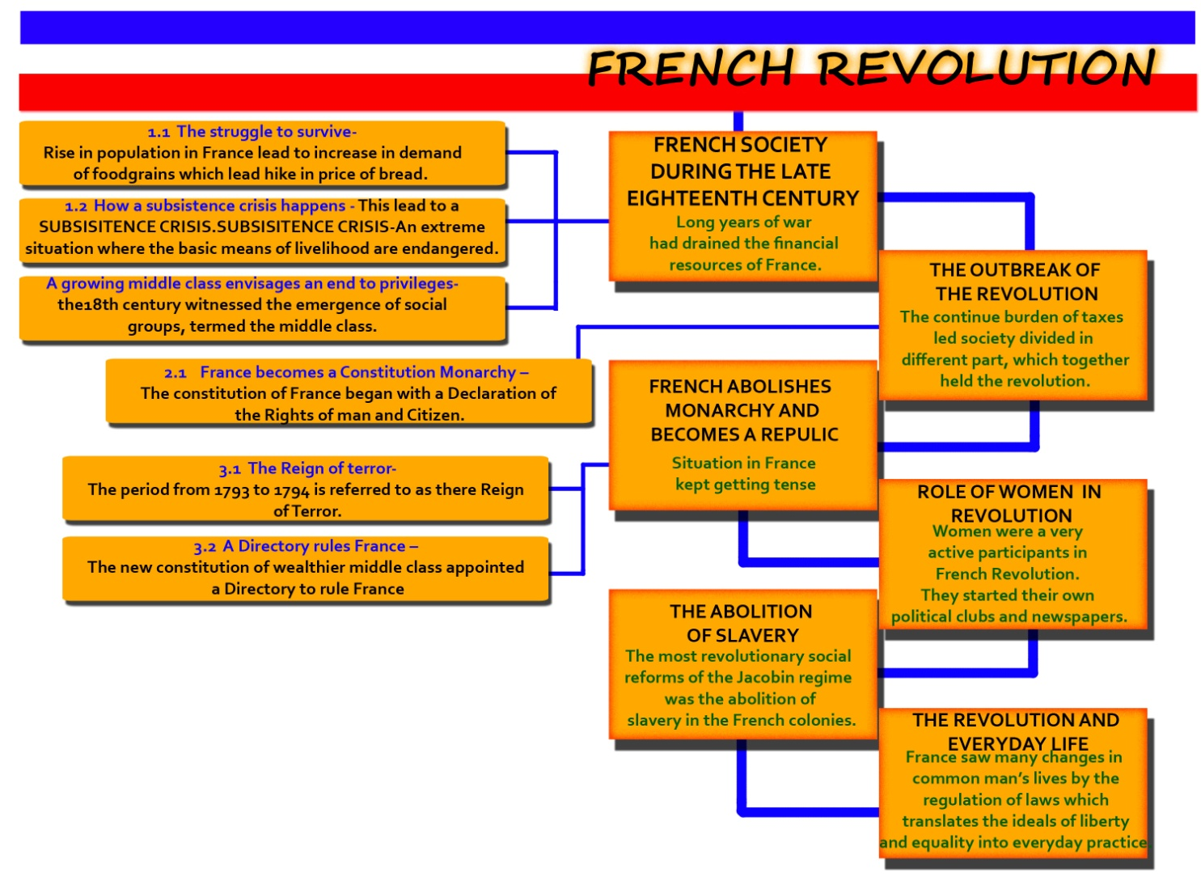
Digital stories :Example

Slide 11
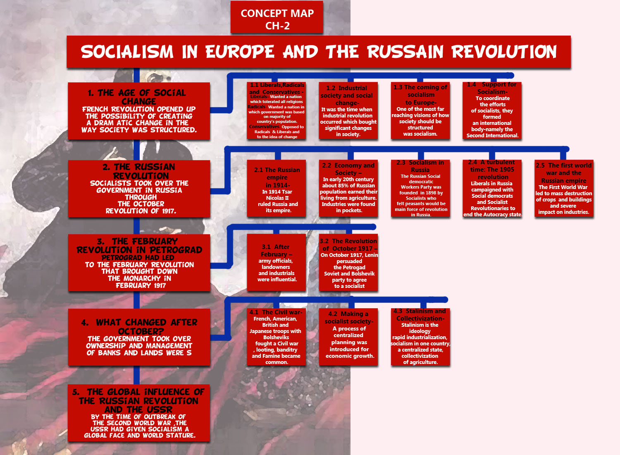
Digital stories :Example

Slide 12
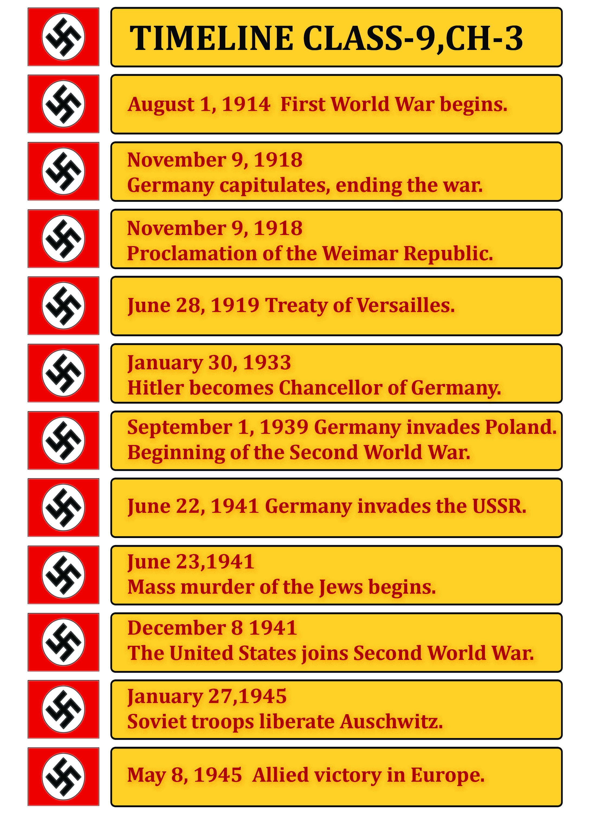
Digital stories :Example

Slide 13
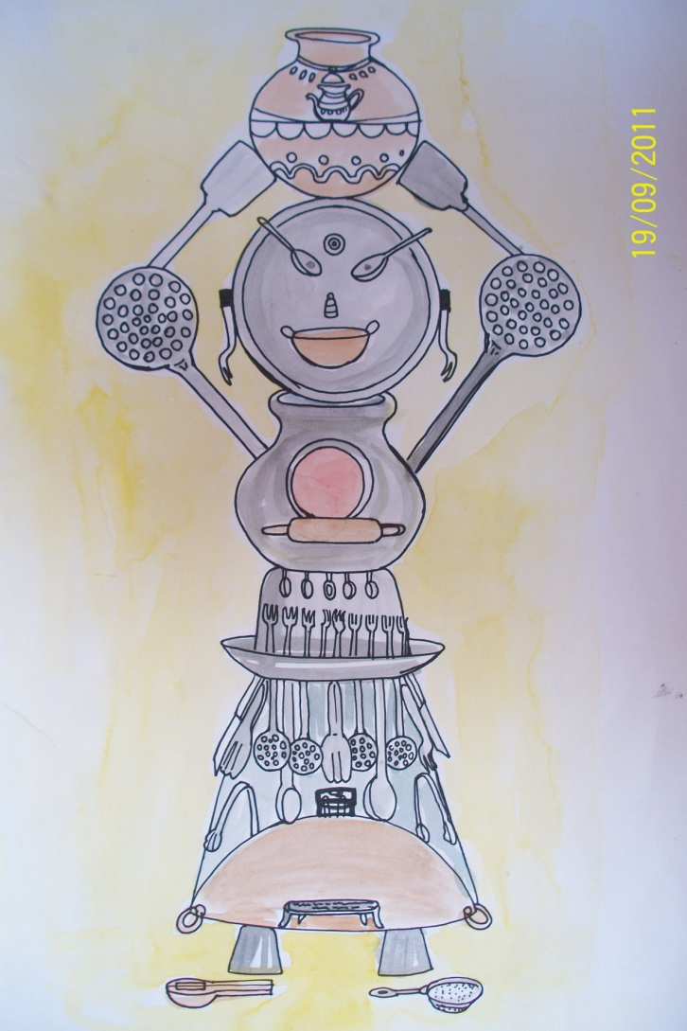
Digital stories :Example

Slide 14
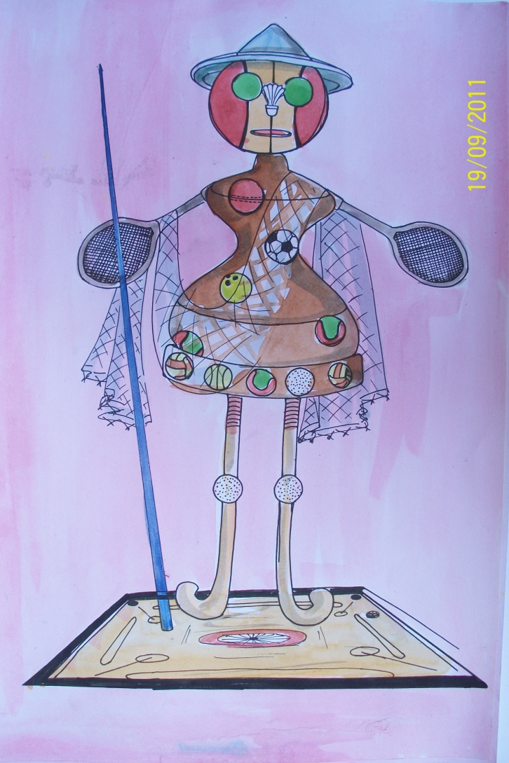
Digital stories :Example

Slide 15
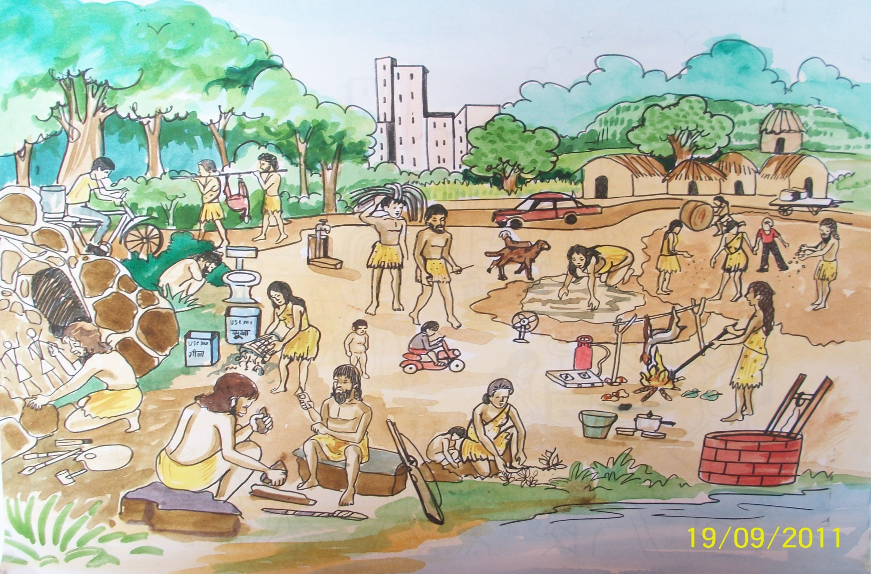
Digital stories :Example

Slide 16
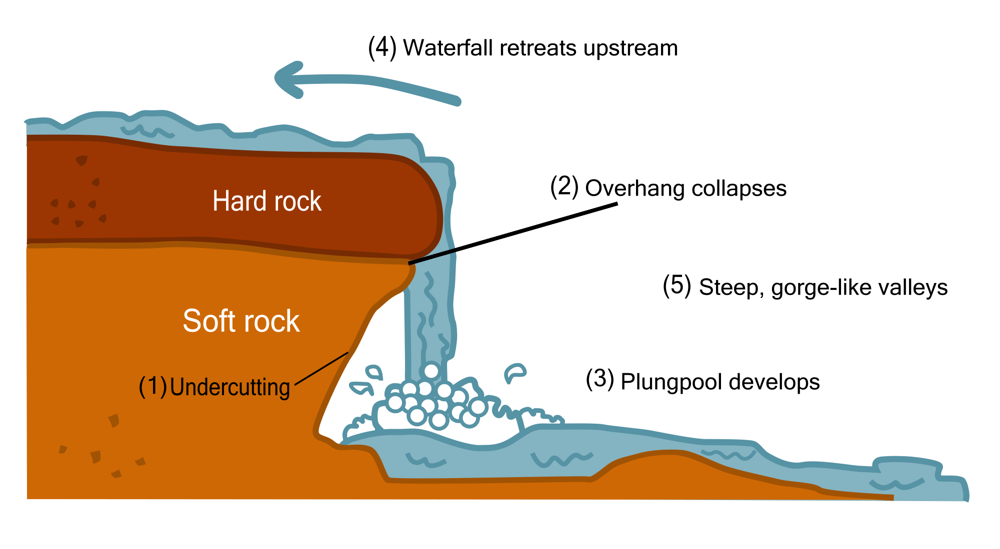
Digital stories :Example

Slide 17
Criteria For Media Selection and Integration
Availability
Accessibility
Reliability and Validity
Economy/Costing

Slide 18
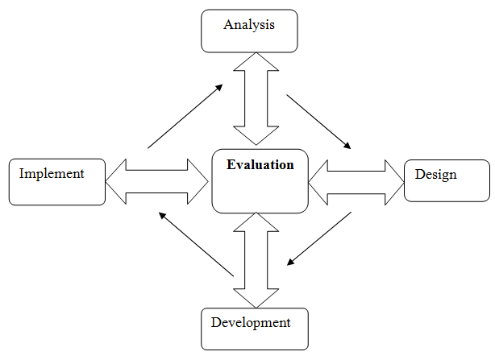
ADDIE Model

Slide 19
Thank You
induk.babra@gmail.com

