Slide 1
Mauritius : A small island experience on ICT and STEM Education
Ricaud AUCKBUR
Ministry of Education
Mauritius
Thursday 3 Nov 2016
International Forum on Adopting an ICT Perspective to Education and Learning
NCERT, New Delhi, India

Slide 2

This is science, and it started my journey in technology in Education back in 1983

Slide 3
No ICT in schools back in 1983, but triggered the concept that technology can assist learning through slide film projectors and telescopes

Slide 4
Presentation Plan
Part 1 : Setting the scene - Mauritius context of ICT in Education
Part 2 : ICT and STEM Education
Part 3 : Hands on practice of ICT and STEM tools used in Mauritius
Part 4 : Discussions

Slide 5
Part 1 : Setting the scene - Context of ICT in Education
in Mauritius

Slide 6

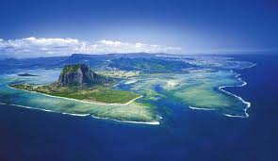
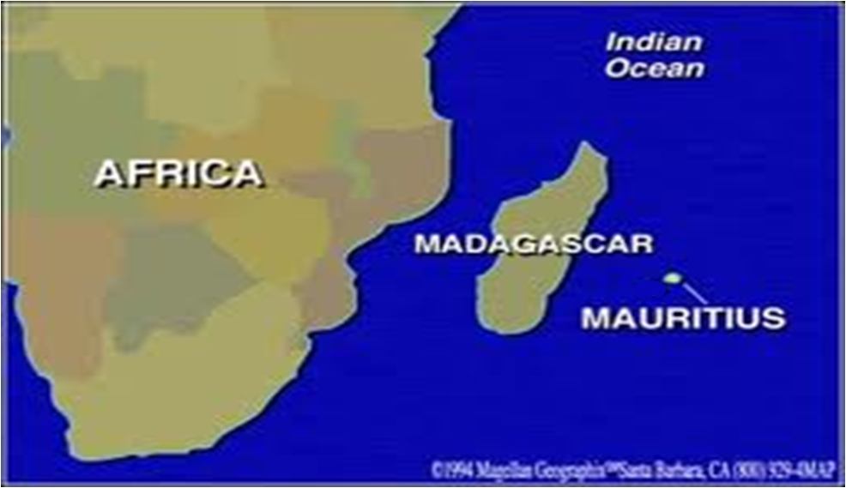
Mauritius at a glance
Independence from UK : 1968
Region : Africa
Sub Region : Small Island State, in Mascarene Indian Ocean
Country Size : 60km x 40 km
Population : 1.3M, multi-ethnic, multilingual in French, English, Bhojpuri, Mandarin
Diversified Economy : Tourism, Services sector, Sugar, Textile ,ICT services, Ocean industries (port, fishing, bunkering)
Narrow natural resource base
GDP per capita : US$ 9200
Mo Ibrahim country Governance Index : 1st in Africa
Education System : Local curricula for Primary schools (270 schools), UK O & A Levels for Secondary (150 schools)
Gender parity in Education (in fact girls do better than boys in Mauritius …)

Slide 7
ICT in overcoming isolation of Small Island Developing States (SIDS)
“SIDS can envisage rapid technological innovation, especially in ICTs, that will help to:
overcome island isolation
create new ways of maintaining social and cultural ties across the island diaspora; and
help evolve new economic activities.”
UNEP 2014 – Global Environment Outlook for Small Island Developing States .

Slide 8
ICT in Education : the Mauritian context
Bridging digital divide in an increasingly globally connected environment
Limited local capacity for digital resource development
ICT imperative
Schools not yet on high speed internet. Relatively limited bandwidth in the country due to geographical isolation remote from global digital highways
Need for the HR to be digitally literate due to the country’s new economic trajectory of growth through the services sector

Slide 9
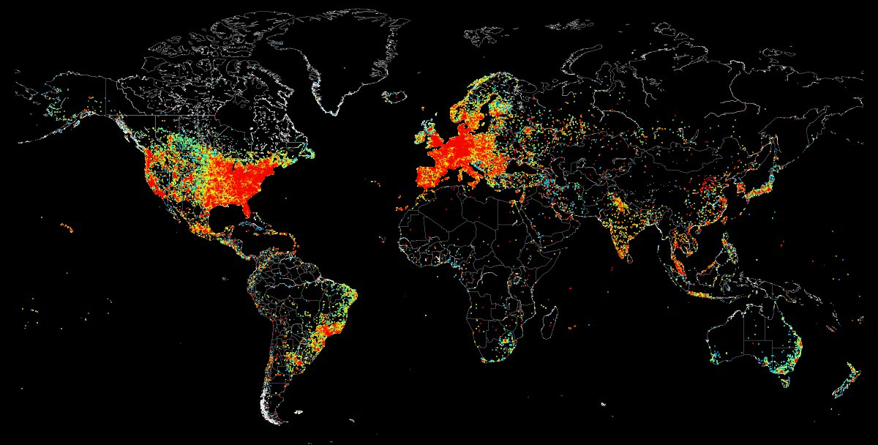
Global digital highways

Slide 10
Implications for Mauritius
One basic premise : our HR is our only natural resource
By 2025 one in three jobs will be related to software use.
Mauritius as a small state benefits in becoming globally connected to compensate for being geographically isolated
National drive for expansion of ICT with expanded Technical and managerial support with assistance of MoICT
Needs a synergized approach with all partners in expansion of ICT to all sectors, including STEM and languages

Slide 11
Managing ICT in Education in Mauritius
Needs effective leadership and management of ICT in Education in a SIDS for success:
The Setting up of a dedicated E-Education directorate at Ministry
The Creation of an inter-ministerial coordination committee for better national coordination for Education ad ICT ( comprising Ministries of Education, ICT, Finance, Gender, Social security)
Subsidized internet connectivity at national level
Designation of one a public agency responsible for training in ICT in Education for all levels of management and educators
Use of varied solutions platforms – to reduce vendor lock-in
Appointment of deidicated ICT Support officers in schools
… small size can be an asset due to small scale deployment

Slide 12
Objectives to enhance teaching and learning at national level
ICT & Curriculum Development
Integrating ICT in the classroom
Equity & Access to ICT
Cooperation between Educational Institutions
OBJECTIVES FOR ICT DEVELOPMENT IN EDUCATION IN MAURITIUS
Enhancing use of ICT in STEM Education
Integrating ICT in Skill
Development
ICT in Educational Management
ICT in Educational Research- linking Universities through NREN

Slide 13
ICT ACTIONS IN EDUCATION
ICT Infrastructure Digital interactive projectors in primary schools All primary schools have at least one computer room Expansion of number of interactive projectors in Primary schools | Connectivity Schoolnet in Secondary schools Computer rooms in Primary schools Tablet PCs in secondary schools
Websites in Secondary schools Tablet PCs to all Form IV students | Support to Educational Management EMIS SMS e-register for attendance Encouraging use of E-timetabling
ICT across the Curriculum Not only as a subject but as a support tool to all subjects CDs provided to Std I-III educators DVD provided to Std IV-VI educators Promoting ICT and SEN Enhancing ICT in STEM through Datalogging, Sankore and Tablet PC project | Teacher Training using ICT ICT Training for Teacher – Pre-service & In service for Std IV-VI and secondary

Slide 14
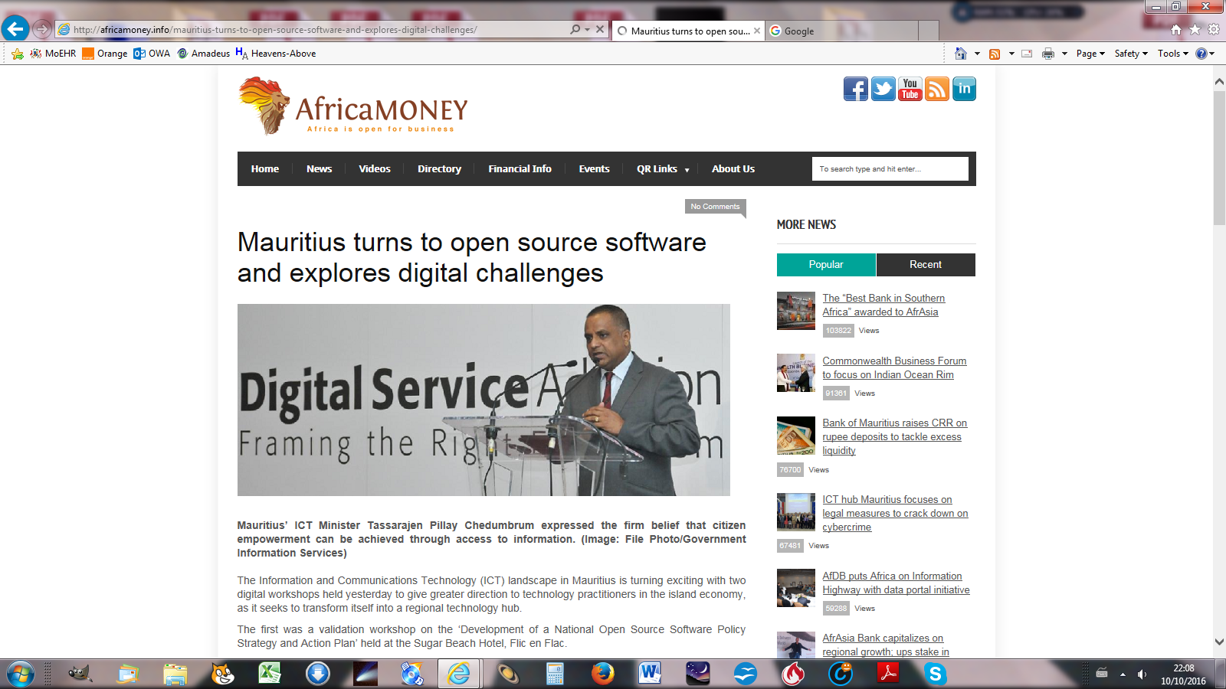
Adoption of an Open Source Policy by the Ministry of ICT
Current approach :
Encouraging use of open software under GNU Public license or Creative Commons
All digital resources publicly produced by Mauritius Institute of Education are OER
Encouraging use of OER software wherever possible … but not completely closing other options

Slide 15
UNESCO definition of OERs
"teaching, learning and research materials in any medium, digital or otherwise, that reside in the public domain or have been released under an open license that permits no-cost access, use, adaptation and redistribution by others with no or limited restrictions."

Slide 16
Why OERs in Mauritius ?
They are easily available and readymade, which is great for Mauritius where preparation of digital resources is limited
They do not cost much, if at all
Teachers can focus on the pedagogy and not on the technological aspects
They can be used both online and offline
They can be recontextualised, depending on the type of OER license they are in
They exist in a diversity of forms – Gardner’s multiple intelligences

Slide 17
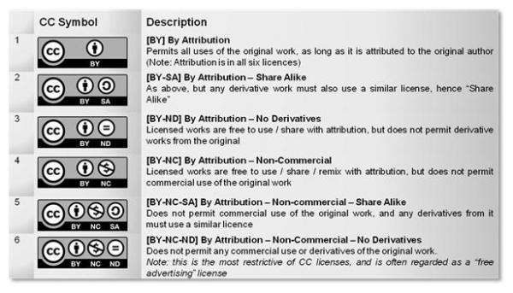
Commonly used licenses
GNU General Public Licence 3.0
Creative Commons

Slide 18
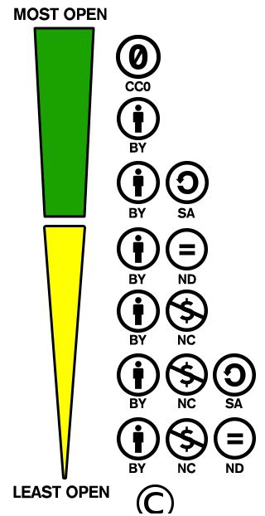
A continuum of licensing options…
…and it is a challenge for developing education departments, especially in small islands, where exposure to latest developments in ICT is limited, to determine which is most suitable for specific products in specific contexts …

Slide 19
Part 2 :ICT and STEM Education

Slide 20
What is STEM Education ?

Slide 21
What is ICT in STEM Education ?
Teaching of
Science
Technology
Engineering
Mathematics
using ICT

Slide 22
There will now be questions on ICT and STEM Education appearing on the screen
For each question, think carefully for 3 seconds and then lift up your cards !
Red card for No !
Green card for Yes !

Slide 23
Are you ready ?
Red for No !
Green for Yes !

Slide 24
ICT in STEM Education
ALL the schools where I work have at least one item of basic ICT equipment (ie at least one PC, one Laptop or one Tablet), anywhere in the school

Slide 25
ICT in STEM Education
Kindergarten through 12th grade education usually focuses on science or mathematics education, as isolated subjects

Slide 26
ICT in STEM Education
There is no intertwining between ICT and the STEM subjects in the real world

Slide 27
ICT in STEM Education
ICT helps to integrate education in science or mathematics from Kindergarten through 12th grade

Slide 28
ICT in STEM Education
Assists in the provision of multimedia stimuli

Slide 29
ICT in STEM Education
Is not a good thing because science education has to be done in a science lab, not in an ICT room

Slide 30
ICT in STEM Education
It is not about ICT, it is about how ICT is used meaningfully to make teaching and learning of science and technology more efficient and effective

Slide 31
ICT in STEM Education
Helps to provide a hands-on approach to presentation and solution of abstract concepts

Slide 32
ICT in STEM Education
Helps to recognize that more than one approach to problem solving in STEM Education may be valid

Slide 33
ICT in STEM Education
ICT cannot be used use to stimulate critical thinking and apply inquiry skills in STEM

Slide 34
ICT in STEM Education
ICT encourages individual learning – the children are always glued to their screens and seldom share with each other

Slide 35
ICT in STEM Education
ICT provides team and interactive work opportunities in STEM Education

Slide 36
ICT in STEM Education
Helps to show how mathematical and technological solutions apply to real world problems

Slide 37
ICT in STEM Education
ICT helps to apply science concepts from more than one science discipline

Slide 38
ICT in STEM Education
Gives the opportunity for alternative methods of assessment

Slide 39
ICT in STEM Education
Helps to recognize that different students approach a problem or topic from different entry points

Slide 40
ICT in STEM Education
Helps to recognize that prior knowledge may determine the approach the student takes to the problem

Slide 41
ICT in STEM Education
Is an argument that software or hardware vendors use to convince schools buy 1 : 1 (one laptop or one tablet per child) deployment solutions, so that they get in more money

Slide 42
ICT in STEM Education
Helps to open up new possibilities of investigation, and to show that sometimes a question simply generates many more questions

Slide 43
ICT in STEM Education
Is an argument that private universities use to attract more students towards STEM because they then get more money through higher university fees

Slide 44
You deserve a big round of applause for your participation !

Slide 45
Pedagogies for ICT and STEM
Presentations | Lesson plans | Printed handouts to students
Syllabi | STEM simulations | Classroom discussions
Assessments | Game based learning | Science videos/ demonstrations

Slide 46
Tools used in ICT in STEM Education
Ebooks
data loggers
PPT
Word
Excel
pdf
Youtube
Still Camera
Movie camera
Image manipulation software
Apps
Skype/Google Hangout
search engines
Moviemaker
Audio recorder
Repositories
+ any others ?

Slide 47
Platforms used in STEM Education in Mauritius
Pre primary schools : the bee-bot
Teaching the sky : Stellarium open software (dark and clear sky in Mauritius)
Using digital interactive projectors in classrooms
Using OERs and multimedia resources freely available or downloaded on the web
Using powerpoint in STEM Education
Using dataloggers in Science
Virtual/augmented reality labs in TVET training
Tablet PCs in secondary schools … but connectivity has been a problem
Open Sankoré - a francophone African OER interactive software initiative:
Interactive apps in Open Sankoré
Contextualised resources produced in Mauritius

Slide 48
Part 3 : Hands on practice of ICT and STEM tools used in Mauritius
3 (i) offline resources
And
3 (ii) online resources

Slide 49
Using offline resources for STEM Education
Hands on session on using Open Sankoré
http://open-sankore.org/
http://planete.sankore.org

Slide 50
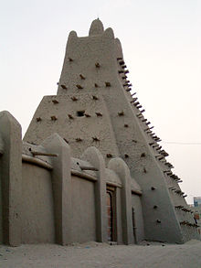
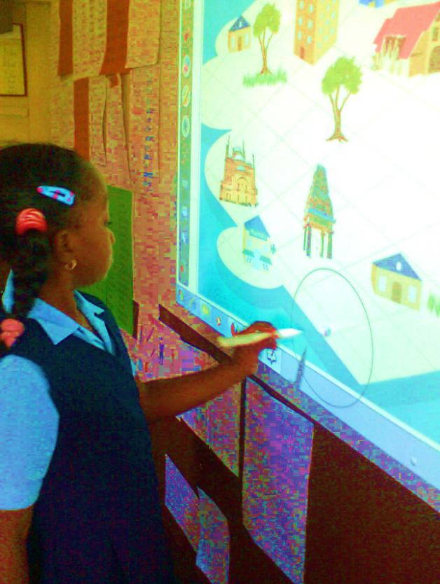
ICT in Education in Francophone African countries : the Sankoré Project
Started as a project in Francophone African countries
Symbolically uses an African name to show that ICT in Education can happen in Africa
Uses digital interactive projectors and Open Sankoré software
Has growth from project into a national programme in Mauritius through Government funding
All primary schools in Mauritius are equipped with the software and used offline.
Sankoré was a 13th Century centre of higher learning in Timbuktu, Mali, Africa

Slide 51
Advantages of Open Sankore
Freely downloadable – Is Open source under GNU GPL version 3 - Any user is given permission to modify the work, as well as to copy and redistribute the work or any derivative version. The user is allowed to charge a fee for this service, or do this free of charge.
Is simple to use for Primary schools
Is well adapted to STEM education in Primary schools due to interactivity
Can be used from a laptop or PC, if interactive projectors are not available
Users can benefit from the OER base of Planete Sankore. This is an open repository of Open Sankore specific contents, especially for the Francophone world.
Teachers can also create their own resources to upload on that site.

Slide 52
Using online resources for STEM Education
Connecting all Primary and Secondary schools to encourage use of online resources
Use of existing repositories – OER Commons. A team of the Mauritius Institute of Education will be visiting the NCERT/NROER to learn further on repository creation and contextualisation
Training in use of online resources

Slide 53
Use of online resources for STEM Education
Hands on session on using OER Commons
http://www. oercommons.org

Slide 54
Observations
Online and offline ICT tools well adapted to Mauritian and Cambridge O/A level curricula and examinations. Exams encourage critical thinking and application of learning, not learning facts
Connectivity is an issue due to geographical remoteness. We train the teachers to download and use resources offline.
Mauritius has the advantage of being bilingual in French and English, so we can use existing large global online resources
Approach helps to create a culture of research and usage of ICT in STEM education given the large variety of OERs available online
Sometimes we have no control on how the online or offline resources used change – but the world is also a changing one …

Slide 55
Conclusion
At the end of it, it is the science or mathematics teacher who makes all the difference
It is not the technology, but instead how that committed teacher creatively makes use of ICT as one of a variety of teaching aids

Slide 56
Thank you !
Ricaud AUCKBUR
rauckbur@govmu.org
http://ministry-education.govmu.org

