Slide 1

KENDRIYA VIDYALAYA SANGATHAN
18

Slide 2

One of the World’s largest chain of schools
19

Slide 3
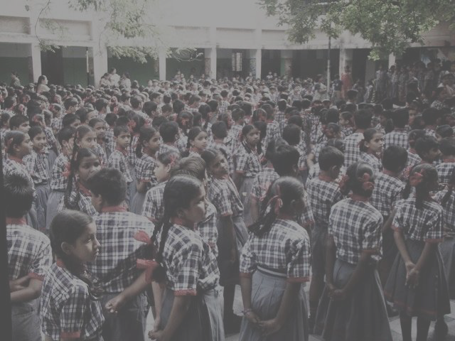
Total Schools
Total Students
Total Parents & Guardians Total Staff
1,142
1.2 million
2.5 million
0.06 million

Slide 4




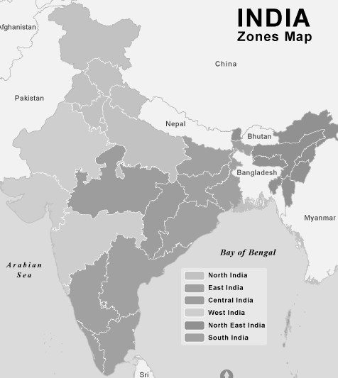






ORGANIZATION SCALE
1,142 Schools
25 Regional Offices
From Dwarka to Dirang From Kargil to Kanyakumari
S.No. | Region | No. Schools
1 | Agra | 39
2 | Ahmedabad | 46
3 | Bangalore | 50
4 | Bhopal | 46
5 | Bhubaneswar | 50
6 | Chandigarh | 52
7 | Chennai | 45
8 | Dehradun | 51
9 | Delhi | 65
10 | Ernakulam | 40
11 | Gurgaon | 50
12 | Guwahati | 45
13 | Hyderabad | 52
14 | Jabalpur | 48
15 | Jaipur | 58
16 | Jammu | 58
17 | Kolkata | 46
18 | Lucknow | 53
19 | Mumbai | 48
20 | Patna | 50
21 | Raipur | 42
22 | Ranchi | 39
23 | Silchar | 31
24 | Tinsukia | 41
25 | Varanasi | 32
22

Slide 5
Four Fold Mission
To cater to the educational needs of children of transferable Central Government including Defence and Para-military personnel by providing a common programme of education.
To pursue excellence and set the pace in the field of
school education.
To initiate and promote experimentation & innovations in education in collaboration with other bodies like CBSE & NCERT.
To develop the spirit of national integration and create a
sense of "Indianness” among children.

Slide 6

Need for eGovernance
24

Slide 7
Key Challenges
Efficiency and effectiveness
Demographic & Geographic diversity
Implementation of uniform Policies & guidelines
Transparency in accounting
Staff transfers
Performance appraisal
Access to quality learning material
Real time Access to large data of the organisation
Connectivity among stakeholders

Slide 8

KV Shaala Darpan
School Automation Application
(MIS / ERP)
33

Slide 9











SMS
School
Mgmt.
Online Admission
Analytics
e-Learning
KV SHAALA DARPAN

Slide 10
Objectives
'Shaala Darpan' refers to mirror view of a school. It is a Mission Mode Project (MMP), with following objectives:
Enable improvement in quality of learning
Improve efficiency of school administration and governance of schools
Improve service delivery of school education department to the key stakeholders including students, parents, community, teachers, and schools
Access to near real-time and better quality data for decision support

Slide 11
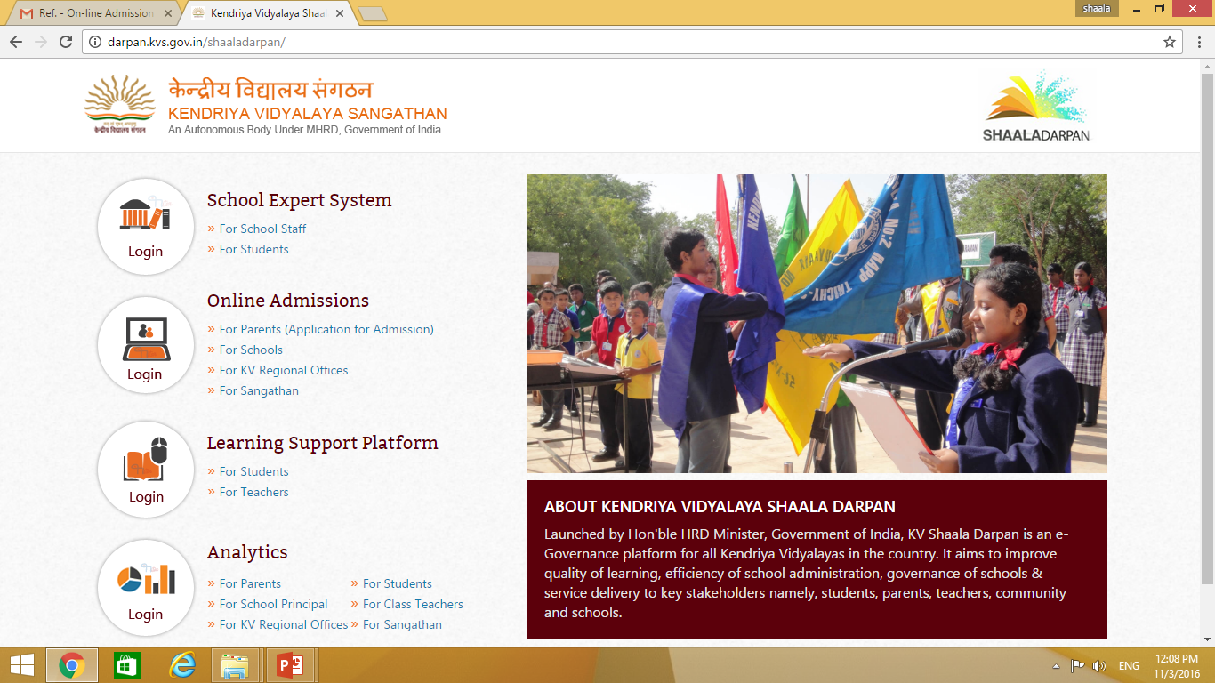
LOGIN TO URL: http://darpan.kvs.gov.in

Slide 12
Module Platforms
# | Applications | # | Modules
1 | admission.kvs.gov.in | 1 | Online Admission
2 | admin.kvs.gov.in | 2 | Parent/ Guardian Information Module
 |  | 3 | Multiple School Integrated Dashboard
 |  | 4 | Principal Dashboard (Additional Feature)
3 | darpan.kvs.gov.in | 5 | Student Management
 |  | 6 | Examination
 |  | 7 | Attendance
 |  | 8 | Time Table
 |  | 9 | Library Management
 |  | 10 | Employee Management
 |  | 11 | Payroll
 |  | 12 | Fee & Fine
 |  | 13 | Financials
 |  | 14 | System Administration
 |  | 15 | SMS Module
4 | learning.kvs.gov.in | 16 | e-Learning System
5 | mip.mgrmnet.com | 17 | MGRM Implementation Practices

Slide 13
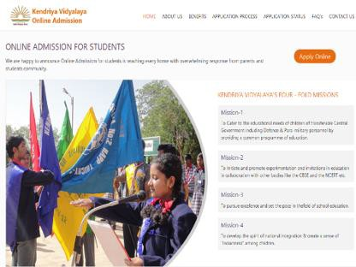
Parents
Search for school online
View school information online e.g. vacancy
Apply Online
Online Acknowledgment
Email Confirmation
School
View list of applicants
Shortlist students
Admit Students
Regional Office
View list of applicants
View list of shortlisted candidates
View list of admitted candidates
Head Quarter
Define Guidelines
Uniform Policy Implementation
View list of applicants
View list of shortlisted candidates
View list of admitted candidates
Online Admission

Slide 14
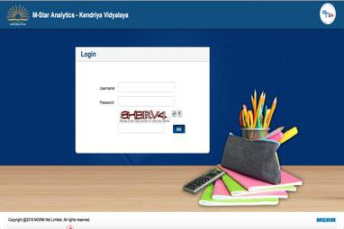
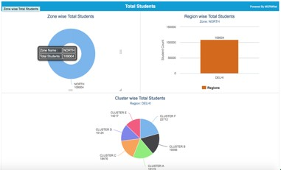
Analytics
DASHBOARDS
Parents
View Childs information –
  Attendance
  Exam Schedule & Results
  Timetable
  Subject teachers
  Health, etc.
Principal
Class-strength
Student Attendance
Result Analysis
Staff information etc.
Student Dashboard
Regional Office & HQ
Number of students across all schools
Number of employees across all schools

Slide 15
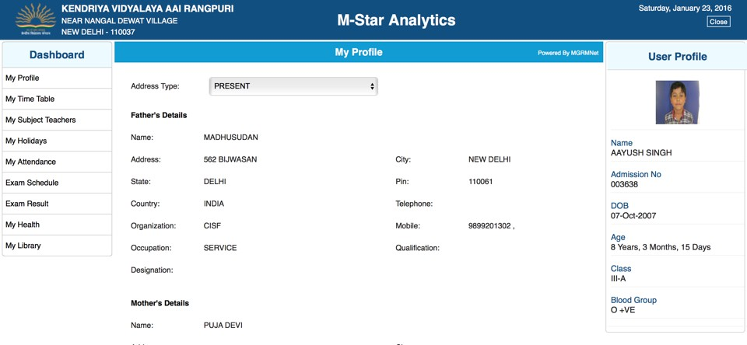
Parent Dashboard

Slide 16
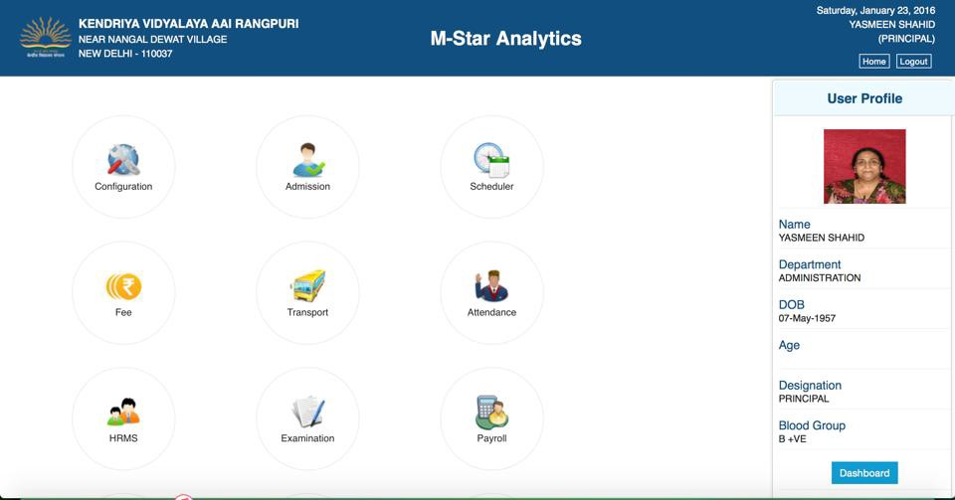
Principal Dashboard

Slide 17
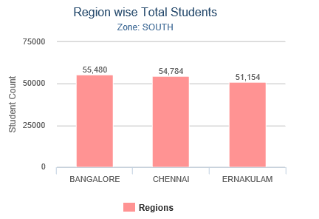
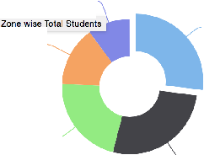

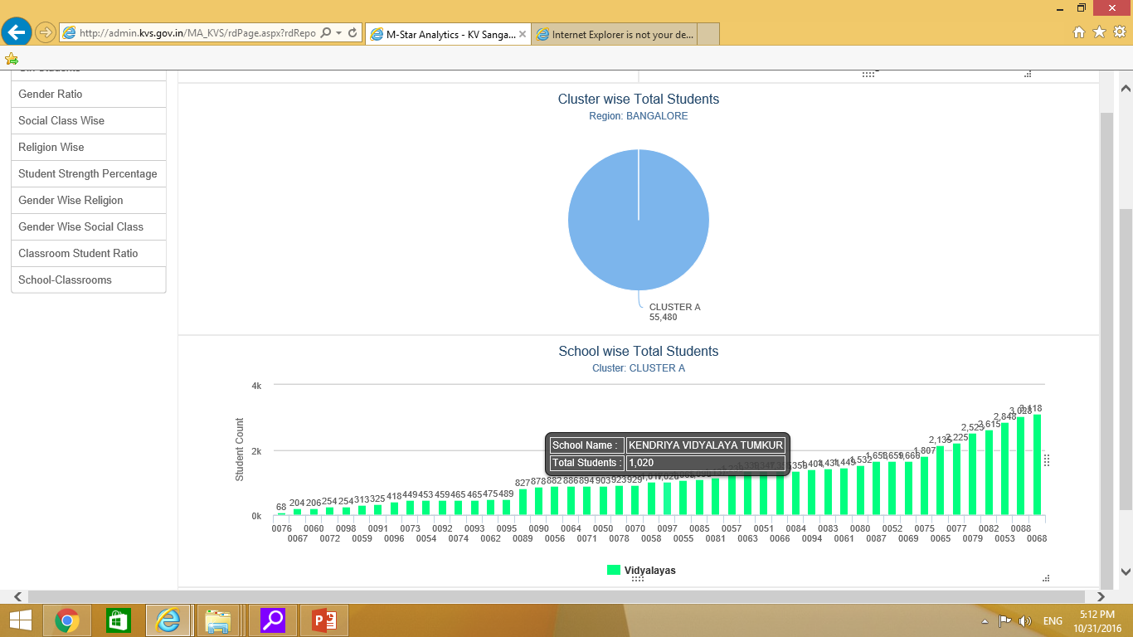


KENDRIYA VIDYALAYA SANGATHAN
DASHBOARD
SHAALADARPAN
Total Students
Po"""'• &, MGRMN
Zone wise Total Students
Region wise Total Students
Zo.1e.SOUTH
C:NTRAL
4"!.852
;'5:100
SOUTH
128,621
g 5()3()()
56605
4t•.098
EAST
ti7./U2
8
 | -
 |  |  | '-
;:
O"i ?5:100
22 918
0
-
'-
Vil: l _,-
1n'>,9M
SA\IGALORE
C ENNA
ERI\AJ<Ul..AIVI
NORTH
127,63£
.Region!:'
.:!
School wise Total Students
Clus or: CLUSTER A
4k
5
0"'
;; 2k
KENCRIY/1 VIDY/\L/\V/1 DONIMI\l/11
"3
<f)
IIIIII
Ok
,..J"IW't...J-o...JII,.JL_..II.,.J-lWL.J'I...-II,.JL,..J-1-"L.-1 SL;huul wi:se Tu lal Sludtm l:s
0059 0067 0060 009' 0074 J073 C093 0092 0054 00!':0 [)J?'1 0058 D097 0085 0051 0053 0066 0080 0086 006' 0075 0052 0079 0068
C098 0076 0072 OOSo€ 0062 0054 0095 0089 0090 0056 0070 0078 0055 0057 OC-81 J084 C094 008<· 0059 OOe7 OJ65 0077 •Jo)82 0053
0098
•Vidvalavas

Slide 18
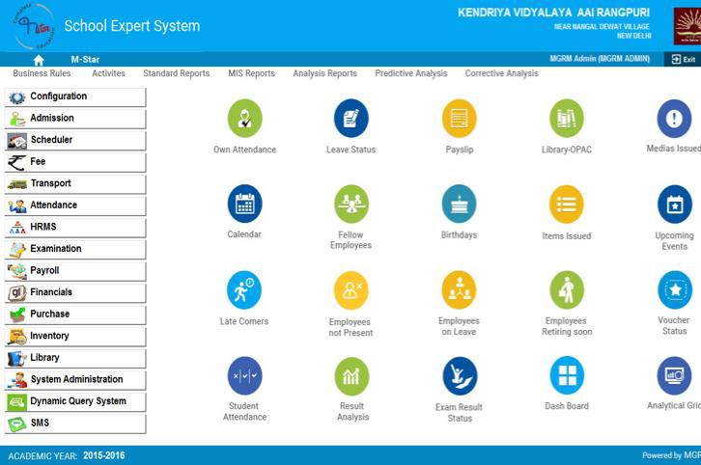
School Expert System

Slide 19
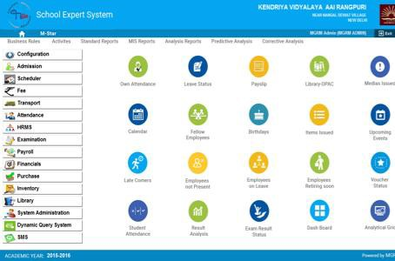
Student Management
School Expert System
Student Information e.g. Name, Class
Parent Information
Health
Relatives in School
PTA Meetings
Events & Awards etc.
Examination
Exam Rules / Policy
CCE
Exam Schedule
Result Entry by Subject Teachers
Result Entry by
Attendance
Daily Class Attendance
Negative attendance by Class Teachers
Auto compilation – Daily / Monthly / Term

Slide 20
Timetable
School Expert System
Class Timetable
Teacher Timetable
Substitution
Library
Record of Books
Issue – Return
Employee Management
Personal & Official information
Attendance (Biometrics)
Health
Awards & Recognitions
Trainings & Workshopts etc.
Payroll
Monthly Salary Processing
Payslip Generation

Slide 21
Fee & Fine
School Expert System
Fee Rules
Fee collection
Finance
Book of Accounts
Online Voucher
Online Ledgers, Balancesheet
System Administration
School Master information
Define Classes
Define Class-sections
SMS
Attendance SMS
SMS Alerts e.g. Holidays etc.

Slide 22
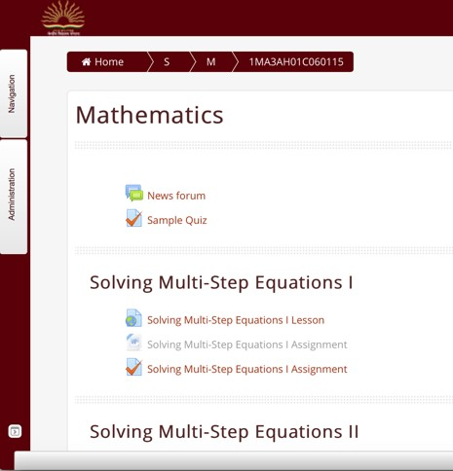
Learning Support Platform
Students
Online Courses
Audio, Video, Text, Images
Self-Assessments
Quiz
Assignments
Teachers
Training courses
Grading of students
Student Performance

Slide 23
Benefits at a Glance
12

Slide 24
Benefits to Key Stakeholders :
Students
Parents
Teachers
Management

Slide 25
Benefits to Students:
Comprehensive record of participation, performance, achievements in academics / extra- curricular activities
Access to academic / personal records
Learning Support Platform for eContent/eLearning
Enhanced interactions with teachers / peers
Strong sense of empowerment

Slide 26
Benefits to Parents:
Direct / seamless information flow from school
Monitoring the wards’:
  Attendance
  Academic progress
  Participation in extra-curricular activities
Experience increased involvement
SMS Alerts

Slide 27
Benefits to Teachers:
Alerted to academic problem areas
Report student attendance & grades in minutes
Learning Support Platform for eContent delivery
Online access to schedules & duty assignments
Improved communication with Students / Parents

Slide 28
Benefits to Management:
Oversee electronic blueprint of school enabling data analysis and decision making
Anytime, anywhere access to reports and information
Ensuring KVS policy framework oriented academic Management
Tracking teacher performance

Slide 29
Public Domain:
What do Parents have to say?
63

Slide 30
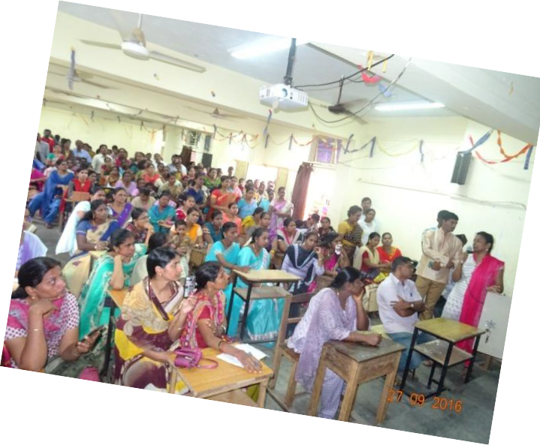
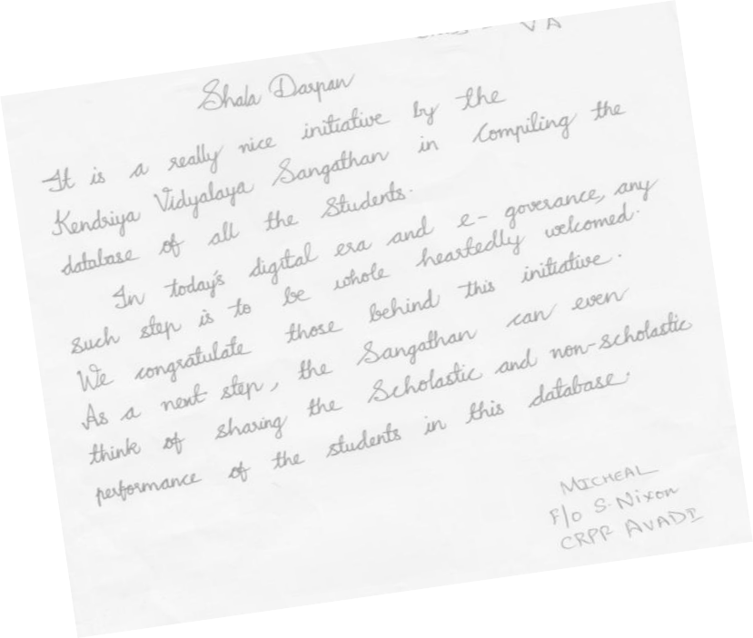
Parent Feedback
Very good portal – student should avoid opening Facebook / email
Makes my daughter’s work easier
Very useful & appreciable portal –
happy to see my child’s details
64

Slide 31
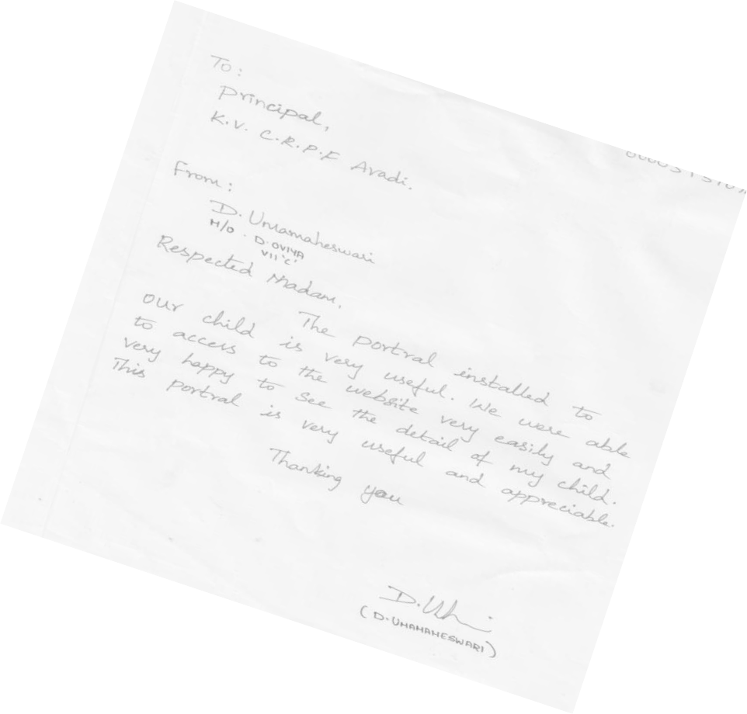
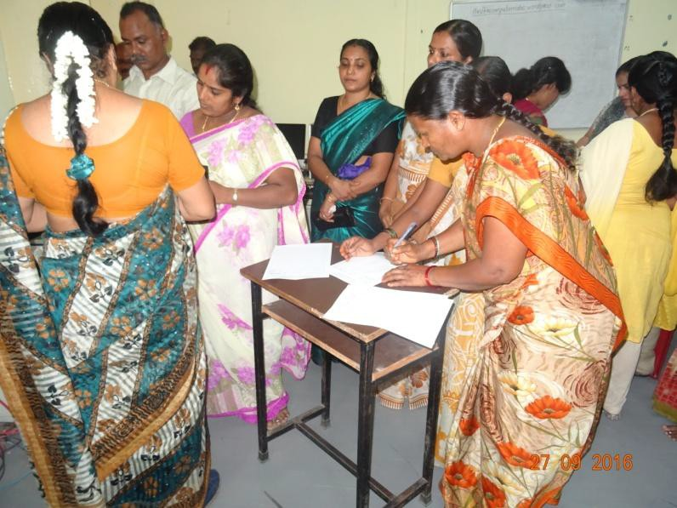
Parent Feedback
Very good initiative by KVS
In today’s digital era, this step is whole-heartedly welcome
Portal gives information about my child in a simple click
65

Slide 32
Thanks

