Slide 1
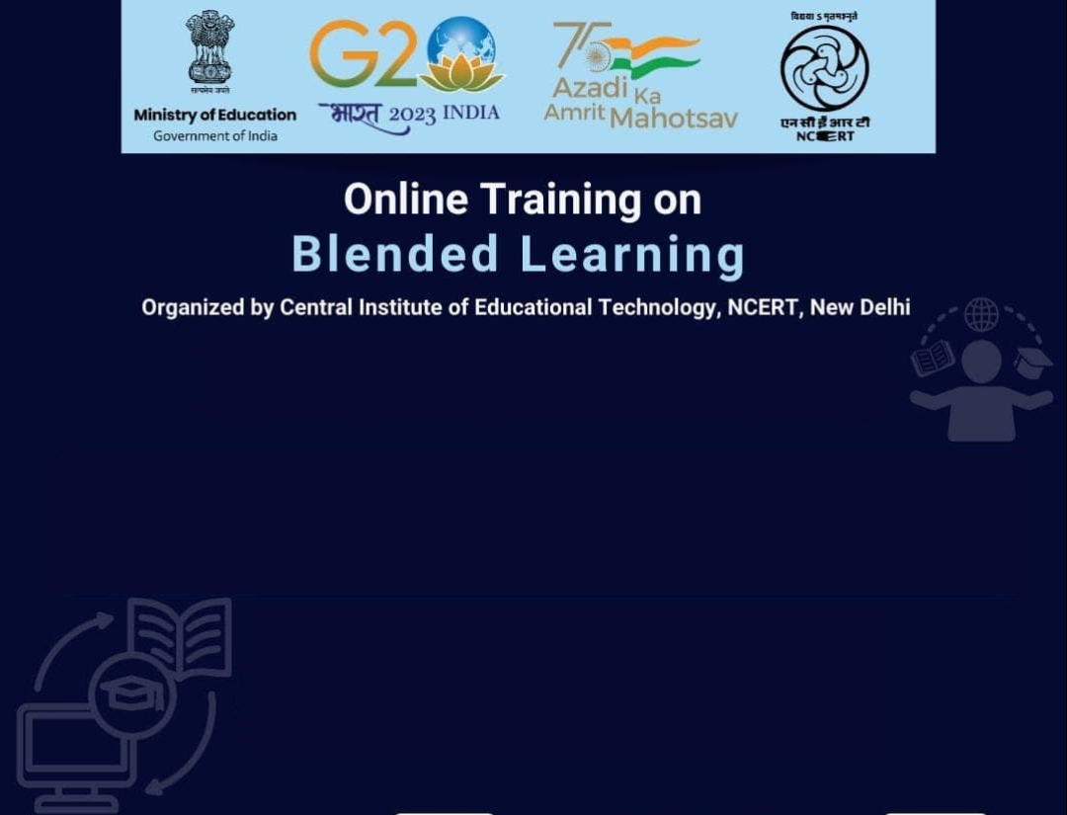
Online Training on
Blended Learning
Organized by Cetral Institute of Educational Technology, NCERT, New Delhi
Designing Blended Learning
Prof. Jayashree Shinde
Head,
Department of Educational Technology,
SNDT Women’s University, Mumbai
jshinde@det.sndt.ac.in

Slide 2
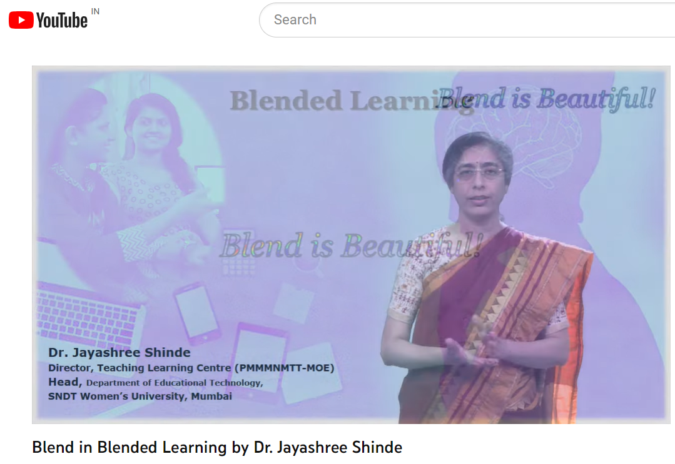
Blended Learning
https://youtu.be/_yfRtCu9jEU

Slide 3


Blend
is
Beautiful!
Image by Chris Martin from Pixabay

Slide 4

Meaningful
Blend
is
More
Beautiful!
Image by Gordon Johnson from Pixabay

Slide 5
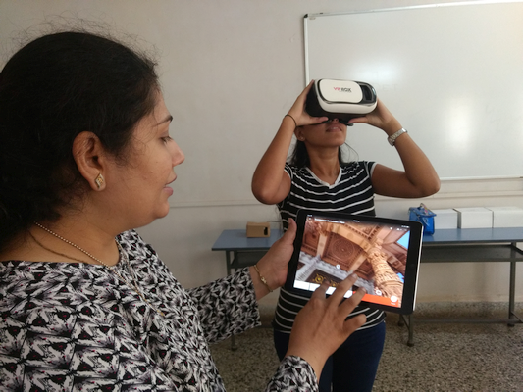
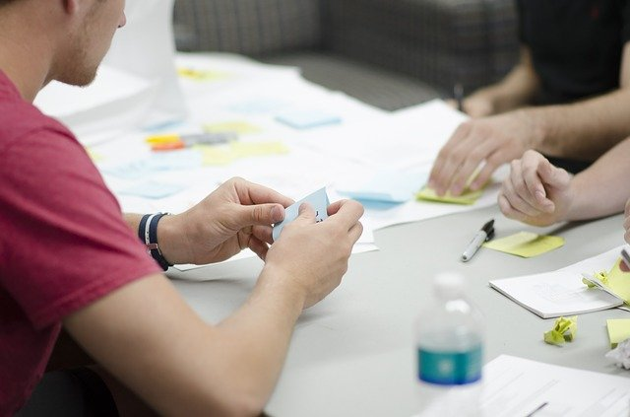
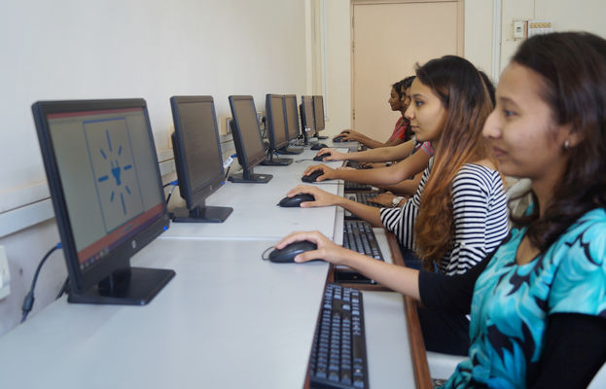
Meaningful
Blend
of
Teaching-Learning Experiences

Slide 6
Meaningful
Blend
needs..
Thoughtful Design
Image by Gordon Johnson from Pixabay

Slide 7
Blended Learning
needs
Planned designs…

Slide 8
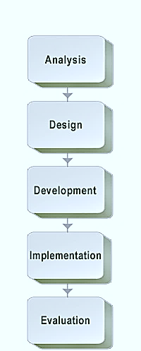
Blended Learning
needs
Planned designs…
Learning Design
Instructional Design

Slide 9
I
P
S
T
I
Blended Learning
needs
Planned designs…

Slide 10
I
P
S
T
I
IPSIT: Indian Framework for BL
Review Learning Outcomes and decide mode of teaching-learning…
Identify Resources and Activities
Provide resources and announce activities
Support and provide scaffolding
Identify learning gaps and provide feedback (Formative Evaluation)
Test (Summative Evaluation)

Slide 11
I
P
S
T
I
Identify
Blended Learning
Online
Flexi
Online and/or Offline
Resources
Activities
Resources
Activities
Offline
Resources
Activities

Slide 12
I
P
S
T
I
Identify
Blended Learning
Resources
Activities
Reading/Viewing Learning resources
Interactive Material
Group interaction with the material
Individualized learning
Group learning with the material
Individual Learner’s Active interaction
User-generated material
(User = Learner)
Collaborative Platforms for large groups
Through Cooperative Learning Strategies

Slide 13
Blended Learning
Resources
Activities
Reading/Viewing Learning resources
Interactive Material
Group interaction with the material
Individualized learning
Group learning with the material
Individual Learner’s Active interaction
User-generated material
(User = Learner)
Collaborative Platforms for large groups
Through Cooperative Learning Strategies

Slide 14
I
P
S
T
I
Identify Resources
Case study
Community place
Book
Game
Community person
Article/ Journal/ Paper
Visuals
Cartoon-strip
Podcast
Interactive Video
Video
Animation
Simulation
TED
Webpages
PDF
Blog
Infographic
eBook
Exhibition
Diagrams
Concept-map/
Mind-map
Poster
OERs

Slide 15
I
P
S
T
I
Provide Resources
Classroom Walls
Corridors
Library
Community
Digital Walls
Projection
Institutional Intranet
Low-cost devices
MOOC Platform
Hard copies
Physical kits
Mobile Groups
Learning Management System
Collaboration tool
Digital Platforms/ ICT Tools
Social Network
Institutional Network
Digital Portal

Slide 16
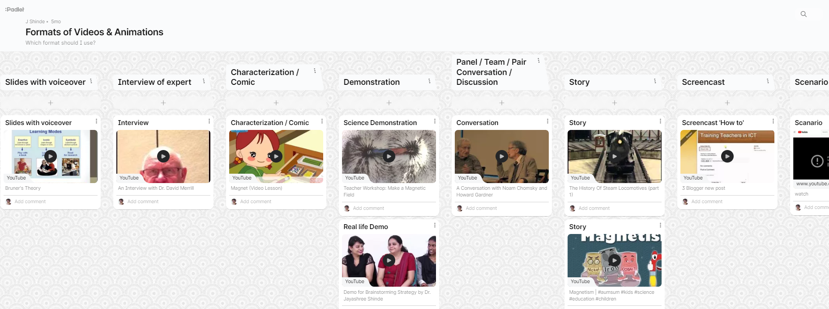
I
P
S
T
I
Provide Resources
https://padlet.com/jshinde/formats-of-videos-animations-2r82qertwtrf

Slide 17
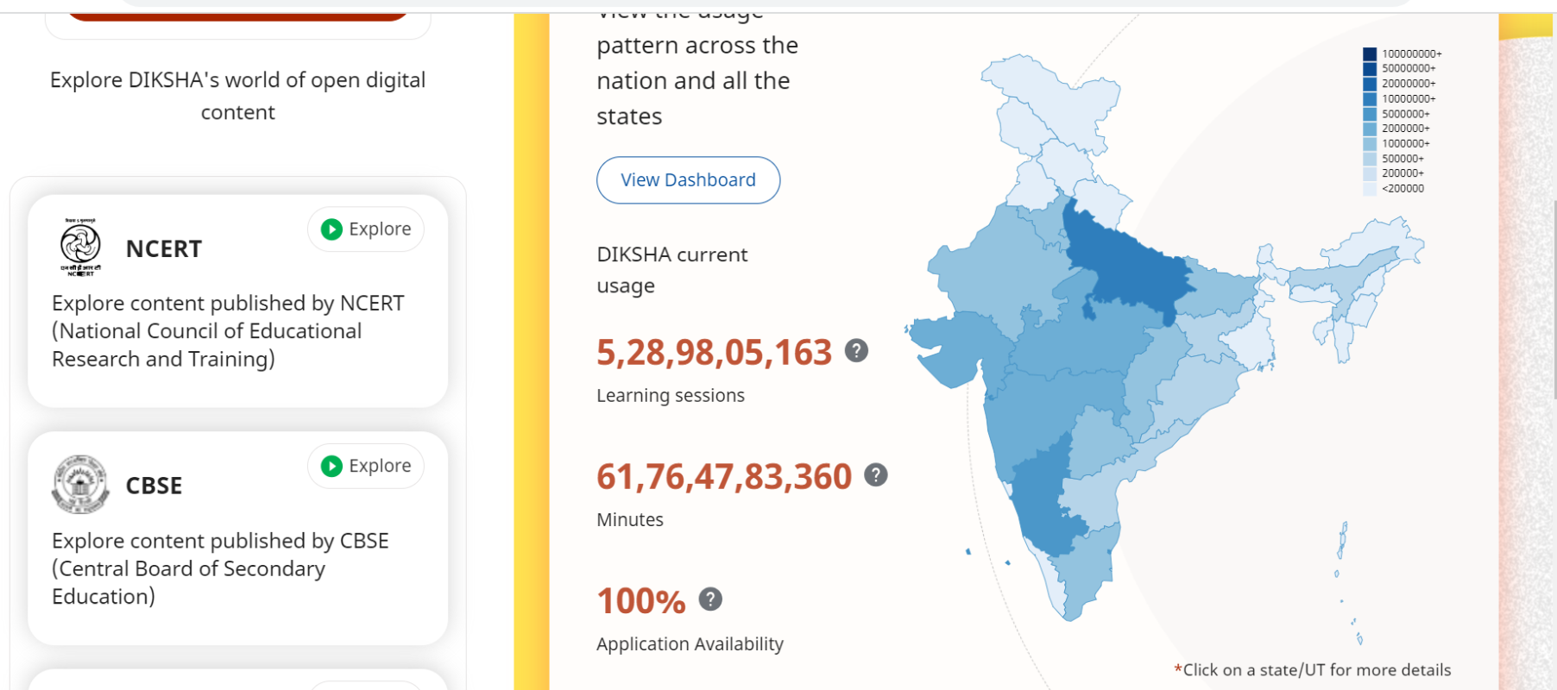
I
P
S
T
I
Provide Resources
https://www.diksha.gov.in/

Slide 18
I
P
S
T
I
Identify
Blended Learning
Resources
Activities
Individualized activities
Whole Group with Facilitator
Pair
Small groups

Slide 19
I
P
S
T
I
Identify & Provide Activities
Discussion
Query-solving
Group-work
Collaboration (e.g. Concept-Mapping, Blogging)
Cooperative Learning Strategies
Co-creation
Experiment/ Simulation
Exploration
Field-work
Makerspaces
Game
Problem-Solving
Survey
Community engagement
Simulation

Slide 20
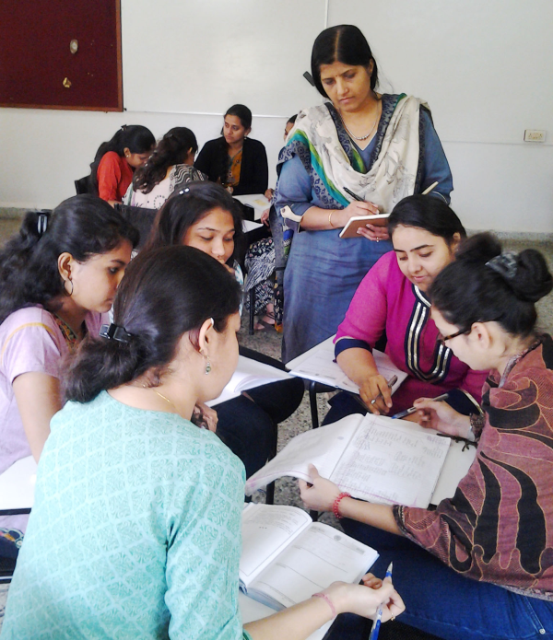
I
P
S
T
I
Support & Scaffolding
teacher
facilitator

Slide 21
I
P
S
T
I
Identify gaps & provide feedback
diagnostic tests
presentations
gamification
assignments
assessment activities
creative products
quizzes
contribution in activities
Continuous Comprehensive Evaluation

Slide 22
I
P
S
T
I
Test
Summative Evaluation
Semester-end exam
Open book exam
Practical exam
Viva voce
Report
Dissertation
Portfolio
Major Products

Slide 23
Meaningful
Blend
of
In-Class & Out-of-Class
Online & Offline
Experiences

Slide 24
In-Class
Out of Class
Meaningful
Blend
of
Pedagogy
&
Technology
in planning…

Slide 25
Designing Blended Learning Sessions
In-Class
Out of Class

Slide 26
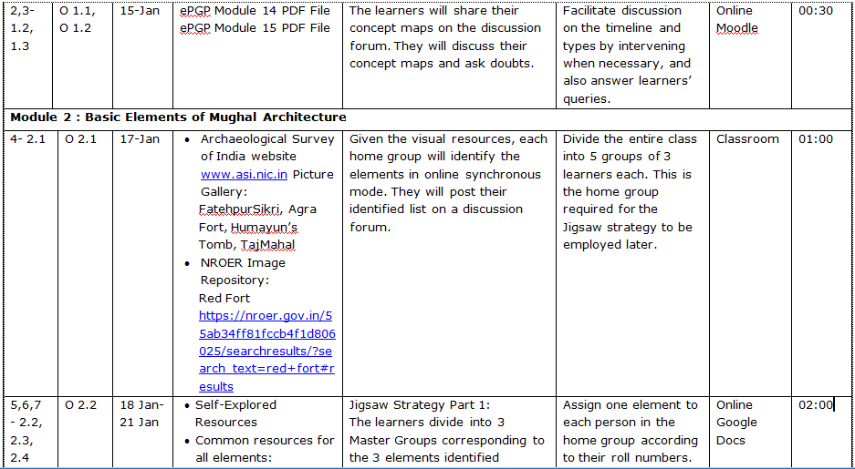

Slide 27
In-Class
Out of Class
Designing BL Sessions…
Course Topic:
Learner will be able to…
Size per batch:
Total Duration:
Learning Outcomes (LO):

Slide 28
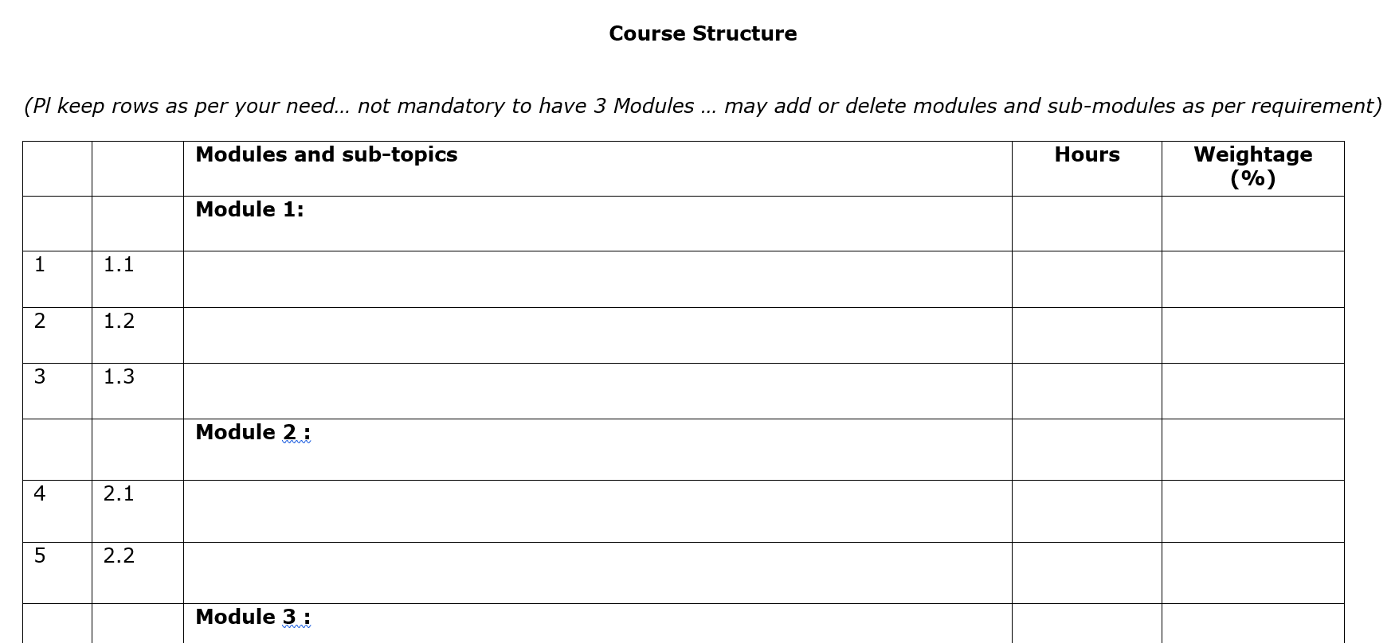
In-Class
Out of Class
Designing BL Sessions…

Slide 29
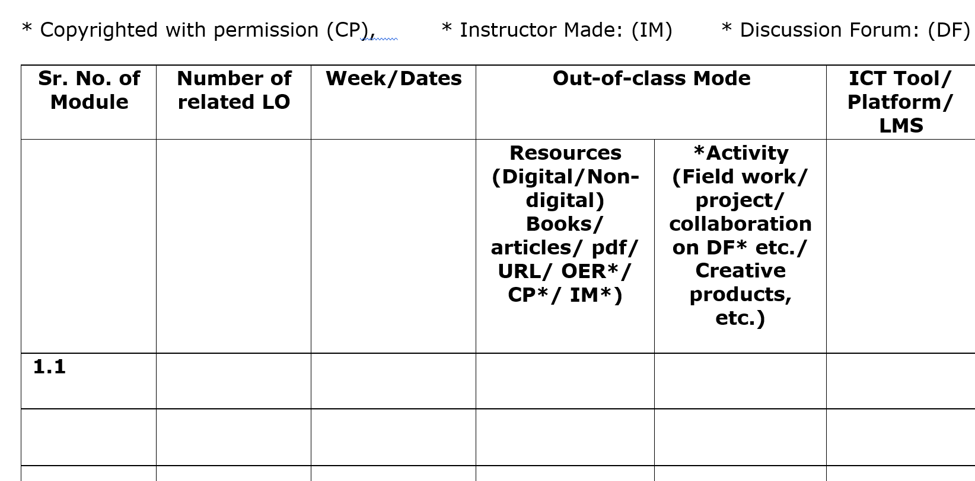
In-Class
Out of Class
Designing BL Sessions…

Slide 30
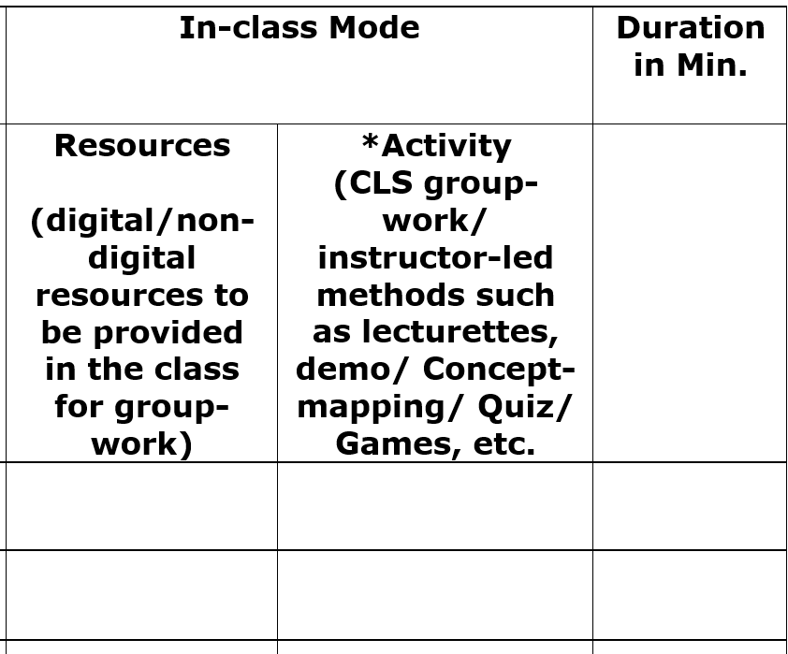
In-Class
Out of Class
Designing BL Sessions…

Slide 31
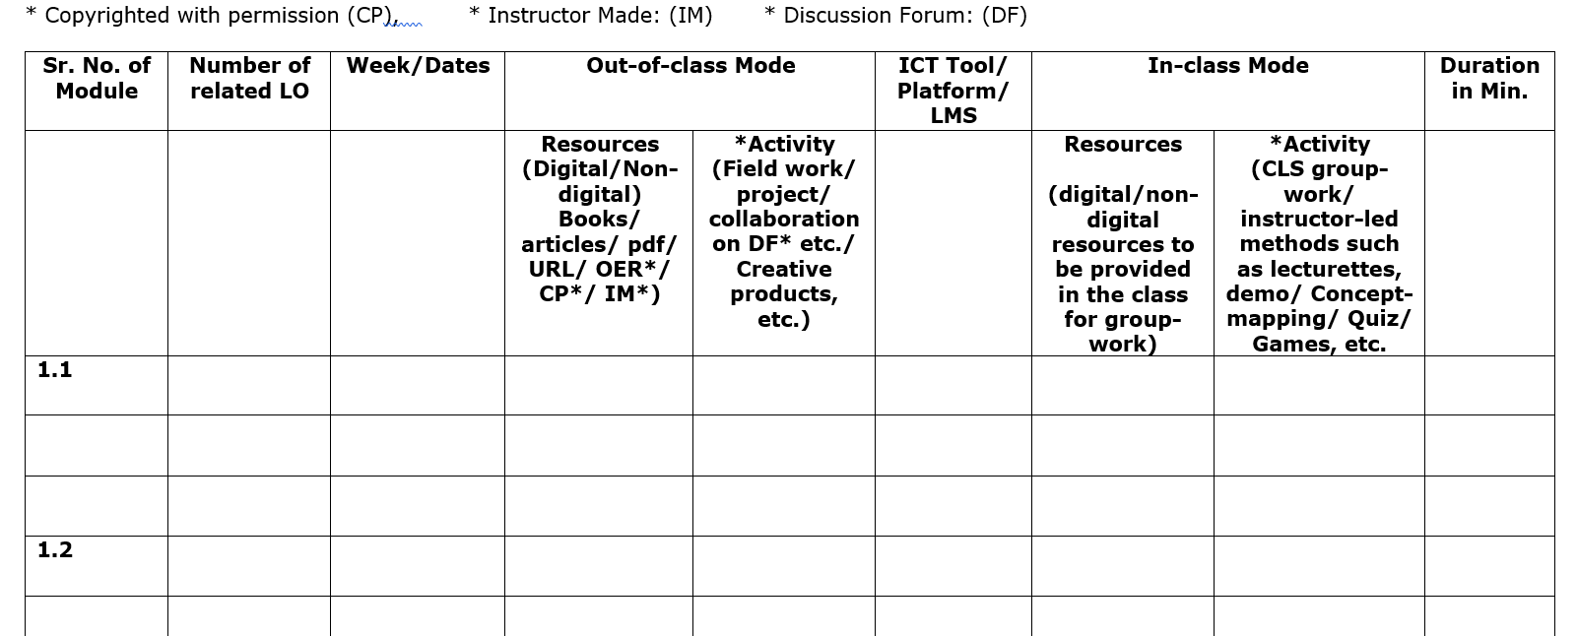
In-Class
Out of Class
Designing BL Sessions…

Slide 32
Online Training on
Blended Learning
Organized by Cetral Institute of Educational Technology, NCERT, New Delhi
Designing Blended Learning
Queries ???
Prof. Jayashree Shinde
Head,
Department of Educational Technology,
SNDT Women’s University, Mumbai
jshinde@det.sndt.ac.in

