Slide 1
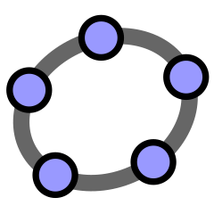
Features & Possibilities
-An Overview
By Sangeeta Gulati
National ICT Awardee
Sanskriti School, New Delhi
GeoGebra

Slide 2
What is GeoGebra?
GeoGebra is a dynamic mathematics software for all levels of education that brings together geometry, algebra, spreadsheets, graphing, statistics and calculus in one easy-to-use package.
Open source software freely available for non-commercial users. Download available at www.geogebra.org
Tasks in GeoGebra may be designed to enable students to make conjectures and understand mathematical concepts.

Slide 3
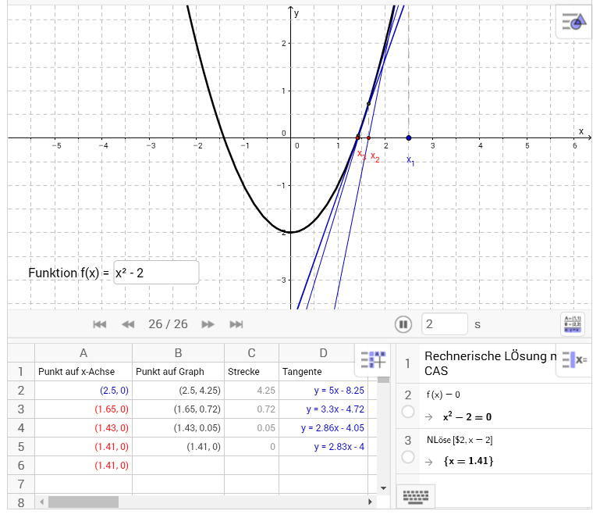
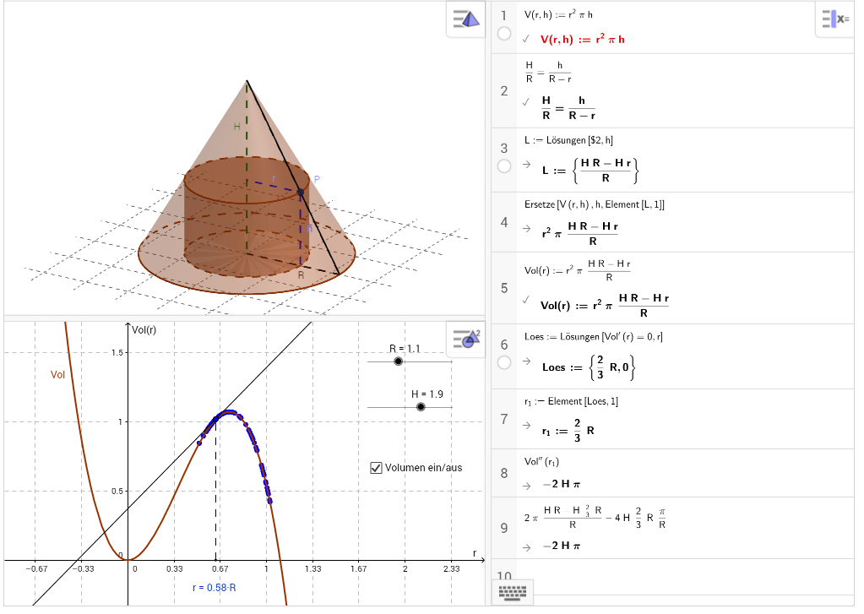
GeoGebra = Geometry + Algebra + Spreadsheet + 3D + Statistics

Slide 4




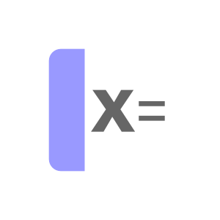
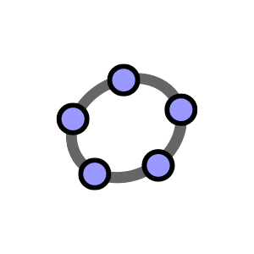


Details
GeoGebra Apps
Scientific
Geometry
Graphing
www.geogebra.org/download
3D
CAS
Suite

Slide 5
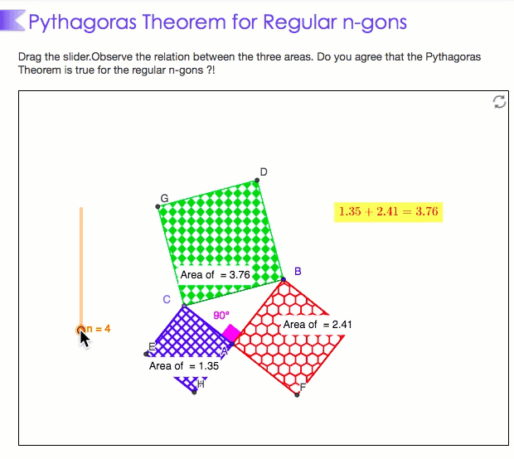
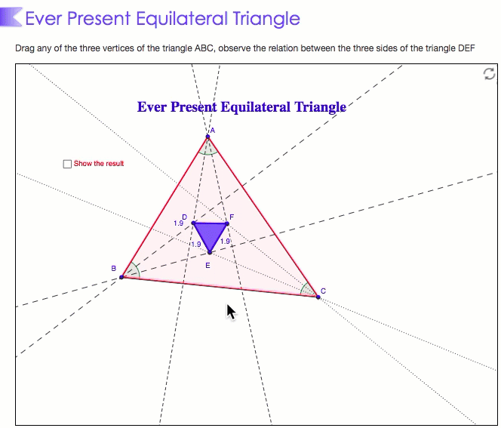
Maths Comes Alive With GeoGebra
Notes:
The ‘dynamism’ of these figures provides opportunities to students to experience mathematical properties very differently from static figures which they generally experience in a traditional geometry class. Geometric explorations leads to the wonders which make maths magical

Slide 6
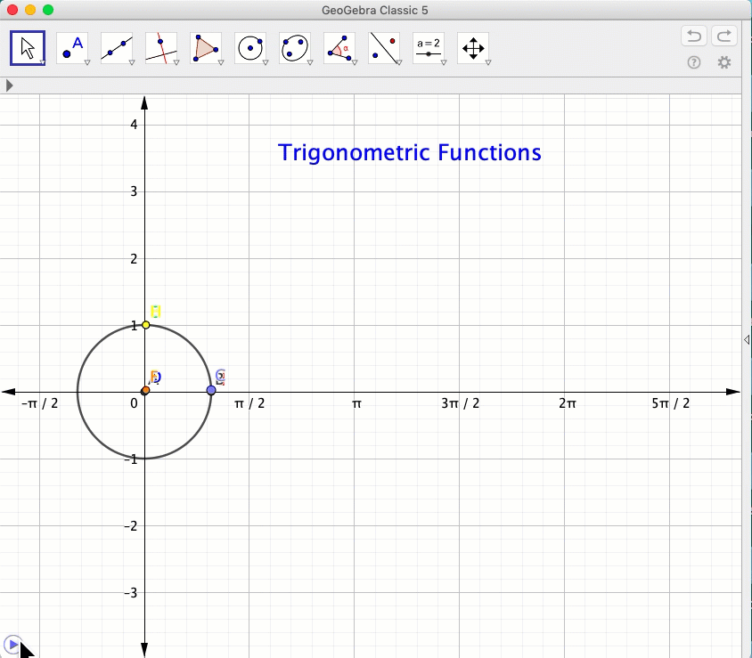
Create those “Aha” Moments

Slide 7
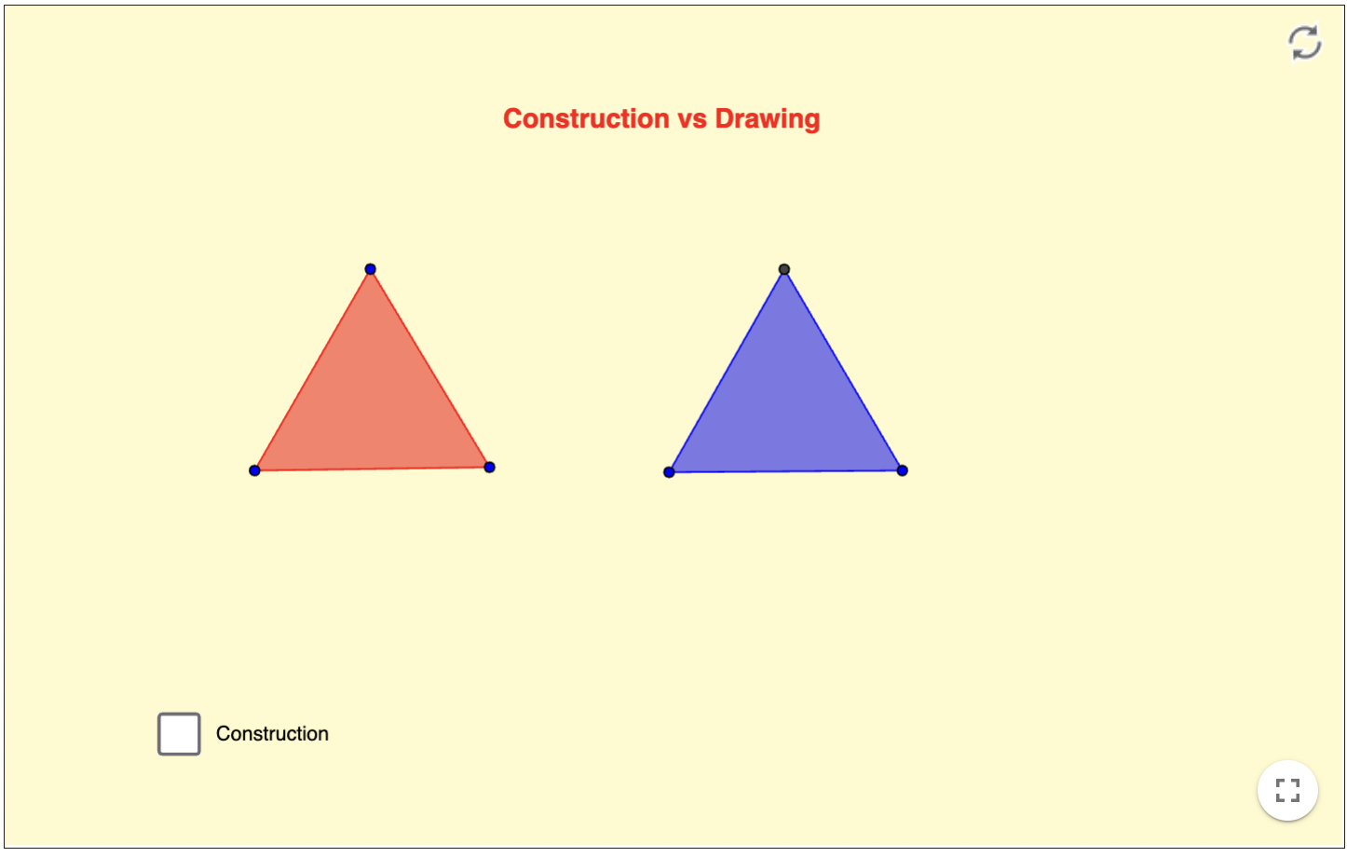
Construction vs Drawing
Drag Test!
Notes:
DRAG Test

Slide 8
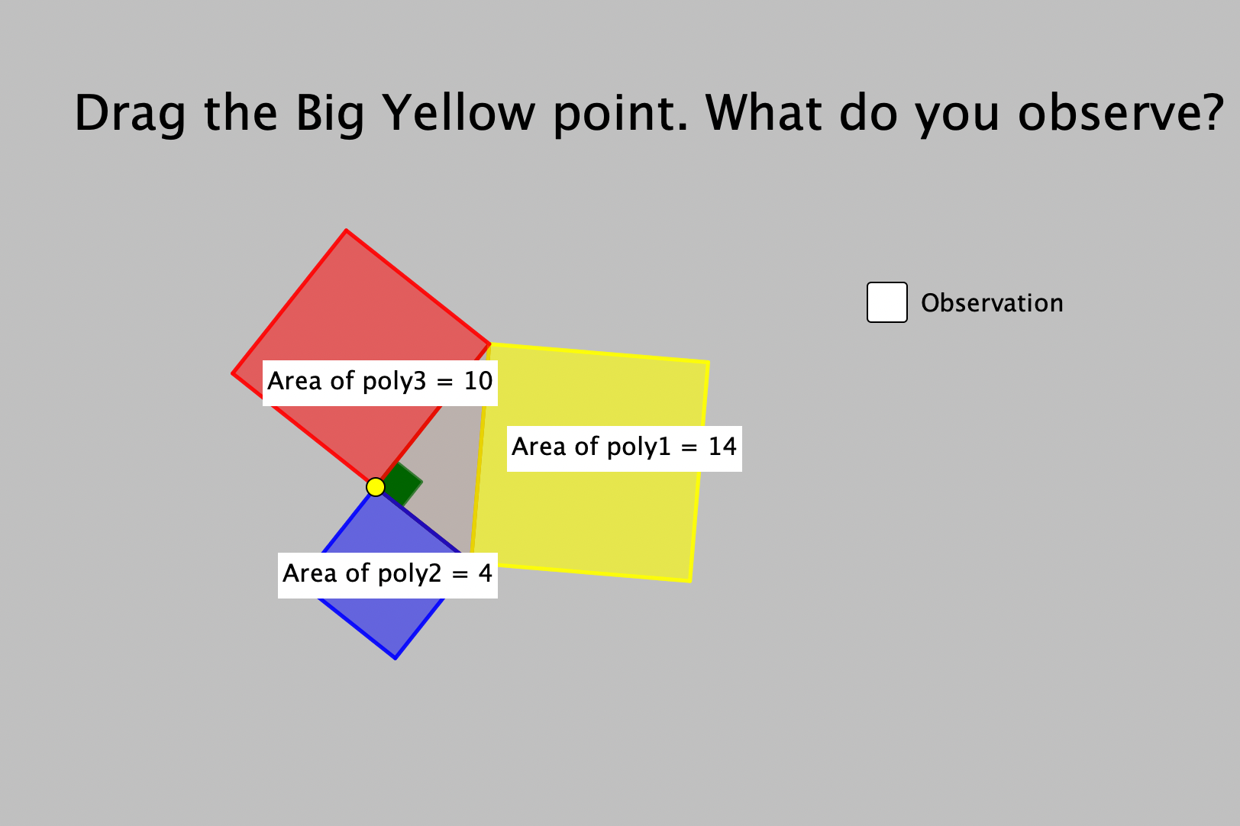
Make Conjectures
Notes:
Making a Conjecture about a geometric relationship is an important part of learning geometry. It is the first step in learning how to argue and prove mathematical statements, and it can be easily done using a dynamic geometry software.

Slide 9
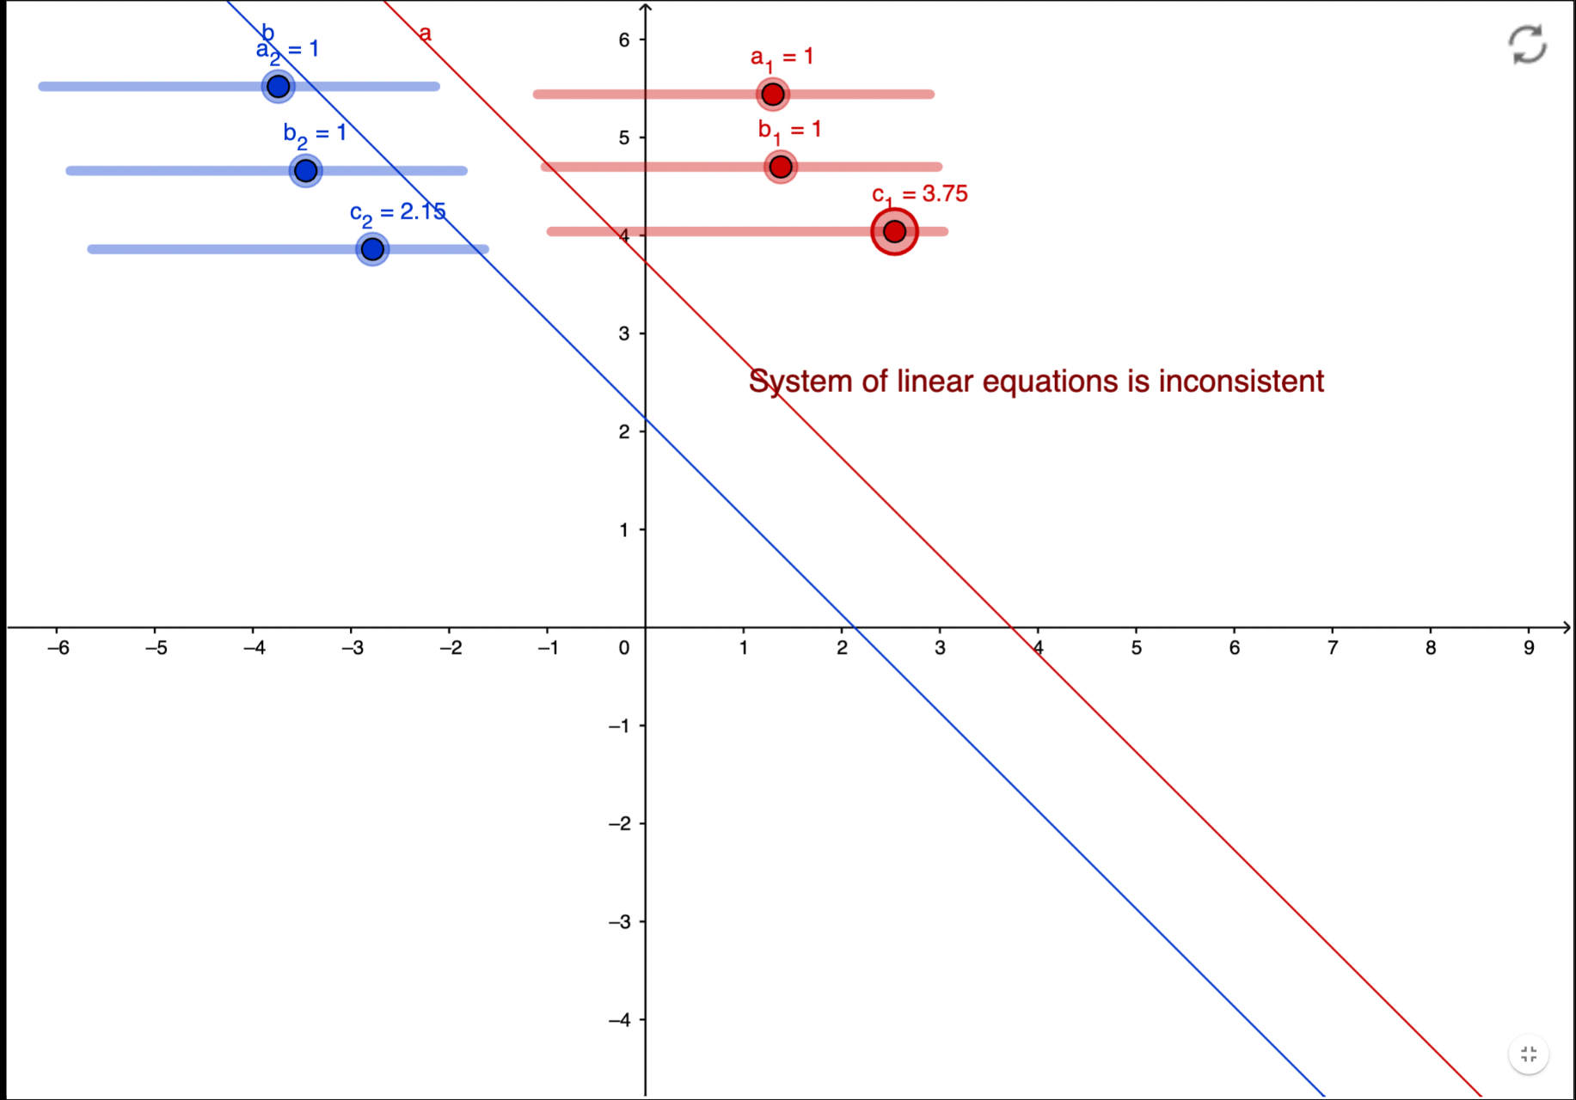
Sliders in GeoGebra

Slide 10
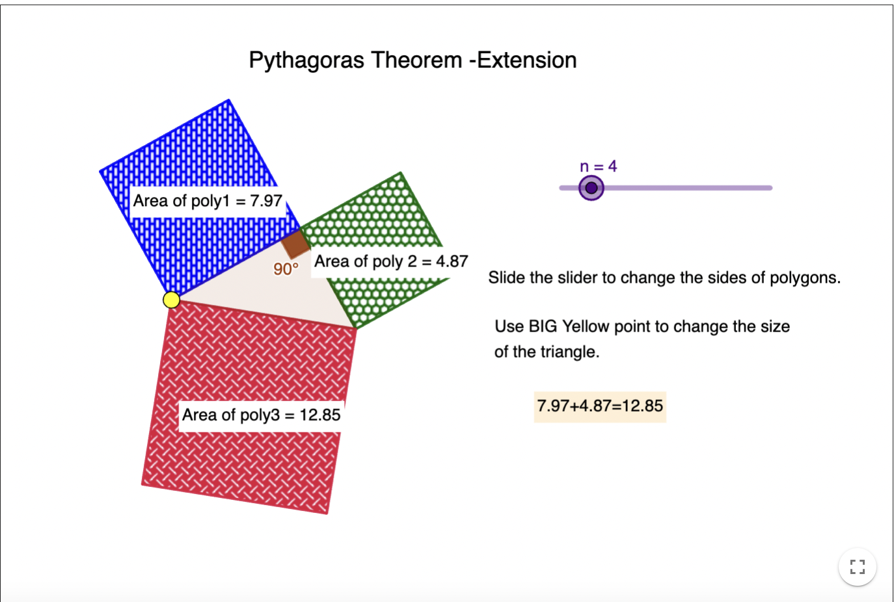
Extensions & Explorations

Slide 11
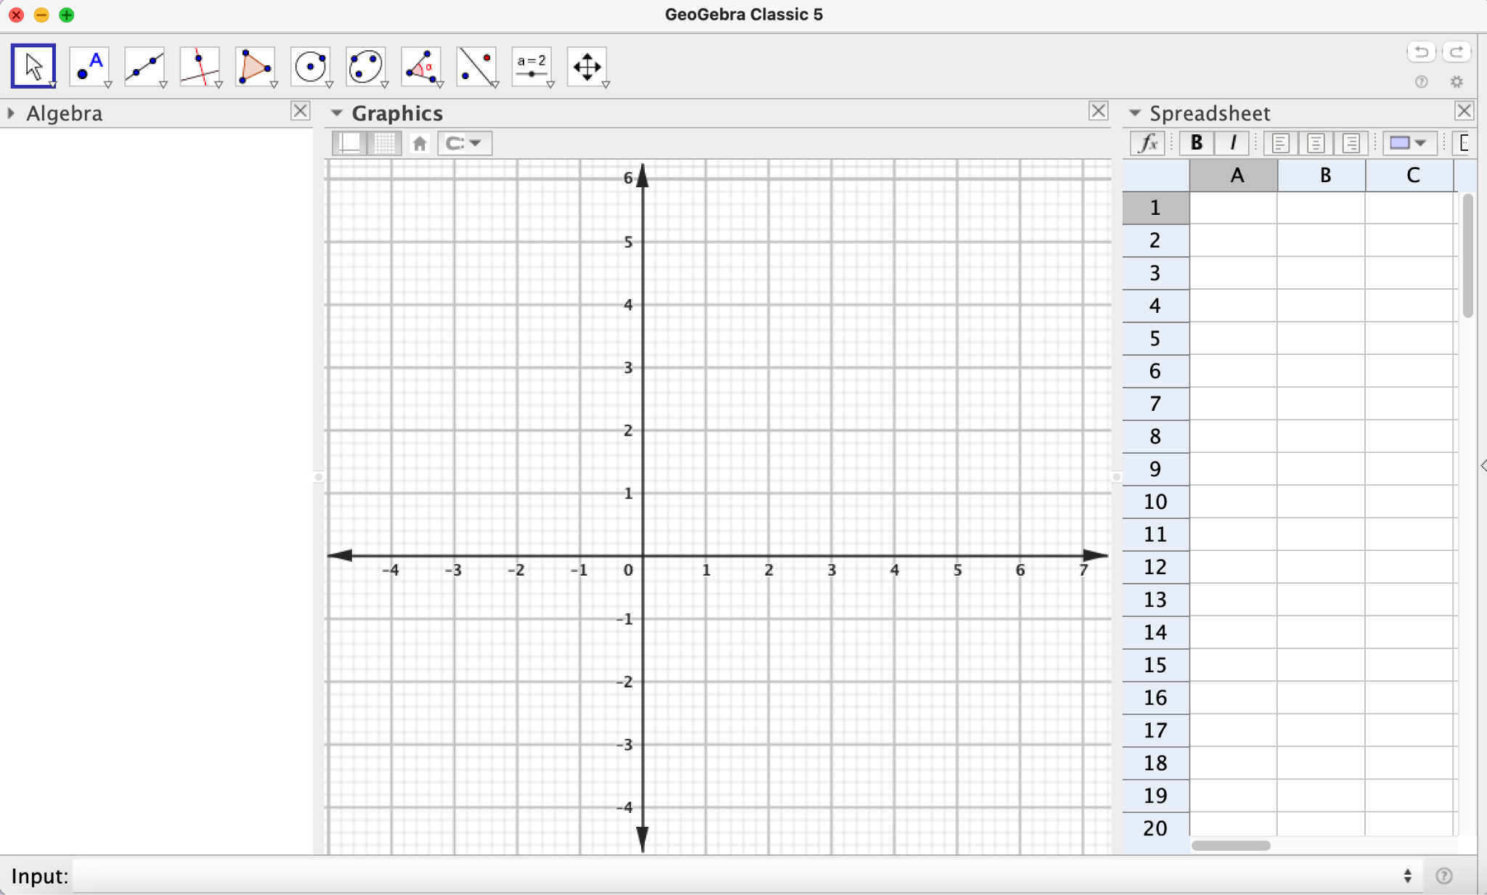
Multiple Representation
Algebra View
Spreadsheets
Graphics View

Slide 12
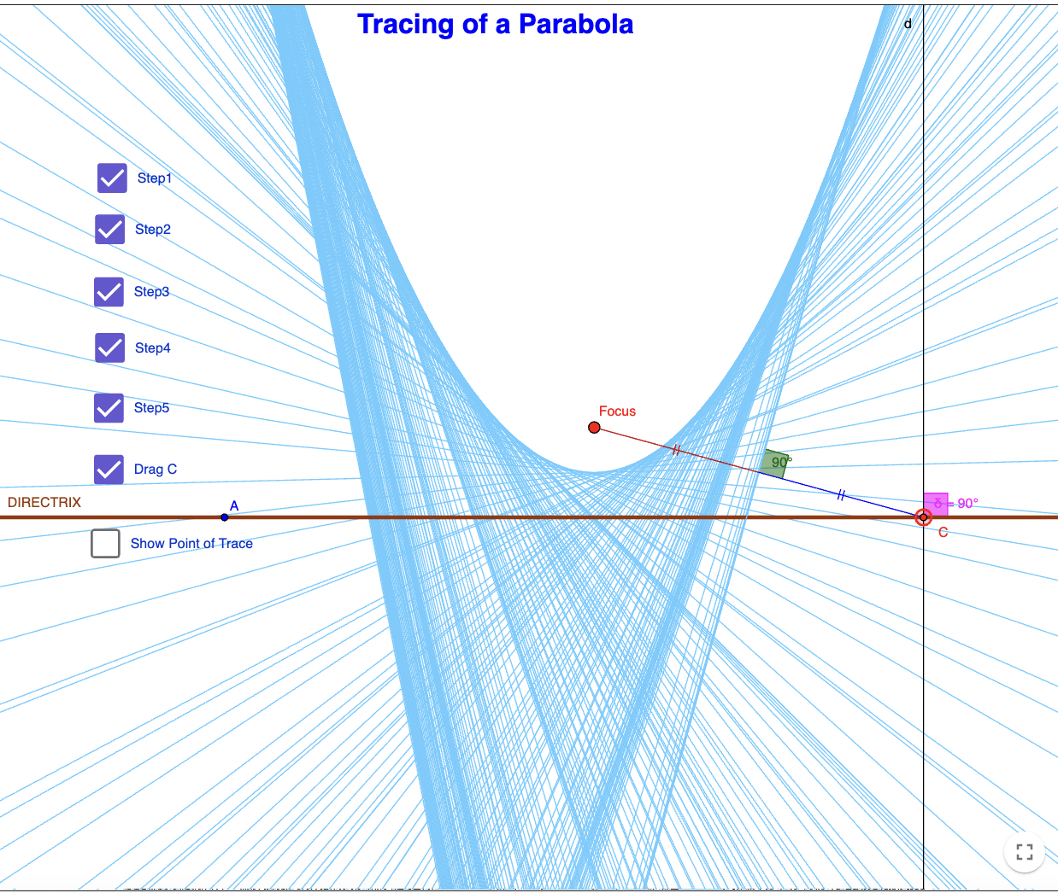
Demonstration Tool- Step by Step Construction

Slide 13
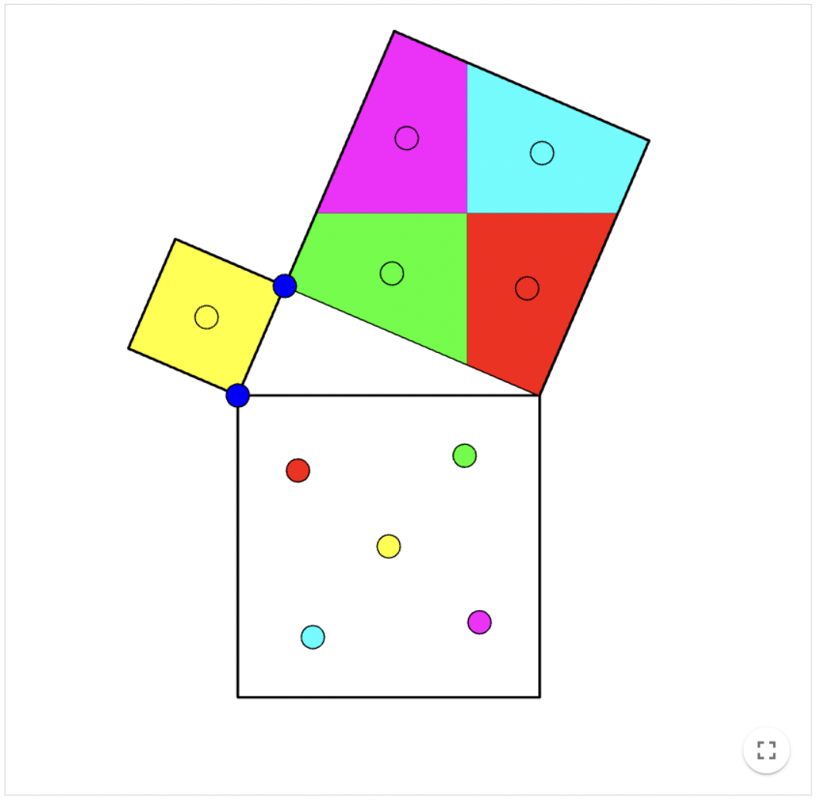
Visual Proofs & GeoGebra Worksheets

Slide 14
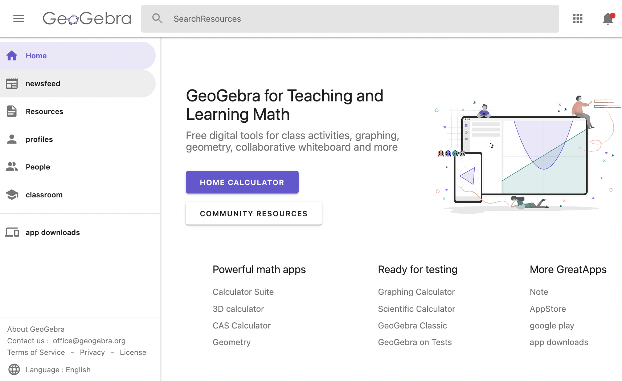
GeoGebra on Web:
www.geogebra.org

Slide 15
Make an account in GeoGebra
www.geogebra.org

Slide 16
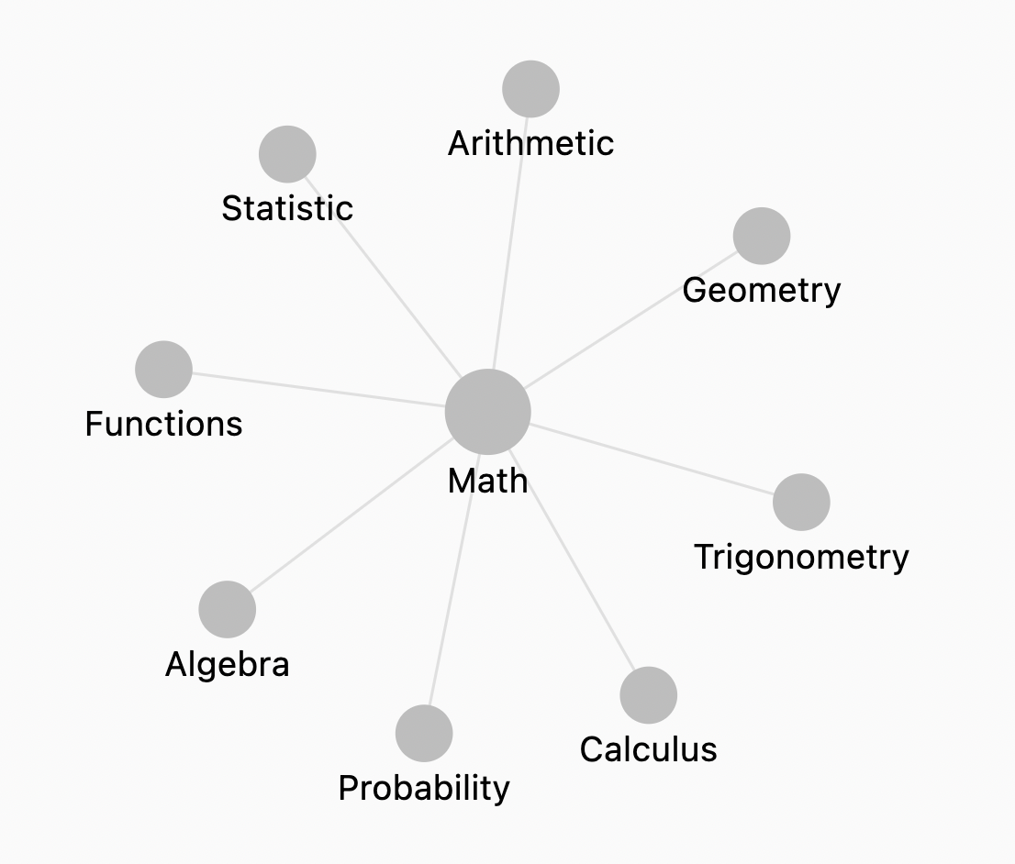
Over 1 million community created, free activities, simulations, exercises, lessons, and games for math & science!
Notes:
Assessment tool-worksheets- Geogebra Classroom - create account - online resources

Slide 17
GeoGebra Classroom: Live conversations with interactive math tools
GeoGebra Classroom is a virtual platform through which teachers can Assign interactive and engaging tasks for students
View live updated progress of students working on a specific task
view which tasks students have (or have not) started
ask the entire class questions and see all student answers instantly
Hide student names when displaying student responses to questions
team-teach together by adding co-teachers
facilitate rich, interactive discussions among all students, groups of students, and individual students.

Slide 18
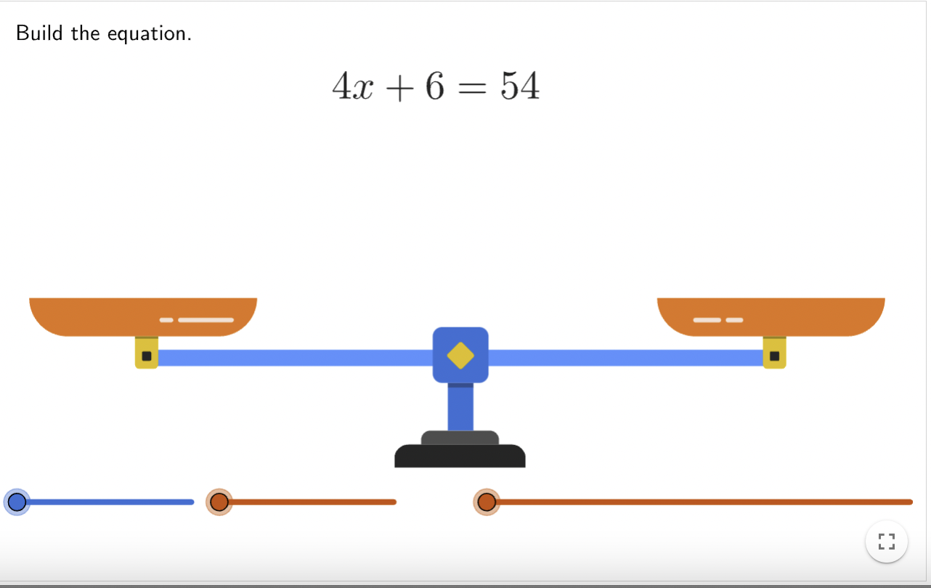
Experience GeoGebra Classroom

Slide 19
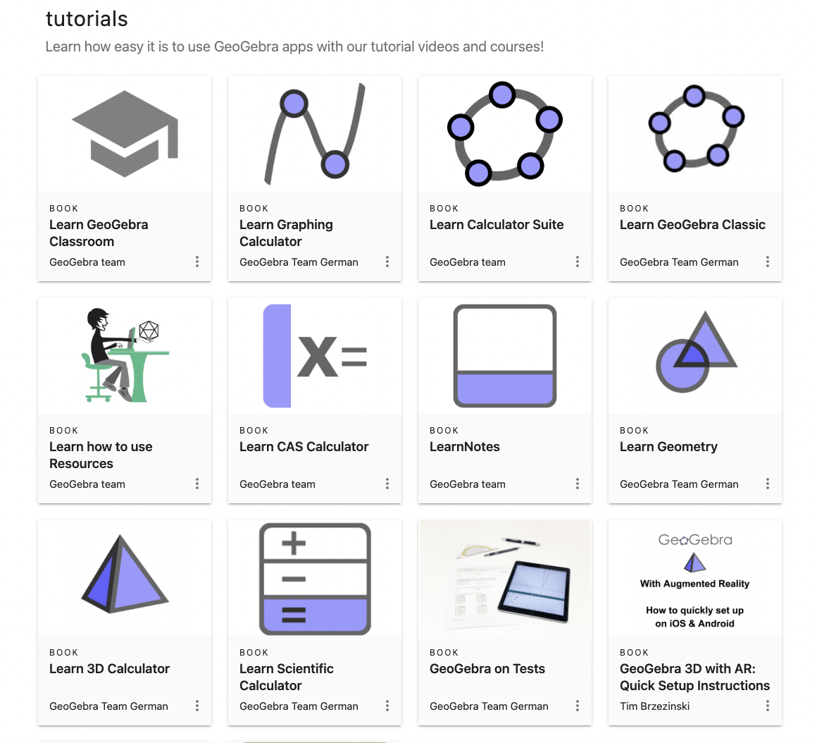
Learn GeoGebra

