Slide 1

Making Classrooms Interactive with Wordwall – NEP 2020 Aligned Approaches
Dr.Jipsy Malhotra ,Assistant Professor ,MPD,CIET,NCERT

Slide 2

Objectives Of The Session
  Why use Wordwall?
  What you’ll learn and create today?

Slide 3
Introduction to Wordwall
A simple tool to create games, quizzes, puzzles
Works on phones, tablets, smartboards
Real-time engagement, printable too!
https://wordwall.net/

Slide 4
Why Go Interactive?
NEP 2020: Pedagogical shifts
  Competency-based, experiential, joyful learning
  Integration of technology (ICT, digital tools)
📌 Quote from NEP 2020
"Pedagogy must evolve to make education more experiential, holistic, integrated, inquiry-driven, discovery-oriented, learner-centred, discussion-based, flexible, and enjoyable."
(NEP 2020, Chapter 4, Para 4.6)

Slide 5
How Wordwall supports this vision?
NEP 2020 Vision | How Wordwall Supports It
🔍 Experiential & Inquiry-driven Learning | Interactive quizzes and games promote exploration and immediate feedback
👧 Learner-Centred Classrooms | Activities can be customized by level, pace, and learning needs
🧠 Competency-Based Learning | Wordwall allows teachers to design activities based on specific learning outcomes
💬 Discussion & Discovery-Based Approaches | Activities spark discussion, collaboration, and peer interaction
🎯 Fun, Flexible, and Enjoyable | Game-based formats make learning playful and motivating
🌐 Digital & Blended Learning Support | Can be used in classrooms, on mobile devices, or shared via QR codes/links

Slide 6
Explore the Possibilities
Activity Type | Examples | Use Case
Quizzes | MCQ, True/False | Assess understanding
Match-up | Concept–Definition | Vocabulary & concept link
Sorting | Group Sort | Classify info (e.g., animals)
Labelling | Diagrams | Science/Geography topics
Games | Maze Chase, Balloon Pop | Motivation & fun revision

Slide 7
NEP-Aligned Activity Ideas
Foundational Stage (Pre/Anghanwadi to Grade 2):
🎯 Picture match, Audio identification, Balloon pop
Preparatory Stage (Grade 3-5):
🔤 Word search, Sorting, Simple quizzes
Middle Stage (Grade 6-8):
🧪 Diagram labelling, Group sort, Concept quizzes
Secondary Stage (Grade 9-12):
💡 Case-based MCQs, Timed quizzes, Complex sorting

Slide 8
Demonstration

Slide 9
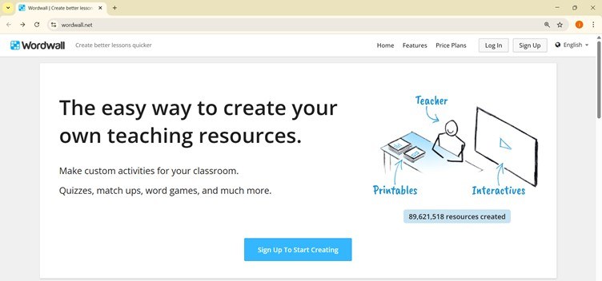

Slide 10
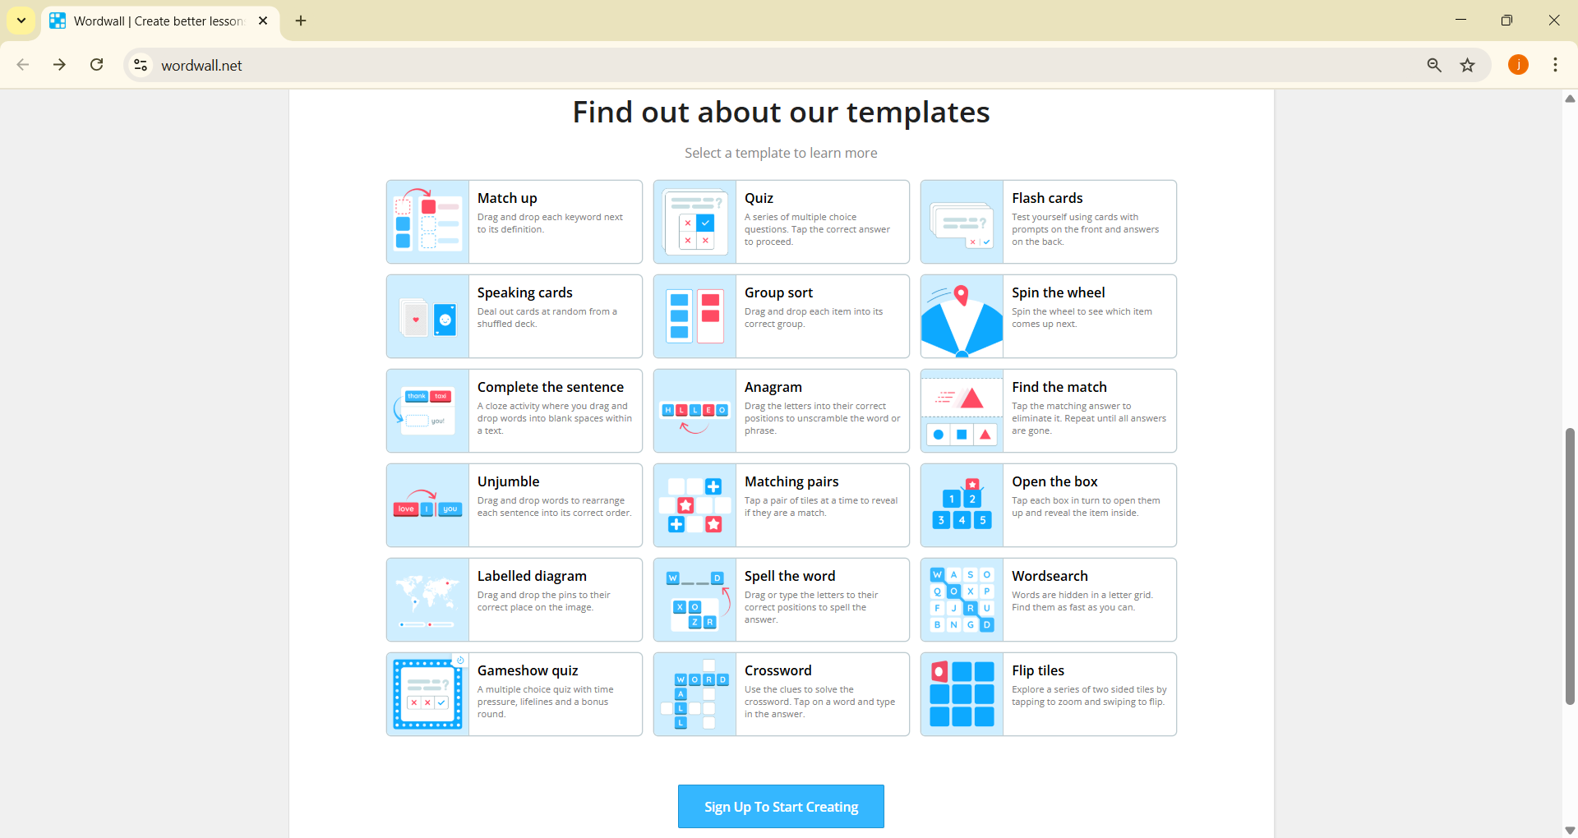
Templates

Slide 11
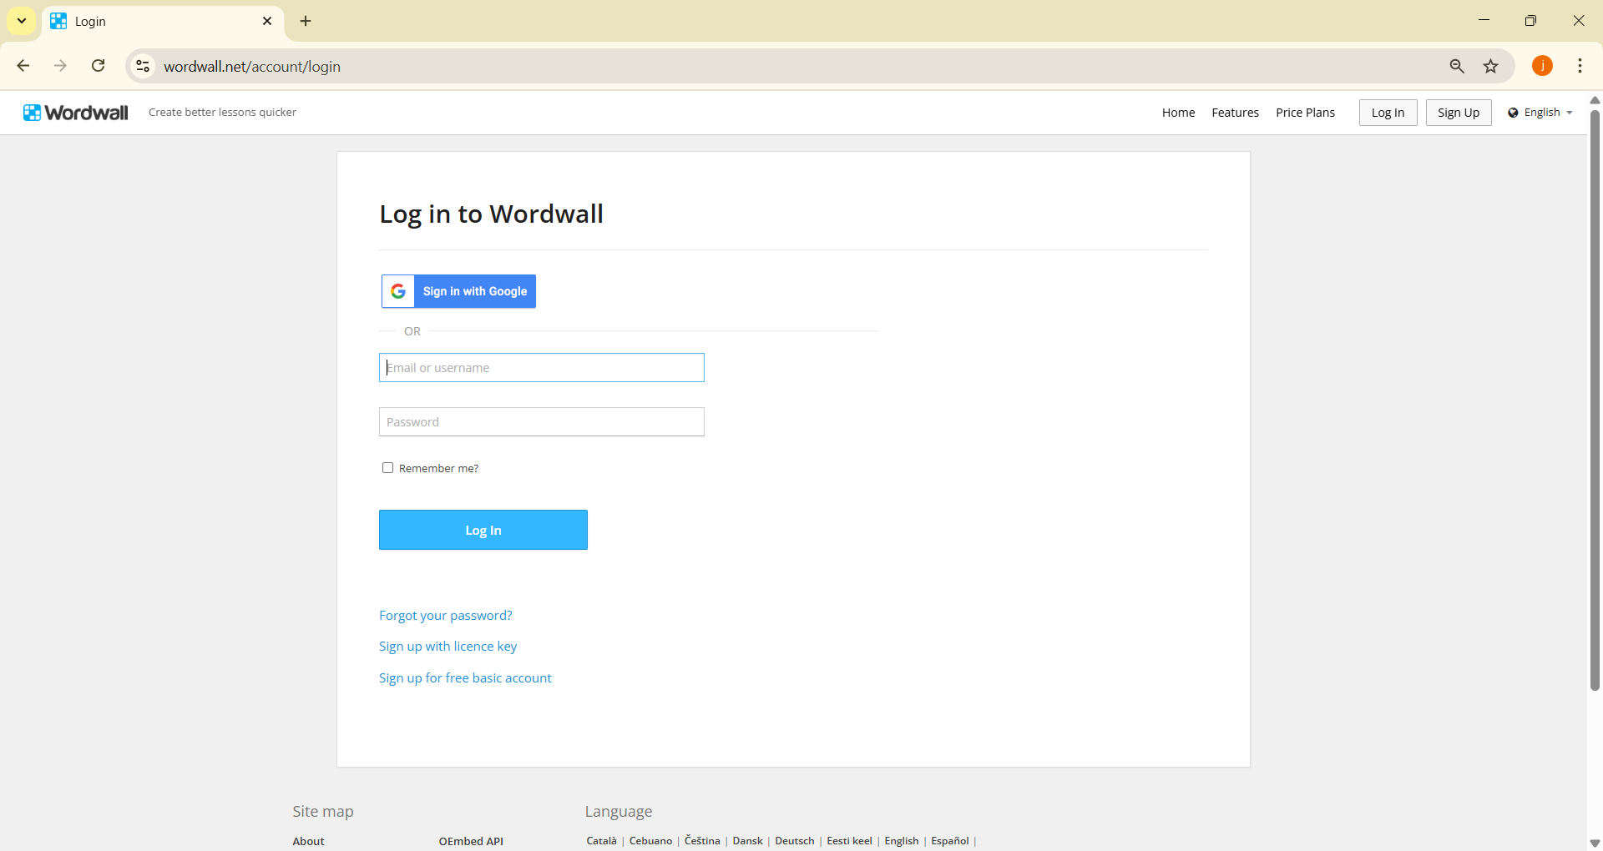
Login

Slide 12
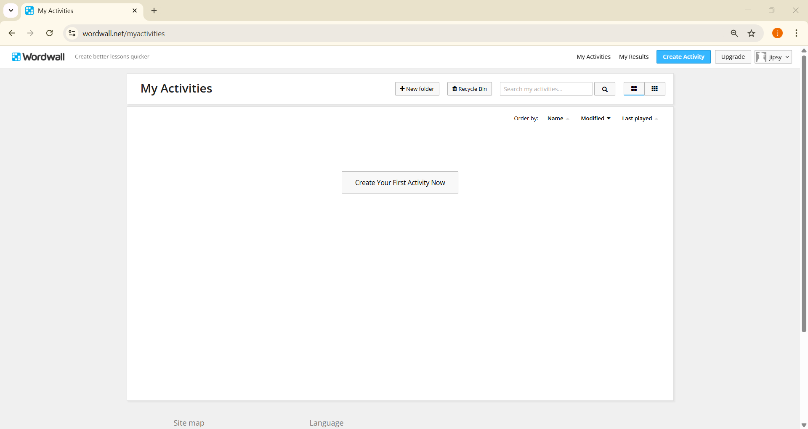
Dashboard

Slide 13
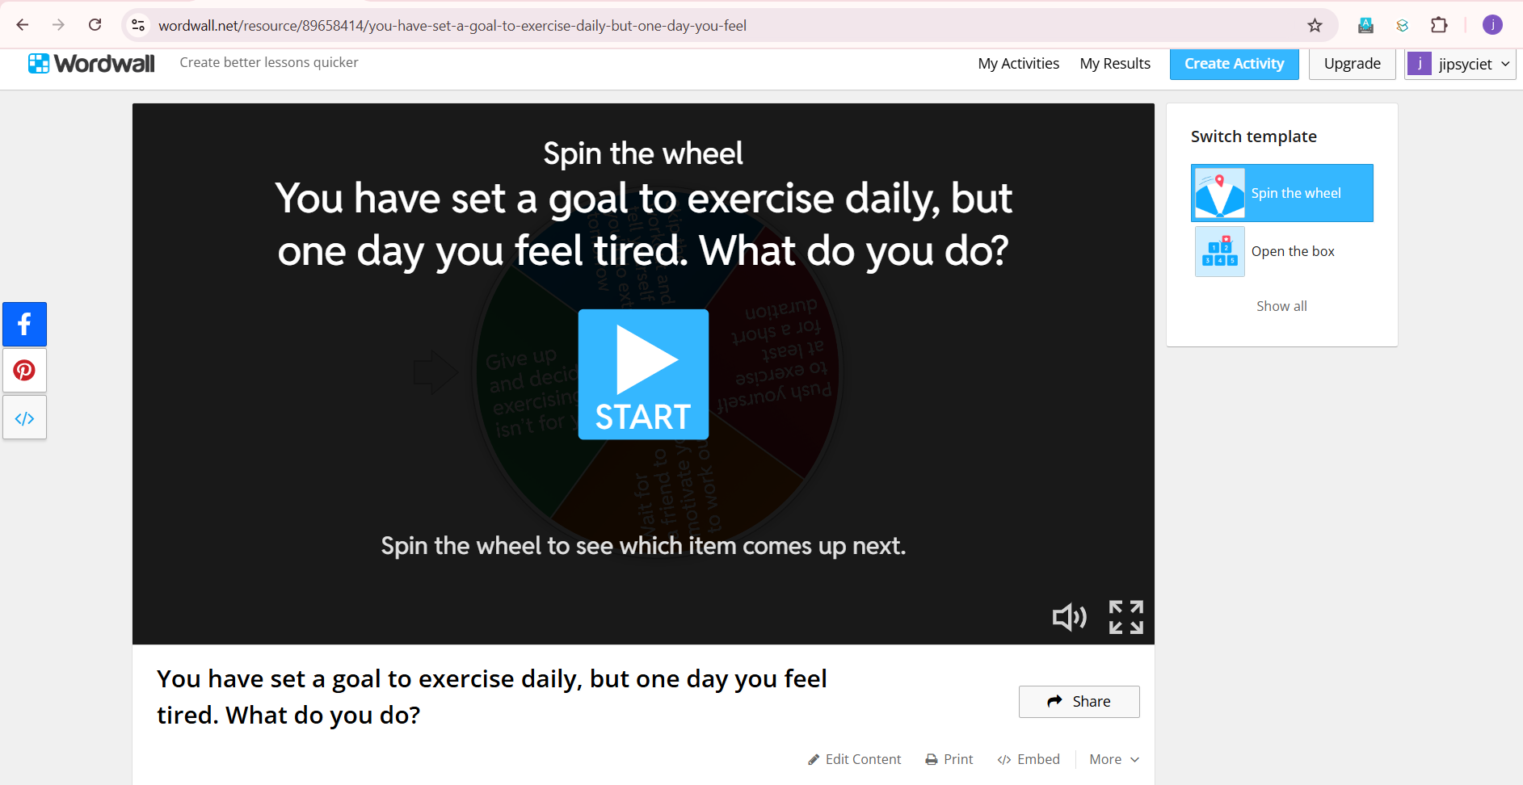
Creating Activity

Slide 14
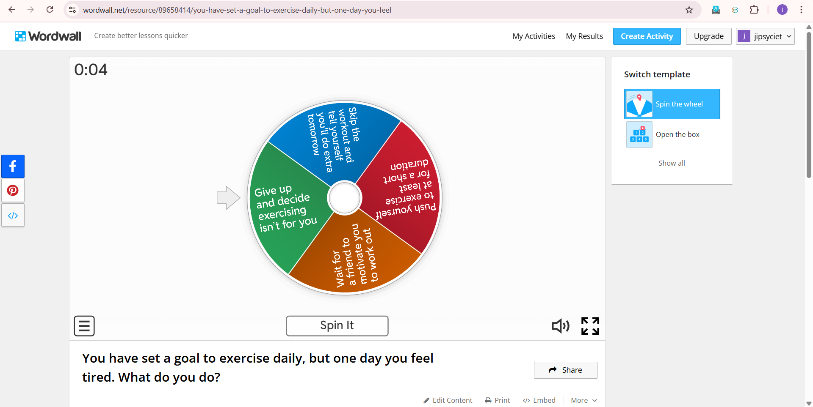
Spinwheel

Slide 15
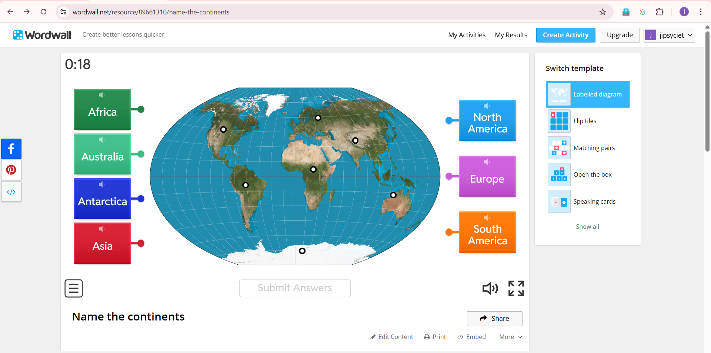
Labelling World Map

Slide 16
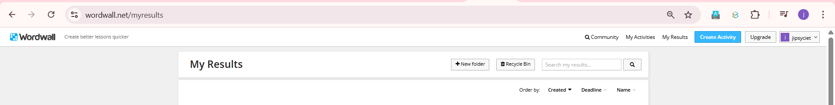
Results

Slide 17
Usage of wordwall
Use it as a starter/warm-up activity
Quick checks during or after a lesson
Peer learning and revision tools
Formative assessments
Homework with QR codes/links

Slide 18
“Tell Me And I’ll
Forget Show Me and I May Remember Involve Me and I Learn”.-
― Benjamin Franklin

Slide 19
Let’s make every class interactive, joyful, and NEP-aligned .

Slide 20
Thank you!
Do you have any questions?
Jipsy.malhotra@ciet.nic.in

