Slide 1




Cybersecurity Threats
Intelligence & Forensics
in the Financial Landscape
06-08-2024

Slide 2
Vision
To create a safer cyber space for the citizens of India
Mission
To create an effective framework and ecosystem for the prevention, detection, investigation, and prosecution of cybercrime in the country

Slide 3


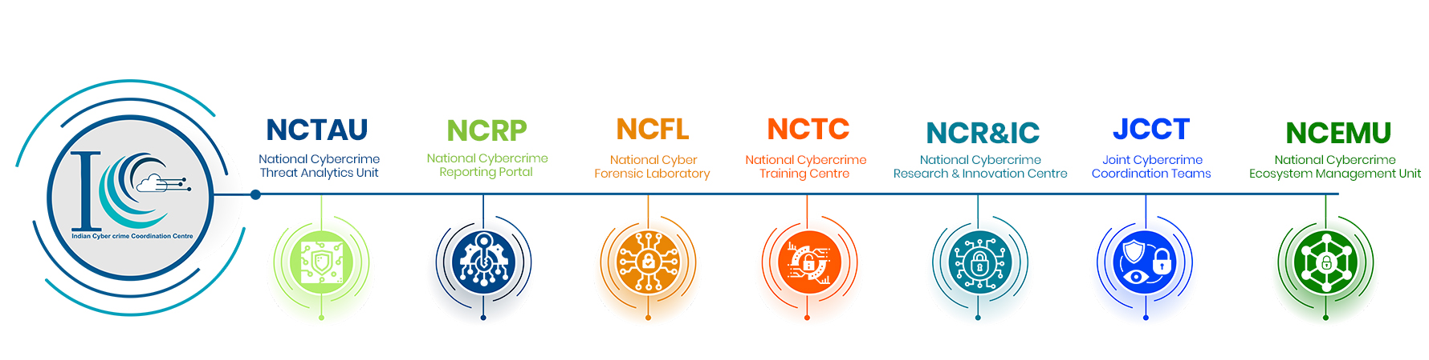
Indian Cyber Crime Coordination Centre (I4C)
I4C scheme was created to act as a nodal point in the fight against cyber crime
Seven Vertical’s of I4C

Slide 4
Evolving Modus Operandi
Nature and spread of Cybercrime hotspots (International)
Illegal Stock Market Scam
Illegal Investment and Fake Gaming Apps
Digital Arrest
Romance / Dating App Scam
Source : NCRP, UNODC

Slide 5
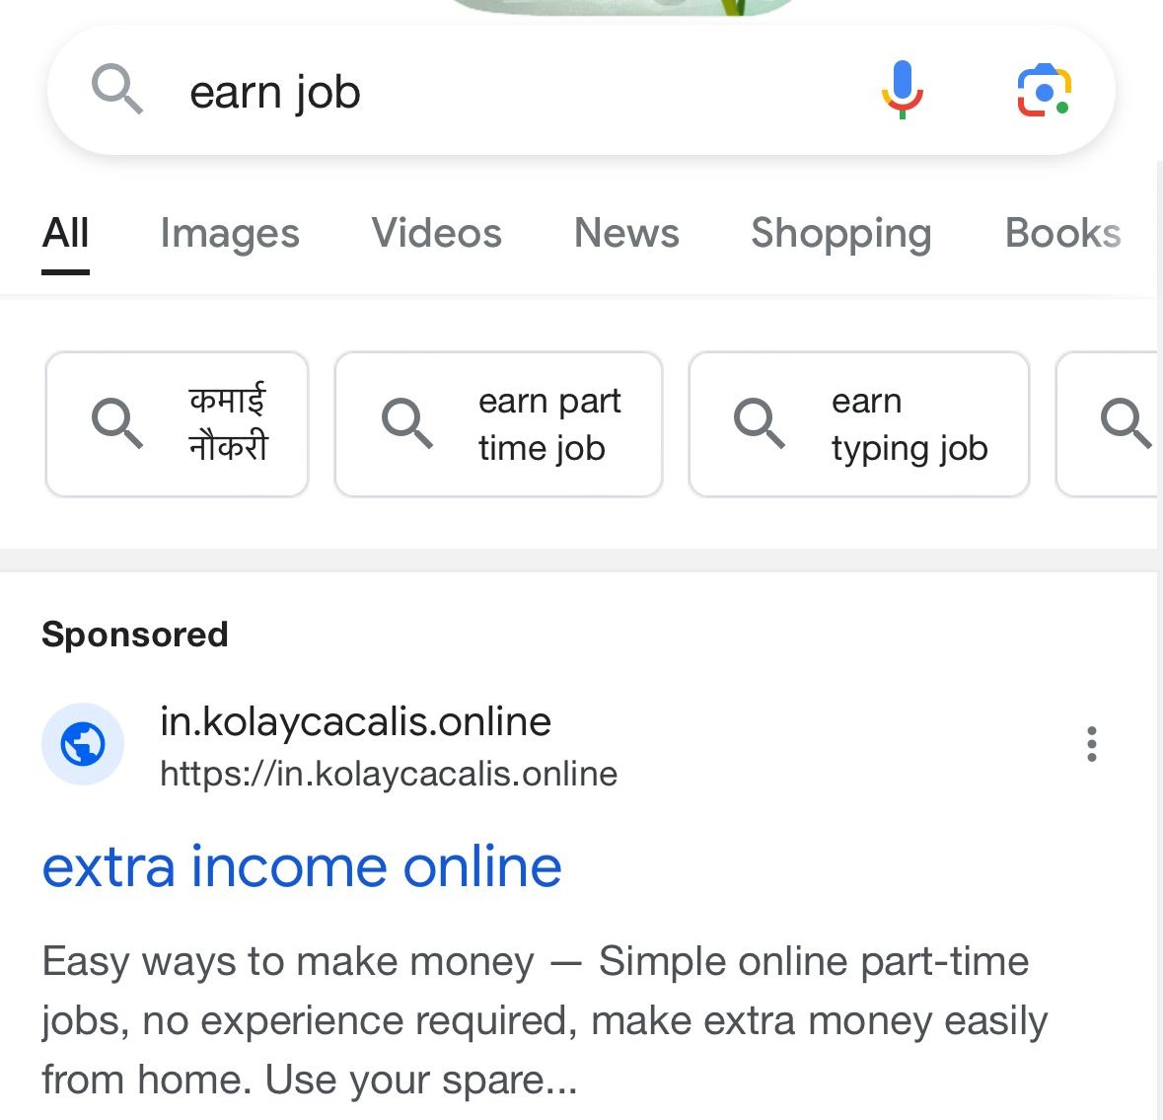
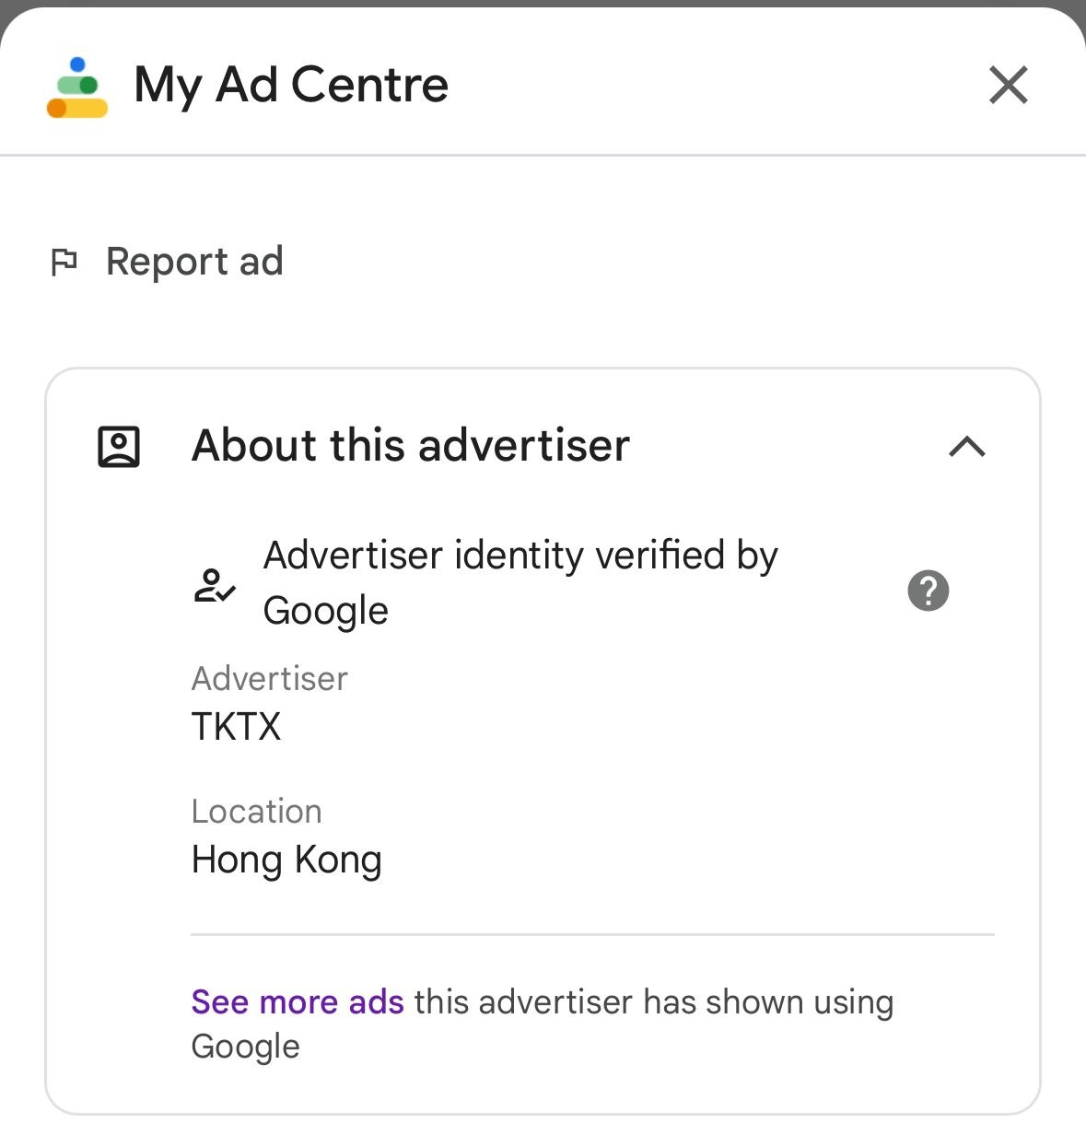

VECTOR 1 – DIGITAL ADS

Slide 6
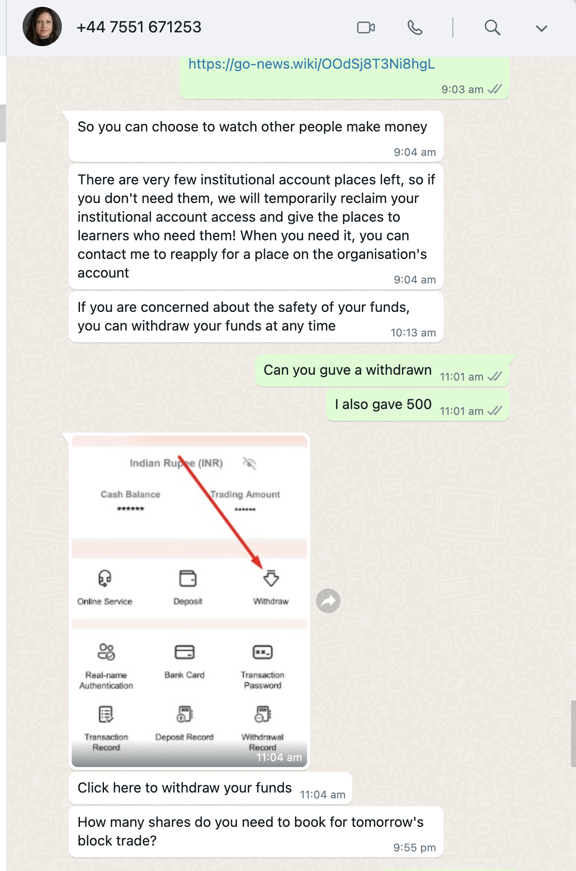
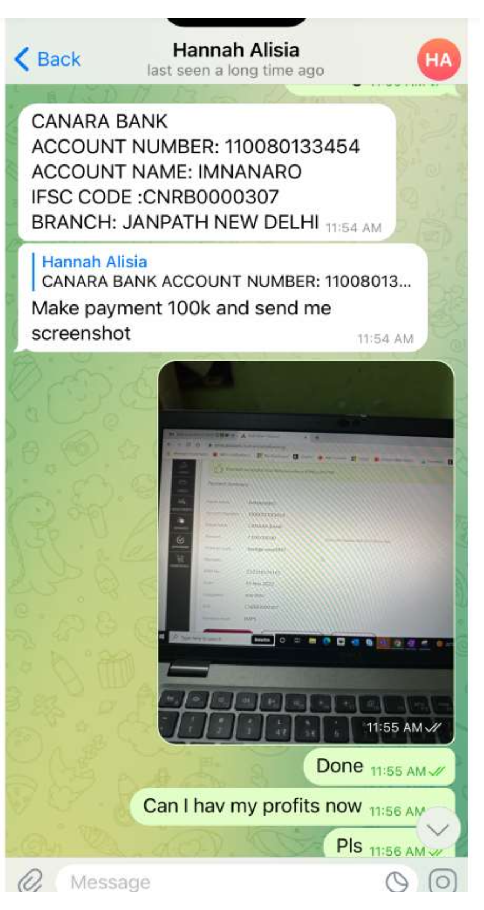
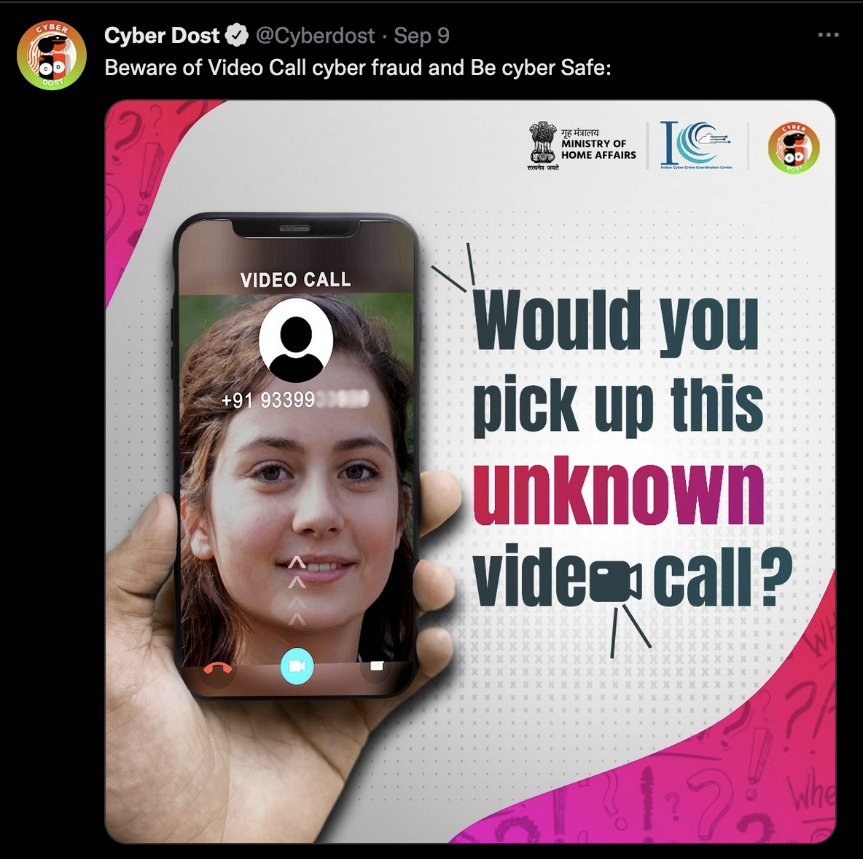
VECTOR 2 – WHATSAPP / TELEGRAM

Slide 7
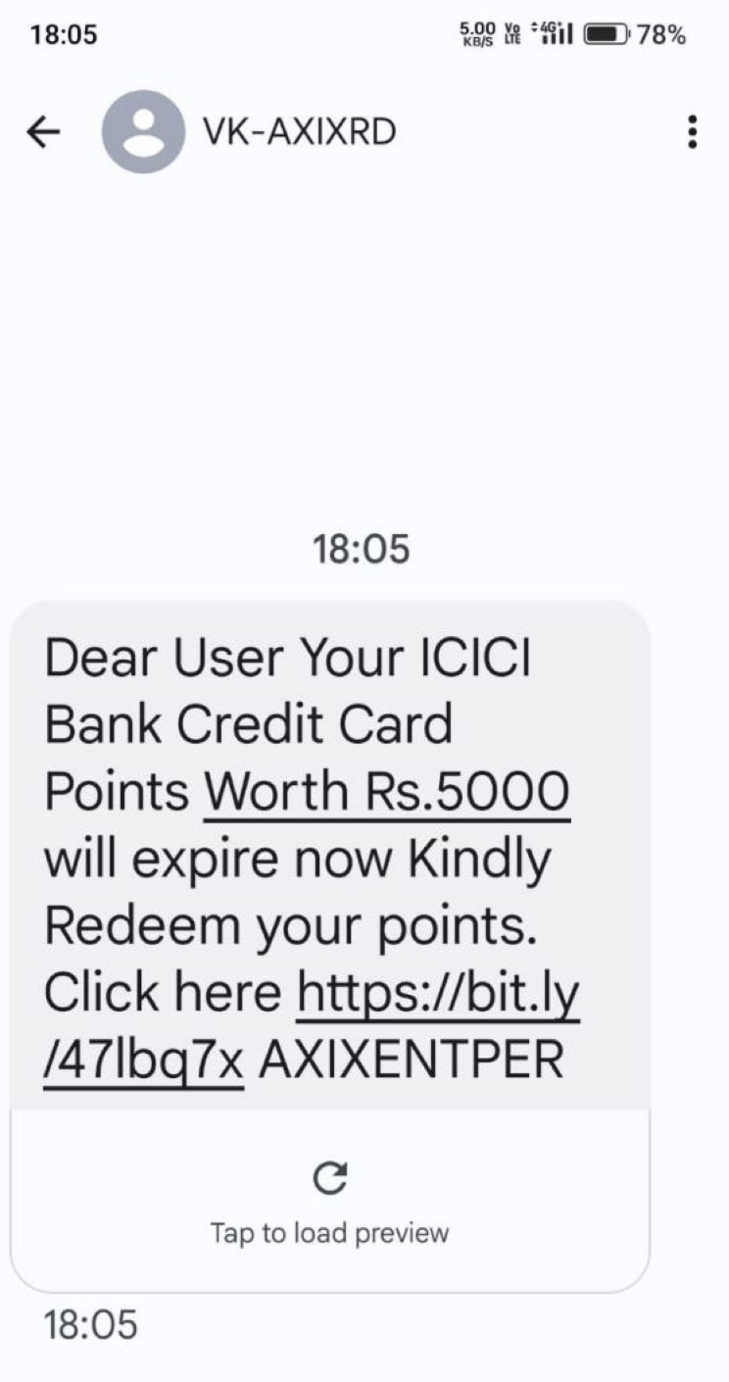
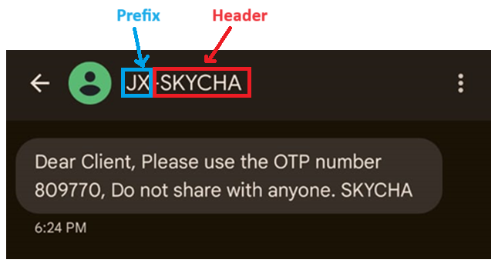
VECTOR 3 – SMS
Phishing Page
Mobile Malware

Slide 8
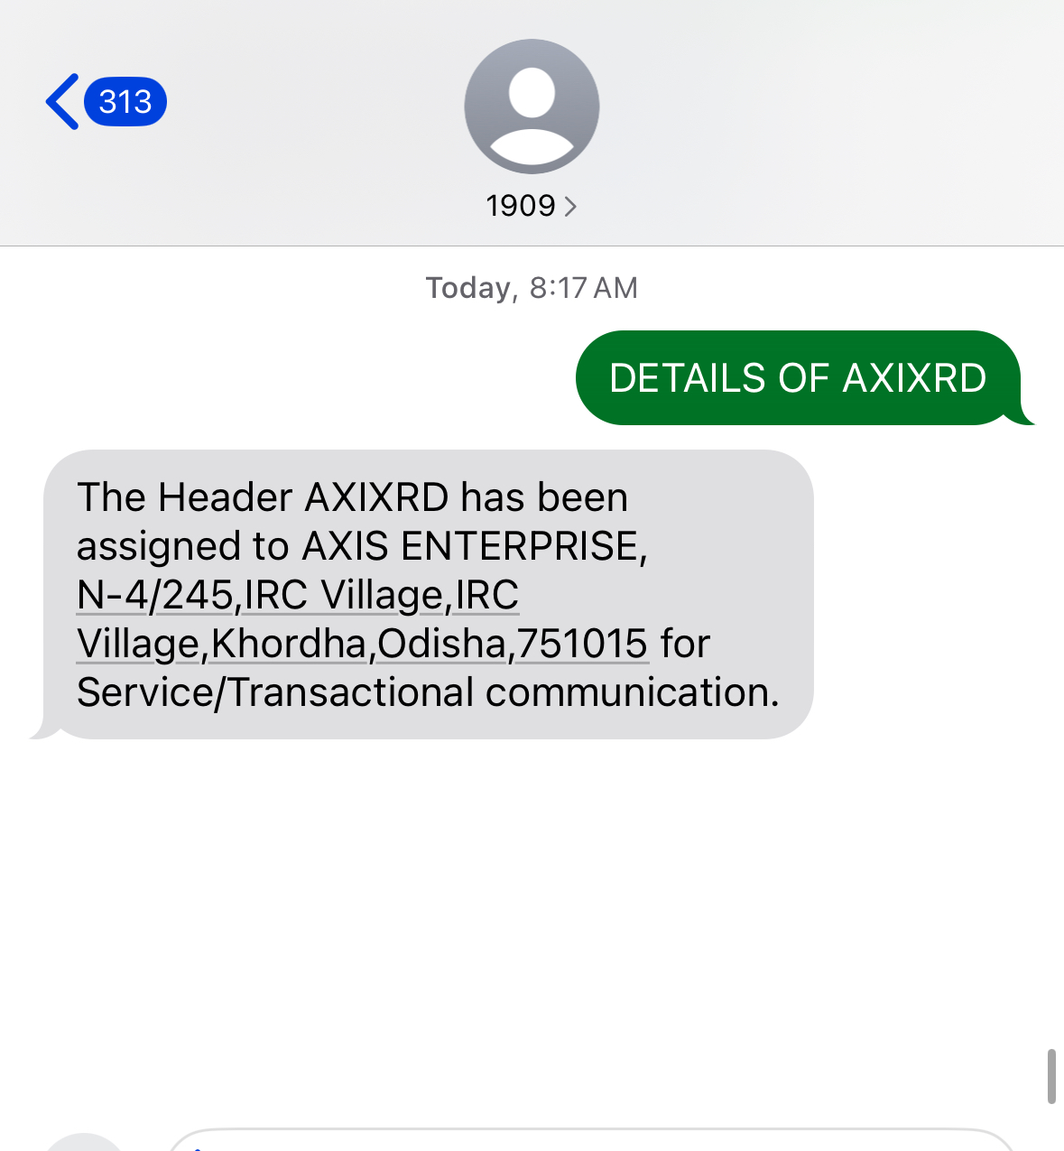
Self Investigation
Send SMS to 1909

Slide 9
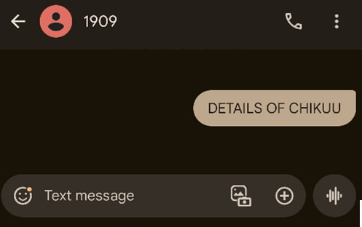
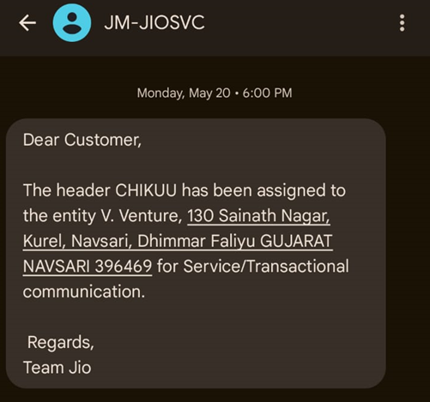
Find the sender of the message from SMS Header
Send Message to 1909
https://smsheader.trai.gov.in/
https://www.cyberyodha.org/

Slide 10
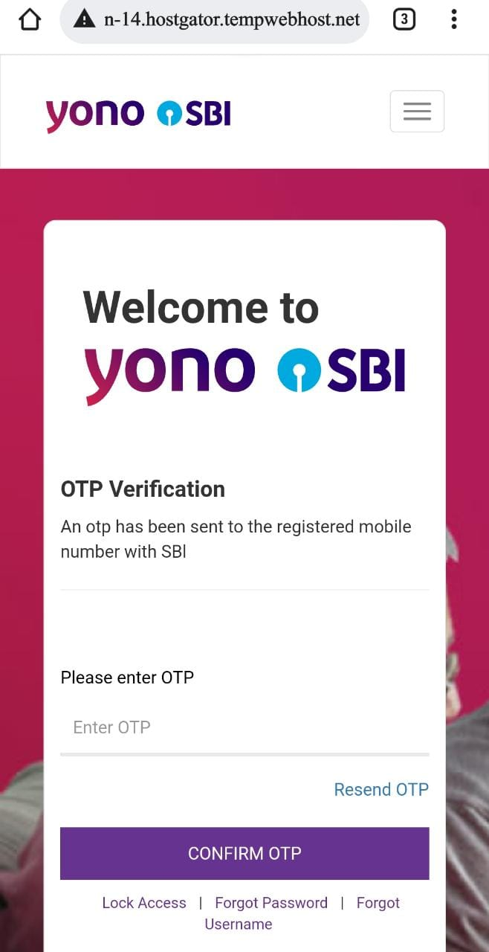
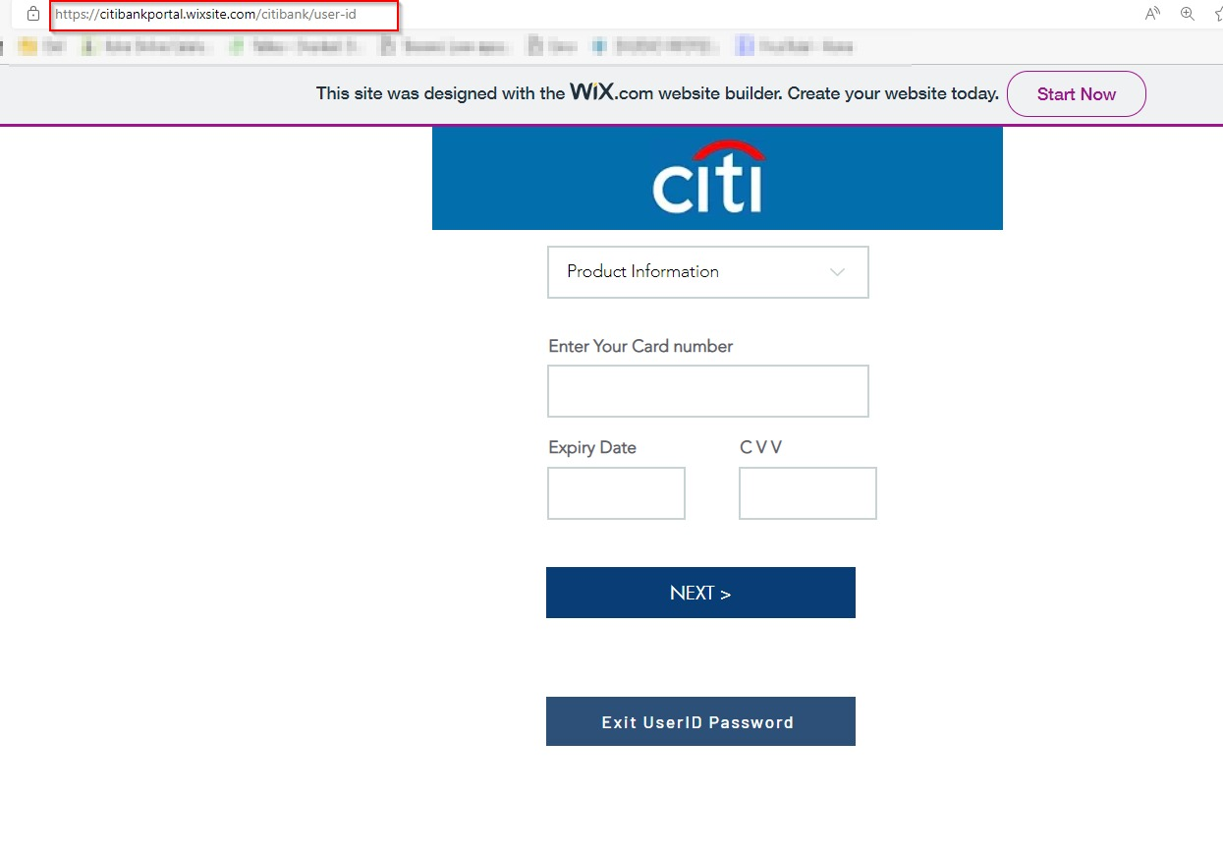
VECTOR 4 – Phishing Website

Slide 11
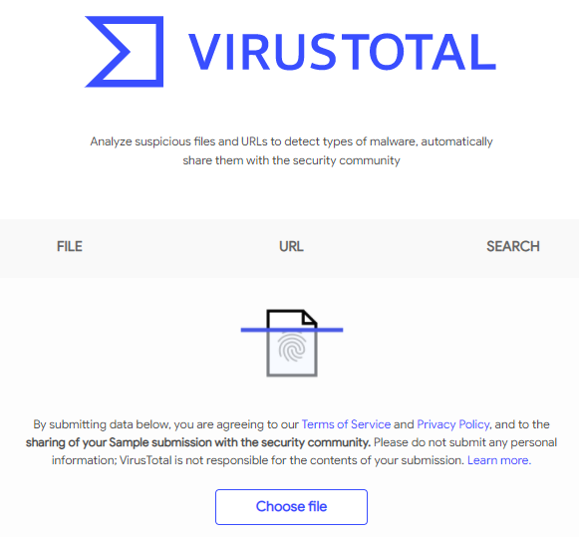
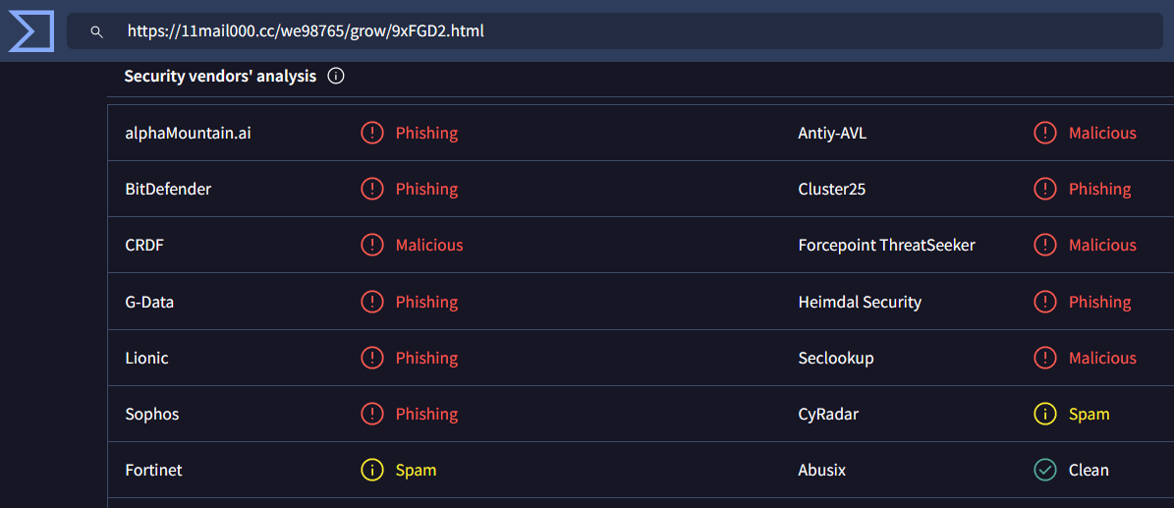
1. How to verify Website or a link

Slide 12

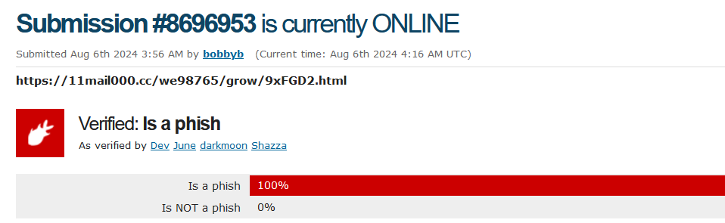
2. How to verify Website or a link

Slide 13

Shortened URLs
https://cutt.ly/Rek1lIDy
http://tiny1.jio.com/HelpfulTips
https://bit.ly/2FEB9QP.&#010

Slide 14
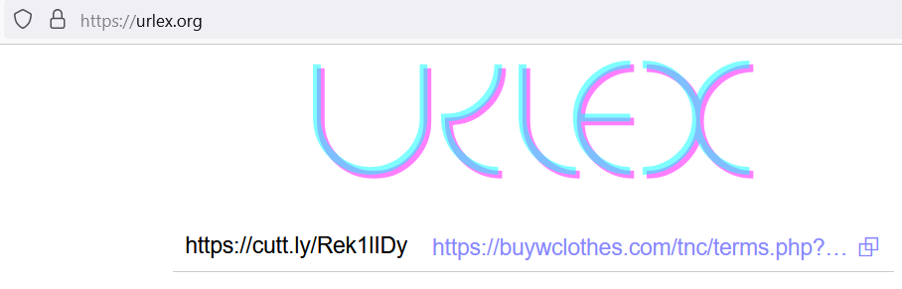
url Expander
urlex checkshorturl

Slide 15
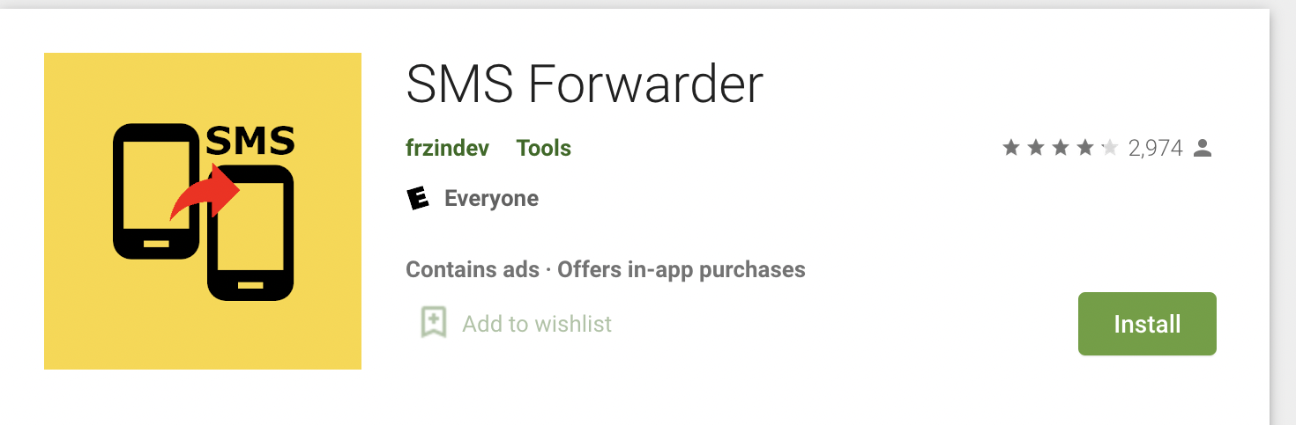
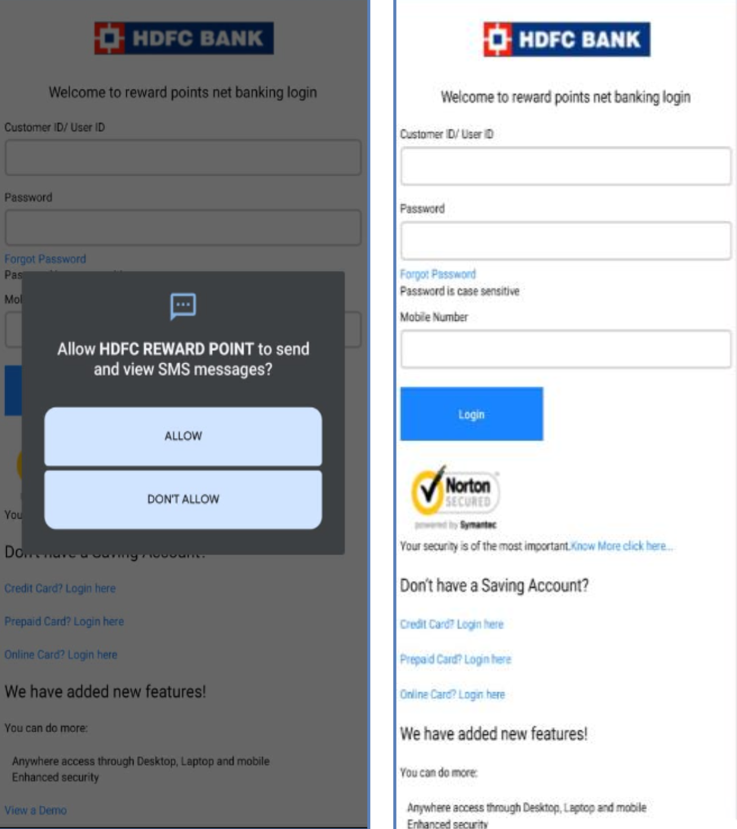
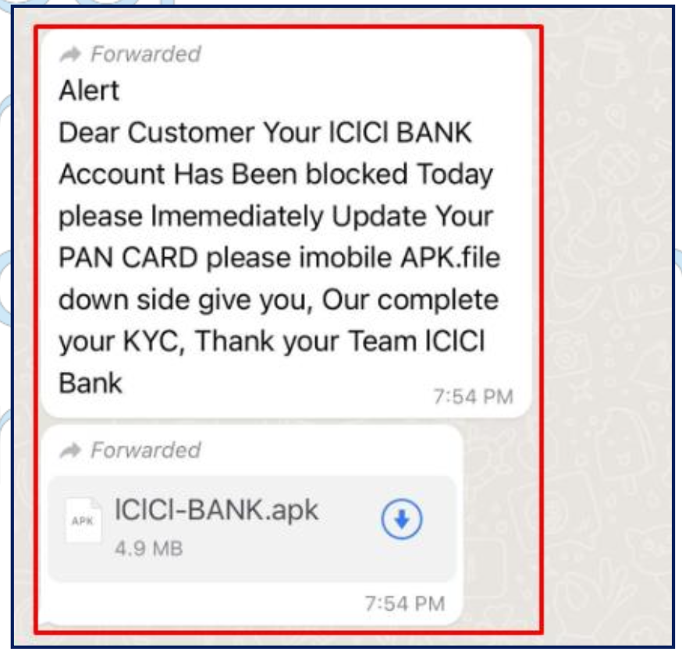
VECTOR 5 – Android Apps
Side Loading

Slide 16
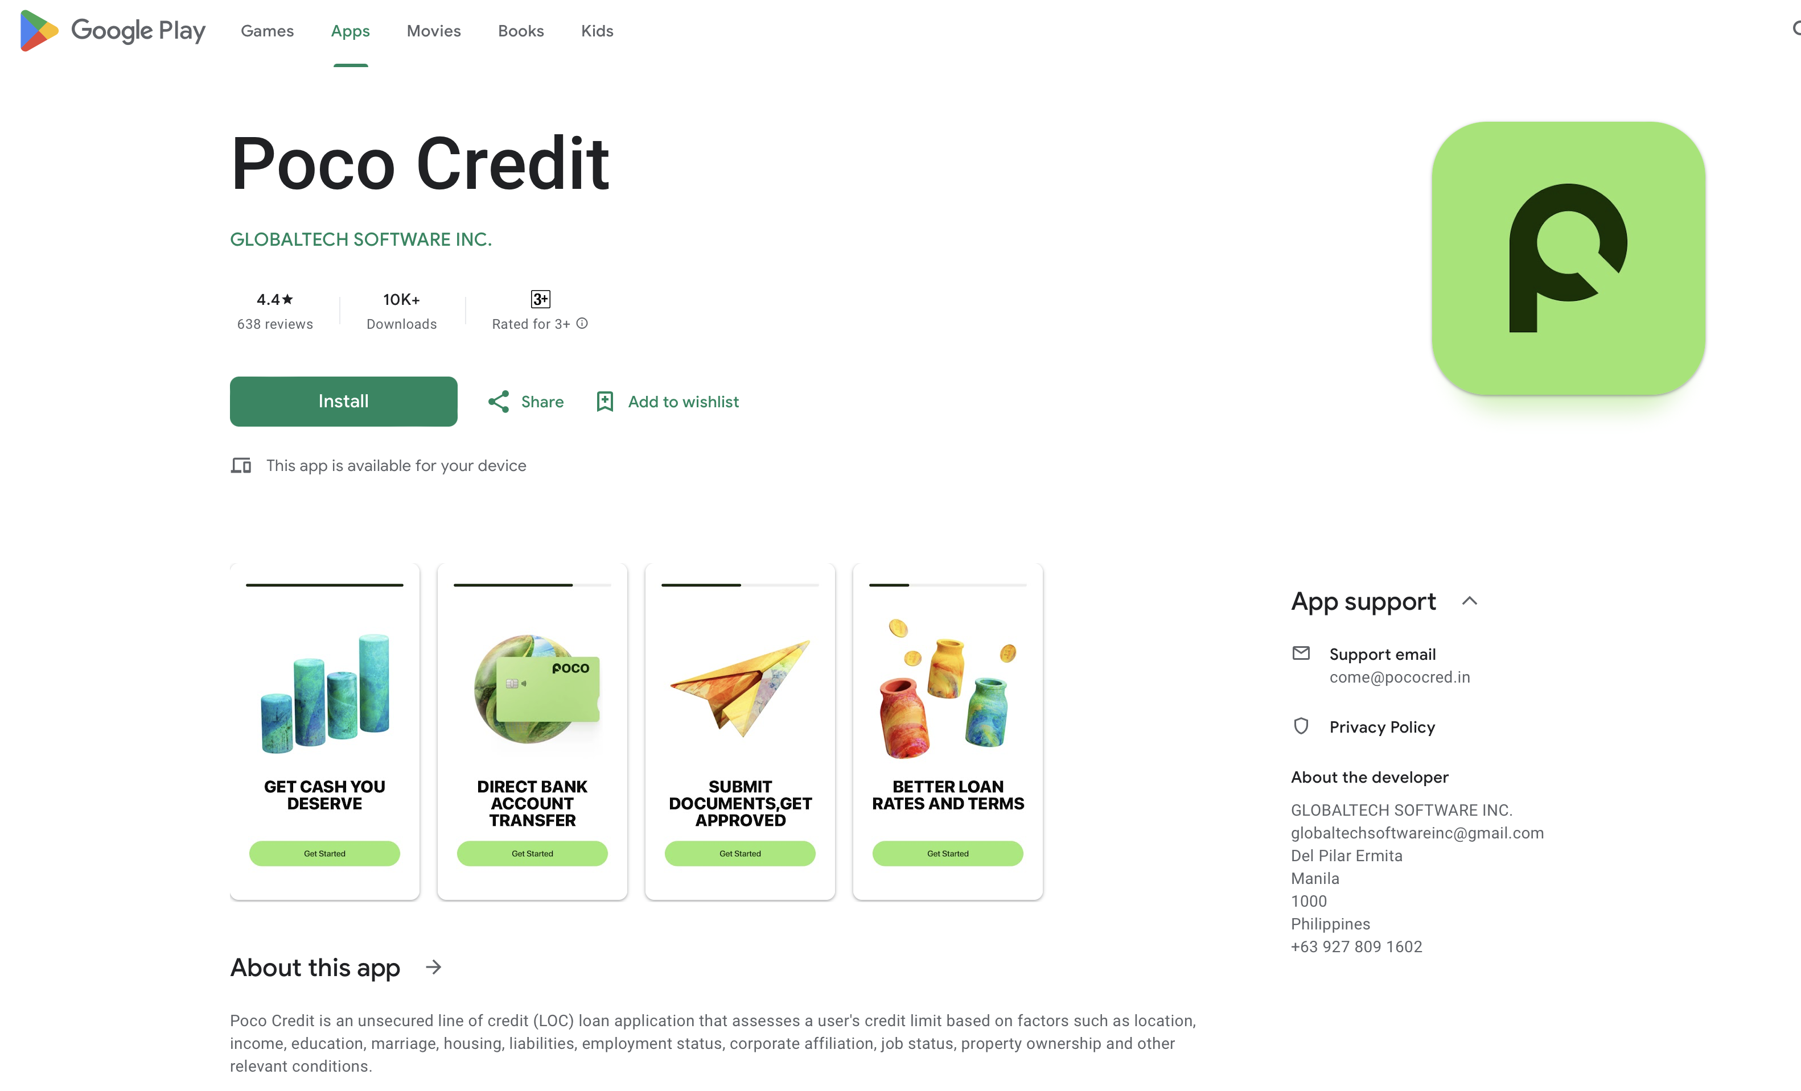
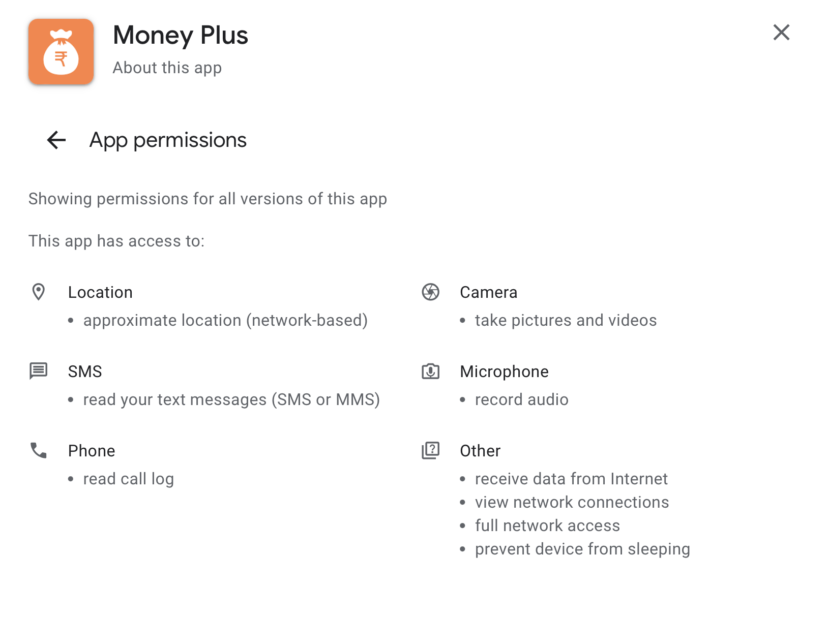
VECTOR 5 – Mobile Apps
Loan Apps
Trading Apps
Gaming Apps
Dating Apps
Utility Apps

Slide 17
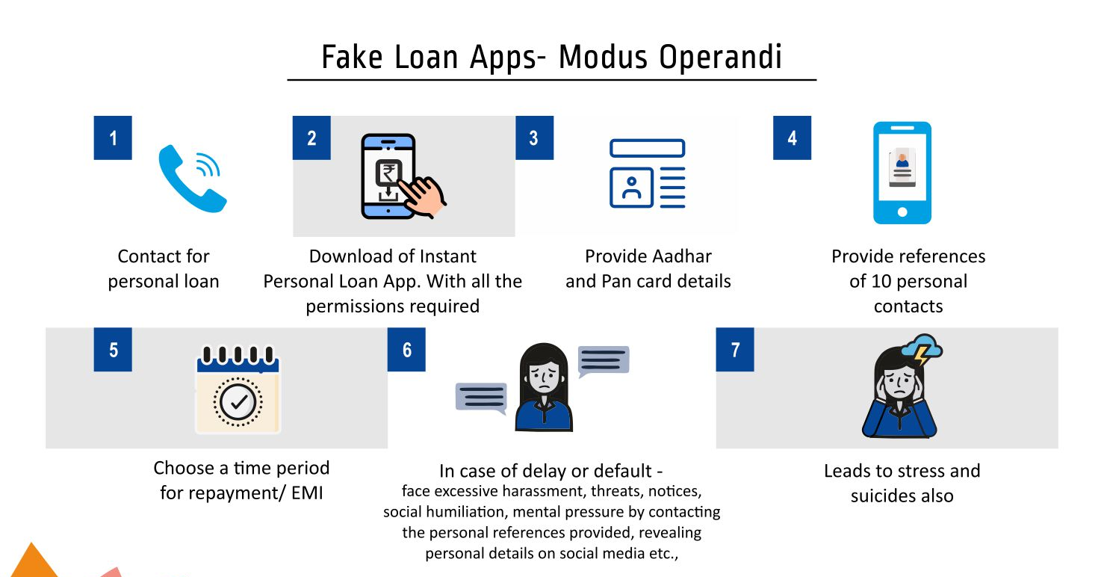

Slide 18
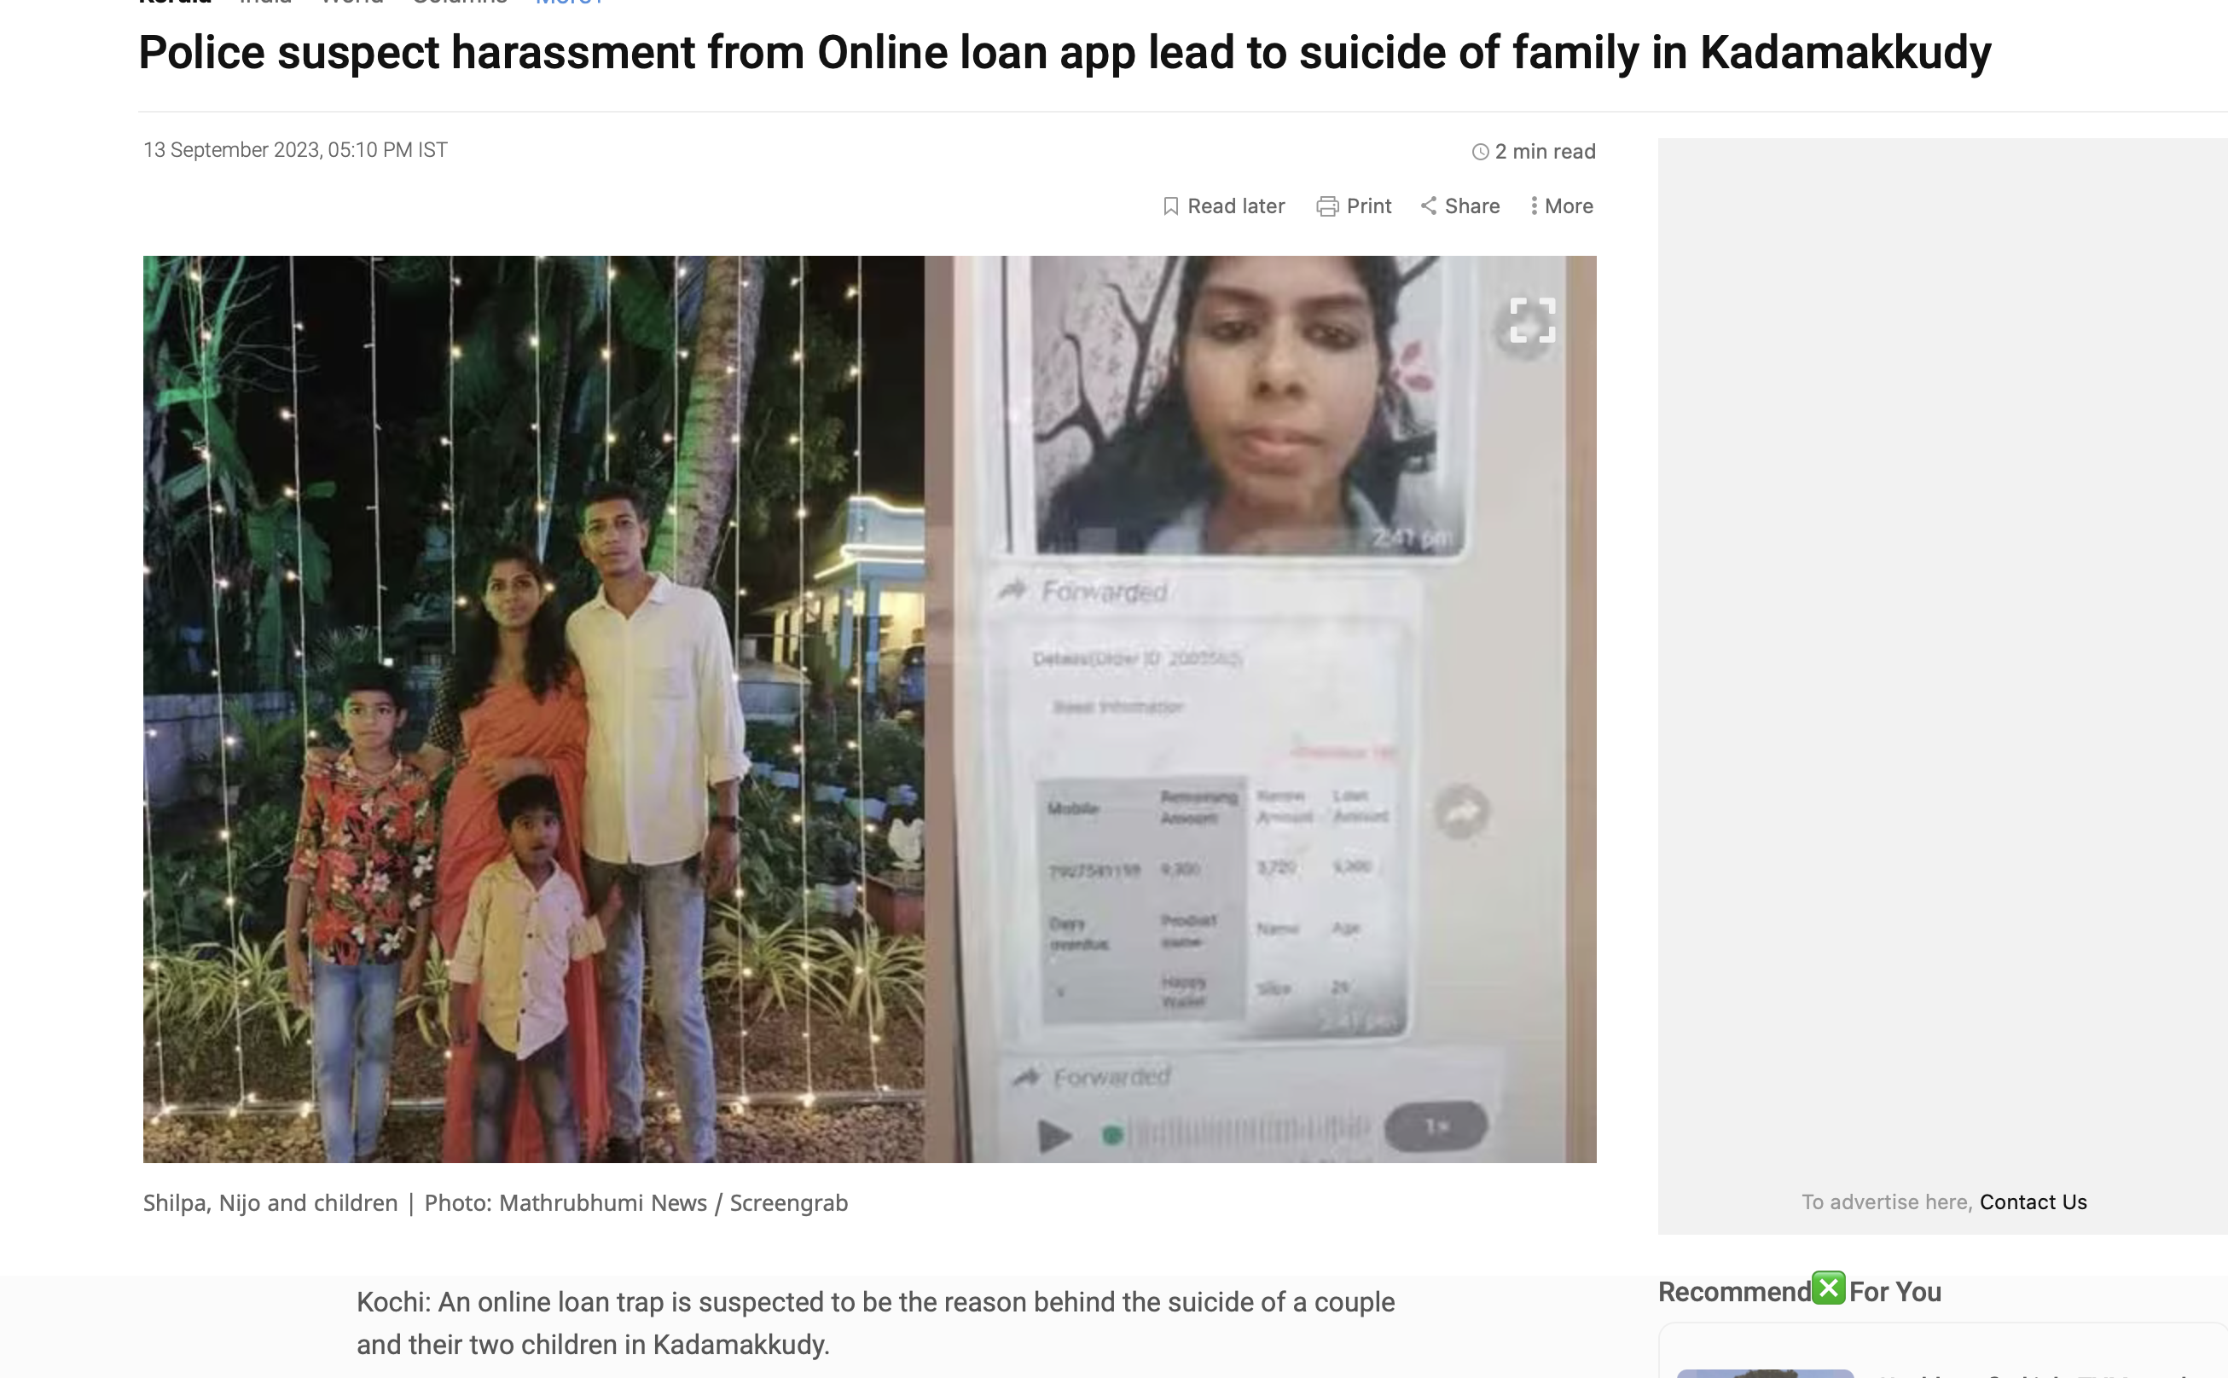
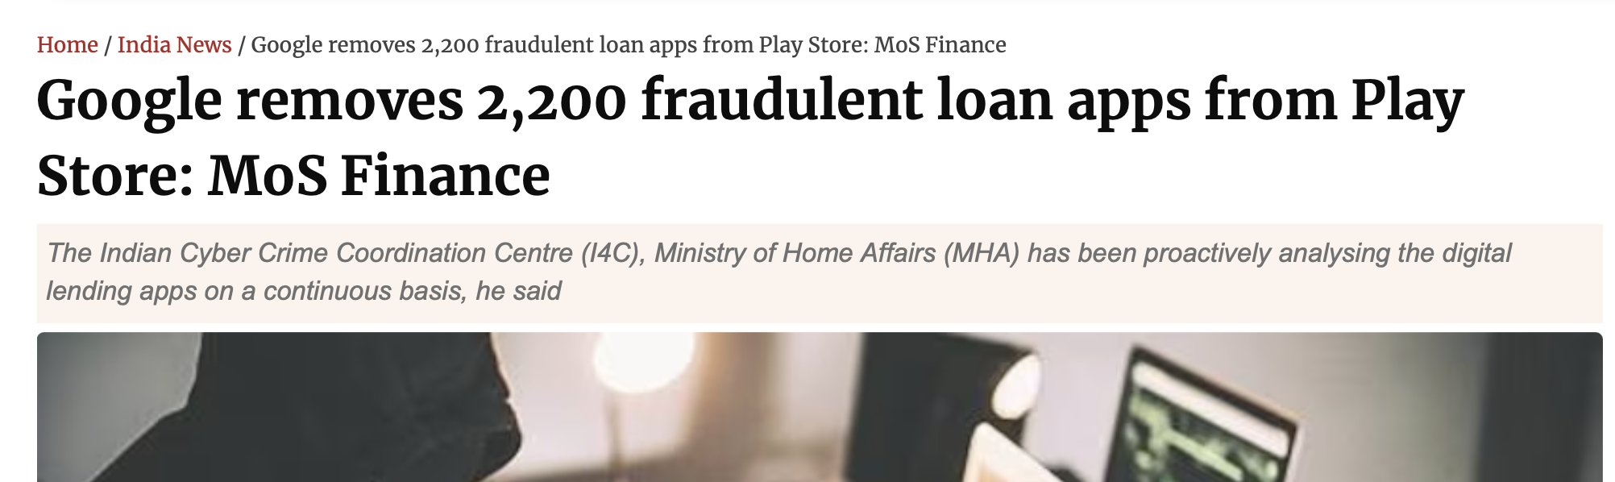
CASE Study – Illegal Loan Apps

Slide 19
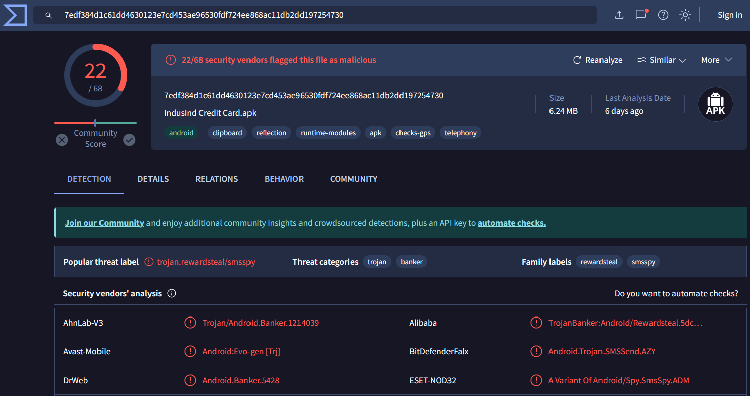

Primary Analysis on APK File

Slide 20
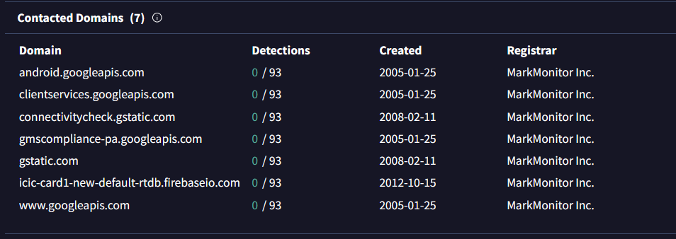
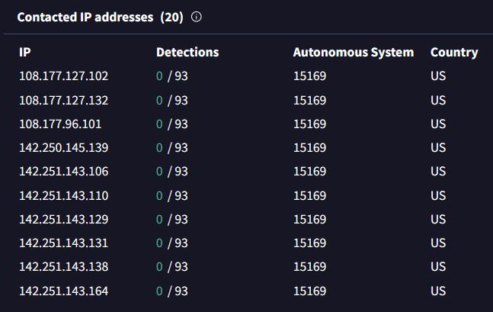
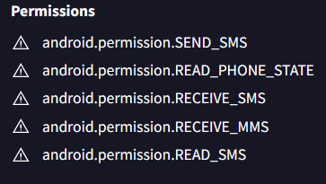
Information about apk from Virustotal

Slide 21
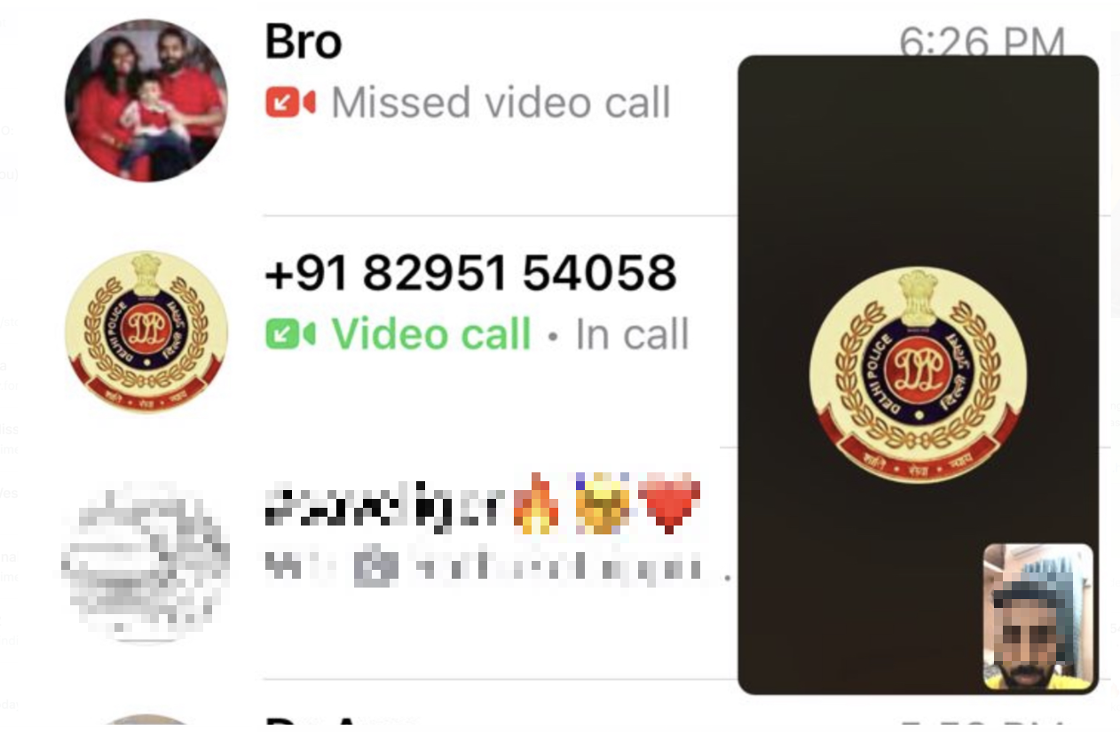
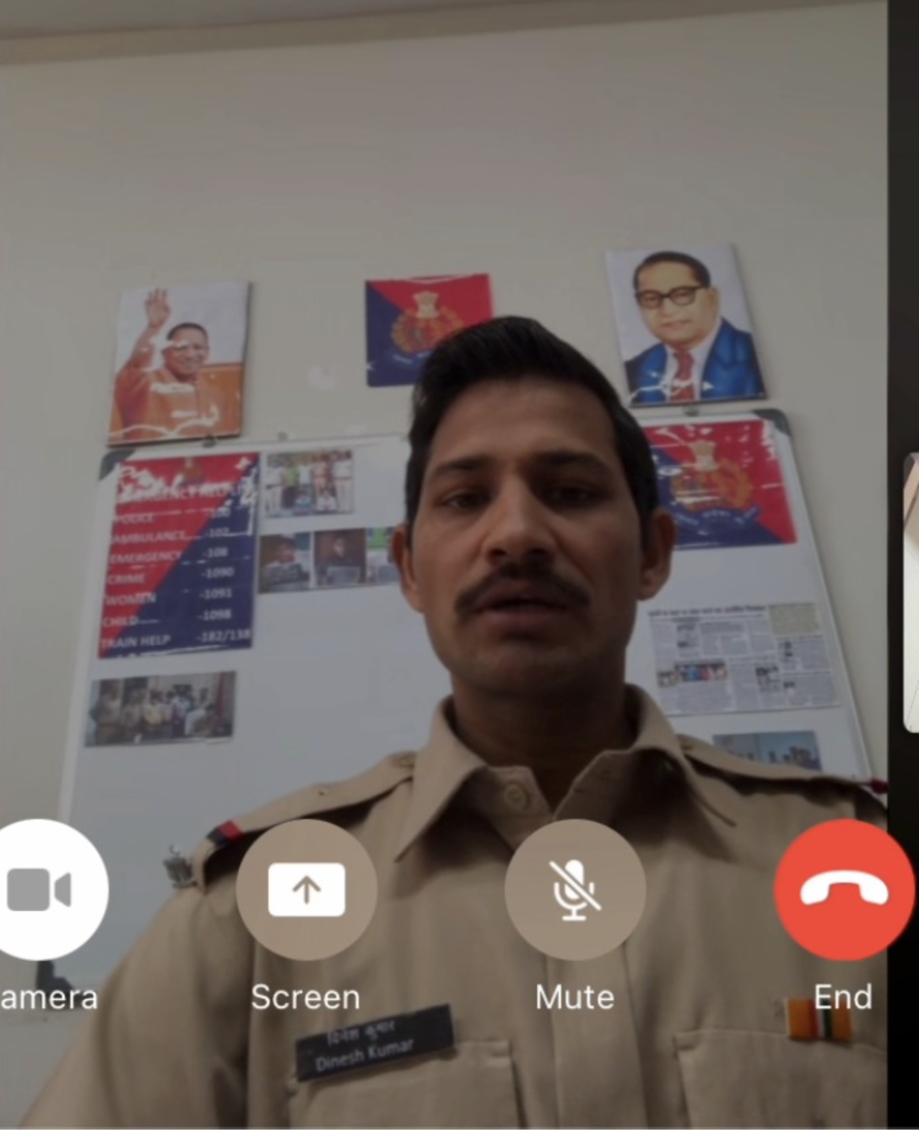
VECTOR 7 – Calls

Slide 22
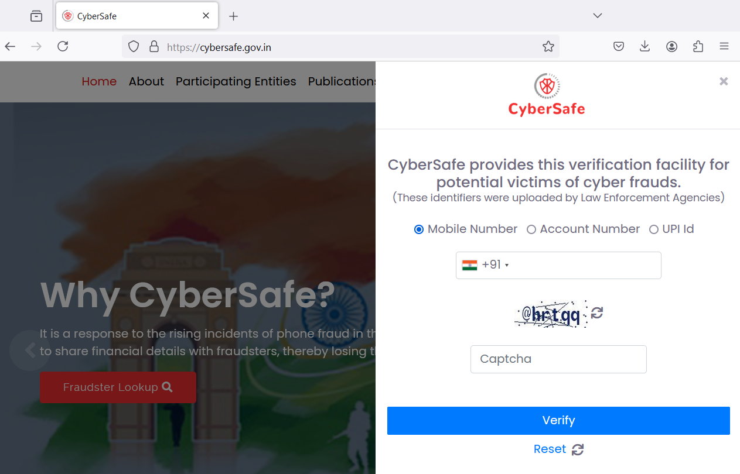
Verify Mobile Number, Account Number and UPI ID
https://cybersafe.gov.in/

Slide 23
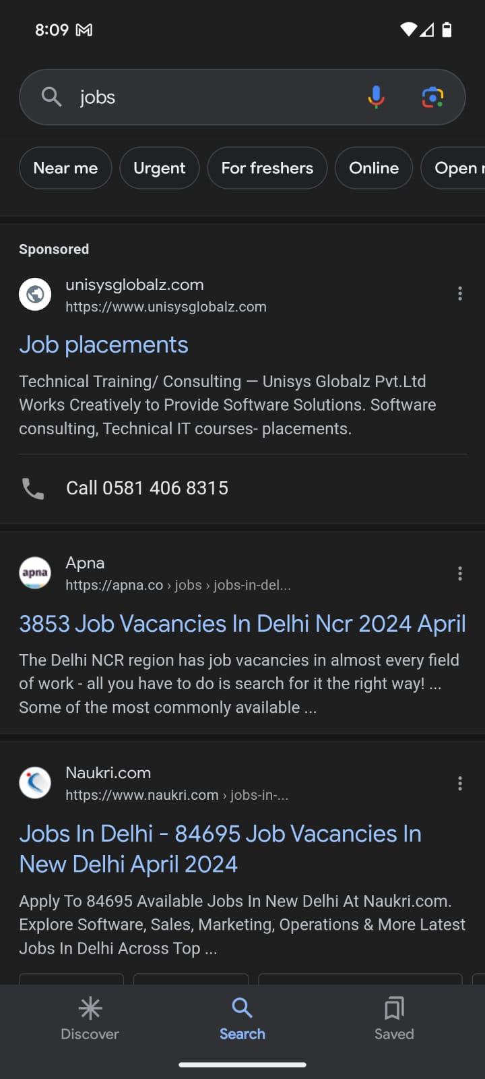
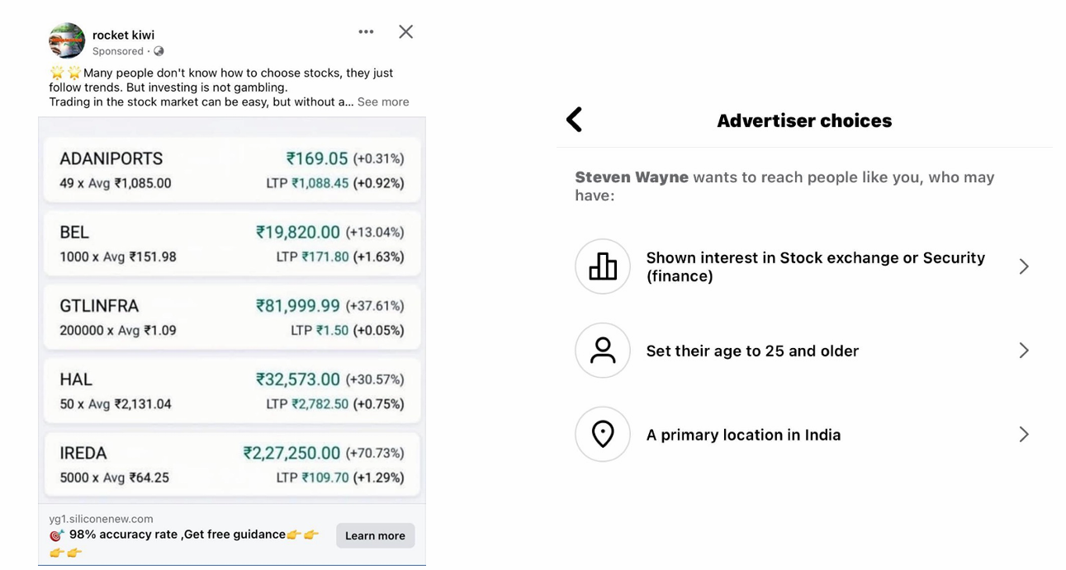
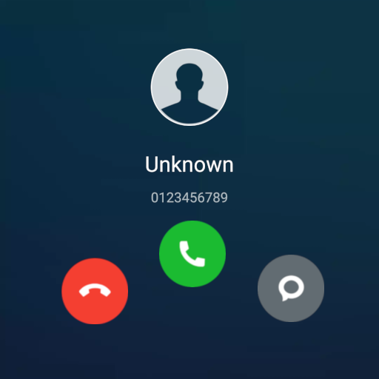
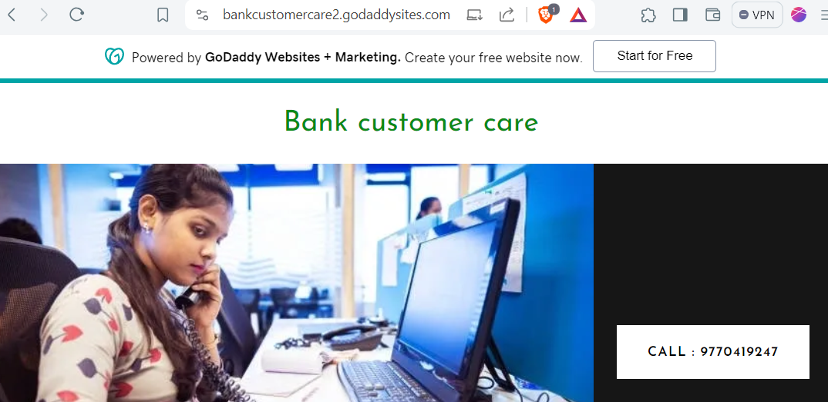
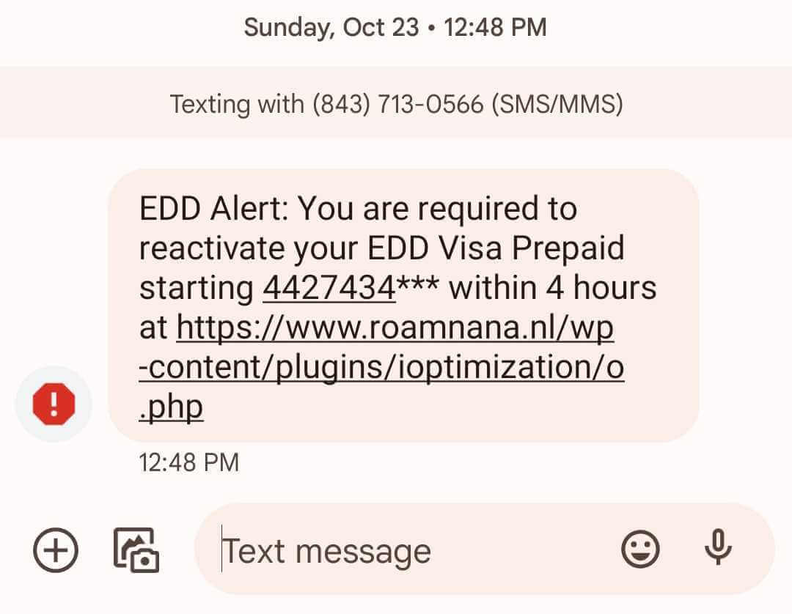
Where does this all start from ?
Social Media
(Sponsored adds)
Fake Calls
Google (Sponsored adds)
Messages
Fake Website

Slide 24
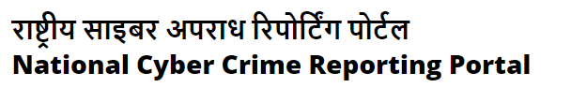
What all can be reported
URL
WhatsApp Number
Telegram Handle
Phone Number
Email Id
SMS Header
Social Media URL
Deepfake Videos
https://cybercrime.gov.in/

Slide 25
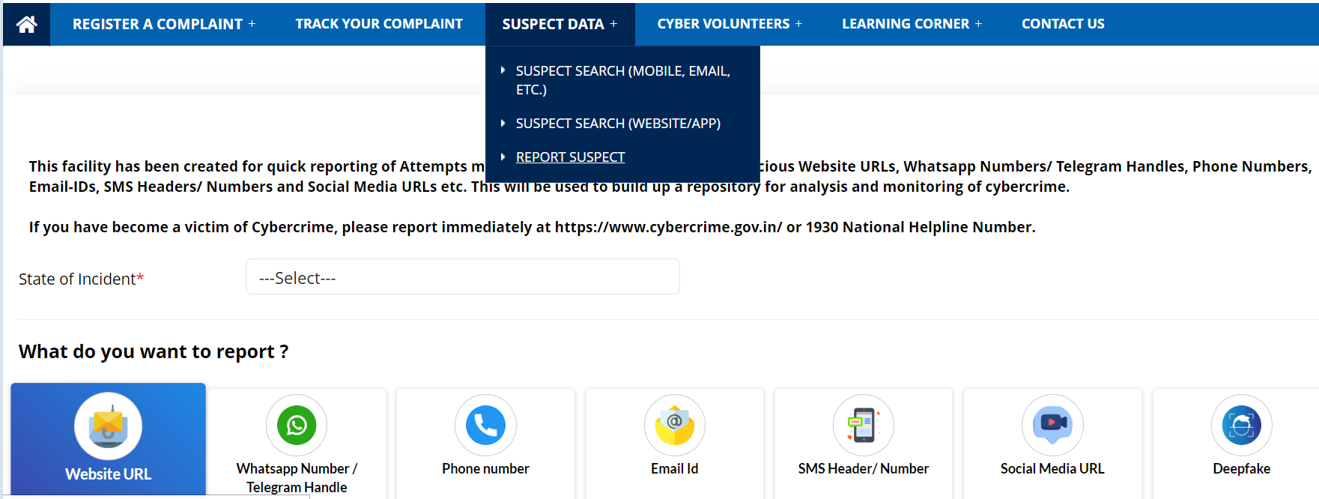
https://cybercrime.gov.in/
How to Report

Slide 26

What can be done on user end for Security ?
Mobile Security
Financial Safety
System Security
Data Vigilance
Account Reporting
Reporting Loss of Phone
Awareness

Slide 27
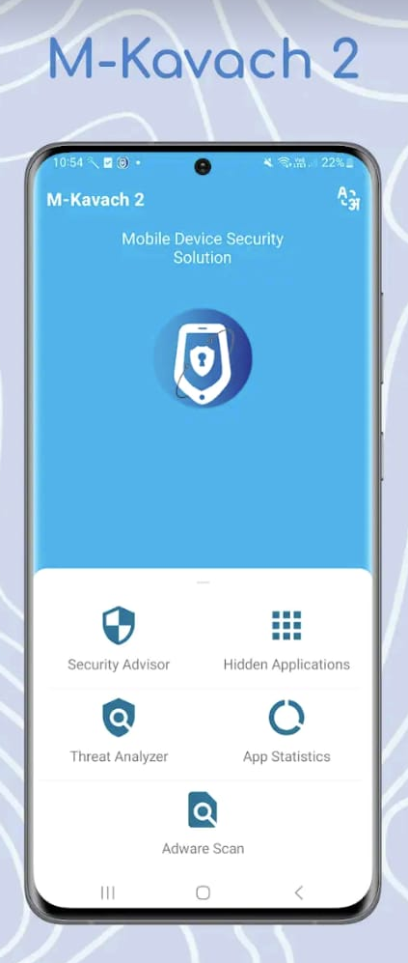
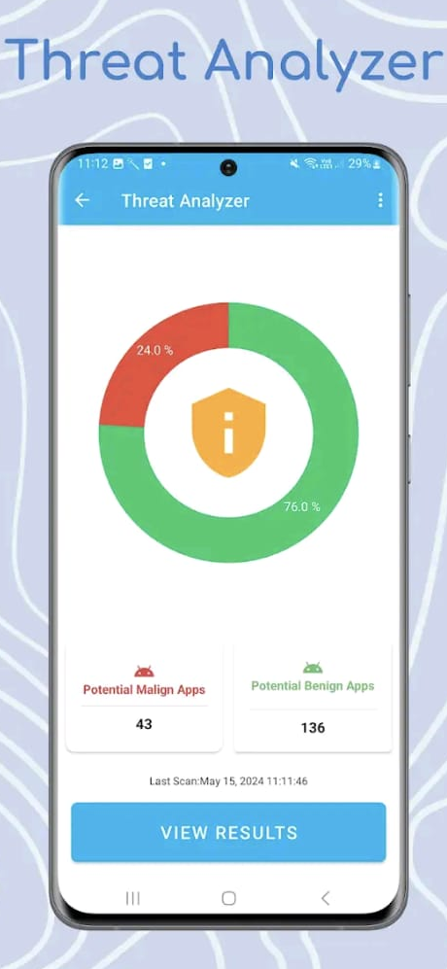
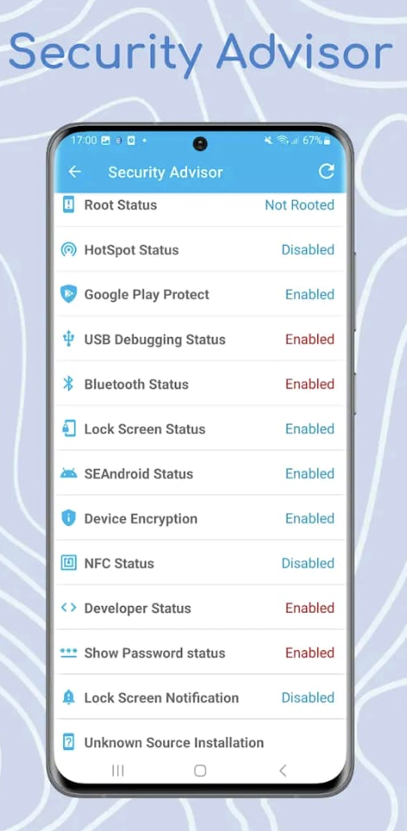
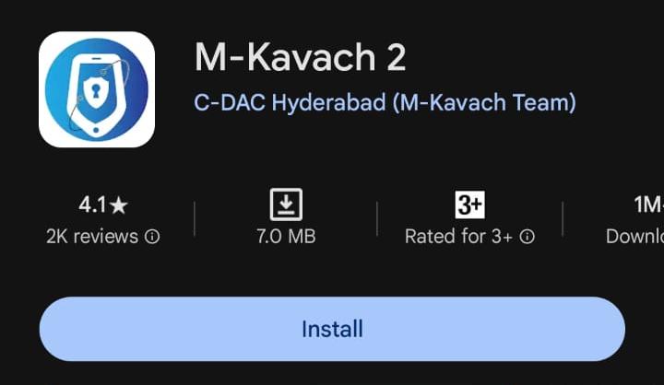
1. Scan Your Phone

Slide 28
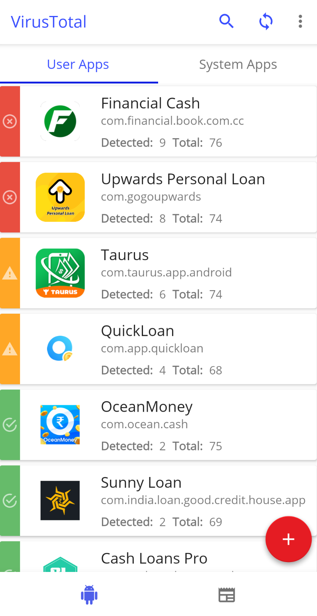
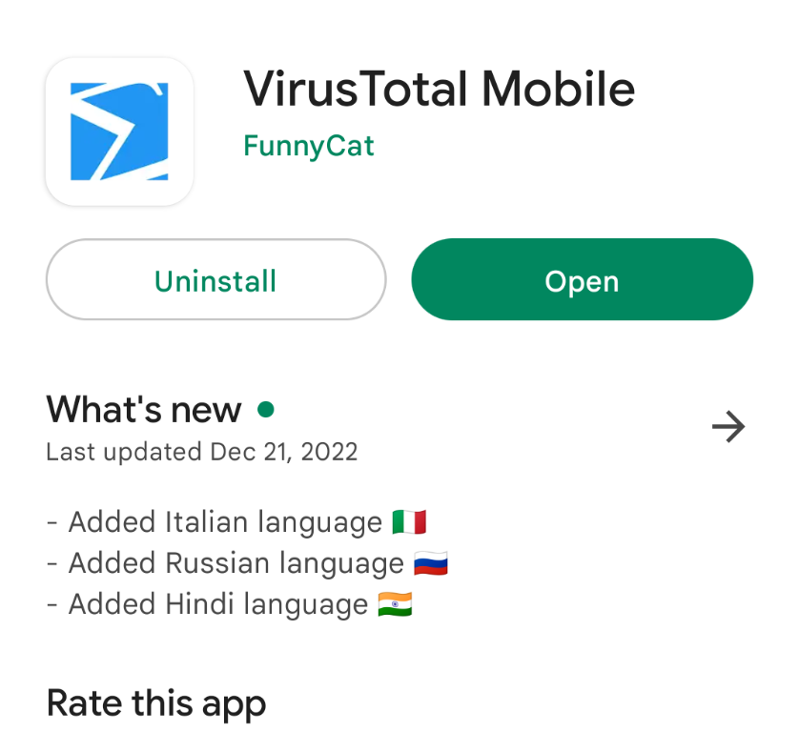
2. Scan Your Phone

Slide 29
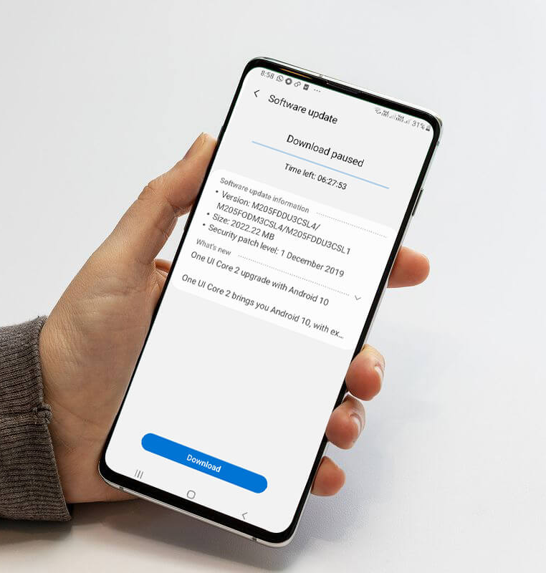
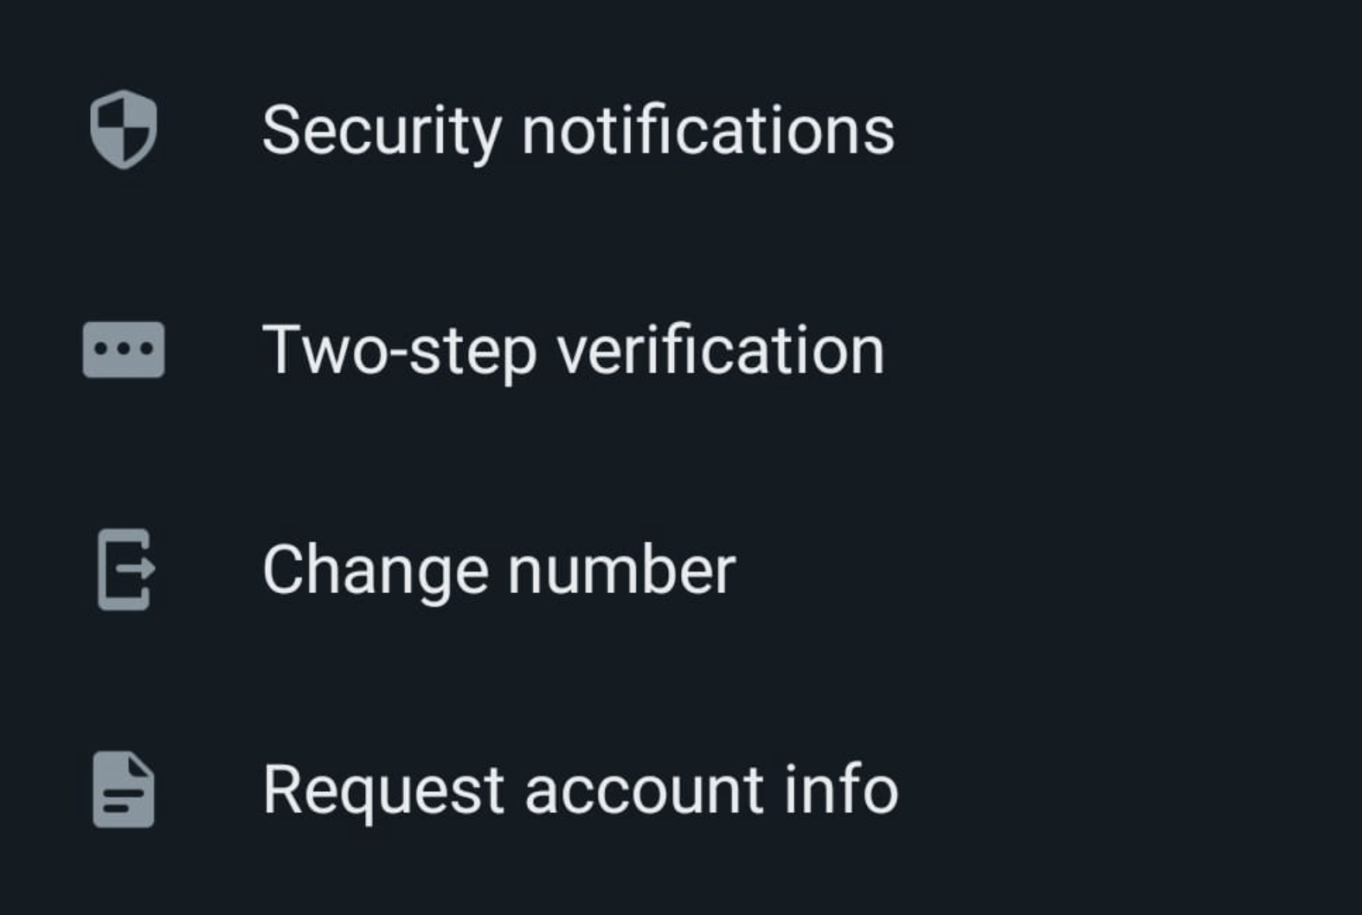
Mobile Security
Mobile Security
Mobile Applications
Permissions
Email
WhatApp & Social Media
Theft
Spywares & Malwares, Non Reputed Apps, Third Party Stores, Updates
Location, Audio, Storage, Contact, Installation.
Official Email, Web Mail, Attachment etc, Multiple Factor Authentication.
Malicious Attachments, Fake News, Over sharing of personal trips etc.
Device Encryption, Find My Device, No Sensitive Photos

Slide 30
Financial Safety
Contact customer care number only from official website.
Use option for Debit/Credit card limits
Use secure system while accessing Internet Banking.
Report your telecom operator immediately on sudden signal loss for long time.
Beware of remote access software; which may be misused for remote control.
Diversify Bank Accounts to reduce risk. Keep watch on Post Office FD.
UPI Pin / QR code is not needed to “Receive Money”

Slide 31
Computer / Laptop Security
USB
Windows Update
Antivirus Update
Software Installation
Disk/Resale
Encrypted USB, Password Protected, Unknown USB, Mobile Phone
Daily Update all Windows Component including office
End Point Protection, Daily Update
Unauthorized Software Installation
Wipe Off, Encryption

Slide 32
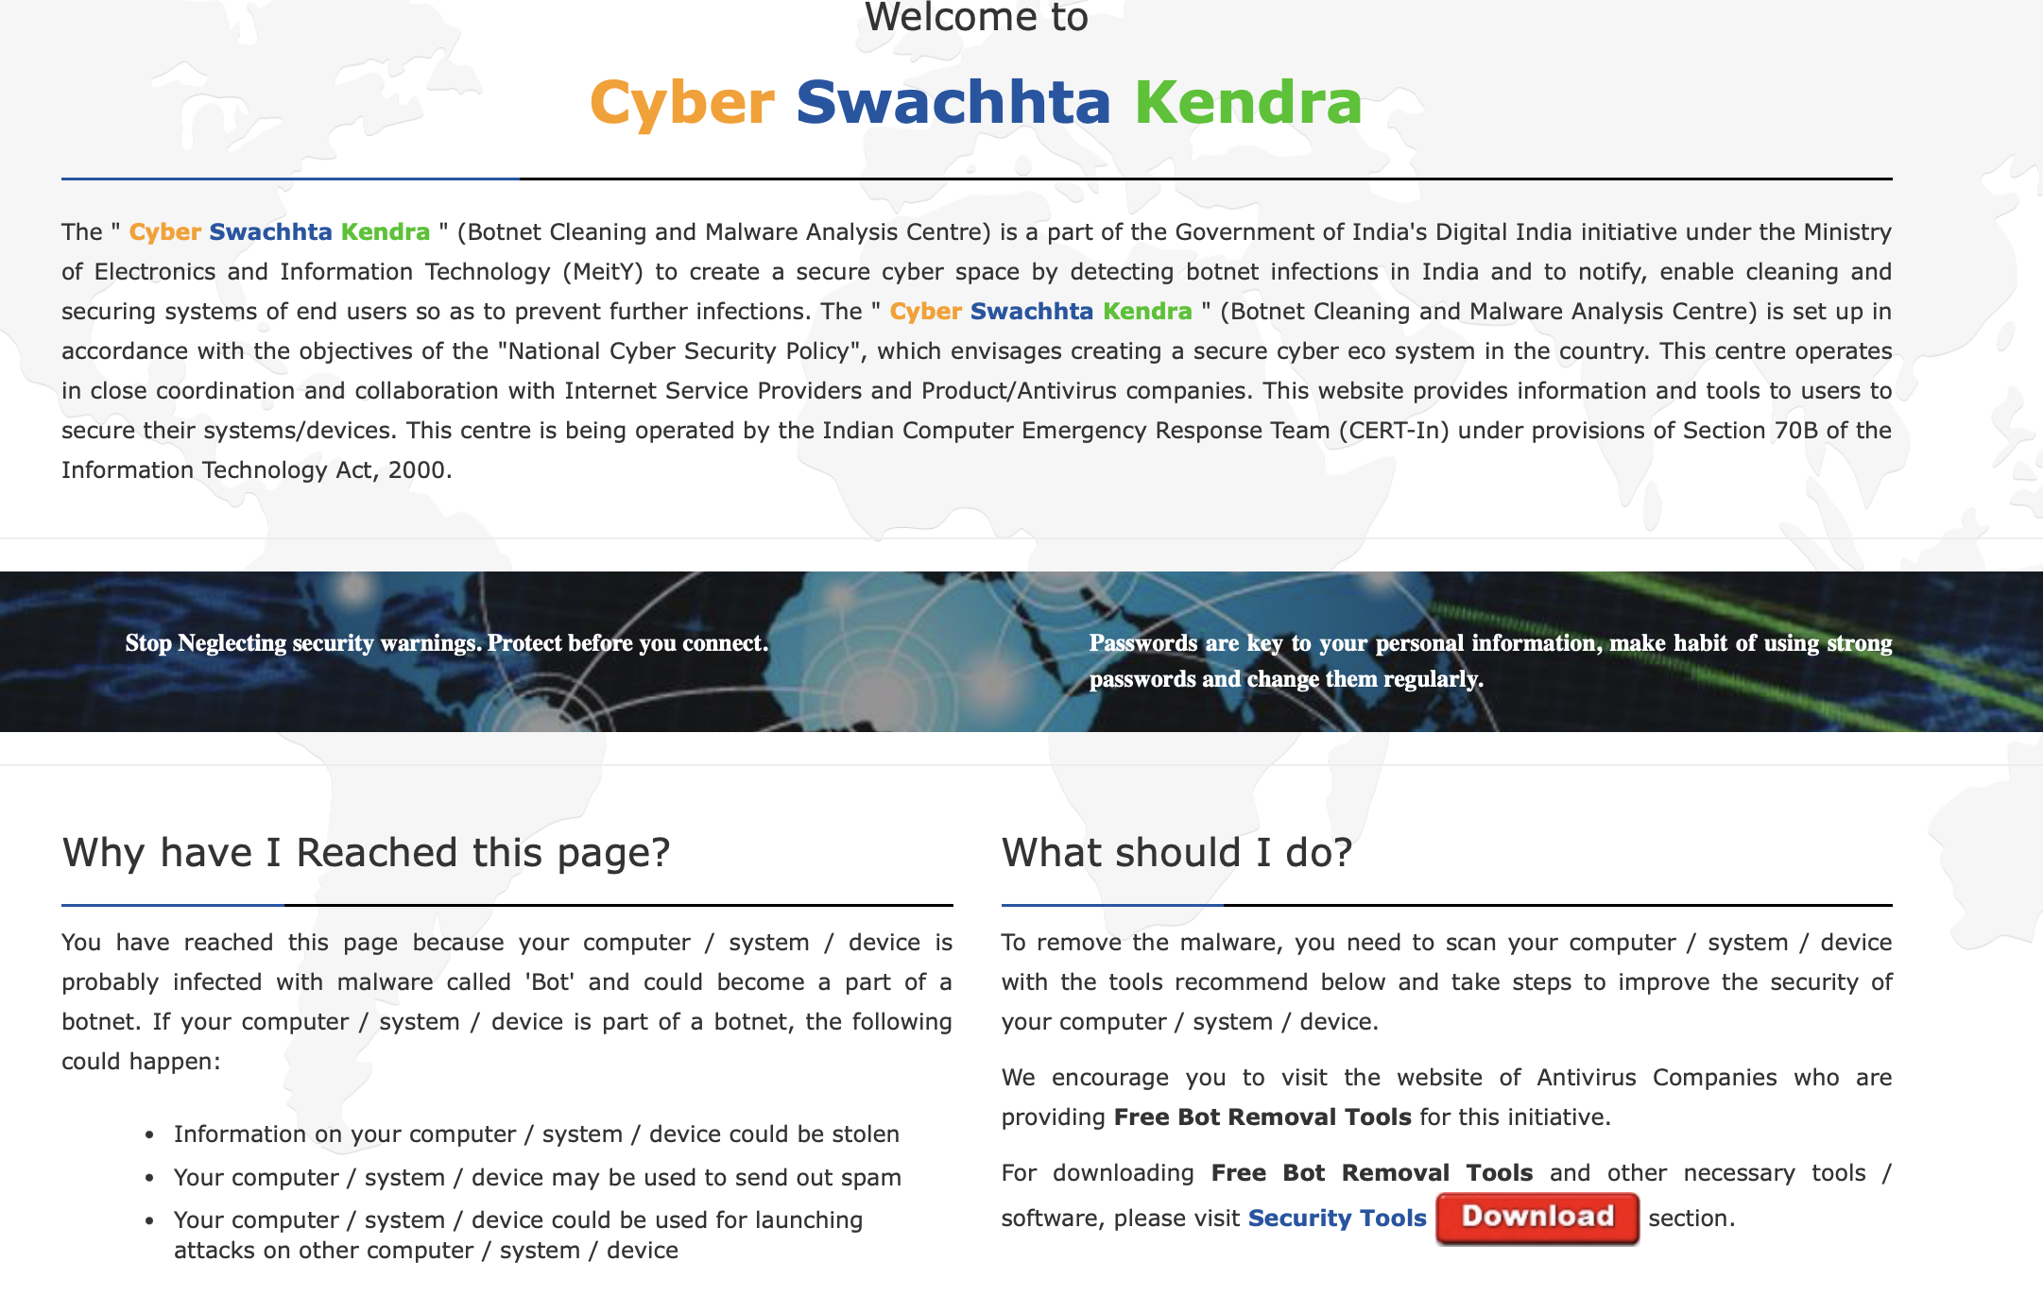
Safeguarding Citizens from Bots
https://www.csk.gov.in

Slide 33
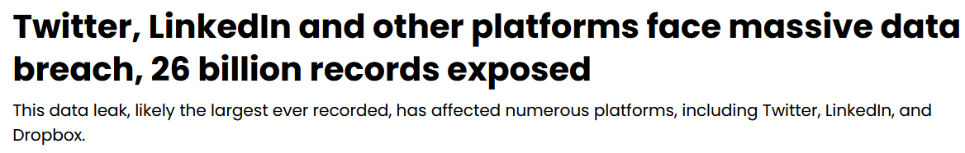
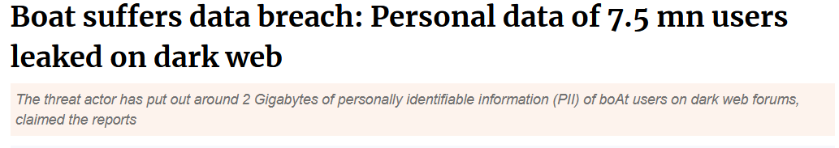
Data Leaks Vs User Security

Slide 34

Check if your data is leaked anywhere

Slide 35
Other sites to check data breaches
Leakpeek
Have I been sold
Dehashed
Firefox monitor

Slide 36

Social Media Account Hack

Slide 37


Hacked Account Recovery
Step 1:
Check your email. If there is an email from Facebook / Instagram safety team intimating for password change, follow the link and reset the credentials.

Slide 38

Hacked Account Recovery
Step 2: If link has expired

Slide 39

Instagram Grievance Officer India
https://help.instagram.com/contact/779201836048501

Slide 40


Slide 41

Fill your details and submit the form
Note the unique ticket number

Slide 42


Final step is to escalate the matter to Government. It is important to note that you need ticket id / reference number given to you in first step.

Slide 43

https://pib.gov.in/PressReleasePage.aspx?PRID=1894258

Slide 44


India Grievance Officer
https://www.facebook.com/help/contact/278770247037228
https://www.whatsapp.com/contact/forms/1534459096974129?lang=en_US

Slide 45


Lost Your Cell Phone??
Here is what you can do about it

Slide 46

https://www.ceir.gov.in/

Slide 47

Community Participation - Cyber Volunteer Squad
Hon’ble Union Home Minister flagged off the Cyber Volunteers Squad from 07 Premier Educational Institutions of India
The Cyber Volunteer Squads will help in dissemination of cyber hygiene in various Institutes/Academies

Slide 48


Cyberdost - An awareness initiative
Prominent presence on leading social media platforms like X, Facebook, Instagram, YouTube, Share chat, Koo, Public, WhatsApp, Telegram, LinkedIn
Over 1 Million followers across all platforms
Memes, Reels, Videos to engage Netizens
Celebrate Cyber Jaagrookta (Awareness) Diwas on 1st Wednesday of every month

Slide 49







Follow I4C on CyberDost
Thanks!

