Slide 1




Financial Fraud Detection and Recovery
14-08-2024

Slide 2


DISCUSSION POINTS
Prevailing Cyber Financial Frauds
Cyber Fraud Detection & Prevention
Cyber Crime Reporting in India
Recovery Process under Cyber Financial Frauds

Slide 3
Modes of Purchasing VDA in India – Crime perspective
PREVAILING CYBER FRAUDS:
DETECTION & PREVENTION

Slide 4
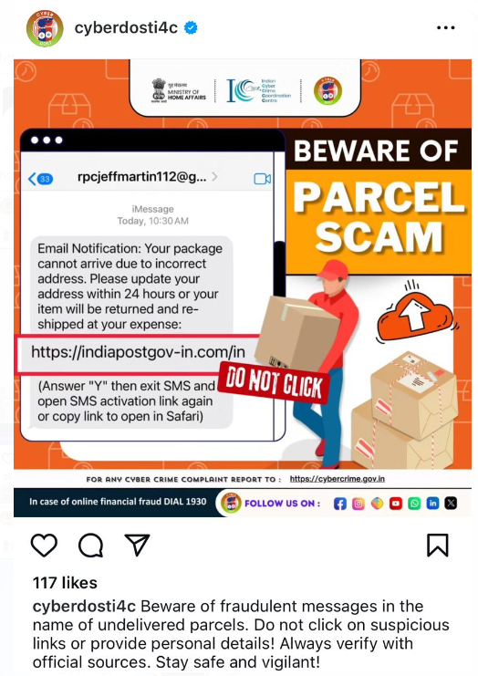
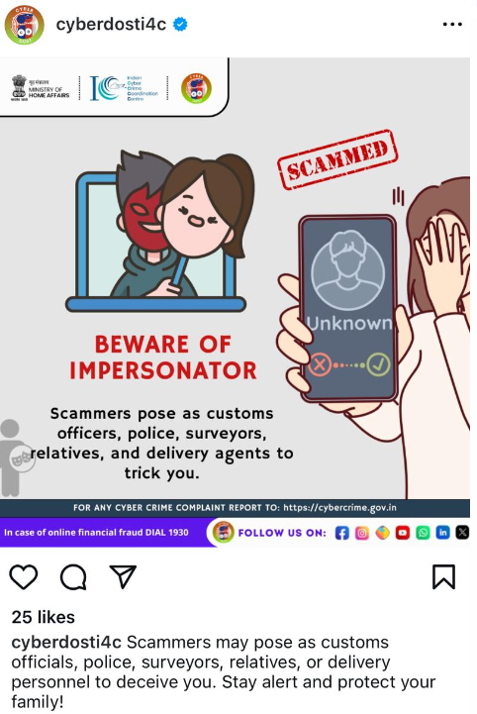
1. DIGITAL ARREST(PARCEL/FEDEX SCAM)
Step 1 :
Victim is contacted via Normal call from Indian number
Call Spoofing used to call the Victims.
Call from Parcel, CBI, RBI, NIA, ED, Narcotics Control, Bank.

Slide 5
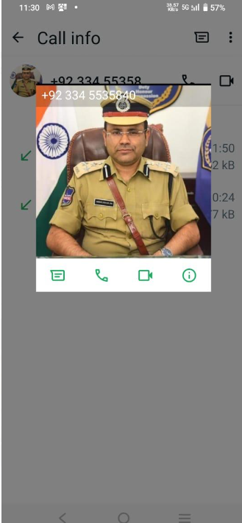
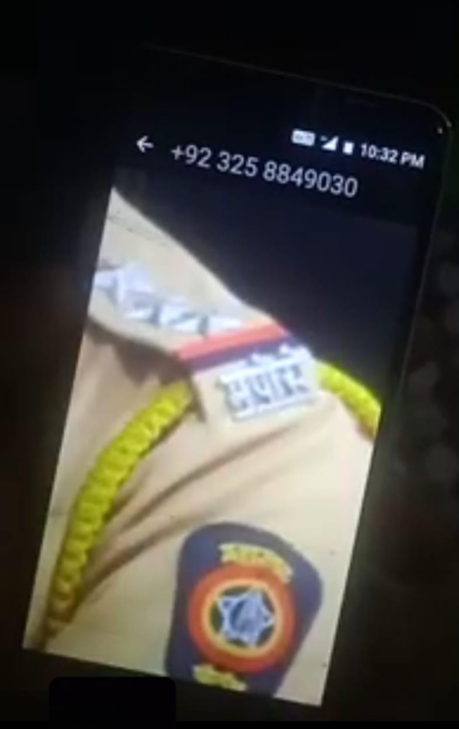
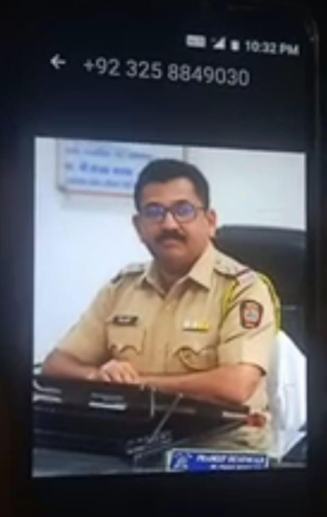
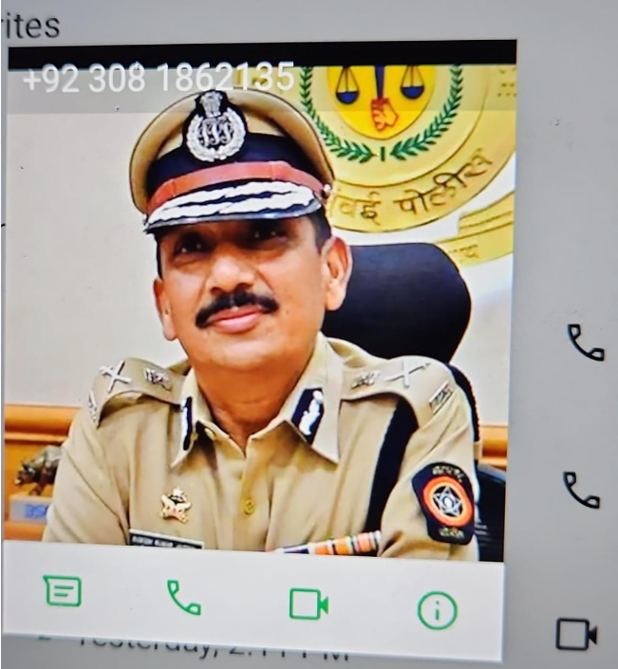
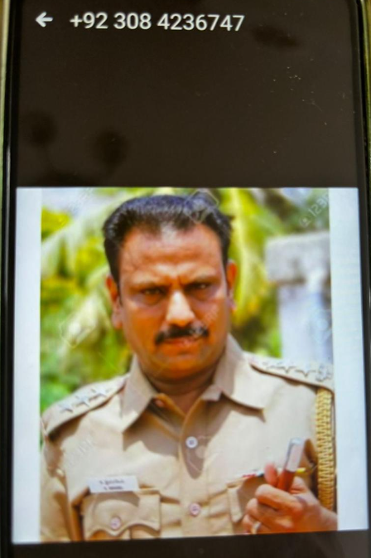
DIGITAL ARREST-FAKE POLICE
Victim is contacted via Normal call, then is called on SKYPE

Slide 6
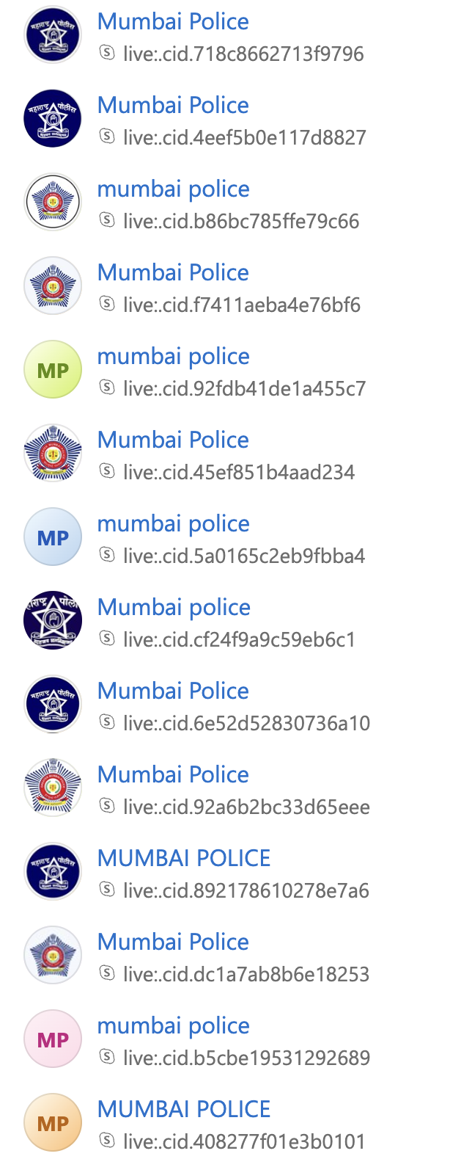
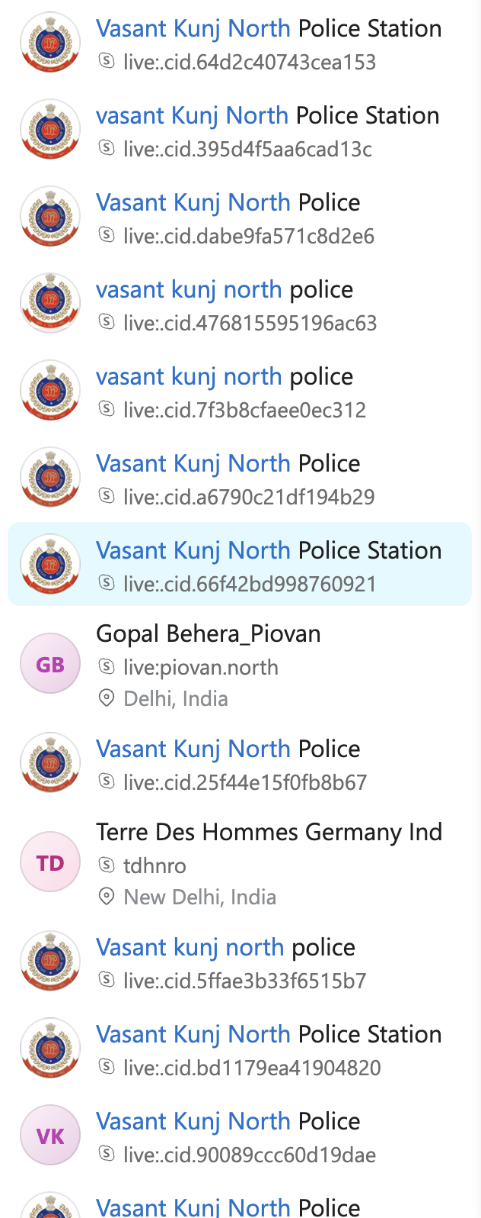
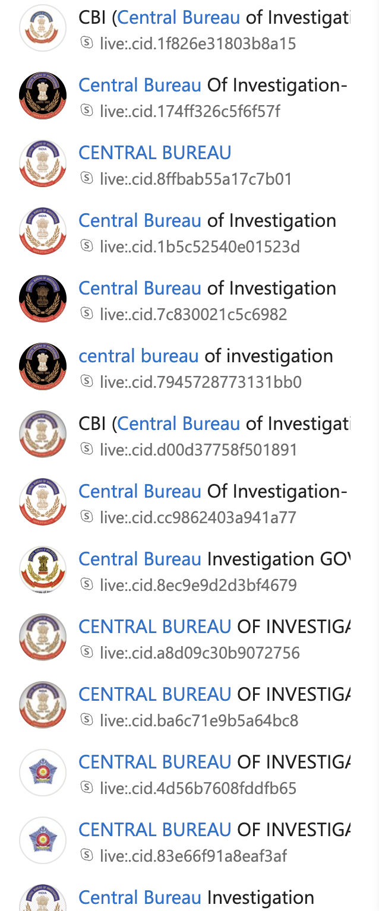
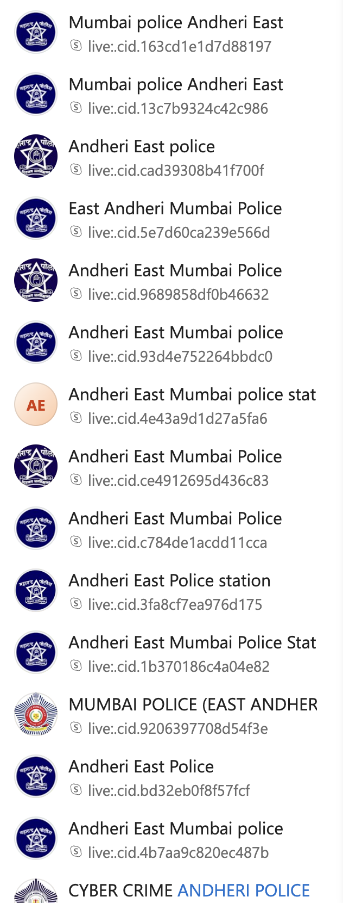
DIGITAL ARREST(PARCEL/FEDEX SCAM)
Step 2 : Thousand of Skype accounts – Impersonating Agencies

Slide 7
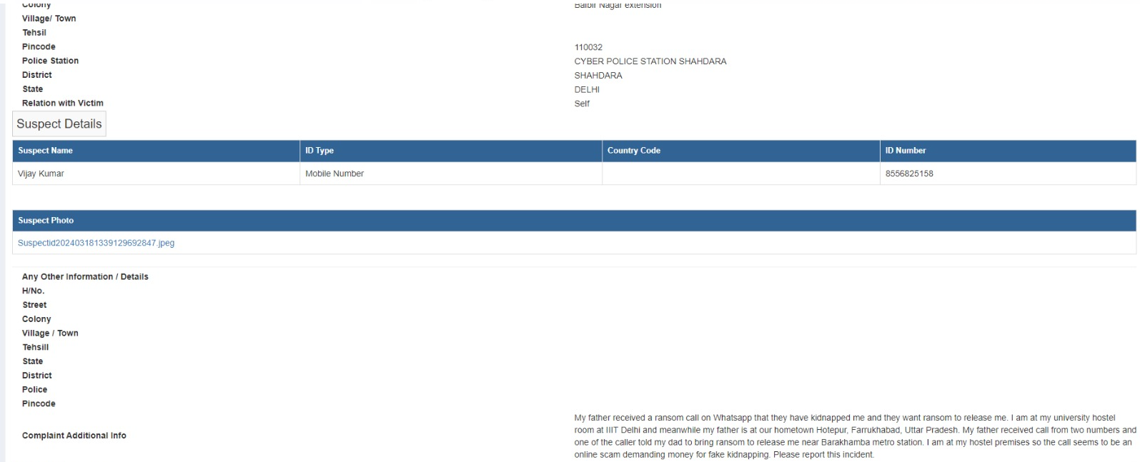
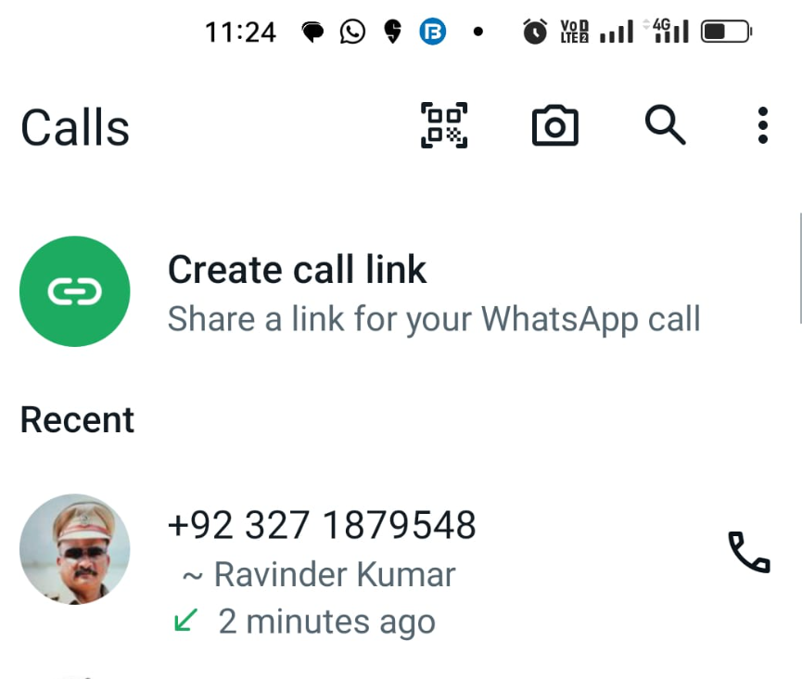
2.1 IMPERSONATION: KIDNAPPING

Slide 8

2.1 IMPERSONATION: KIDNAPPING

Slide 9
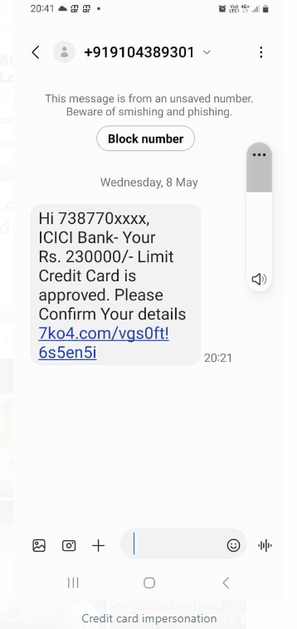
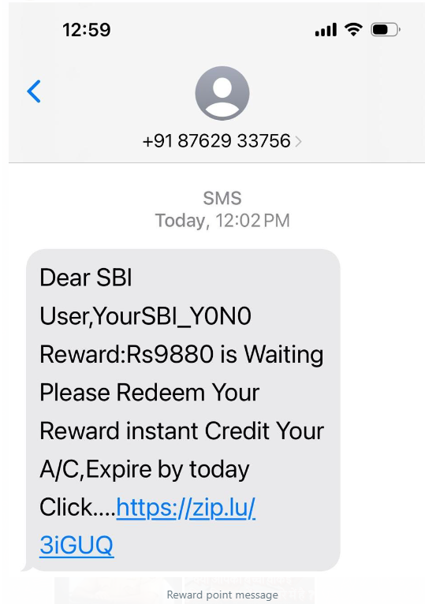
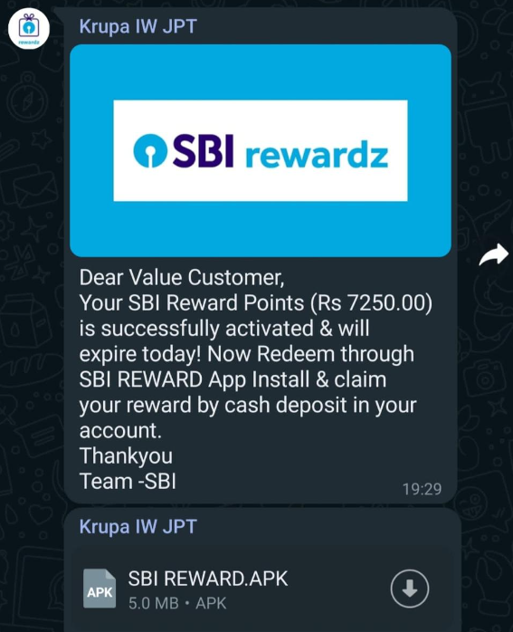
2.2 IMPERSONATION: CREDIT/DEBIT CARD FRAUDS

Slide 10
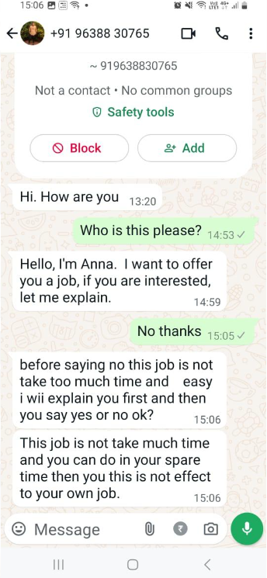
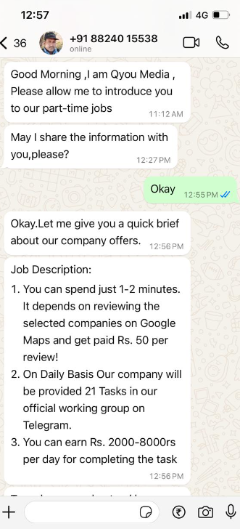
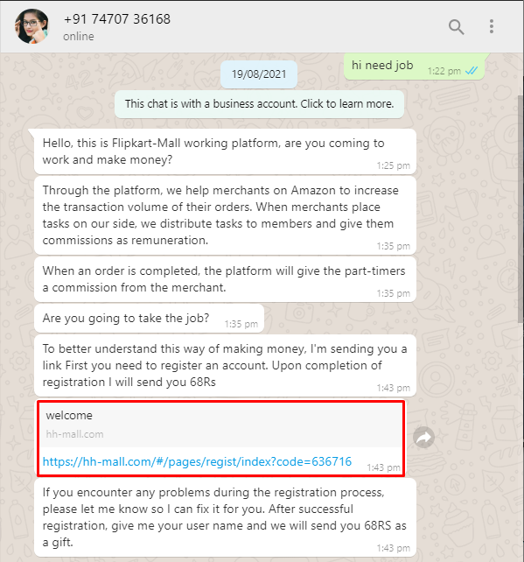
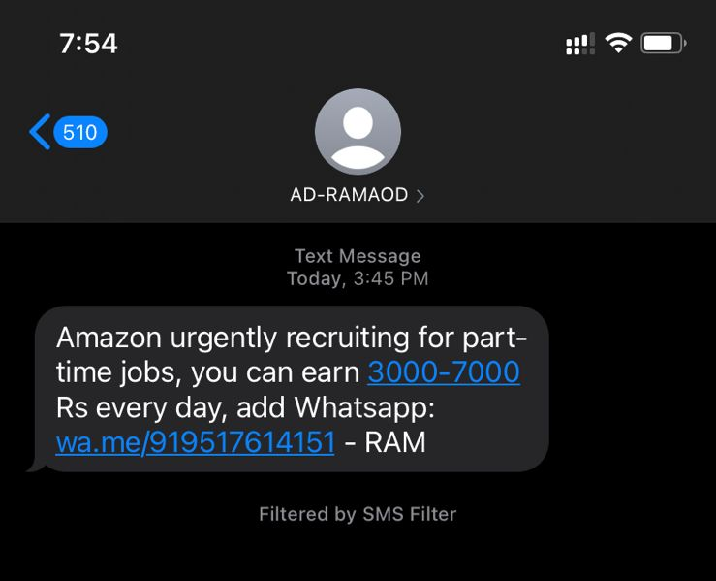
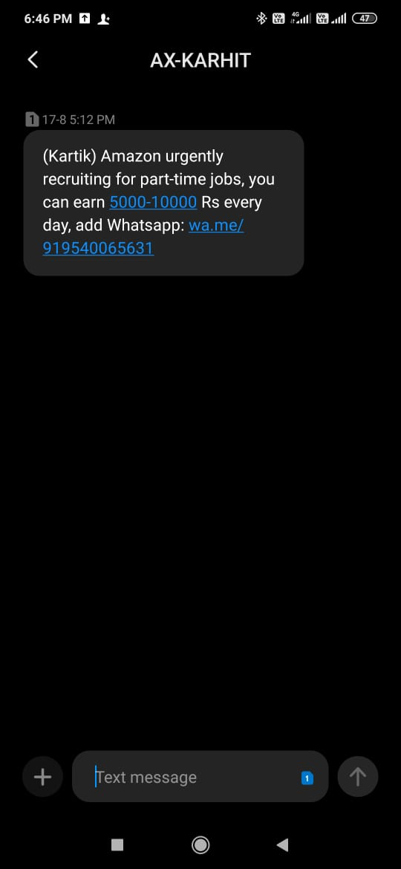
2.3 IMPERSONATION: JOB FRAUD

Slide 11
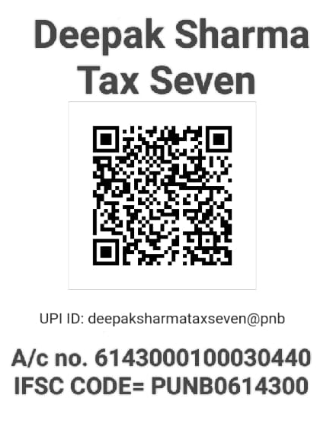

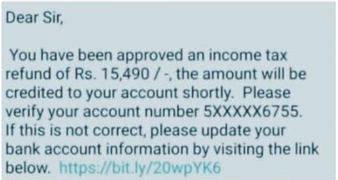
2.4 IMPERSONATION: INCOME TAX FRAUD

Slide 12
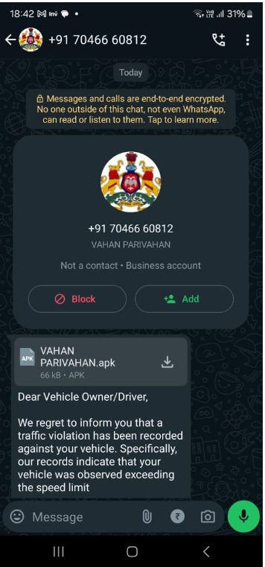
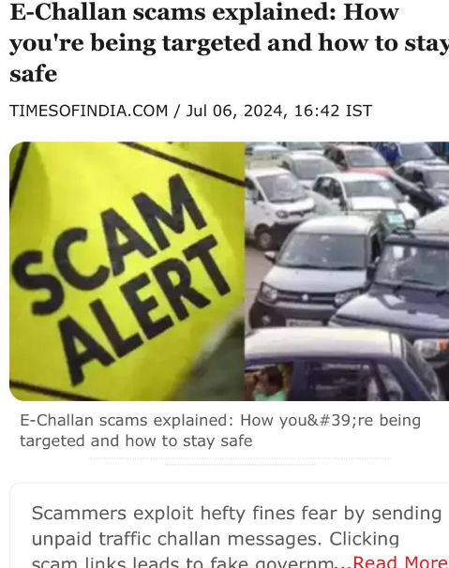
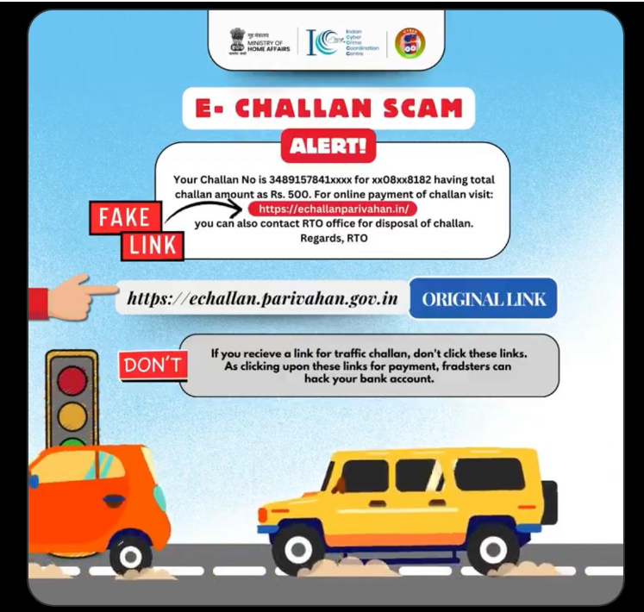
2.5 IMPERSONATION: E-CHALLAN SCAM

Slide 13

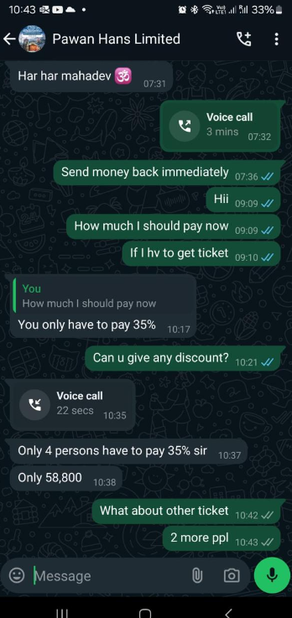
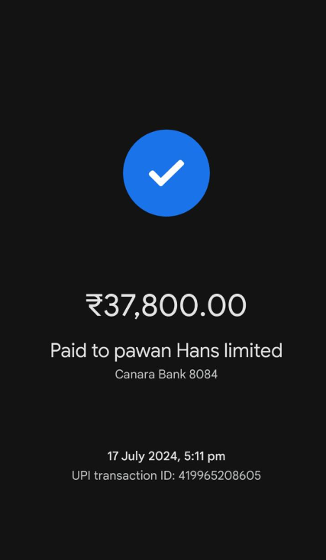
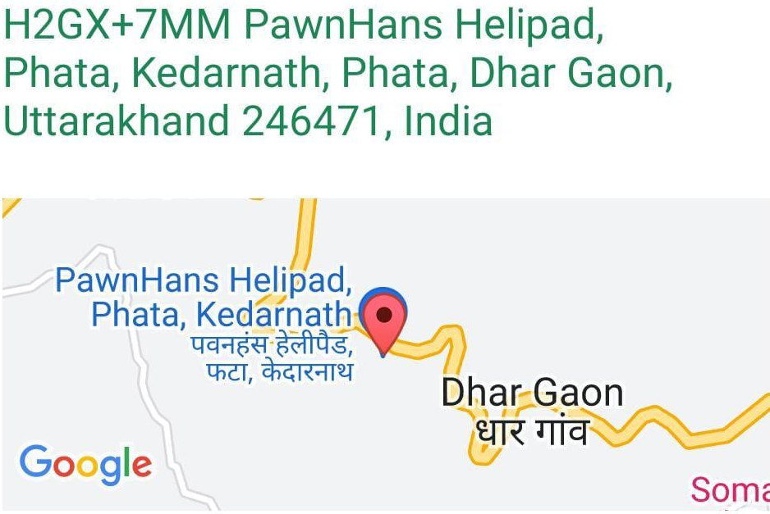
2.6 IMPERSONATION: CHAR DHAM YATRA FRAUD

Slide 14
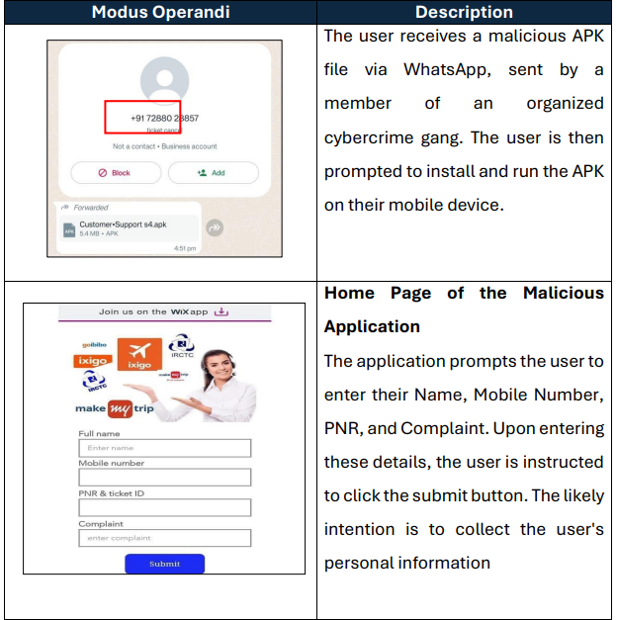
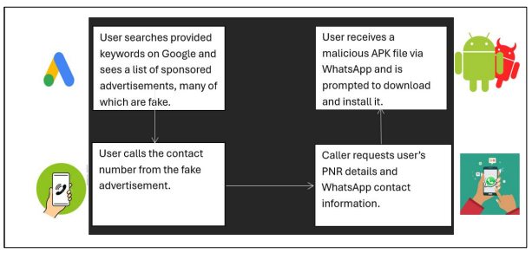
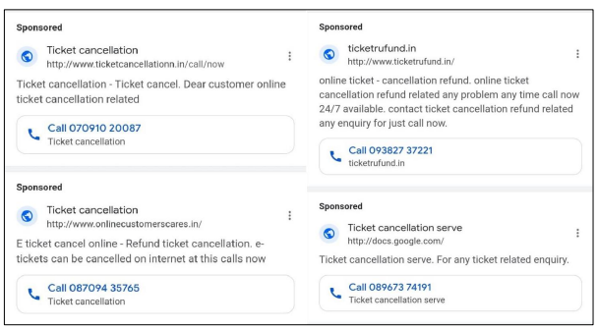
2.7 Fraud in the Name of IRCTC Ticket refund

Slide 15
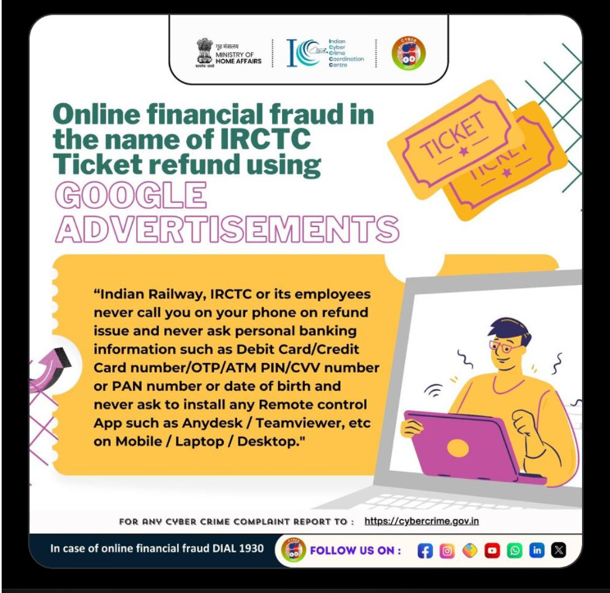
2.7 Fraud in the Name of IRCTC Ticket refund

Slide 16
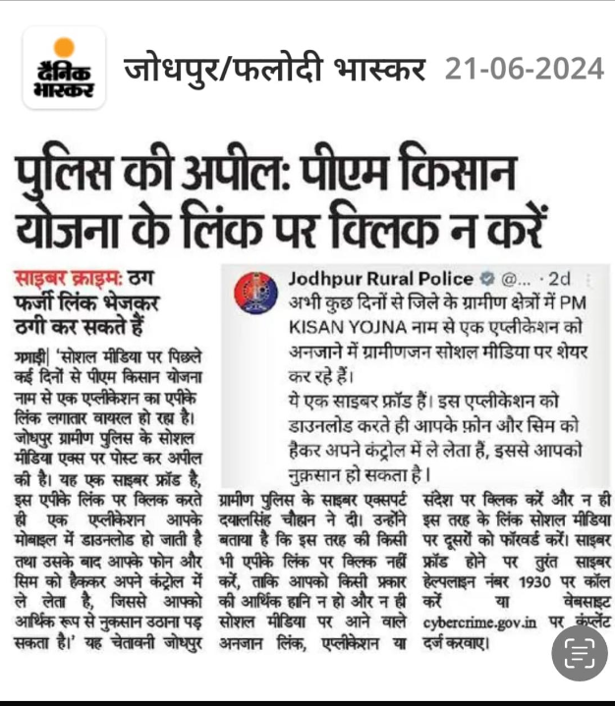
2.8 Fraud in the name of PM KISAN YOJNA

Slide 17
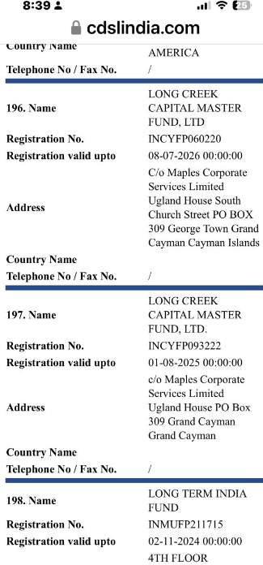

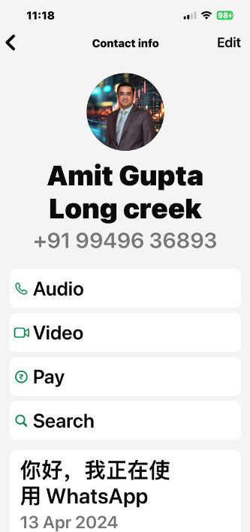
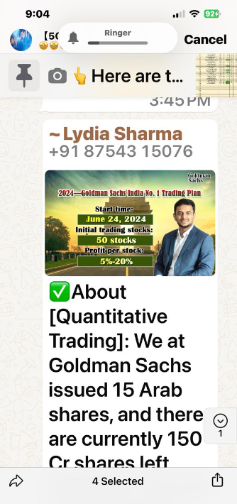
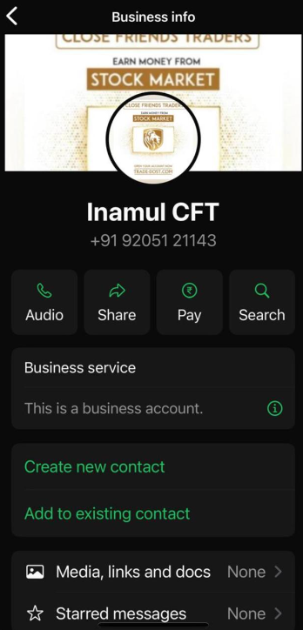
3.1 INVESTMENT SCAM (STOCK MARKET /TRADING)
FAKE APPS & PROFILES LURING FOR INVESTMENT

Slide 18
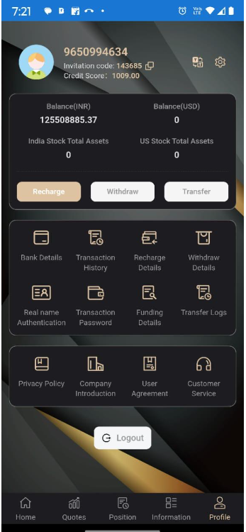
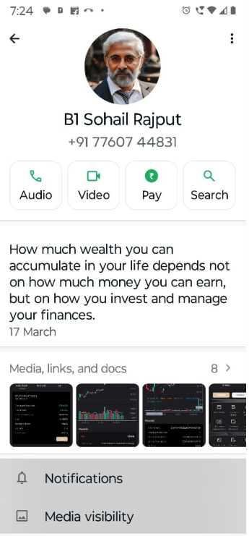
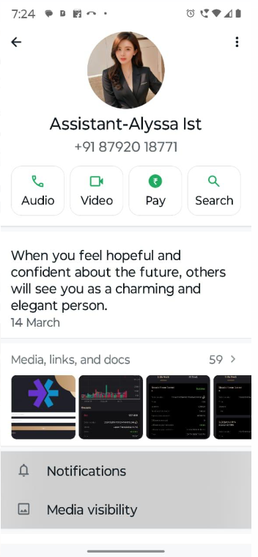
3.1 INVESTMENT SCAM (STOCK MARKET /TRADING)
FAKE INVESTMENT ADVISORS

Slide 19
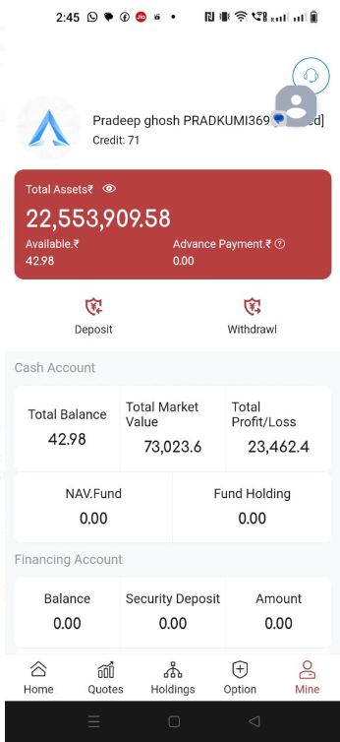
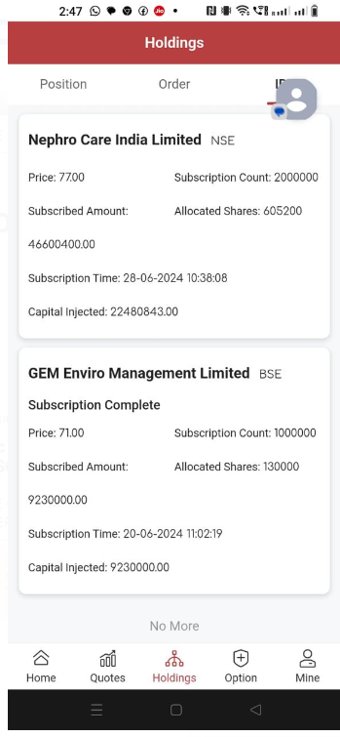
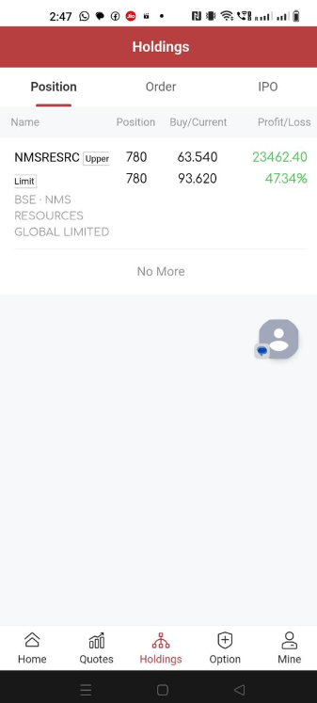
3.1 INVESTMENT SCAM (STOCK MARKET /TRADING)
PROMISING FAKE GROWTH ON INVESTMENT

Slide 20
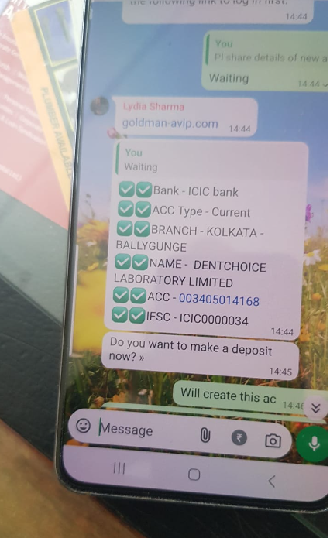
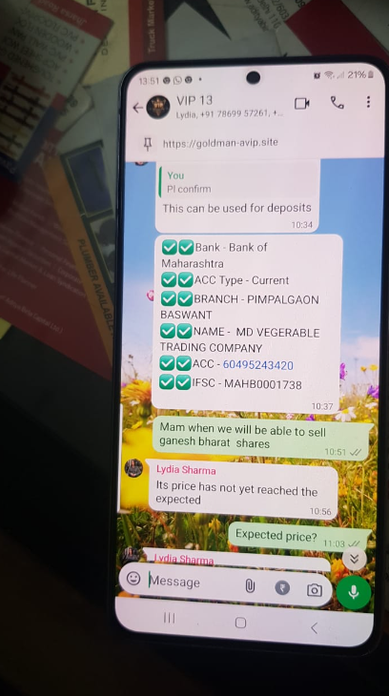
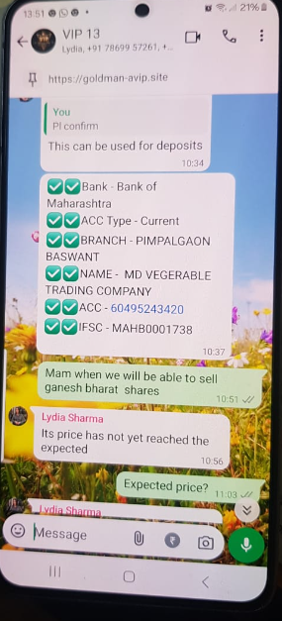
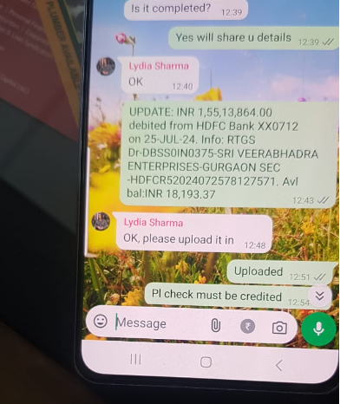
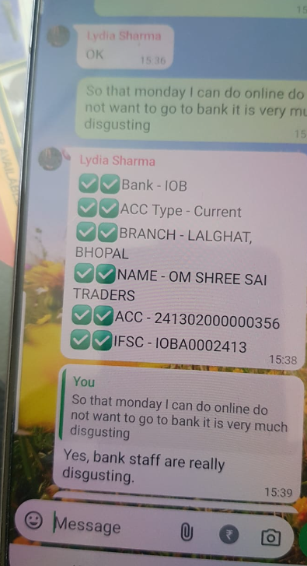
3.2 INVESTMENT SCAM (STOCK MARKET /TRADING)
6. LOTTERY & JACKPOT SCAM
ACCOUNTS THROUGH WHATSAPP GROUP

Slide 21
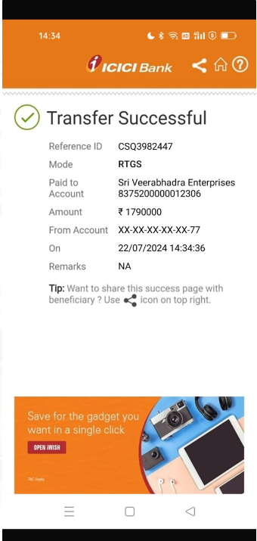



3.3 INVESTMENT SCAM (STOCK MARKET /TRADING)
PAYMENT MODES FOR INVESTMENT

Slide 22


4. LOTTERY/ JACKPOT FRAUD

Slide 23

5. ILLEGAL LOAN APPS

Slide 24

6. MATRIMONIAL/ DATING SCAM

Slide 25

7. FAKE NOTICES

Slide 26

7. FAKE NOTICES

Slide 27

7. FAKE NOTICES

Slide 28


RBI INITIATIVES

Slide 29

Customer Protection : Limited Liability of customers

Slide 30

Customer Protection : Limited Liability of customers

Slide 31

Customer Protection : Limited Liability of customers

Slide 32

Customer Protection : Limited Liability of customers

Slide 33

Customer Protection : Limited Liability of customers

Slide 34
Modes of Purchasing VDA in India – Crime perspective
REPORTING CYBER CRIMES

Slide 35

National cyber crime reporting portal is an initiative of Government of India to facilitate victims/complainants to report cyber crime complaints online. This portal caters to complaints pertaining to cyber crimes only with special focus on cyber crimes against women and children. Complaints reported on this portal are dealt by law enforcement agencies/ police based on the information available in the complaints.
NCRP
    NCRP Features
All Types of Cybercrime Incidents can be reported from anywhere.
Online status tracking facility for the complainant.
A new module “Citizen Financial Cyber Fraud Reporting and Management System” links intermediaries with the Cybercrime Portal, enabling citizens to report cyber financial frauds via National Helpline 1930

Slide 36

Types of complaints
On an average, more than 7,000 cybercrime complaints are registered per day.
3 Unique Complaints Category
WOMEN/CHILDREN RELATED CRIME
FINANCIAL FRAUD
OTHER CYBER CRIME

Slide 37




NCRP COMPLAINT WORKFLOW
Cyber Police Portal
Bank
LEA’s
NCRP
TSP’s
Victim
1930 Cyber Crime Helpline

Slide 38

COMPLAINT FILLING PROCESS

Slide 39

COMPLAINT FILLING PROCESS

Slide 40

COMPLAINT FILLING PROCESS

Slide 41

COMPLAINT FILLING PROCESS

Slide 42

COMPLAINT FILLING PROCESS

Slide 43

COMPLAINT FILLING PROCESS

Slide 44

COMPLAINT FILLING PROCESS

Slide 45

COMPLAINT FILLING PROCESS

Slide 46

COMPLAINT FILLING PROCESS

Slide 47

COMPLAINT FILLING PROCESS

Slide 48

COMPLAINT FILLING PROCESS

Slide 49



COMPLAINT FILLING PROCESS

Slide 50
Modes of Purchasing VDA in India – Crime perspective
RECOVERY

Slide 51

RECOVERY
STEP-1:
Form to be filled by the victim for refund

Slide 52


RECOVERY
Step-2:
Court Order issued by Magistrate

Slide 53
RECOVERY
Step-3:
BANK REFUND THE MONEY OF VICTIM

Slide 54



THANKS

