Slide 1


Media & Information Literacy
NEED AND SCOPE

Slide 2
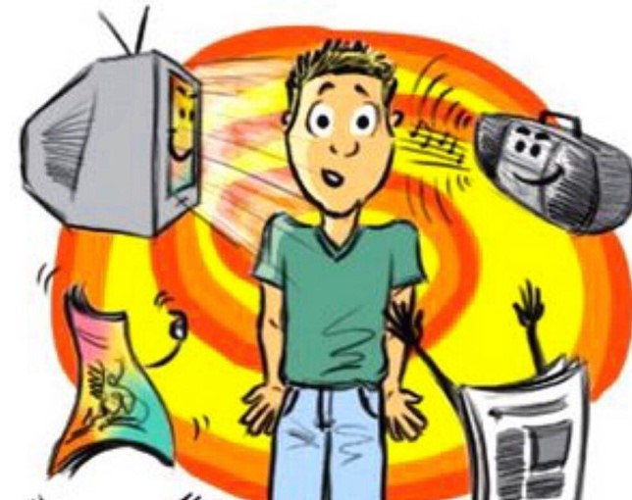
IT IS ALL PERVASIVE

Slide 3
Media Ecosystem
1,46,000+
800+Million
Newspapers+Periodicals
Internet Users
the world’s largest print-media market
India has one of the largest internet populations in the world which is second only to China in terms of total number of internet users.
850+ Satellite Channels
1000
Movies per year (appx)
400+ News Channels. TV is the largest segment in Media and Entertainment Industry
The Indian film industry is one of the largest in the world and produces a significant number of movies every year.

Slide 4
Media Ecosystem
Radio
1400+ Operational Radio Stations
350+ FM radio stations
591 AIR stations
500 Community Radio Stations
Online Gamers
500Million. Fourth largest Segment in Media and Entertainment Industry
Social Media
467 Million on Social Media
435 million on Facebook

Slide 5
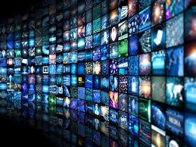
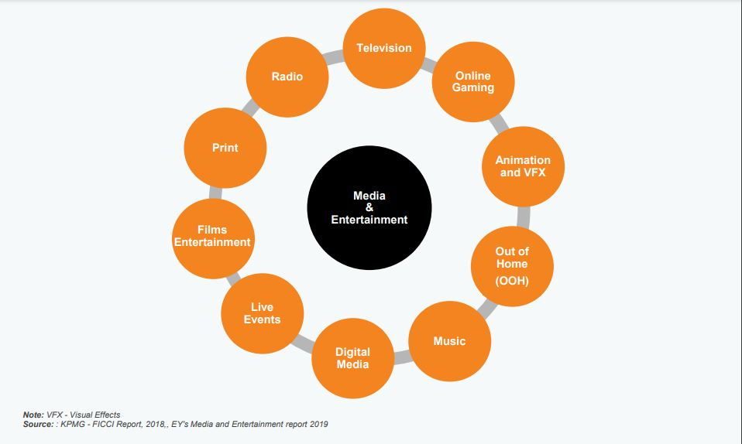
Media and Entertainment Sector 2024
2,55,000 crore ((US$ 30.8 billion)

Slide 6
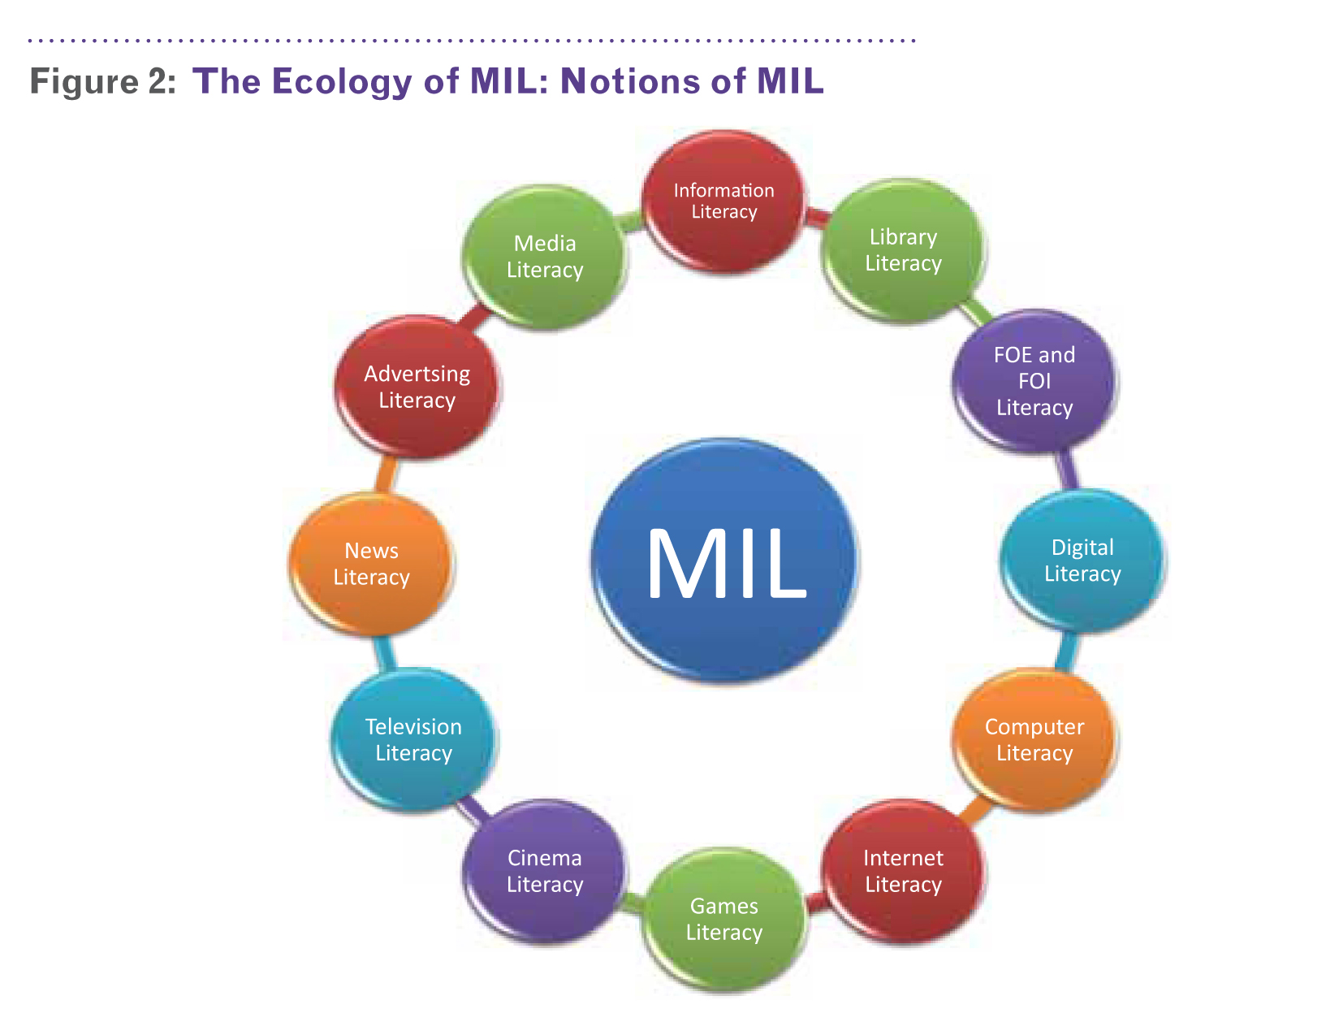
MEDIATED SOCIETIES REQUIRE
MEDIA LITERATE CITIZENS

Slide 7
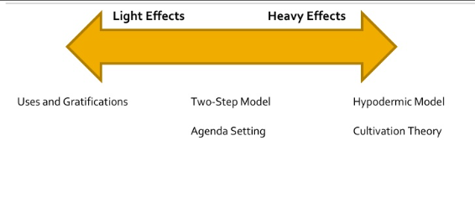
MEDIA EFFECTS

Slide 8
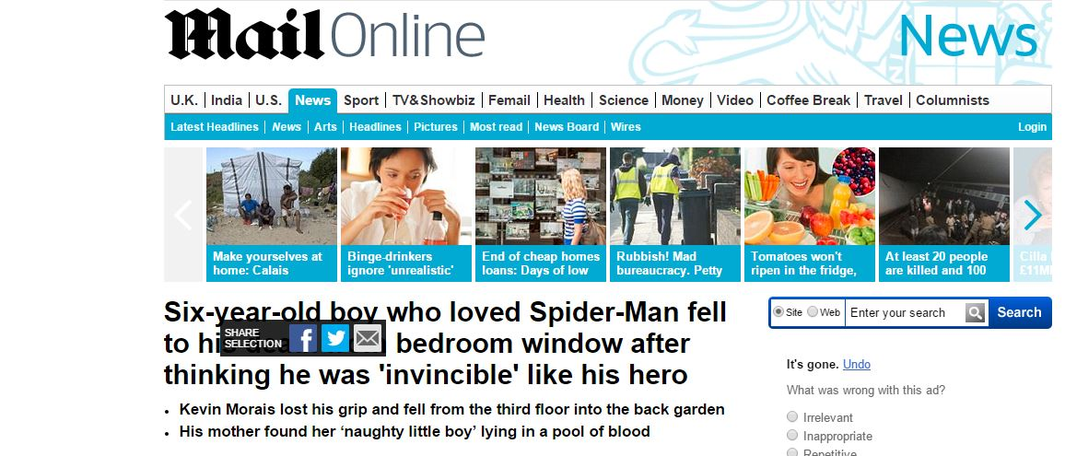

Slide 9


Slide 10
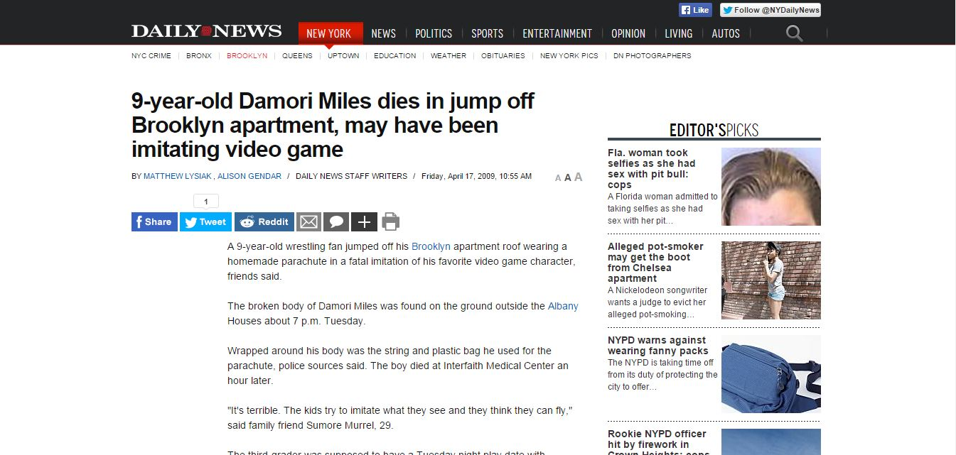

Slide 11
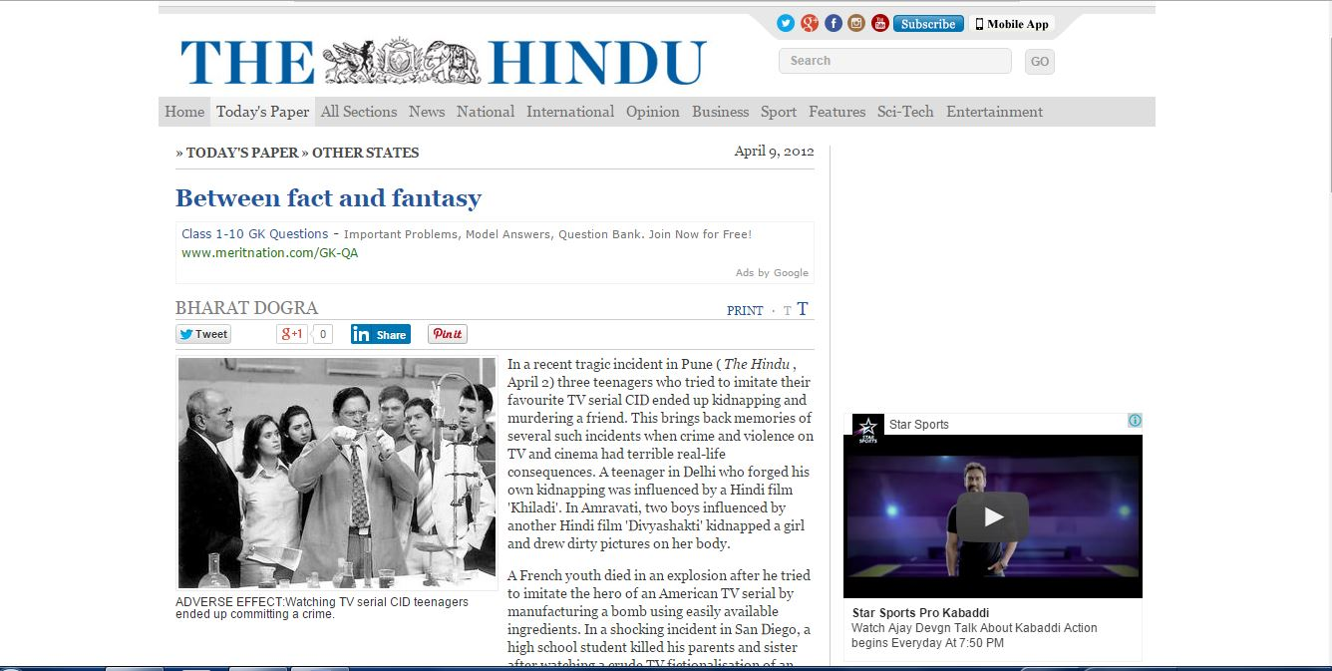

Slide 12
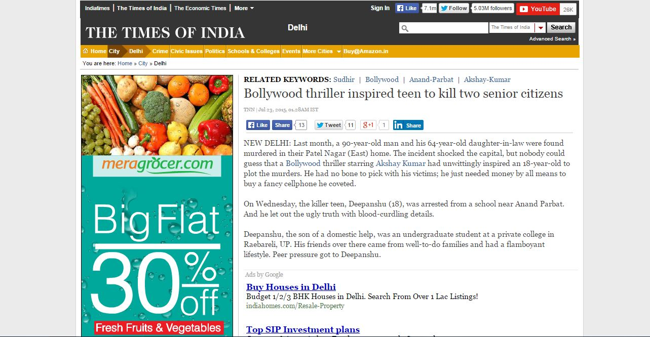

Slide 13
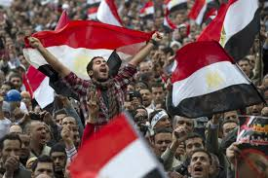
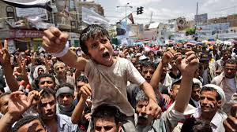
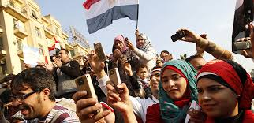
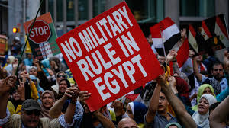
Arab Spring

Slide 14
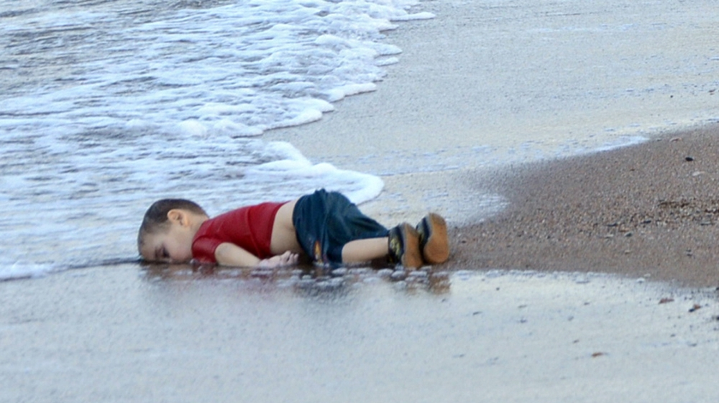

Slide 15
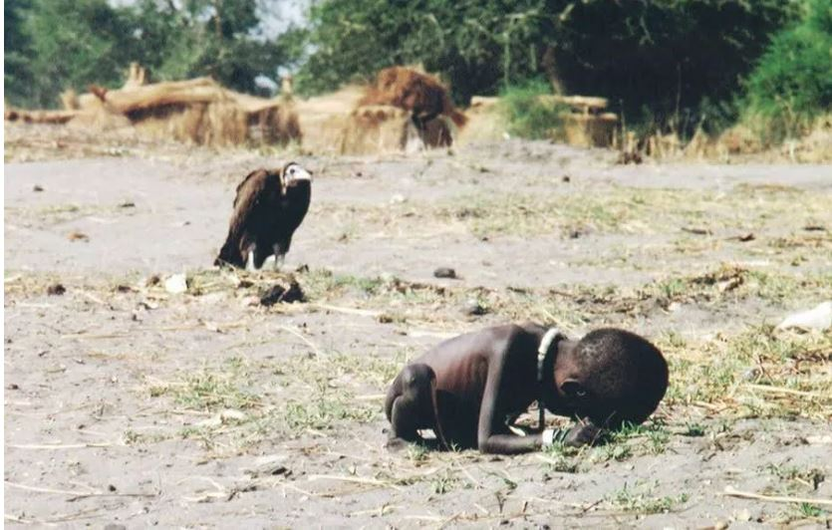

Slide 16
Media & Information Literacy
MEDIA AND INFORMATION LITERACY IS A SET OF COMPETENCIES THAT HELP PEOPLE TO MAXIMIZE ADVANTAGES AND MINIMIZE HARMS OF MEDIA MESSAGES
1
2
3
4

Slide 17
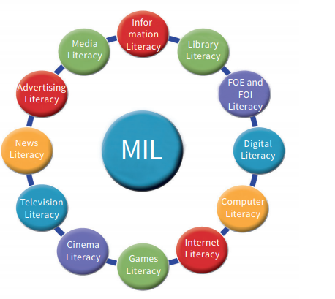
What is Media and Information Literacy
Media literacy is the ability to
ACCESS, ANALYZE, EVALUATE,
CREATE, and ACT using all forms of communication.

Slide 18
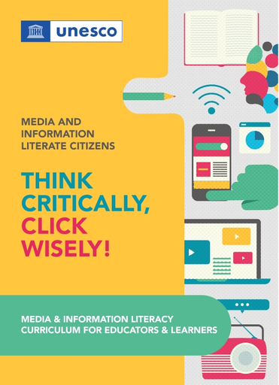
Media Literacy Benefits
In teaching and learning processes, it equips educators with enhanced knowledge about how to critically engage with information, media, and digital technologies to empower future citizens and learners
Through MIL, people can self-empower to understand the positive things that they can do through media and digital tools, thereby ensuring a better Internet and contributing to information for the public good
Media and information literacy imparts crucial knowledge about the functions of content providers and mediators such as libraries, archives, museums, media, and digital communications companies, reasonable understanding about the conditions needed to perform those functions effectively and critical skills required to evaluate the performance of content providers in light of the expected functions..

Slide 19
MIL helps in dealing with the cases of Misinformation and Disinformation
It is Prerequisite for other forms of literacies like Health Literacy, Science Literacy Financial literacy, cultural literacy, global citizenship education and education for sustainable development – because it strengthens the skills needed to identify and navigate beneficial and harmful information.
Media and information literate persons are more likely to reject unvalidated information, biases and stereotypes that reinforce inequalities between women and men of all ages, and discrimination towards peoples, religions, etc
.

Slide 20
“
Five Concepts in Media Literacy
All media messages are ‘constructed’
Who created this message?
2. Media messages are constructed using a creative language with its own rules.
What creative techniques are used to attract my attention?
3. Different people experience the same media message differently.
How might different people understand this message differently from me?
4. Media are primarily businesses driven by a profit motive.
Why is this message being sent?
5. Media have embedded values and points of view.
What lifestyles, values and points of view are represented in, or omitted from, this message?

Slide 21
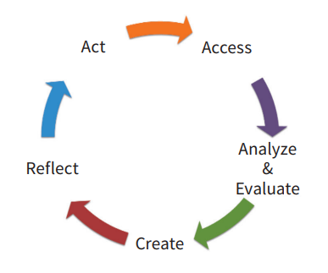
Media Literacy Competencies

Slide 22
Websites for cross-checking
ACCESS
World Health Organization - https://www.who.int/
Centers For Disease Control and Prevention (https://www.cdc.gov/)
Food and Drug Administration (https://www.fda.gov/emergency-preparedness-and-response/mcm-issues/coronavirus-disease-2019-covid-19)
Ministry of Health and Family Welfare, New Delhi (https://www.mohfw.gov.in/)
Indian Council of Medical Research, New Delhi https://www.icmr.nic.in/
State Health Ministries and public health departments/hospitals

Slide 23
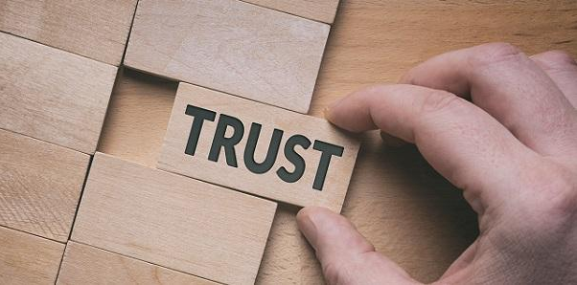
Trusted sources you can use to verify:
WHO Whatsapp number that you can access
and get information on everything regarding this
pandemic +41798931892
You can also visit https://www.who.int on
your mobile and access this service through
the link given there
Government of India has also launched a
MyGov Corona Helpdesk on Whatsapp. You can access this service on Whatsapp on this
number: +91 9013151515
Notes:
WHO and the Government of India have launched Whatsapp services for your questions to be answered. If you still dont find your answers here, you can visit their website to get the accurate information

Slide 24
Qs to ask when you see any ‘news’ about COVID-19:
ANALYSE
The Source: Is the source credible and authentic?
The Content: Is the content believable or is it outlandish?
Does the news quote authoritative sources?
Is it a social media post that is compelling you to forward and share?
Is the content inciting extreme emotions?
Any news from a questionable source, that is unbelievable, and compels you to share and forward further, need verification

Slide 25
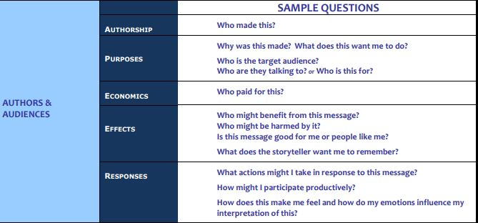

Slide 26
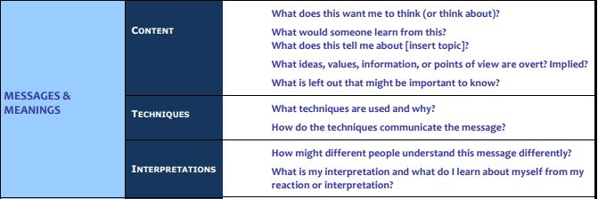

Slide 27
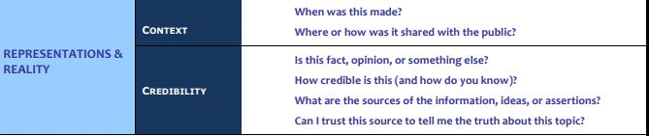

Slide 28
AM I?
REFLECT
Compulsively forward Whatsapp posts without verifying?
Regularly share sensitive Facebook posts that suit your line of thinking?
Mindlessly retweet anything that suits your judgment?
If you do any of the above, then STOP. You are, most probably, contributing to the Misinformation Menace.

Slide 29
Identifying Fake News in the midst of information explosion
ACT

Slide 30
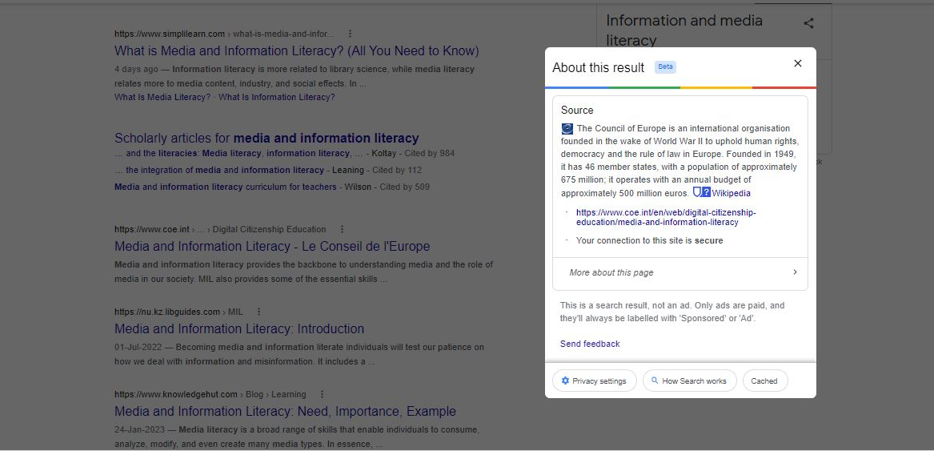

Slide 31
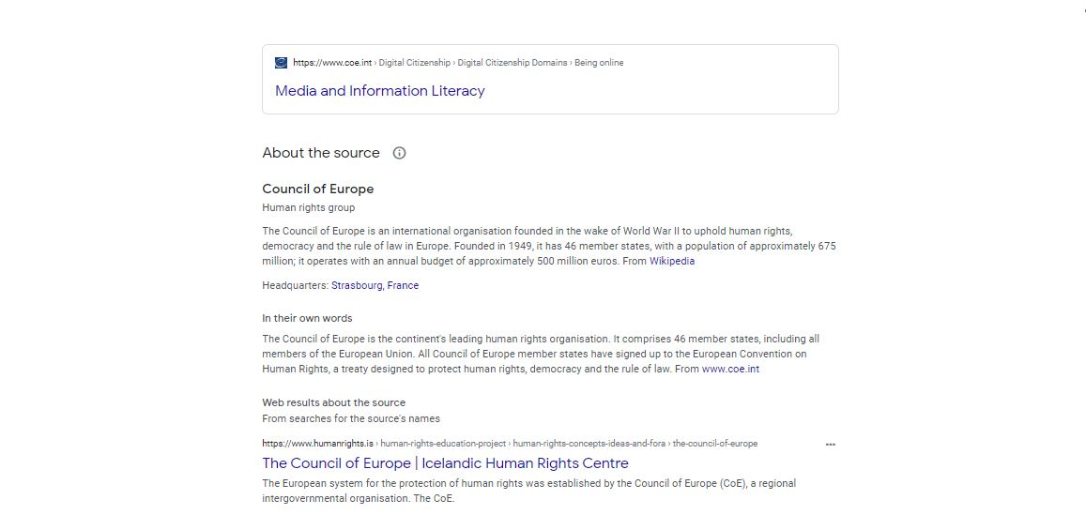

Slide 32
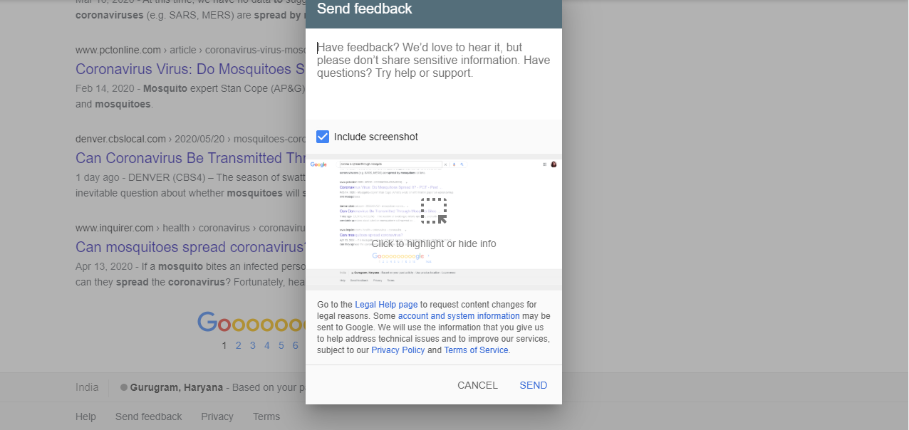
REPORT

Slide 33
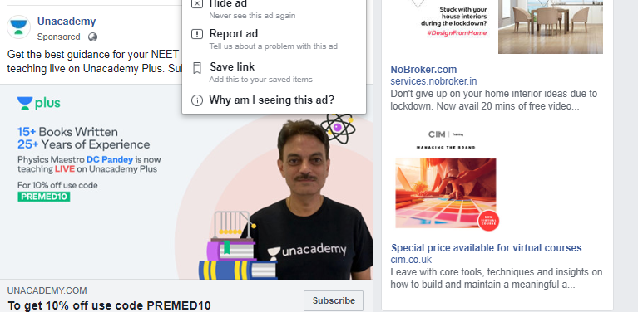
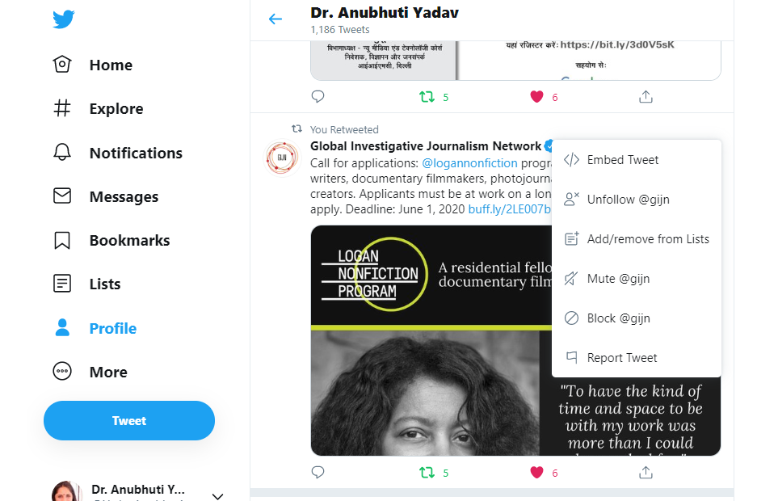

Slide 34
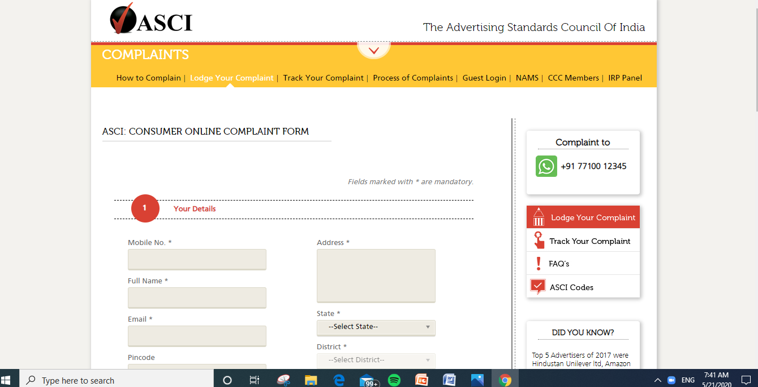

Slide 35
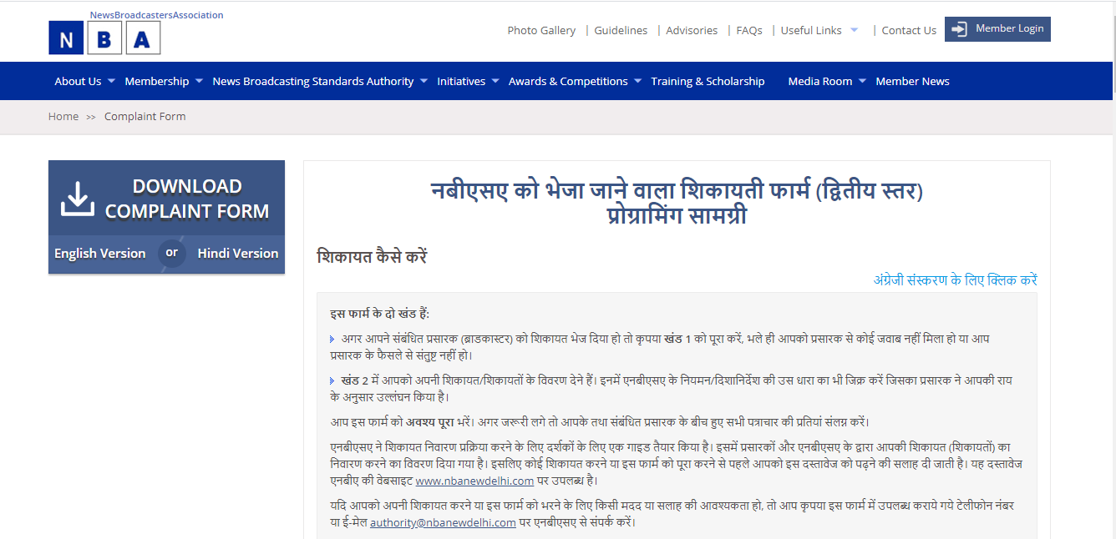

Slide 36
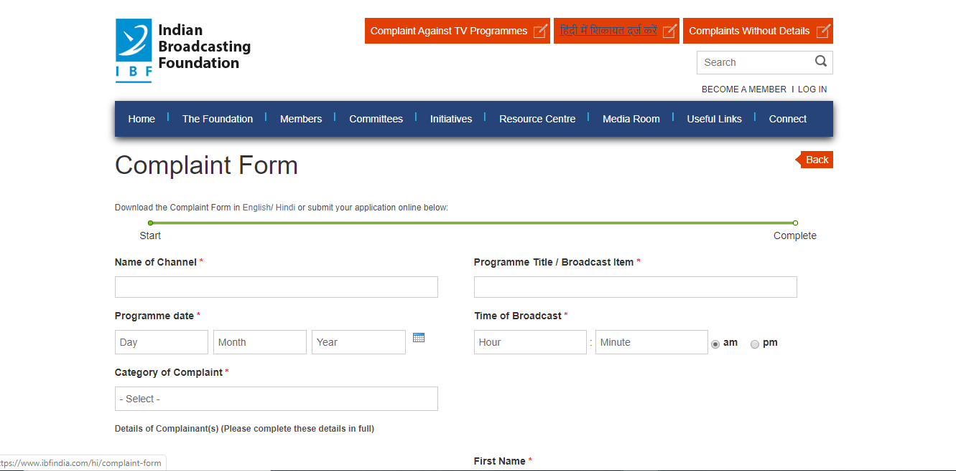

Slide 37
HOW THIS CAN BE ACHIEVED?
Step 2
Step 4
Media Clubs in schools
Offering Mass Media – Being Media Literate 7-9
Step 1
Step 3
Step 5
Integrating this with the existing subjects
Offering Media Studies at XI and XII
Workshops for Teachers and Parents
MAKE STUDENTS AMBASSADORS for MEDIA LITERACY

Slide 38
THANKS
Prof. Anubhuti Yadav
Professor, New Media
Indian Institute of Mass Communication
E Mail : anubhutiy@gmail.com
Twitter: @YadavAnubhuti
Website: www.anubhutiyadav.com

