Slide 1
Media Literacy
& Non- Violent Communication
By SARIMA THAKUR
Academic cum Teaching Associate
Indian Institute of Mass Communication

Slide 2
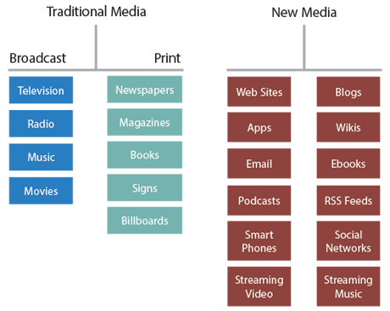
Understanding Media
https://thoughtfullearning.com/inquireHSbook/pg246

Slide 3
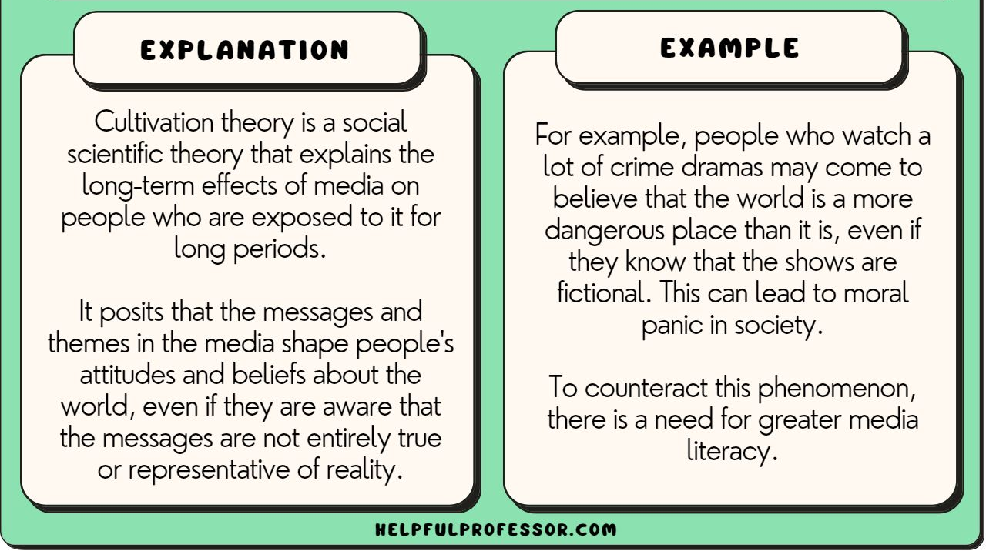
How Media Works:
Cultivation Theory:
It is social scientific theory that explains the long-term effects of media on people who are exposed to it for long periods.

Slide 4
Examples:
Crime Perception and Media Exposure
Gender Roles in Indian Soap Operas
Social Media and Youth Behavior
Perception of Rural Life Through Media

Slide 5
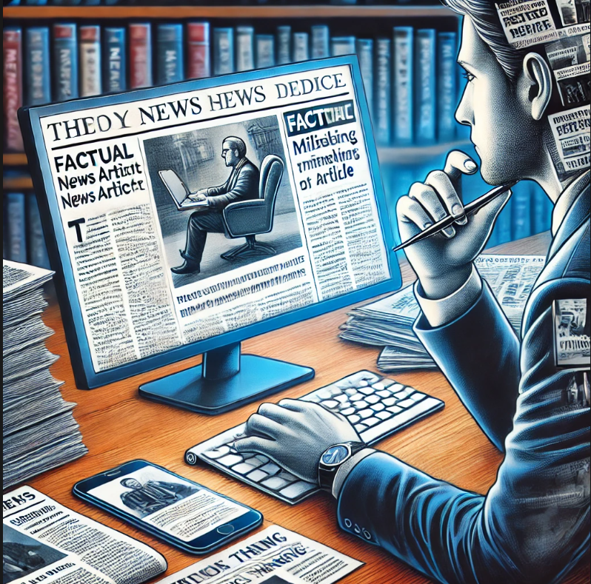
Media and Information Literacy
Media literacy refers to the ability to access, analyze, evaluate, and create media in a variety of forms. It is crucial for understanding the complex messages we receive from television, radio, the internet, newspapers, and other media outlets.
A person who is media literate can discern between a factual news report and a misleading article

Slide 6
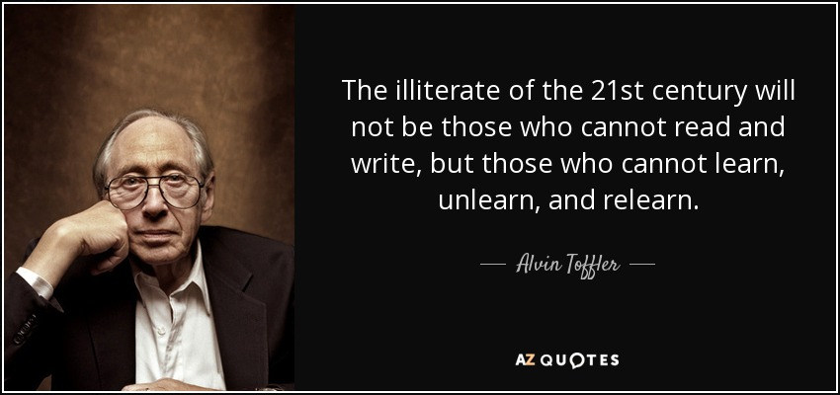

Slide 7

Importance of Media and information Literacy
Critical Thinking:
Media literacy encourages individuals to critically analyze the information presented to them, helping to distinguish between facts, opinions, and propaganda.
Example: When watching a news segment, a media-literate person may notice subtle bias in the language used to describe different political figures.
https://www.apple.com/in/newsroom/2019/03/apple-teams-with-media-literacy-programs-in-the-us-and-europe/

Slide 8
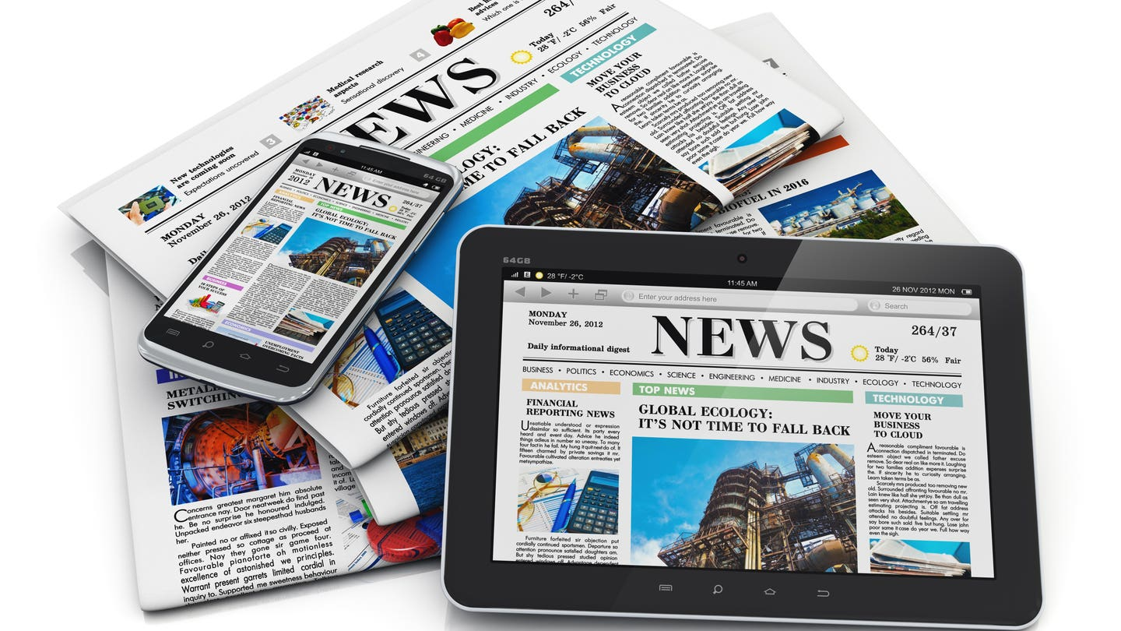
Informed Citizens:
Being media literate enables individuals to make better decisions, particularly in a democratic society where media plays a significant role in shaping public opinion.
Example: Voters who are media literate can better assess the credibility of political advertisements and campaign promises.

Slide 9
Empowerment:
Media literacy empowers people by giving them the tools to create their own media content, offering alternative perspectives and challenging dominant narratives.
Social media platforms allow individuals to share their stories, often providing a voice to marginalized communities.
Example: The #MeToo movement is an example of how media literacy and social media empowered individuals to speak out against sexual harassment and assault, leading to significant social change.

Slide 10
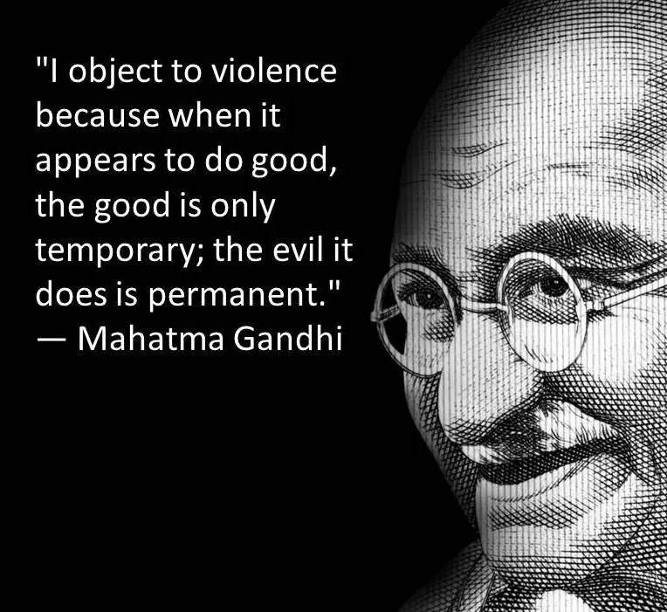
Understanding Non-Violent Communication
COMMUNICATION helps mould our realities, our perspectives and emotions.
It makes us to feel more connected to each other.
Our communication is a reflection of the inner workings of our mind.
Everything we communicate originates from the contents of our mind
https://www.timesnownews.com/the-buzz/article/international-day-of-non-violence-10-quotes-of-mahatma-gandhi-on-non-violence/661146

Slide 11
Challenges to Communicators today
Increase in hate speech and hate narratives
Polarizing & divisive communication
Frozen communication at all levels
So the challenge is on how to promote heart-to-heart communication, counternarratives to hate speech
How communication can be a source of positive values and mutual co-existence.

Slide 12
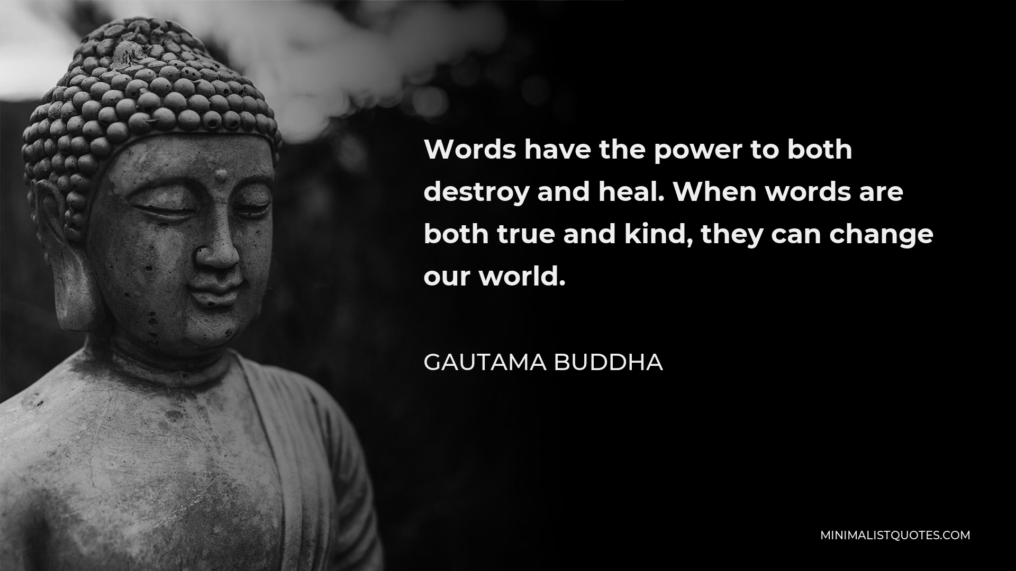

Slide 13
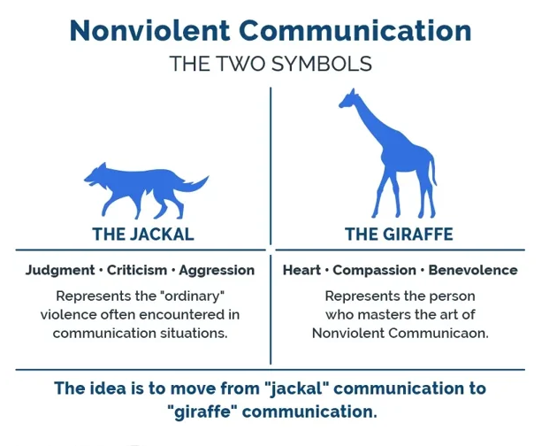
Non-Violent Communication
NVC is a communication process developed by Marshall Rosenberg that focuses on expressing oneself honestly and empathetically while listening to others without judgment or criticism.
https://blog.proactioninternational.com/en/nonviolent-communication-best-practices-at-work

Slide 14
Nonviolent communication is a holistic communication approach which underlines the significance of human interconnectedness.
It encompasses our intrapersonal communication, communication with others, communication in the society at large, communication with nature and communication with other living beings.
Its premise is that in the event of a dysfunctional communication whether it is a destructive self-communication, interactions with others, in the society, with nature or with other living beings, there would be disruptions in our relationships.
As a holistic communication approach, it contributes to our cognitive, emotional and moral development

Slide 15
Factors affecting Non- Violent communication
Half-truths or misleading information
Hate speech
More violent content in Media
Commercial Interests
Sensationalism

Slide 16
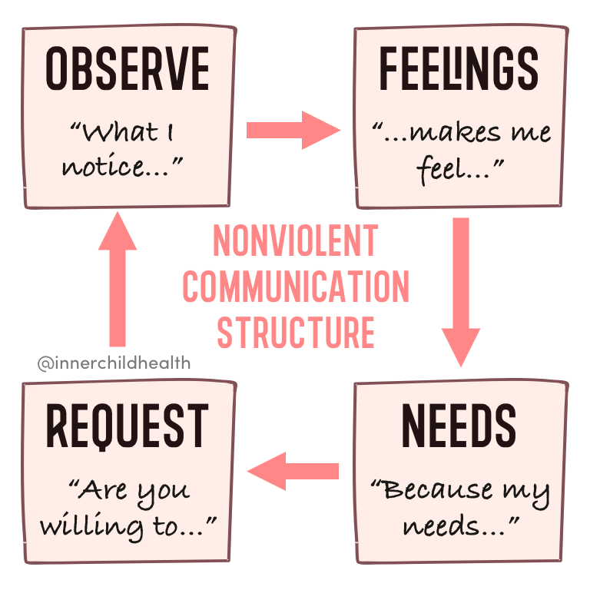
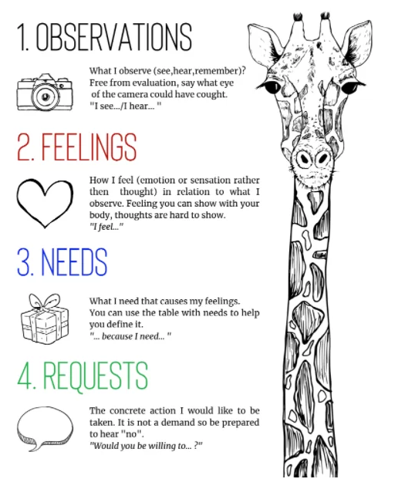
Four Components of Non-Violent Communication

Slide 17
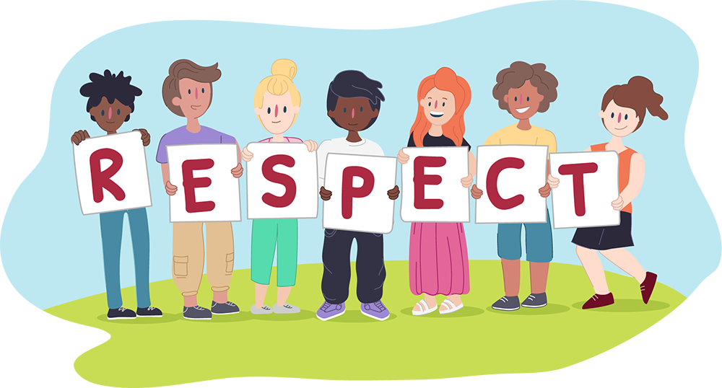
Five Pillars of Mahatma Gandhi’s Nonviolence
Respect:
Respect involves recognizing the inherent dignity and worth of every individual, regardless of differences in beliefs, culture, or social status. Gandhi believed that nonviolence starts with respecting others' humanity, which means treating others with kindness and consideration, even in disagreement or conflict.
https://kidshelpline.com.au/teens/issues/all-about-respect

Slide 18
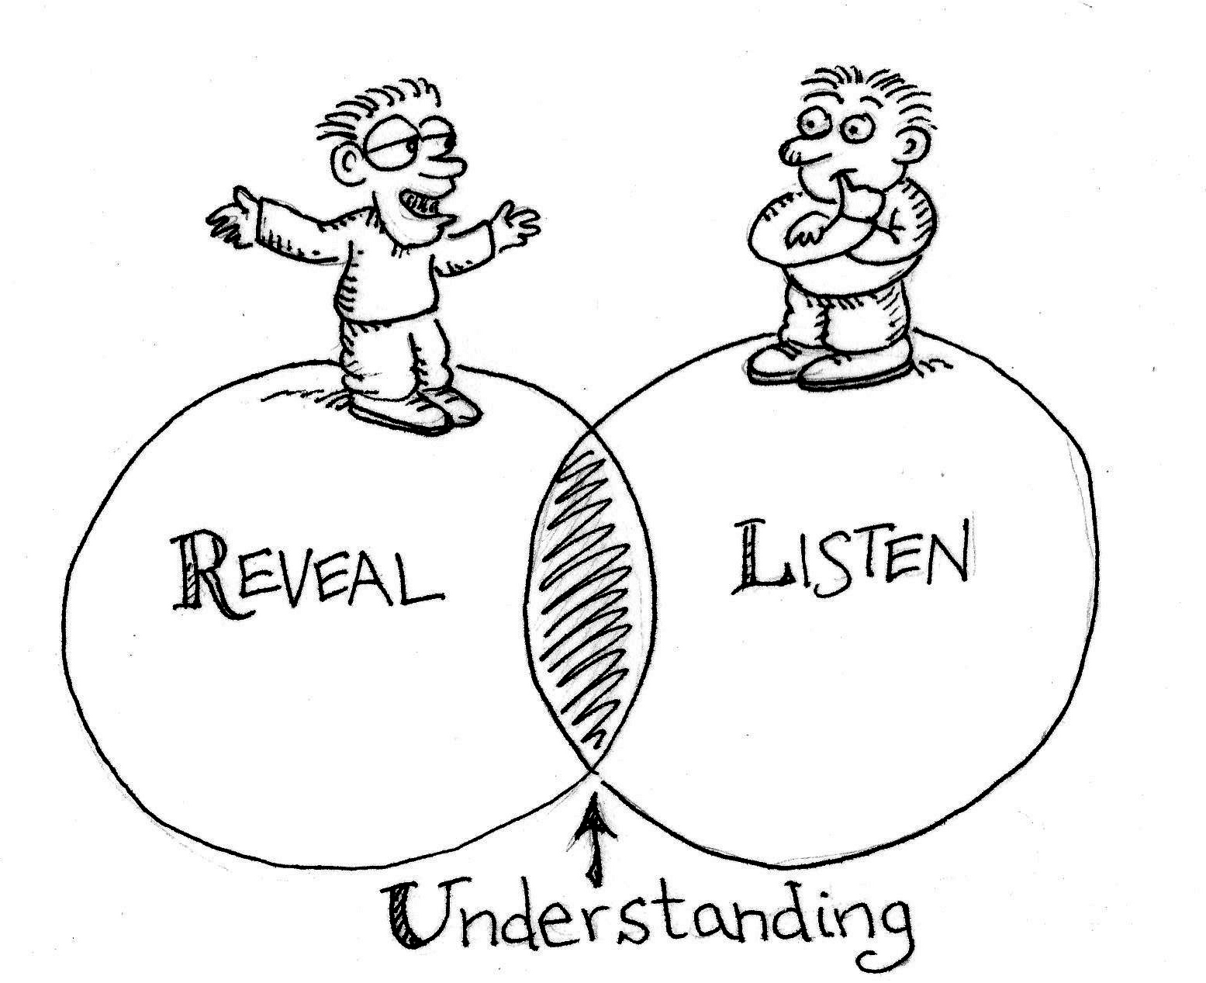
Understanding:
Understanding requires actively listening to others and seeking to comprehend their perspectives, needs, and emotions. In Gandhian nonviolence, understanding others' viewpoints is crucial to resolving conflicts and building meaningful connections that transcend violence.
http://www.stuartduncan.name/general/understanding-and-acceptance-means-listening-even-if-you-disagree/

Slide 19
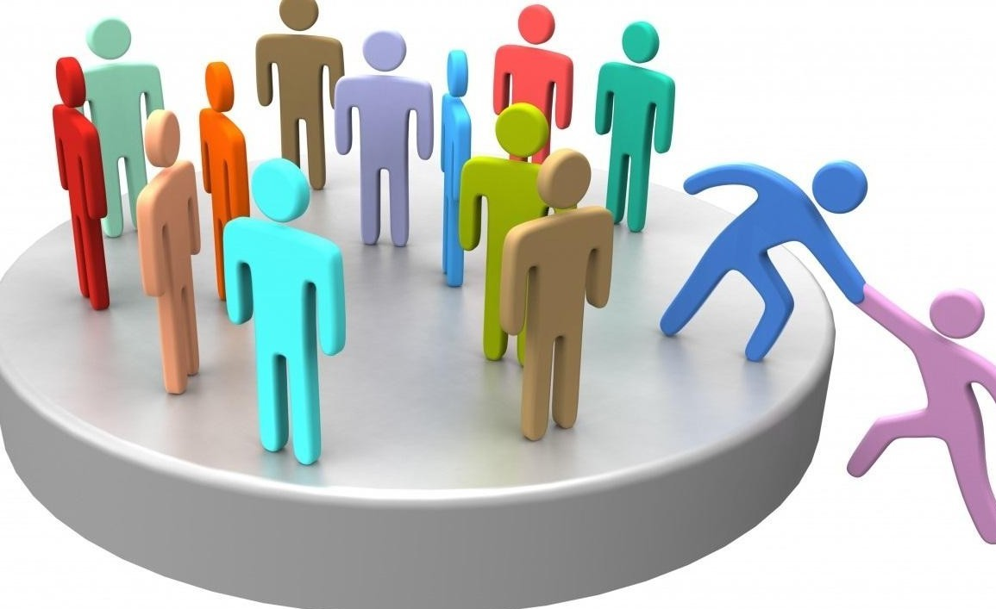
Acceptance:
Acceptance means embracing others as they are, without trying to change or judge them. Gandhi emphasized the importance of accepting differences and working towards common ground. This pillar encourages tolerance and the acknowledgment that diversity in thought and action is natural and valuable.
https://www.linkedin.com/pulse/social-acceptance-parallel-story-prasanna-m-sridhara/

Slide 20

Appreciation:
Appreciation goes beyond mere acceptance; it involves valuing the contributions and existence of others. Gandhi’s nonviolence teaches that by appreciating the positive aspects of people and situations, we can foster a more harmonious and supportive community.
https://www.inspirus.com/blog/20-examples-of-employee-appreciation-day-messages-for-2024/

Slide 21

Compassion:
Compassion is the deep, empathetic concern for the suffering and well-being of others. It is the driving force behind Gandhi’s nonviolent actions. Compassionate behavior includes acts of kindness, empathy, and a genuine desire to alleviate others' pain and hardship, which is at the heart of nonviolence.
https://www.csustan.edu/tag/self-compassion

Slide 22
Principles of NVC
Observing a situation or behavior without attaching any judgments, evaluations, or labels.
Clearly expressing your feelings in response to what you observe, without blaming others for how you feel.
Recognizing and stating the underlying needs or values that are connected to your feelings.
Asking for what you want in a clear and specific way, without making demands

Slide 23
Listening to others with empathy, trying to understand their feelings and needs without judgment or interruption.
Being honest and transparent in expressing your feelings, needs, and requests, while maintaining respect for others.
Prioritizing the connection and understanding between individuals rather than winning an argument or proving a point.
Encouraging cooperation rather than trying to control or manipulate others through guilt, fear, or rewards.
Showing compassion towards others and yourself, understanding that everyone has needs and makes mistakes.

Slide 24
Media literacy & Non- Violent communication
Promoting Empathy:
Media literacy helps individuals understand and respect diverse perspectives, which is crucial for empathy—a core component of NVC.
A media-literate person who watches news from multiple sources can better understand the perspectives of people from different backgrounds.
Example: News coverage of global crises, like the Syrian refugee situation, can inspire empathy when presented through personal stories and human experiences.

Slide 25
Reducing Conflict:
Both media literacy and NVC work together to reduce conflicts by promoting understanding and constructive dialogue.
Online discussions about sensitive topics often escalate, but applying NVC can help de-escalate tensions by focusing on feelings and needs rather than accusations.
"Communication is the most important skill in life." — Stephen Covey

Slide 26
Empowering Voices:
Media literacy enables marginalized communities to create and share their narratives, while NVC ensures these communications are respectful and heard.
Grassroots media projects that give voice to underrepresented groups in a way that is constructive and heard by a broader audience.
Example: Indigenous media platforms using NVC to engage with audiences on cultural preservation and rights issues.

Slide 27


