Slide 1
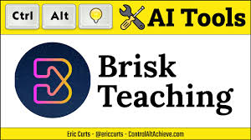
Brisk Teaching – AI Assistant for Teachers
Empowering Educators, Enhancing Learning
Presenter
S Ganesh
Graduate Teacher
PUMSchool Kilariyam
Thiruvarur dt Tamilnadu

Slide 2
The Ever-Increasing Demands on Teachers
Heavy workloads: Lesson planning, grading, feedback, etc.
Time constraints: Limited time for individual student attention.
Need for personalized learning: Catering to diverse student needs.
Administrative tasks: Reports, documentation, etc.
Teacher burnout is a significant concern.

Slide 3
Key Features of Brisk Teaching
Create:
  Generate lesson plans, quizzes, and other materials quickly.
  Personalize and differentiate content for diverse learners.
  Develop IEPs and progress reports efficiently.
Give Feedback:
  Provide targeted and actionable feedback to students.
  Offer feedback in various modes (Glows & Grows, Targeted, Rubric Criteria, Next Steps).
  Integrate feedback seamlessly within Google Docs.
Inspect Student Writing:
  Analyze student writing to understand their revision process.
  "Replay" student writing process.
  AI writing detection.
Leveled Resources for All Students:
  Adjust reading levels of materials.

Slide 4
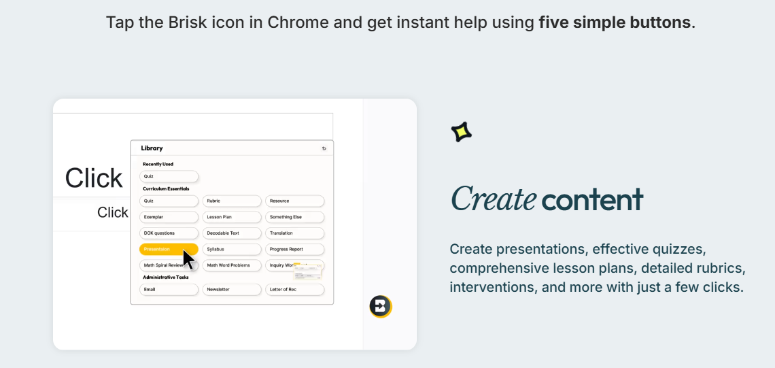
What Can Brisk Do for Teachers?
Create Content
Generate lesson plans,
quizzes,
Google Docs, Forms, and Slides in over 30 languages
—auto-saved to your Google Drive.

Slide 5
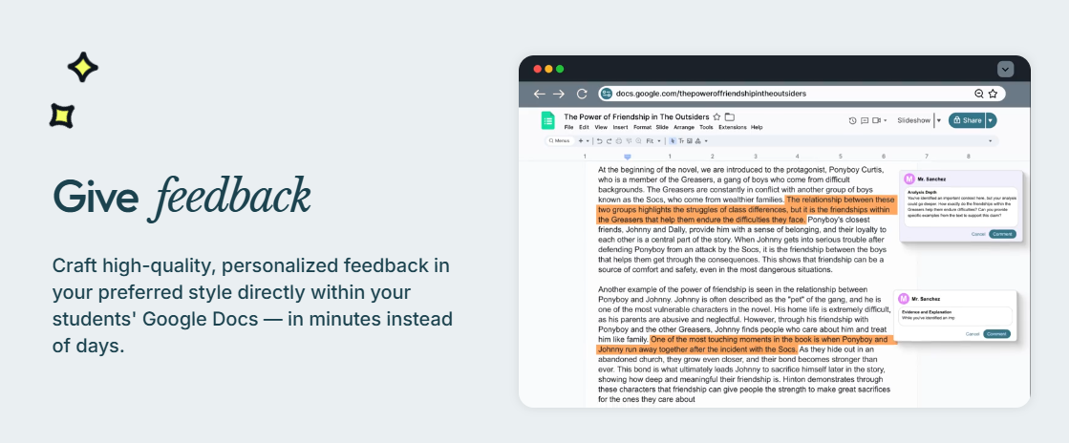

Slide 6
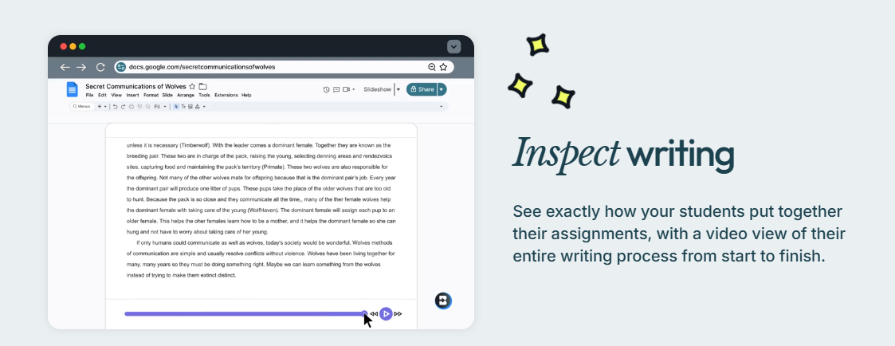

Slide 7
Save precious time
Make teaching easier
Inspire your students

Slide 8
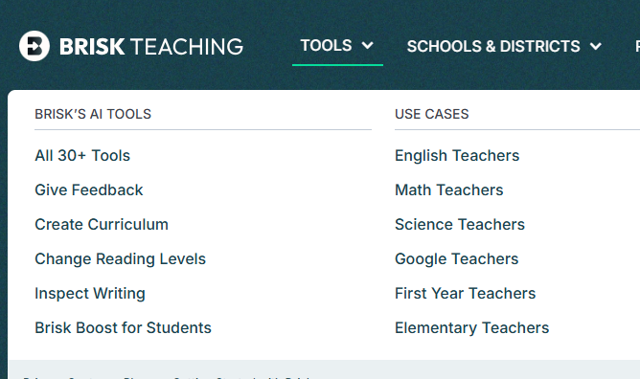

Slide 9
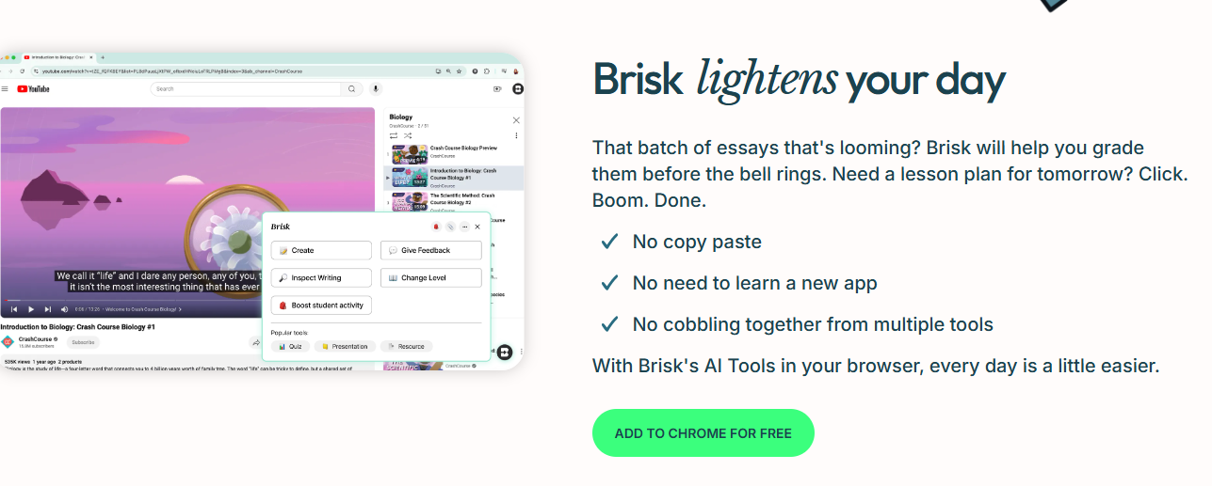

Slide 10
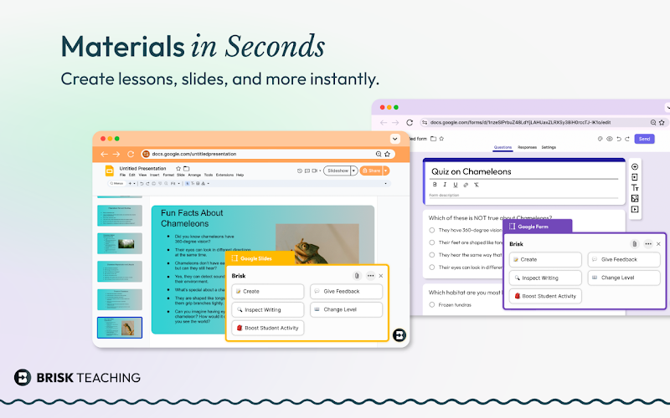

Slide 11
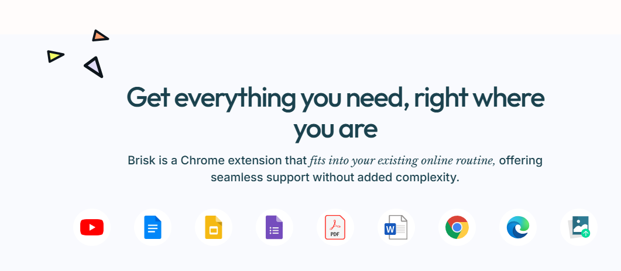

Slide 12
Getting Started Is Easy
1. Install: Add the Brisk extension to Chrome and pin it.
2. Brisk It: Click the Brisk icon to start creating, giving feedback, and boosting engagement.
3. Relax: Let Brisk handle the heavy lifting while you focus on teaching.

Slide 13
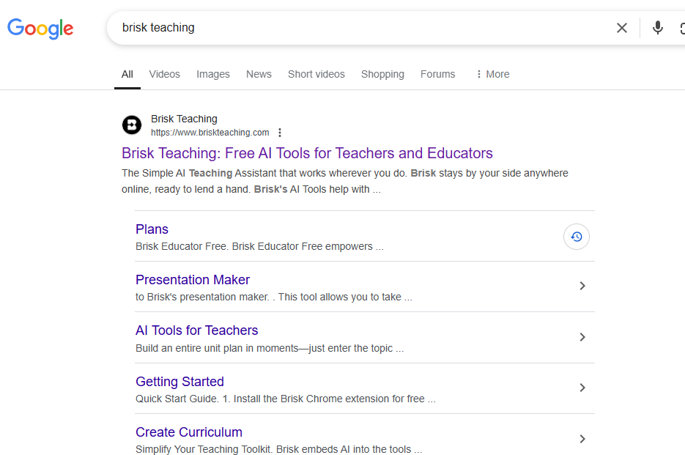
Step 1:
Search Brisk teaching in browser
Step 2:
click and select brisk teaching

Slide 14
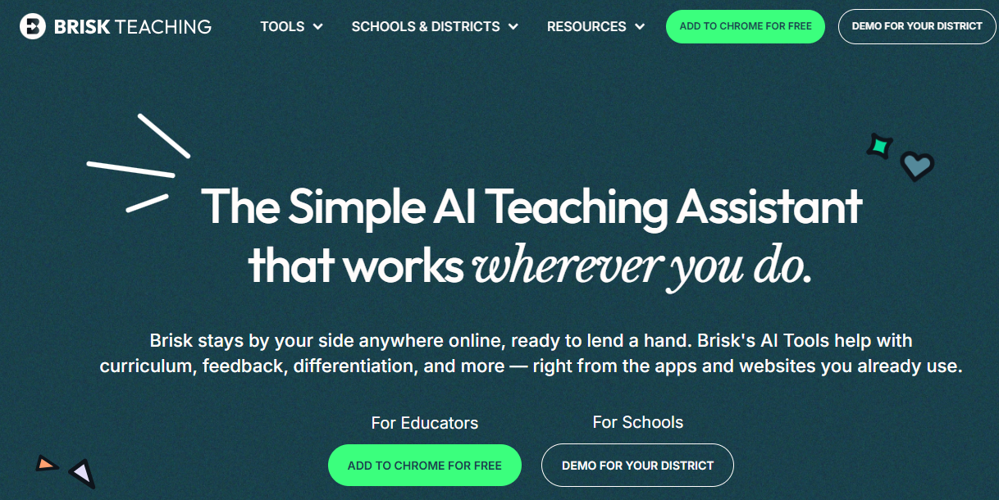

Slide 15
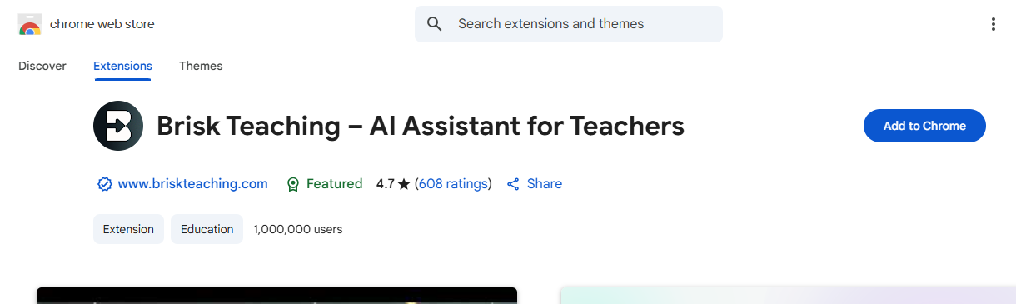

Slide 16
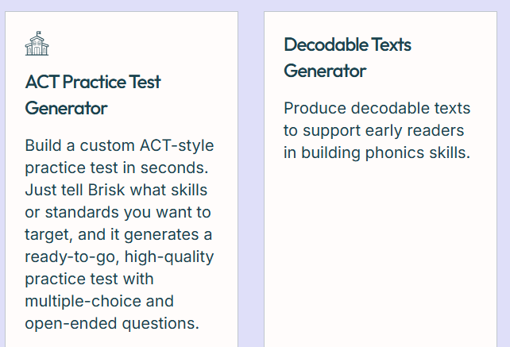

Slide 17
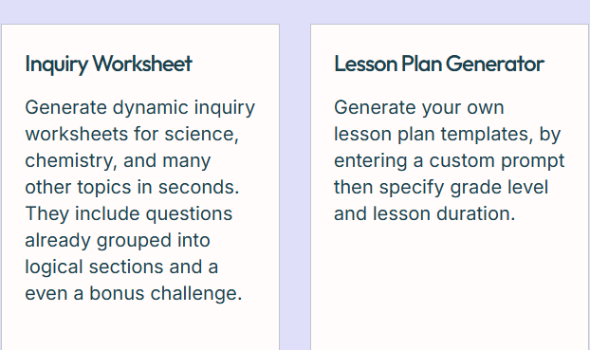

Slide 18
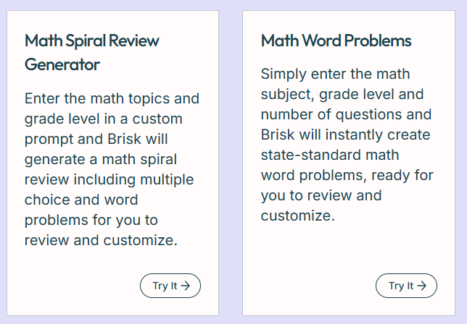

Slide 19
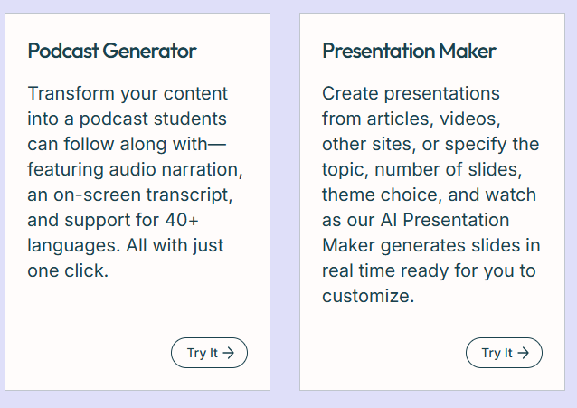

Slide 20
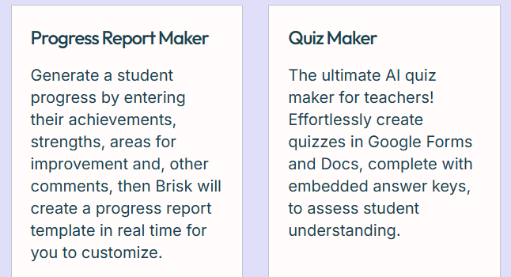

Slide 21
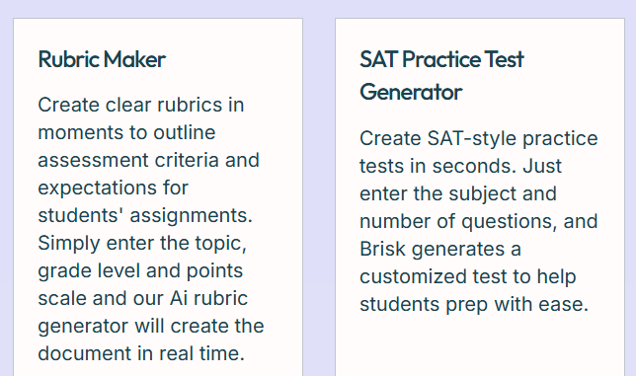

Slide 22
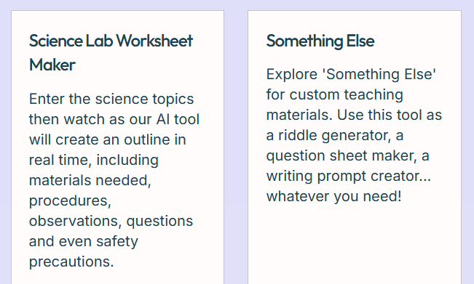

Slide 23
How Brisk Empowers Teachers
Lesson Planning: Quickly generate a first draft of a lesson plan, which you can then customize.
Feedback: Provide students with detailed feedback on their essays in a fraction of the time.
Differentiation: Adapt a reading passage to multiple reading levels with a few clicks.
Quiz Creation: Instantly create a quiz from a document or article.

Slide 24
Benefits of Using Brisk Teaching
Significant time savings for educators.
Increased efficiency in completing administrative and instructional tasks.
Facilitates more personalized instruction.
Supports differentiated learning.
Potential for improved student outcomes through more effective feedback and resources.
Reduces teacher workload and burnout.

Slide 25
Privacy and Security
Brisk prioritizes data privacy.
Adheres to high AI privacy standards.
Compliant with COPPA, FERPA, GDPR, and state privacy laws.
Protects student and staff data.
Requires no personally identifiable student information.

