Slide 1


Unleash Your Inner Ideas: Create AI-Powered Videos with Invideo.io
Engage students with dynamic AI-generated videos. No video editing skills needed. Transform lessons into vivid tutorials with ease.
by
National Awardee. S.Dhilip
English Graduate Teacher
GHSS , Sathiyamangalam,
Villupuram Dt -604153
Tamil Nadu

Slide 2

Why Video? Captivating the 21st-Century Learner
Visual Learners
65% of people learn best visually, making videos effective.
Retention Boost
Videos increase information retention by 95% compared to text.
Massive Reach
YouTube sees 500 million daily views on science education content.
Diverse Learning
Supports auditory, visual, and kinesthetic learning styles.

Slide 3

Step 1: Account Setup & Invideo.io Interface Overview
1
Navigate to Invideo.io
2
Plan Options
Choose free or paid plan
Access the platform and create a free account to start.
3
Explore Tools
Discover templates, AI text-to-video, and editing options.

Slide 4
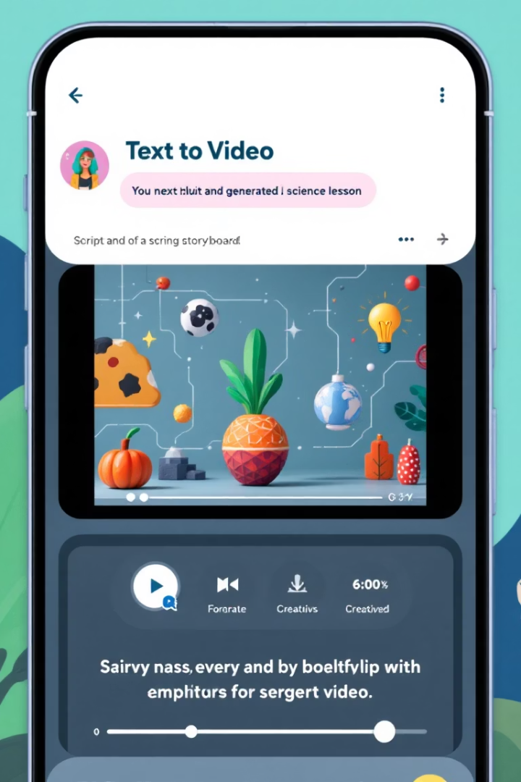
Step 2: Mastering AI Text to Video - From Script to Screen
Select AI Text to Video
Begin by clicking the AI Text to Video tool on Invideo.
Paste Your Script
Input your science lesson script, e.g., photosynthesis.
Choose Video Style
Pick Explainer, Educational, or Social Media styles.
Review Storyboard
AI generates a storyboard with suggested visuals automatically.

Slide 5
Step 3: Customizing Your Video - Bringing ideas to Life
Replace Clips
Upload Assets
Personalize Design
Swap visuals using Invideo’s vast stock library for science themes.
Add your own photos, diagrams, or videos explaining concepts.
Adjust text styles, fonts, colors, and smooth transitions.

Slide 6




Step 4: Adding the "Aha!" Factor - Voiceover and Sound Effects
Record Voiceover
Use AI Voice
Directly record your narration in Invideo for personal touch.
Subscribe to AI voice options for diverse, affordable narration.
Add Music & Effects
Enhance engagement with background music and sound effects.

Slide 7
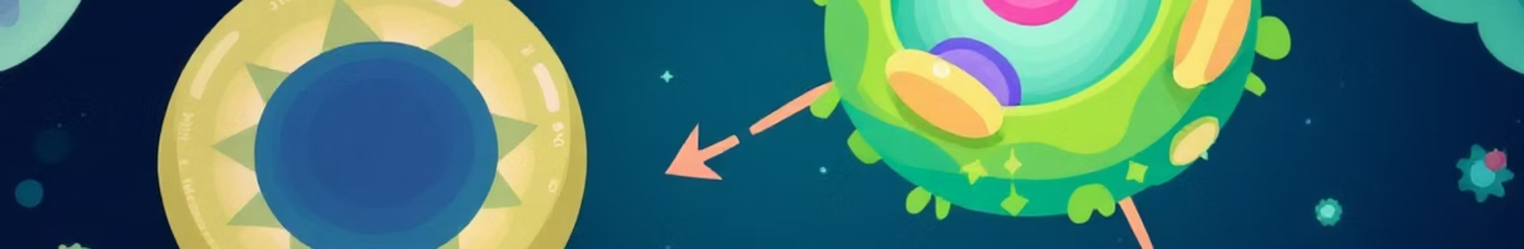



Step 5: Animating Concepts - Visualizing the Invisible
Use Animation Tools
Illustrate complex processes like cell division with animations.
Kinetic Typography
Highlight key terms with dynamic moving text effects.
Import Diagrams
Bring in animated .SVG charts from sources like BioRender.

Slide 8
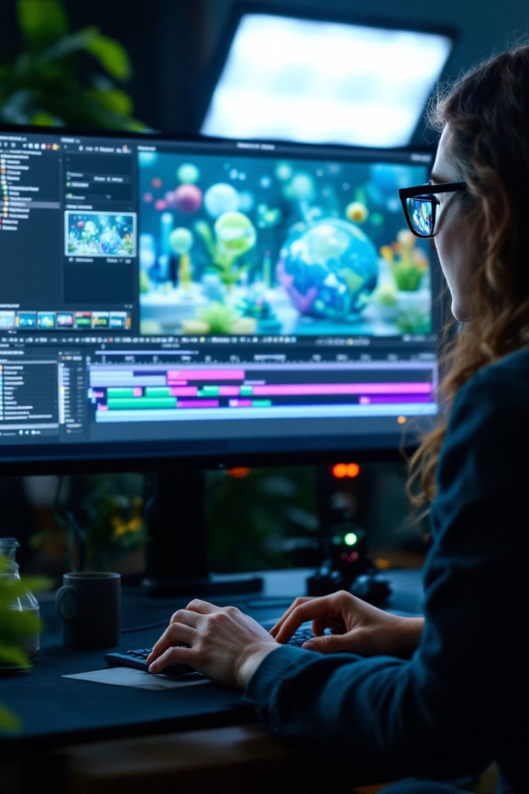




Step 6: Refining and Exporting Your Masterpiece
Preview Carefully
Review for smooth transitions and clear audio.
Final Adjustments
Fix errors and enhance visuals before export.
Export Settings
Export in 1080p or 4K for best quality.
Share Easily
Upload directly to YouTube or school platforms.

Slide 9
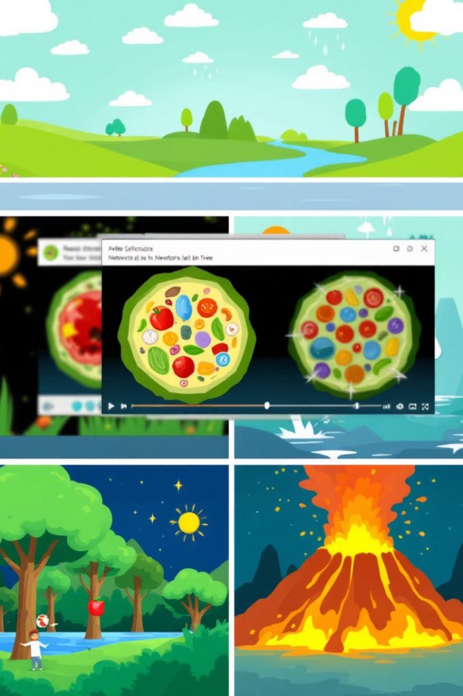
Examples in Action: Inspiring Videos
Made with Invideo.io
"The Water Cycle Explained"
2.3 million views showcasing dynamic water cycle animation.
"Cell Structure and Function"
1.8 million views teaching biology fundamentals visually.
"Newton's Laws of Motion"
900K views breaking down physics concepts engagingly.
Teacher Review
Saved 10 hours weekly using AI video creation tools.

Slide 10

Transform Your Classroom with AI Video
Simple & Engaging
Free Trial Available
Get Support
AI-powered videos make lessons captivating effortlessly.
Start experimenting with no upfront cost today.
Join Q&A sessions to enhance your video skills.

Slide 11
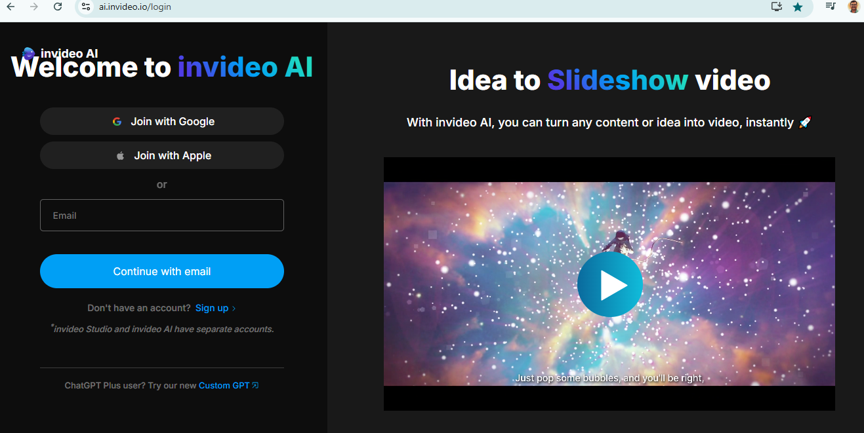

Slide 12
Can we create a Video with prompts?

Slide 13
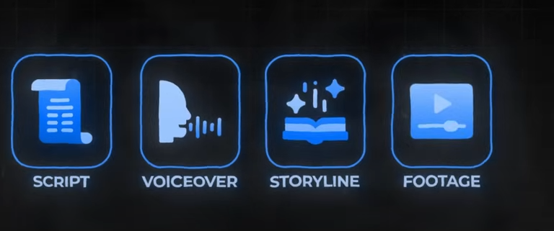
Generative AI creates a video

Slide 14
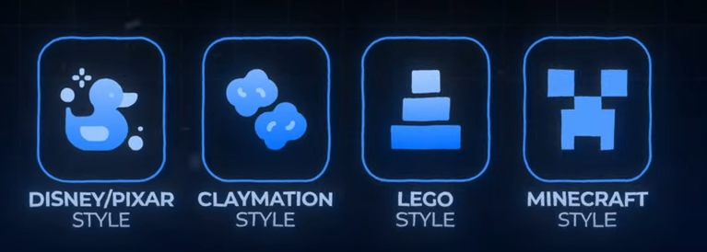
Different styles available

Slide 15
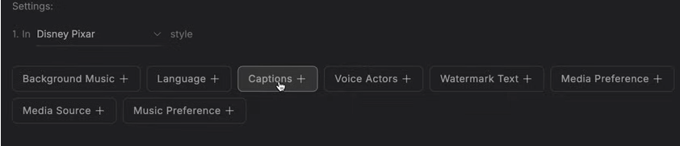

Slide 16
Decide the subject
Title of the video
Style of the video
Script for the video
Voice over

Slide 17
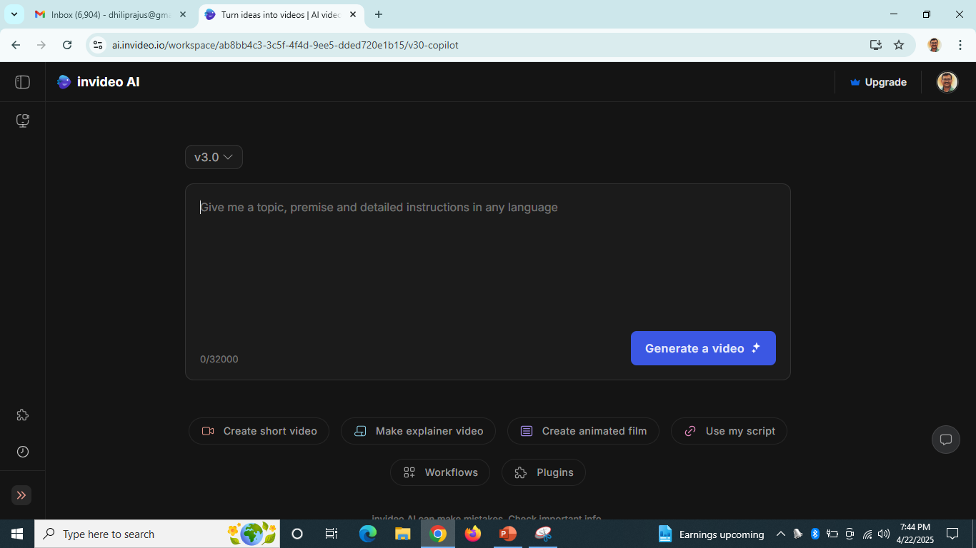

Slide 18
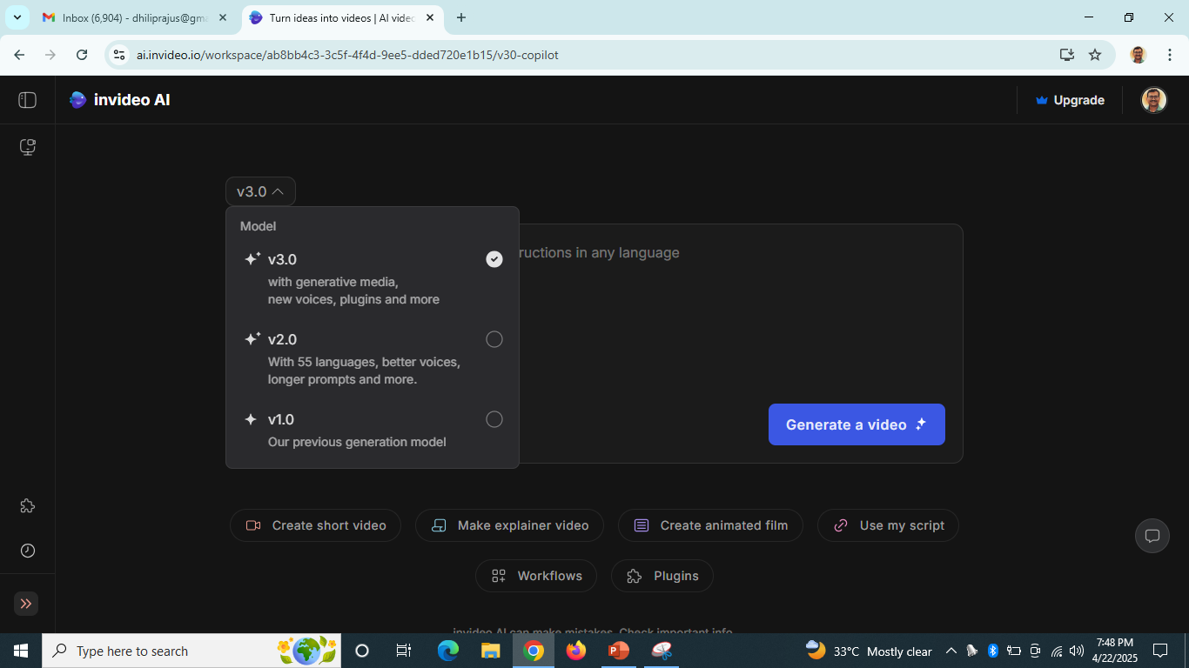

Slide 19
Types of videos

Slide 20

Any Questions

Slide 21


