Slide 1








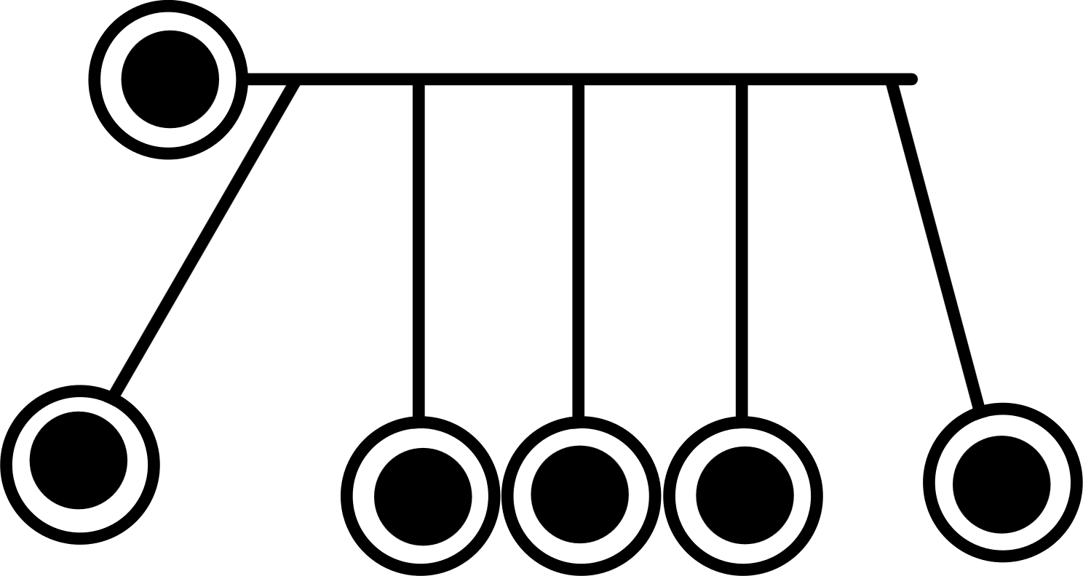



DIGITAL INITIATIVES: VIRTUAL LABS
Dr. Praveen B. Binjha
Associate Professor
CIET-NCERT, New Delhi
Ms. Nidhi Adlakha
Senior Academic Consultant
CIET-NCERT, New Delhi

Slide 2




Policy Perspective (NEP 2020 vision)
Technology use and Integration
Ensuring Equitable use of technology
Extensive Use of technology in teaching and learning
Content Creation, digital repository and Dissemination
Blended mode of learning
Addressing digital divide

Slide 3


Policy Perspective (NEP 2020 Vision) and Virtual Labs
01
Empowering Students with Digital Tools
  Promoting digital literacy as a core competency among students and teachers.
  Enabling accessible, hands-on learning for all students.
02
Equity and Inclusivity
  Enables remote experimentation, making practical knowledge accessible to all.
  Bridging the gap for students in remote areas with virtual access to quality labs.
  ands-on learning for all students.
03
Blended Learning Approach
  NEP 2020 advocates for a blend of traditional and digital learning, with Virtual Labs enhancing physical lab experiences.
  Encouraging teachers to adopt a hybrid teaching model that includes digital simulations.
04
Experiential Learning Goals
  Moving from rote learning to practical, skills-based learning experiences.
  Encourages inquiry-based and hands-on learning.

Slide 4




Pedagogical Perspective
01
Strengthening Conceptual Understanding.
  reinforce theoretical concepts with practical applications, improving comprehension and retention.
02
Enhanced Student Engagement.
  Interactive elements keep students engaged, making learning enjoyable and less intimidating.
03
Enhancing Lesson Plans
  Interactive simulations to make concepts tangible and engaging
04
Differentiated and Collaborative Learning
  Tailored experiences for various learning styles, supporting self-paced learning.
05
Ownership of Learning
  Encouraging students to explore concepts independently and build confidence.

Slide 5
Technological Perspective
01
Scalable and Cost-Effective
  reduce the need for costly physical infrastructure and materials, making lab experiences more scalable
02
Internet, devices, and reliable software for a smooth experience
03
Offline and Low-Bandwidth Solutions
04
Integrating Emerging Technologies
  Leveraging AI, AR, and VR to enhance the Virtual Lab experience with immersive and personalized learning
05
Continuous Monitoring and Updates
  Virtual Labs are regularly updated with new content and tools, ensuring relevance to the latest curricula

Slide 6

Virtual Labs as Teaching-Learning Tools
01
Bridging the Theory-Practice Gap
  help in visualizing complex processes that are difficult to perform in physical labs.
02
Access to Hands-On Experiences
  Realistic simulations that replicate laboratory experiments.
03
Reinforcement of Classroom Concepts
  Using Virtual Labs to deepen understanding in STEM through practice.
04
Accommodating Diverse Learners
  Allows students with disabilities to experience lab learning without accessibility issues of physical labs.
05
Encouraging Safe Experimentation
  Conducting high-risk or resource-intensive experiments virtually.

Slide 7

Virtual Labs on DIKSHA
01
Virtual Labs Vertical on DIKSHA
  A centralized resource access for students and teachers across disciplines.
02
Support for Teacher Training and Professional Development
  Templates, lesson plans and assessments guides, professional development for effective integration.
03
Fostering Collaboration
  Opportunities for peer interaction, expert guidance, and teacher support.

Slide 8


Biology in Virtual Labs
01
Simulating Biological Processes
  Visualizations of photosynthesis, cell division, and genetics.
02
Exploring Advanced Topics
  Interactive modules for genetics, ecology, and anatomy.
03
Realistic Experiment Simulations
  Virtual dissections and cellular observations without ethical/logistical

Slide 9



Chemistry in Virtual Labs
01
Safe Experimentation
  Conducting complex chemical reactions without physical risks.
02
Lab Safety Training
  Practicing protocols in virtual environments before real lab exposure.
03
Molecular Visualization
  Interactive tools to explore molecular structures and bonding.

Slide 10


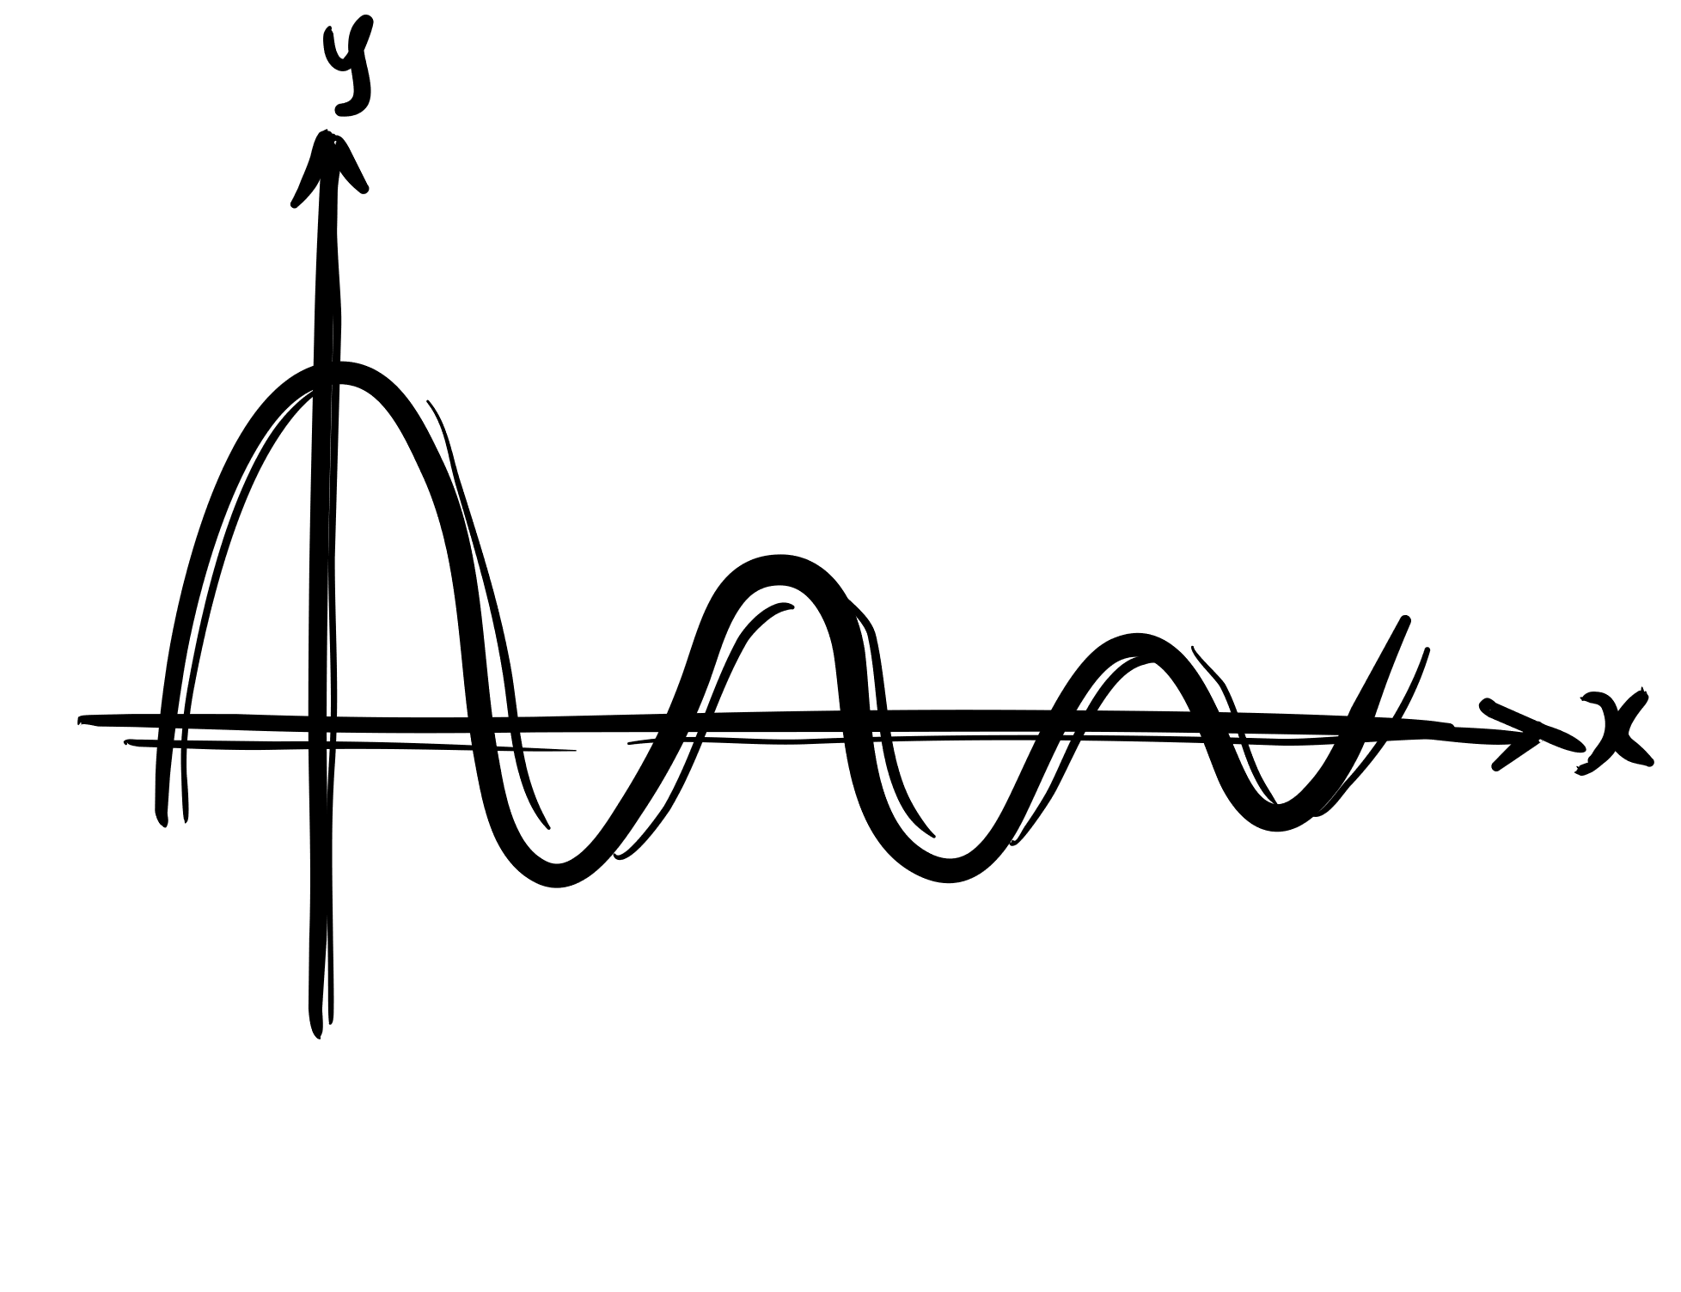
Physics in Virtual Labs
01
Simulating Physics Phenomena
  Exploring concepts like projectile motion and electric circuits interactively.
02
Complex Experiment Access
  Demonstrating high-energy and vacuum scenarios virtually.
03
Visualizing Abstract Concepts
  Experiencing atomic and wave theories that are challenging in traditional labs.

Slide 11
Virtual Labs as Assessment Tools
01
Automated and Immediate Feedback:
  Students receive instant feedback on their performance, enabling them to learn from mistakes and improve.
02
Gamified and Interactive Assessment
  Virtual Labs incorporate elements of gamification to make assessments more engaging and less stressful.
03
Practical Skills Evaluation
  Monitoring experiment accuracy and understanding through virtual labs.
04
Data-Driven Feedback
  Using student activity data for personalized, targeted feedback.
05
Tracking Longitudinal Progress
  Virtual Labs on DIKSHA provide tools for tracking student progress over time, giving insight into growth and development.
06
Assessing Analytical and Critical Thinking
  Open-ended tasks to gauge analytical and problem-solving abilities.

Slide 12

Conclusion
01
Virtual Labs as a key enabler for NEP 2020 goals.
  Bridging accessibility gaps and fostering a practical understanding of core concepts.
  Contributing to a well-rounded, skill-based education system envisioned by NEP 2020.
02
Benefits: Accessibility, engagement, safety, and skill development.
03
Future of Virtual Labs: Continued integration to support holistic education.

Slide 13

THANK YOU!

