Slide 1


eduActiv8 for Game-Based Learning
Presented By: Dr. Menka Choudhary
Sr. Academic Consultant
CIET NCERT
New Delhi

Slide 2
Game based learning
Game-Based Learning (GBL) is a teaching approach that uses games to enhance learning. It involves designing learning activities that are structured like games to make education more engaging, interactive, and effective. Such Games can be Educational Games, Puzzle and Logic Games, Simulation Games, Memory and Matching Games, Role-Playing Games (RPGs), Quiz based Games, Adventure and Exploration Games etc. Games can be traditional and digital in nature.

Slide 3
Digital Games
A digital game is a form of game which Kids play on a phone, tablet, computer, or TV screen. It uses sounds, pictures, and fun activities to teach or entertain. Kids can learn things like letters, numbers, and problem-solving by playing these games. They feel like play, but they help them to learn at the same time.

Slide 4
Digital Games:Supporting NEP 2020 Goals
Digital games are powerful tools that align with the National Education Policy (NEP) 2020’s vision for making learning engaging, joyful, and interactive, especially during the foundational stage (ages 3–8). These games promote Foundational Literacy and Numeracy (FLN) by integrating core concepts into playful, story-based, and age-appropriate formats that help children learn through exploration and problem-solving.

Slide 5
Digital Games:Supporting NEP 2020 ………
They support experiential and competency-based learning, foster critical thinking and creativity, and encourage self-paced learning. By being multilingual and visually rich, digital games ensure inclusivity and can bridge learning gaps for children from diverse backgrounds. NEP 2020 also emphasizes the use of technology in education, and digital games are a great example of how edtech can be leveraged to make learning more effective and fun.

Slide 6
Digital Games:Supporting NEP 2020……
Moreover, digital games can provide real-time feedback and allow for personalized learning pathways, helping educators track progress and tailor interventions accordingly. As such, they play a vital role in achieving universal FLN goals by 2026-27, as set out by the NEP.

Slide 7
Need of Digital Games?
Engaged Learning which makes learning fun, interactive, and immersive for young learners.
Supports FLN by building foundational literacy and numeracy through repetition and feedback.
Play-Based Pedagogy which aligns with NEP 2020 by offering story-driven, exploratory learning experiences.

Slide 8
Need of Digital Games?
Personalized Pace which allows learners to progress at their own speed, building confidence and reducing fear of failure.
Inclusive and Accessible by offering multilingual support and low-bandwidth versions for diverse learners.
21st-Century Skills that foster critical thinking, problem-solving, and creativity as emphasized in NEP 2020.
Teacher and Parent Support through analytics and progress tracking that help guide and support learning effectively.

Slide 9
Some Example of Digital Games App
Akshara Foundation’s "Ganit Mala" App
Google’s "Read Along" App (formerly Bolo)
DIKSHA Platform Games (by NCERT)
Chimple Learning App
eduActiv8

Slide 10
What Is eduActiv8?
A free, offline collection of interactive educational activities for children aged 3–10
Formerly known as pySioGame
Cross-platform: Laptop, tablets, smart phone, Smart TV
Open-source and community-supported
Designed to support early age learning by play

Slide 11

Why Choose eduActiv8?
Completely free and open-source
Offline access – ideal for limited connectivity environments
Supports multiple languages and keyboard layouts
Suitable for both classroom and home learning
Encourages learning through interactive play​ and real-time feedback

Slide 12

Key Features
Math Activities
Logic & Memory
Language Activities
Interactive Worksheets
Counting, addition, subtraction, multiplication, division, Fractions, patterns, symmetry, time
Puzzles, memory games, matching exercises
Alphabet learning, word recognition, spelling, typing tutor
Drag-and-drop exercises, simulations

Slide 13
Which Platform Support this App?
Desktop
Mobile
Windows OS
macOS,
Linux OS
Android OS
iOS

Slide 14

Book Title. P52
How to Get Started:-
Download:
Official Website: eduactiv8.org
SourceForge: sourceforge.net/projects/eduactiv8
Mobile Versions:
iOS Apps: hackranch.com/eduactiv8-mobile
Installation:
No installation required for desktop; simply download and run​

Slide 15
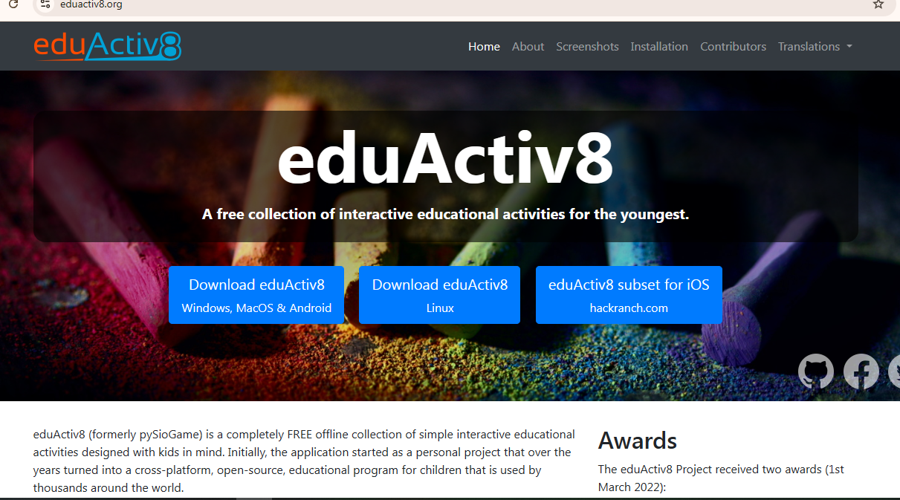

Slide 16
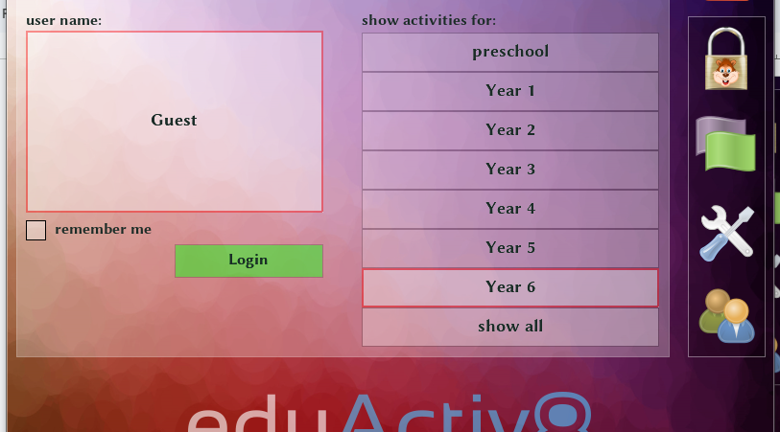

Slide 17
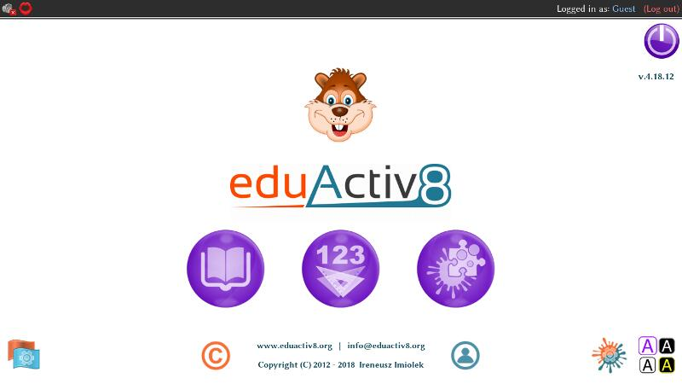

Slide 18

Why Teachers Should Use eduActiv8
Interactive Learning
Cross-Disciplinary Content
Customizable Content
Offline Access
Multilingual Support
Safe and Ad-Free

Slide 19


Why Parents Should Use eduActiv8?
Supports At-Home Learning
Fun + Learning = Engagement
Safe for Kids
No Login Needed

Slide 20


Conclusion
Powerful, free, and child-friendly
Bridges learning and play
Usable by teachers, parents, and students
Safe, engaging, and accessible
Reinforces academic skills
Offers interactive activities
Offline access and multilingual support
Supports self-paced learning
Fosters curiosity, creativity, and lifelong learning

Slide 21
Thanks!

