Slide 1
Cyber Bullying
Prevention and Response Strategies
Ms. Mohini Arora
HOD, Computer Science
Air Force Golden Jubilee Institute

Slide 2

What is Cyber Bullying?
Use of technology for bullying – takes place over digital devices
Bullying / harassing / victimizing a person online
Willful and Repeated harm
https://tse4.mm.bing.net/th?id=OIP.ls73msJv9DoVK9HvTAmUdAHaHa&pid=Api&P=0&h=180

Slide 3
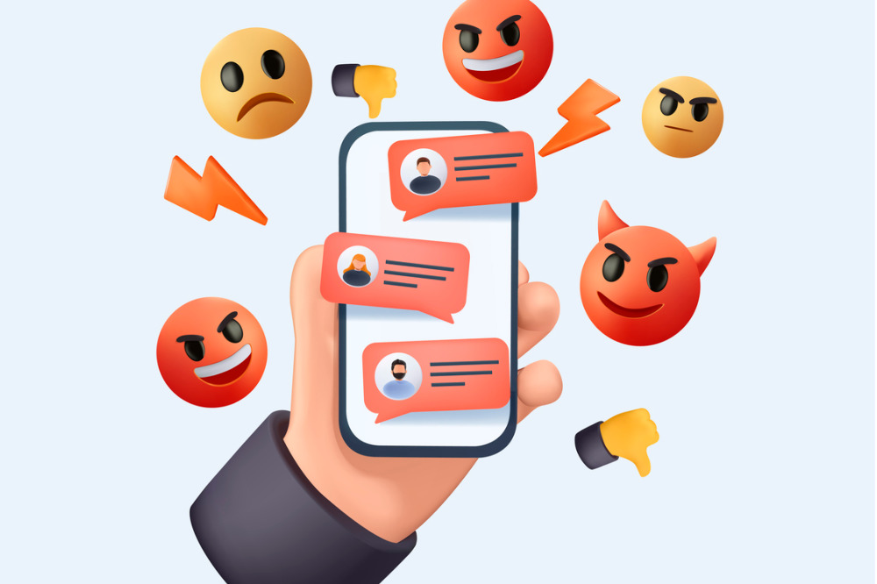
Anyone can become a victim of cyber bullying
Common among students
https://cdn-res.keymedia.com/cms/images/au/130/0417_638278264116880488.jpg

Slide 4
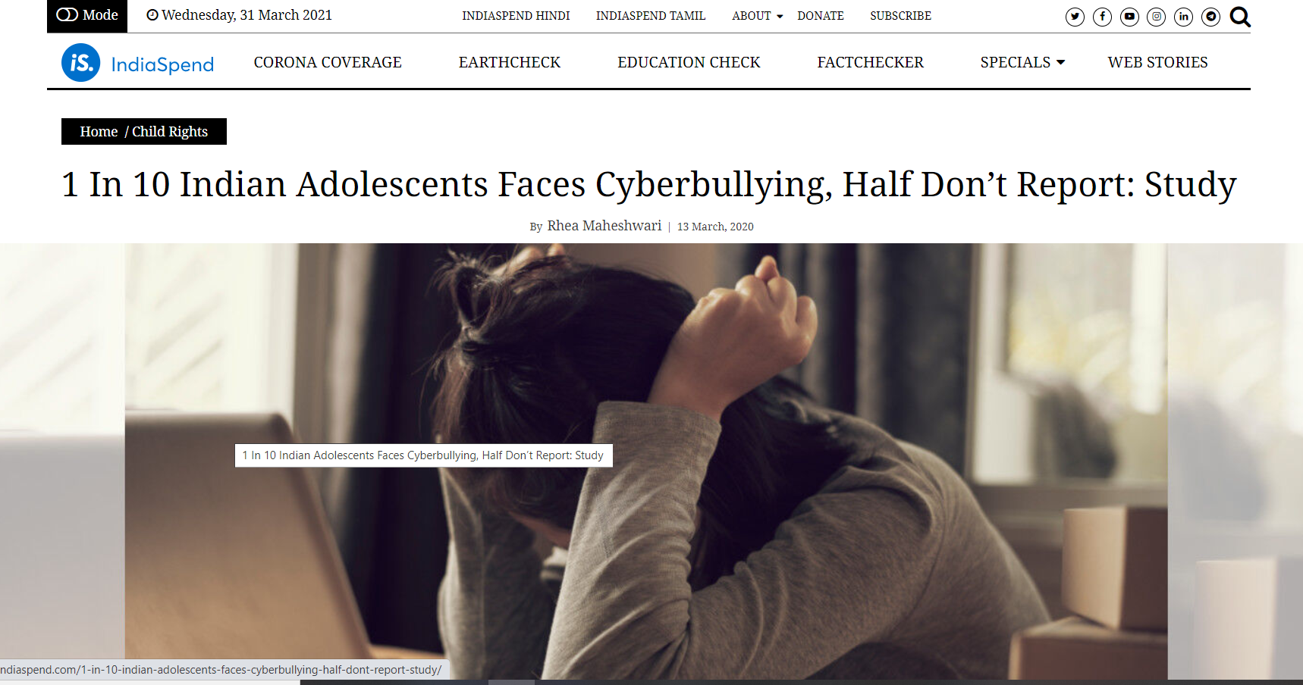
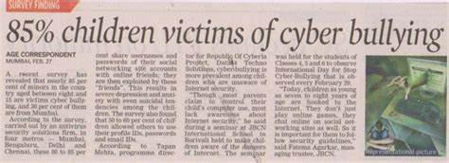

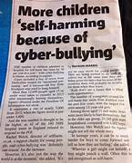
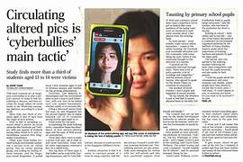
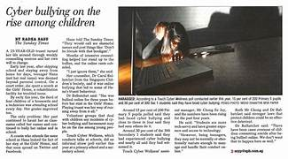

Slide 5
37% of middle and high school students report being victims
15% admit to cyberbullying others

Slide 6
How does it happen?
Text, audio, and video messages on:
  apps
  Social media forums
  Gaming Platforms
where people can view, participate in, and share content.
Always leaves a digital footprint

Slide 7
Potential Targets….
Appearance
Religion/Race
Ethnicity
Sexual orientation
Socio-economic status
Disability
and many more ……………………………

Slide 8
Common Cyber Bullying Activities
Offensive Name Calling
Spreading of False Rumours
Receiving explicit images / abusive remarks
Constantly being asked about their whereabouts
Physical Threats
Explicit images / private information shared without consent
Exclusion
Humiliation and Disrespect
Creating False Social Media Account or user profile just to harass

Slide 9



Why do children bully?
They think its funny and cool
They think no one will find them out
They feel powerful
Revenge after a fight / break up
https://tse4.mm.bing.net/th?id=OIP.nVhgTFHlXb4PAql9fExuUAHaG3&pid=Api&P=0&h=180
https://cdn.imgbin.com/12/19/5/imgbin-emoticon-emoji-smiley-wink-emoji-cvKeevfSTak1tjUixzgE8ZLQx.jpg
https://www.shutterstock.com/image-vector/emoticon-emoji-strong-muscle-bodybuilder-260nw-1615658050.jpg

Slide 10
Potential Effects of Cyber Bullying
Embarrassed and Ashamed
Angry
Low Self Esteem
Anxiety
Isolation
Depression
Loss of Sleep
Violent Behaviour
Academic Difficulties
Skipping School
Feeling guilty about things you did / did not do
Suicidal Ideation or Attempts
Stomach Aches / Head Aches/Nausea
Lack of Sleep
May turn to alcohol or substance use

Slide 11
Signs to look for….
(child as a victim of cyber bullying)
Shy and Withdrawn
Drop in Self Confidence
Moody, Agitated, Anxious
In extreme cases might have suicidal thoughts
Acts more aggressively towards others
Doesn’t want to go to school
Drop in grades
Changes in eating/ sleeping habits
Attempts self-harm
Change in friends group
Isolation
Stops using digital devices

Slide 12
Signs to look for….
(child may be bullying others)
Stops using computer or phone when someone comes near
Looks nervous when online
Secretive about online activity
Spends a lot of time on digital devices, especially during late hours at night
Becomes angry/aggressive when digital devices are taken away

Slide 13
Prevention and Intervention Strategies

Slide 14
The first line of defense against cyberbullying could be YOU

Slide 15
How to Protect Yourself from Cyber Bullying?
(Prevention Strategies)
Hide your personal details
Block the sender of hurtful or nasty messages
React appropriately to hurtful or nasty messages
Never open messages from unknown senders
Save nasty texts, links, images, and emails
Always ask permissions before revealing someone else’s details
Change your password frequently
Never support others’ bullying
Follow netiquettes

Slide 16
If Bullied………What should you do?
LOG Off immediately
Adjust your privacy settings
Think before you post anything
Block the person bullying you to avoid further communication
Save the email and messages and share with a trusted adult
Discuss what happened and how you feel with a trusted adult

Slide 17
The RSB RULE….
REPORT
SAVE
BLOCK

Slide 18
For Parents and Educators
Increase your digital awareness. Have knowledge about the apps trending among the students.
TALK ABOUT:
  Age restrictions, adequate usage, privacy, and good online behaviour
  Friends and followers on social media apps.
  True friends and online friends/followers
  Blocking and reporting bullies.
  what all photos they post. If possible, be their friends/followers
Make them aware that it is very important to have positive digital footprints.
Negative posts do affect their admissions/job prospects.

Slide 19
Tips for Educators/Teachers
If you think a child is being cyberbullied :
  Speak to them privately to ask about it
  They may also have proof on their digital devices.
If you believe a child is being cyberbullied:
  Speak to a parent about it.
  Serve as a facilitator between the child, parent, and the school if necessary.

Slide 20
Tips for Educators/Teachers
Develop activities that encourage self-reflection
  To express what they think and feel
  To be considerate about others’ feelings and emotions
  Learn self-awareness and self-regulation skills
  Learn Digital Citizenship Skills
Be a Role model
Reinforce, and reward positive behavior towards others.
Teach students digital citizenship skills
Encourage peer involvement in prevention strategies.

Slide 21
Tips for Educators/Teachers
Use restorative rather than punitive practices
Monitor the student behaviours and activities
Implement school based cyber bullying prevention programs
  Class / Group Discussions
  Role Plays
  Workshops / Talk by experts
Open communication between school and parents

Slide 22
Tips for Parents……..
Be a supportive parent
Have screen time limits and restrictions on use for the entire family. Involve them in making such rules.
Do NOT take away digital devices without building a trust with the child – it will look like a punitive action
Talk to the child and help them think through the situation – work towards the solution together
Involve the child in problem solving – it will help build resilience in the child

Slide 23
Tips for Parents……..
Know the RSB rule – REPORT, SAVE, BLOCK
Report the site online
Adjust settings to avoid the bully from the victim
Report to Cyber Police / (www.cybercrime.gov.in ) if cyberbullying involves messages that involve violence, stalking , sending explicit messages/photos

Slide 24
Challenges in Preventing
Cyber Bullying
Keeping up with technological advances
Not able to maintain balance between privacy and protection
Underreporting –
This can be overcome by:
  Reducing stigma
  Ensuring Confidentiality
  Providing Support

Slide 25
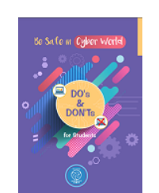
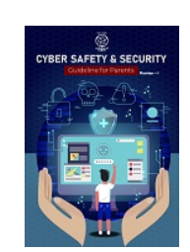


Online Anti Bullying Tools
Educational Tools and guidance for children and parents
Examples
    Facebook’s Bullying Prevention Hub
    Instagram’s Safety Page
    Meta’s Family Centre
    Learning corner on National Crime Reporting Portal (https://cybercrime.gov.in )
    Resources on Cyber Safety and Security by NCERT

Slide 26
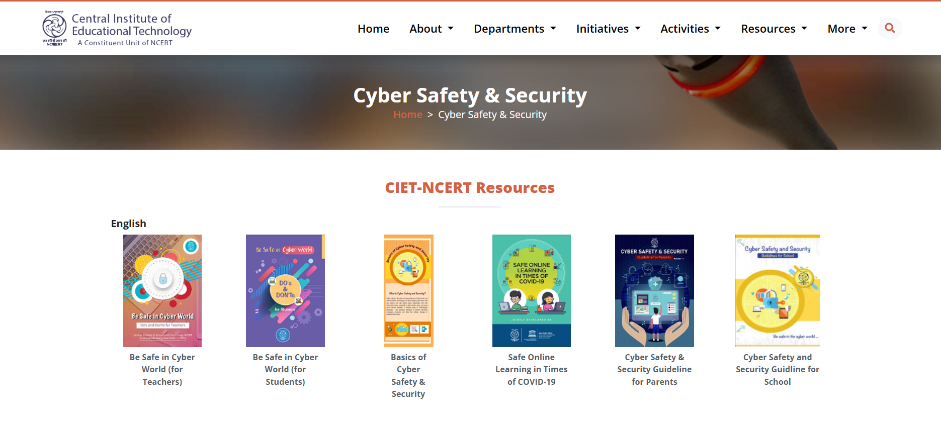

Slide 27
Thank You

