Slide 1





Google AI Experiments: Unleashing the Power of AI in Education
Inspiring Students and Empowering Educators
By Anni Kumar
National ICT Awardee 2019
HoD Computer Science
Vikas Bharati Public School

Slide 2
Welcome to the World of AI!
What is AI in Simple Terms?
Machines that can learn from data and perform tasks that typically require human intelligence (like problem-solving, understanding language, recognizing patterns).
Why is AI Important Today?
It is transforming industries, shaping our future, and understanding its potential is crucial for navigating the modern world.

Slide 3
Welcome to the World of AI!
Introducing Google AI
A leading force in AI research, dedicated to making AI helpful for everyone.
Google AI Experiments
A platform to explore the possibilities of AI through fun, interactive projects.

Slide 4
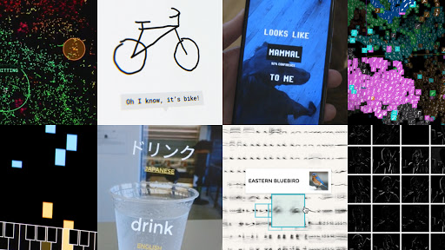
From Playful Beginnings to Educational Powerhouse

Slide 5
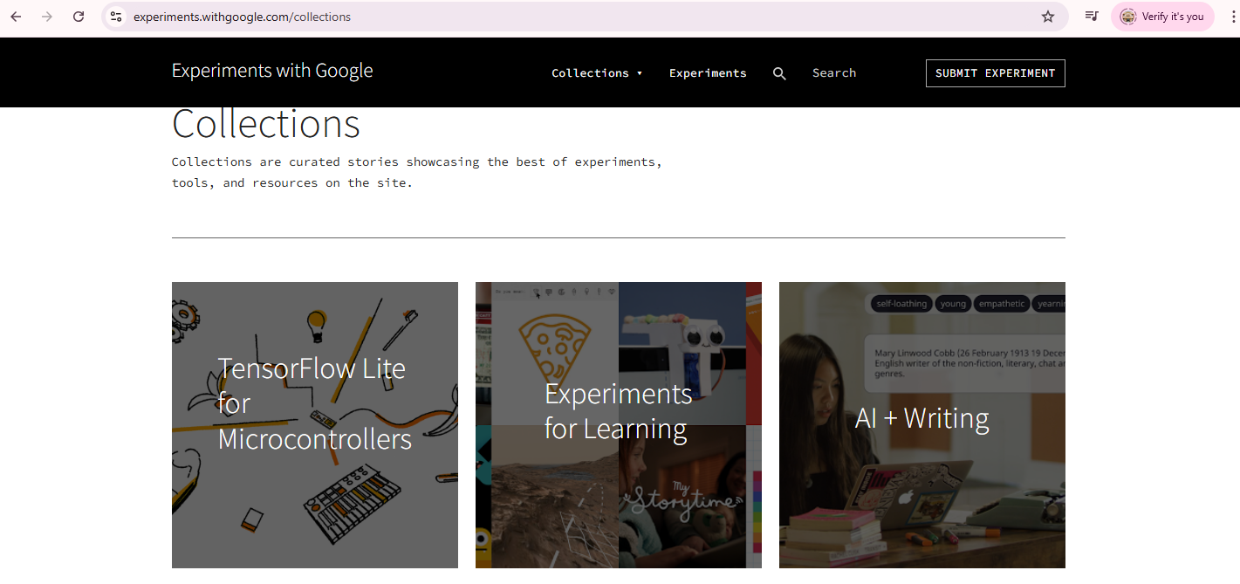
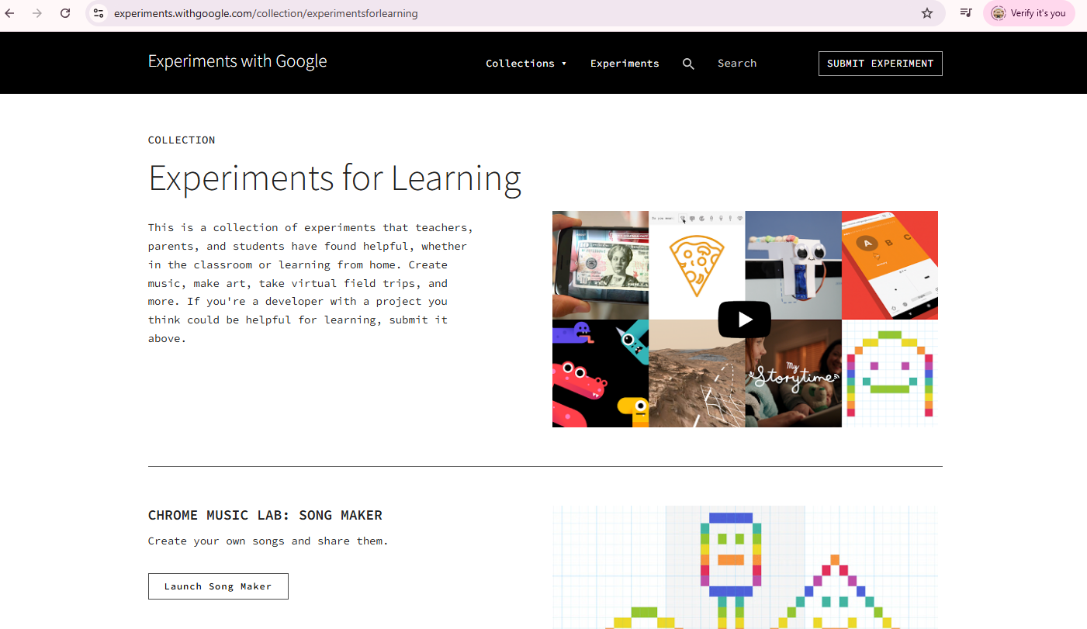
https://experiments.withgoogle.com/collections

Slide 6
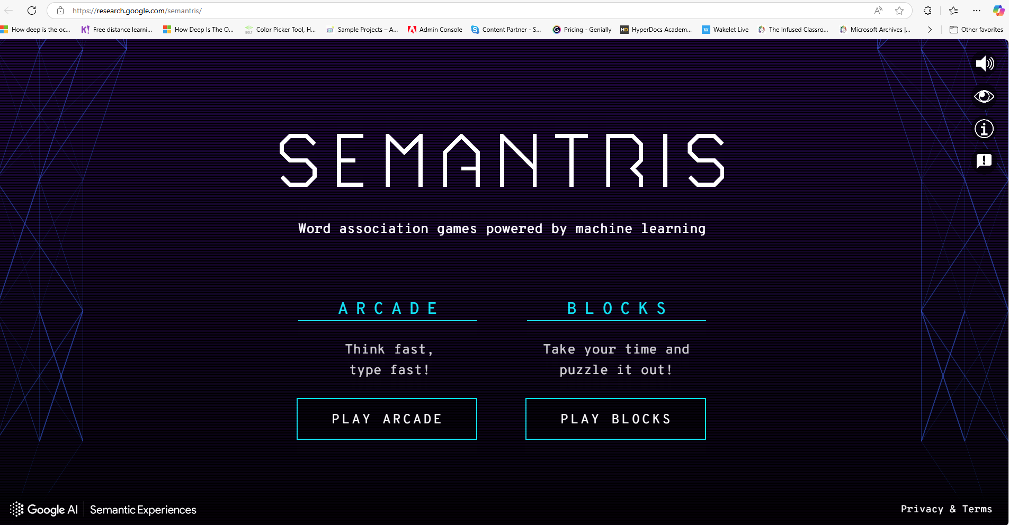
The Word Association Game Powered by AI
Expanding vocabulary and understanding nuances in word meaning.
Developing quick thinking and word association skills.
Reinforcing learning of new concepts in a fun and interactive way.
Improving critical thinking by making connections between words.
https://research.google.com/semantris/

Slide 7
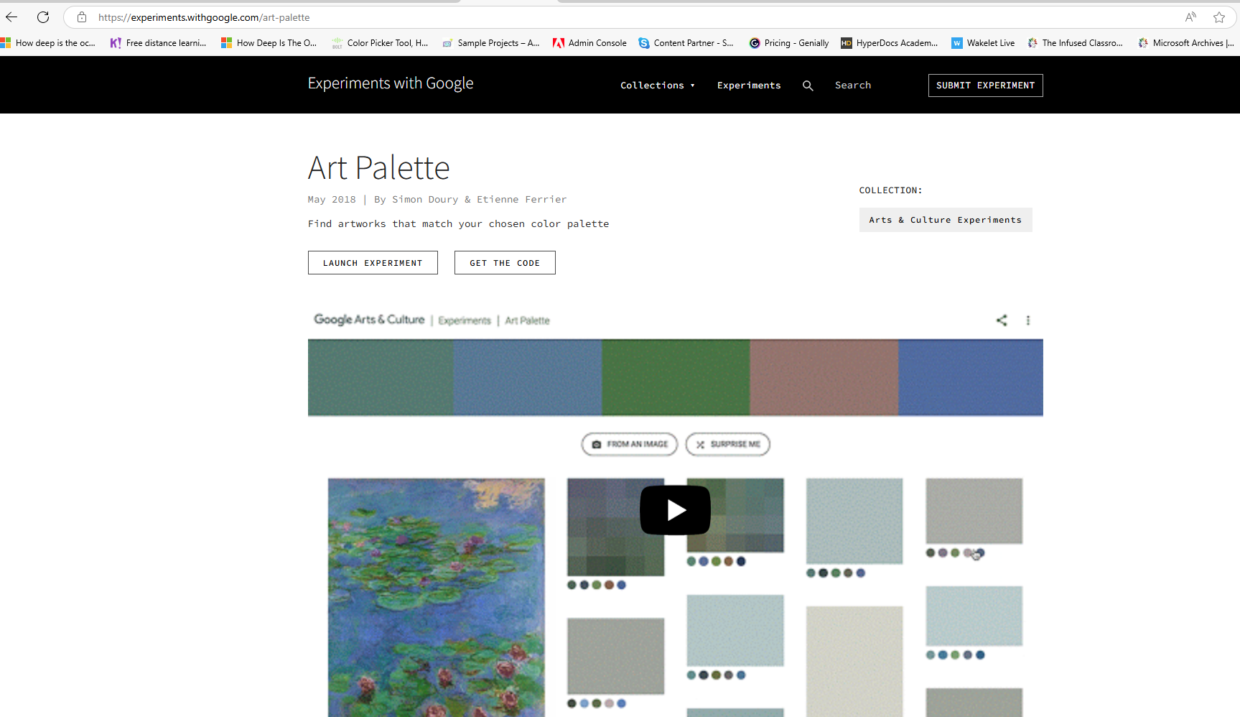
Art Palette: Exploring Art Through Color
Learning about color theory and its application in art.
Exploring art history through a unique visual lens.
Developing visual literacy and appreciation for artistic composition.
Making connections between colors and emotions or themes in art.
https://experiments.withgoogle.com/art-palette

Slide 8
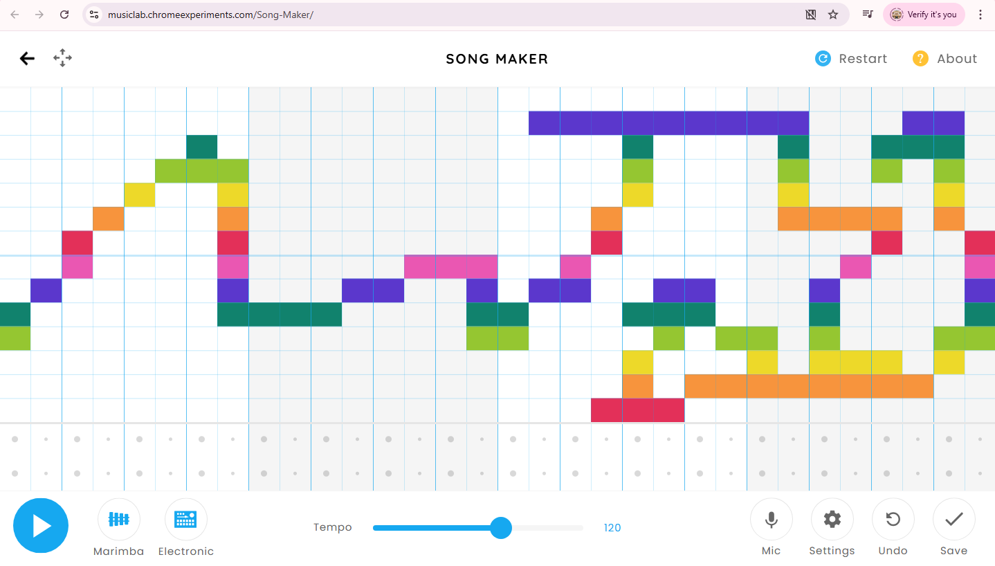
https://musiclab.chromeexperiments.com/Song-Maker/

Slide 9
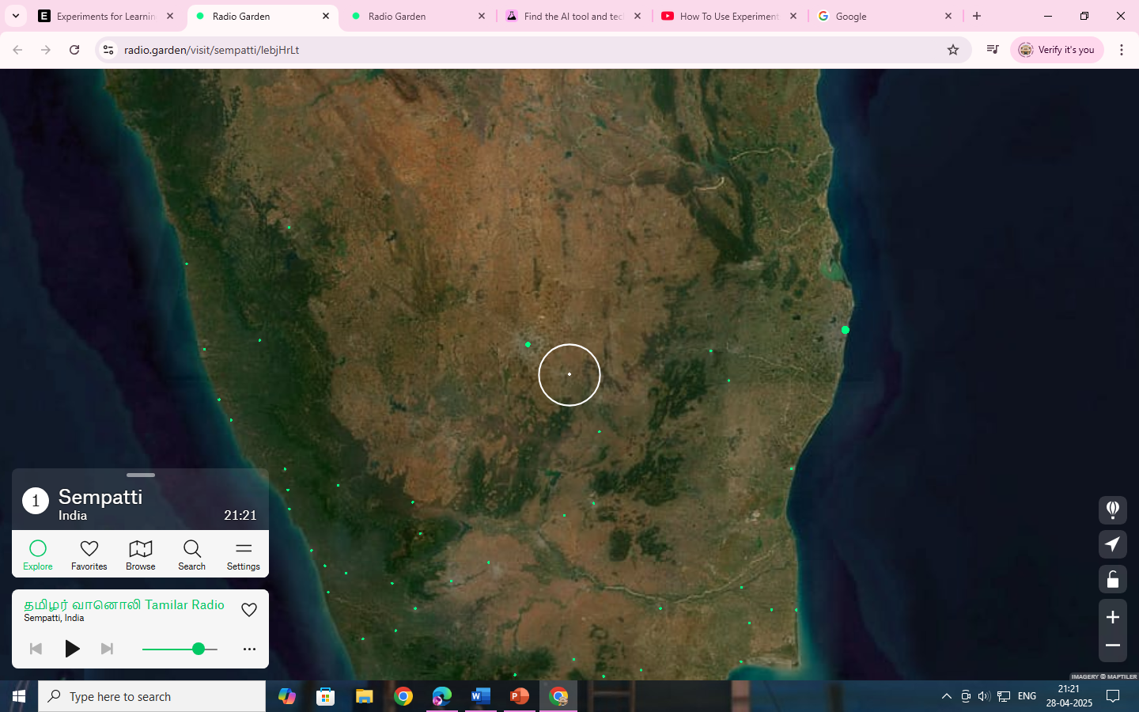
https://radio.garden/visit/sempatti/lebjHrLt

Slide 10
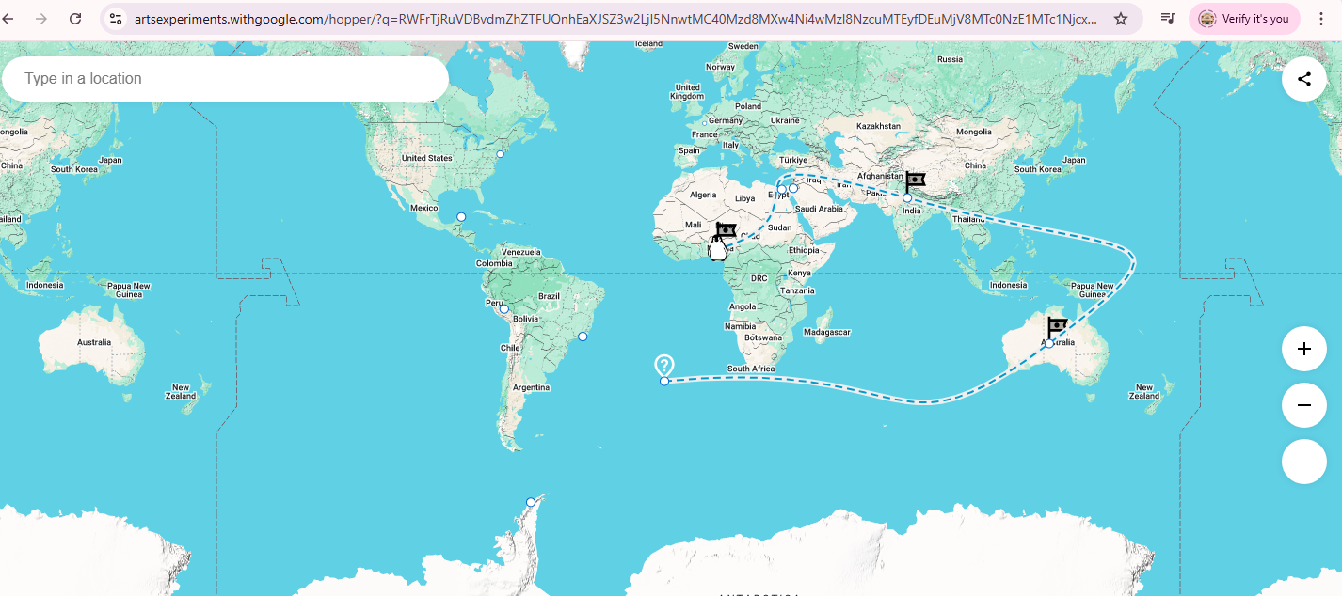
https://artsexperiments.withgoogle.com/hopper

Slide 11
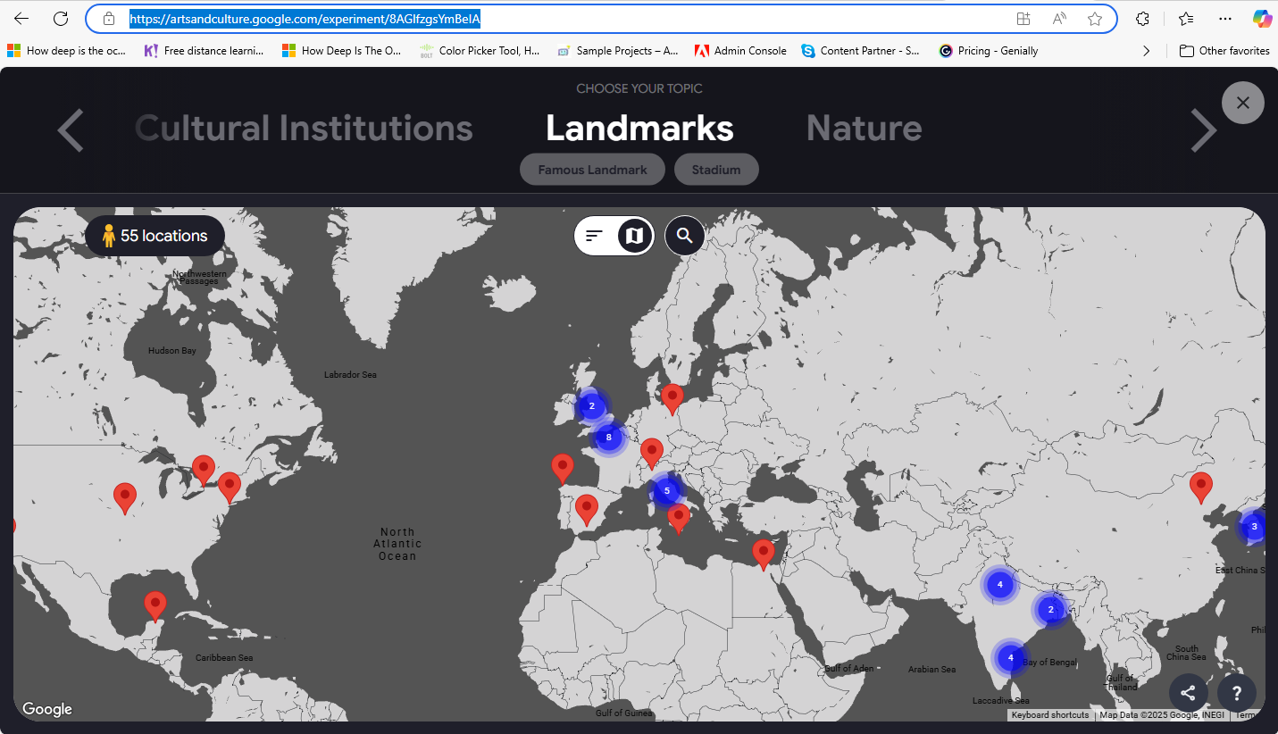
https://artsandculture.google.com/experiment/8AGlfzgsYmBeIA

Slide 12
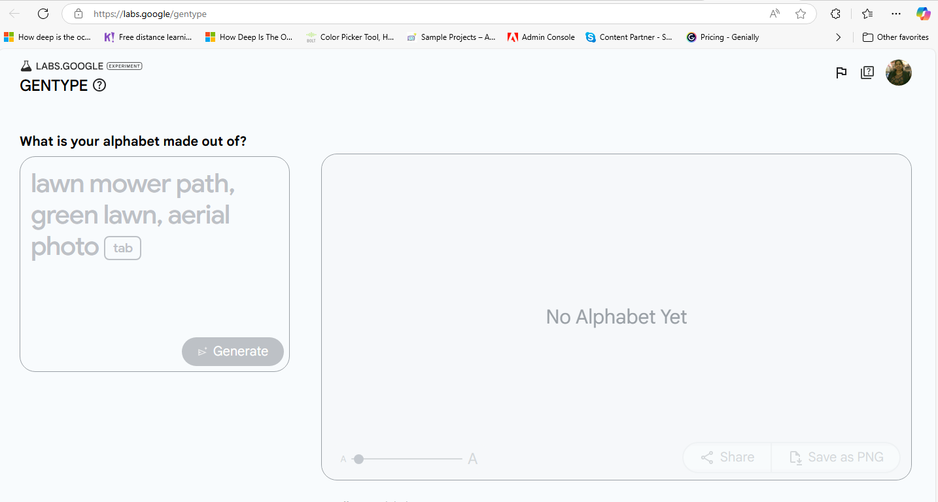
https://labs.google/gentype

Slide 13
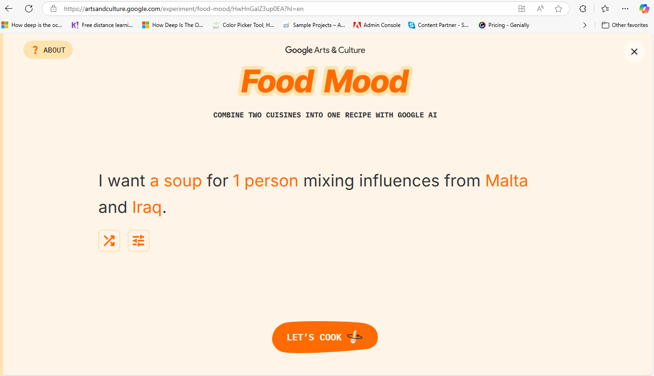
Food Mood — Google Arts & Culture

Slide 14
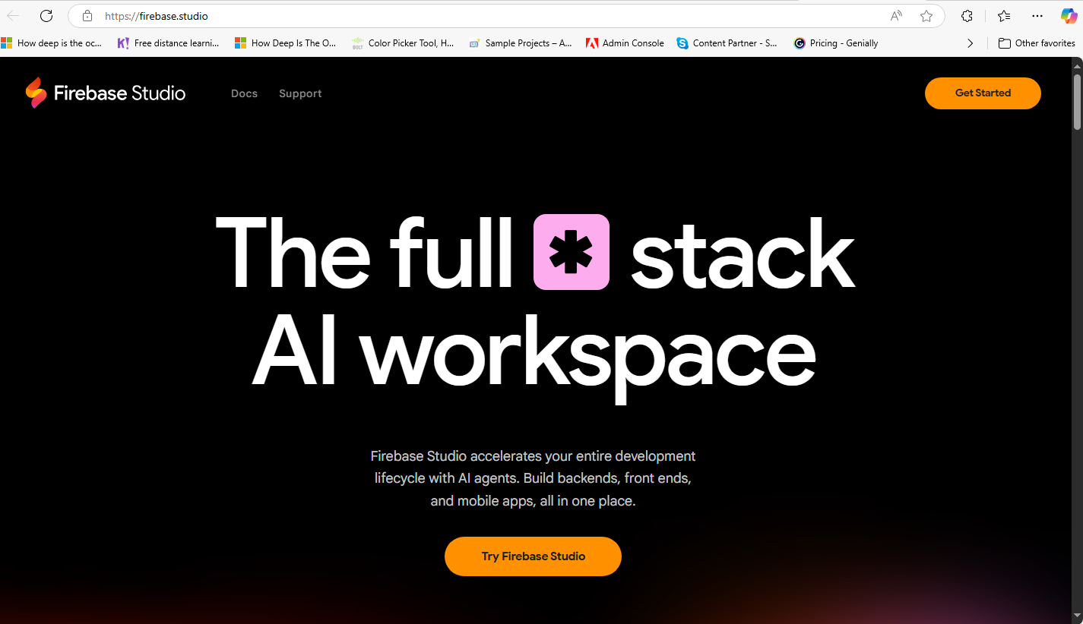
https://firebase.studio/

Slide 15
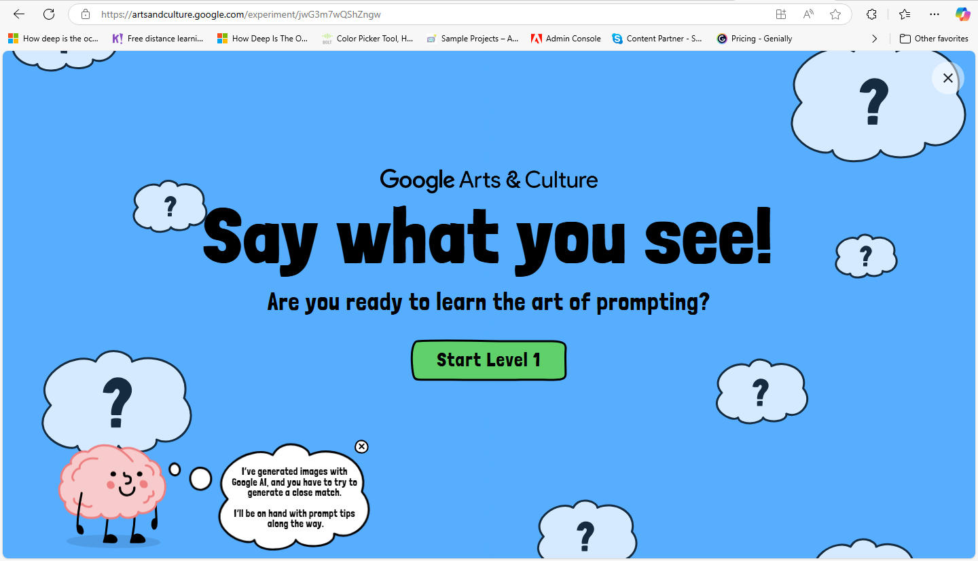
Say What You See — Google Arts & Culture

Slide 16
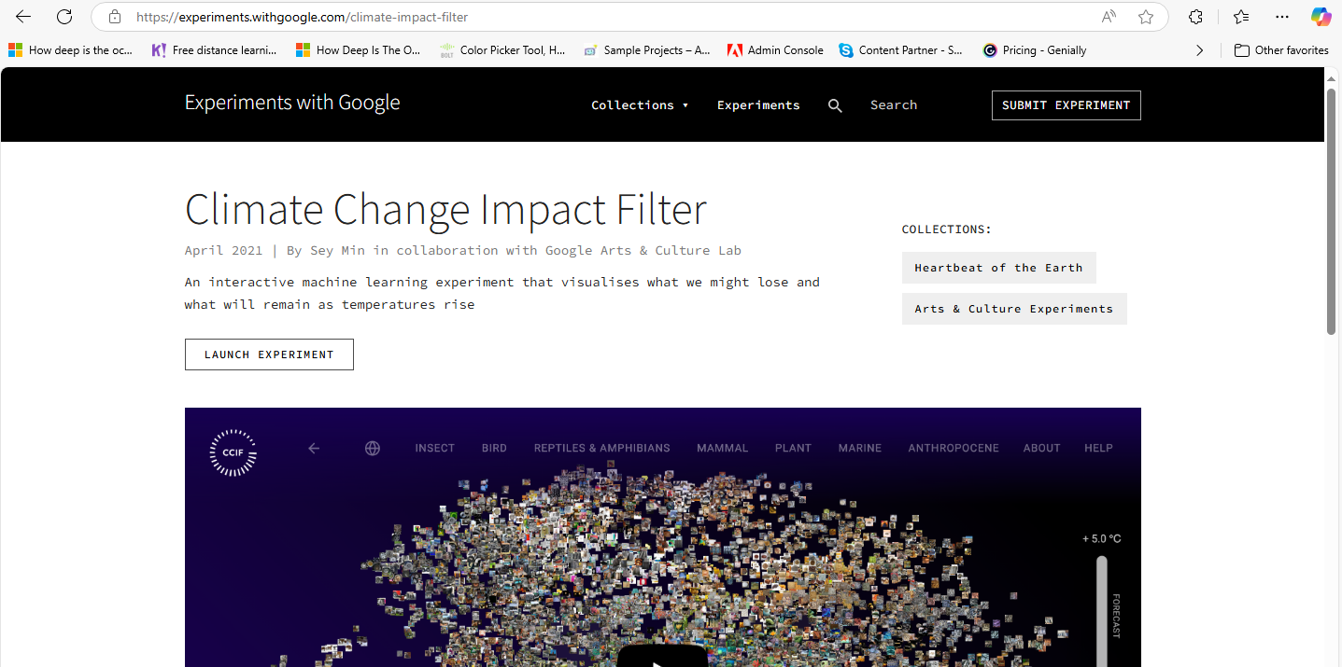
https://experiments.withgoogle.com/climate-impact-filter

Slide 17
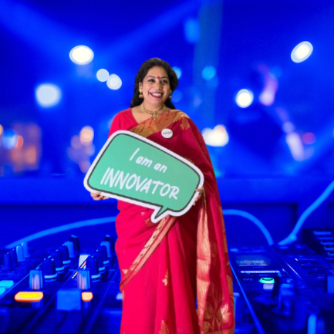

Thank You
https://www.linkedin.com/in/anni-kumar-2131a343/

