Slide 1



Brew Teaching Materials with AI
Welcome to Edcafe AI
Session by:
Dr. Naveen Gupta
National ICT Awardee
Delhi State Best Teacher Awardee

Slide 2


Brew teaching materials
with AI.
Edcafe AI is an AI toolkit designed for educators to generate and organize quality instructional and learning content using AI.

Slide 3

Only the best solutions
for the best teachers.
Advanced tools educators need, done better than any other AI.
Upload your knowledge to create tailored, AI-driven content.
Smart AI for interactive content with AI feedback and insights.
A Google Drive-like library for creating, sharing, and managing AI resources.

Slide 4
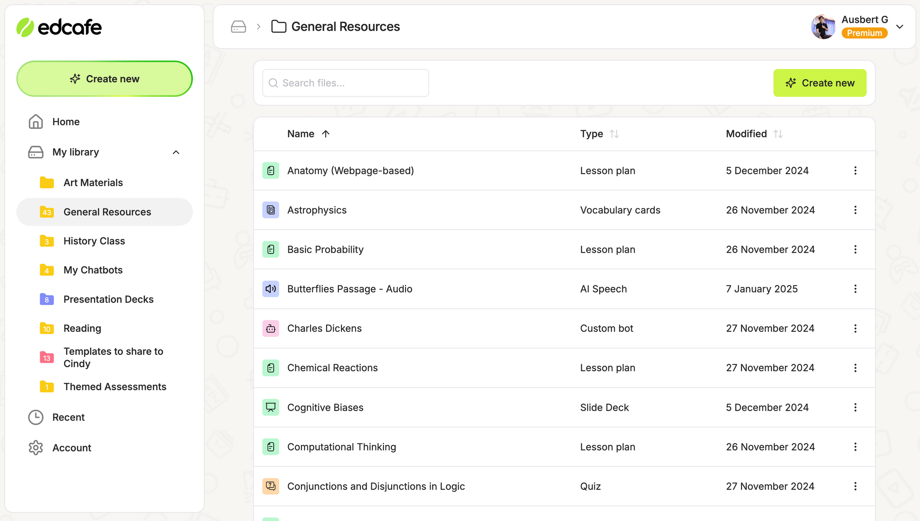
Create and organize AI content.

Slide 5









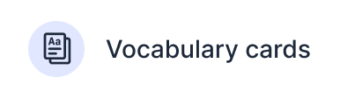





Planning
Quiz
Teaching Materials
Chatbot

Slide 6



Sign up to get started.
Visit
www.edcafe.ai
Sign up
for free
Create your
first content

Slide 7
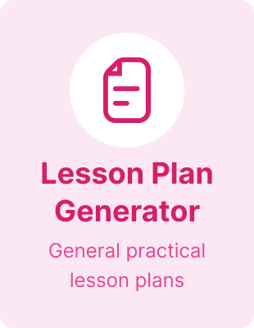
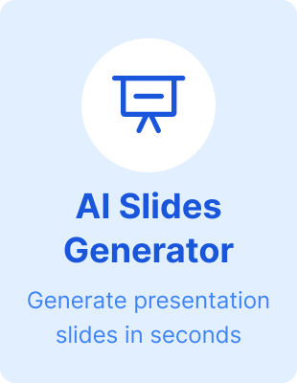

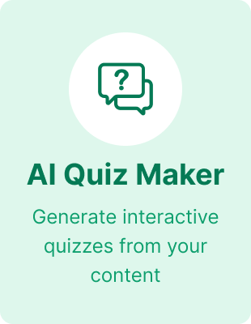
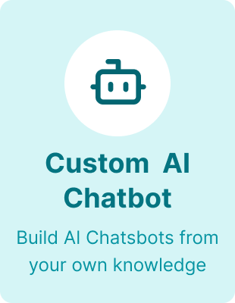
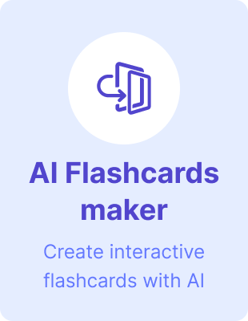


Popular
Features
Assignment Grader
Automatically grade student work

Slide 8
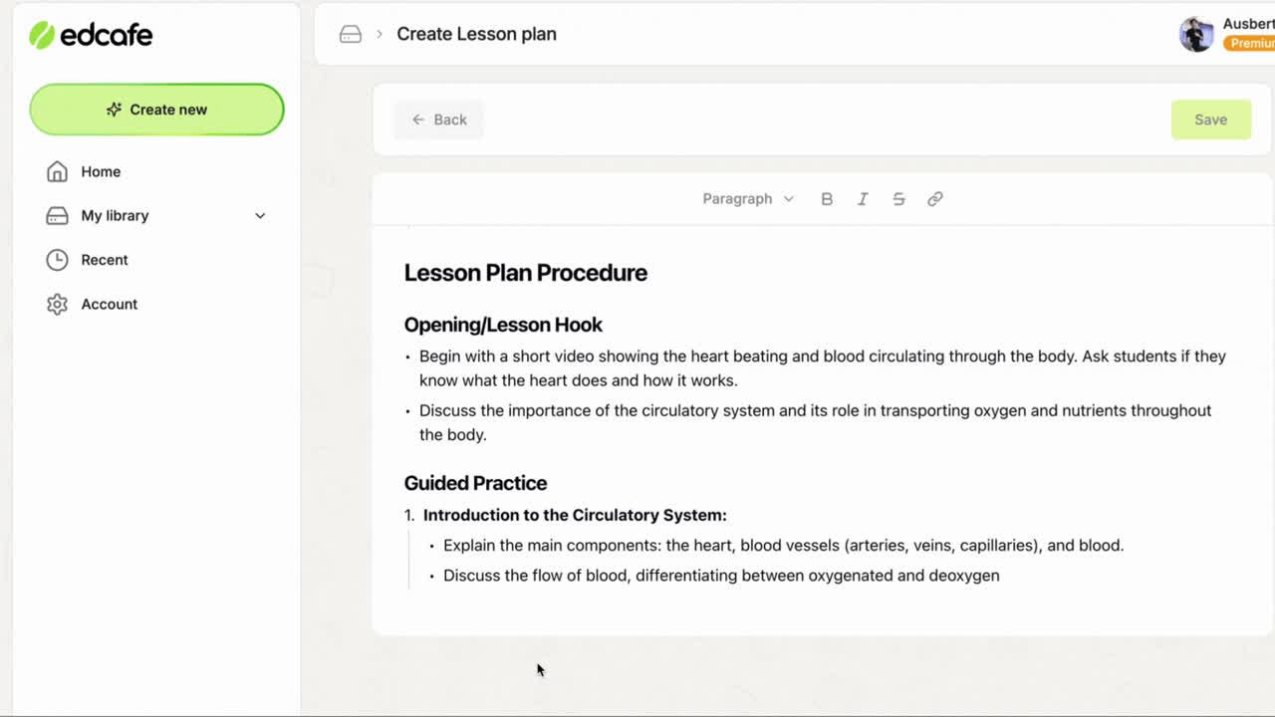
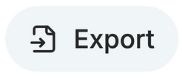


Lesson Plan
Standards-aligned, end-to-end plan in seconds
  Generate from various content sources
  Align with state standards
  Includes lesson hooks, differentiation, and reflection
Microsoft Word
Google Docs

Slide 9
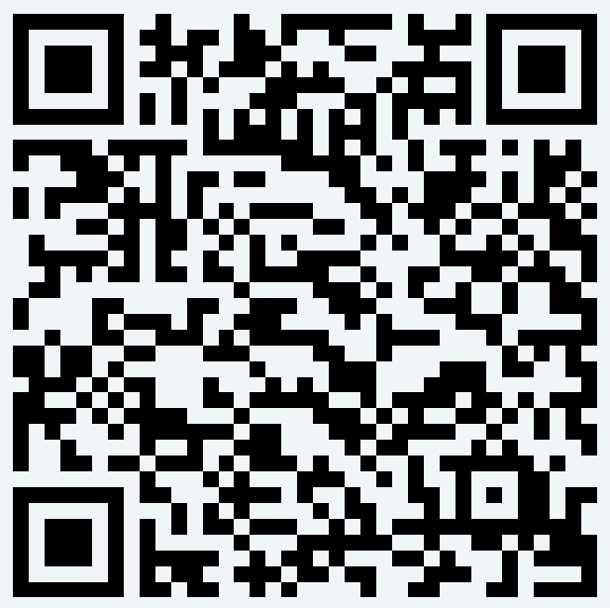
Lesson Plan
Sample Edcafe AI lesson plan
Lesson Plan on Stereotypes and Discrimination
This lesson plan on "Stereotypes and Discrimination" engages students in understanding and identifying stereotypes through interactive activities, including group discussions and role-playing scenarios.

Slide 10

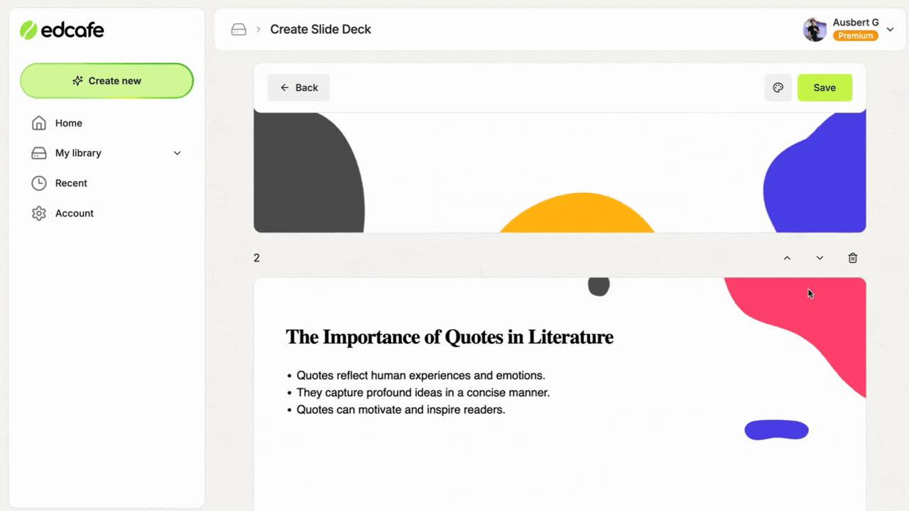


Slide Deck
Generate smart, visual slides
  Choose from different design themes
  Customize slides with images powered by Google
  Smart slide content you can control
Microsoft PowerPoint
Google Docs

Slide 11
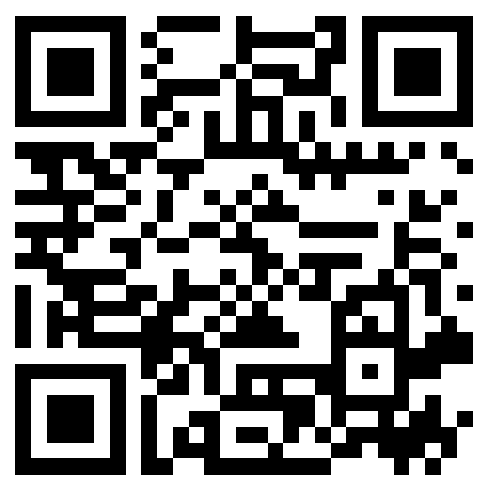
Slide Deck
Edcafe AI-generated slide deck
Slide Deck on World Wonders
Explore the breathtaking Wonders of the World in this vibrant slide deck, where each slide captures the beauty and significance of these remarkable sites. Perfect for inspiring curiosity and appreciation!

Slide 12

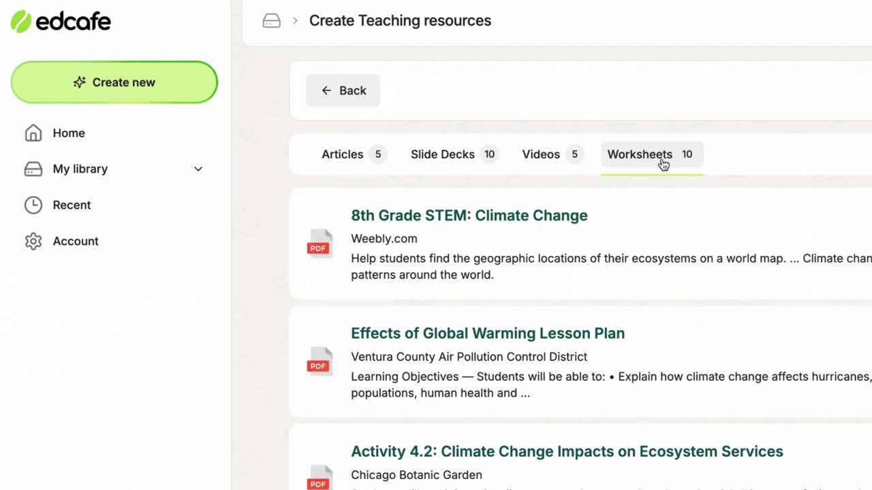
Teaching Resources
Curated, just for you
  Top articles
  Downloadable slide decks
  On-demand YouTube videos
  Printable worksheets

Slide 13
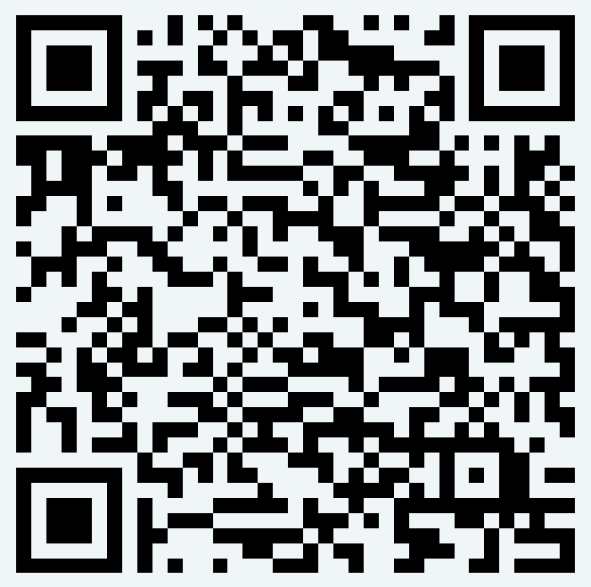
Teaching Resources
Edcafe AI-curated resources
To Kill a Mockingbird Teaching Resources
Explore comprehensive teaching resources on "To Kill a Mockingbird," featuring engaging articles, slide decks, videos, and worksheets to enhance your students' understanding of this classic novel.

Slide 14

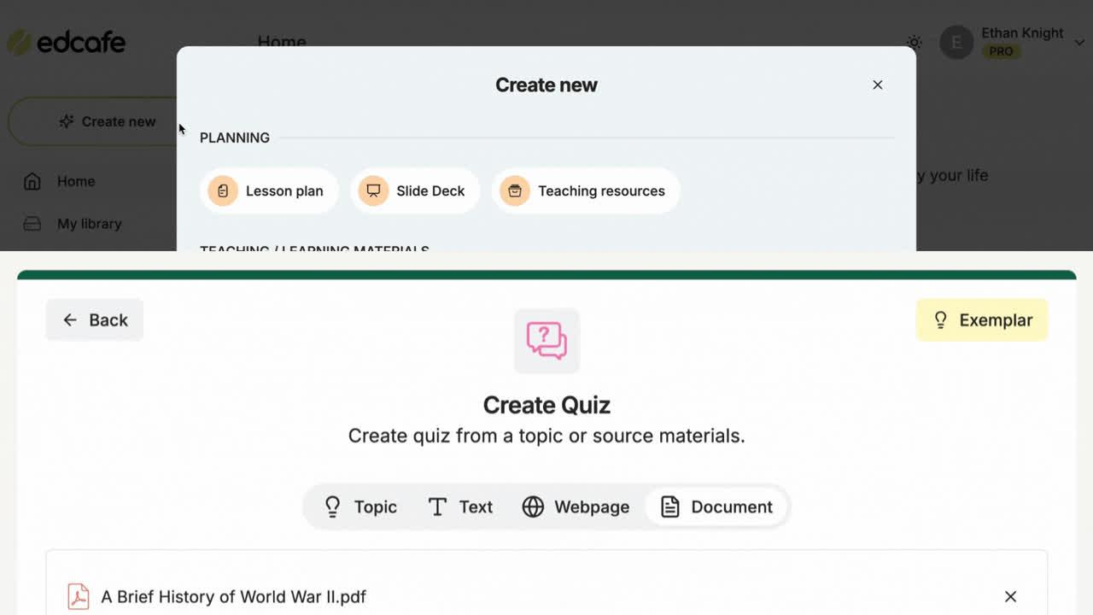

AI Quiz
AI assessments that go beyond text
  Launch your quiz so students can work on them asynchronously
  Personalized student feedback
  Smart activity dashboard
Microsoft Word
Google Docs
Microsoft PowerPoint
Google Docs
PDF

Slide 15
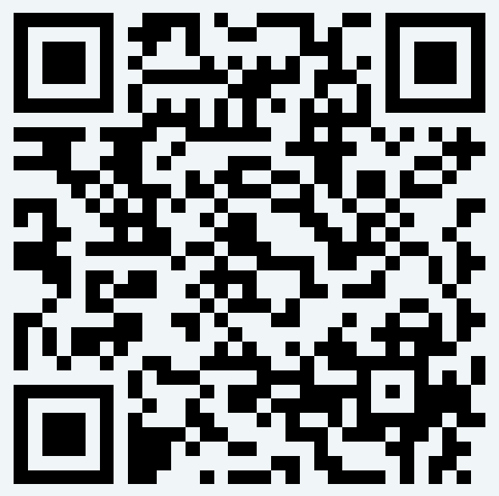
AI Quiz
Edcafe AI-generated quiz
Quiz on Major Art Movements
Test your knowledge of Major Art Movements with this engaging quiz designed for Grade 8 students. Explore various artistic styles and their historical significance while having fun!

Slide 16
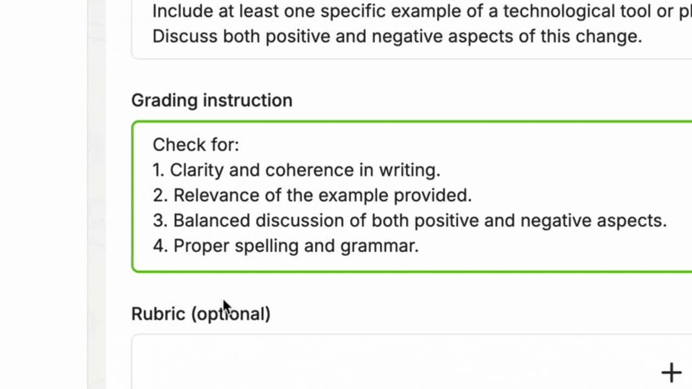
Assignment Grader
Create auto-graded assigments
  Auto-grade assignments
  Attach a rubric to guide AI grading
  Students get instant, full personalized feedback
  Smart submission dashboard to manage assignments

Slide 17
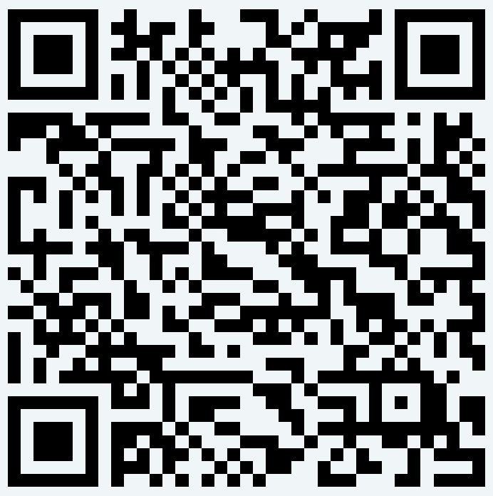
Assignment Grader
Sample auto-graded assignment
Technology Assignment
This Assignment Grader evaluates essays discussing the impact of technology on education, focusing on clarity, relevance of examples, balanced discussions, and adherence to grammar standards.

Slide 18

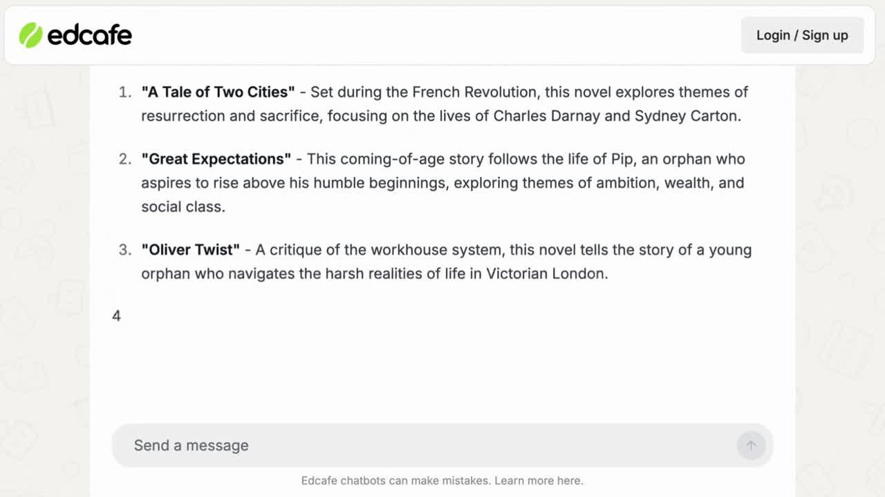
Custom Chatbot
Automate any persona
  Feed the chatbot your own knowledge
  Personalize chatbot behavior
  Launch the chatbot so students can directly interact with it

Slide 19
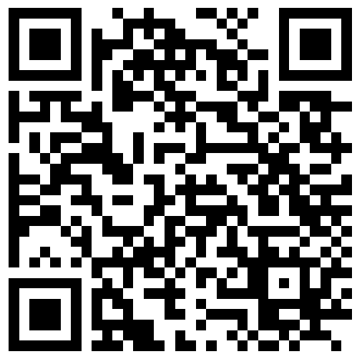
Custom Chatbot
Edcafe AI-generated chatbot
Charles Dickens Chatbot
This interactive bot serves as a virtual guide to the life, works, and legacy of the renowned Victorian novelist. It offers detailed analyses, answers questions, and engages literature enthusiasts with fun trivia.

Slide 20
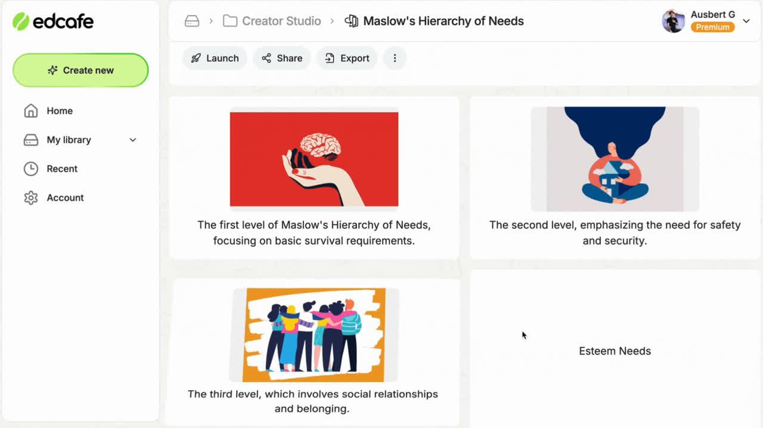
Flashcard Set
Visual, audio-supported flashcards
  Add images
  Assign flashcards so students can study at their own pace
  Enable text-to-audio for AI read alouds
Microsoft Word
Google Docs
Microsoft PowerPoint
Google Docs
PDF

Slide 21
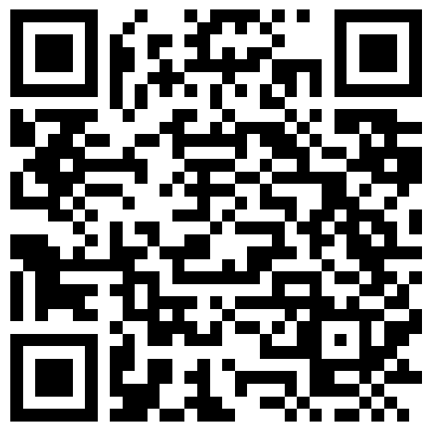
Flashcard Set
Edcafe AI-generated flashcards
Flashcards on World Civilizations
This Flashcard Set explores the historical significance of major world civilizations, providing insights into their impact and contributions. Perfect for students and history enthusiasts alike.

Slide 22




Our Commitment to Security & Compliance.
Edcafe AI is fully compliant with SOC 2, GDPR, FERPA, COPPA, ensuring that your information is protected with the highest industry standards. You can trust us to safeguard your data while delivering a seamless and secure experience.
Visit the Trust Center

Slide 23









Brew Teaching Materials with AI
www.edcafe.ai

