Slide 1
Cyber Safety and Security
A Step Towards a Happy and Prosperous Digital Life

Slide 2
Life
Personal Identity
Relationships
Health
Social and cultural belonging
Safety and Security
Sense of self and others

Slide 3
Cyber Life = Our experiences+ identities+ interactions in the connected, online world
Life
Personal Identity
Relationships
Health
Emotions
Sense of self and others
Cyber Life
Profiles/
Display Pictures
Followers/
Communities
Screen Time/
Addiction/ Posture
Emotions
Likes/Filters/
Echo chambers
Safety and Security

Slide 4
Life
Personal Identity
Relationships
Health
Emotions
Sense of self and others
Cyber Life
Profiles/
Display Pictures
Followers/
Communities
Screen Time/
Addiction/ Posture
Emotions
Likes/Filters/
Echo chambers
Safety and Security

Slide 5
Life
Personal Identity
Relationships
Health
Emotions
Sense of self and others
Cyber Life
Profiles/
Display Pictures
Followers/
Communities
Screen Time/
Addiction/ Posture
Emotions
Likes/Filters/
Echo chambers
Safety and Security

Slide 6
Life
Personal Identity
Relationships
Health
Emotions
Sense of self and others
Cyber Life
Profiles/
Display Pictures
Followers/
Communities
Screen Time/
Addiction/ Posture
Emotions
Likes/Filters/
Echo chambers
Safety and Security

Slide 7
Life
Personal Identity
Relationships
Health
Emotions
Sense of self and others
Cyber Life
Profiles/
Display Pictures
Followers/
Communities
Screen Time/
Addiction/ Posture
Emotions
Likes/Filters/
Echo chambers
Safety and Security

Slide 8
Life
Personal Identity
Relationships
Health
Emotions
Sense of self and others
Cyber Life
Profiles/
Display Pictures
Followers/
Communities
Screen Time/
Addiction/ Posture
Social Engineering/ Ai Scams
Likes/Filters/
Echo chambers
Safety and Security

Slide 9
Life
Personal Identity
Relationships
Health
Emotions
Sense of self and others
Cyber Life
Profiles/
Display Pictures
Followers/
Communities
Screen Time/
Addiction/ Posture
Emotions
Likes/Filters/
Echo chambers
Safety and Security

Slide 10
Personal Identity in Cyber World
Username /Password
Biometrics
OTP
Social media profile
Photos/Videos
Location

Slide 11


Personal Identity in Cyber World
Username /Password
Biometrics
OTP
Social media profile
Photos/Videos
Location

Slide 12
Personal Identity in Cyber World
Identity Theft
Username /Password
Biometrics
OTP
Social media profile
Photos/Videos
Location

Slide 13
Identity Theft
🔐 Financial Loss ➤ Bank fraud, unauthorized purchases, loan defaults in your name.
🧾 Legal Trouble ➤ Criminal records or legal actions for things you didn’t do.
💻 Reputation Damage ➤ Harmful posts or messages sent from hacked accounts.
👤 Loss of Access ➤ Locked out of your own accounts, emails, or even devices.
🧠 Emotional Stress ➤ Anxiety, fear, and trust issues — online and offline.

Slide 14
Identity Theft
💳 Protect Financial Data
➤ Use strong, unique passwords for banking apps. Enable two-factor authentication (2FA).
⚖️ Secure Personal Info
➤ Never share Aadhar, PAN, or OTPs via phone or chat. Avoid uploading sensitive documents online.
🔒 Monitor Digital Identity
➤ Regularly check your social media, email, and bank activity for suspicious behaviour.
📱 Use Security Tools
➤ Install antivirus, keep devices updated, and avoid using public Wi-Fi for sensitive transactions.
🧠 Stay Aware & Educated
➤ Think before you click. Be alert to phishing, fake profiles, and “too-good-to-be-true” offers.

Slide 15

Relationships in Cyber World
Type | Examples
🌐 Digital Friendships | Social media connections, gaming pals
💬 Virtual Intimacy | Online dating, digital love
🤝 Professional Bonds | LinkedIn contacts, online mentors
🧠 Parasocial Relationships | Influencers, YouTubers, Celebs
👤 Anonymous Connections | Reddit, forums, alternate avatars

Slide 16
Relationships in Cyber World – Be Mindful
👀 Surveillance & Stalking ➤ Followers can silently track your activities, locations, routines — leading to digital stalking or even offline risk.
🧠 Echo Chambers & Misinformation ➤ Communities can reinforce false beliefs or bias, spreading fake news.
🎯 Cyberbullying & Trolling ➤ Negative comments, or public shaming
🧟 Identity Cloning & Impersonation ➤ Public profiles with lots of followers are often cloned to create fake accounts.
🔗 Unknowingly Sharing Personal Information ➤ Oversharing in ‘friendly’ groups can expose passwords, family details, or habits.

Slide 17
Prevention is better than cure
Search your name periodically to check for fakes. Ask friends to report impersonators. Report cloned accounts quickly — platforms take them down faster with multiple reports.
Use block, mute, and report features aggressively.
Maintain support networks — talk about it with someone you trust.
Document incidents (screenshots) in case legal action is needed.
Encourage positive digital behaviour in your circles.
Avoid sharing family schedules, birthdays, passwords, routines publicly.
Keep private groups truly private — audit who’s inside.

Slide 18
Prevention is better than Cure
Follow diverse sources for news and opinions.
Don't accept friend/follow requests from strangers.
Never share OTP, banking info, or passwords.
When available, enable 2-factor authentication (2FA) for important transactions
Turn off location sharing on social media posts.
Regularly review privacy settings on apps.
Avoid posting real-time updates about your whereabouts.
Use nickname, usernames if possible, and restrict story views to close friends.

Slide 19
Health in Cyber World
🧠 Mental Health Awareness
➤ Access to online therapy, support groups, mindfulness apps
💪 Physical Fitness Tools
➤ Fitness trackers, yoga sessions, health coaching via apps
📚 Health Education
➤ Reliable information, webinars, awareness about diseases
👥 Community & Connection
➤ Support networks for chronic illness, disabilities, etc.

Slide 20
Beware!!
Researches state that :
📉 Rise in Anxiety & Depression: “Use of social media is associated with increased risk of depression, anxiety, and psychological distress.”
Source: Stanford Law – Social Media Addiction Report
🧍Loneliness & Empathy Loss: “Excessive social networking leads to feelings of isolation, reduced face-to-face interaction, and lower empathy.”
Source: Cureus – Systematic Review on Adolescents & Mental Health
👍Like-Based Self-Worth: “Users’ self-esteem is influenced by online feedback; lack of likes causes emotional stress and self-doubt”

Slide 21
Be Mindful
Set daily screen limits with apps like Digital Wellbeing (Android) or Screen Time (iOS).
Schedule “No-Social” zones: no phones at meals, bedtime, or first thing in the morning.
Encourage offline hobbies (sports, arts, journaling) to reduce reliance on digital gratification.
Promote mindfulness practices — meditation, breathing exercises, journaling thoughts.
Prioritize in-person connections: plan meetups, family time, group activities.
Talk openly about mental health and normalize seeking professional help.

Slide 22
Physical Health concerns in Cyber World
Tech Neck – Head bent forward, hunched shoulders while looking down at phone Risk: Neck pain, headaches, spinal strain
Laptop Slouch – Leaning forward toward screen Risk: Lower back pain, poor digestion, fatigue
Phone Cradle – Holding phone between ear and shoulder🦴 Risk: Neck and shoulder stiffness
Wrist Strain / Text Claw – Excessive typing or scrolling Risk: Tendonitis, numbness, finger cramps

Slide 23
Physical Health concerns in Cyber World
🪑 Sit back with your spine supported
💻 Screen at eye level
⌨️ Prioritize ergonomics
⏰ Take a break every 30–45 minutes
🧘‍♀️ Do quick neck, wrist, and shoulder stretches
🌿 Practice "20-20-20 Rule" (every 20 mins, look 20 feet away for 20 seconds)
Notes:
Ergonomic = Designed for comfort, efficiency, and to reduce strain or injury.

Slide 24
Emotions – Social Engineering and AI scams
Emotion | Example | Action
Fear | "Your bank account will be blocked!“ “You are under DIGITAL ARREST” | People panic and share sensitive data without verifying.
Greed | "You’ve won ₹1 lakh—click to claim!" | Too-good-to-be-true offers prompt impulsive clicks.
Trust | Fake emails or DMs pretending to be from a friend, boss, or organization. AI-generated deepfakes or cloned voices make it more convincing. | People panic and share sensitive data without verifying.

Slide 25
Emotions – Social Engineering and AI scams
Emotion | Example | Action
Urgency | “Act now or Lose your OTP access!" | Users are pushed to act emotionally rather than rationally.
Loneliness & Likeability | “I am there for you”. Romance scams or phishing via dating apps tap into emotional vulnerability. | People share personal info due to emotional bonding with strangers.
Sympathy | “This child needs your help”. AI-generated charity scams showing emotional appeals or fake victim videos. | Viewers donate or share data out of sympathy.

Slide 26



Emotions – Practice Cyber Resilience
Think
" Is this message meant to provoke a quick emotional response — like fear or urgency?“
Pause
“Take a deep breath”
Verify
“I have all the right in the world to check a claim”

Slide 27
Cyber Scams that feed on your Emotions
Scam Name | Emotion Targeted | Tactic Used
Digital Arrest Scam | Fear & Authority | Fake calls from "cyber crime officers" alleging illegal activity to extort money.
Romance Scam | Loneliness & Love | Fake online relationships to emotionally manipulate and steal money or data.
Lottery/Fake Prize Scam | Greed & Excitement | “You won ₹1 crore!” messages prompting payment of a "processing fee."
Emergency Scam | Panic & Concern | “Your friend is in trouble—send money now!” impersonating loved ones.

Slide 28
Cyber Scams that feed on your Emotions
Scam Name | Emotion Targeted | Tactic Used
Charity Scam | Guilt & Empathy | Fake causes post-disaster to emotionally exploit people into donating.
Job Offer Scam | Hope & Desperation | Too-good-to-be-true jobs requiring upfront payment or personal data.
Deepfake Blackmail | Shame & Fear | AI-generated explicit videos/images used for extortion.
Social Media Account Hijack | Trust & Urgency | "Urgent help" messages from hacked accounts to emotionally convince contacts.

Slide 29
Stay Updated - Read Newspapers and
Check your bank websites
for regular updates
on
Cyber Safety and security.
You can also visit :
https://www.infosecawareness.in
https://i4c.mha.gov.in/

Slide 30
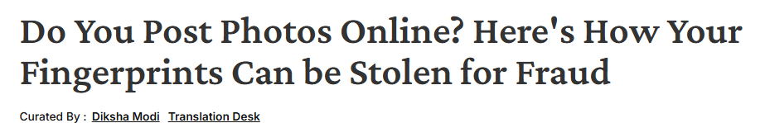
Case Study
can lead to Biometric Identity Theft
Preventive Measures:
Limit Hand Visibility in Photos: Avoid sharing high-resolution photos where fingerprints are clearly visible.
Enhance Biometric Security: Use multi-factor authentication that combines fingerprints with other methods like passwords or facial recognition.
Stay Updated: Be aware of current threats and protect your privacy settings on social media to limit who can view your content.
Source: https://www.news18.com/tech/do-you-post-personal-photos-online-heres-how-your-fingerprints-can-be-stolen-9033343.html

Slide 31
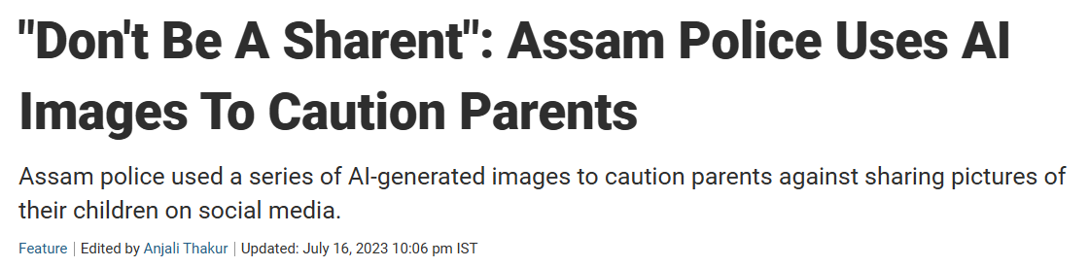
Case study
It can lead to an AI driven Scam
Precautions to Minimize Risks:
Privacy Settings: Ensure strict privacy controls on social media accounts to limit access to shared content.
Selective Sharing: Avoid sharing personal details such as full names, birth dates, or location tags.
Awareness of AI Capabilities: Understand that AI can rapidly analyze and use publicly available data, making it crucial to think before sharing.
Source: https://edition.cnn.com/2024/09/25/health/sharenting-children-social-media-dangers-wellness/index.html

Slide 32
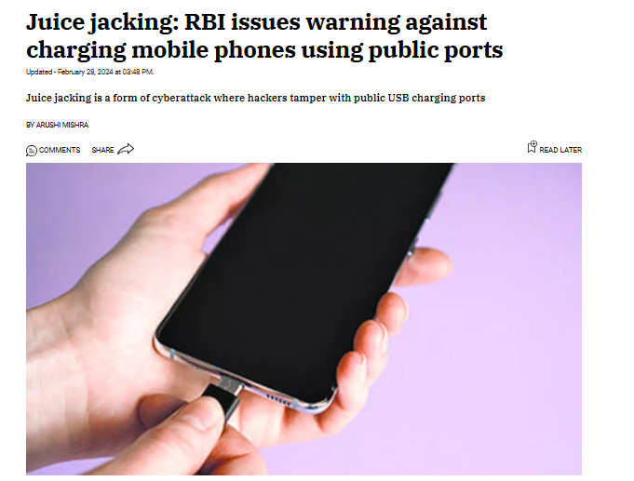
Case study
Preventive Measures for Juice Jacking:
Use Personal Charger or portable power banks
Avoid Public USB Ports
Charge Through Wall Outlets
Disable Data Transfer: Set your device to “Charge Only” mode when plugged in.
Stay Updated: Keep your device's software up-to-date to safeguard against potential vulnerabilities.

Slide 33
Personal Protection
Use strong passwords: At least 8 characters, include letters, numbers & symbols.
Enable 2FA (Two-Factor Authentication) on all major accounts.
Avoid sharing personal info like address, school, or routine publicly.
Log out from public/shared devices.

Slide 34
Safe Browsing
Access only HTTPS websites (🔒 icon in URL bar).
Be cautious with pop-ups and suspicious links.
Don’t download pirated software or unknown files.
Install ad blockers to prevent malvertising.

Slide 35
Social Media Safety
Keep profiles private; limit visibility to friends only.
Don’t accept friend requests from strangers.
Think before you post: Would I say this in public?
Turn off location sharing unless absolutely needed.

Slide 36
Communication Hygiene
Don’t share passwords or OTPs over chats.
Report suspicious emails or messages (phishing).
Verify identities before clicking unknown links or attachments.
Watch for scam calls and fake job offers.

Slide 37
Report
In case of a fraud:
https://cybercrime.gov.in/webform/crmcondi.aspx
Call 1930 –Cyber Crime Helpline
Preserve evidence
Contact local police station in case of an emergency

Slide 38
“The virtual world mirrors our real world — it’s a digital extension of who we are.”
"Cyber safety and security isn’t just about technology — it’s about understanding ourselves and securing our cyber life."

