Slide 1



AI – Powered Presentations
M. Vijayakumar,
(ICT National Awardee)
English Graduate Teacher,
GHSS – Somandargudi.
Kallakurichi district - Tamil Nadu.
28-04-2025, Monday

Slide 2
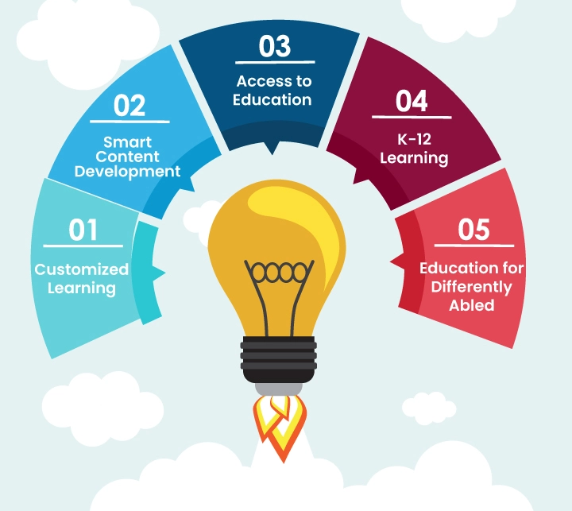
Artificial Intelligence in Education
Customized learning
Smart Content Development
Access to Education
K-12 Learning
Differently abled

Slide 3
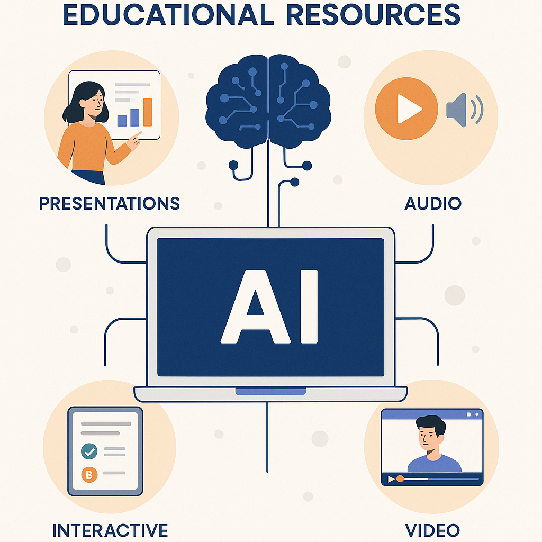

Gen - AI in creating Educational resources

Slide 4
Points to be considered for creating a good presentation
Know your audience
Plan your content (Organize the points : Intro, Main points, Conclusion)
Keep slides simple (Focus on key points and minimize text clutter)
Use Visuals wisely ( Relevant visuals)
Choose clear fonts ( Ensure readability)
Use consistent style (Maintain uniform style, colour and layouts)
Limit transitions and animations)
Highlight important points (Bold / coloured text)
Practice

Slide 5

PRESENTATIONS.AI
Presentations.ai is a cloud-based tool that uses AI to create presentations.
It streamlines the presentation design process by automating tasks like
    generating slides,
    suggesting layouts, and
    crafting content.

Slide 6
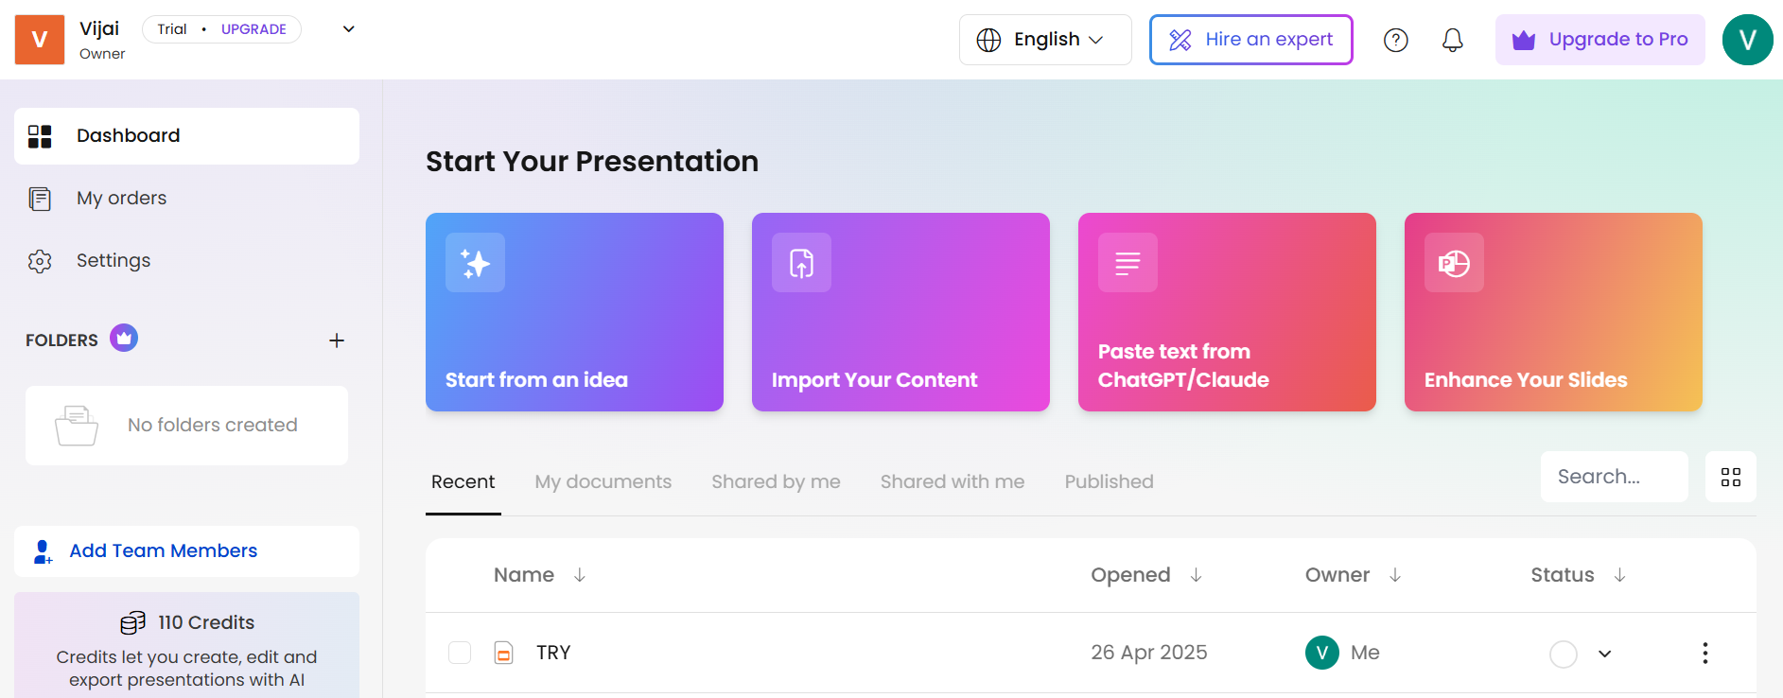

Slide 7
Advantages
Save Time: Traditional slide making can take hours; Presentations.AI does it in minutes.
Easy to Use: No graphic design skills needed.
Professional Look: Consistent colors, fonts, spacing automatically done.
Focus on Content: Spend more energy on your ideas, not on choosing fonts or arranging images.
Collaborative: Share links, get feedback, and work with others easily.

Slide 8
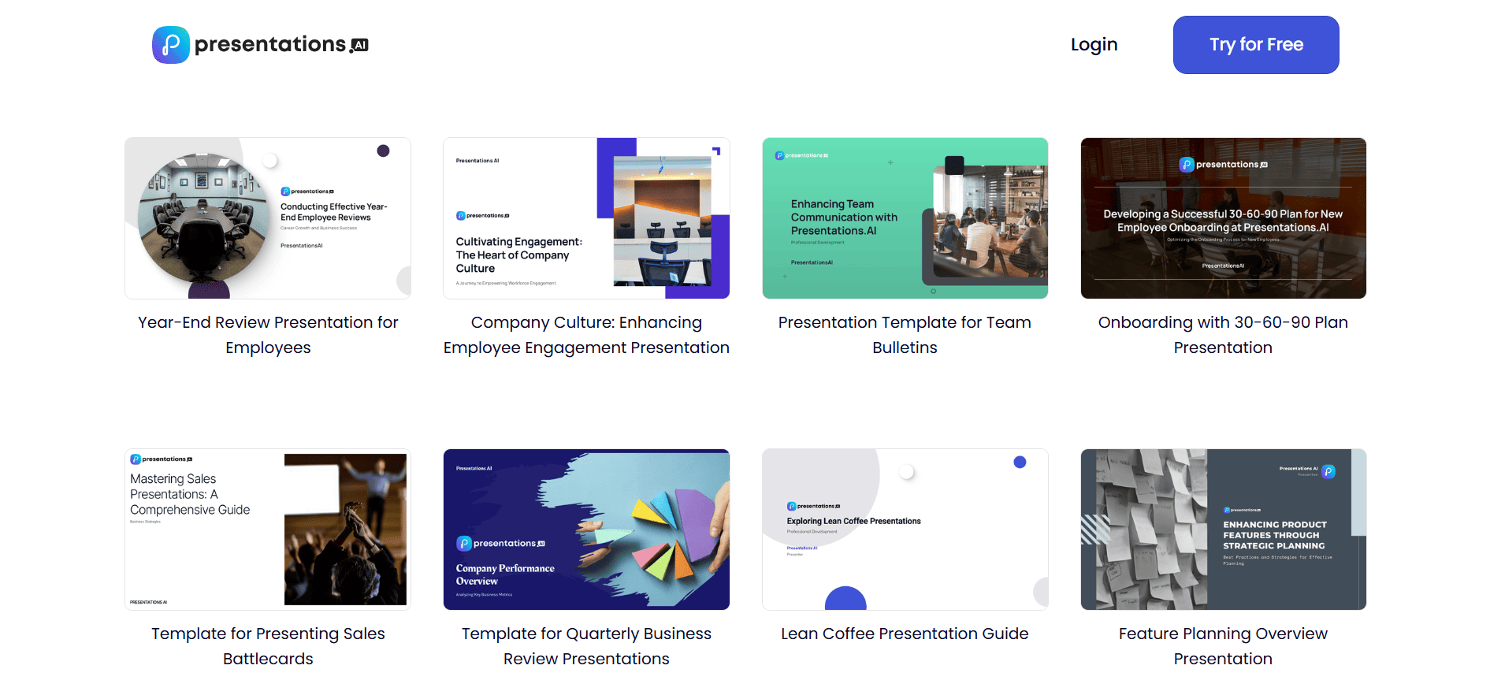
Presentations.ai offers templates that adapt to content changes, ensuring consistency

Slide 9
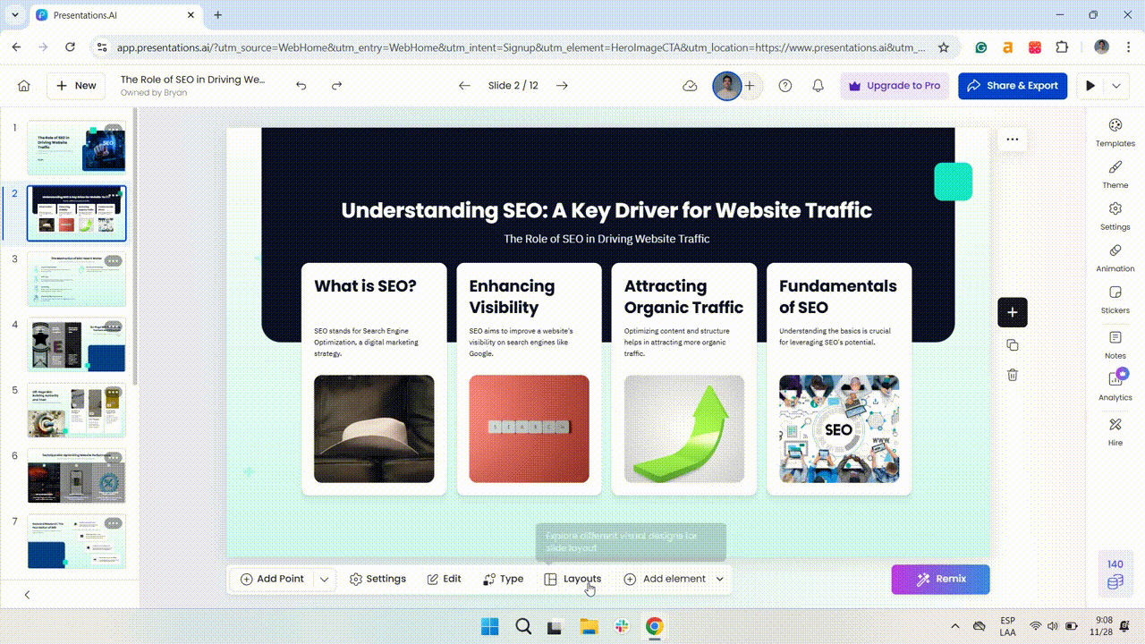
Personalized Design: It offers design recommendations tailored to your content and style. This ensures a polished presentation without the need for advanced design skills.

Slide 10
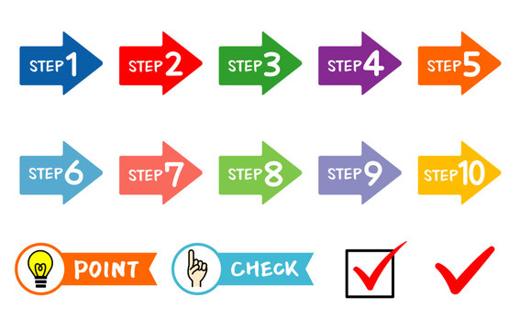
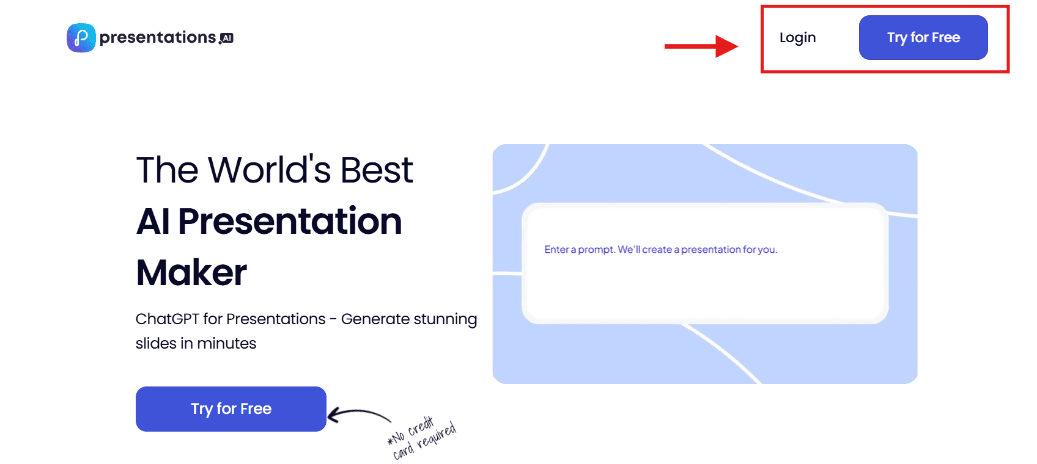
Sign Up or Log In
Go to the Presentations.ai website.
Click "Login" or "Try for Free" to create an account.

Slide 11
Choose a creation method
Go to the "Create a Presentation" section.
Select a creation method from these options.

Slide 12
Start your Presentation:
Choose the “Start with a prompt” option to create a presentation from scratch. Briefly describe the type of presentation. Be specific, be flexible, and include details.
The "Import Your Content" option lets us turn any document, video, or link into a presentation.
If file isn't supported, we can also use the "Paste in Text" option.

Slide 13
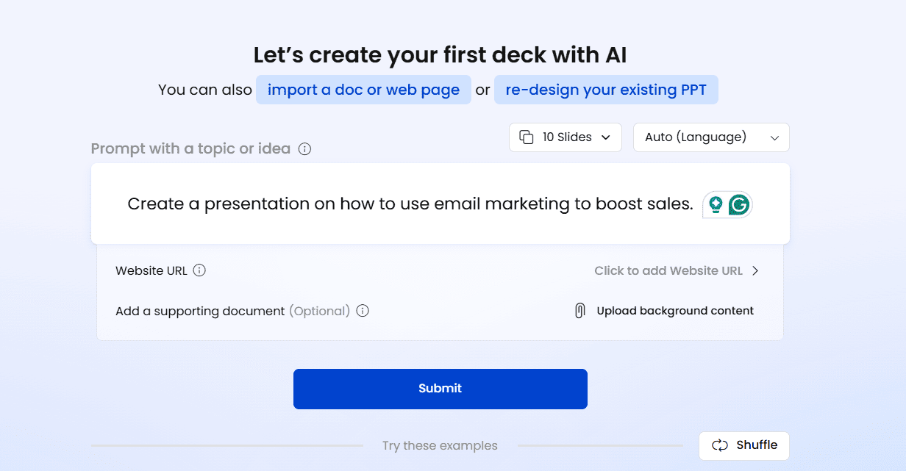

Slide 14
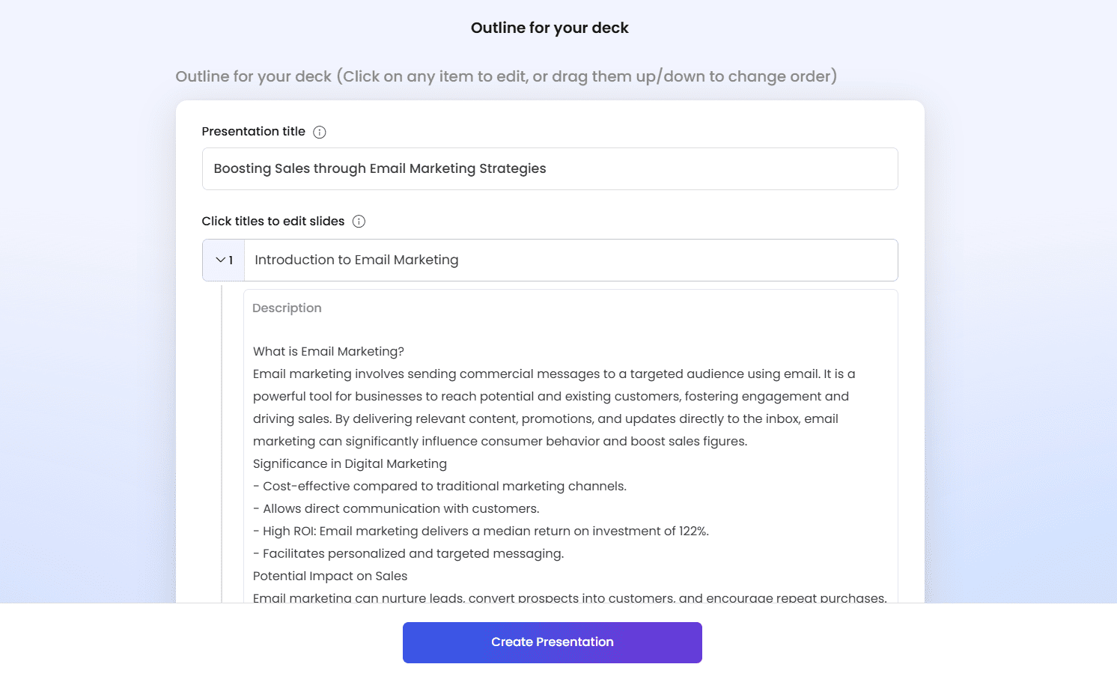
Refine Your Outline
Use the outline editor to refine our input. We can modify the titles, content, brand options, and slide density.

Slide 15
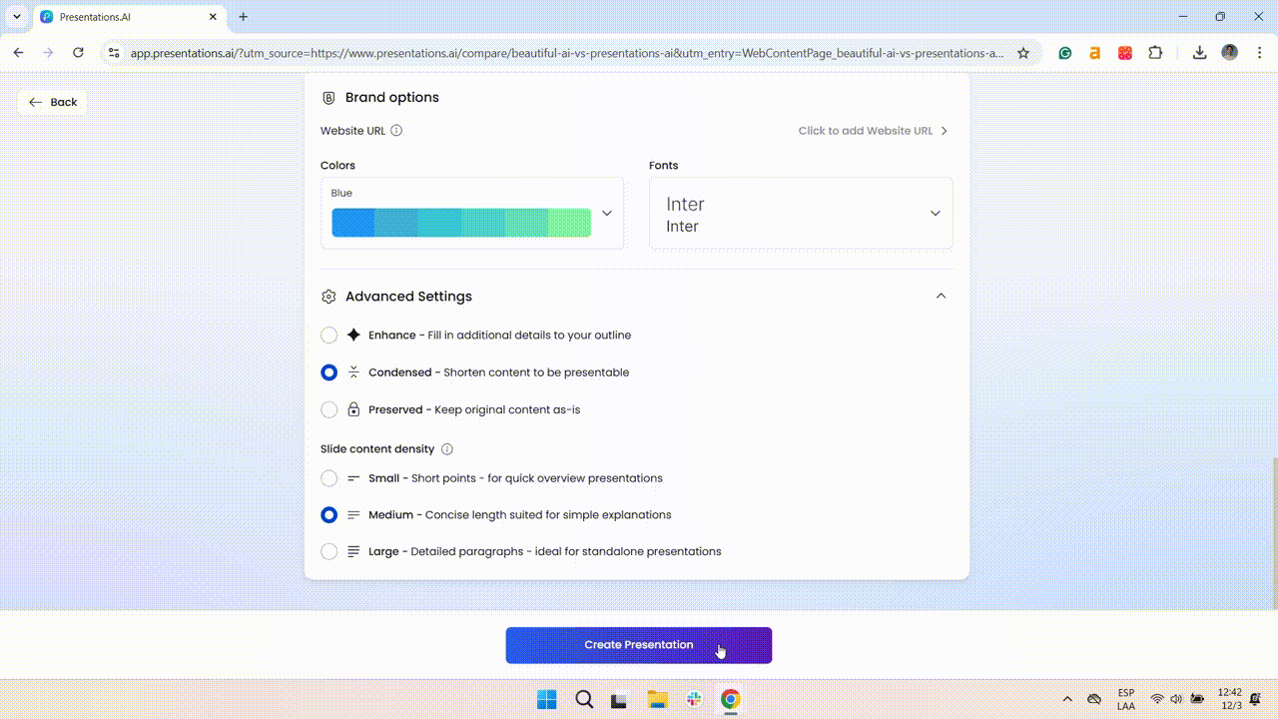
Create Your Presentation
Click the "Create Presentation" icon.
Source: 24slides.com

Slide 16
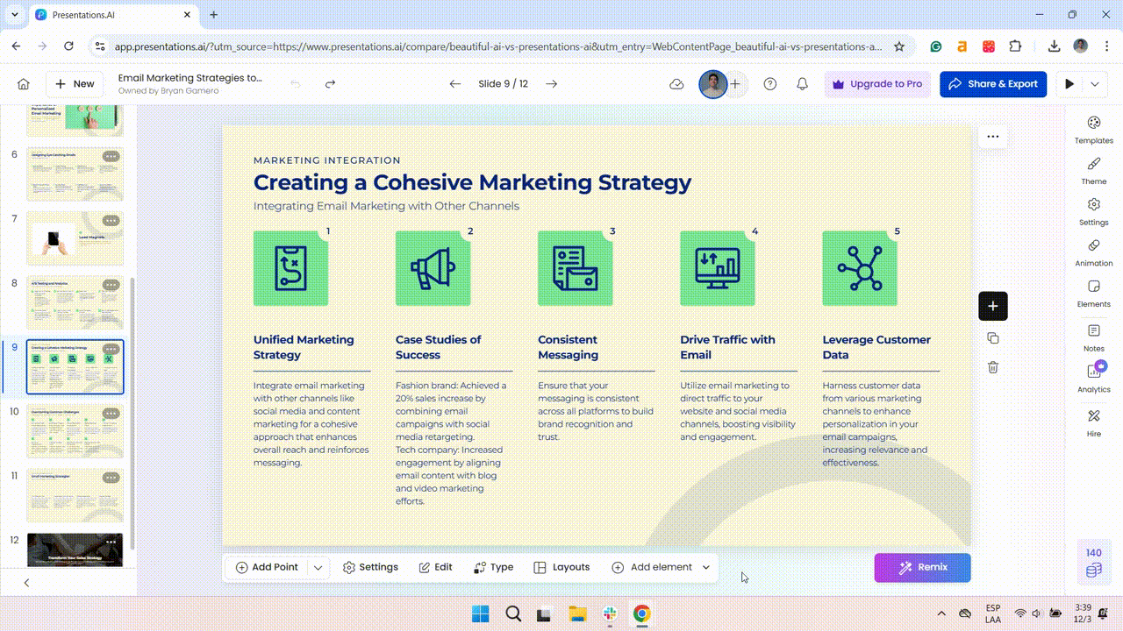
Edit your Presentation
Use editor to customize the content, layout, and design of your slides. To update the overall look, choose a new template from the right-hand toolbar.

Slide 17
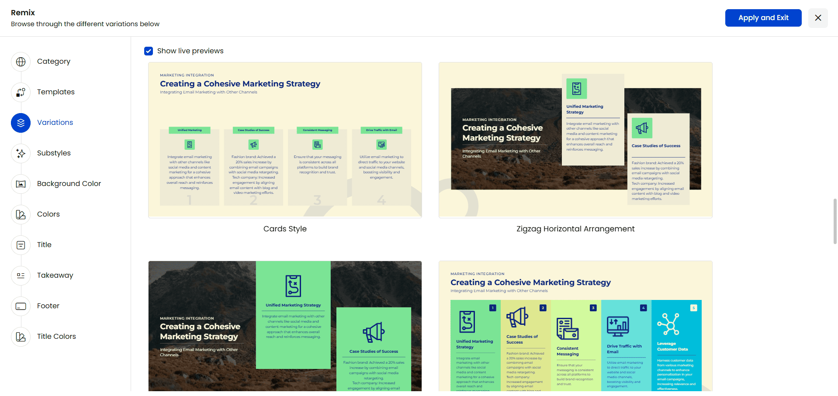
We can click the “remix” option to explore additional design suggestions.

Slide 18

https://www.presentations.ai/

Slide 19
LIMITATIONS
Presentations.ai offers a free plan. The free plan doesn’t allow us to download our presentation in any format.
The free plan gives new users 200 credits.
We need a paid subscription to keep using Presentations AI after our credits run out.
As a reference, core features like AI slide generation and PowerPoint export use 5 credits per slide.

Slide 20




ALTERNATIVES

Slide 21



