Slide 1


Youth and Social Media
A Deep Dive into Global Trends, Popular Platforms, and Cyber Safety

Slide 2
TOPICS
Study of social media use by global and Indian youth
Examination of current popular platforms
Analysing what draws youth to social media
Awareness of youth regarding potential threats on social media
Understanding that cybersafety awareness is the key to a safe social media experience

Slide 3
OVERVIEW
Social media has become an integral part of youth culture, shaping how young people connect, communicate, and express themselves.
With billions of active users worldwide, platforms like Facebook, Instagram, Snapchat, and YouTube have transformed the way youth engage with each other and the world. In India, the youth spend several hours daily navigating these digital spaces, drawn by entertainment, self-expression, and peer validation.
However, alongside the opportunities for creativity and connection, social media also presents challenges, including privacy risks, cyberbullying, and misinformation.
Understanding these dynamics and fostering cybersafety awareness is key to ensuring a safe and enriching social media experience for young users.

Slide 4
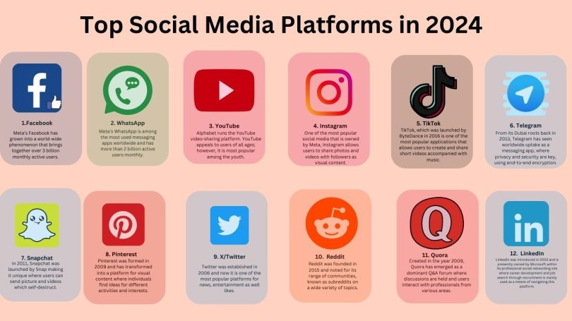

Slide 5
Social Media & Statistics
Global Statistics
Social Media Users: As of July 2024, there are approximately 5.17 billion social media users globally, which is over 63.7% of the world's population.
Users spend an average of 2.5 to 3 hours per day on social media platforms.
Most Popular Platforms:
- Facebook: 3.05 Billion Monthly Active Users
- WhatsApp: 2.7 Billion Monthly Active Users
- YouTube: 2.7 Billion Monthly Active Users
- Instagram: 2 Billion Monthly Active Users
- Telegram: 800 Million Monthly Active Users
- Snapchat: 750 million active users
Over 90% of people aged 18–29 use social media, with teenagers and young adults being the most engaged demographic.

Slide 6
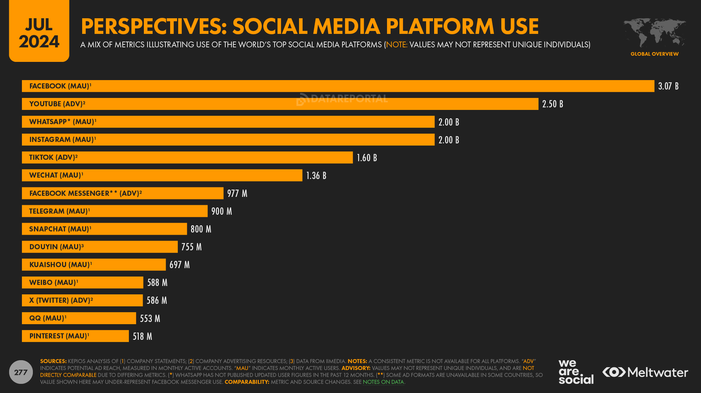

Slide 7
Social Media & Statistics
Indian Statistics
India has the second-largest social media user base in the world, with around 660 million users.
Most Popular Platforms:
- WhatsApp: Most popular messaging platform (530 million users)
- Facebook: Over 320 million users
- Instagram: 300 million users
- YouTube: Around 500 million users
- TikTok (before the ban): Over 200 million users
A significant portion of users between 16-24 years spend over 4 hours a day on social media platforms in India.

Slide 8
Current Popular Social Media Platforms
Global Platforms:
Instagram: Popular for sharing photos and short videos, especially among users aged 16-25.
Snapchat: Known for its disappearing messages and stories feature; very popular among teens.
YouTube: The go-to platform for long-form content and influencers.
X (Twitter): Used for quick news, updates, and discussions.
Facebook: Still widely used but seeing a decline among youth.

Slide 9
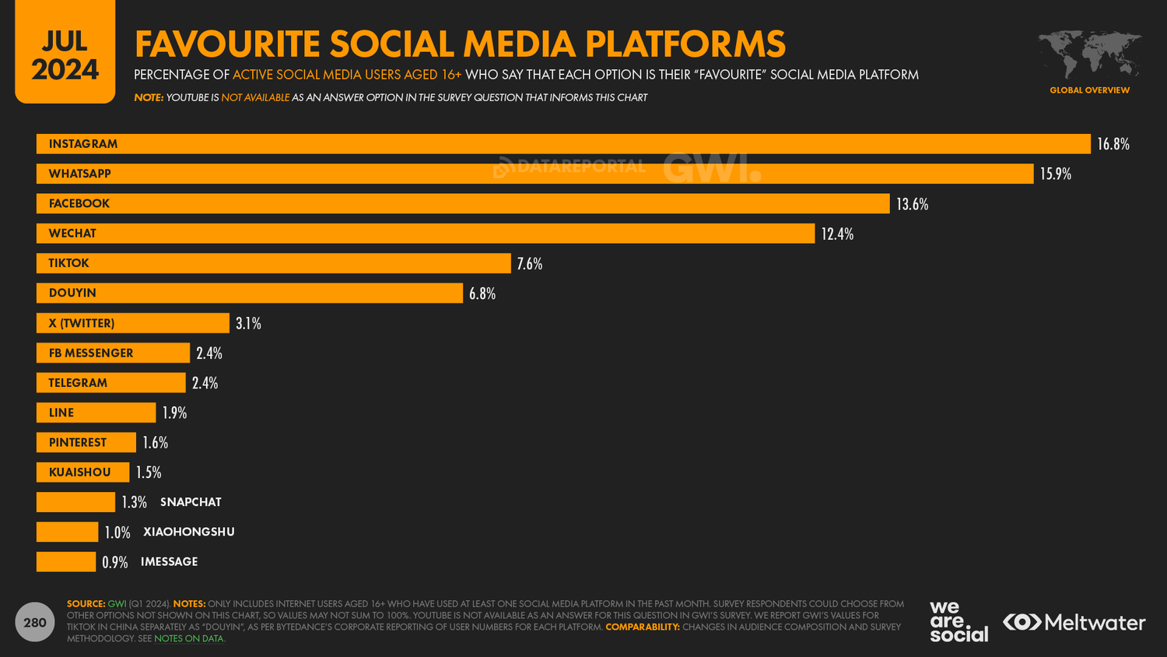

Slide 10
Current Popular Social Media Platforms
Indian Platforms:
WhatsApp: Dominates in terms of messaging and group communication.
Instagram: Gaining popularity for reels, influencers, and trends.
YouTube: Widely used for educational content, entertainment, and tutorials.
Telegram: Gaining traction for its channels and large group chats.
User Preferences:
Youth prefer platforms that are mobile-friendly, easy to use, and offer diverse content.
Shift toward short-form content (reels, short videos) over long-form formats.

Slide 11
What Draws Youth to Social Media?
1. Connectivity and Communication: Keeping in touch with friends and family.
2. Self-Expression: Sharing thoughts, experiences, and creativity (photos, videos, status updates).
3. Entertainment: Videos, memes, challenges, and viral content keep youth engaged.
4. FOMO (Fear of Missing Out): Desire to stay up-to-date with trends, news, and social interactions.
5. Influencer Culture: Youth look up to influencers for lifestyle trends, fashion, and opinions.
6. Gaming & Virtual Communities: Platforms like Discord or Twitch are popular for gaming discussions and streaming.

Slide 12
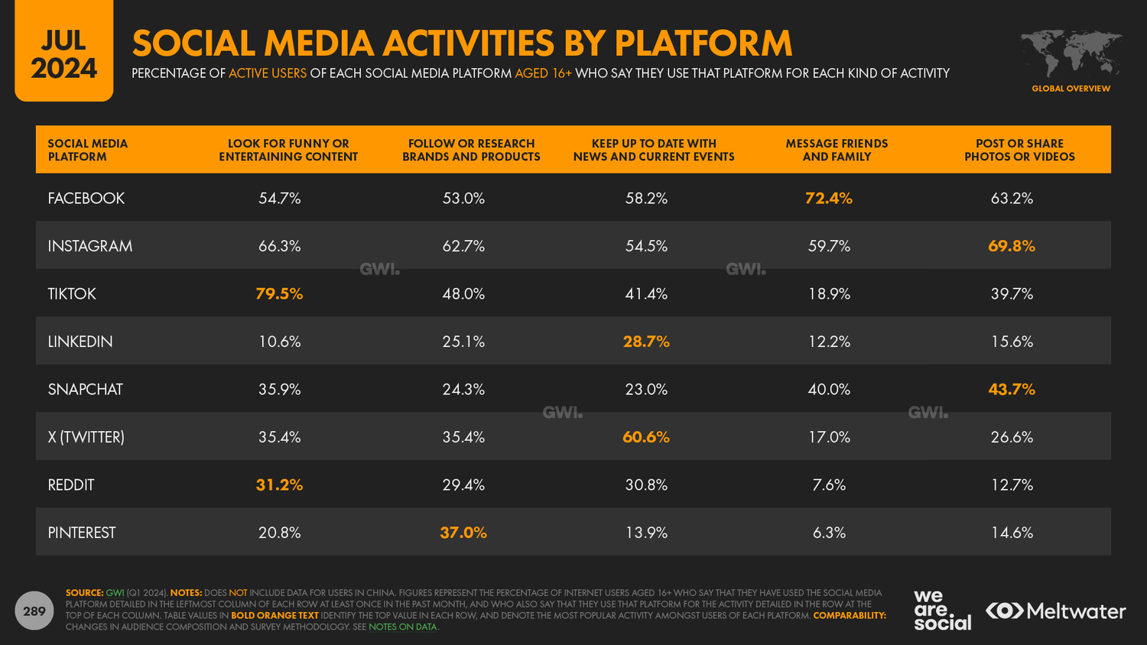

Slide 13
Potential Threats on Social Media
1. Cyberbullying: Persistent online harassment, especially through comments and direct messages.
2. Privacy Invasion: Sharing personal information without fully understanding privacy settings.
3. Scams and Fraud: Youth are vulnerable to phishing, fake profiles, and online fraud (e.g., fake giveaways).
4. Misinformation: False information spreads quickly through shares, influencing opinions and behaviors.
5. Online Predators: Risk of interacting with strangers who could have malicious intent.

Slide 14
Cybersafety Awareness
Key to a Safe Social Media Experience

Slide 15
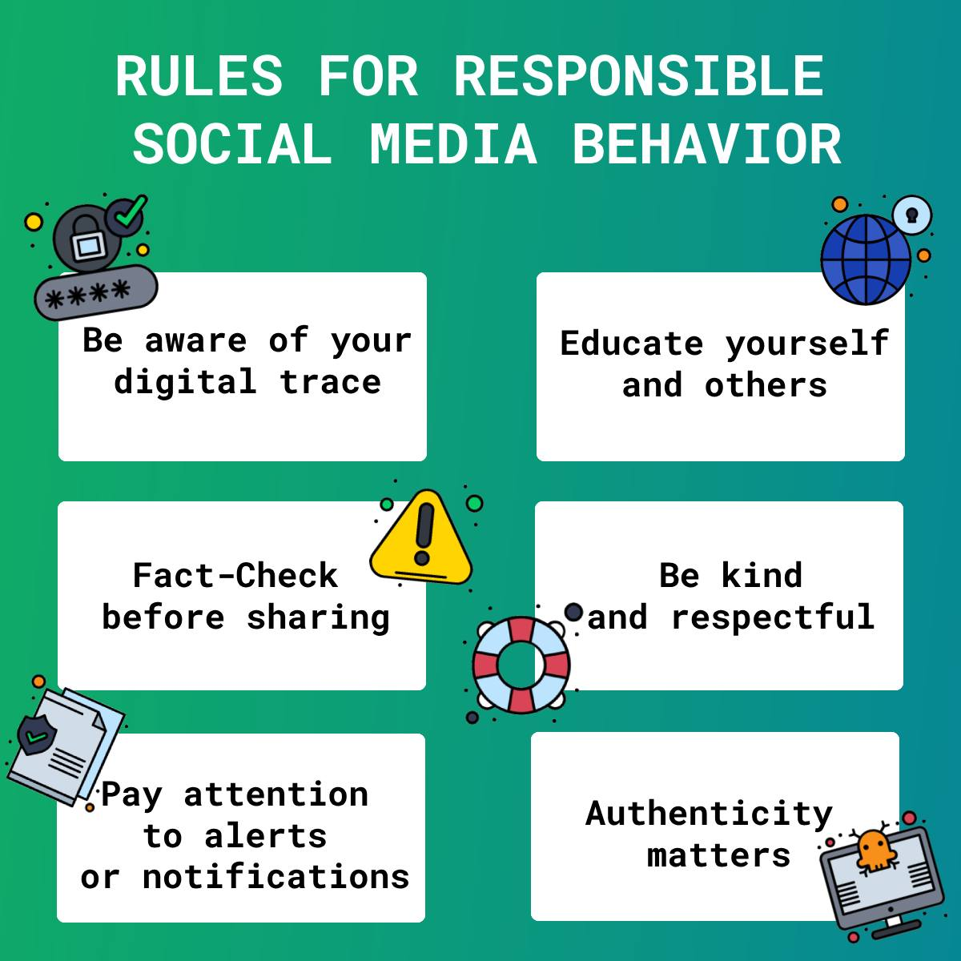

Slide 16
Best Practices
1. Strong Passwords and 2FA: Encouraging the use of strong, unique passwords and two-factor authentication.
2. Privacy Settings: Managing the account visibility, restrict data sharing, and block unwanted users.
3. Recognizing Phishing and Scams: Learn to identify suspicious links, fake accounts, and fraudulent offers.
4. Reporting and Blocking: How to report abusive content or accounts to platform moderators.
5. Critical Thinking: Questioning the credibility of information shared online and not believing everything at face value.

Slide 17
Conclusion
Social media offers many benefits to youth but comes with serious risks.
Awareness and education are critical to ensuring a safe and enriching experience on social platforms.
A collective effort from youth, educators, parents, and organizations is needed for promoting a safer online environment.

Slide 18


Slide 19
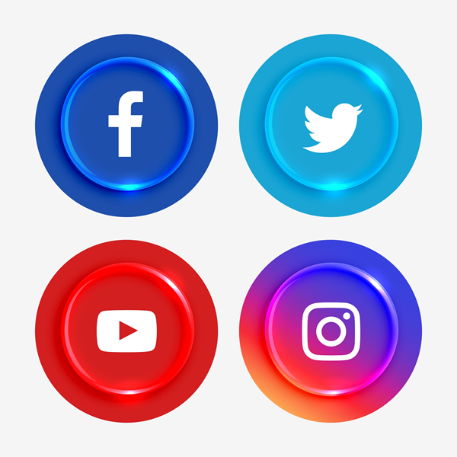

THANK YOU
For assistance, contact us on our WhatsApp helpline
at +91 957 00000 66
Or via mail at helpline@cyberpeace.net
@cyberpeacefoundation
@cyberpeacefoundation
@cyberpeacengo
@cyberpeacetv

