Slide 1

Introduction to Social Media
Role, Benefits, Threats
A CYBERPEACE PRESENTATION

Slide 2
INDEX
The advent and rise in popularity of social media (Using graphs)
Role of social media- across all ages and races
Advantages of social media -education, entertainment, connectivity
Disadvantages of social media- addiction, misinformation, risky activities
Favourite hunting grounds for cybercriminals

Slide 3
OVERVIEW
The social media landscape has evolved into a dynamic, fast-paced environment where platforms shape trends, influence culture, and connect billions of users.
It's a space where influencers, brands, and everyday people share content in real-time, generating waves of viral moments and instant communication.
AI-driven algorithms and short-form videos drive engagement today.
However, this vast digital playground has its challenges and concerns. It is necessary to know how NOT to abuse this privilege.

Slide 4
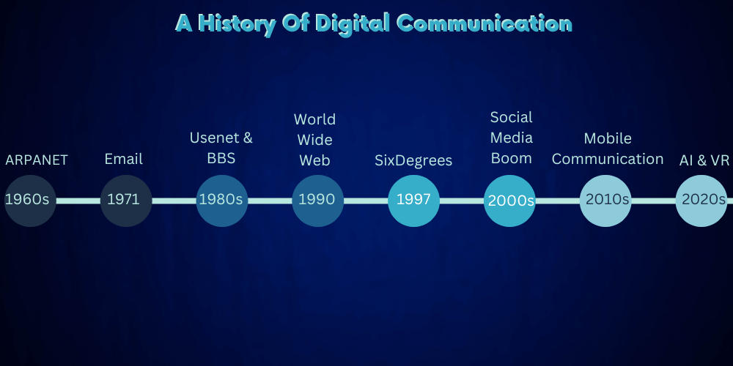
Courtesy: https://www.qqtube.com/blog/when-did-social-media-start

Slide 5
ACTIVITY – Social Media Platforms
Facebook Reddit
                Messenger
TikTok
Telegram
Tumblr Insta
LinkedIn
YouTube
Pinterest WhatsApp
Snapchat X
Twitch

Slide 6
THE SOCIAL MEDIA TIMELINE
Social media has exploded from humble beginnings to an unstoppable global force—and it's not done growing yet.
But have you ever wondered when it all began? What sparked the rise of this digital phenomenon, and what did those early days look like?
Let’s dive into the fascinating history of social media, trace its rapid evolution, and explore the endless possibilities offered

Slide 7
THE FORERUNNERS
It started with the birth of platforms like SixDegrees in 1997.
Followed by:
Friendster – 2002
Myspace -2003
Orkut - 2004

Slide 8
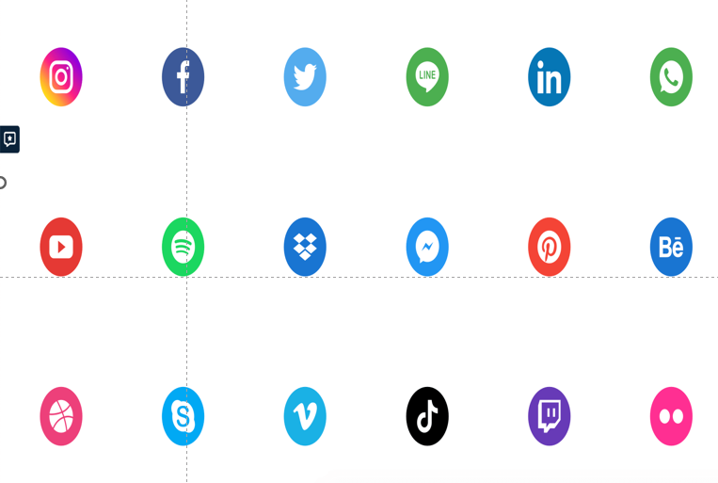
POPULAR SOCIAL MEDIA APPS

Slide 9
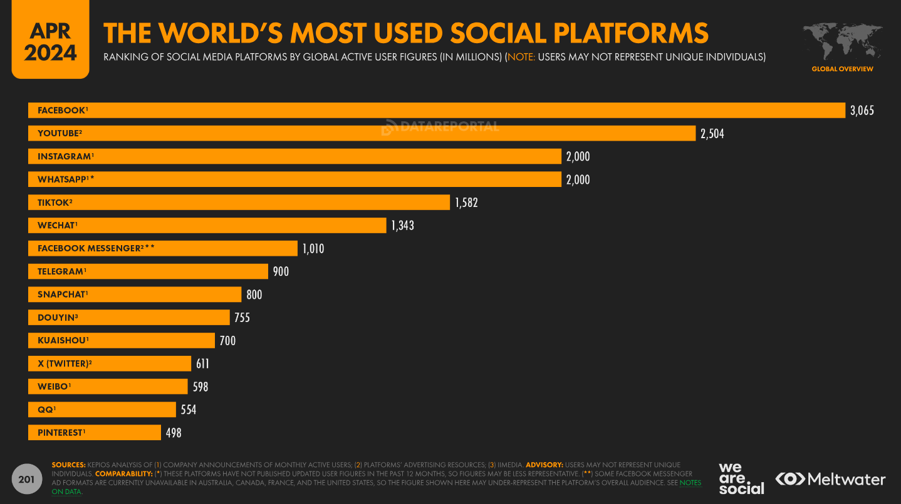

Slide 10
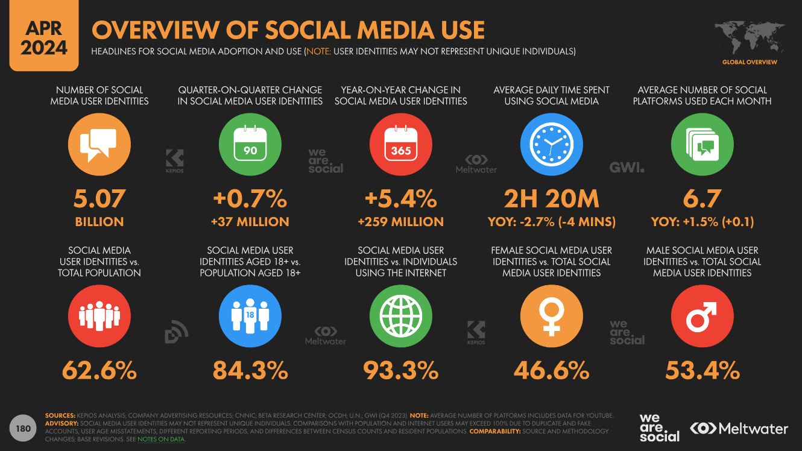

Slide 11
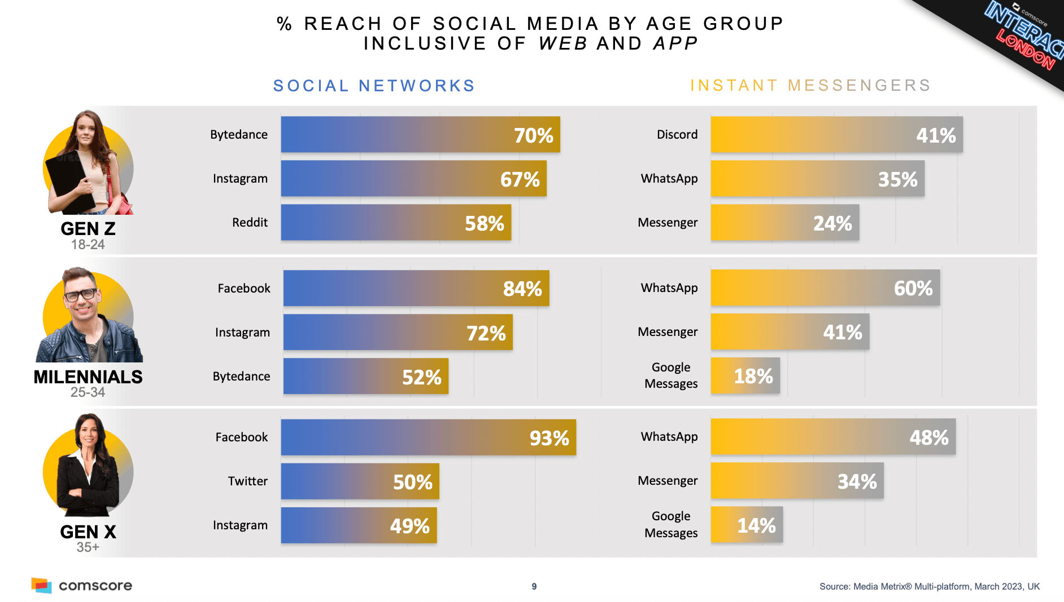

Slide 12

SOCIAL MEDIA ALGORITHM
Algorithms are complex sets of rules and calculations used by social media platforms to determine what content users see in their feeds, search results, and recommendations.
Content-Type
Relevance
Engagement
Recency

Slide 13

ROLE OF SOCIAL MEDIA
Communication and Connectivity
Breaks the age and race barriers, transcending language and cultural gaps
Education
Entertainment
Community Building
Promotes e-commerce and knowledge sharing

Slide 14
IMPACT OF SOCIAL MEDIA
Communication Democracy
Connected Community
Influence on popular culture
Expression of individual and group sentiment
Voice of the people
Commerce To Consumers
Jobs and Careers

Slide 15
THE UPSIDES
Social Movements: Gives a voice to the downtrodden and marginalized
Personal Growth: Offers an opportunity for people to share innovative and creative ideas
Online, Collaborative Learning and Interactive learning
Self-Learning
Strengthens Relationships
Campaigns, Contests, Alerts and more
Commerce And Careers
Health and Wellbeing
Socia
Promotion and Preservation Of Culture, Good Habits, and History

Slide 16
THE DOWNSIDES
Anxiety and Depression
Cyberbullying
Excessive screentime
Need for constant positive reinforcement
Fake news and misinformation
Brainwashing
Echo chambers
Privacy and Security concerns
Disruption in focus
Social disparity and unrest

Slide 17

The key to a safe, productive, and positive social media experience is being mindful and responsible user

Slide 18

ASSOCIATED CYBER THREATS
As social media platforms continue to grow in popularity, they have become a prime target for cybercriminals looking to exploit unsuspecting users. The very features that make social media so engaging—connectivity, information sharing, and global reach—are also what make it a goldmine for malicious actors.

Slide 19

PHISHING AND SOCIAL ENGINEERING
Manipulation of Trust
Fake Accounts and Impersonation
.
Credential Harvesting
Investment and Ponzi Schemes
Infrastructure breakdown

Slide 20
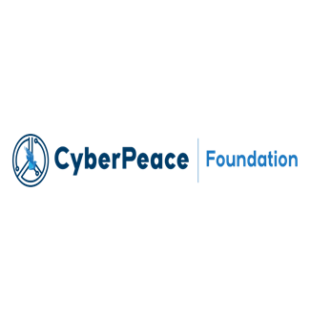

DATA THEFT AND PRIVACY BREACH
Over-sharing of Personal Information:
Exploitation of Weak Privacy Settings:
.
Account Hijacking And Identity Theft:
Fake profiles to carry out defamation/fraud.

Slide 21

MALWARE AND RANSOM ATTACKS
Malicious Links and Downloads:
Cybercriminals often spread malware through infected links shared via direct messages, posts, or comments.
Trojan Apps and Games:
Seemingly innocuous third-party apps and games may be embedded with malware. When users grant these apps permission to access their accounts, hackers gain entry to personal data or can control the account itself.

Slide 22

FAKE NEWS AND MISINFORMATION
Disinformation Campaigns
Clickbait and Fraudulent Content
Sextortion and Social Unrest

Slide 23
CYBERBULLYING
Online bullying can take different forms:
Trolling
Outing
Stalking
Abusing
Blank Calls
Inappropriate Photos and Videos
Memes and Doctored content

Slide 24
ENHANCE YOUR SOCIAL MEDIA SAFETY
Maximise Privacy
Maximise Security
Use Strong, Unique Passwords
Verify the Authenticity of Links, Attachments, and Calls
Be Wary of Suspicious Links and Profiles
Share with care

Slide 25





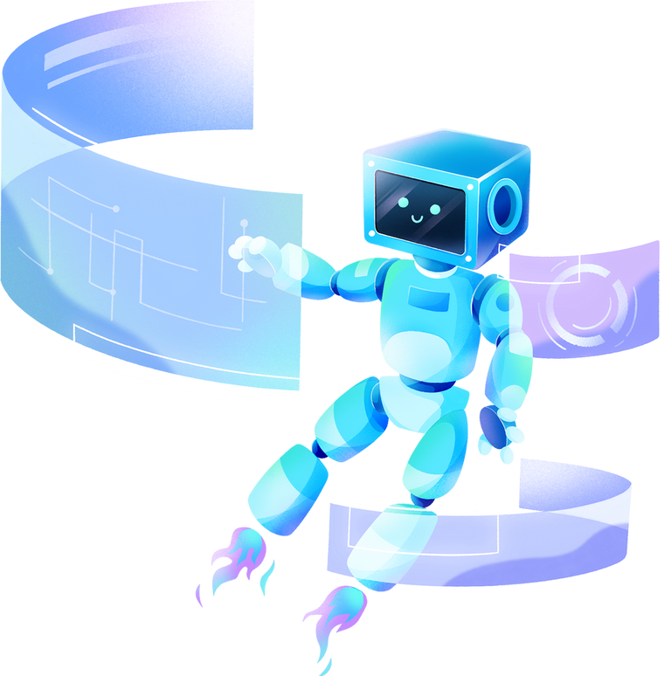







L29- 34, First Floor
Connaught Place, New Delhi - 110001
+91 823 5058 865
+ 1- 202- 922- 2121
611 Gateway BLVD Suite 120 San Francisco, United States CA- 94080

