Slide 1

Developing Media Literacy Skills
· Critical thinking
· Being an ethical digital user
· Inculcating the habit of creating and consuming positive content
· Responsibility and accountability of digital users
· Tools to use- source credibility and Google search strategy

Slide 2


Slide 3
Critical thinking

Slide 4
Critical thinking
What is Media Literacy?
Ability to access, analyze, evaluate, and create media. - Understanding media's role in society and the messages they convey.
2. Why Media Literacy is Important:
- Navigating vast amounts of information. - Recognizing biases and misinformation. - Making informed decisions as a consumer and citizen.

Slide 5
3. Key Components of Media Literacy:
- Access : Finding reliable and diverse sources of information.
- Analyze: Evaluating the credibility, purpose, and bias in media. - Evaluate: Understanding different perspectives and the impact of media on beliefs and actions.
- Create : Producing responsible and ethical media content.
4. Critical Thinking in Media Literacy:
- Question the Source : Who created the content?
What is their purpose?
- Recognize Bias: Does the media favor a particular perspective? Why?
- Distinguish Fact from Opinion: Identify what is being presented as fact and what is opinion or interpretation.
- Cross-verify Information : Check multiple sources to confirm the validity of information.
- Evaluate Emotional Appeals: Does the media use emotional language or imagery to sway opinions?

Slide 6
5. Steps to Develop Media Literacy:
- Stay curious: Ask questions about the media you consume.
- Be skeptical: Don’t accept information at face value.
- Diversify your sources: Seek multiple viewpoints for a more rounded perspective.
Fact-check: Use fact-checking tools to verify claims.
6. Conclusion: - Media literacy empowers individuals to be critical thinkers and responsible consumers of information in a digital age.
This outline can be expanded into slides with visuals, examples, and interactive elements for a more engaging presentation.

Slide 7
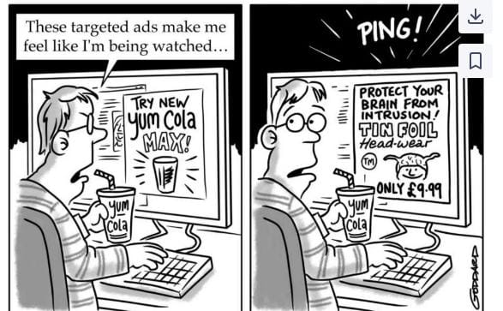

Slide 8
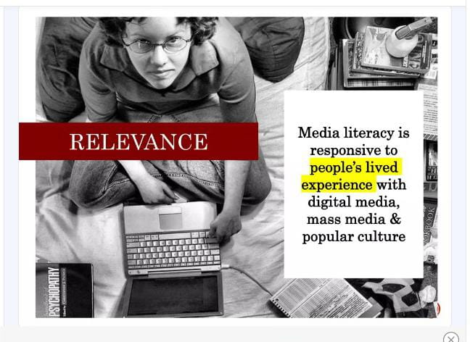

Slide 9
Being an ethical digital user

Slide 10
Being an ethical digital user
What Does It Mean to Be an Ethical Digital User?
Responsible, respectful, and informed behavior when engaging online.
2. Importance of Ethical Digital Use:
Protects personal privacy and that of others.
Promotes a safer and more respectful online community.
- Reduces the spread of misinformation and harmful content.

Slide 11
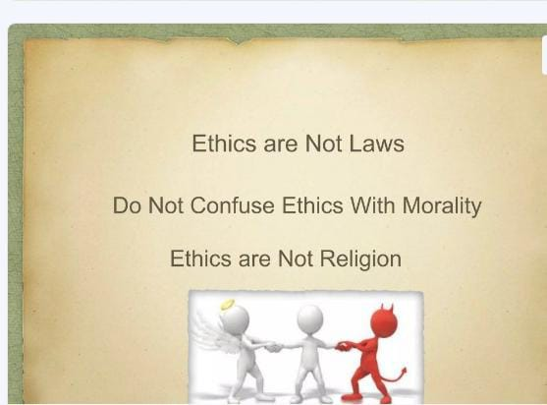

Slide 12
3. Key Principles of Ethical Digital Use:
- Respect Privacy: Don’t share others' personal information without consent.
- Avoid Plagiarism: Give proper credit when using or sharing content.
- Be Truthful: Share accurate, fact-checked information.
- Promote Positive Engagement: Avoid cyber bullying, trolling, and hate speech.
- Follow Laws & Guidelines: Adhere to copyright laws and platform rules.

Slide 13
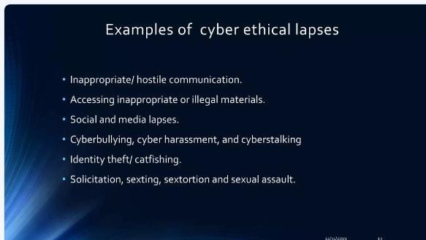

Slide 14
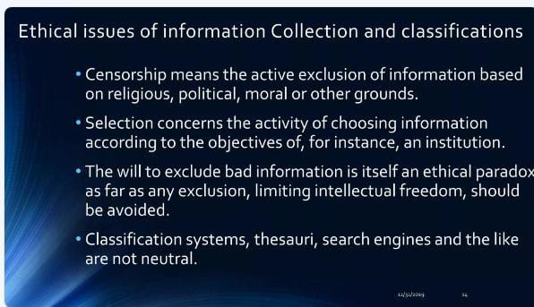

Slide 15
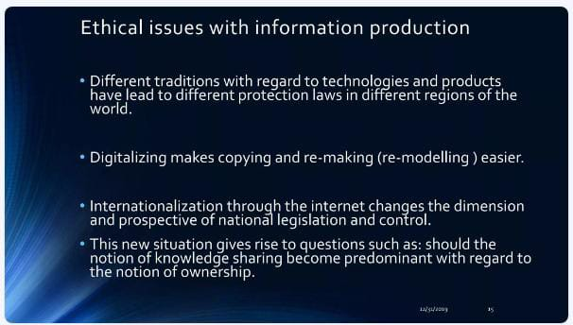

Slide 16
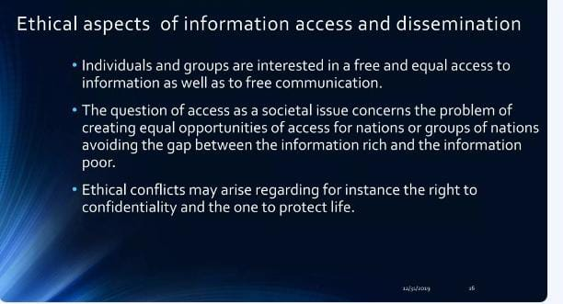

Slide 17
4. Practical Steps to Be Ethical Online:
Think before posting: Is it kind, necessary, and true?
- Protect your data and be mindful of online security.
- Report harmful content and inappropriate behavior.
- Encourage positive digital citizenship by being a role model.
Conclusion: Being an ethical digital user promotes integrity, respect, and safety in the online world, fostering a healthier digital environment for all.

Slide 18
Inculcating the habit of creating and consuming positive content

Slide 19
Inculcating the habit of creating and consuming positive content
What is Positive Content?
- Content that is constructive, informative, respectful, and promotes empathy, learning, and well-being.
2. Why Focus on Positive Content?
- Contributes to a healthier online environment. - Reduces negativity, misinformation, and harmful behavior.
- Promotes mental well-being and encourages constructive dialogue.

Slide 20
3. Inculcating the Habit of Creating Positive Content:
- Be Mindful: Create content that adds value, educates, or uplifts others.
- Promote Kindness: Share messages that foster understanding, inclusivity, and respect.
- Avoid Harmful Content: Refrain from spreading hate, misinformation, or divisive material.
- Uplift Voices: Amplify positive and diverse perspectives.
4. Consuming Positive Content:
Seek Constructive Sources: Follow accounts and media that provide educational, inspiring, or solution-oriented content. - Be Selective: Avoid consuming toxic or sensationalized media that fuels negativity.
- Engage Thoughtfully: Comment and share content that encourages healthy discussions and learning.
-Fact-Check: Ensure the information is accurate before sharing to avoid spreading falsehoods.

Slide 21
5. Benefits of Positive Content:
- Promotes personal growth, mental health, and a sense of community.
- Encourages meaningful digital interactions.
Conclusion:
By creating and consuming positive content, individuals can contribute to a more constructive, respectful, and enriching digital environment.

Slide 22
Responsibility and accountability of digital users

Slide 23
Responsibility and accountability of digital users
What is Digital Responsibility?
- Acting with integrity, respect, and care in online interactions, understanding the impact of one’s actions in the digital world.
2. Why Responsibility and Accountability Matter:
Prevents the spread of misinformation, cyber bullying, and unethical behavior.
- Fosters a safe, respectful, and informed online community.

Slide 24
3. Key Aspects of Digital Responsibility:
- Respect Others’ Rights: Acknowledge privacy, intellectual property, and differing opinions.
- Verify Information: Ensure content shared is accurate and fact-checked.
- Think Before You Post: Consider the consequences of online actions on others and yourself.
- Uphold Online Etiquette: Engage in respectful, constructive discussions and avoid harmful behavior.

Slide 25
Accountability in the Digital World:
- Own Your Actions: Be prepared to take responsibility for what you share or say online.
- Correct Mistakes: If you share misinformation or harmful content, acknowledge and rectify it.
- Report Unethical Behavior: Hold others accountable by reporting falsehoods, cyber bullying, or harmful content.
- Follow Digital Laws and Guidelines: Respect copyright, data protection laws, and platform policies.

Slide 26
5. Benefits of Responsible and Accountable Digital Behavior:
- Builds trust, credibility, and positive relationships online.
- Contributes to a safer, more constructive digital environment for all.
Conclusion:
Being a responsible and accountable digital user ensures a more respectful, ethical, and trustworthy online community, protecting both individuals and society.

Slide 27
Tools to use- source credibility and Google search strategy

Slide 28
Tools to use- source credibility and Google search strategy
Why Source Credibility is Important:
Helps identify trustworthy, accurate, and unbiased information.
Prevents the spread of misinformation and promotes informed decision-making.
2. Tools to Evaluate Source Credibility:
- Fact-Checking Websites: Use platforms like Snopes FactCheck.org, or PolitiFact to verify claims.
- Domain Evaluation: Prefer reliable domains like .gov, .edu, and well-known .org or .com sources.
- Author Credentials: Look for reputable authors with relevant expertise or affiliations.
- Publication Date: Check for the timeliness of information, especially in fast-changing fields.
- Cross-Reference: Compare information across multiple credible sources.

Slide 29
3. Effective Google Search Strategies:
- Use Keywords Effectively: Focus on specific terms relevant to your search (e.g., "climate change statistics 2024").
Use Quotation Marks (“ ”): Search for exact phrases to get more accurate results.
- Use Search Operators:
- site: Limits search to a specific domain (e.g., *site:.edu*).
Excludes unwanted terms (e.g., *apple -fruit*).
- Check Snippets and URLs: Preview content before clicking and assess whether the snippet shows credibility. - Look for Bias: Be mindful of sites with extreme or highly partisan perspectives.

Slide 30
4. Additional Tools for Source Credibility:
- Google Scholar: For academic and peer-reviewed sources.
- Media Bias Fact Check: To assess the political leaning or bias of media outlets.
- CRAAP Test: Evaluate sources based on Currency, Relevance, Authority, Accuracy, and Purpose.
5. Benefits of Using Credible Sources and Search Strategies:
- Ensures you access reliable, accurate, and well-informed content.
- Helps avoid misinformation traps and biased viewpoints

Slide 31
Conclusion:
By using tools to assess source credibility and employing smart Google search strategies, digital users can make informed, accurate decisions and contribute to a well-informed online environment.

Slide 32
THANKS
BINDU CHAUDHARY
9414217632 /
8949296929

