Slide 1
NCERT Webinar on the Series on ET & ICT Tools
Online Assessment using ProProfs QuizMaker on
23.05.2024
Presenter:
Dr.Faiza Altaf
Assistant Professor
MANUU,CTE Asansol(W.B)

Slide 2
To be discussed:
Introduction:ProProfs Quiz maker
Salient Features of ProProfs Quiz maker
How to create Quiz on ProProfs Quiz maker?

Slide 3
ProProfs Quizmaker
ProProfs Quizmaker is an online tool that allows user to create and customize their own quizzes. It is a cloud-based software.
It can be used for educational assessments ,surveys and professional purposes

Slide 4
Salient Features of ProProfs Quizmake:
It offers various questions types(15+ Question Types such as multiple-choice, matching, hotspot etc.)
It offers multimedia supports (videos , images, themes, sounds can be added in quizzes).
It supports multiple languages

Slide 5
It offers question banks for easy quiz creation (100,000+ ready-to-use questions)
It offers customizable themes.
It offers the ability to embed quizzes on websites or blogs so the learners can take quizzes without leaving the Page.
It features time limits and scoring options.

Slide 6
It is a monitoring and reporting tool.
It includes security settings to protect quiz content.
It allows integration with learning management systems
It allows collaboration for team-based quiz creation.
It offers branding options for a personalized touch.
It offers customized quiz completion certificates with your institution logo.

Slide 7
FREE PLAN
Ideal for short quizzes
free forever
Get started with quizzes up to 12 questions (8 quiz + 4 lead capture fields).
All Features
No Limits
12 Questions
90-Day History

Slide 8
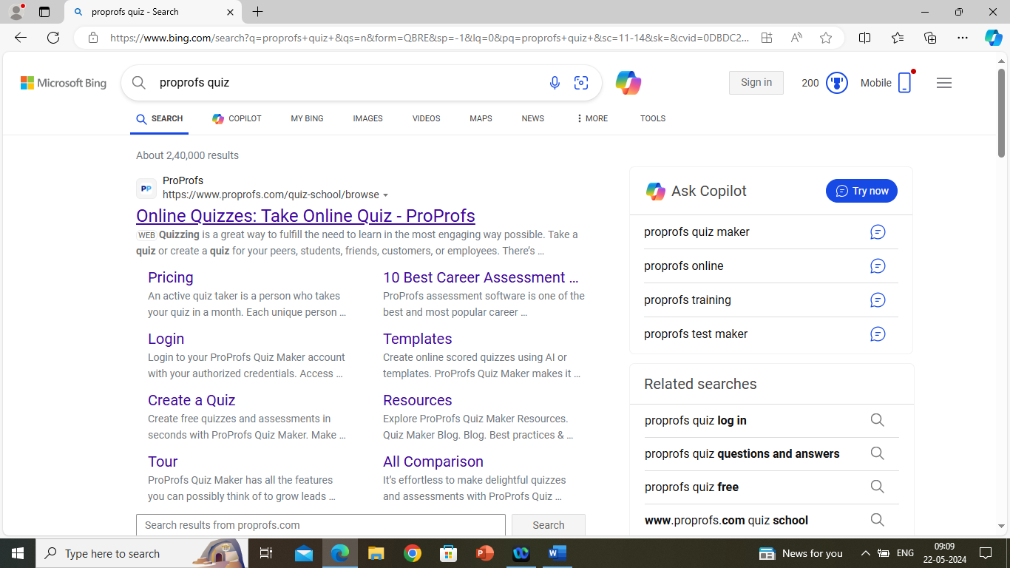
How to create Quiz on ProProfs Quiz maker?
1.Type ProProfs quiz in any search engine or ProProfs.com

Slide 9
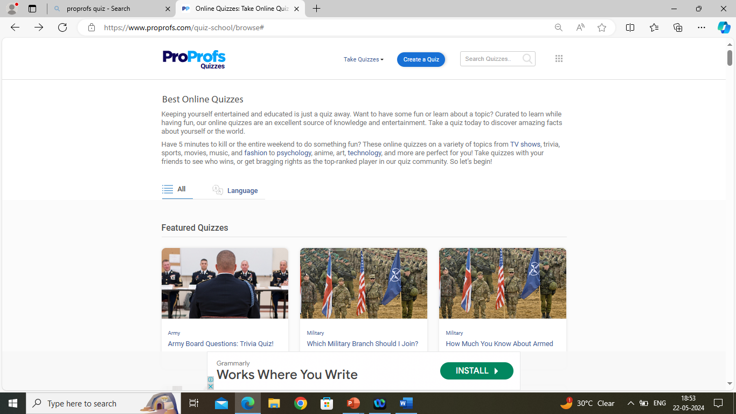

Slide 10
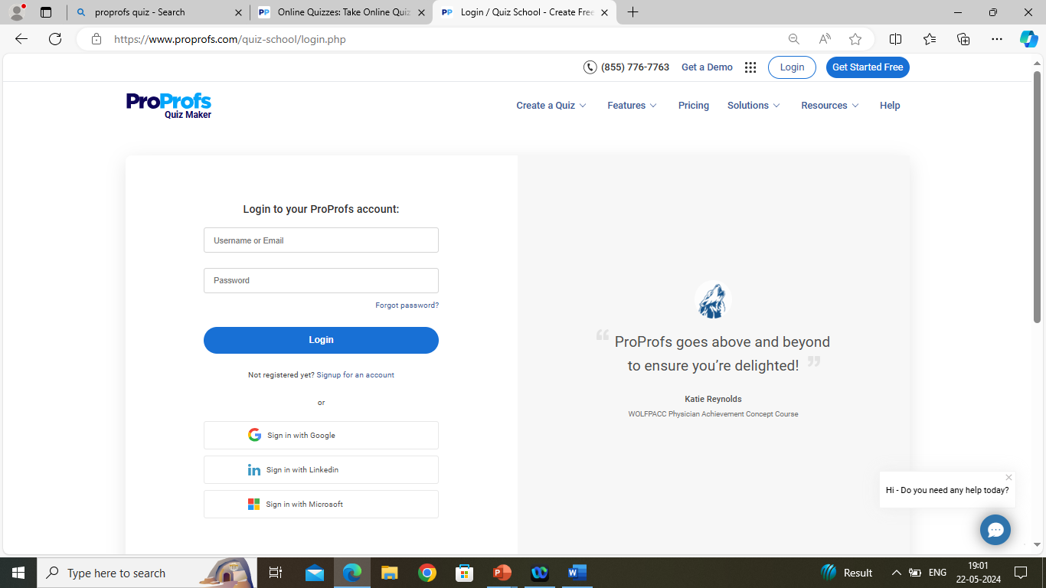

Slide 11
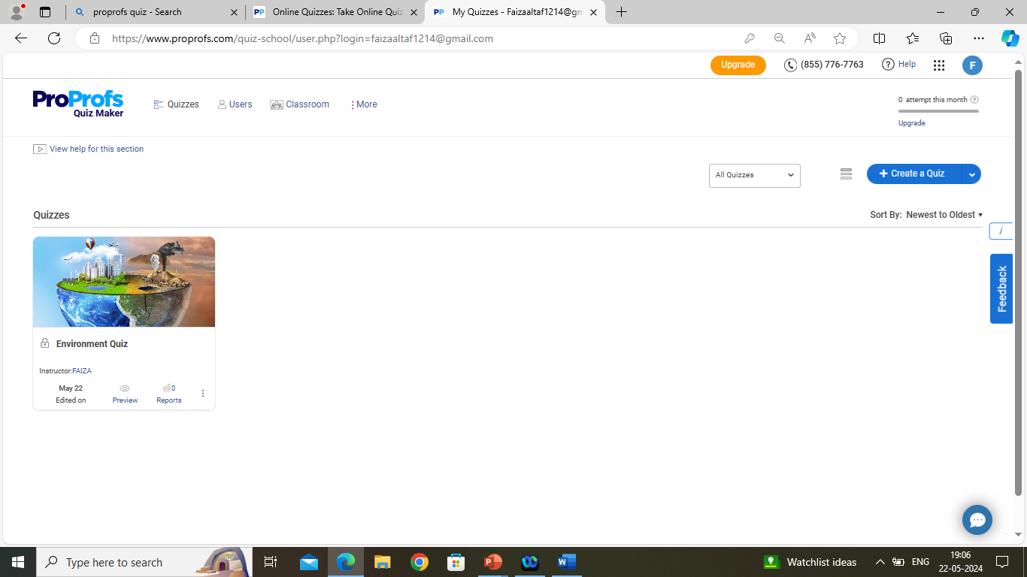

Slide 12
