Slide 1
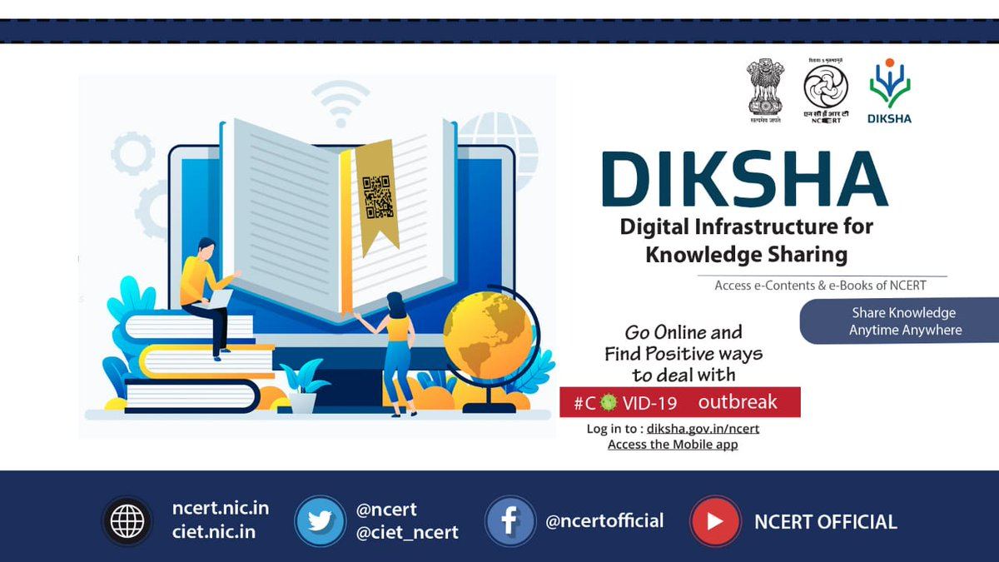

Online Courses
for
School Education

Slide 2
Policy Perspectives
The NEP 2020 has a special focus on online education.
Online tools and platforms like DIKSHA and SWAYAM to be pursued for training content, in-class resources, assessment aids, profiles, etc. that will allow seamless interaction.
One of the objective is to transform the education system and structure while focusing on online education.
It emphasizes the role of DIKSHA and SWAYAM as a tech platform for integrating teaching - learning practices.
Reaffirms the bridging of social gaps, ensuring equitable education for all.

Slide 3
Benefits of online courses
Every individual learner attends the course in their own choice of environment
There are diverse courses available online, giving a choices to the learners.
The learner can attend at any time of the day allowing flexibility in schedule.
Online courses are free from the boundations of time and place
They are cost effective for all the learners.
Personalised
education
Content
variety
Affordability
Convenience
Flexibility

Slide 4
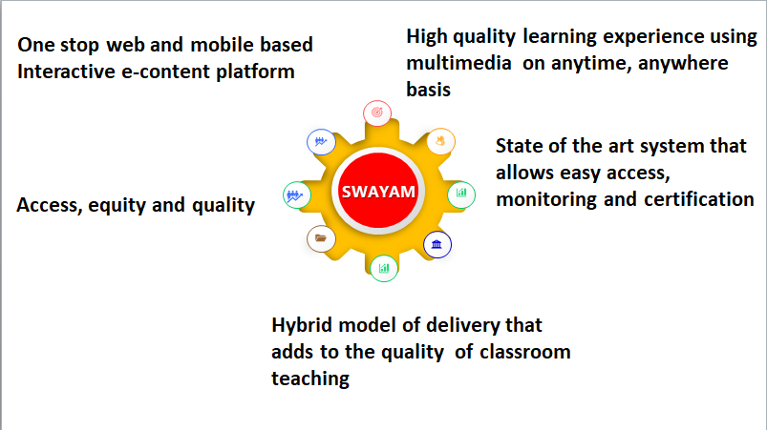
Study Webs of Active–Learning for Young Aspiring Minds (SWAYAM)

Slide 5
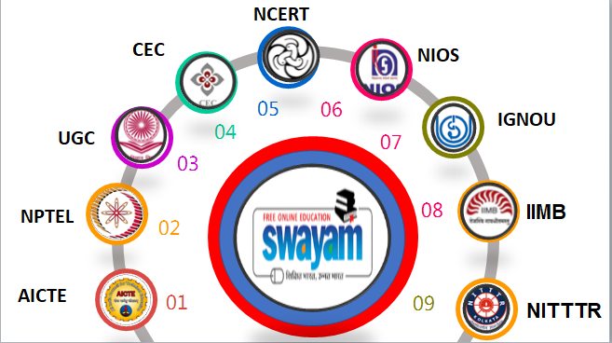
National Coordinators on SWAYAM

Slide 6
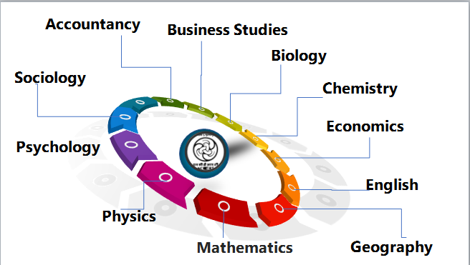
Online Courses offered by NCERT on SWAYAM
28 courses for Class XI and XII across 11 subjects
Yearly two cycle:
  April to September
  October to March
Who can join?
  Students
  Teachers
  Parents
  Any one

Slide 7




Components of Course
01
eTutorial (Video)
YOUR TITLE
02
03
04
eContent (PDF, Text, e-Books, Illustrations and Documents) including Web resources (Related Links, Wikipedia, Open Content etc.).
01
YOUR TITLE
02
Assessment (Problem/ solutions, MCQs, Short answers type, Quizzes, Assignments etc.).
03
04
Discussion forum
YOUR TITLE
Live session on TV channel, Live interaction with mentors, Final assessment

Slide 8
How to join and complete the course
Access the course links from CIET site : https://ciet.ncert.gov.in/initiative/moocs-on-swayam
Access the Course by clicking on the course link
Register on https://swayam.gov.in/
Join the selected course for FREE
Learn the content and complete all activities
Take up the final assessment and get certified

Slide 9
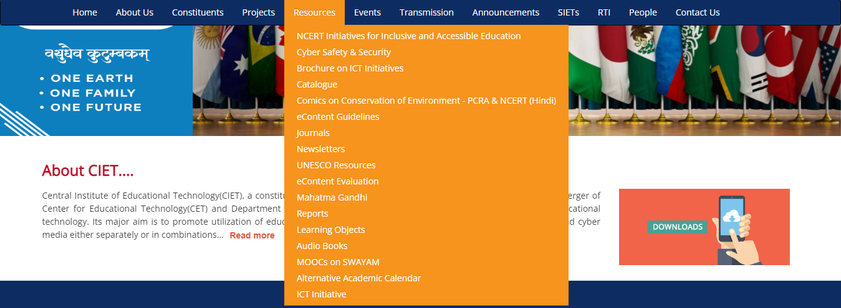
Step 1: Access the course links from CIET site

Slide 10
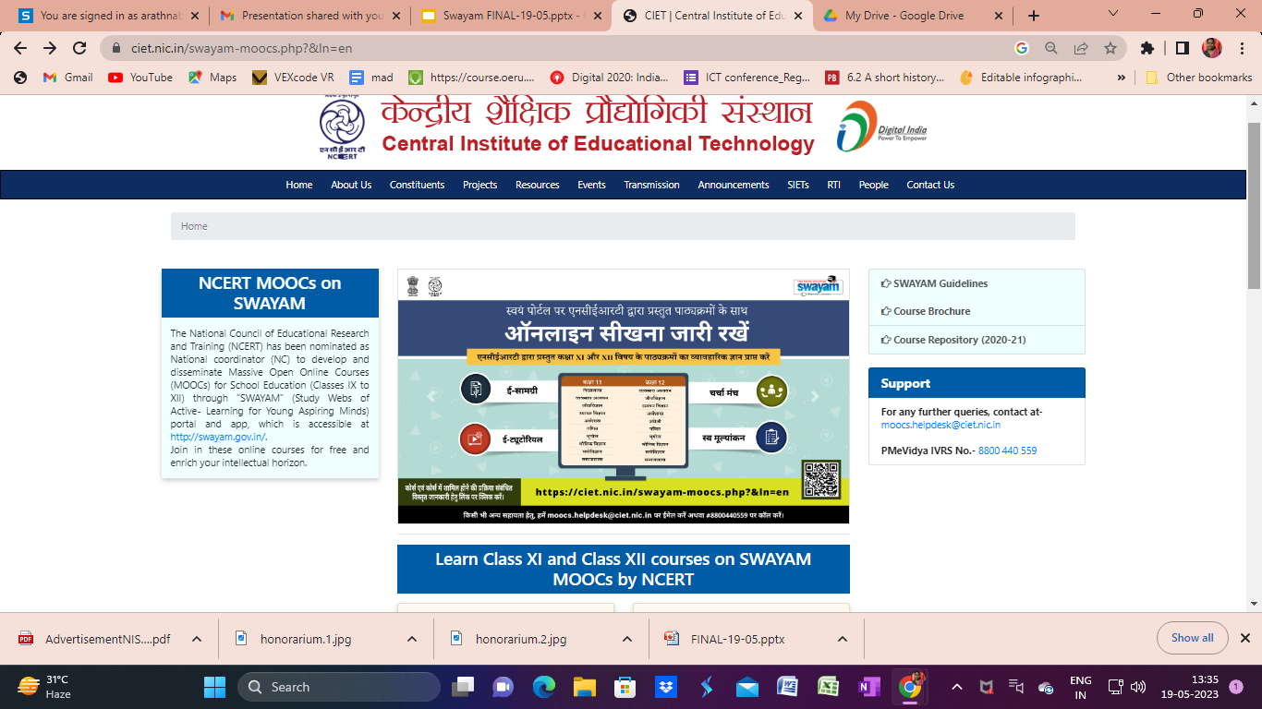

Slide 11
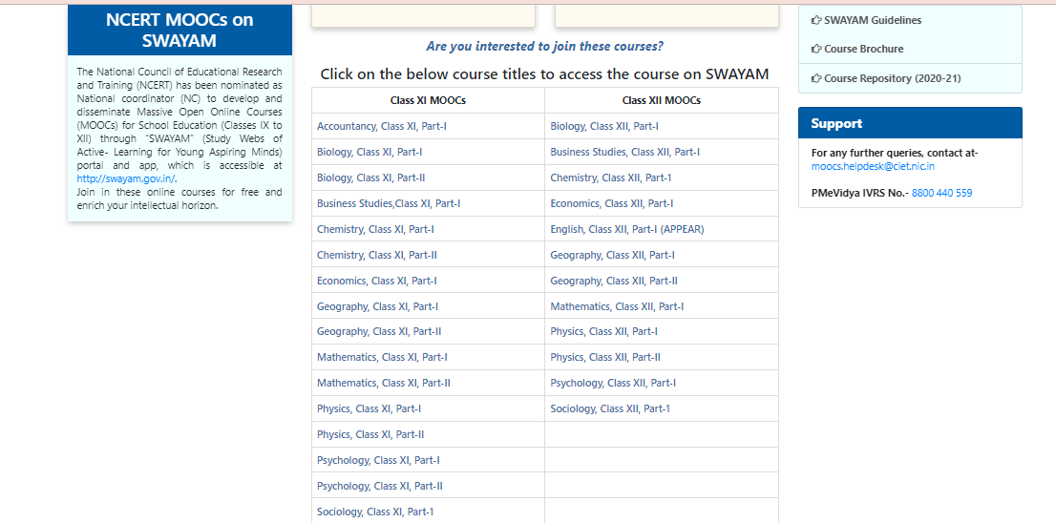
Step 2: Access the course by clicking on the course

Slide 12
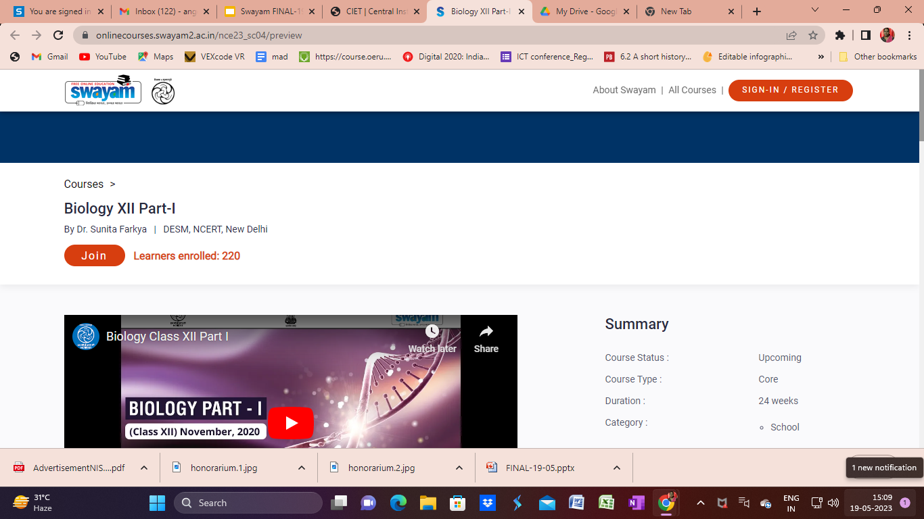

Slide 13
Step 3: Register/ Login on the SWAYAM portal

Slide 14
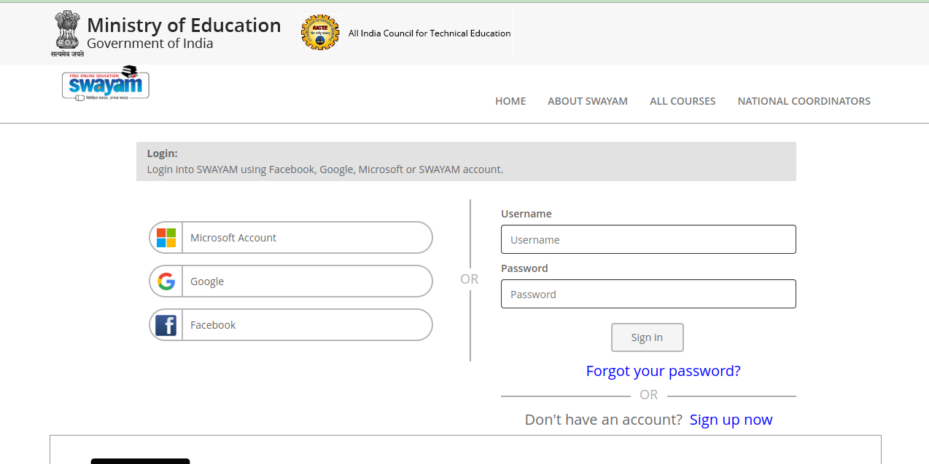

Slide 15
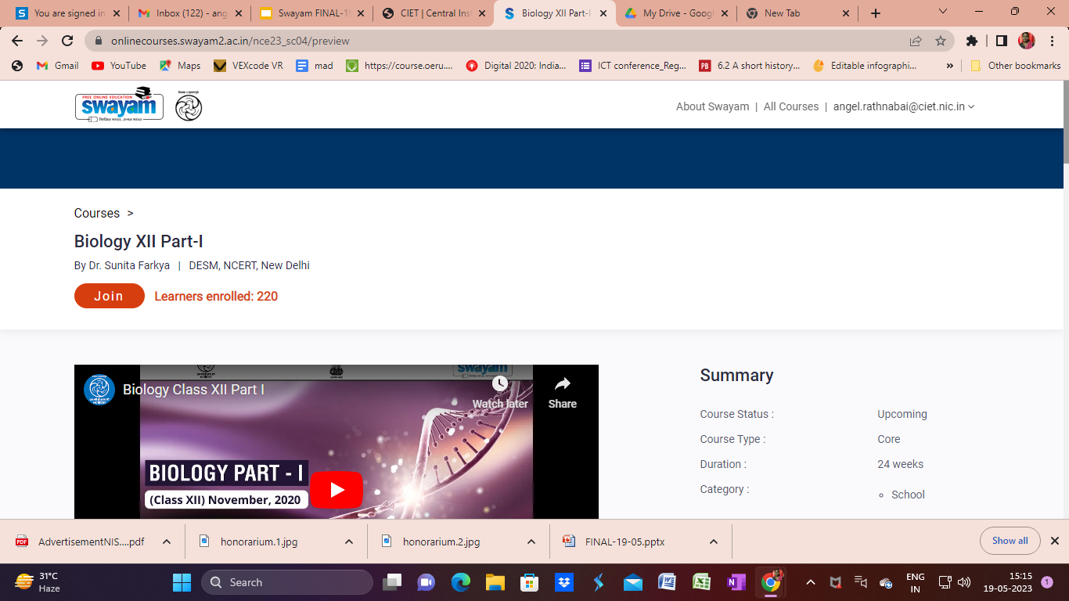
Step 4: Join the course

Slide 16
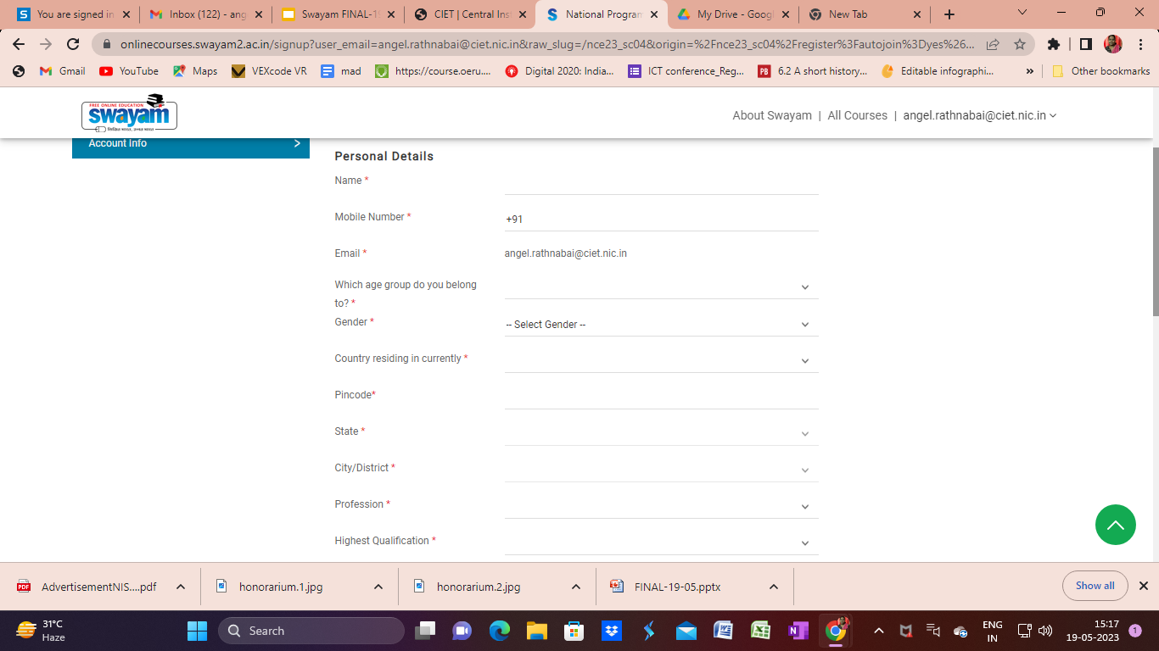

Slide 17


Slide 18
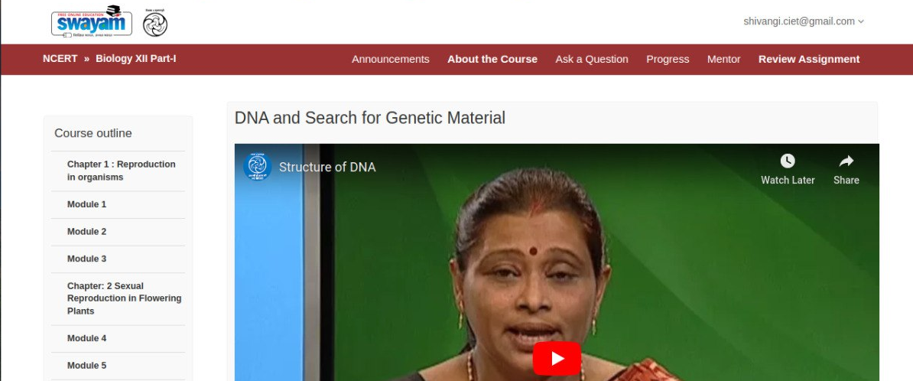
Step 5: Learn the content and complete the activities

Slide 19
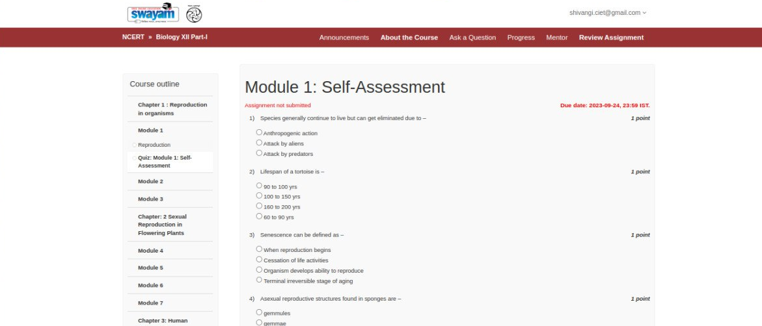
Self Assessment for module

Slide 20
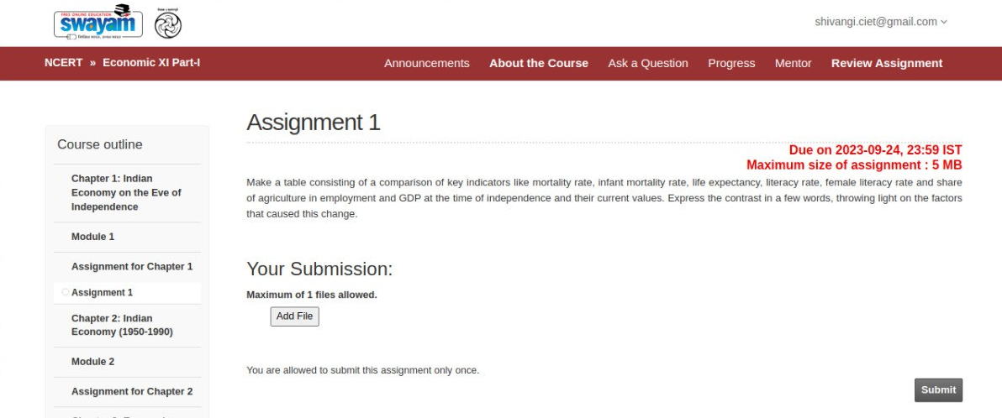
Assignment for chapter
Notes:
Shivangi- then we have assignment after every chapter is completed. these assignment are to be submitted before the due date displayed on the top right corner of the page. these will be corrected, evaluated and feedback will be given.

Slide 21
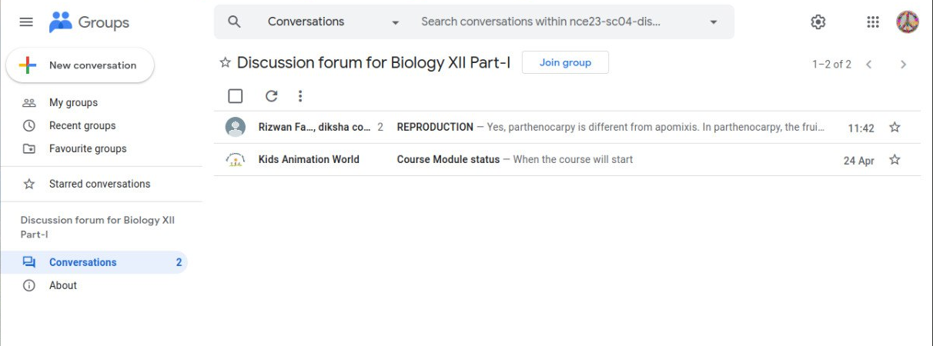
Queries can be resolved by Discussion Forum
Notes:
Shivangi- we also have a discussion forum which we can find on the course outline page. the tab ASK A QUESTION allows to put your queries on the portal. so after clicking on that, this page opens where we first join the group to be a part of the discussion forum.
then we put our doubts and queries by clicking on the tab NEW CONVERSATION.

Slide 22
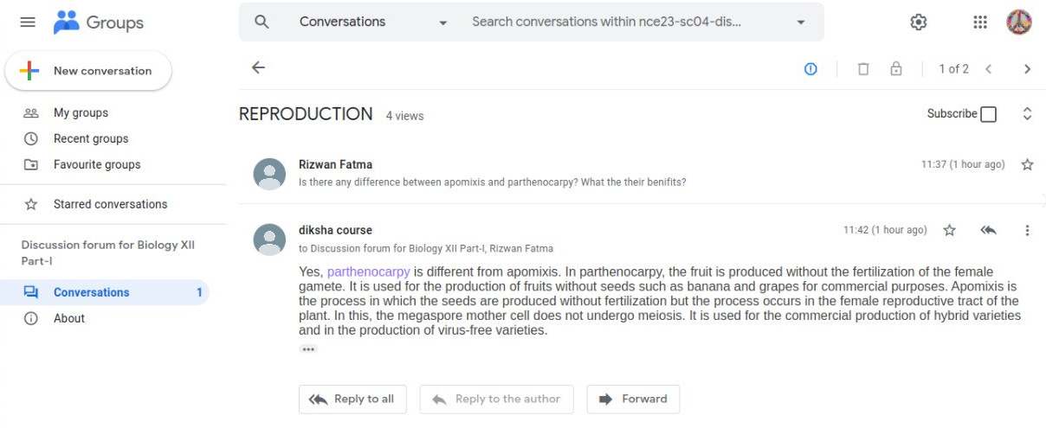
Discussion Forum
Notes:
Shivangi- when we put our query. it can be answered by anyone in the group.
now these were the details about the course. as we have talked in the earlier slide, we have self assessment questions

Slide 23
Assessment & Certification
Based on objective type summative assessment and performance in the course, certificate will be provided
Course Completion Certificate - Learners who scored 50% and above in the internal assessments along with 60% and above in the final assessment
Course Participation Certificate - Learners who scored 50% and above in the internal assessment
Certificate of Appreciation -Learners who scored 60% and above in the final assessment
Notes:
Kriti- Read the slide.

Slide 24

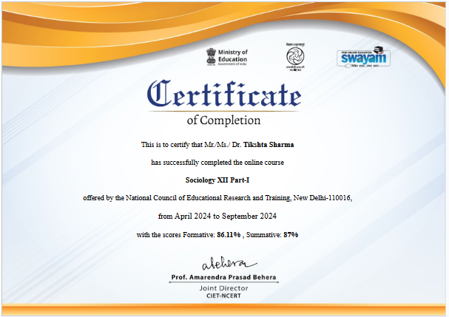
Certificate of Completion
C
SUMMATIVE ASSESSMENT
60%
FORMATIVE ASSESSMENT
50%
Notes:
Simultaneously, slide to be demonstrated.

Slide 25
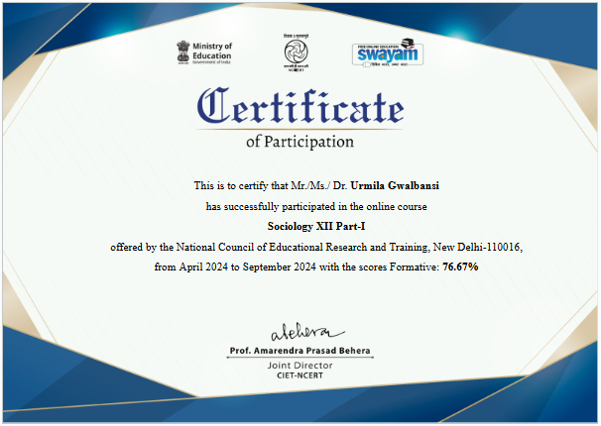
Certificate of Participations
P
FORMATIVE ASSESSMENT
50%
Notes:
Simultaneously, slide to be demonstrated.

Slide 26
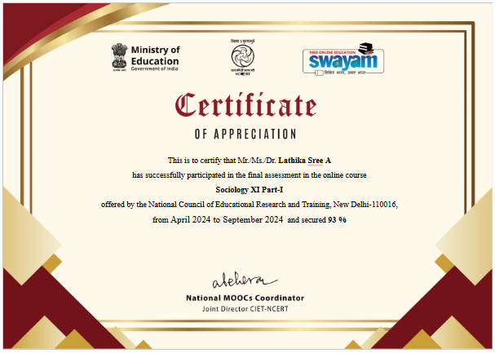
Certificate of Appreciation
A
SUMMATIVE ASSESSMENT
60%
Notes:
Simultaneously, slide to be demonstrated.

Slide 27
THANK YOU

