Slide 1
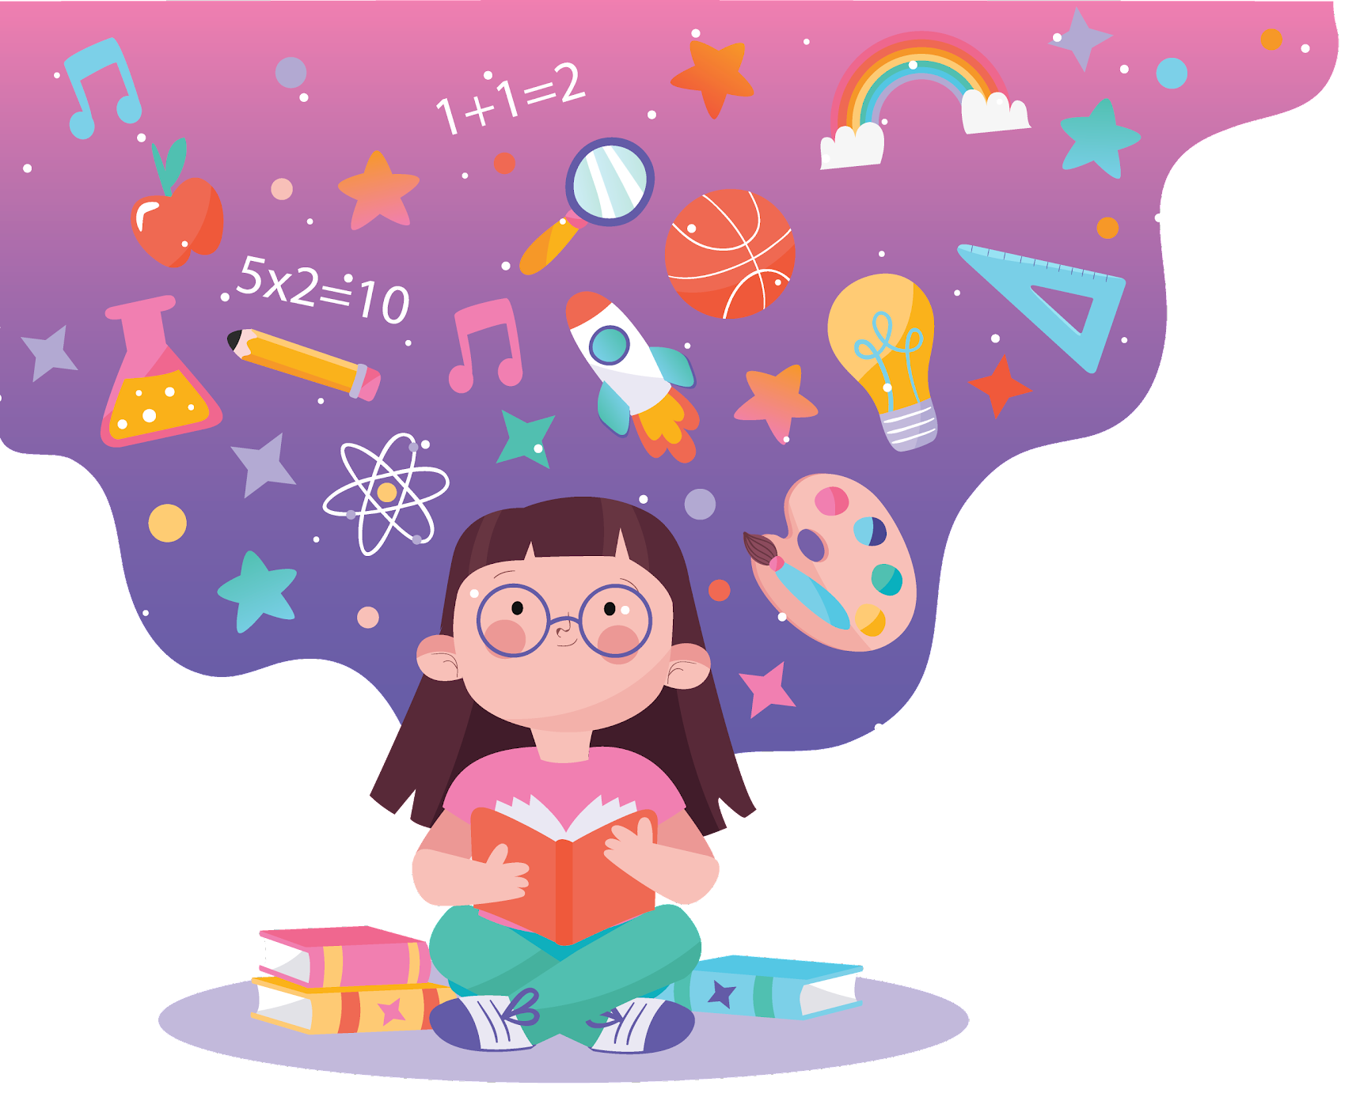
Animations: Concept, Types and Usage

Slide 2
What is Animation?

Slide 3
Animation is the process of creating the illusion of movement by displaying a sequence of images, drawings, or frames that change slightly from one to the next

Slide 4
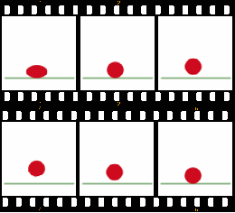

The above bouncing ball animation consists of these six frames, repeated indefinitely.

Slide 5
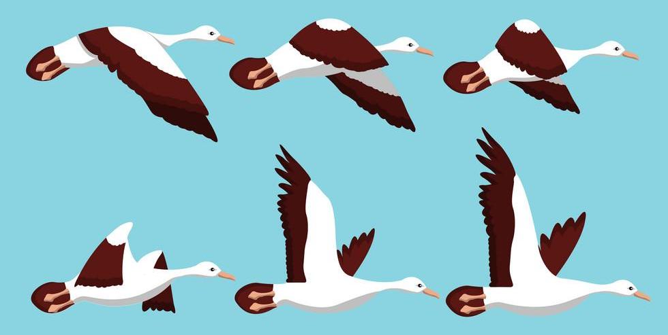
It is a process in which the pictures are arranged in a specific sequence that creates an illusion of motion of the object.

Slide 6
WHAT ALL DOES ANIMATION INCLUDES ?
Cartoons
Graphics
Moving Pictures
GIF

Slide 7
Uses of Animation
Advertisement
Entertainment
Scientific visualization
Education
Gaming
Simulations

Slide 8
Benefits of using Animations in Teaching and Learning
Enhances Understanding of Complex Concepts
Increases Engagement and Attention
Improves Retention and Recall
Encourages Active Learning
Supports Inclusive Education
Caters to Different Learning Styles
Makes Learning Fun and Enjoyable
Promotes Creativity and Imagination
Improves Communication of Ideas

Slide 9
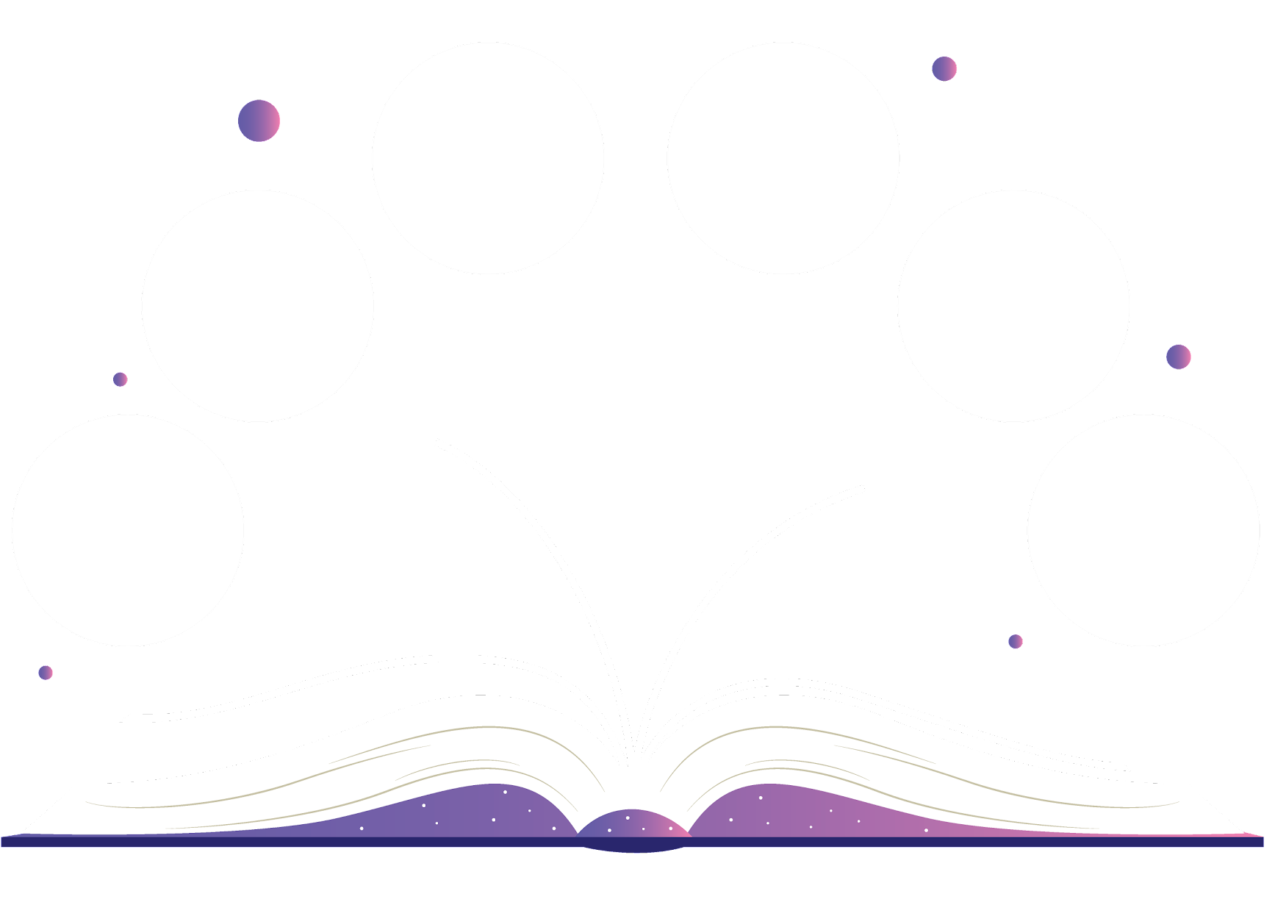
Advantages
Makes learning faster
Motivates curiosity among children
Improve engagement
Attempt risk-free experiments in a safe environment.
Visualize subjects for better Understanding
A different method of teaching to the traditional classroom lecture

Slide 10
Challenges
Requires a lot of effort and time
Technical knowledge know-how
Cost-consuming

Slide 11
Types of Animations
Traditional Animation
Motion Graphics
2D Animation
Stop Motion Animation
Rotoscope Animation
3D Animation

Slide 12
Traditional Animation
Hand-drawn animation: In this classic form, each frame is drawn by hand. It involves drawing on paper or celluloid sheets, which are then photographed and displayed in sequence.
Flipbook animation: A simpler version of traditional animation where a series of drawings on different pages create the illusion of motion when flipped through quickly.
Examples: Early Disney films like Snow White and The Lion King (original).
https://www.youtube.com/watch?v=csI3yilRPcY

Slide 13
2D Animation
In this type, computer software is used to create animations with vector graphics. Unlike traditional animation, where each frame is drawn separately, vector-based animation allows the animator to manipulate parts of the character or object.
Vector animation is scalable, meaning it can be resized without losing quality.

Slide 14
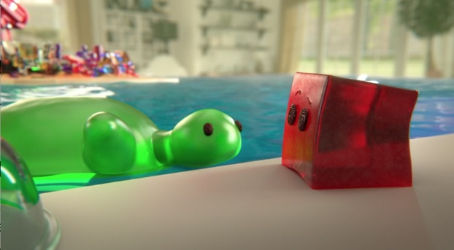
3D Animation
3D animation involves creating characters and environments in a three-dimensional space using computer software. The animator manipulates the models to move and interact.
3D animation is commonly used in movies, video games, and virtual reality.

Slide 15
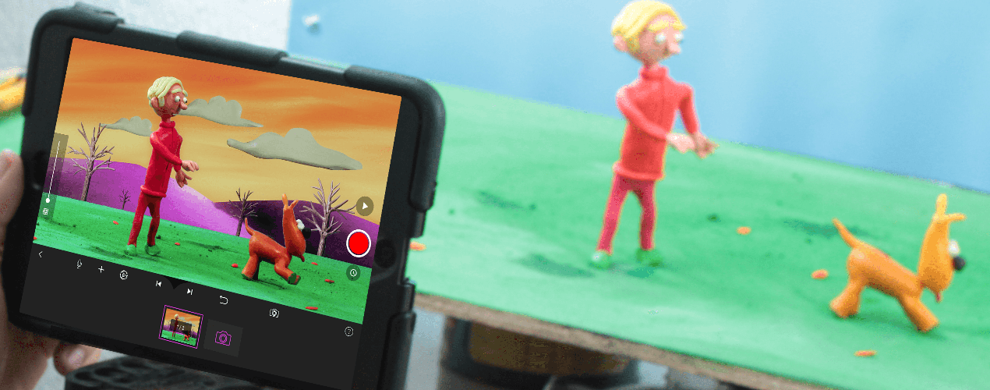
Stop Motion Animation
In stop-motion, physical objects are photographed one frame at a time, with slight movements between each shot. When played in sequence, the objects appear to move. It requires careful attention to detail as every movement is manually created.
There are different types of stop-motion based on the materials used:
Claymation: Uses clay models (e.g., Wallace and Gromit).
Puppet animation: Uses puppets (e.g., The Nightmare Before Christmas).
Cutout animation: Uses flat materials like paper (e.g., South Park in early episodes).
Object animation: Uses objects like toys or household items.

Slide 16
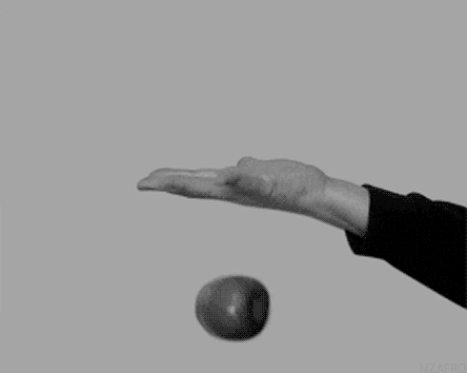
Object-Motion — moving or animating objects

Slide 17
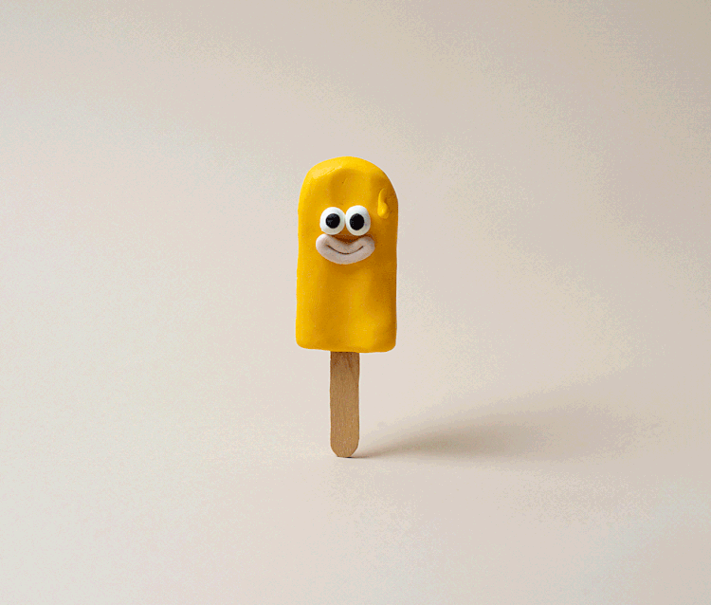
Claymation — moving clay

Slide 18
Motion Graphics
Motion graphics focus on animating graphic elements like text, logos, or abstract shapes. They are typically used for commercials, title sequences, or explainer videos rather than character-driven storytelling.
This type of animation often combines elements of graphic design and animation to convey information in a dynamic way
Examples: Intro sequences of TV shows or movies, animated infographics, logo animations.

Slide 19
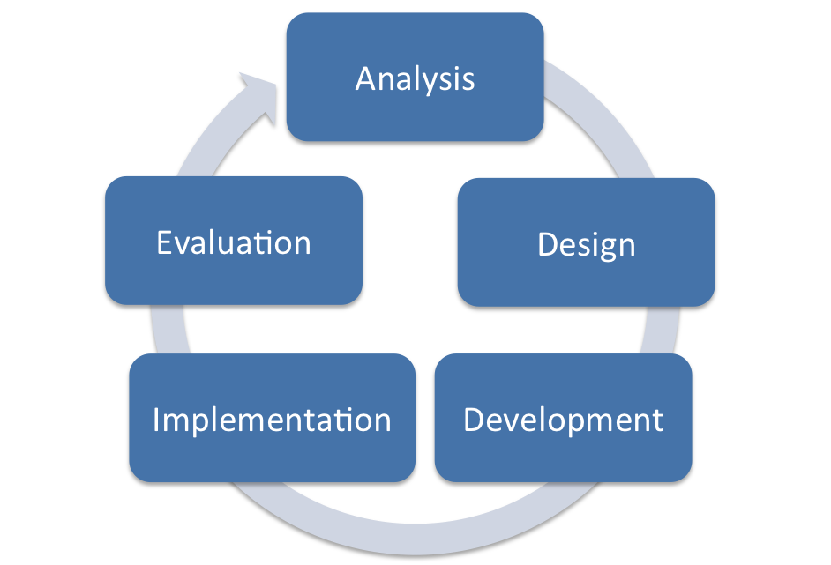
Process of Developing Animation
Analysis: Define objectives, audience, and content.
Design: Plan the script, storyboard, and animation style.
Development: Create and animate the content.
Implementation: Deliver the animation to learners.
Evaluation: Assess its effectiveness and make improvements.

Slide 20
Analyse
In this phase, you identify the goals, objectives, audience, and resources needed for the animation. You also determine how the animation fits into the broader learning context.
Key Steps:
Identify learning objectives: What is the purpose of the animation? What knowledge or skills should learners gain from it?
Understand the target audience: Who will watch the animation (age, learning style, background knowledge)?
Assess resources and constraints: What tools, software, budget, and time are available?

Slide 21
Design
During this phase, you create a detailed plan or blueprint for the animation. This includes scripting, storyboarding, and selecting the style and tools for the animation.
Key Steps:
Develop a script: Write a detailed script outlining the narrative, dialogue, and key information for the animation. Ensure it aligns with the learning objectives.
Create storyboards: A storyboard is a visual representation of the animation’s key scenes and frames. It maps out the sequence of events, character movements, and dialogue.
Choose the animation style: Decide whether the animation will be 2D, 3D, motion graphics, or stop-motion, depending on the objectives and audience.
Select software and tools: Identify the animation software you will use (e.g., Adobe Animate, Blender, After Effects).
Determine the assessment strategy: Decide how you will assess if learners understand the animation's content (e.g., quizzes, interactive questions)

Slide 22
Develop
This is where the actual animation is produced based on the design plan. You build the assets (characters, backgrounds, text) and bring the animation to life.
Key Steps:
Create animation assets: Develop characters, objects, backgrounds, and other visual elements that will appear in the animation.
Animate the scenes: Using the chosen animation software, animate the frames or sequences outlined in the storyboard.
Add audio elements: Record and integrate voice overs, sound effects, and background music to enhance the animation.
Test the animation: Check for timing, pacing, and quality. Ensure the animation conveys the intended message effectively.

Slide 23
Implement
In this phase, you deliver the animation to the intended audience. This might involve embedding it into a lesson, uploading it to a platform, or using it in a classroom setting.
Key Steps:
Deploy the animation: Share the animation on the intended platform, such as a learning management system (LMS), website, or classroom projector.
Facilitate interaction: Depending on the setup, provide opportunities for learners to engage with the content. This could include discussions, interactive elements, or quizzes.
Provide instructions for use: Ensure that learners or instructors know how to use the animation as part of the learning process.

Slide 24
Evaluate
The final phase involves assessing the effectiveness of the animation in achieving the learning objectives. You evaluate both the learners' performance and the quality of the animation itself.
Key Steps:
Formative evaluation: Collect feedback during development, such as testing with small groups to identify areas for improvement.
Summative evaluation: After implementation, evaluate whether the animation helped achieve the learning objectives. This can be done through tests, quizzes, surveys, or direct observation of learner behavior.
Revise as necessary: Based on feedback and evaluations, make any adjustments to the animation for future use.

