Slide 1


Identifying And Handling Social Media Threats
How To Become A Savvy Social Media User
A CYBERPEACE PRESENTATION

Slide 2
Overview
Social media threat encompasses actions that jeopardize an individual's or organization's social media account. Bad actors use tools to surreptitiously acquire data, spy, or steal money by compromising their accounts. Data protection issues and loopholes in privacy controls can put user information at risk.
As boycotting all social media accounts is not an option in the digital age, we need to know how to identify and resolve threats – both old and new.

Slide 3
Table Of Content
• Common Social Media Threats
• The New Threats
• Strategies To Identify Social Engineering Techniques
• Effective Response Strategies

Slide 4
Common Social Media Threats
Cyberbullying
Scams
Data Breach
Account hack
Defamation
Grooming
Impersonation and Fake profile
IPR Violation
Fraud
Ransomware

Slide 5
ADDITION OF AI AND ML

Slide 6
AI-Generated Deepfakes
Cheapfakes or Shallowfakes are conventionally created altered media
Deepfakes use AI to synthetically create hyper-realistic videos, images, or audio by manipulating content.
Misuse includes impersonating people, spreading misinformation, or conducting fraud.
Scams include (e.g., deepfake videos of CEOs asking for financial transfers) or reputation attacks (e.g., compromising videos).

Slide 7
The New Threats On Social Media
• Misinformation
• Digital arrests
• Deepfakes
• Voice Cloning
• Website Spoofing
• QR scams

Slide 8


Deepfake Creation
Source: Norton

Slide 9
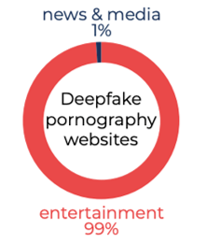
How Deepfake Technology is Being Used
Source: Deeptrace Lab.

Slide 10
AI-Powered Phishing
AI and machine learning are increasingly used to craft highly personalized phishing messages.
Such Targeted media makes it much harder for users to distinguish between real and fake communications.
Voice Cloning using AI tools enables mimicking of real voices.
Think about it- How can these Phishing techniques fool users?

Slide 11

Voice Cloning

Slide 12
Noida resident held for sharing Deepfake video of Uttar Pradesh Chief Minister Yogi Adityanath
Teen girls confront an epidemic of deepfake nudes in United States schools
Delhi Police arrests creator of deepfake video of Rashmika Mandanna
SP Oswal, Vardhman Group Chairperson, was duped of Rs 7 crore by cyber fraudsters after he was digitally arrested.

Slide 13
Social Media Bots and Automated Attacks
Bot networks (automated accounts) are increasingly being used to manipulate public opinion, amplify disinformation, or execute large-scale scams.
These bots create fake engagement, making fraudulent posts or malicious links seem more legitimate by driving likes, comments, and shares.

Slide 14

USE OF DEEPFAKES TO CONDUCT SCAMS AND FRAUDS

Slide 15
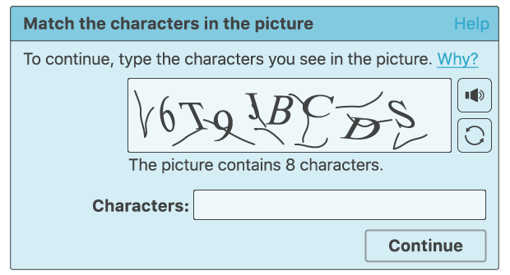
Identifying Bad Bots
CAPTCHA is a popular example of challenge-based detection.
Advanced bots can use ML to identify these distorted letters and are sophisticated enough to make up 50% of passed reCAPTCHA challenges.

Slide 16
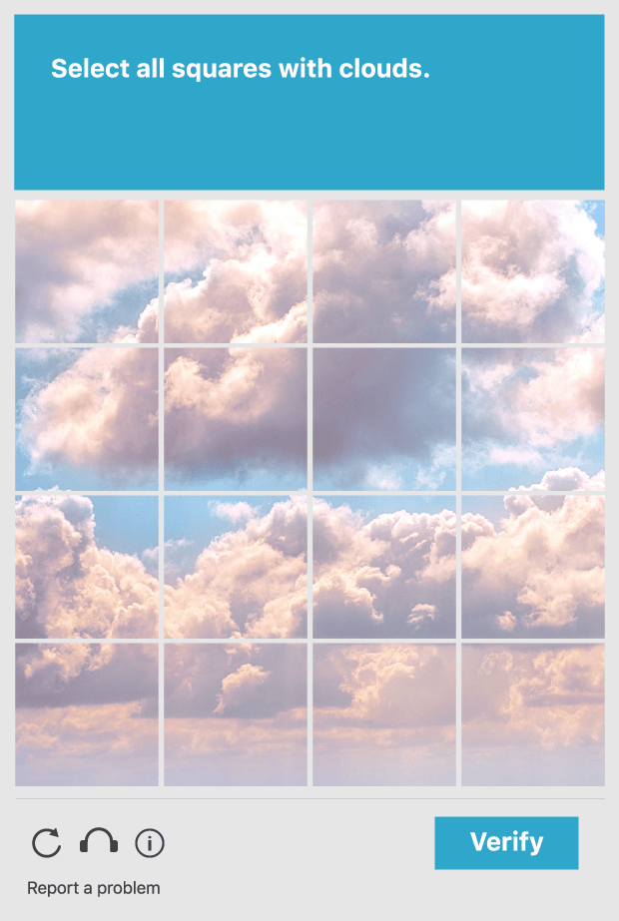
Image Recognition Using reCAPTCHA
Google reCAPTCHA has developed several tests to sort out human users from bots

Slide 17
Cryptocurrency Scams and NFT Fraud
As cryptocurrencies and NFTs grow in popularity, social media has become fertile ground for crypto-related scams.
Fraudsters often use social media to promote fake investment schemes, fraudulent ICOs (Initial Coin Offerings), or even hijack celebrity accounts to endorse scam projects.

Slide 18

Celebrity Name/Photo Use For Crypto Scams
Beware! Elon Musk’s Deepfake livestream scams thousands with fake crypto scheme
Source Credit: cnbctv18.com

Slide 19
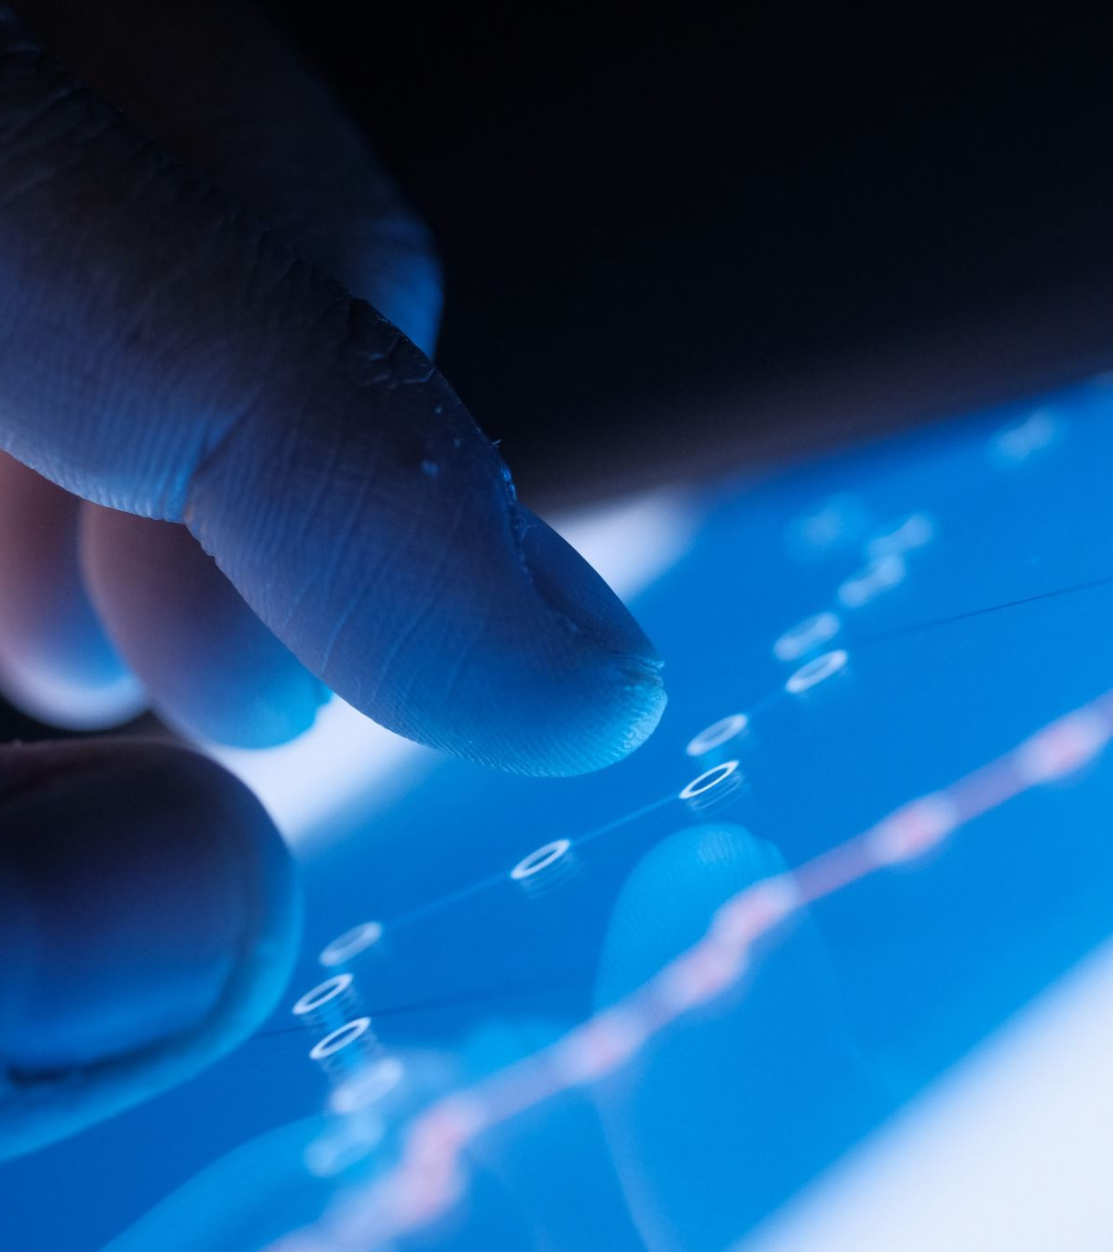
Data Scraping and Shadow Profiles
Using advanced tools, cybercriminals scrape personal data and build shadow profiles.
This data can be used for anything from spear-phishing to account takeovers or sold on the dark web.
Even people not on social media can have shadow profiles, courtesy of friends & family.

Slide 20
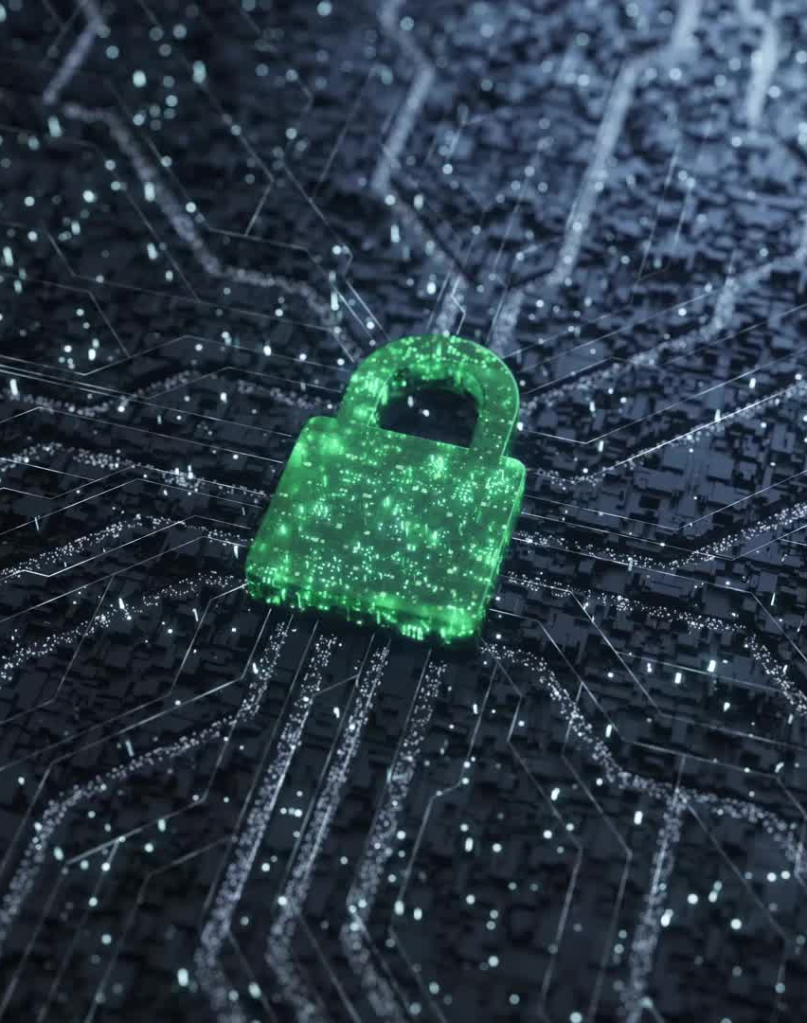
Social Media Ransomware
Attackers infiltrate social media accounts and lock users out, demanding a ransom to restore access.
Hackers also threaten to expose private or sensitive information from social media accounts unless paid in cryptocurrency

Slide 21

Fake Influence and Follower Fraud
Criminals are exploiting the rise of influencer culture by selling fake followers, likes, and comments to inflate influence.
Users and brands fall prey to fake influencers who appear legitimate but use bought engagement to scam followers or sponsors.

Slide 22
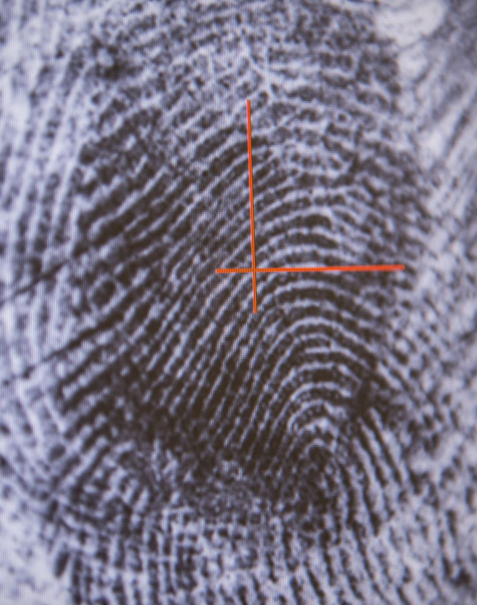
Biometric Data Theft
As social platforms begin incorporating biometric logins (like facial recognition), attackers are targeting this sensitive data.
Biometric data, if stolen or spoofed, can be harder to reset or secure compared to traditional passwords, making it a prime target.

Slide 23

Social Media Supply Chain Attacks
Hackers target third-party applications and integrations used within social media platforms (e.g., social media management tools or analytics apps) to breach security.
Compromising these apps gives cybercriminals indirect access to social media accounts or sensitive data.

Slide 24
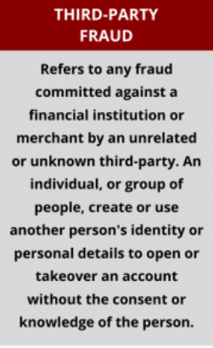
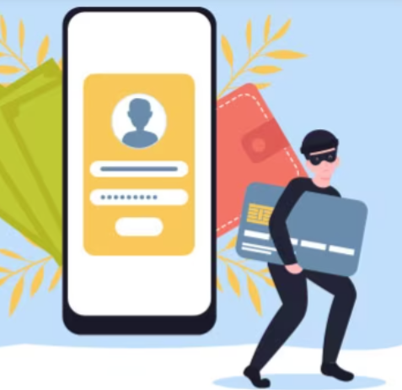
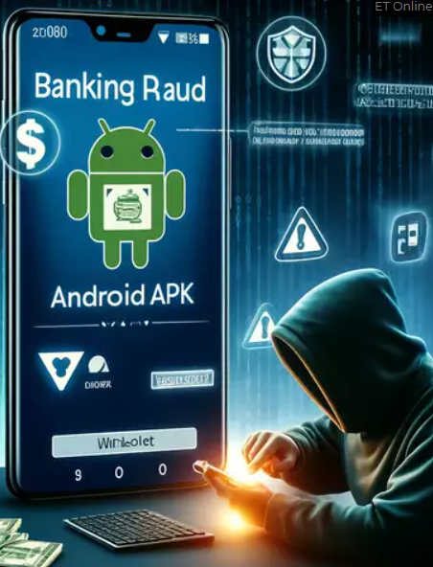
3rd Party Frauds
Account Takeover
Credit Card Fraud
APK Fraud
https://fraud.net/d/3rd-party-fraud/

Slide 25

Fighting The Fake

Slide 26

Strategies To Identify Social Engineering Techniques
Unsolicited content
Calls from Unknown Numbers
Friendship requests from Strangers
Urgent Demand for Help
Pressure Tactics
Emotional Manipulation
Suspicious URLs
Tempting offers
Fear Mongering
Officious messages Seeking Verification Of Sensitive Data
Odd or confusing language
Weird Email address
General address
Message/call from doctors, army officers, teachers
Remote Tech Support

Slide 27
Effective Strategies
Use strong, unique passwords
Be cautious of clicking on links.
review and update privacy settings.
Avoid sharing sensitive info

Slide 28
Effective Strategies (Contd.)
Use biometric and AI-based identity verification
Regularly audit A/Cs and 3rd party apps
Beware of offers that sound tEMPTING
Always enable 2fa And maximize privacy
Stay informed about latest tRENDS

Slide 29













L29- 34, First Floor
Connaught Place, New Delhi - 110001
+91 823 5058 865
+ 1- 202- 922- 2121
611 Gateway BLVD Suite 120 San Francisco, United States CA- 94080

