Slide 1

Ministry of Electronics and Information Technology(MeitY)
Government of India
Cyberbullying
How Parents Can Protect Their Children

Slide 2


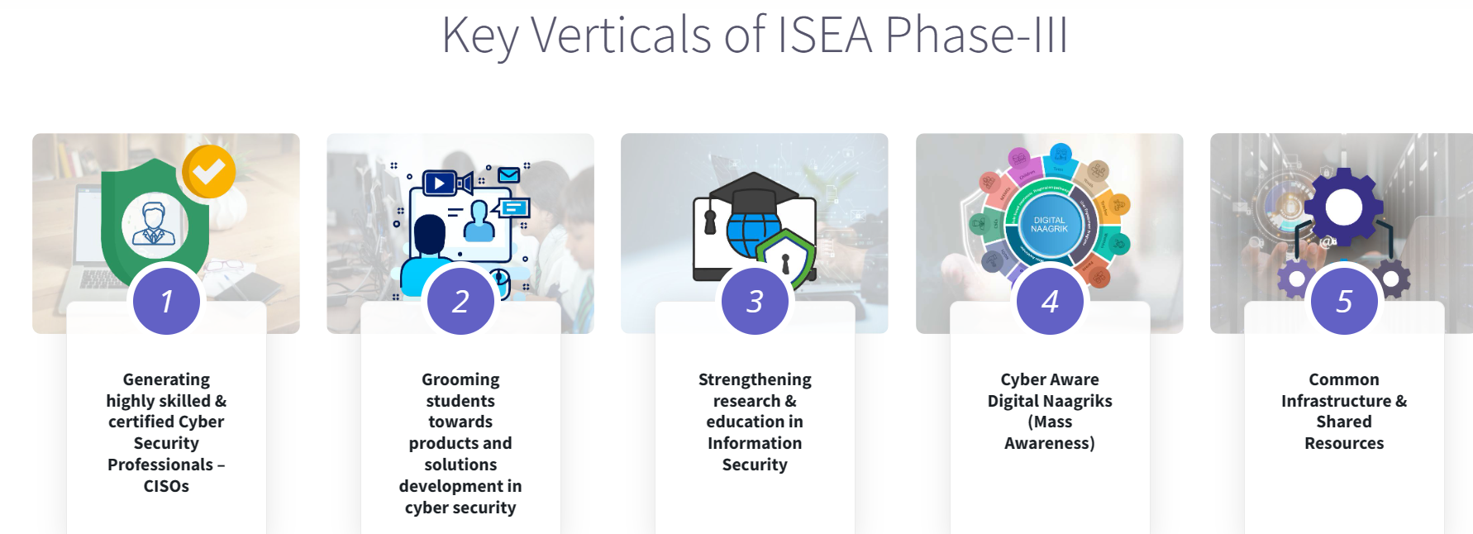

Slide 3
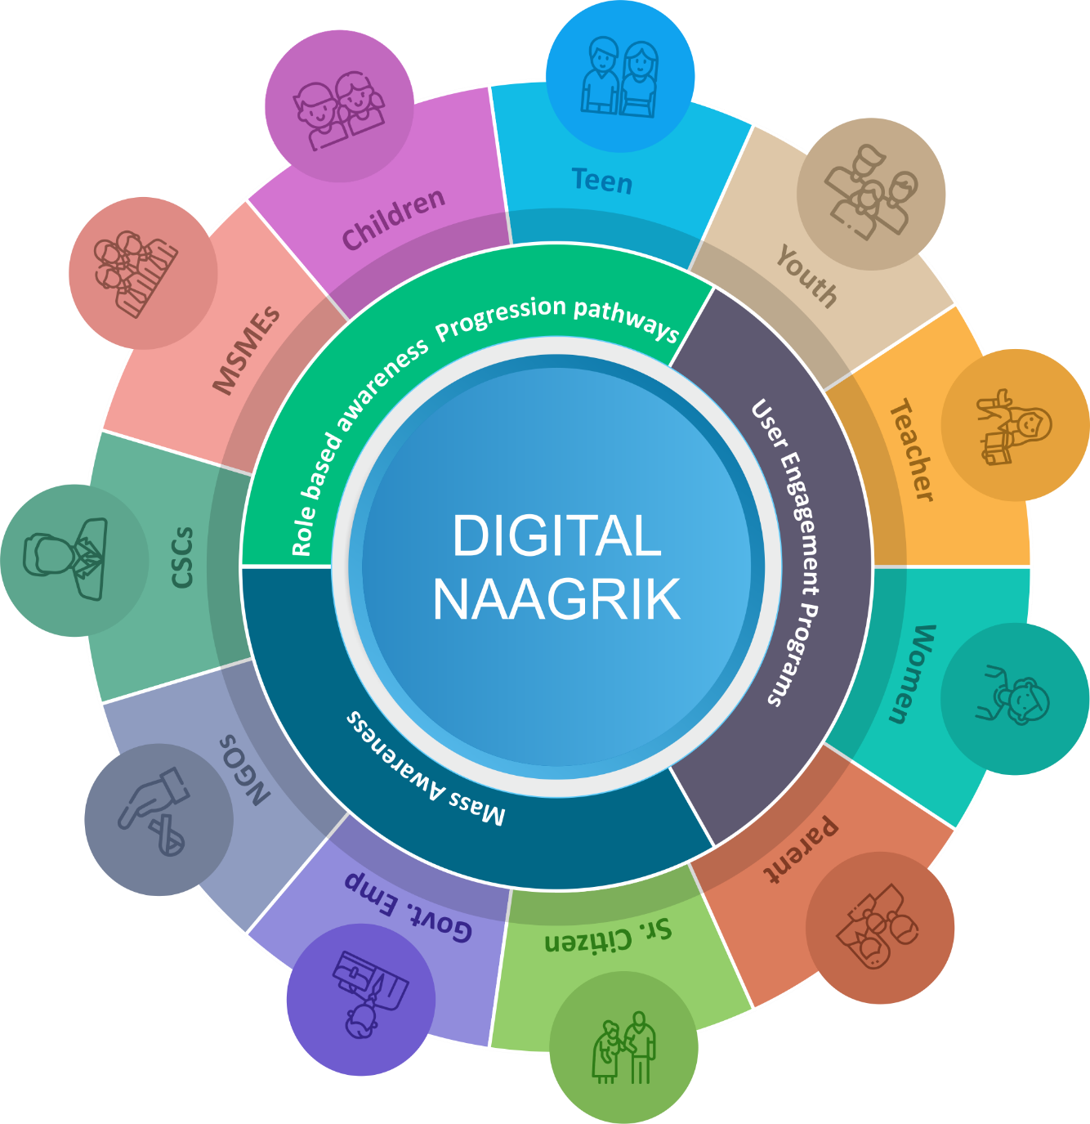
Cyber aware Digital Naagrik
1. Mass Awareness activities
  Awareness workshops / Webinars
  Awareness weeks
  AIR/DD/ Community Radio programmes
  Educational TV Programs (Digi shala)/YouTube
  Mobile App (Cyber fitness/Awareness App)
2. Multilingual awareness content
  Website, Handbooks, posters, cartoon, videos, etc.
  Leverage Print, Electronic, Social media for dissemination
  3. Role-based Awareness & Progression Pathways
  Interactive programs for Cyber Kid, Cyber Cadet, Cyber Women and Cyber Trainer
  User engagement: competitions, quiz, cyber clubs
Notes:
Digital naagrik or citizens are people who are actively engaged in the digital world for their day to day activities

Slide 4
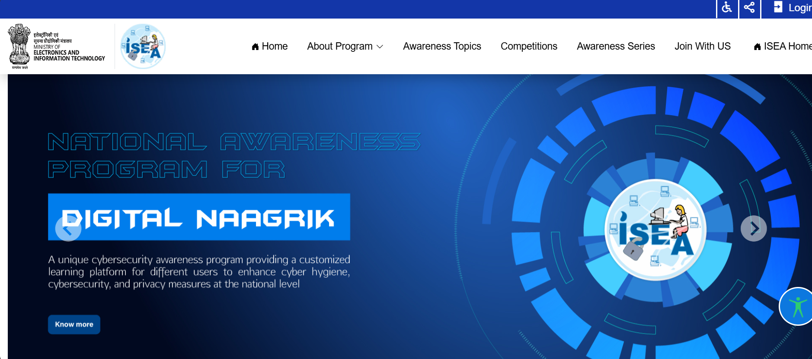

Slide 5

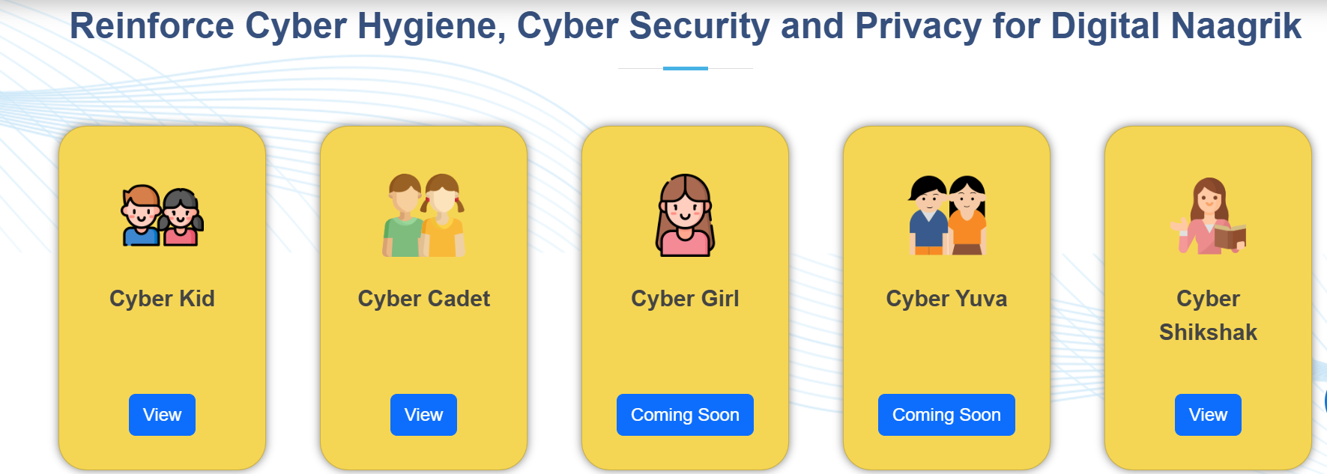
https://dn.isea.app/

Slide 6

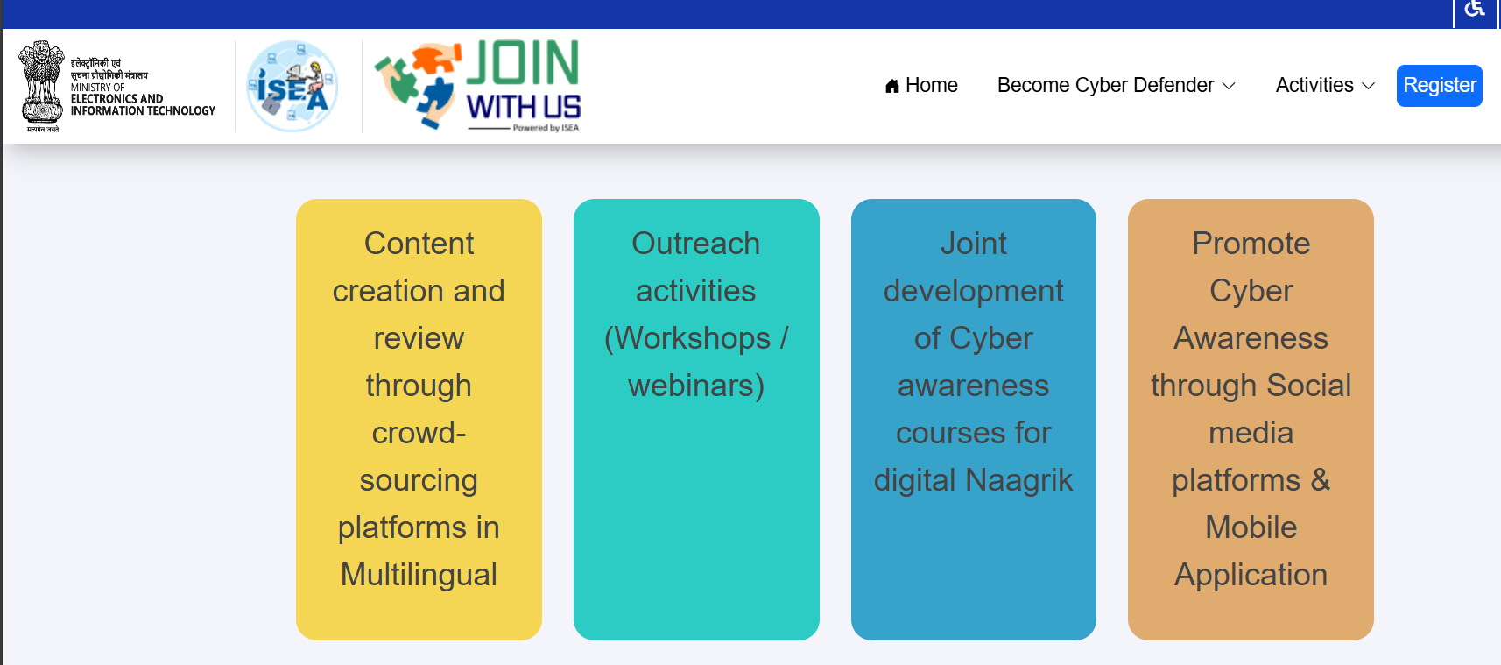
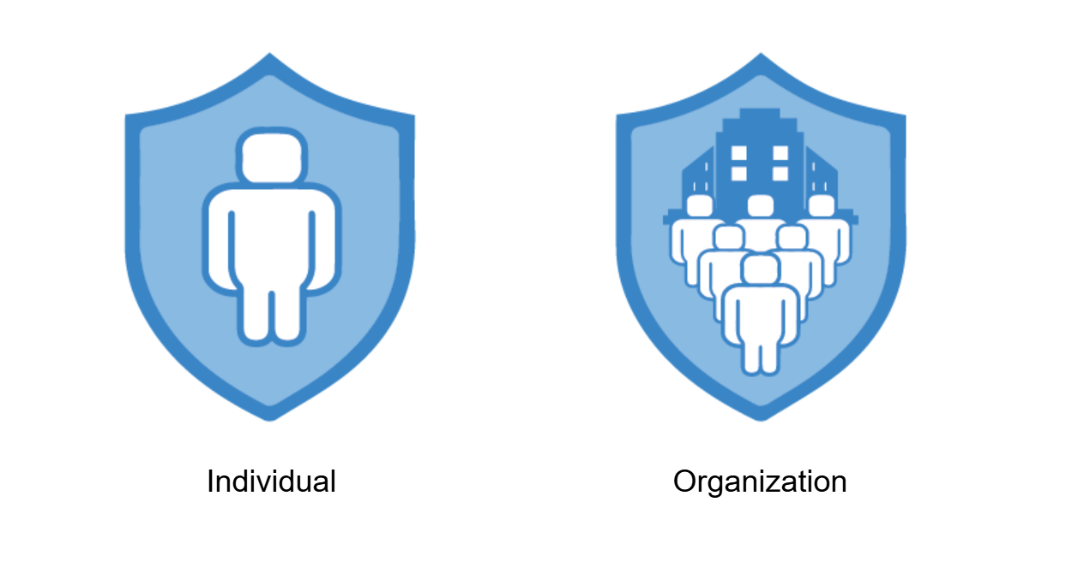
https://dn.isea.app/joinwithus

Slide 7

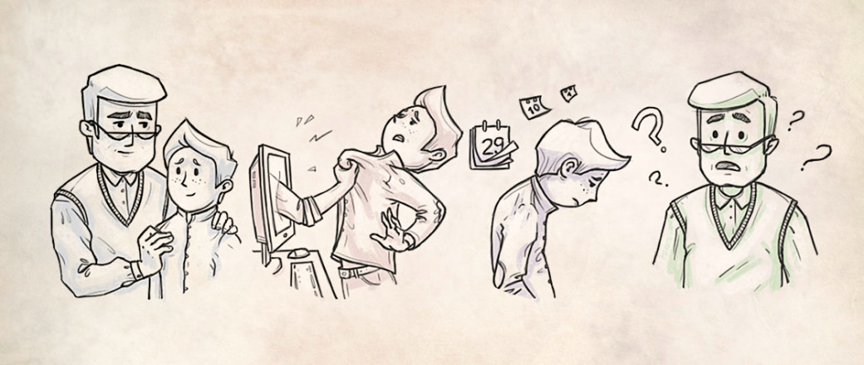
What every parent needs to know!
Cyber Bullying

Slide 8
What is Cyber Space for your children?
What is Cyberbullying ?
Recognizing the Signs of Cyberbullying
The Impact of Cyberbullying on Children and Teens
Preventative Measures for Parents
Steps to Take if Your Child is Being Cyberbullied
Resources and Tools for Parents and Kids
Topics of Discussion

Slide 9
What is Cyber Space for your children?

Slide 10






What is Cyber Space for your children
Safe Social Media Platforms
Educational Websites and Apps
Entertainment and Games
Creative Tools
Virtual Communities
Parental Controls and Safety Tools

Slide 11
What is Cyberbullying ?

Slide 12

Cyber Bullying
When a child, preteen or teen is tormented, threatened, harassed, humiliated, embarrassed, targeted by another child, preteen or teen using the Internet, interactive and digital technologies or mobile phones.
It has to have a minor on both sides, or at least have been instigated by a minor against another minor.

Slide 13

Every day, 160,000 children miss school out of fear of being bullied by other students.
​
Every 7 minutes a child is bullied on a school playground, with over 85% of those instances occurring without any intervention.​
Bullying occurs most frequently from sixth to eighth grade.
What Does the Research Say?

Slide 14
6 out of 10 Indian teens witness bullying at least once a day.
1 out of every 10 students who drops out of school does so because of being repeatedly bullied.
Those who are bullied are 5x more likely to be depressed and far more likely to be suicidal.
What Does the Research Say?

Slide 15
How it Works – Direct Attacks
Instant/Text Messaging Harassment
Stealing Passwords
Sending Pictures through E-mail and Cell Phones
Interactive Gaming (PS3 and Xbox)
Websites
Blogs
Internet Polling
Sending Malicious Code
Sending Porn and Other Junk E-mail
Impersonation

Slide 16
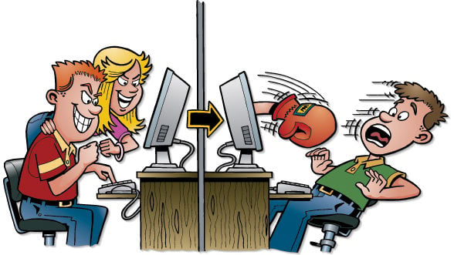
Why do kids Cyberbully?
Motivated by Anger, Revenge, and Frustration
Entertainment
Accident
Tough Guy or Gal
To Bolster or Improve their Social Standing
Think it’s Cool

Slide 17
Recognizing the
Signs of Cyberbullying

Slide 18
Is your child a victim?
Has a sudden fear of going to school.
Stops talking about school
Has a sudden drop in grades
Acts overly aggressive and angry or unusually withdrawn.
Has stomachaches, headaches or difficulty sleeping.
Has bruises, cuts or ripped clothing.

Slide 19
The Impact of Cyberbullying on Children and Teens

Slide 20
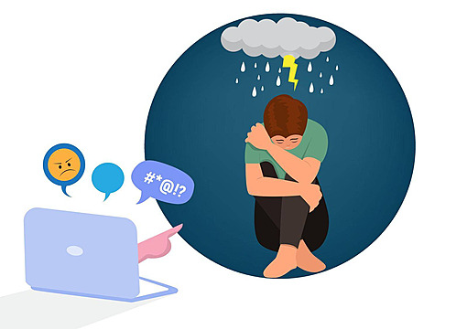
Social Withdrawal
Low Self-Esteem
Academic Decline
Anxiety and Depression
Physical Symptoms

Slide 21

Anxiety and Depression: Victims often feel isolated, anxious, and depressed due to the relentless nature of cyberbullying.
Low Self-Esteem: Persistent harassment can erode a child's self-confidence and sense of self-worth.
Social Withdrawal: Fear of further bullying may lead victims to withdraw from social activities and avoid interactions, both online and offline.
Academic Decline: The stress and distraction caused by cyberbullying can negatively impact a child's academic performance and interest in school.
Physical Symptoms: Victims may experience physical symptoms such as headaches, stomach-aches, or other stress-related ailments.

Slide 22
Preventative Measures for Parents

Slide 23

Prepare your child
Children are less likely to be victims of bullying if they appear confident and resourceful. To make sure your child isn’t a victim
Build your child’s self-respect: Teach him that he is strong and worthwhile. His rights and opinions count.
Teach your child how to be assertive. Tell him to clearly express his feelings, say no when he feels pressured, and stand up for himself with words—not fists.

Slide 24
Prepare your child
Role-play tough situations: Practice using different ways to deal with bullies.
Identify supportive people: Tell your child where to get help, such as from parents, teachers and other trusted adults.
Encourage friendships: Give your child opportunities to socialize with like-minded kids. Joining a club or team may help

Slide 25
Prepare your child
Stay involved: Know what’s happening at school and with friends.
Tell your child to avoid children who display bullying behavior.
Insist that your child walk away from dangerous situations. Children should never defend themselves or others from bullies who have a weapon.

Slide 26
Steps to Take if Your Child is Being Cyberbullied

Slide 27
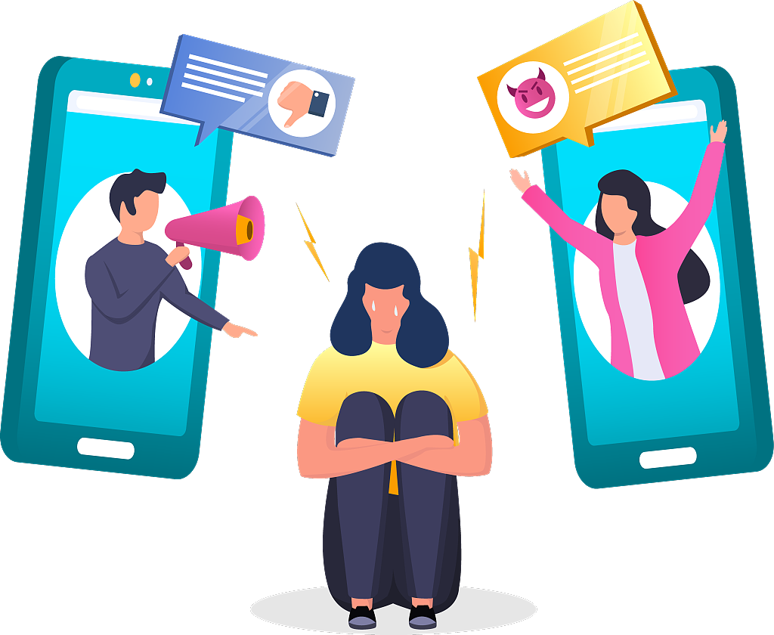
Prevent Bullying Behavior
In a recent study, nearly one-third of kids admitted to having bullied someone. To prevent your child from becoming a bully:
Set an example: Be caring and non-aggressive. When you are angry, act calm.
Provide outlets: Channel high energy into sports and other activities.
Monitor influences: Limit the amount of violence your child sees on TV and in video games.

Slide 28
Prevent Bullying Behavior
Use firm, fair and consistent discipline. Enforce sensible limits without fail.
Encourage values. Say, “Treat others as you want to be treated.”
Pay attention: Notice how your child behaves and address any problems immediately.
Seek advice: If you’re worried that your child might be a bully, talk with a professional.

Slide 29
Resources and Tools for Parents and Kids

Slide 30
Prevent Bullying Behavior
Educational Websites‍
  Websites like StopBullying.gov provide extensive resources and advice for preventing and dealing with cyberbullying.
  These sites often include tips, strategies, and real-life stories to help children understand the impact of bullying.
Parental Control Apps‍
  Apps like Qustodio and Net Nanny can help parents monitor and manage their children's online activities.
  These tools offer features like activity tracking, content filtering, and screen time management to ensure safe online interactions.

Slide 31
Prevent Bullying Behavior
Support Groups‍
  Online and local support forums can offer advice and emotional support for both parents and children dealing with cyberbullying.
  Connecting with other kids and parents who have had similar experiences can give comfort and practical insights.
Counselling Services
  Professional counselling can be beneficial for children affected by cyberbullying, helping them cope with the emotional aftermath.
  Counsellors can offer strategies for resilience and recovery, enabling children to rebuild their confidence and well-being.

Slide 32
Kids need to know that all online transactions are recorded by the computer internet address.
Law departments can work with Internet providers to identify exactly where that computer is located (anywhere on the planet).
Device fingerprint – Makes it easy to find the real users.
Anonymity

Slide 33

Cyber Safety Resources
http://www.facebook.com/safety
http://www.netsmartz.org/Parents
http://staysafeonline.org/
http://stopcyberbullying.org

Slide 34

Tentative Plan for Awareness week
20 Days before AW | Planning and conducting Training for Master Trainers and Preparations plan for Awareness Week (AW)
7 Days before AW | Media Plan by Police Department
Proposed Parallel Activities | Inauguration / General Public Awareness / Media coverage
 | Awareness Workshops / Schools, colleges, Police, SMEs, CSC VLEs / sharing details to media for coverage in the news paper
 | Awareness Workshops / Live DD / Private TV channel program – with Police, ISEA representatives
 | Awareness Workshops / AIR FM Radio live Phone-in program / Community radio programs – Police, ISEA Team
 | Awareness Workshops / Road shows - media coverage
 | Awareness Workshops / Malls, Theatres, crowded public places coverage – media coverage
 | Awareness workshops / Closing ceremony - media coverage

