Slide 1



Educational Apps and Games: Maximizing Learning Opportunities
Bhumika Narang
Project Engineer
C-DAC, Bangalore

Slide 2
Necessity of Learning
Personal Growth
Cognitive Benefits
Career Advancement
Social and Emotional Benefits
Health and Well-Being
Economic Advantages

Slide 3




Traditional Educational System
Teacher-Centered Approach
Fixed Syllabus and Content
Limited Resources and Flexibility
Periodic exams

Slide 4

Traditional Educational System
Lecture Formats
Facts Memorization
No real world connection
Disengagement
Lack of motivation
Poor Academic Results

Slide 5



Modern Education System
Dynamic Syllabus and Frequent Updates
Student-Centered and Flexible Learning Paths
Diverse Resources

Slide 6





Curriculum Planning and Design
Personalized Learning Paths and Adaptive Curriculum
Data-Driven Decisions and Predictive Analytics
Integration of AI Tools and Real-Time Updates

Slide 7
Educational Apps and Games
Engagement
Instant Feedback
Motivation
Availability
Self Pace based Learning

Slide 8
Benefits of Educational Apps and Games
Other
10%
Skill Building
20%

Slide 9

Engaging Learners through Gamification
Points & Rewards
Challenges & Quests
Interactive Storytelling

Slide 10

Incorporating interactive elements in learning
Quizzes and Polls
Roll-Playing Scenarios
Game Narratives
Game-Based Learning
Discussion Forums
Group Projects
Peer Reviews
Teamwork Skills

Slide 11

Developing Critical Thinking Skills
Problem-Solving
Interactive puzzles and challenges
Logical Reasoning
logic and deductive reasoning
Decision-Making
Weigh the evidence and Alternatives

Slide 12




Personalized Learning Experiences
Adaptive Learning
Difficulty level based on individual performance.
Personalized Feedback
Real-time feedback on progress and areas for improvement.
Learning Paths
Personalized learning pathways based on student needs.

Slide 13
Accessibility and Inclusivity
Subtitles and Audio Descriptions
Enhance accessibility for students with hearing impairments.
Alternative Controls
Provide options for students with physical disabilities to interact with apps.
Multilingual Support
Accessible to students from different language backgrounds

Slide 14

Integrating Apps and Games in Classroom
Planning & Selection
Carefully choose apps and games that align with curriculum goals
Implementation & Differentiation
Integrate apps into lessons and provide support for diverse learners
Assessment & Reflection
Evaluate the effectiveness of apps and make adjustments as needed

Slide 15





Future Trends
AI-Powered Learning
Personalize learning paths and tailored support
Virtual Reality Immersive Learning
Immersive and engaging learning experiences, Enhanced Realism
Advanced Gamification
Sophisticated and personalized
Cloud-Based Learning
Access to educational resources

Slide 16
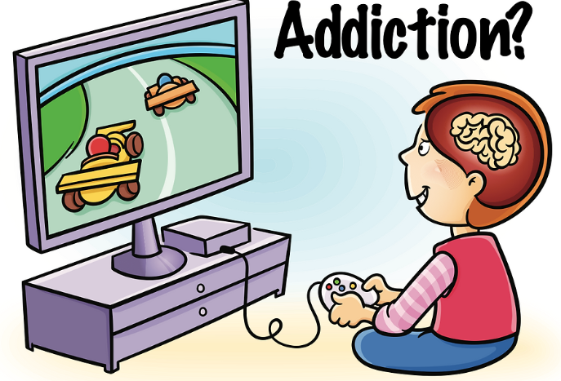


Limitations
Quality and Content Concerns
Technological Dependence
Privacy and Data Security
Lack of Personalization
Lack of Socialization

Slide 17
Conclusion
Harnessing the Potential
Addressing Challenges
Balancing Innovation and Pedagogy
Focus on Outcomes

Slide 18
Thank You

