Slide 1





Socrative: A Comprehensive Guide to Interactive Assessment
PRESENTED BY
Dr. Ruchi Dwivedi,
Assistant Professor, CIET, NCERT

Slide 2








Socrative can be…
Dynamic online tool that can facilitates real-time assessment & student engagement through interactive quizzes, polls, & activities.
Allows educators to create & launch various assessment types, gather instant feedback, & analyze student’s understanding.
Can be used with various devices (laptops, tablets, smartphones)

Slide 3
Useful for!
Real-time Feedback: Instantly gauge student comprehension & identify areas needing further instruction.
Increased Engagement: Transform traditional assessments into interactive & engaging activities.
Data-Driven Insights: Collect data on student performance to inform instructional decisions.
Time Efficiency: Automate grading for certain question types & streamline assessment workflows.
Versatility: Adaptable for various subjects, grade levels, & learning environments.

Slide 4
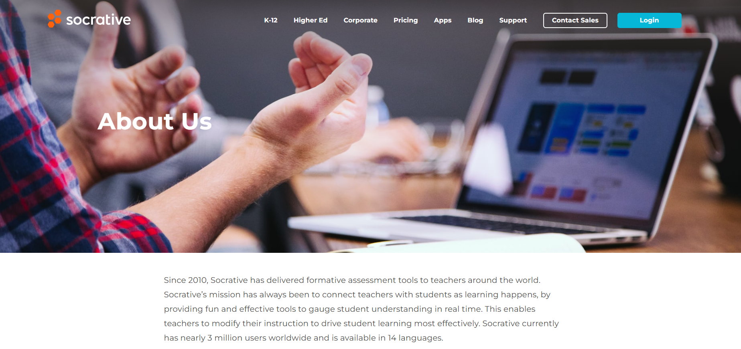


Slide 5
Session Covers:
Creating Quizzes & Activities
Exploring Advanced Features
Socrative Interface & Navigation
Launching & Managing Activities

Slide 6
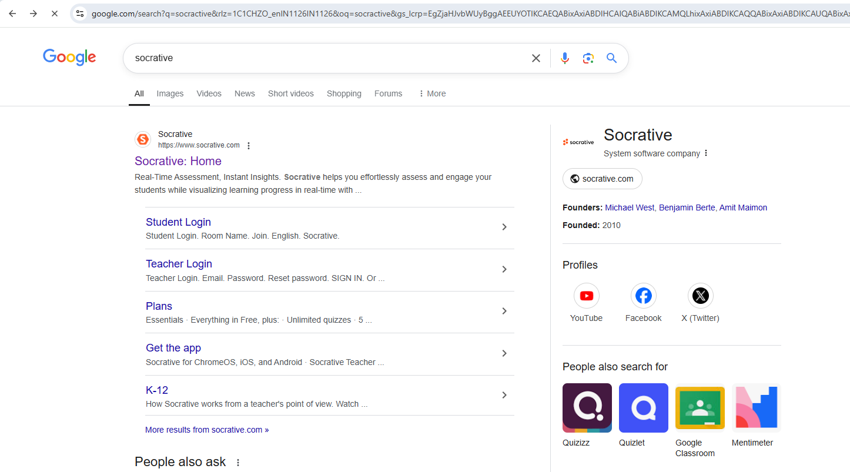

1. Socrative Interface & Navigation
1.1

Slide 7
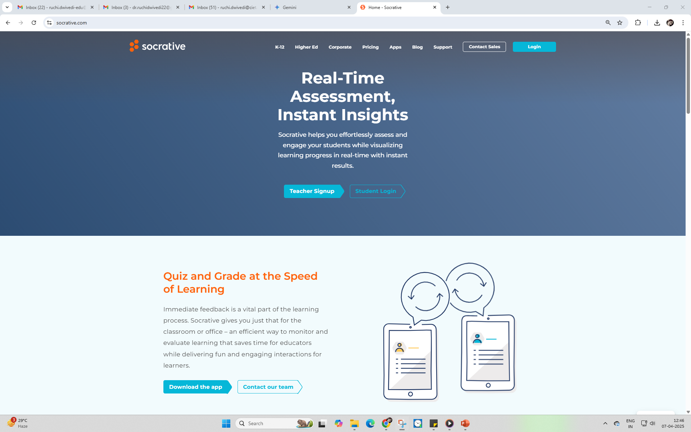
1.2
For Students
For Teachers

Slide 8

1.3

Slide 9
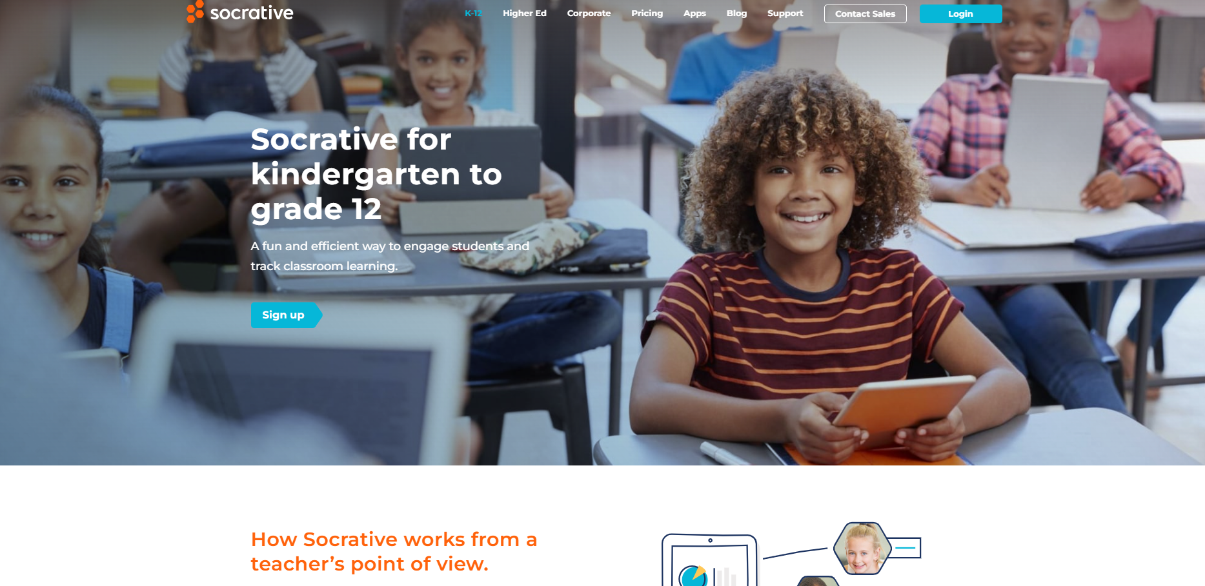
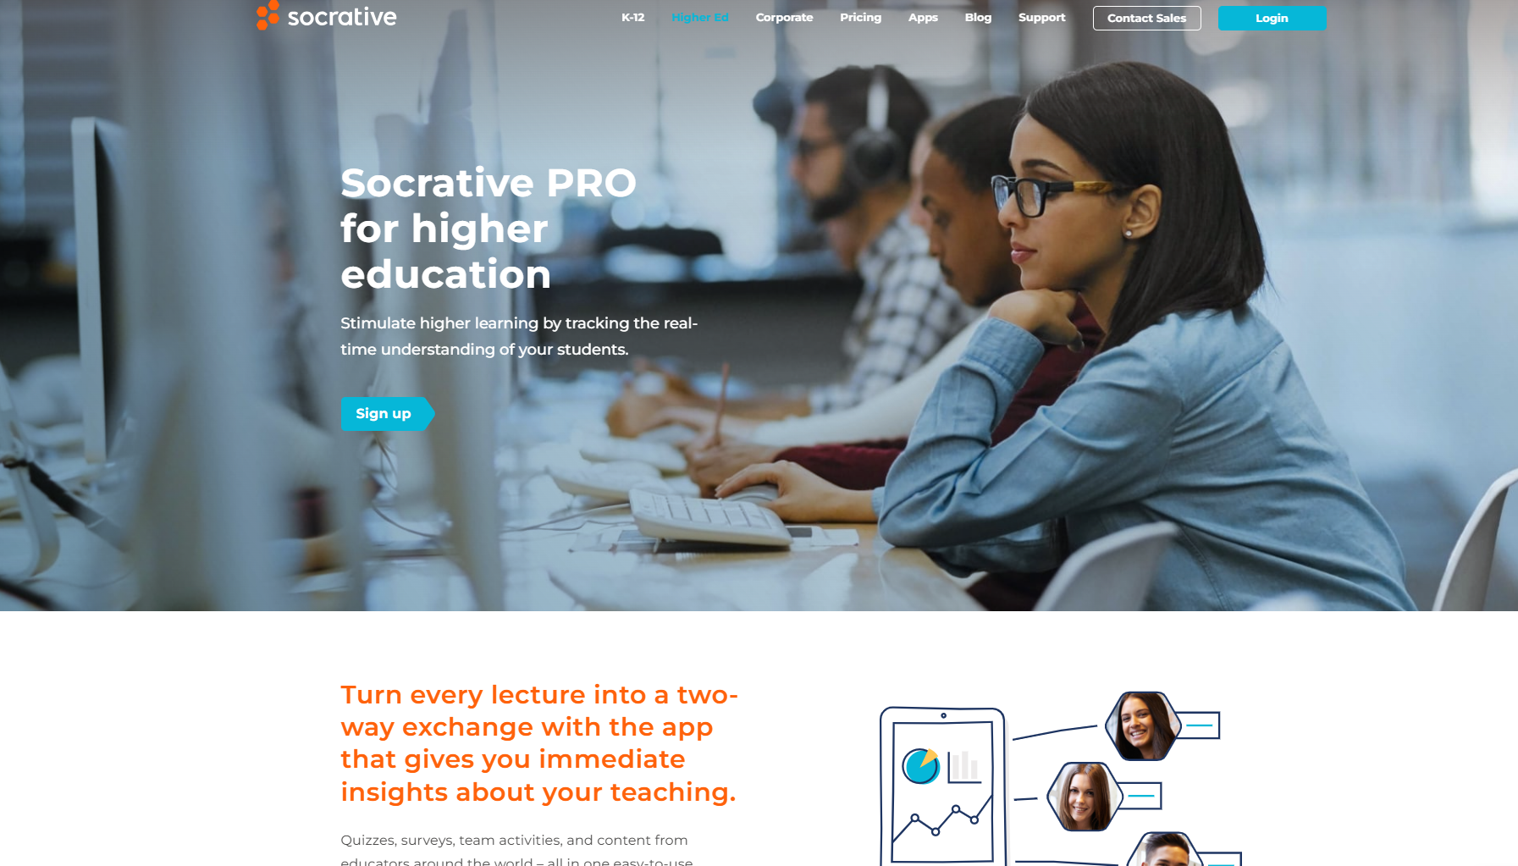
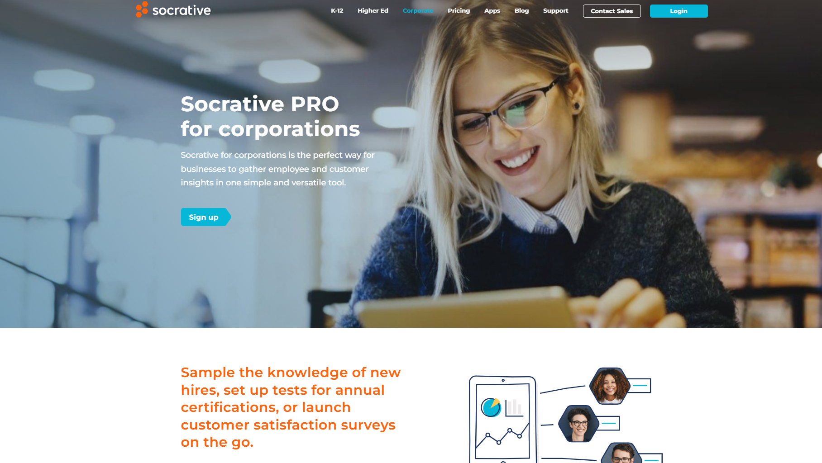
K12
Higher Edu
Corporate
1.3.1

Slide 10
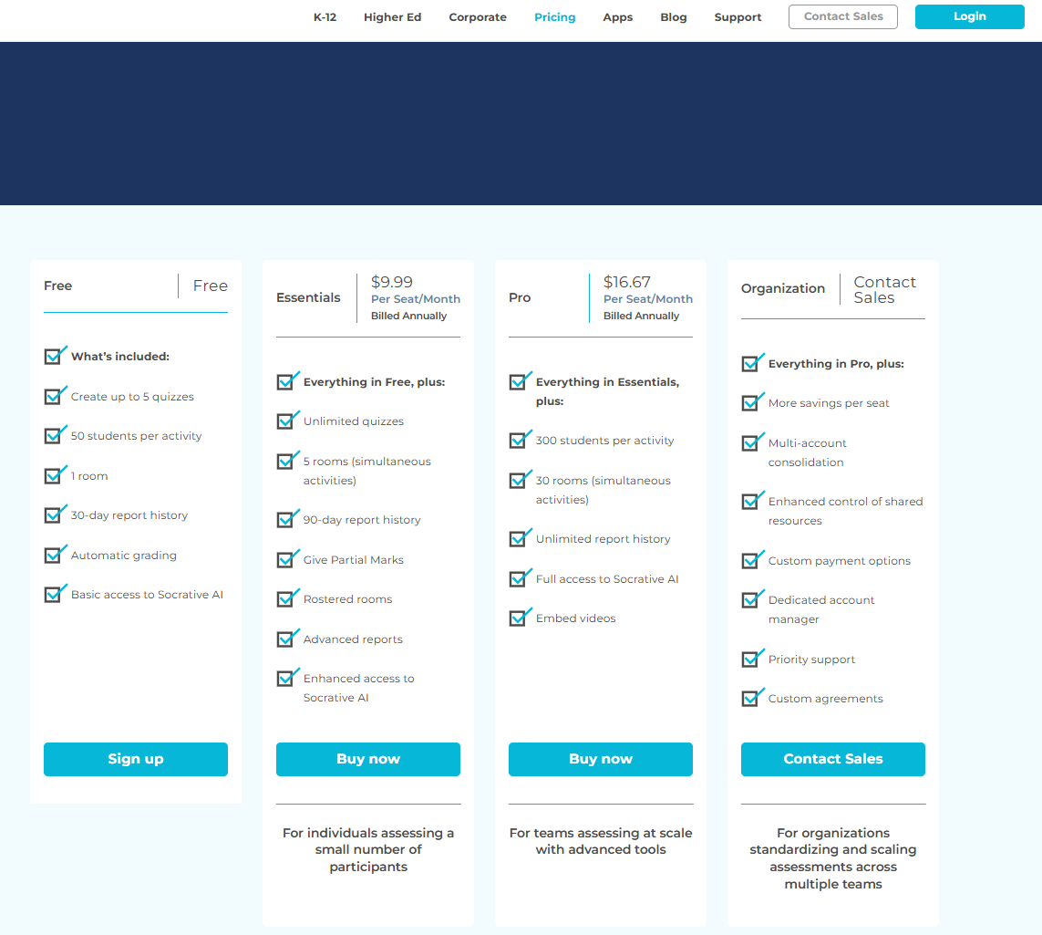
1.3.2
Pricing

Slide 11
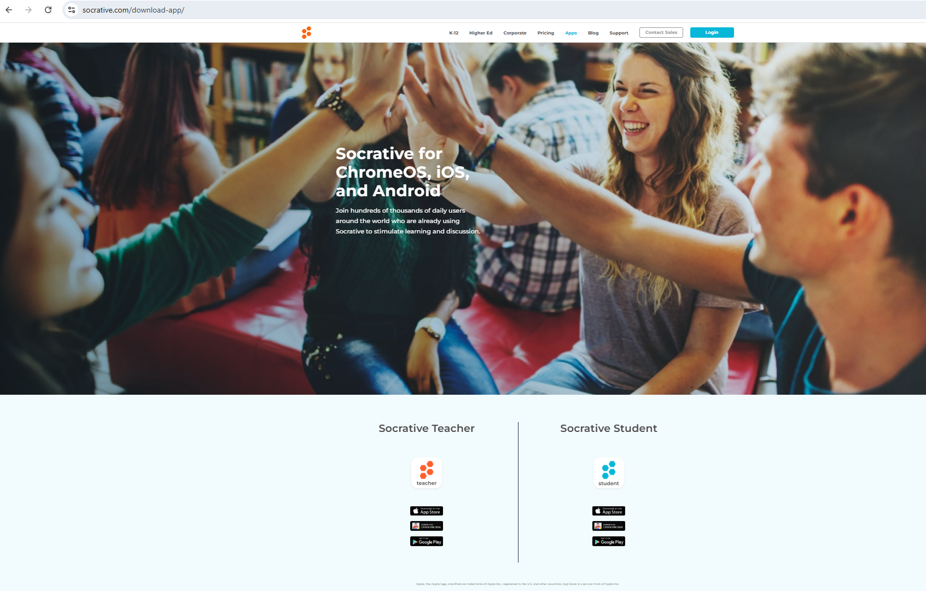
1.3.3
Apps

Slide 12
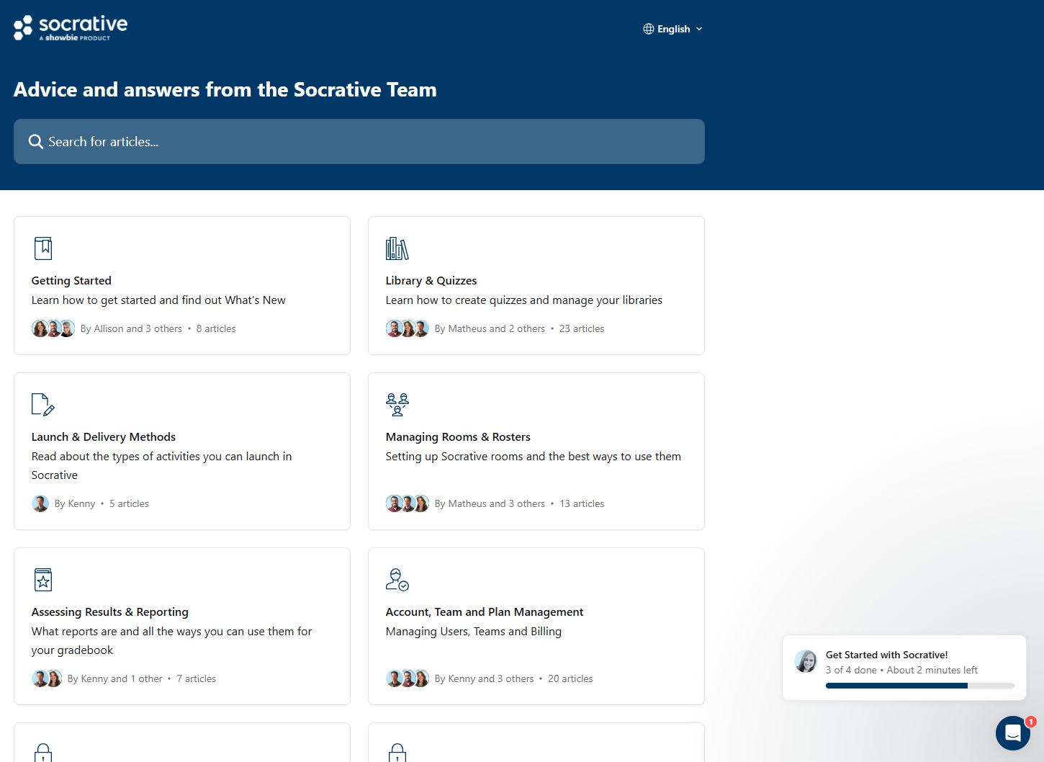

1.3.4
Support
Blog

Slide 13
1.3.5
Login

Slide 14
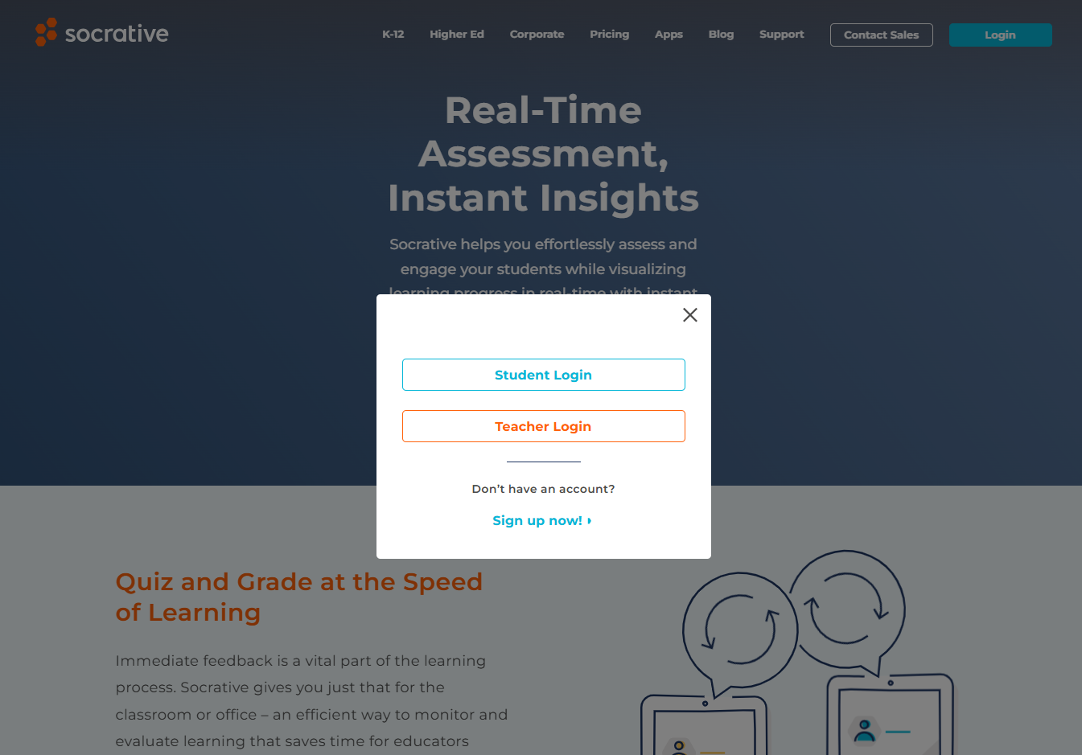
1.6

Slide 15
1.7
Student Login

Slide 16
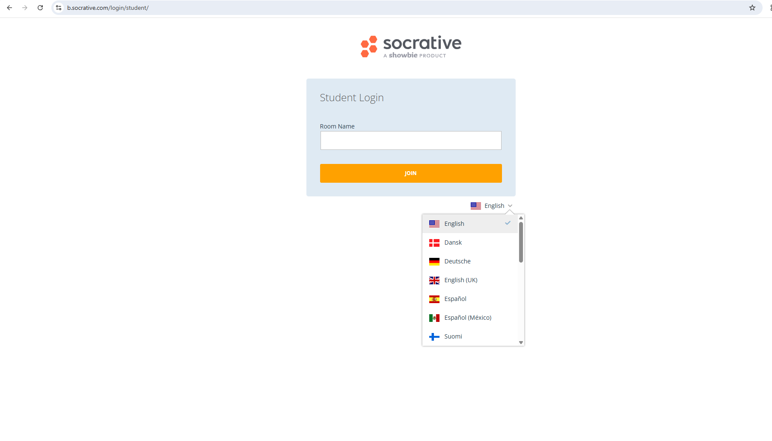
1.7.1

Slide 17
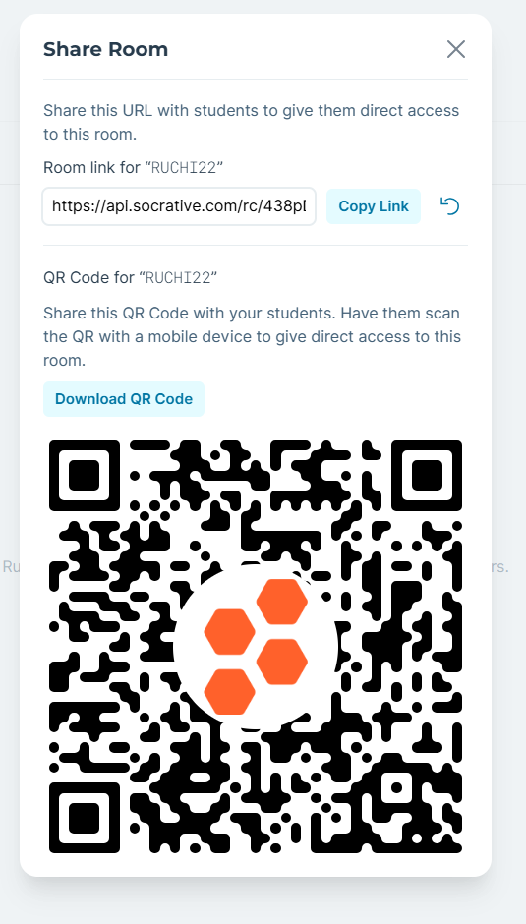

1.7.2
Edit

Slide 18
1.8
Teacher Signup

Slide 19
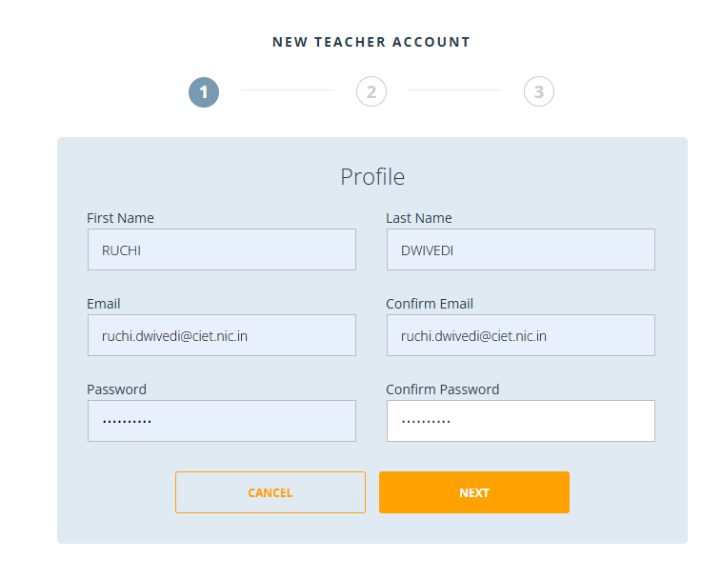
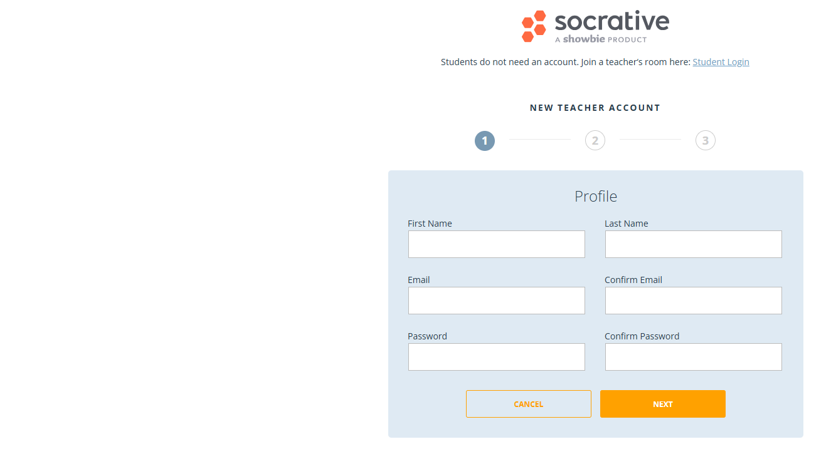
1.8.1

Slide 20
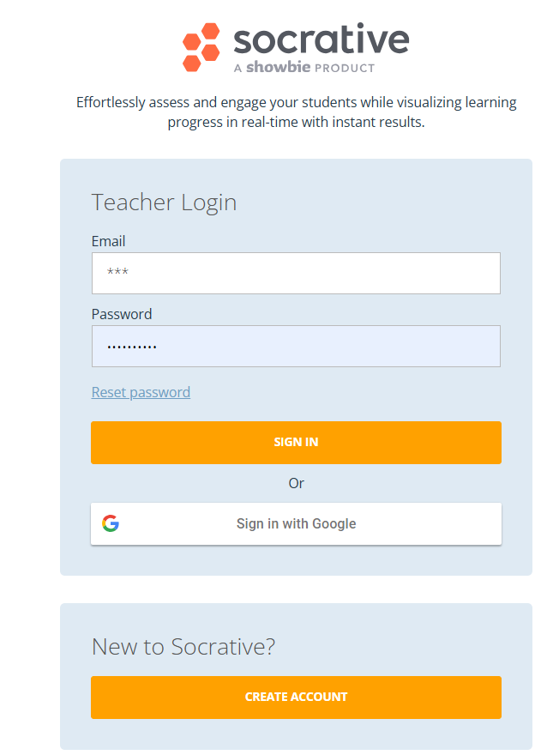
1.8.2

Slide 21
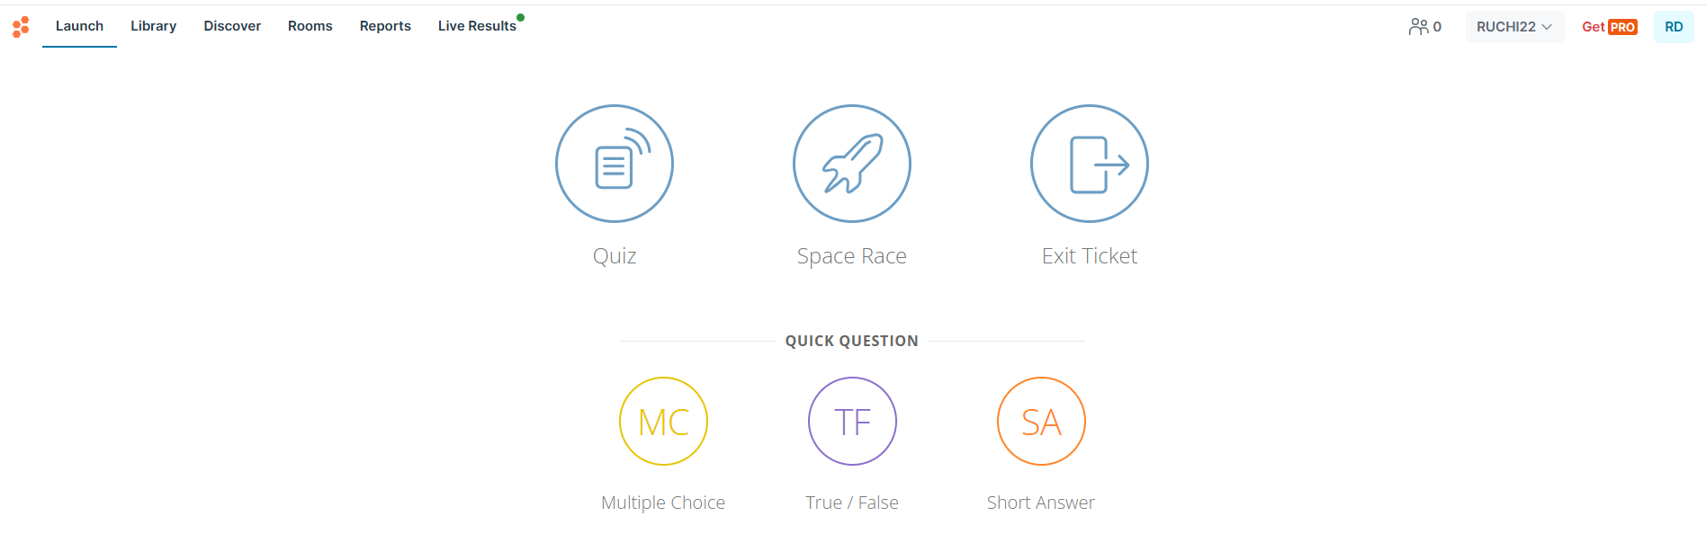
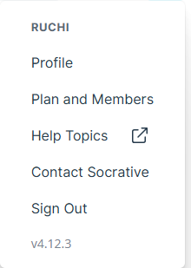
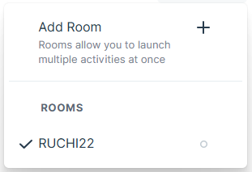
2. Creating Quizzes & Activities
2.1
Launch

Slide 22
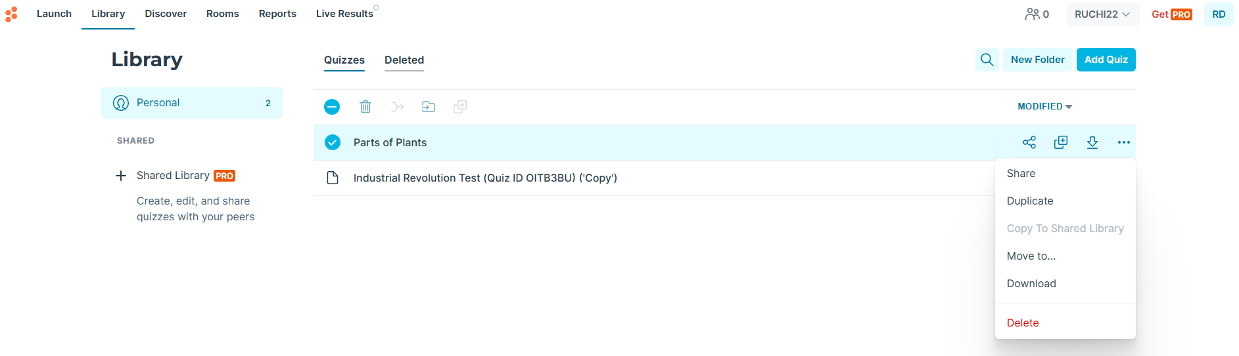
2.2
Library

Slide 23
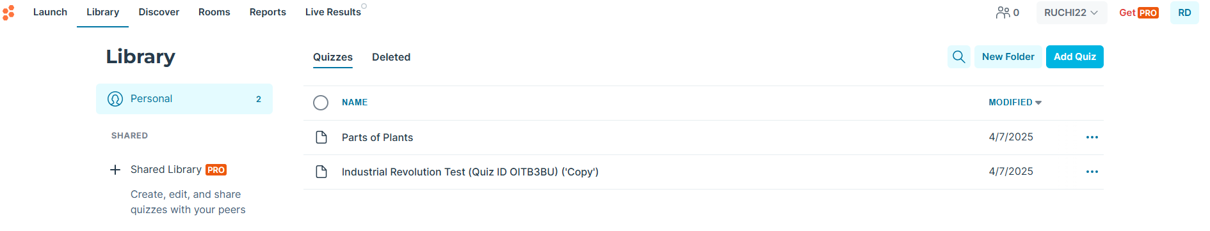
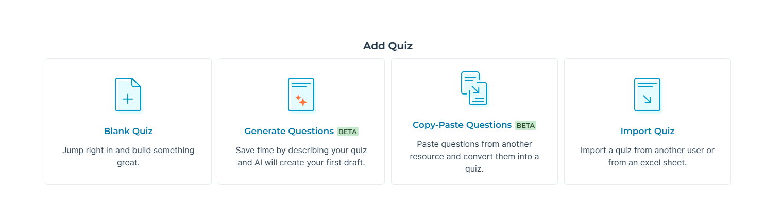
2.3

Slide 24

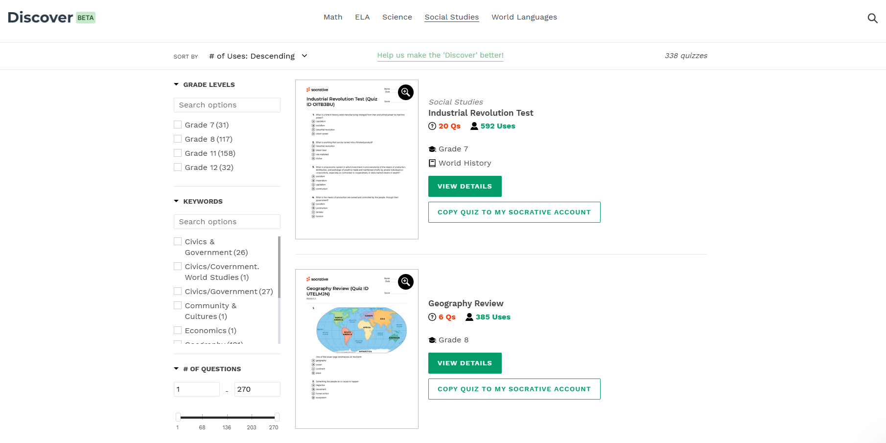
2.4
Discover
Scroll down…

Slide 25
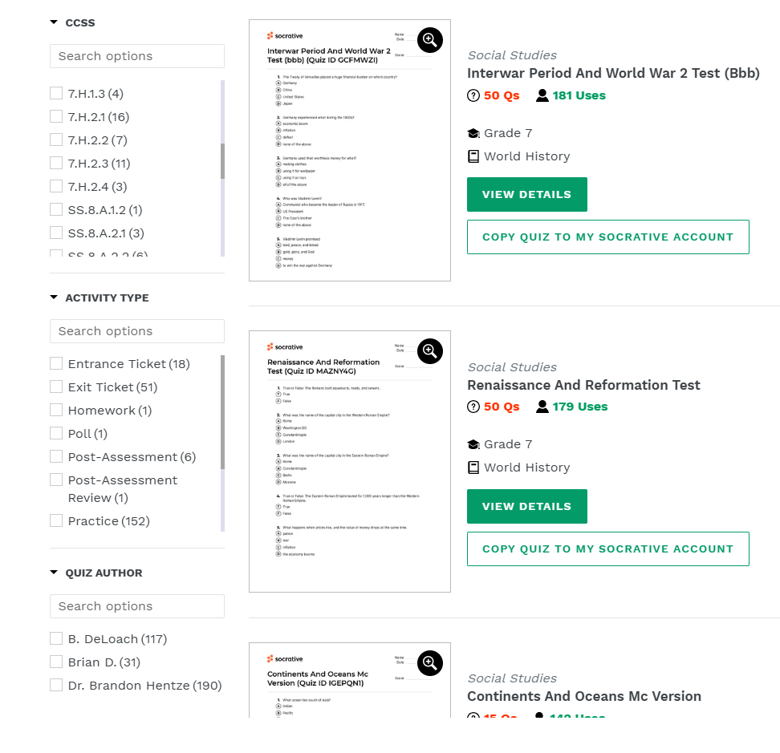
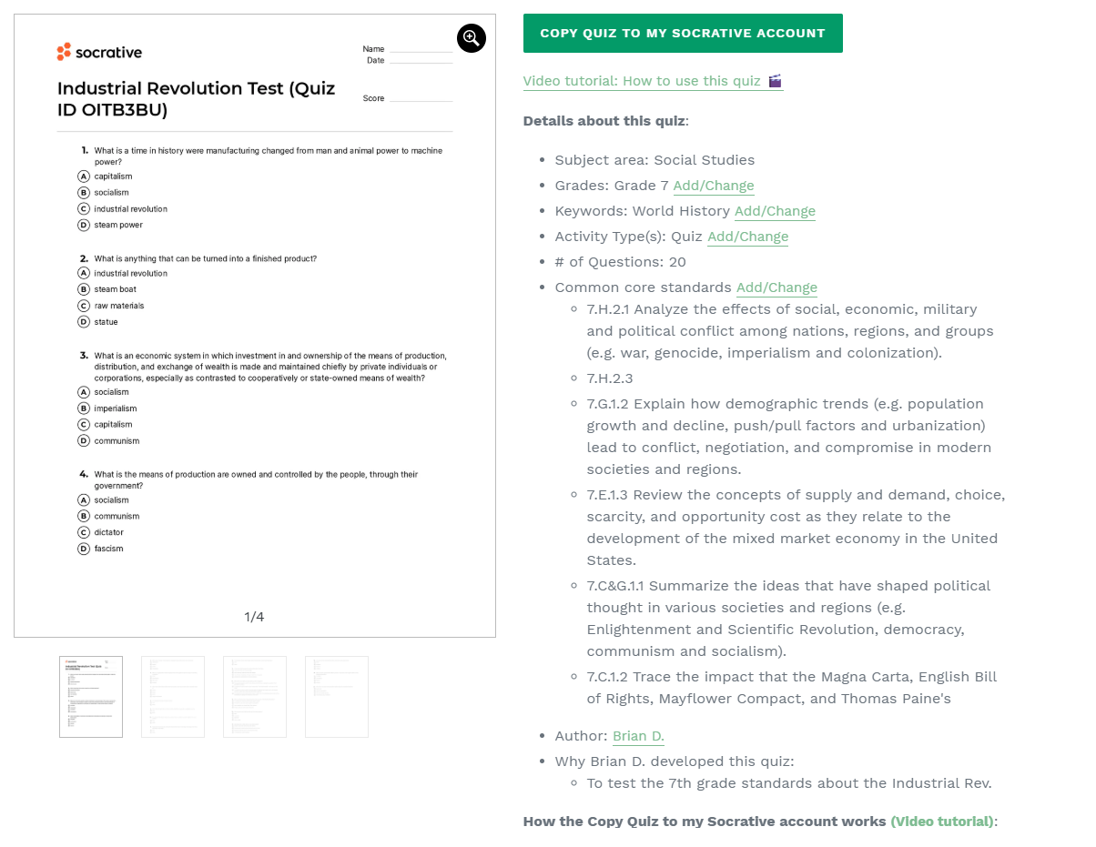
End.
Scroll down…

Slide 26
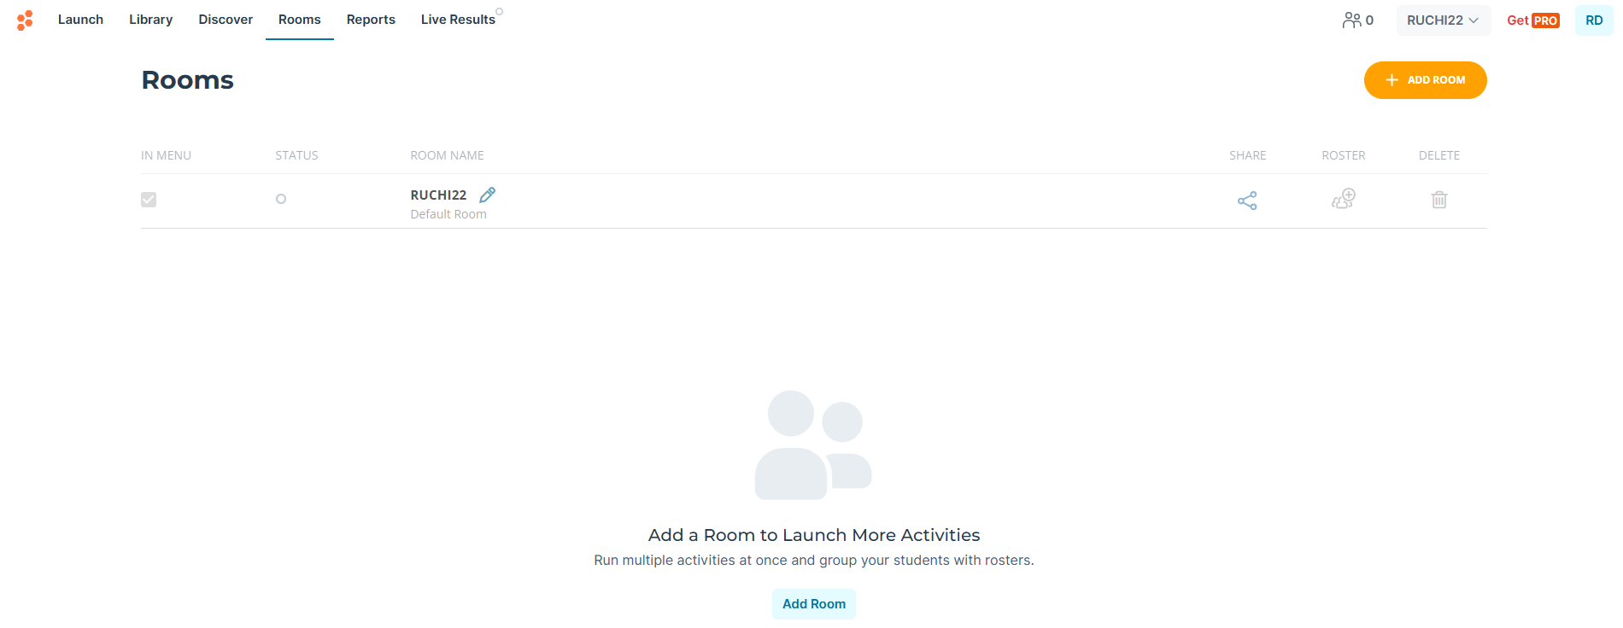
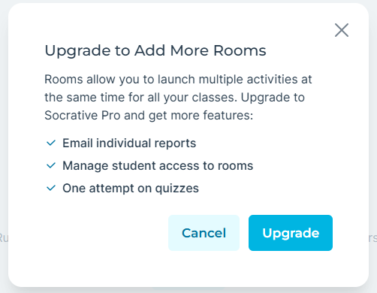
2.5

Slide 27


2.6

Slide 28
3. Launching & Managing Activities
3.1
MCQ
True/False
Short Answer (yet no word limit)
Launch

Slide 29
Feature | Quiz | Space Race | Exit Ticket
Purpose | FA/SA, in-depth evaluation of learning | Review games, engaging practice, collaborative activities | Quick checks, lesson reflection, feedback collection
Question Types | MCQ, true/false, short answer |  | Pre-set questions (Teacher's question)
Customization | Highly | Moderate | No
Features: What/When/Why

Slide 30
Feature | Quiz | Space Race | Exit Ticket
Pacing | Teacher/Student, or open navigation | Teacher but depends on team/individual setup | Student
Response | Can be customized (immediate, delayed, etc.) | Immediate | Usually aimed for immediate
Engagement/ Sync. | High/Moderate | High | Lower (focused on reflection)

Slide 31
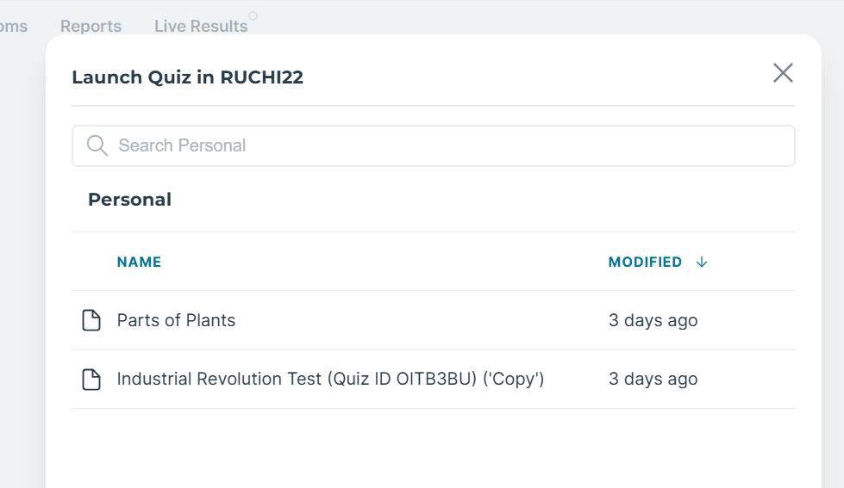
3.2
Quiz

Slide 32
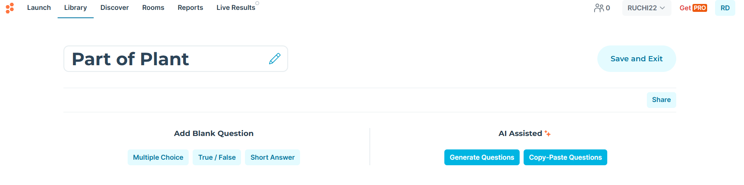
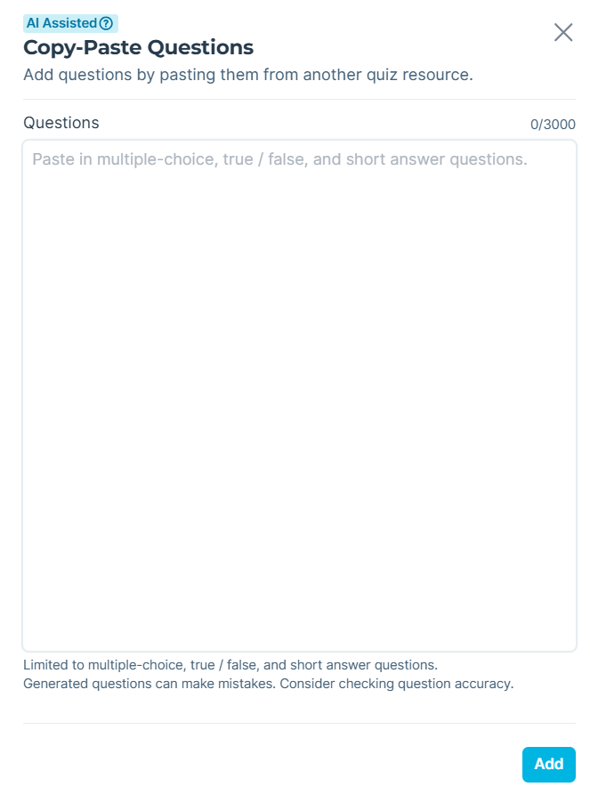
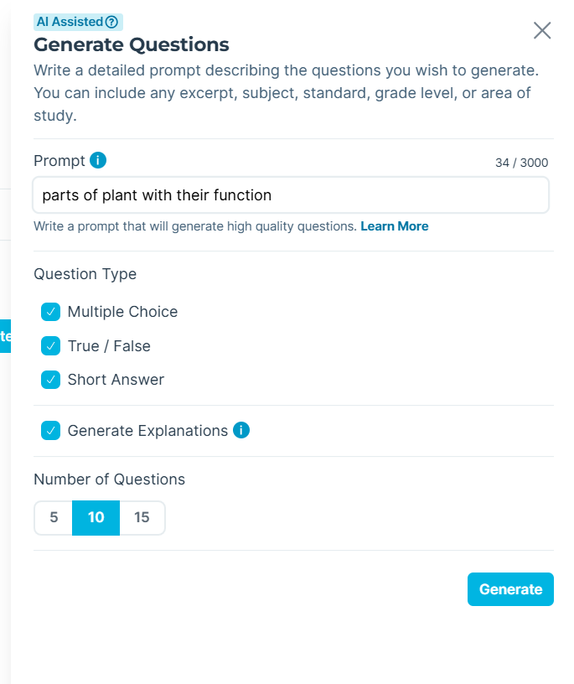
Edit
3.2.1
Edit

Slide 33
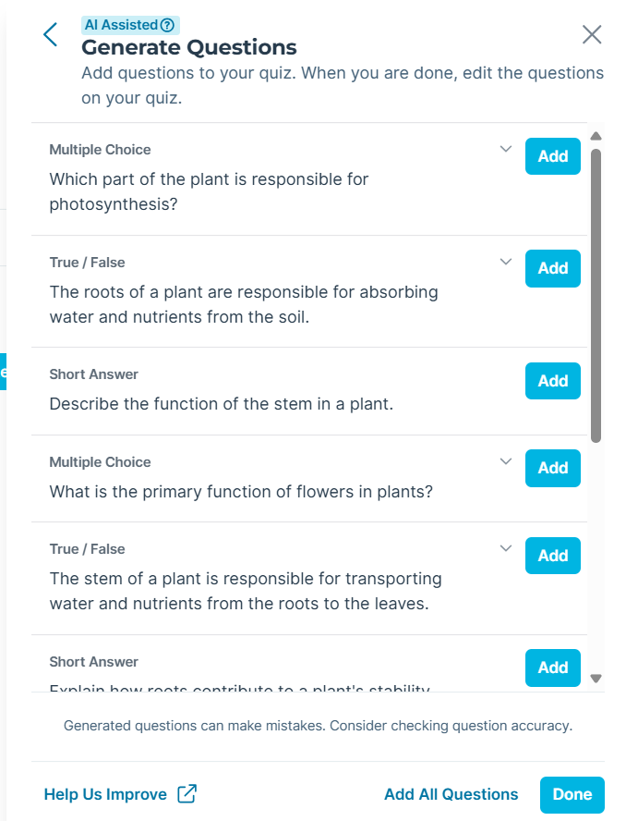
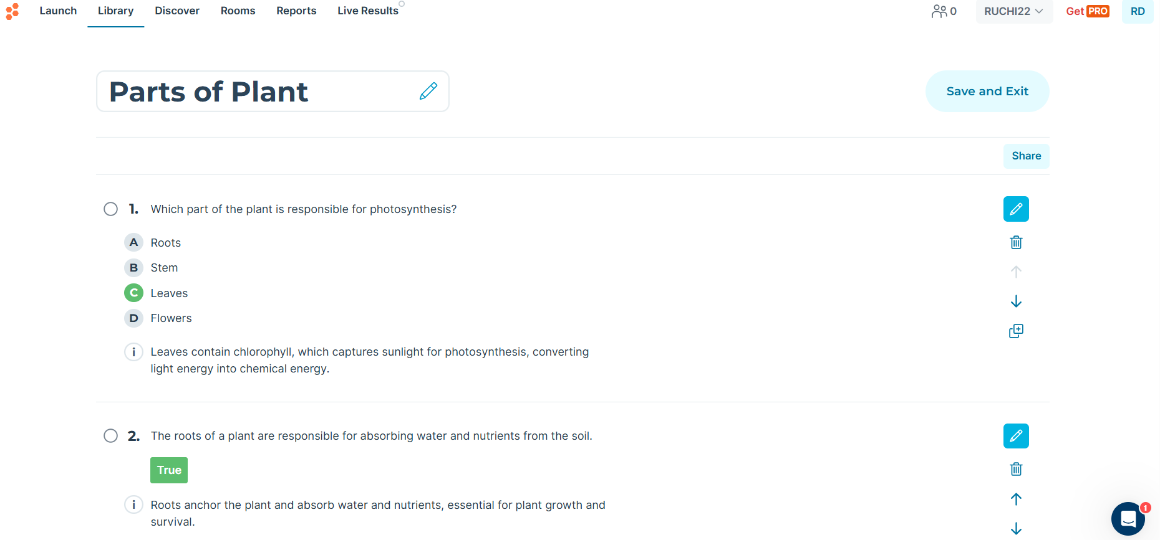
3.2.2

Slide 34
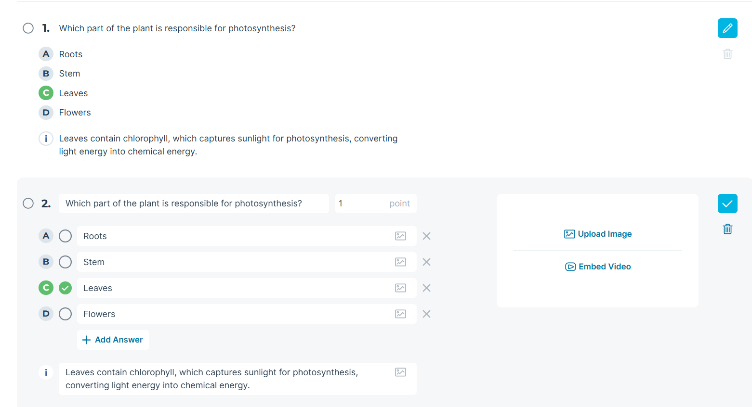
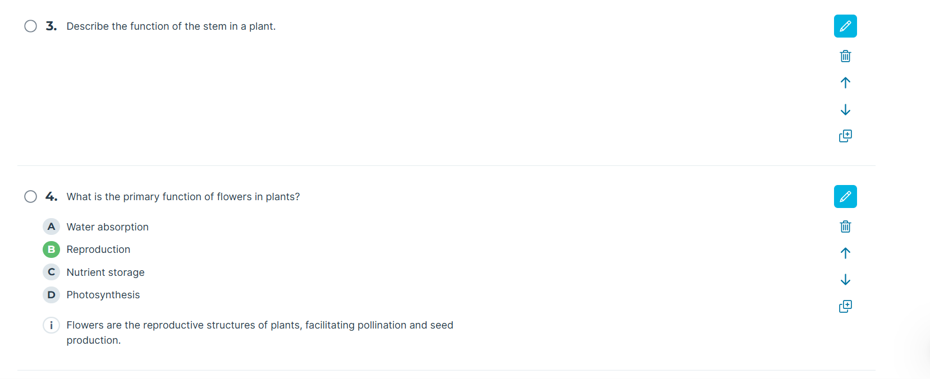
3.2.3

Slide 35
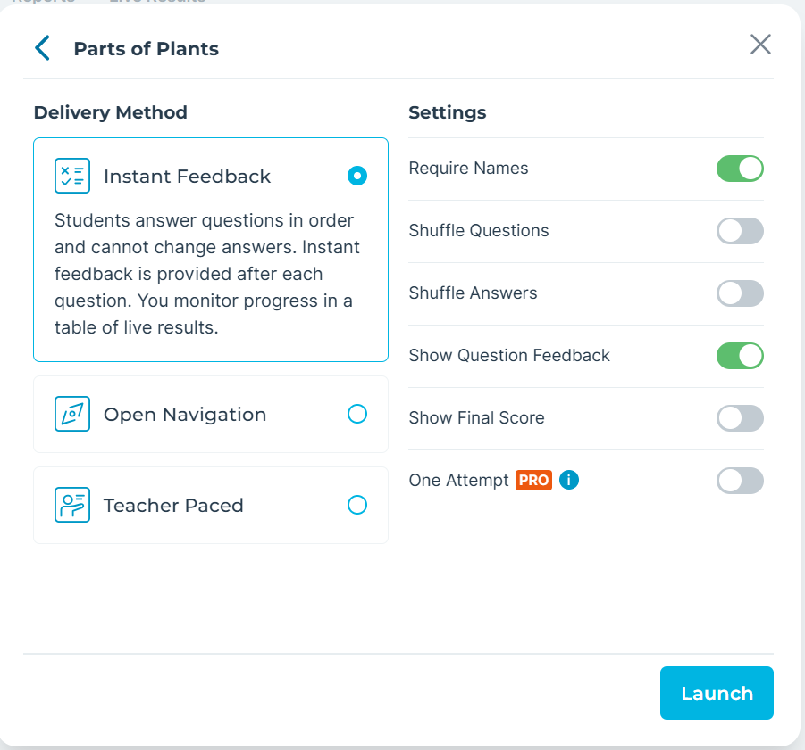
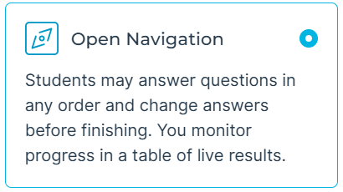
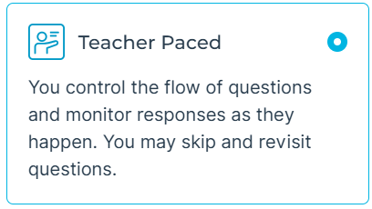
3.2.4
Activity Start

Slide 36
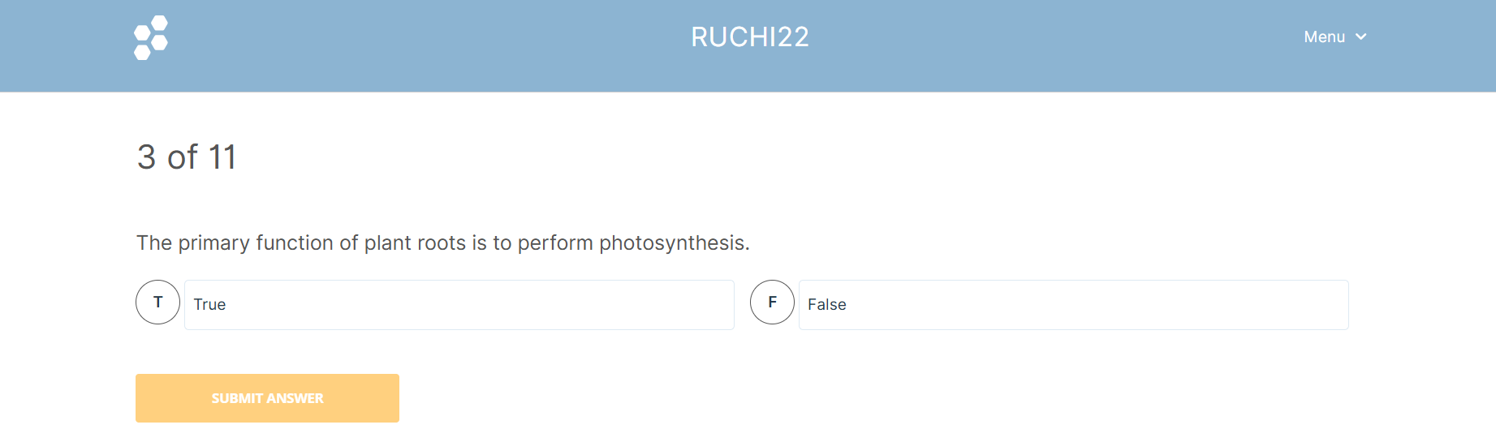
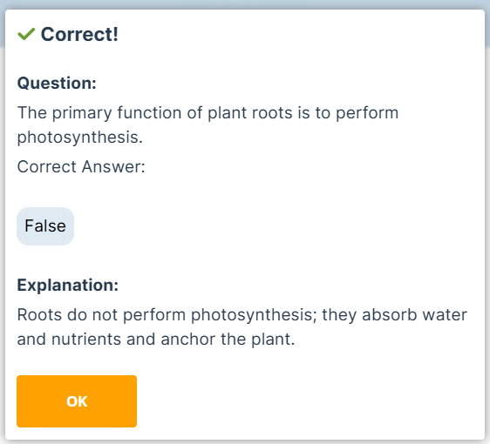
3.2.5
Student Interface

Slide 37
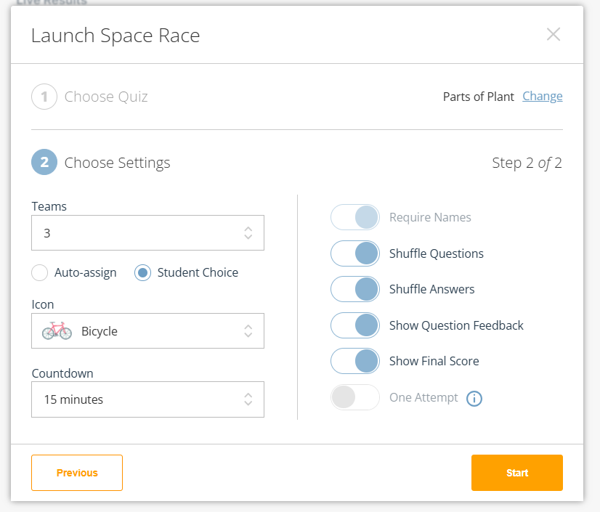
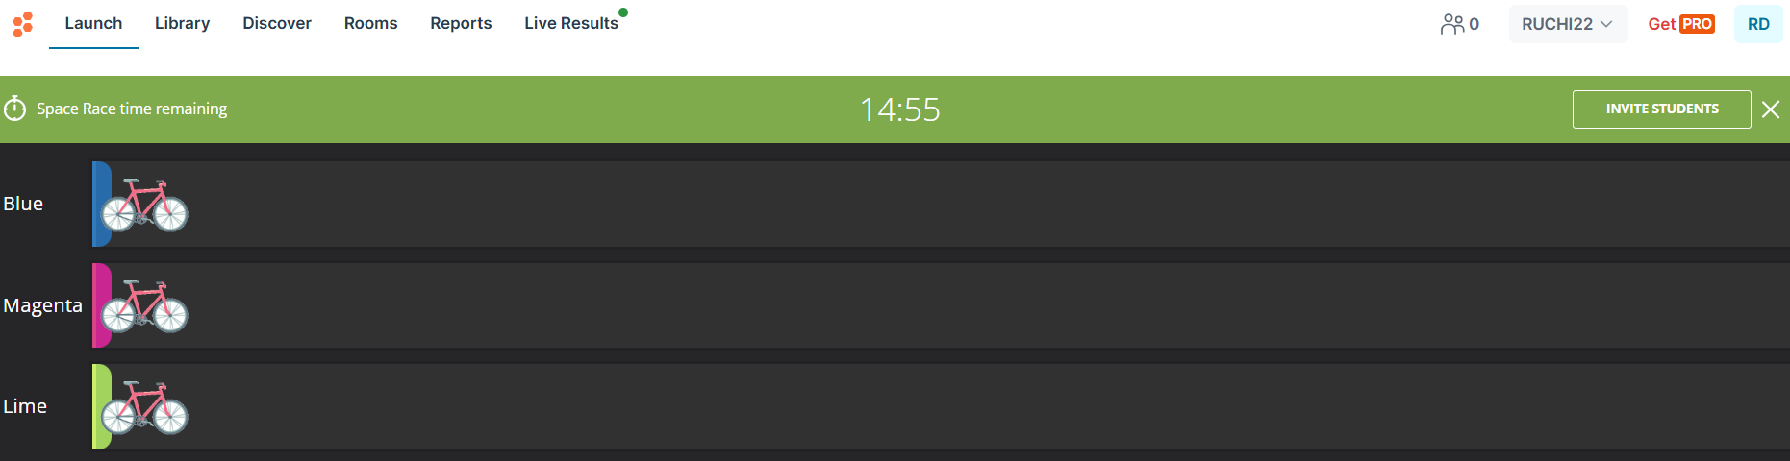
Space Race
3.3

Slide 38
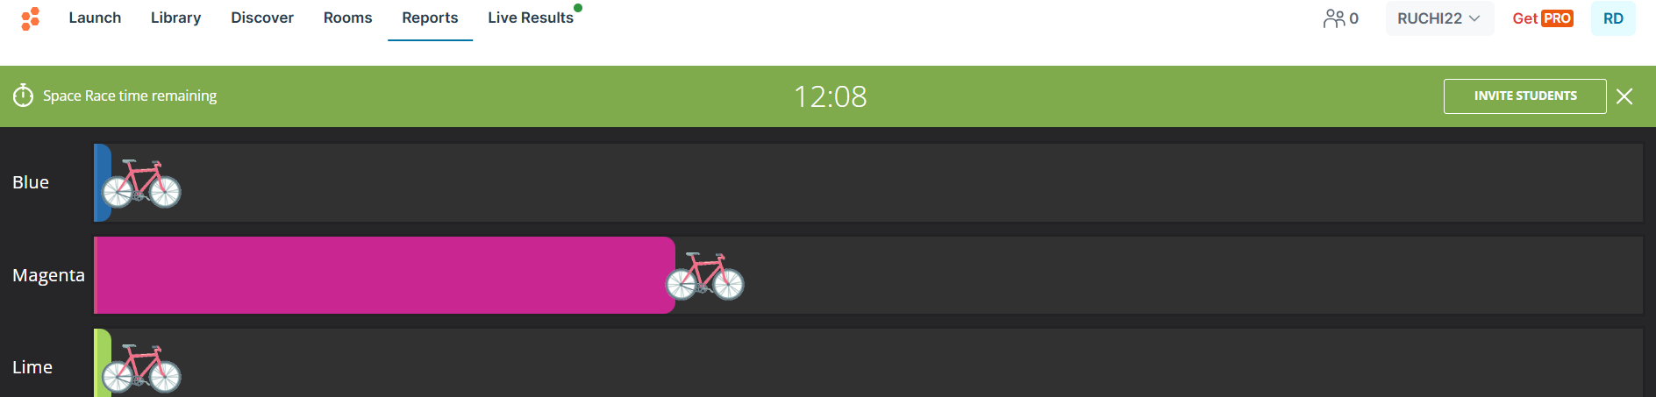
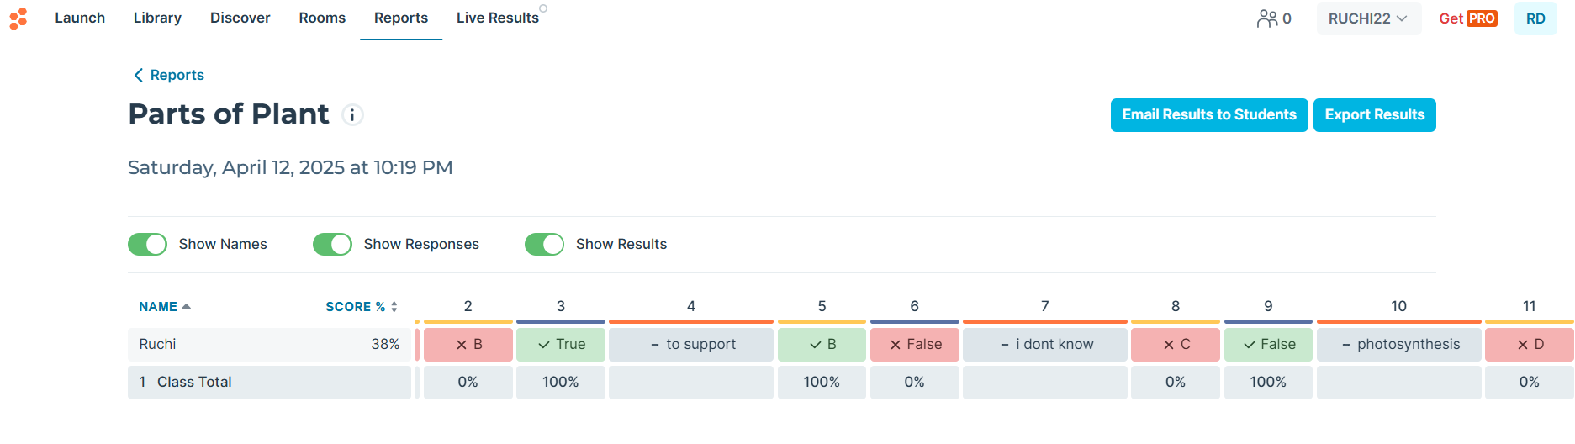
3.3.1

Slide 39
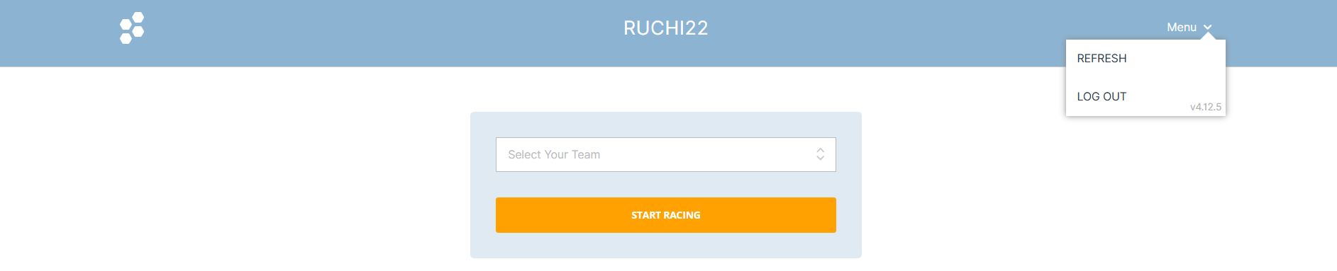
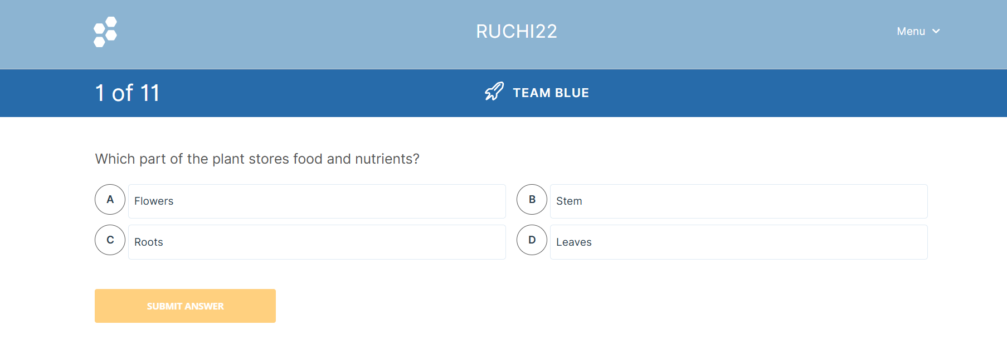
3.3.2
Student Interface

Slide 40
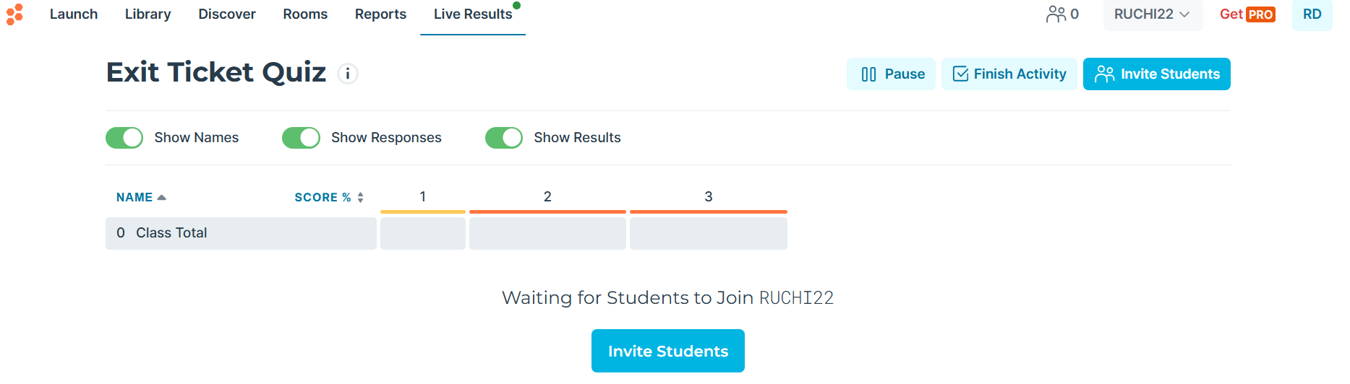
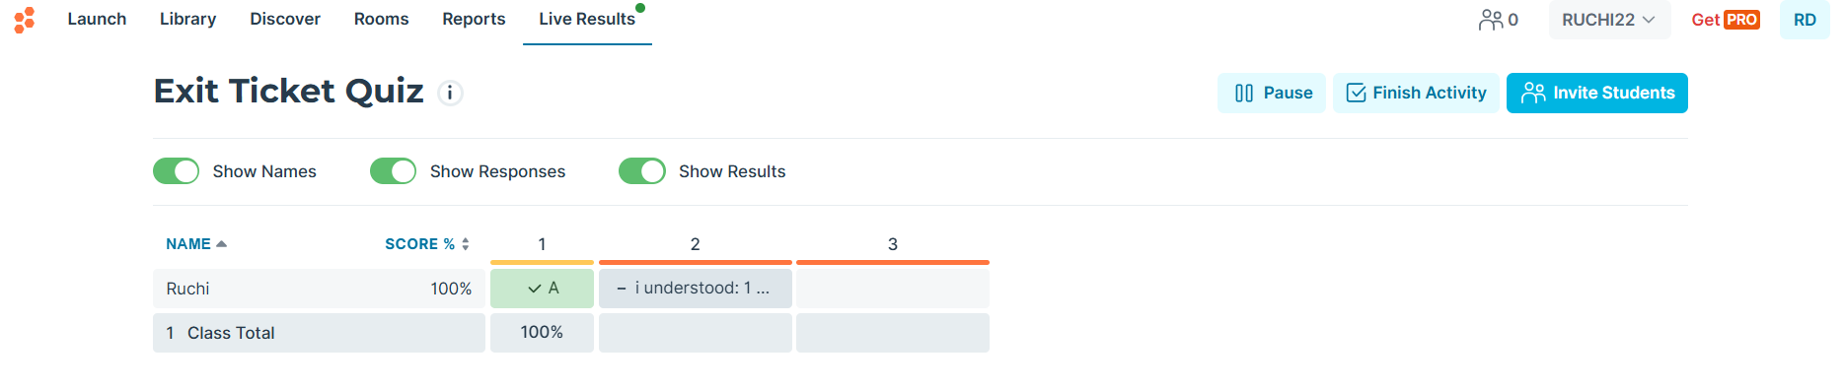
3.4

Slide 41
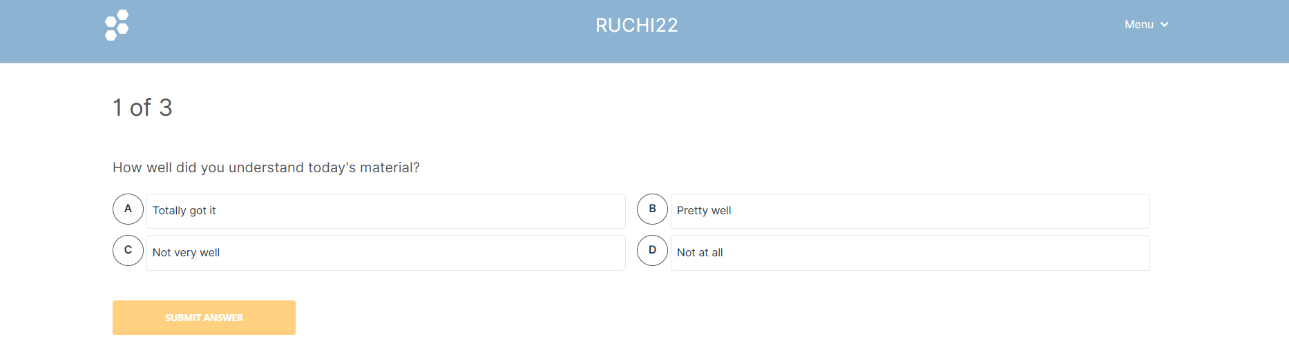
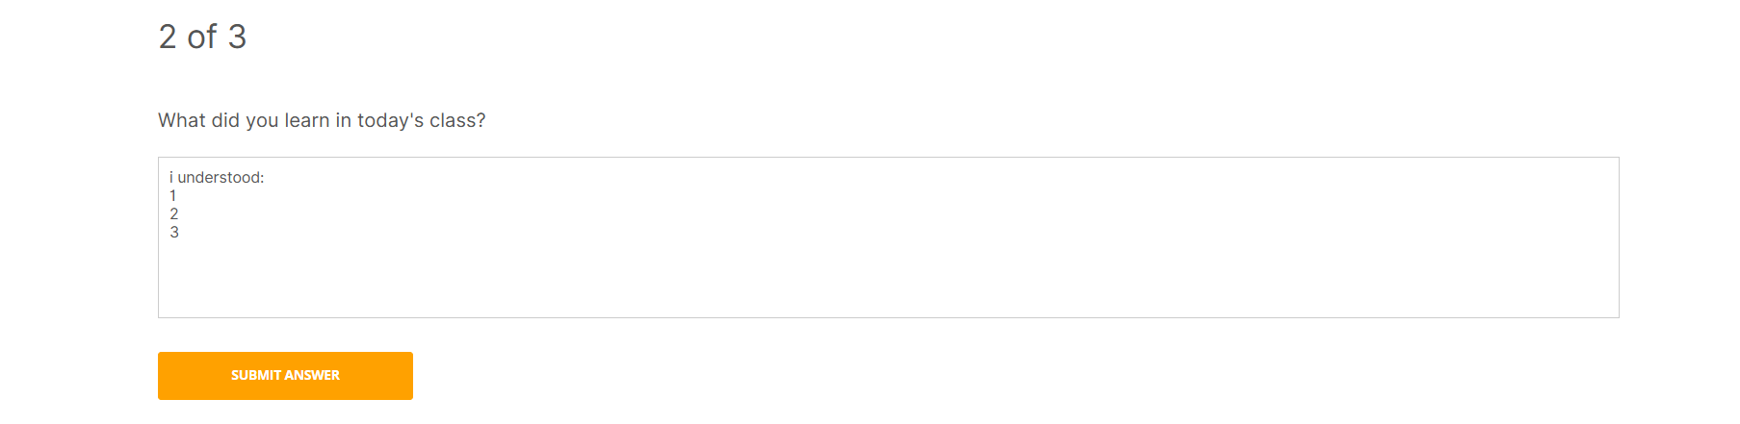
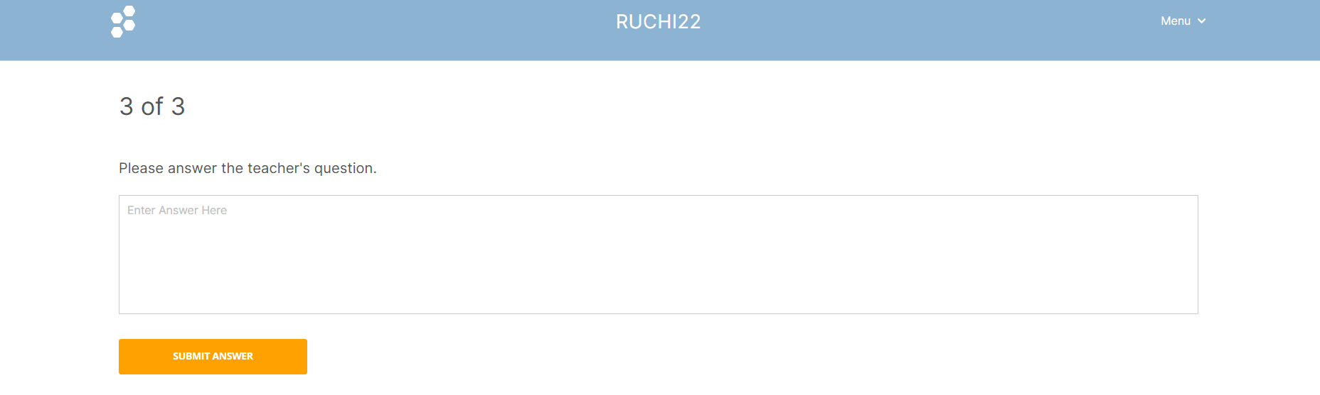
3.4.1
Student Interface

Slide 42

4. Exploring Advanced Features
4.1

Slide 43

4.2

Slide 44



4.3

Slide 45

4.4

Slide 46

4.6
The learning will goes on…

Slide 47
Best Practices for Effective Use
Socrative should not be employed merely as a novelty, but rather as a tool to actively support & enhance specific pedagogical objectives.
Efficacy of Socrative as an assessment tool is contingent upon the quality & clarity of the questions employed.
Adaptability of this tool allows for its strategic integration into diverse teaching & learning environments, enhancing pedagogical effectiveness.

Slide 48

Ethical considerations:
  Student privacy
  Equitable access & participation
  Avoid (Focus from assessment for learning to assessment as punishment )

Slide 49
CONCLUSION
Effective utilization of Socrative, guided by these best practices, has the potential to transform assessment from a mere evaluation tool to a catalyst for:
Student Learning
Engagement
Participation

Slide 50
THANK
you

