Slide 1
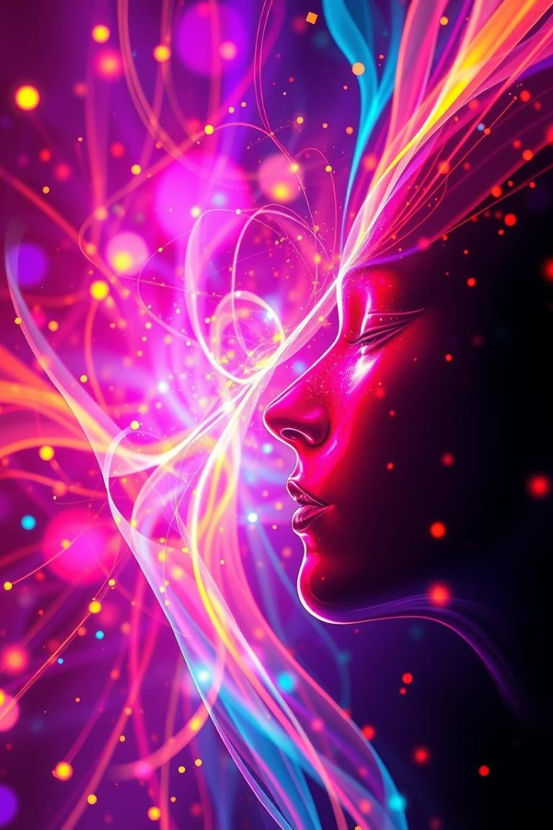
Unleash Your Creativity: An Introduction to Adobe Firefly
Transform imagination into reality with AI-powered creativity. Explore Firefly’s core capabilities: Text to Image and Generative Fill. Millions of users have already generated stunning images with early access success.
FL
by Fireup UR Learning
Notes:
What is FireflyFirefly is a suite of generative AI-powered features for creating image content. It’s available as a standalone website at firefly.adobe.com. Firefly lets you use everyday language and simple inputs to generate extraordinary outputs with generative AI.
The next evolution of creative AI is here. Now you can create images, video, audio, and vector graphics in the Firefly app. Ideate, create, and collaborate on concepts with Firefly Boards. And work with the latest, greatest, commercially safe Firefly generative AI models.
Overview of Firefly modulesThe Text to image module is for generating entire images from text prompts and buttons.The Generative fill module is for adding objects to and removing objects from images.The Text effects module is for embellishing text with unique decorative effects.The Generative recolor module is for exploring color schemes for vector images.

Slide 2
Text to Image: Describe It, See It
Generate custom images from simple text prompts like "a corgi wearing sunglasses."
Example prompt:
"photorealistic sunset over a mountain range" produces vivid, detailed images instantly.
Control style, composition, and color palettes precisely to suit your vision.
Notes:
Text to image
Bring your ideas to life with Generate Image.
You can generate images quickly and
easily, now with higher quality,
more detail and improved lighting and colour.

Slide 3
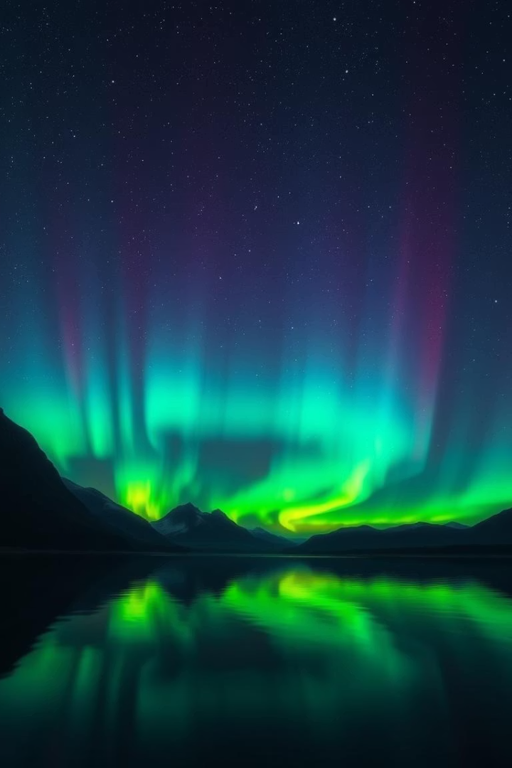
Generative Fill: Reimagine Your Images
Add or Remove Elements
Example
Select the sky and prompt "add aurora borealis" to enhance atmospheres creatively.
Modify photos non-destructively by selecting areas and applying descriptive prompts.
Refine Images
Adjust warmth, lighting, and other elements seamlessly to perfect visuals.

Slide 4
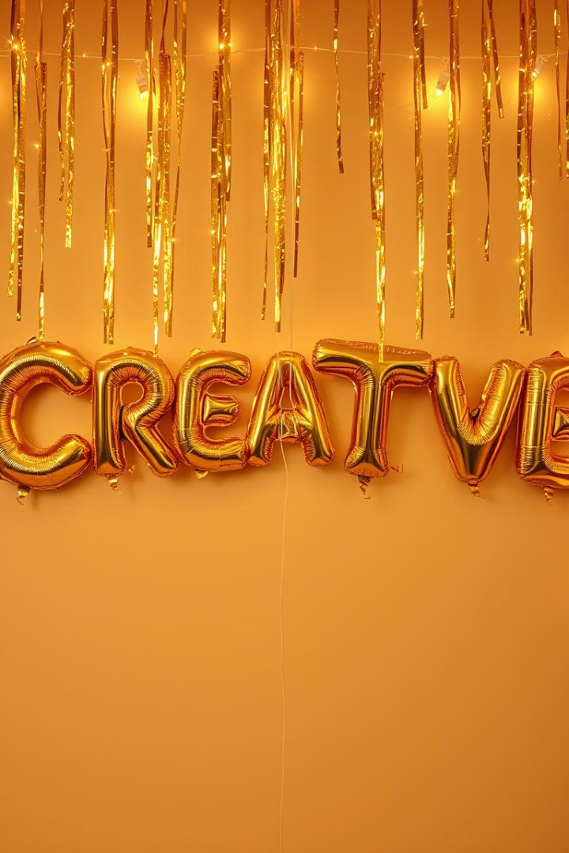
Text Effects: Words That Pop
Dynamic Text Visuals
Examples
Apply textures like "gold foil balloon letters" for eye-catching impact.
Transform basic text into artistic effects with creative prompts.
Experimentation
Explore patterns, textures, and styles to make text visually striking.

Slide 5
Generative Recolor: Explore Infinite Variations
Easily change color palettes of vectors and designs with AI assistance.
Ideal for creative exploration and rapid color experimentation.
Apply themes and moods instantly to fit branding or marketing needs.
Streamline branding materials with consistent, on-brand visuals.

Slide 6
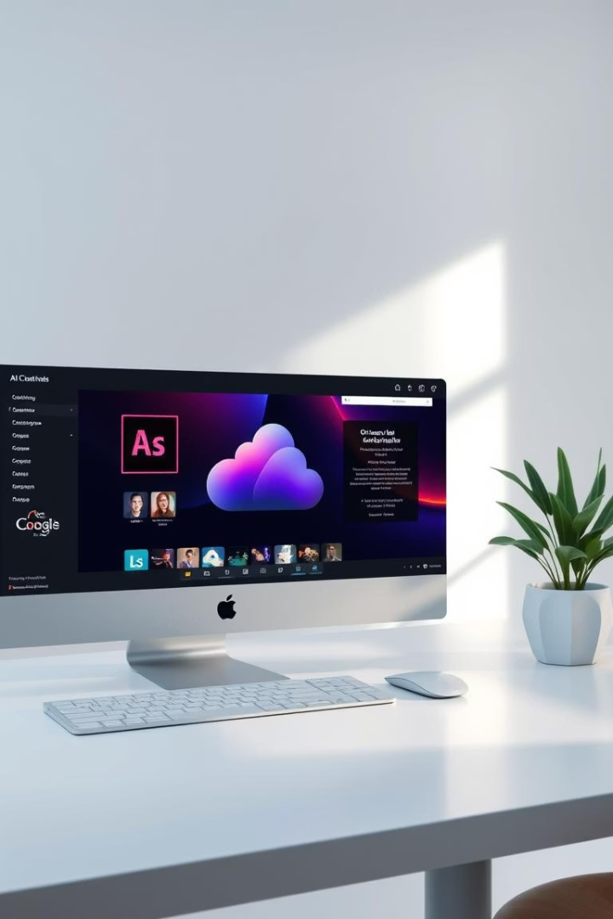



Adobe Firefly Advantages: Power and Precision
Creative Cloud Integration
Non-destructive Editing
Content Credentials
Ensure transparency and authenticity in AI-generated content.
Seamlessly work within familiar Adobe apps for smooth workflows.
Make flexible changes without altering original content.

Slide 7
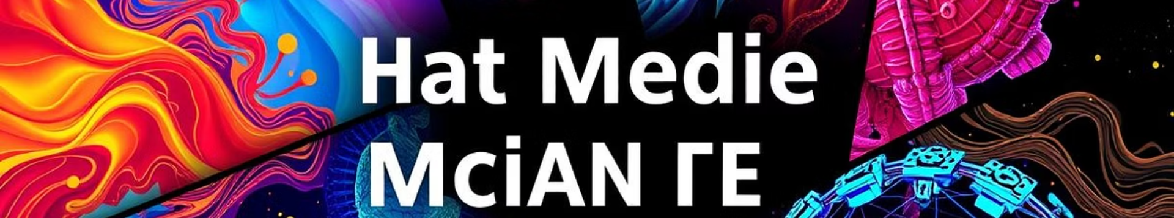



Real-World Applications: From Concept to Creation
Marketing
Design
Photography
Generate fresh campaign visuals quickly and efficiently.
Rapidly prototype concepts and experiment with variations.
Enhance and transform images creatively with AI tools.

Slide 8
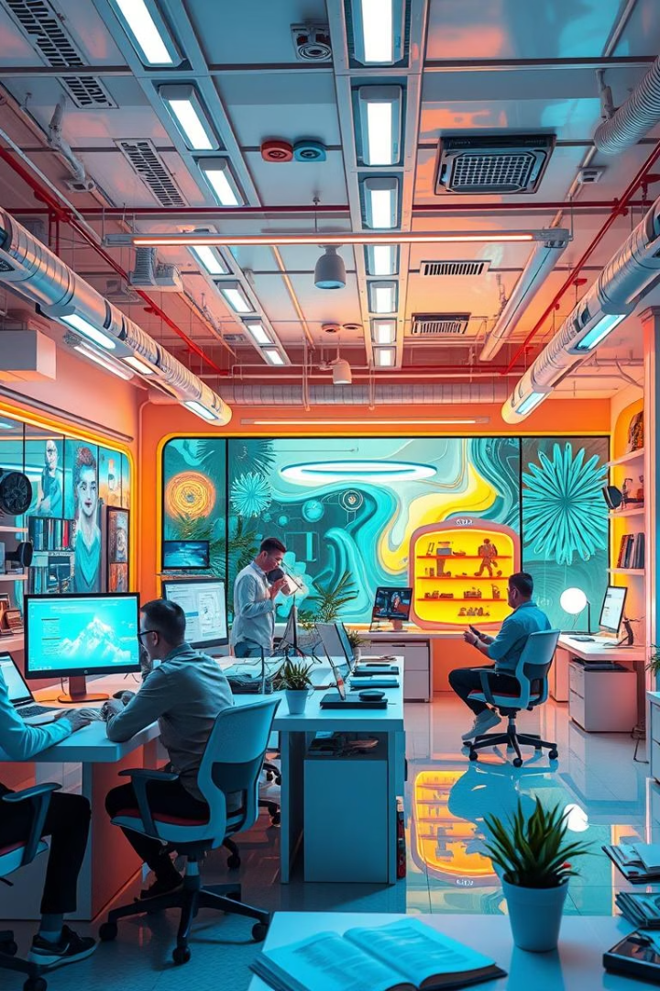
The Future of Creativity is Here
Continuous Innovation
Ongoing development of new features and AI capabilities.
Community Engagement
Join Firefly’s vibrant user base to share ideas and feedback.
Accessible AI
Empowering creators with intuitive AI tools for all skill levels.

