Slide 1
CEMCA-CIET Webinar on
Curating OER for Teaching, Learning and Assessment
Dr. Indira Koneru
International eLearning Consultant
Curating OER for Teaching, Learning and Assessment​ by Indira Koneru is licensed under CC BY 4.0

Slide 2

Agenda
Understanding openness in OER
Integrating OER with teaching-learning-assessment
Finding OER (Demo)
Evaluating OER
Curating OER (Demo)

Slide 3
Openness in OER

Slide 4
Openness in OER
Legal openness
Permission to use content through an open license
Open license grants perpetual permission to retain/ reuse/revise/remix/redistribute (5Rs) (David Wiley, 2013)
Technological openness
Accessible with different kinds of devices & software
Available in interoperable / reusable file formats
Pedagogical openness (Open Educational Practices)
Adaptation freedom
Adaptable to different learning contexts
Convert into engaging activities and interactive content (using FOSS)
Co-creation with students (open pedagogy)
Open Educational Resources (OER) are teaching, learning, and research materials that are either (a) in the public domain or (b) licensed in a manner that provides everyone with free and perpetual permission to engage in the 5R activities (Creative Commons)
Notes:
Successful implementation of OER-enabled teaching-learning-assessment requires understanding different the types of openness and overcoming the obstacles, if any.
shift from an emphasis on resources (i.e., OER) to pedagogical practice
Open educational practices (OEP) – including open pedagogy, open collaboration, and open assessment – should be implemented to keep the learners motivated and engaged

Slide 5
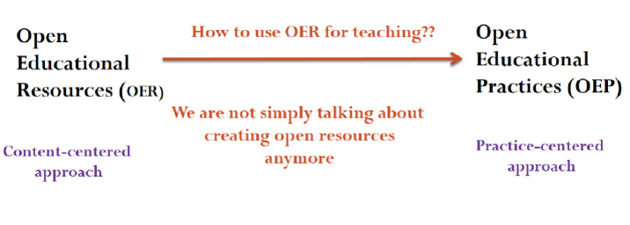
Open Educational Practices (OEP)
OEP is an umbrella term (Cronin et al., 2022)
creation, use, and reuse of open educational resources (OER)
pedagogical practices encouraging peer learning, collaborative knowledge creation, sharing, and empowerment of learners (open pedagogy)
systemic and structural initiatives to support and embed openness
OEP practices - open pedagogy, open collaboration, and open assessment keep learners motivated and engaged
Shift from content-centred approach to practice-centred
Guidance on Open Educational Practices during School Closures by Smart Learning Institute of Beijing Normal University is licensed under CC BY-SA 4.0
Notes:
"https://edtechbooks.org/encyclopedia/oep" by Cronin et al. is licensed under CC BY 4.0

Slide 6
OER Adoption in India
OER adoption in India is relatively low due to lack of (Mishra & Singh, 2017)
Understanding of copyright and open licensing
Advocacy and capacity building initiatives
Time and funding
Institutional incentives and support

Slide 7
OER Competency Framework for Teachers
OER Competency Framework (IOF, UNESCO et al., 2016)
58 competencies grouped into five clusters
Becoming familiar with OER
Finding OER
Using OER
Creating OER
Sharing OER

Slide 8
OER-enabled Teaching, Learning & Assessment

Slide 9
Mainstreaming OER
Adopt OER – reuse
Adapt OER - revise, modify, alter, customize OER to fit (y)our course curriculum
Author / create OER

Slide 10
Integrating OER in Teaching-Learning-Assessment
Create new part of course materials by using or re-purposing OER
Create new courses by using, reusing and repurposing OER
Improve existing material / replace expensive textbooks with Open Textbooks
Assign OER-based learning activities to students (open pedagogy)
OEP
Enhance an existing course by integrating OER
Develop OER-enabled online courses & MOOCs using an LMS (Moodle)

Slide 11
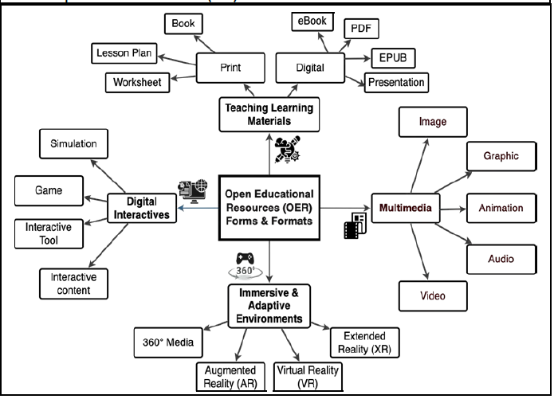
OER Forms and Formats
CETE. (2023). Curating and Creating OER to Enable Active Learning and Professional Development in Teacher Education Institutions ...

Slide 12
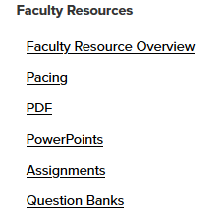
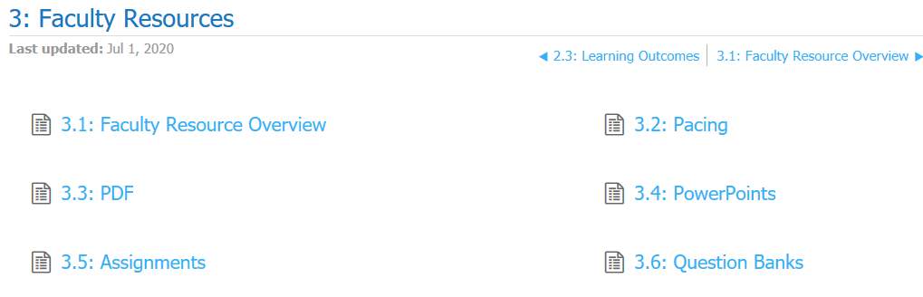
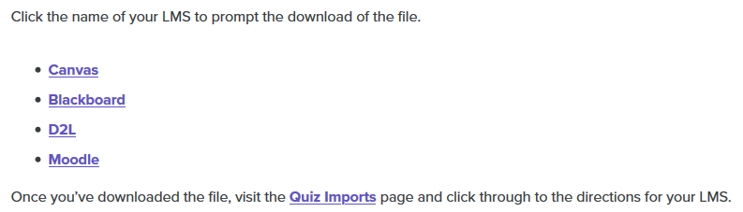
Ancillary Material
15 question banks with a total of 374 multiple choice questions
Lumen Learning. Organizational Behavior / Human Relations

Slide 13
Curating OER

Slide 14
Curation
Curation refers to process of identification, evaluation and selection of appropriate information meeting as per requirement (NCERT, n.d.)
Systematically selecting, annotating, adapting and integrating OER in the teaching and learning practice (CETE, 2023)
Notes:
NCERT Guidelines for Development of eContent for School Education
CETE - Centre of Excellence in Teacher Educagtion

Slide 15
OER Curation Process
Step 1. Plan: Identify OER, considering learning outcomes and classroom context
Step 2. Search & Select: Find & select resources based on a rubric selected in the planning process
Step 3. Adopt and Adapt: Contextualize, tweak and adopt the OER
Step 4. Integrate with teaching-learning: Use OER in schools and classrooms
CETE (2023) Policy & Practice Paper Series: Curating OERs & Teacher Education

Slide 16
Step 1 | Plan
Identify OER, considering learning outcomes and classroom context
  Create or identify a rubric to guide the curation process
  List out the key topics and concepts that students commonly find difficult to understand
  Map the topics to the textbook chapters and learning outcomes

Slide 17
Step 2 | Search & Select
Find & select resources based on a rubric selected in the planning process
  Search for OERs that match the learning outcomes identified
  Evaluate OER content and validate accuracy, and authenticity
  Select OERs that broadly fulfill the rubric criteria promoting the following learning experiences
    interactivity - between teacher and students and among students
    develop higher-order thinking among students
    inclusivity - addressing diverse learning needs of a classroom

Slide 18
Step 3 | Adopt and Adapt
Adopt and Adapt: Adopt or contextualize and adapt
  Ensure the OER license allows adaptation
  Consider the language, culture and classroom context
  Determine the changes required to meet learning outcomes identified in the planning phase
  Make changes to the OER to fulfil your requirements
  Give appropriate attribution (TADL attribution)
  Provide appropriate metadata and a CC license to organise OERs on the curation platform

Slide 19
Step 4 | Integrate with teaching-learning
Use OER in schools and classrooms
  Engage teachers in developing OER-enabled activities to improve students' understanding and higher-order thinking
  Suggest formative assessment strategies for teachers to assess students’ understanding
  Create relevant teacher facilitation notes
    Suggestive notes rather than prescriptive to allow teachers to contextualise further based on specific classroom contexts

Slide 20
Evaluating OER

Slide 21
Evaluating OER Checklist
Relevance
  Does the information directly address one or more of the learning outcomes?
Accuracy
  Is the information accurate and aligned with the learning outcomes?
  Are there major content or spelling errors or omissions?
  Has the material been peer reviewed?
Production Quality
  Is the layout and interface easy to navigate?
  Do the design features enhance learning?
  For multimedia resources, are the audio/video quality high?
Faculty Guide for Evaluating Open Education Resources by BCcampus is licensed under CC BY 4.0

Slide 22
Evaluating OER Checklist
Accessibility
  Is the resource available in alternative formats (e.g. .doc or .odf)?
  For audio or video resources, is there a transcript or subtitles?
Interactivity
  Does the resource encourage active learning and class participation? If not, are you able to add that to the resource?
  Are there opportunities for students to test their understanding of the material (e.g. a video with embedded questions)?
Licensing
  Does the license allow for educational reuse of the materials?
  Does the license allow modifications or adaptations of the materials?
Faculty Guide for Evaluating Open Education Resources by BCcampus is licensed under CC BY 4.0

Slide 23
RAP-OER-IFP Curation Rubric
Relevance, Affordance and Pedagogical Practice (RAP) Curation Rubric
3 parameters and 15 indicators
A comprehensive framework to assess the pedagogical potential of OER for use on the Interactive Flat Panel (IFP) devices in schools
Review OER with a view to select, curate and use meaningfully on IFP devices in order to
  involve students actively
  provide them with opportunities to engage in the learning process
  interact with each other and the teacher
  enhance overall pedagogy to promote higher order thinking
RAP Curation Rubric to Assess the Pedagogical Potential of Open Educational Resources (OER) for use on Interactive Flat Panel (IFP) Devices in Schools Version 1 by CETE, Tata Institute of Social Sciences is licensed under CC BY-SA 4.0

Slide 24
Finding OER

Slide 25
Finding & Curating OER |Demo
Use Finding Outcomes-aligned OER template
Finding OER – text
Finding OER – open textbooks
Finding OER – images
Finding OER – videos
Finding OER – interactive content
Build attribution using Open Attribution Builder
Curating OER

Slide 26
Finding Outcomes-aligned OER | Template
Chapter # & title and Learning Outcomes | Content Format | Title | Author / creator / institution | Source / URL | License (CC License) | CC Attribution (TASL) | Content Curation Purpose (how will use and deliver OER)
 | Text / open textbook |  |  |  |  |  | Use Chapter # content Use first 3 paragraphs Use H5P activities Create quiz questions Create forum questions
 | Video |  |  |  |  |  | Convert into interactive video and create H5P activity on Moodle
 | Image |  |  |  |  |  | Create H5P image hotspots

Slide 27
How to attribute a CC Licensed Work!
Title – Copy the title of the work to be adopted
TASL
Author – Copy author’s name and web page link, if available
Source - Hyperlink the title to the original source
License – Copy the CC license name and hyperlink to the CC license deed page

Slide 28
Attribution Example – Web Resource​
Title: Best practices for attribution
Author: Creative Commons
Source: https://wiki.creativecommons.org/wiki/Best_practices_for_attribution (hyperlink this to the title)
License: CC BY 4.0 (hyperlink license deed URL)
  License deed URL: https://creativecommons.org/licenses/by/4.0/ (hyperlink it to the license)
Best practices for attribution by Creative Commons is licensed under CC BY 4.0
  Attribution generated using Open Attribution Builder by Open Washington, SBCTC is licensed under CC BY 4.0

Slide 29
Attribution Example – Image​
​
Title: Social Media Icons in Powder Tins
Author: Mike Corbett
Source: https://flic.kr/p/29Kkshj
License: CC BY 2.0
  License deed URL: http://creativecommons.org/licenses/by/2.0
Social Media Icons in Powder Tins by Mike Corbett is licensed under CC BY 2.0
  Attribution generated using Open Attribution Builder by Open Washington, SBCTC is licensed under CC BY 4.0

Slide 30
Attribution Example – Video​
Title: What is Blended Learning ?
Author: Frederic Skrzypek
Source: https://youtu.be/lIh4jJlvF44
License: CC BY 3.0
  License deed URL: http://creativecommons.org/licenses/by/3.0
What is Blended Learning ? by Frederic Skrzypek is licensed under CC BY 3.0
  Attribution generated using Open Attribution Builder by Open Washington, SBCTC is licensed under CC BY 4.0

Slide 31
Attribution for Adaptations / Remix ​
Use the phrase “Adapted from" for attributing one OER
  Example: Adapted from Attributing OER by Community College Consortium for Open Educational Resources (CCCOER) is licensed under CC BY 4.0
Use the phrase “Adapted from the following sources” for listing multiple OERs
  Example: The content of this course is adapted from the following sources"
    Best practices for attribution by Creative Commons is licensed under CC BY 4.0
    Attributing OER by Community College Consortium for Open Educational Resources (CCCOER) is licensed under CC BY 4.0
    How to make an open online course by Open University is licensed under CC BY-NC-SA 4.0

Slide 32

Queries

