Slide 1



DIKSHA
Home Page and it’s Navigation

Slide 2
Introduction
•DIKSHA (Digital Infrastructure for Knowledge Sharing) is a national platform for school education
•It is an initiative of National Council for Educational Research and Training (NCERT), under the aegis of the Ministry of Education (MoE), GoI. Launched in 2017
•DIKSHA is a content management system having more than 3.5 Lakh content in the form of Video, Audio, PDF, Interactive content in 84 languages etc
•DIKSHA has been adopted by almost all the States, Union Territories, central autonomous bodies/boards including CBSE.
•There are 6410 Energized Textbooks and 20797 e Courses available on DIKSHA platform

Slide 3
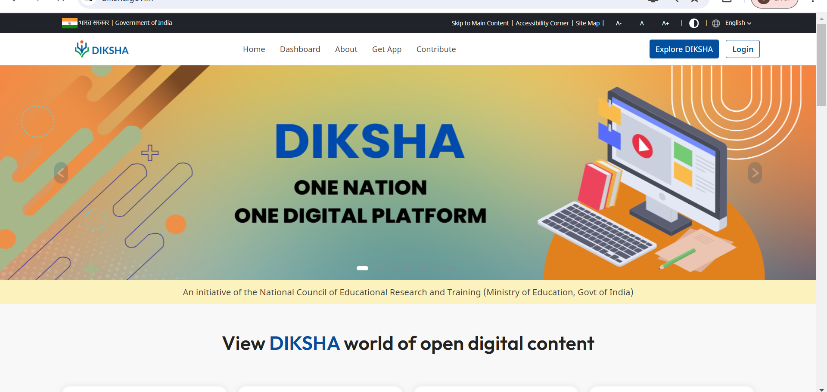

Slide 4
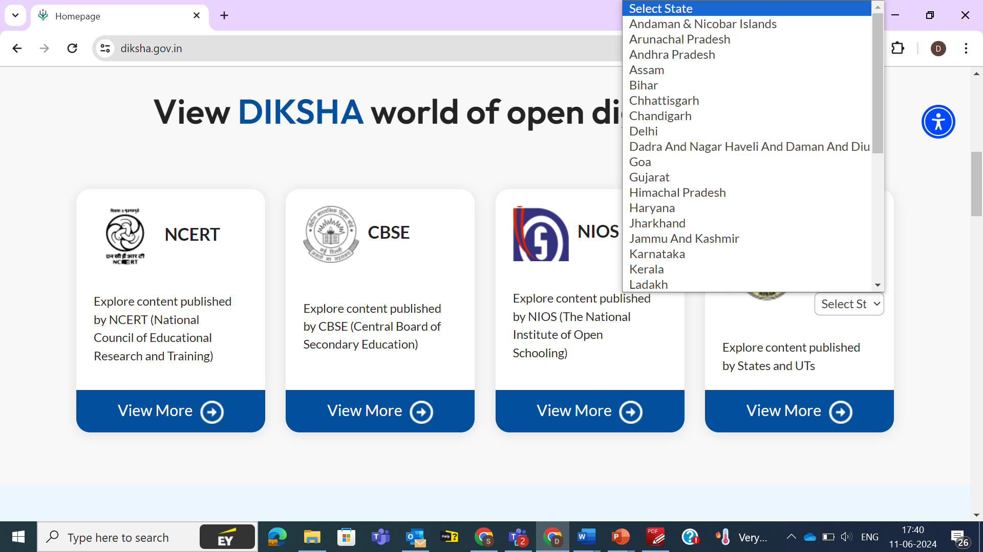
Tenants on DIKSHA
(35 States/UTs and 3 Autonomous Bodies)

Slide 5
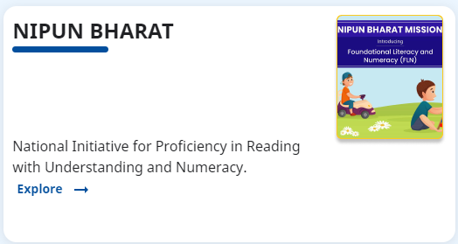
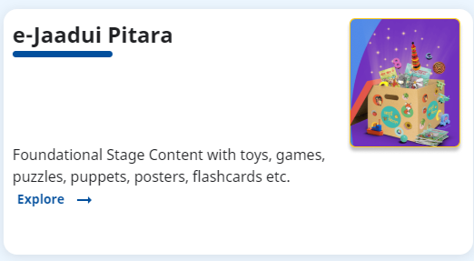
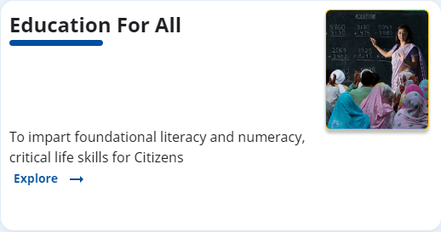
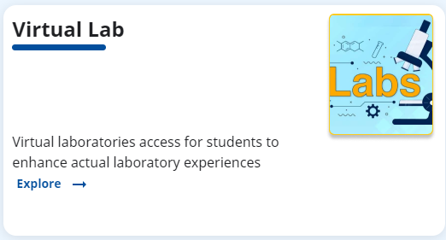
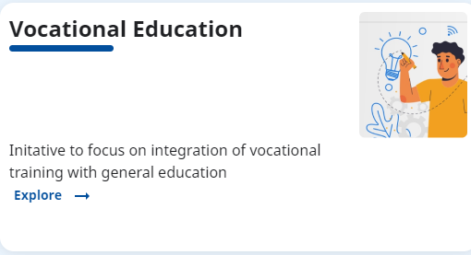
VERTICALS IN DIKSHA

Slide 6
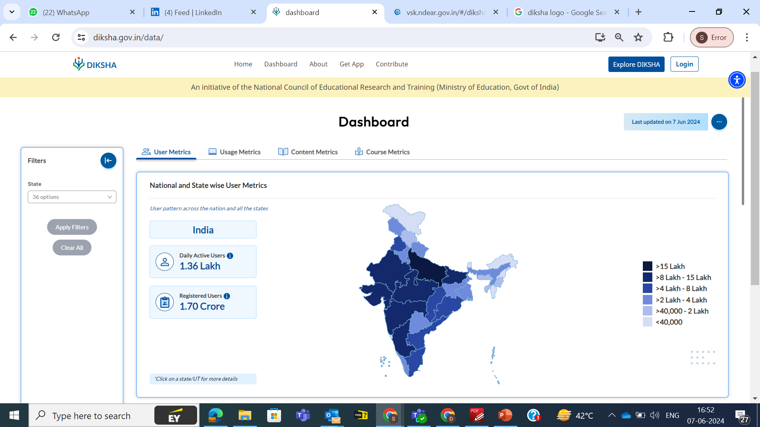

Slide 7
Dashboard
User Metrics
Usage Metrics
Content Metrics
Course Metrics
Registered Users Trend
Learning Trend
Energized Textbooks
e-Content
National and State wise Course Metrics
Last 3 Months Active Users Trend
Learning sessions
Medium wise
Year wise e-Content Trend
Course Consumption Trend Year wise
Registered Users across all States/UT
Learning minutes
Grade wise
Medium wise
Enrolments across all States/UT
Subject wise
Grade wise
Data Based on Content Type
Tenant wise

Slide 8
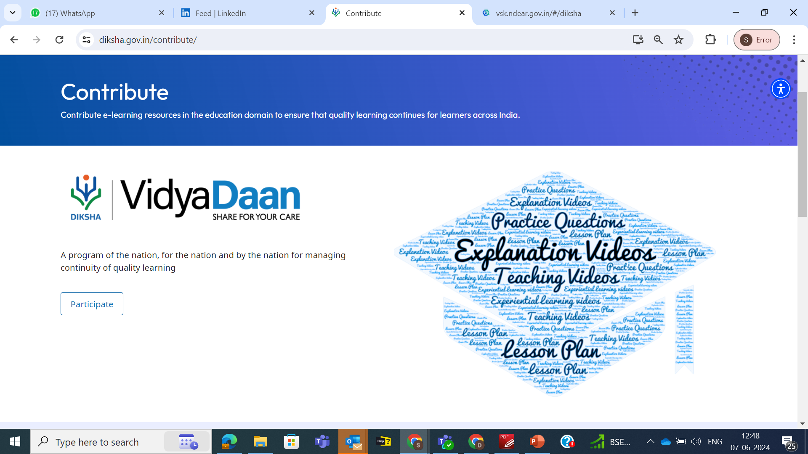
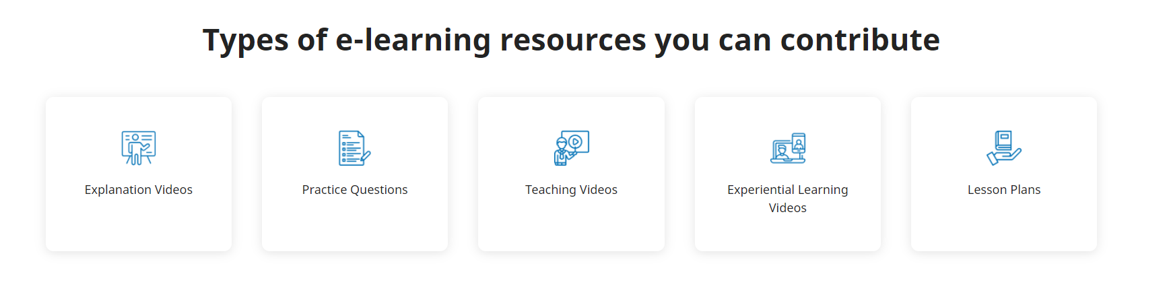

Slide 9

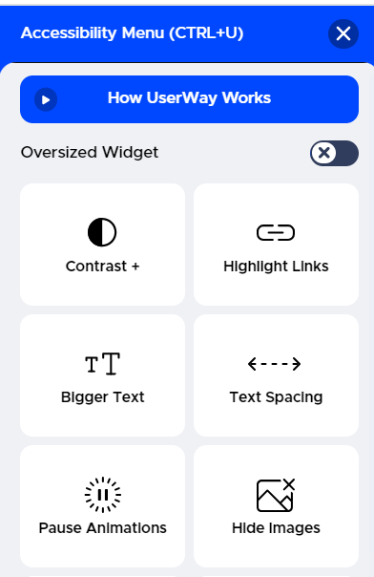
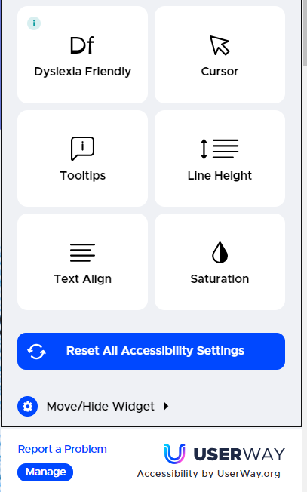
Accessibility Menu on DIKSHA

Slide 10





Ways to access DIKSHA
Via Mobile app: Learners can simply download the mobile app from play store/app store, register themselves and start using it. All types of content ranging from eContent, Assessment/Quiz, PDF, eTextbook are available on the app.
Via Portal: Learners can also access e-content by visiting https://diksha.gov.in/
Via QR code: States/UTs have printed Textbooks with contextualized QR codes, which can simply be scanned using any scanner from a smartphone and the learner gets redirected to the concept video/PDF/simulation directly.

Slide 11
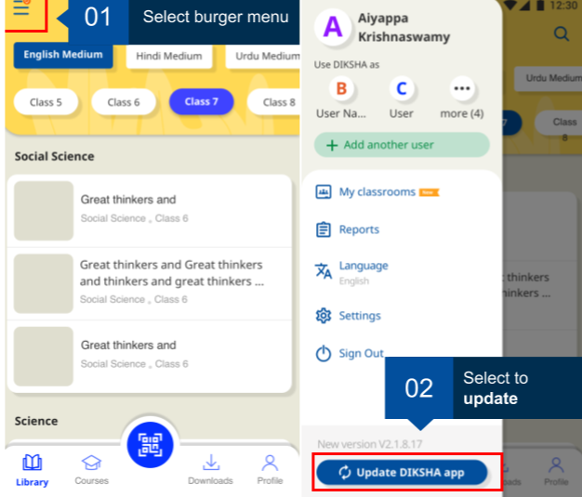
How to access content via Mobile app?
Access to Play Store, search for DIKSHA app, download and install it on device
The Login feature allows authorized users to access unlimited DIKSHA content using the app

Slide 12
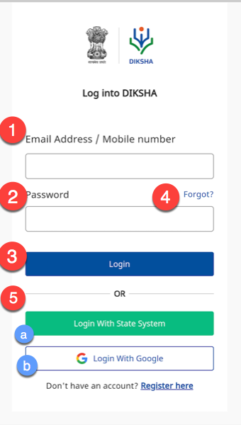
How to login on DIKSHA Mobile app?
Log in to DIKSHA mobile app using your registered credentials
1. Enter your registered Email Address or Mobile Number
2. Enter the Password
3. Tap Login
4. If you have forgotten your password, tap Forgot?
For details on recovering password, refer Recovering Password
5. Alternatively, you can login on DIKSHA app using your:
a. Google Account Credentials
b. State Credentials

Slide 13
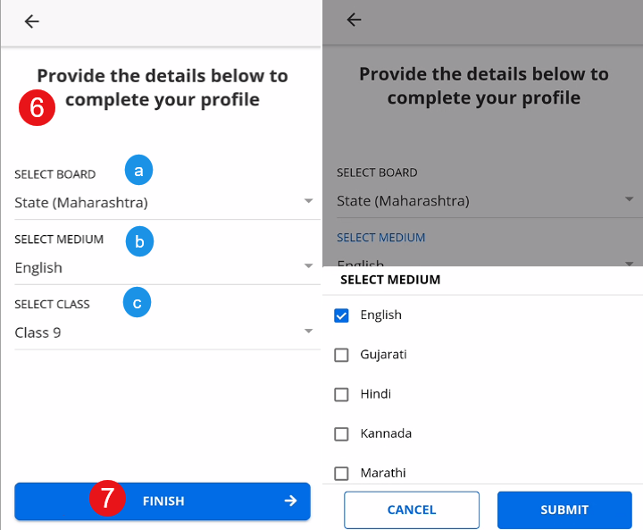
How to login on DIKSHA Mobile app?
On successful login, a pop-up window is displayed
6. Select the following from the respective drop-down menus to discover content relevant to you:
a. Board
b. Medium
c. Class
7. Tap FINISH to complete updating the profile. The library page is displayed with content suggestions based on the selected search criteria

Slide 14
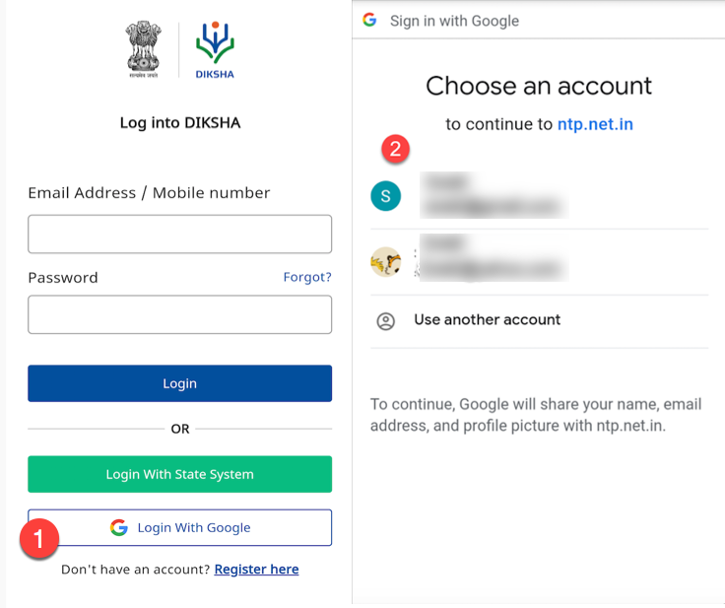
How to login on DIKSHA Mobile app?
You can log in to DIKSHA app using your Google account credentials. To log in with your Google account:
1. Tap log in with Google
2. Select the account with which you would like to log in
3. Tap Allow for providing permission to DIKSHA app to access your Google account. A Terms and Conditions page is displayed
4. Tap I agree to the terms and conditions of use
5. Tap Continue

Slide 15
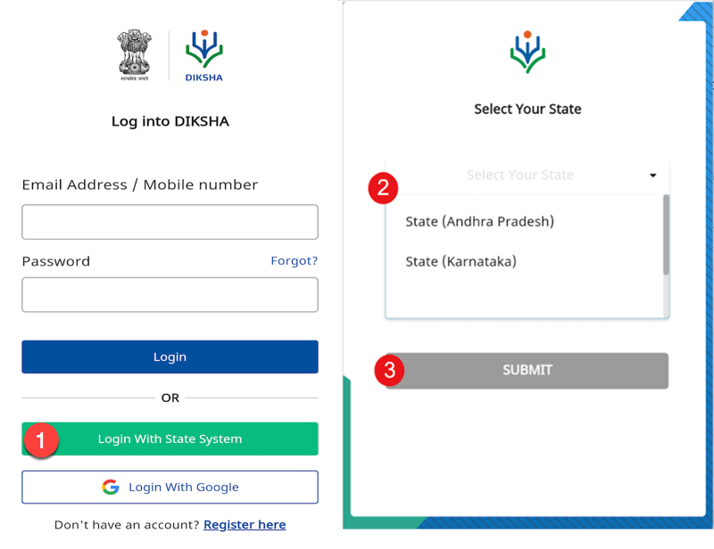
How to login on DIKSHA Mobile app?
You can log in to DIKSHA app using your State account credentials.
1. Tap Login with State System. State selection page is displayed
2. Select the state from the drop-down list
3. Tap SUBMIT. You are redirected to the home page of the respective state website
Login with valid credentials provided by the state. On successfully logging in, you are redirected to DIKSHA app as a logged in user

Slide 16
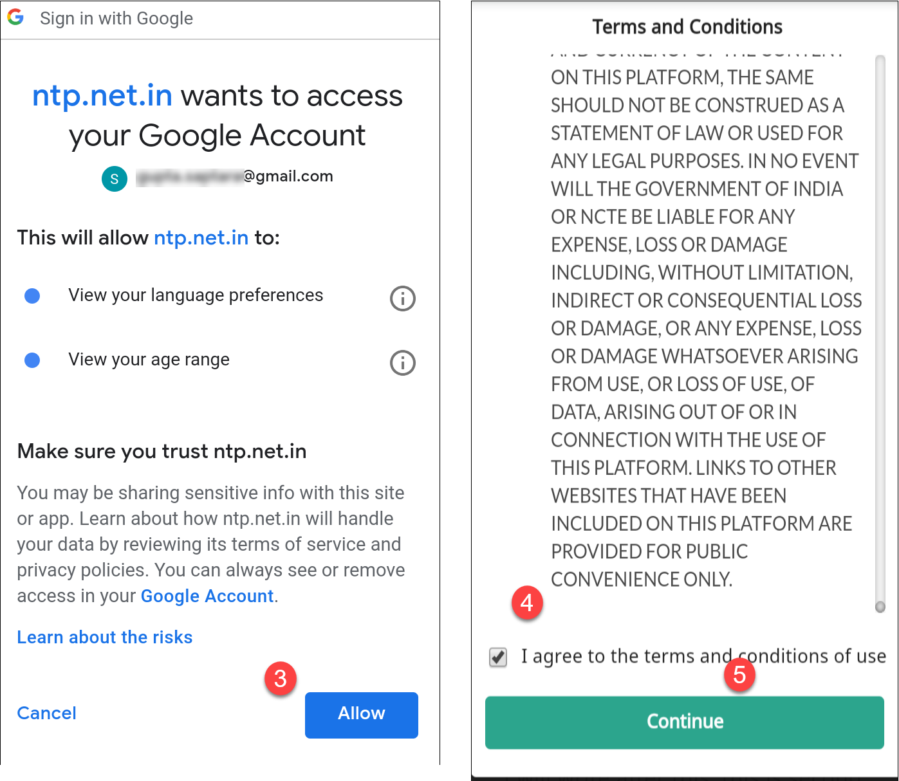
How to login on DIKSHA Mobile app?
3. Tap Allow for providing permission to DIKSHA app to access your Google account. A Terms and Conditions page is displayed
4. Tap I agree to the terms and conditions of use
5. Tap Continue

Slide 17
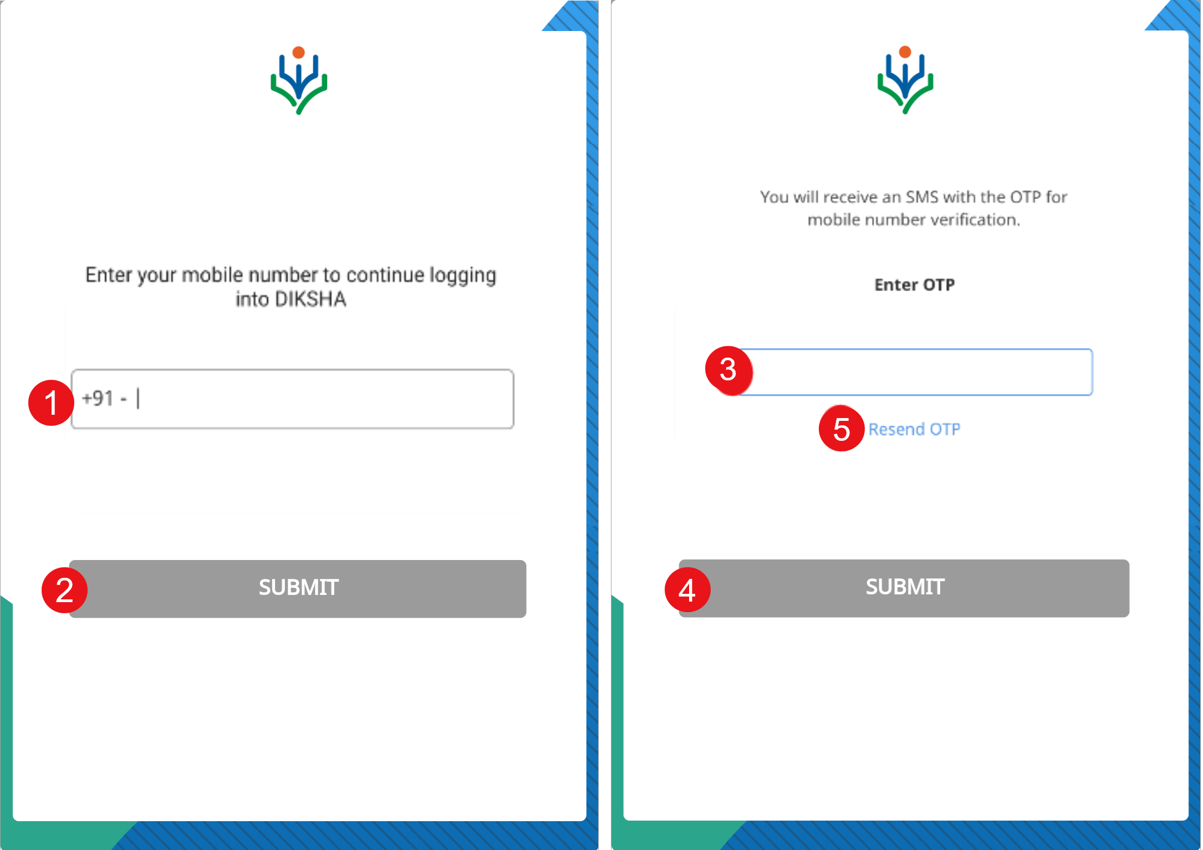
Things to Remember for first time users
First time users must enter the mobile number which is registered with the state portal. An OTP is sent to this registered number for verification
1. Enter your mobile number
2. Tap SUBMIT
3. Enter the OTP received on your registered mobile number
4. Tap SUBMIT
5. Tap Resend OTP, in case you have not received the OTP

Slide 18
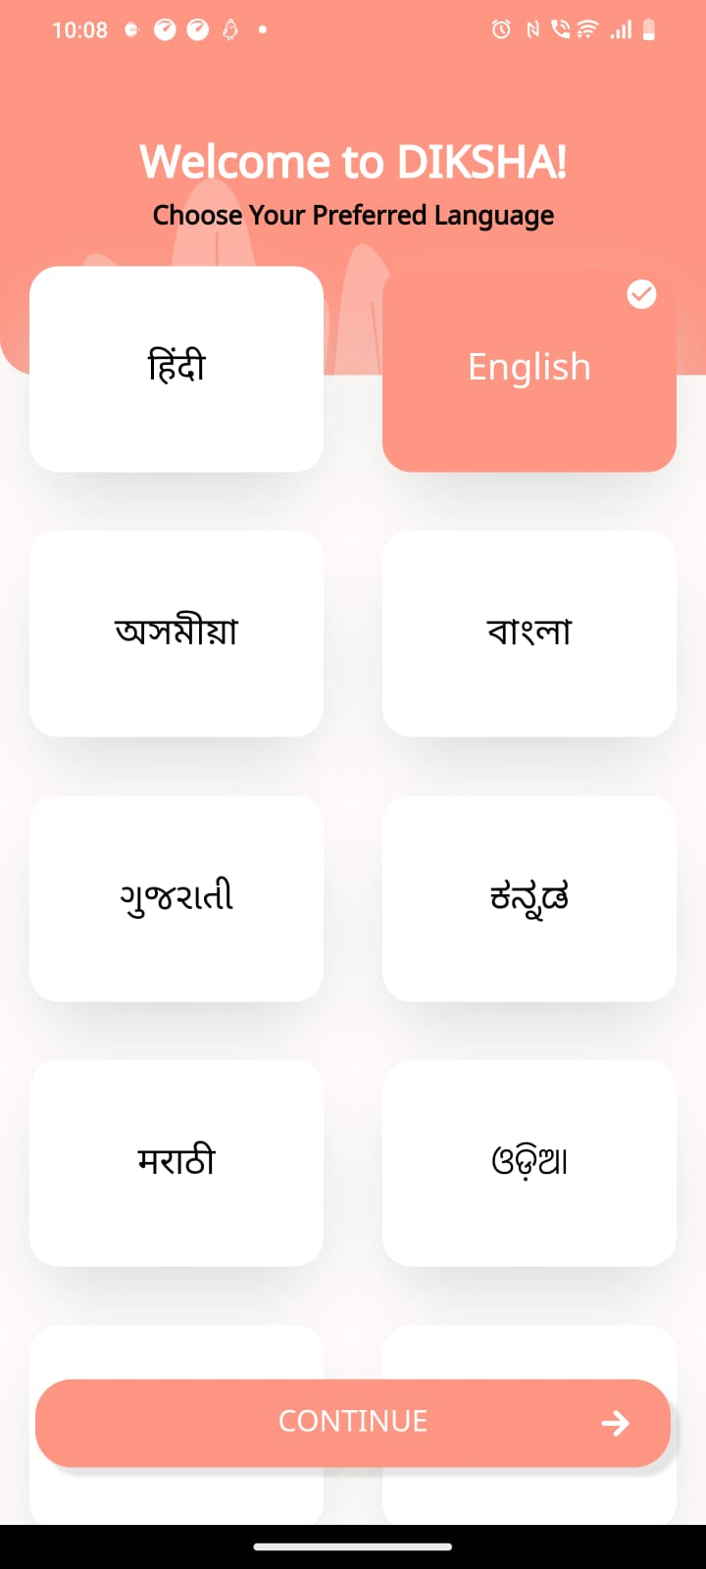
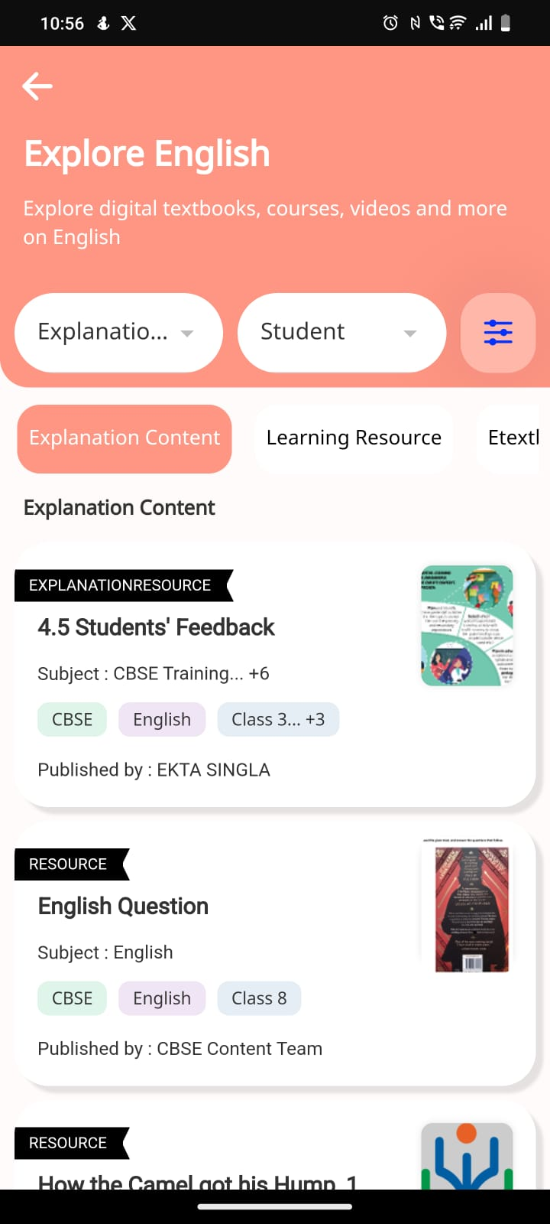
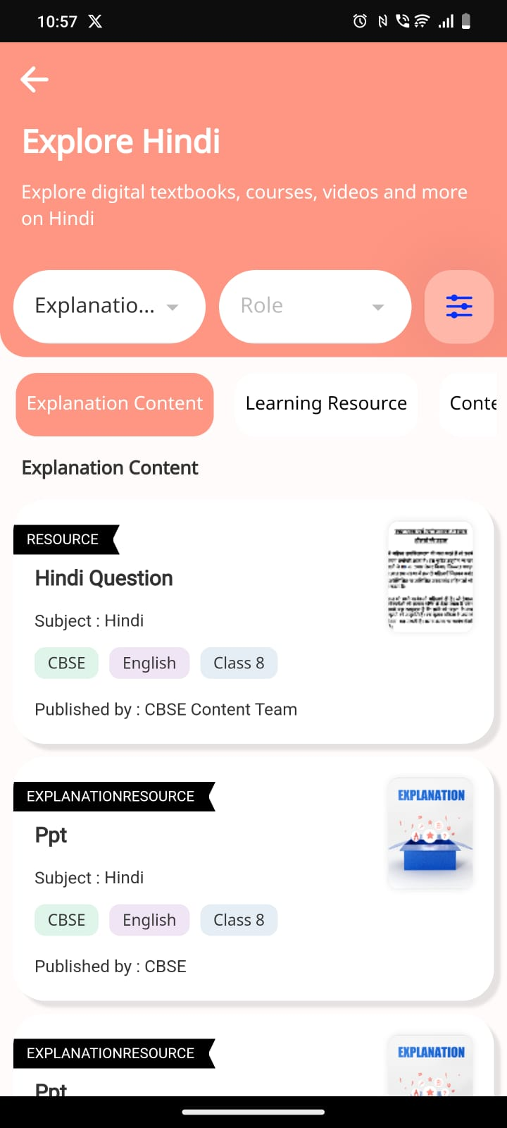
MOBILE DESIGN ENHANCEMENTS
Mobile design transformation:
  New color scheme and icon set for improved visual appeal and user engagement
Decision to adopt PANTONE Color of the Year after discussions with NCERT:
  Ensures contemporary design aligned with current trends
Planned dynamic change of color scheme annually to reflect PANTONE color
Streamlined landing page of mobile app:
Enhances user experience by simplifying navigation
Improves accessibility for users
Notes:
The mobile design has undergone a refreshing transformation, featuring a new color scheme and icon set to enhance visual appeal and user engagement. Following discussions with NCERT, we have decided to adopt the PANTONE Color of the Year, ensuring our design remains contemporary and aligned with current trends. Moving forward, our color scheme will dynamically change each year to reflect the designated PANTONE color. Additionally, we plan to adapt the mobile color theme to coincide with major Indian festivals such as Holi, Republic Day, Independence Day, Dusshera, Diwali, and Christmas, with the final festival list to be confirmed by NCERT.
Furthermore, we have streamlined the landing page of the mobile app to deliver a more intuitive user experience, simplifying navigation and enhancing accessibility for our users.

Slide 19
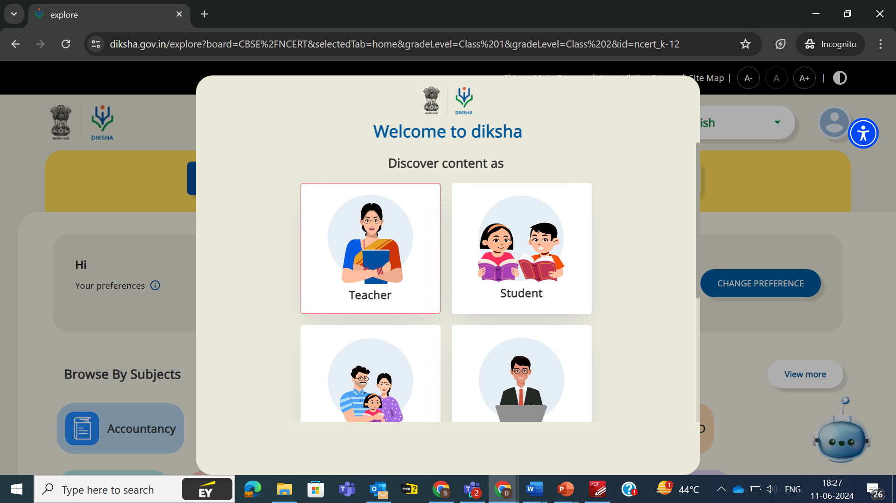
Logging in to the DIKSHA portal
Choose the respective role and then click on Continue

Slide 20
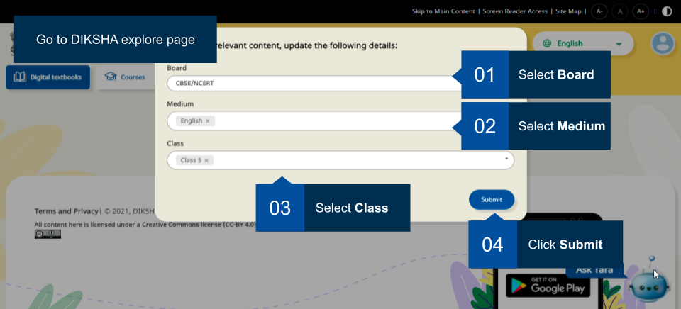
Logging in to the DIKSHA portal
To explore content on DIKSHA, type diksha.gov.in in the browser, and follow the below steps:

Slide 21
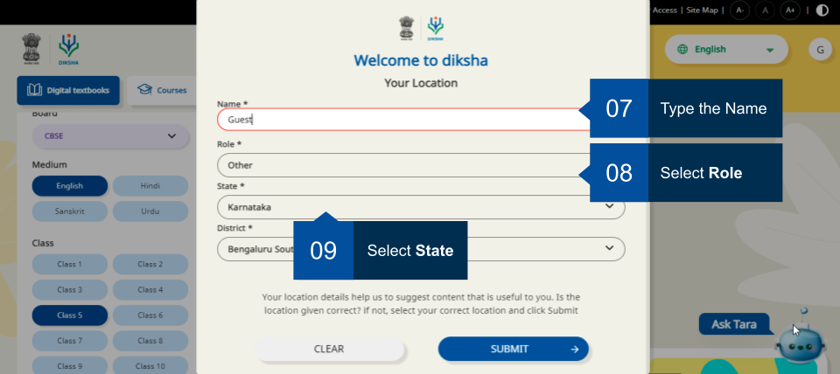
Logging in to the DIKSHA portal
Fill in the details such as
Name, role, state, and district

Slide 22
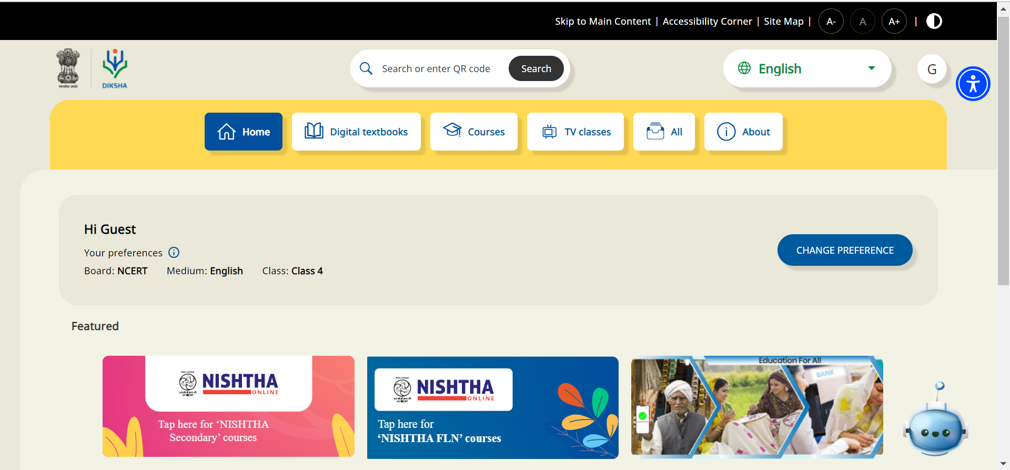
On clicking Explore DIKSHA

Slide 23
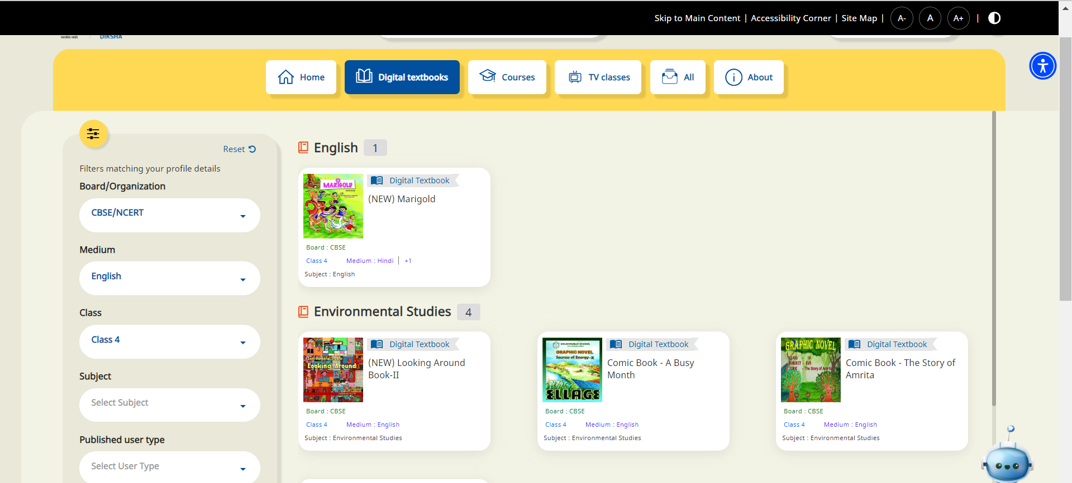
On clicking Digital Textbooks
(Board, Medium, Class, Subject)

Slide 24
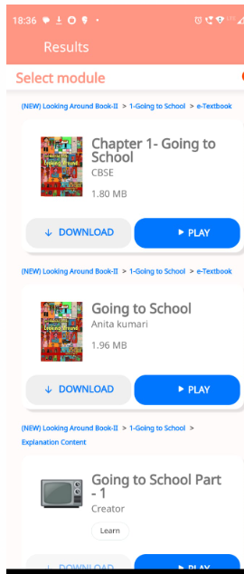
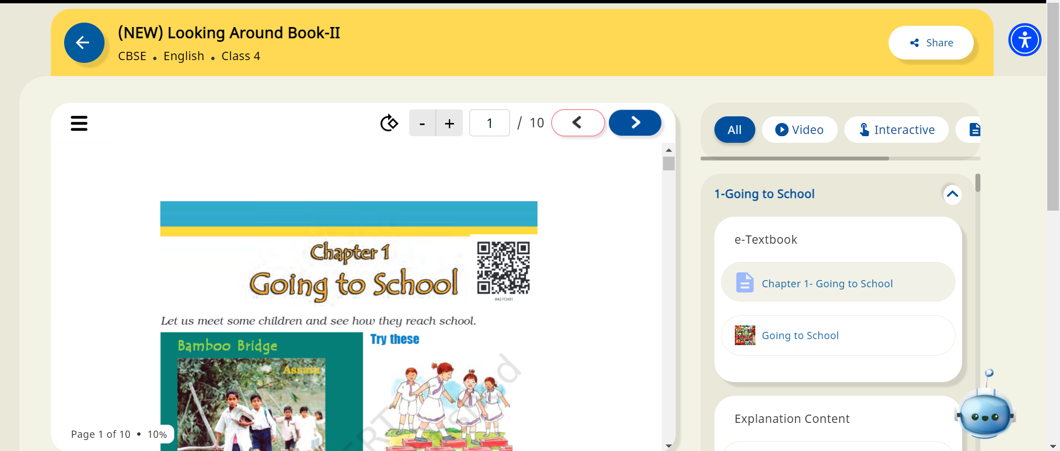
How to access content via QR Code?
Step 1: Download the DIKSHA app on your device
Step 2: Open the app and click on the scanner of DIKSHA app
Step 3: Scan the QR code mentioned on the book
Step 4: The corresponding content will further open on the app

Slide 25

Things to remember while accessing content through QR code
If there is one content resource associated with the scanned QR code, you directly see the content details page. If more than one content resource is associated with the same QR code, you see a list of results
You can see results across all content types - courses, textbooks or individual content resources
When you scan a QR code of a unit or a content that exists on your device (downloaded) on your device, the QR scan will display relevant content, irrespective of whether you are online or offline

Slide 26
Thank You

