Slide 1
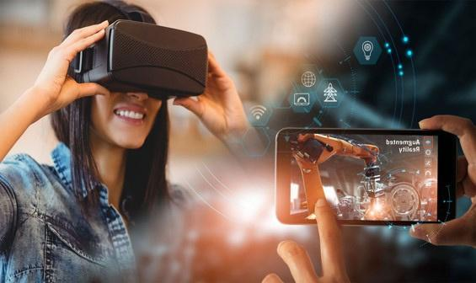


Orientation of State Resource Groups (SRGs) on Development of eContent for DIKSHA
Immersive Technologies for Teaching-Learning and Assessment
Extended Reality (AR, VR and Virtual Labs)
By: Shweta Bhardwaj
Technical Consultant (AR/VR)
CIET,NCERT

Slide 2



Session Outline
Introduction: Concepts and Technologies
The Spectrum of Reality-Virtuality Continuum
Immersive Technologies
Elements of Reality
Augmented Reality (AR)
Virtual Reality (VR)
Virtual Labs
Immersive Technologies and Assessment
Script Writing and Story Boarding
Challenges and Consideration

Slide 3


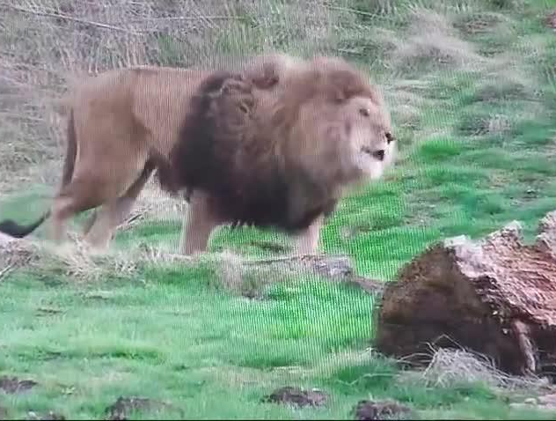
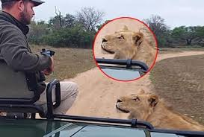
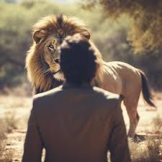
Not All Learning Tools Are Equally Effective
Some tools are better than others
The lion is like a king, commanding respect with its powerful roar
Text
Image
Video
Near to Real Engagement

Slide 4
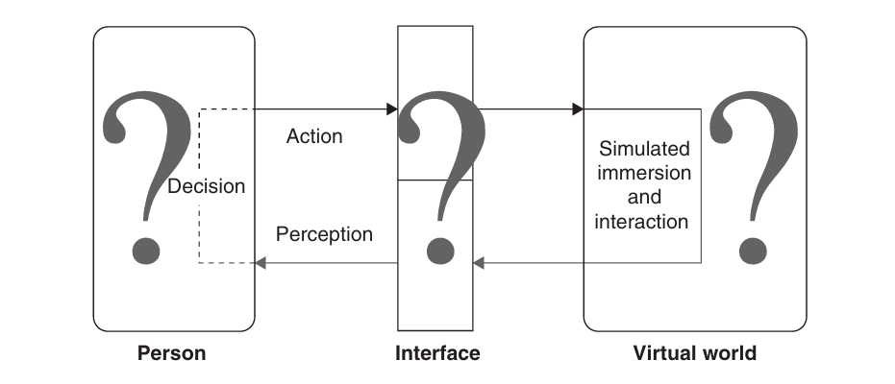
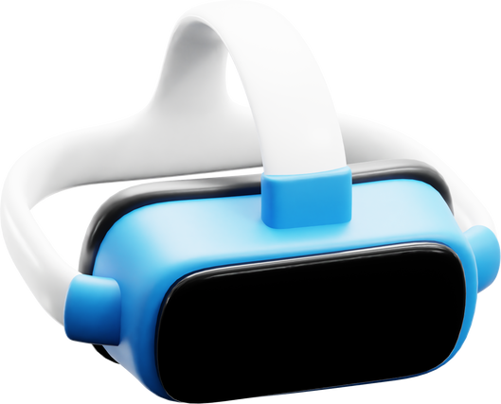
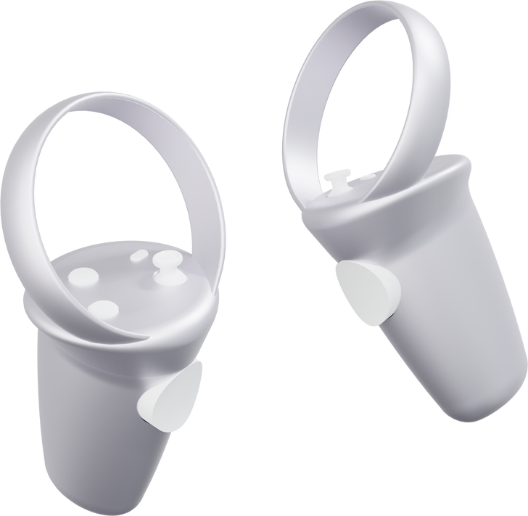
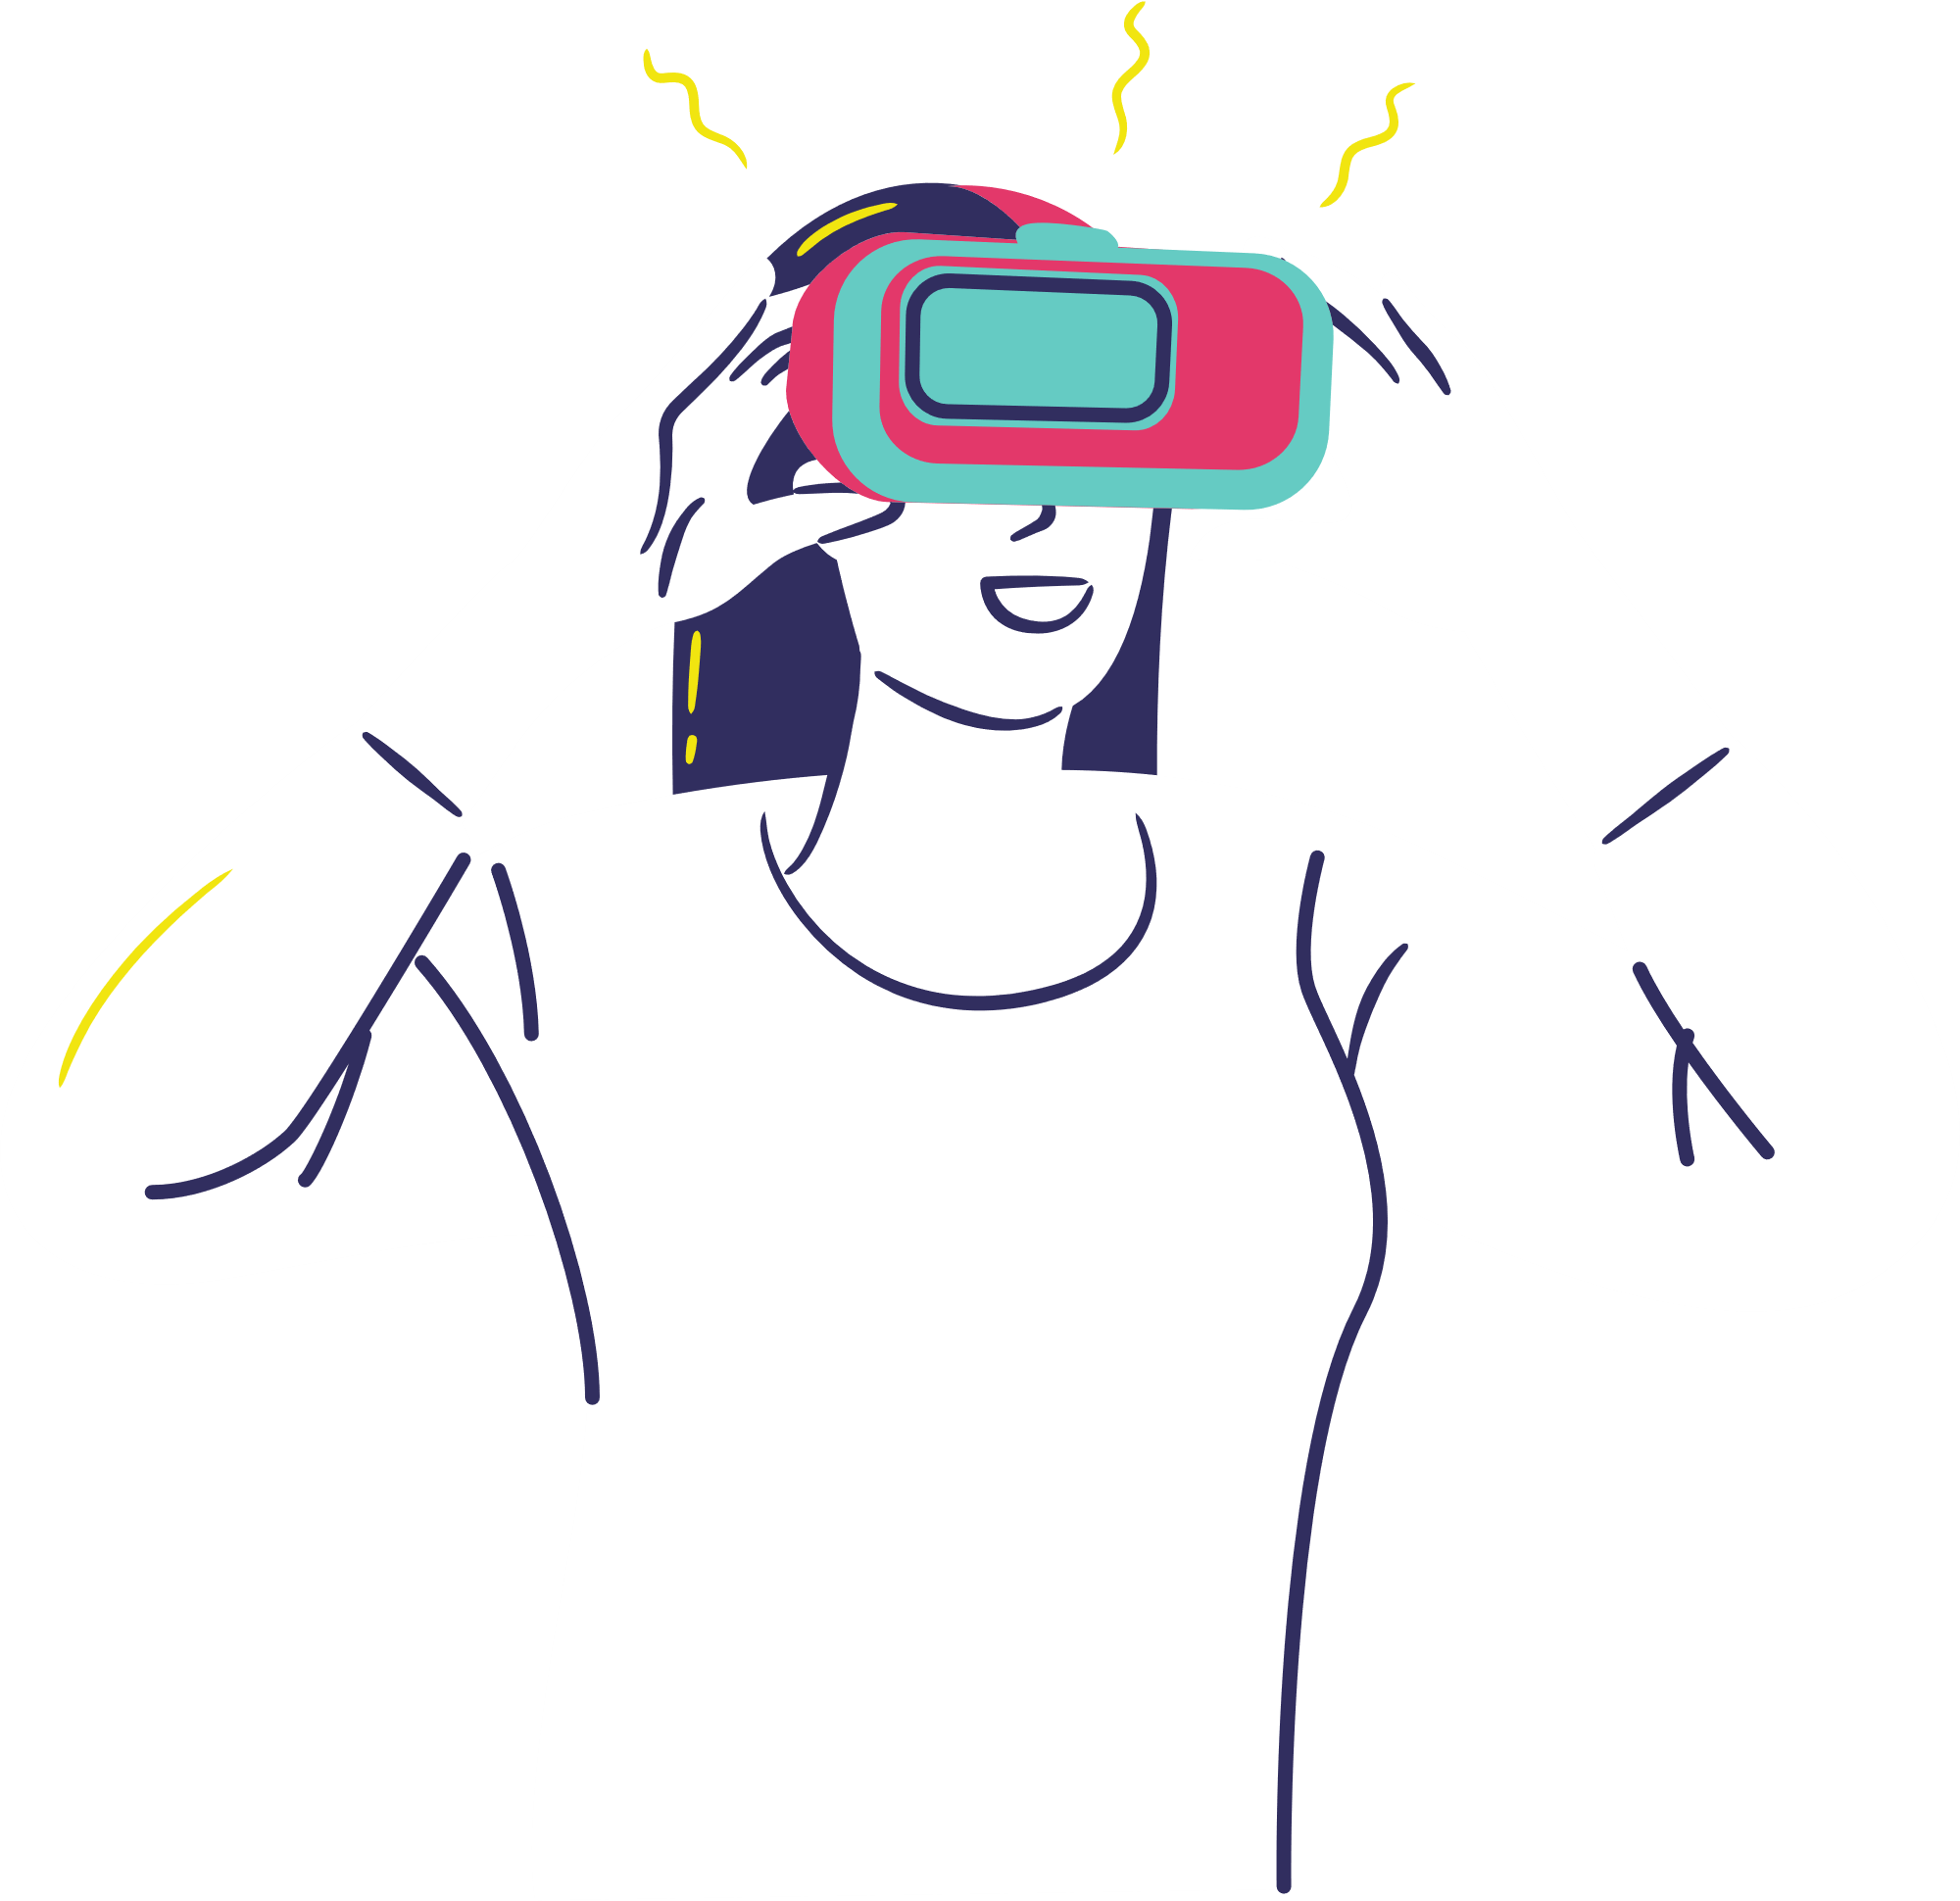
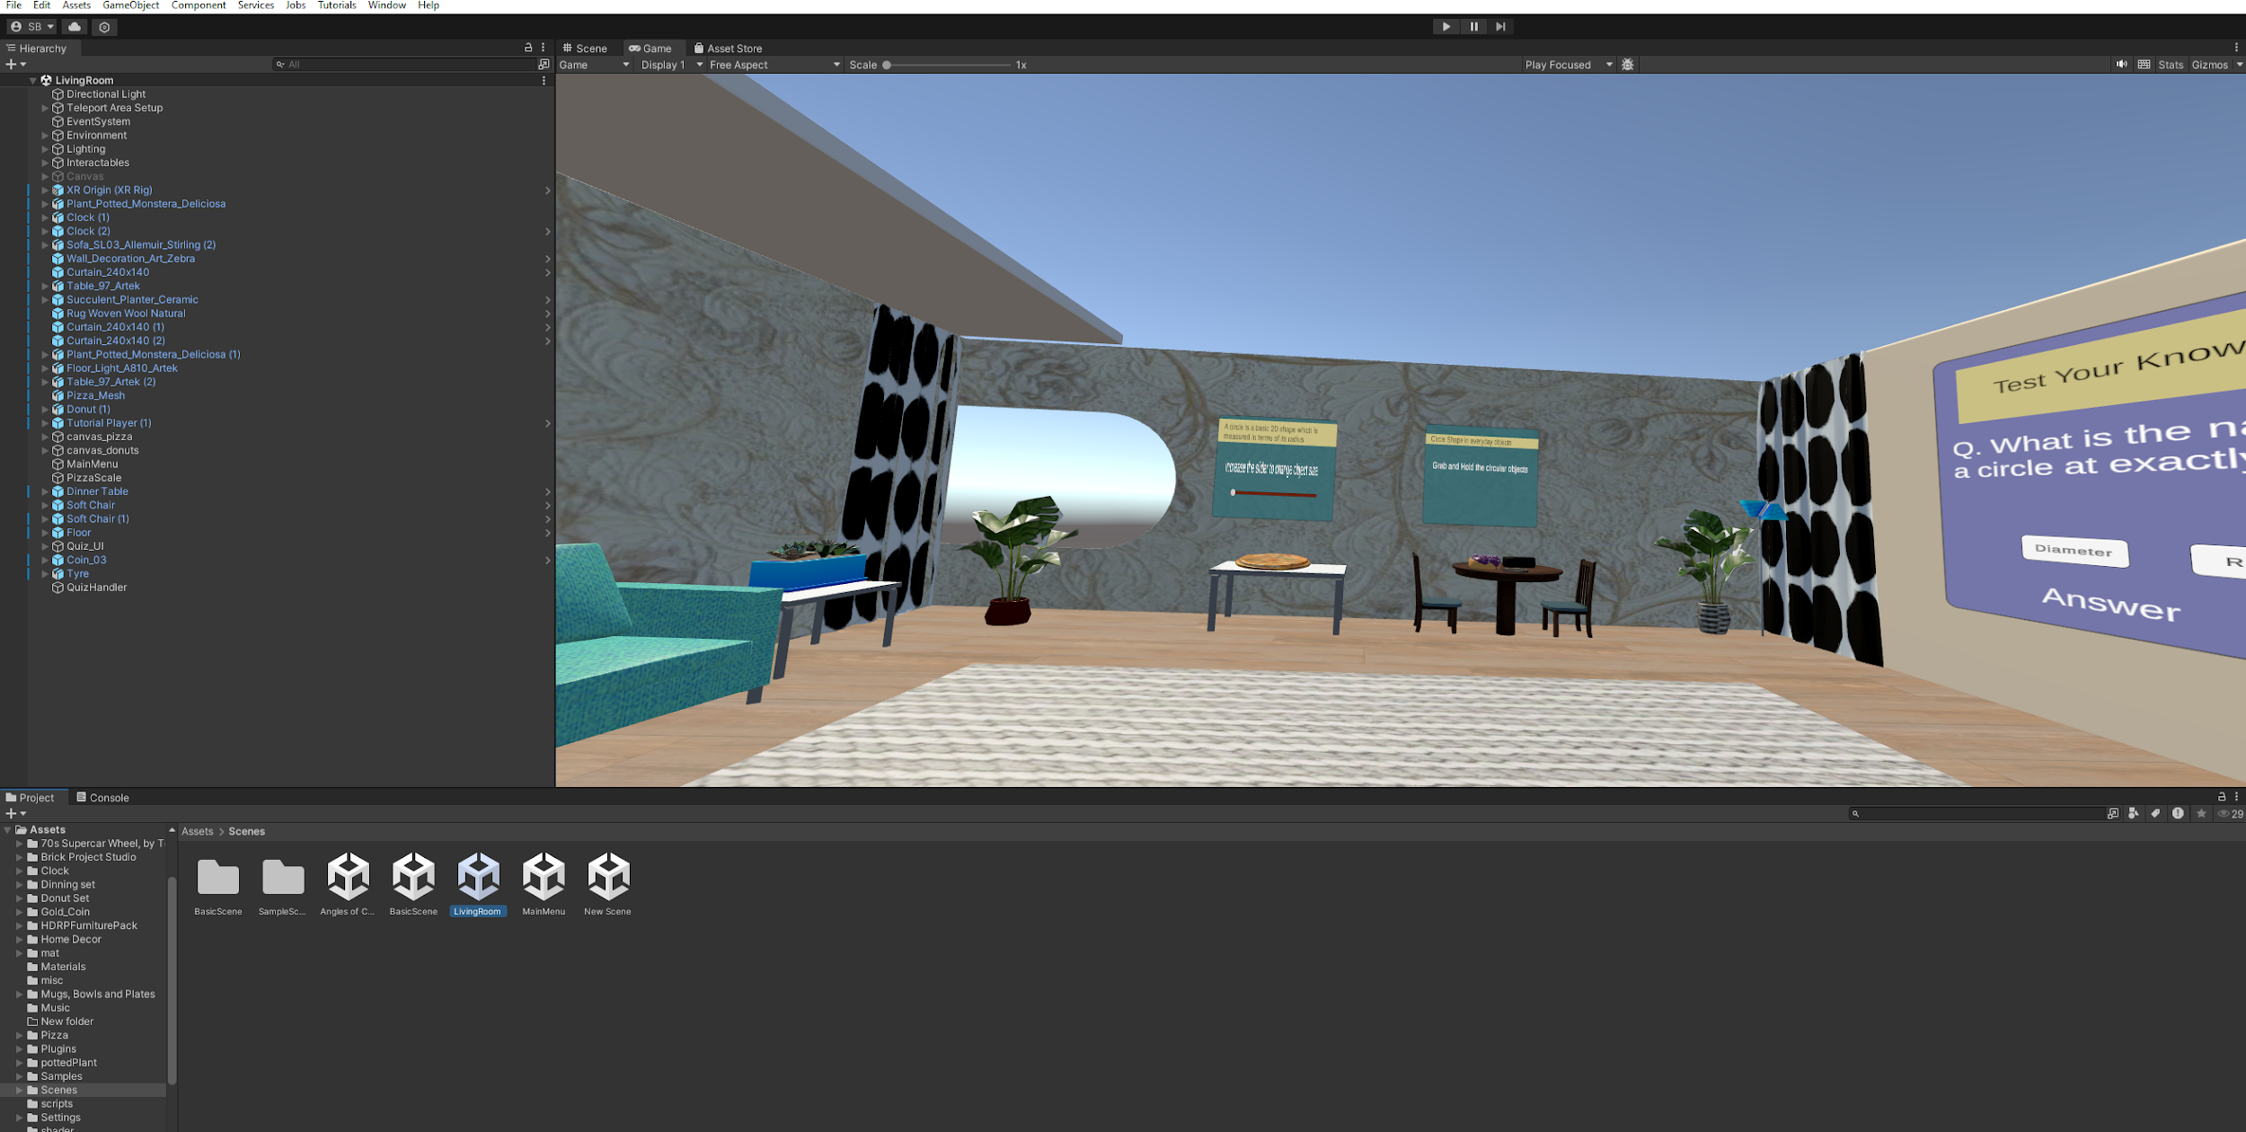
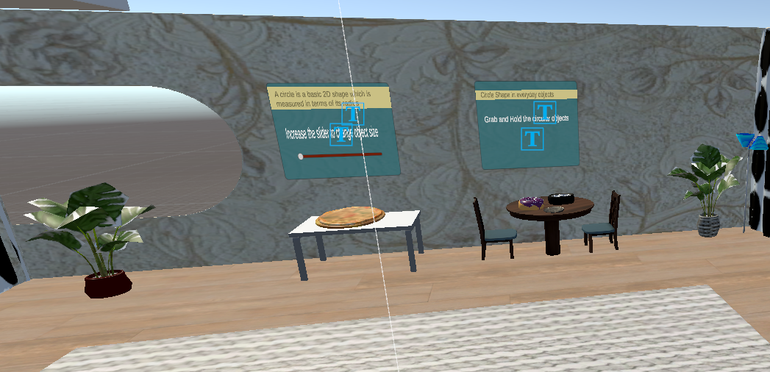
Introduction: Concepts and Technologies

Slide 5

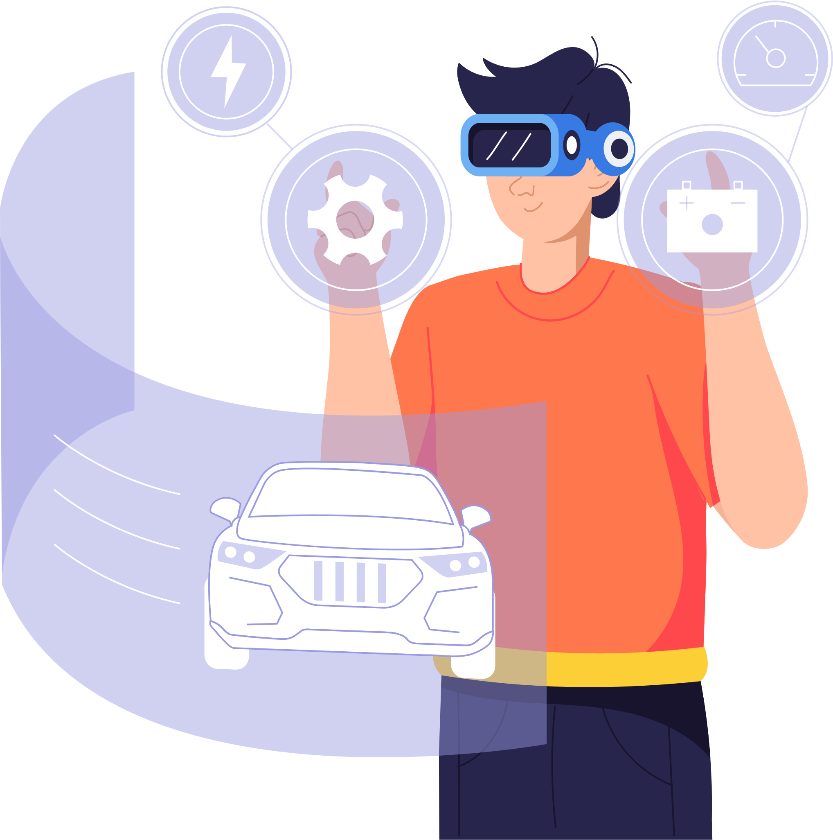



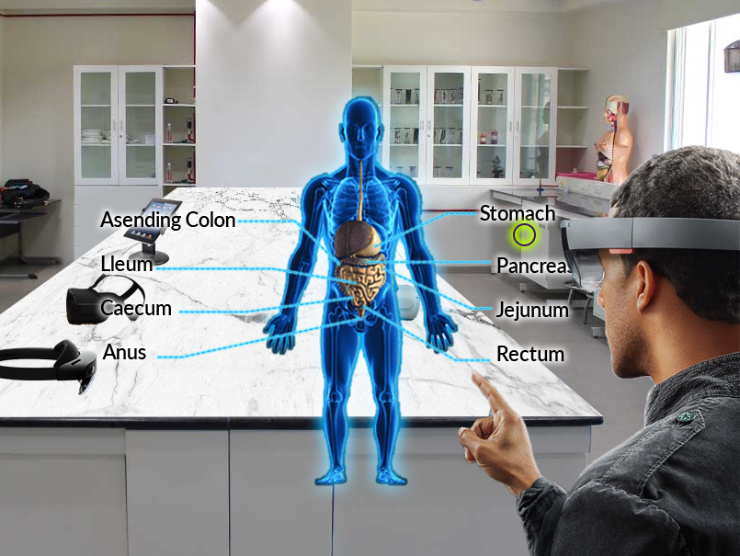

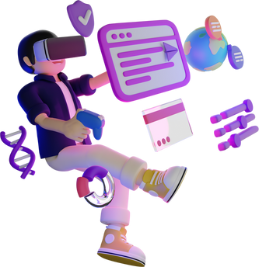
The Spectrum of Reality-Virtuality Continuum
Reality
Augmented Reality
Virtual Reality

Slide 6


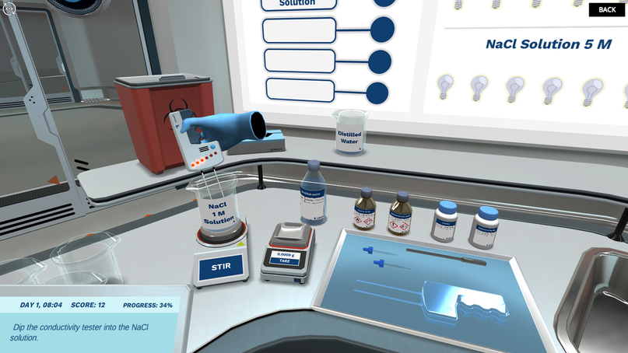
Immersive Technologies
360 Videos
AR (Augmented Reality)
VR (Virtual Reality)

Slide 7

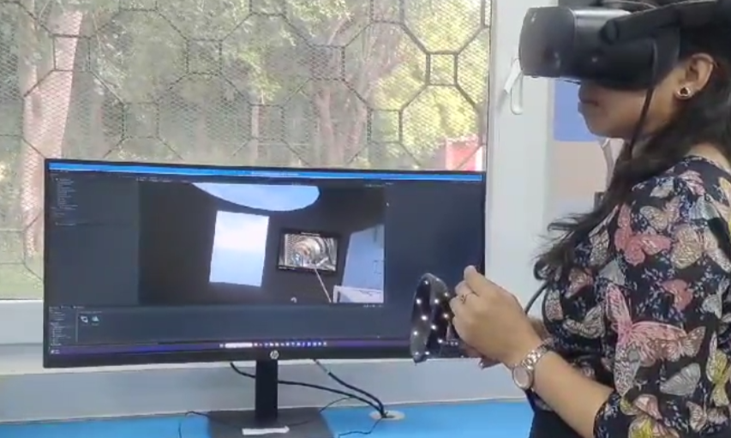
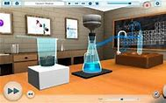

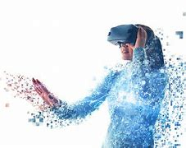

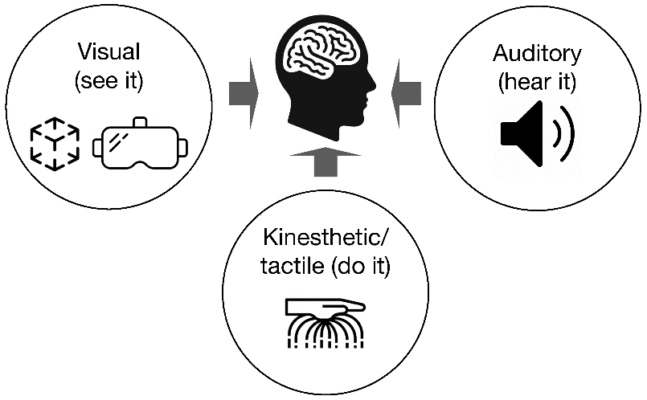
ELEMENTS OF REALITY
Element 1
The Virtual Environment
Element 5
01
Interactivity
05
02
Element 2
04
Element 4
Virtual Presence
05
Perspective
03
Element 3
Sensory Feedback

Slide 8
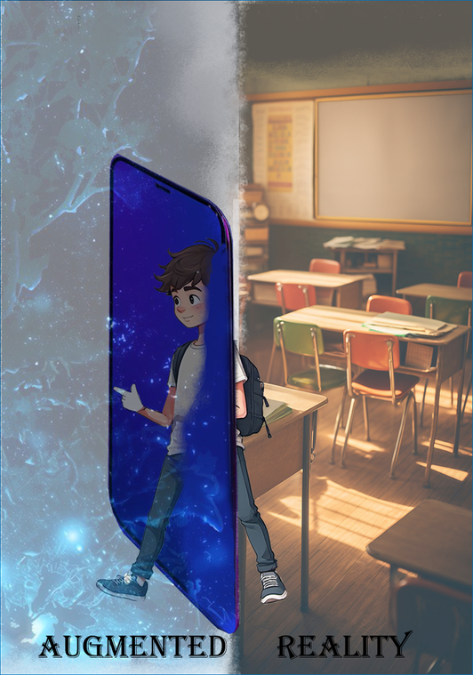
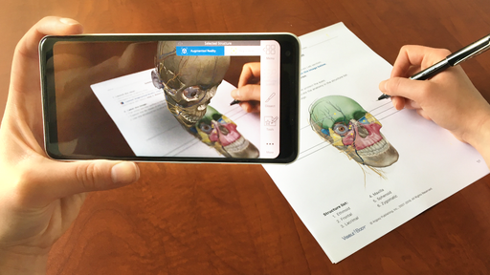
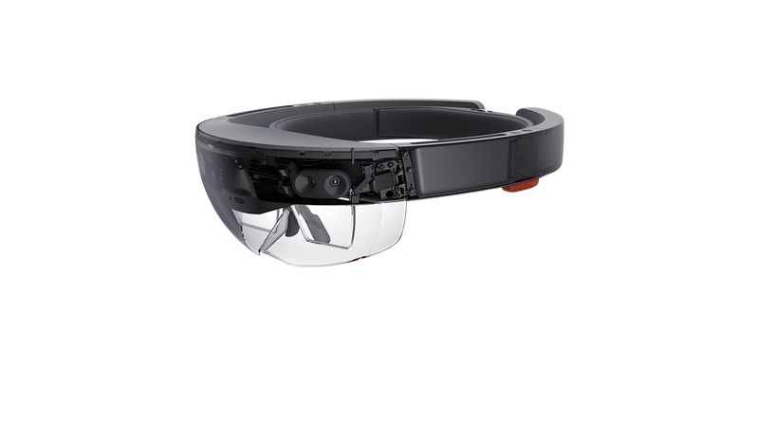
Augmented Reality (AR)
Augmented reality (AR) refers to the real-time integration of digital information into a user’s environment.
AR technology overlays content onto the real world, enriching a user’s perception of reality rather than replacing it.
AR Devices
Smartphones and tablets are the most common AR devices.
Augmented Reality (AR) Glasses
Augmented Reality (AR) Headsets
AR APPS
E-Pathshala AR (Augmented Reality)
SkyView
ARloopa

Slide 9
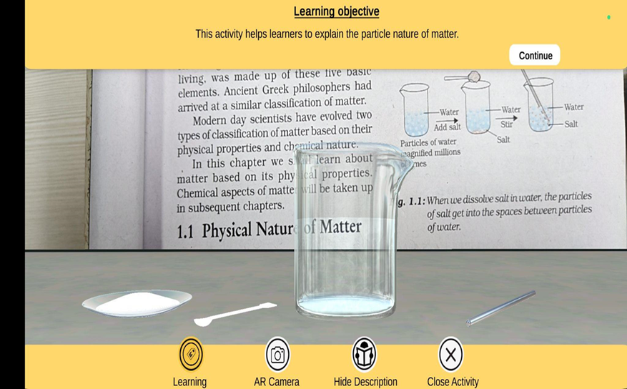
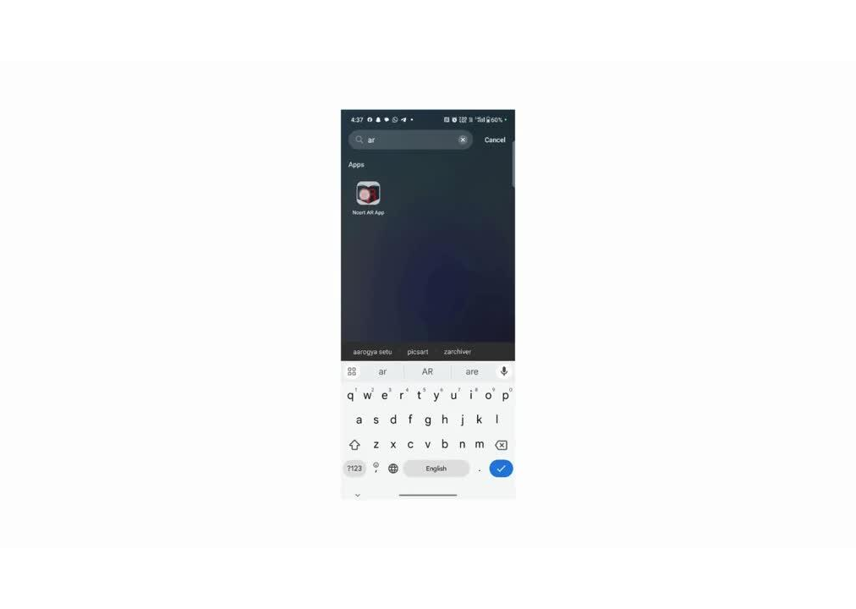
NCERT epathshala AR app

Slide 10
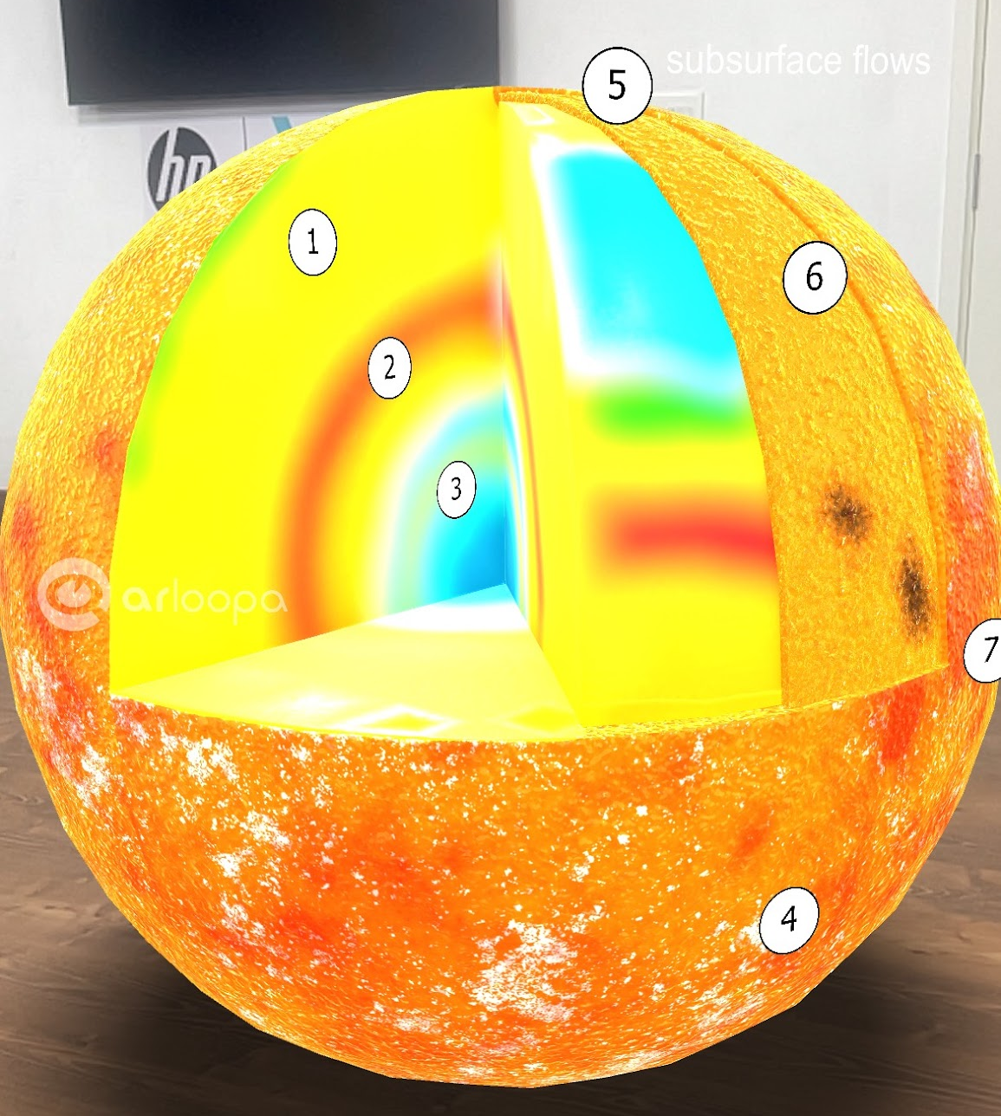
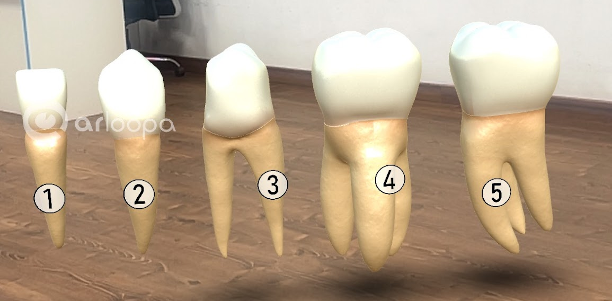
Augmented Reality (AR)
Model of Teeth
Layers of Sun

Slide 11

Collaborative Learning Experiences
Shared Experiences
AR can create shared experiences for students, allowing them to collaborate on projects, solve problems together, and learn from each other in a more engaging way.
Interactive Games
AR can be used to create interactive games that promote collaboration and teamwork. Students can work together to solve puzzles, complete challenges, and learn new concepts.
Accessibility
AR can make learning more accessible to students with disabilities by providing personalized and adaptive learning experiences.

Slide 12

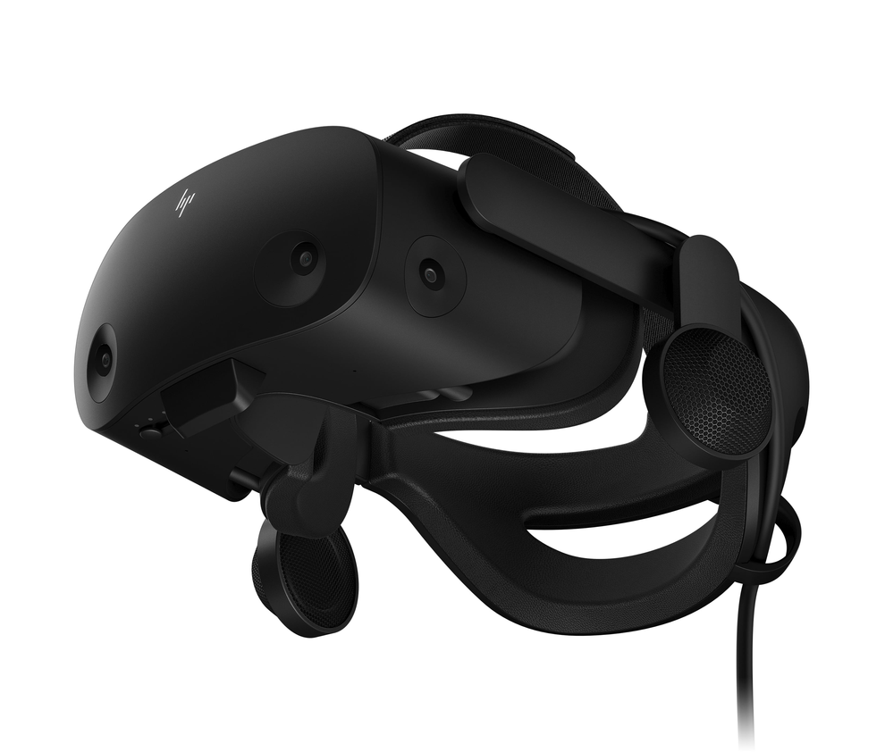
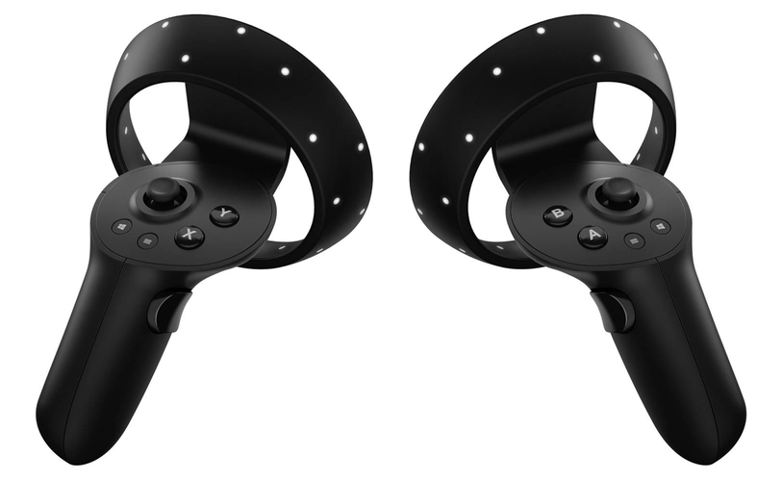
Virtual Reality
Virtual Reality (VR) is a simulated experience created by computer technology that immerses users in an interactive, three-dimensional environment.
It allows users to experience and interact with a virtual world as if they were physically present.
Devices Used to See VR:
VR HEADSETS
VR CONTROLLERS

Slide 13
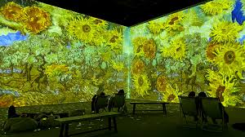



HOW VR WORKS
Immersive
Interactive
Multisensory
VR uses headsets and other devices to create a simulated environment that surrounds the user.
Users can interact with the virtual world using controllers, sensors, or other input devices.
VR can engage multiple senses, including sight, sound, and touch.

Slide 14
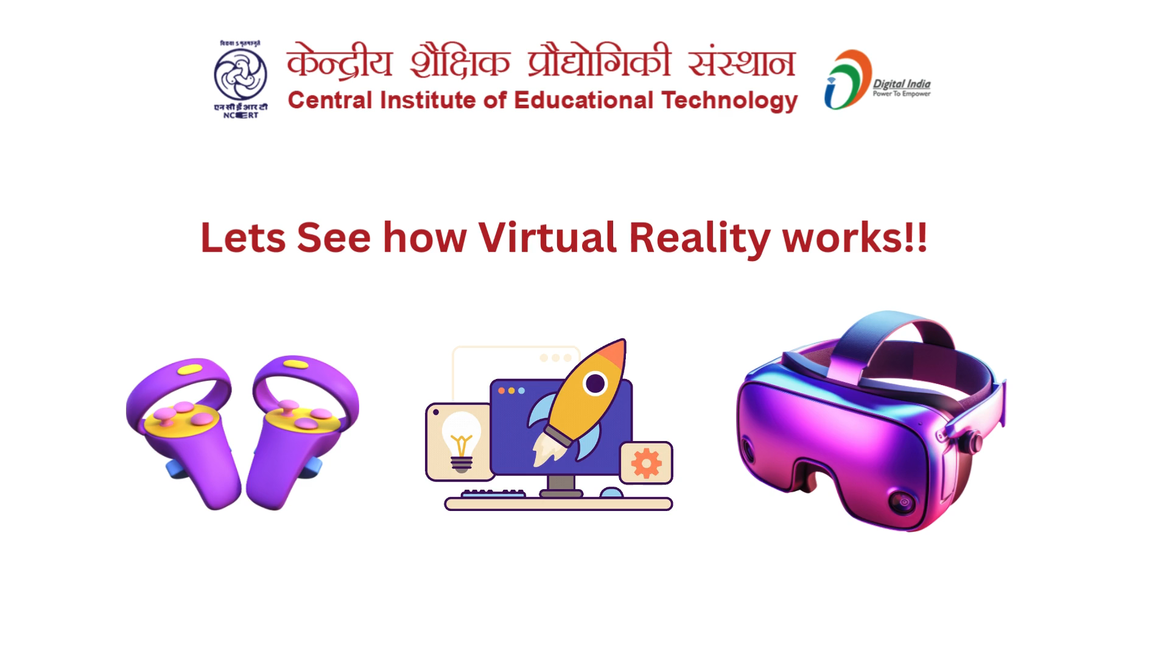
HOW VR WORKS

Slide 15

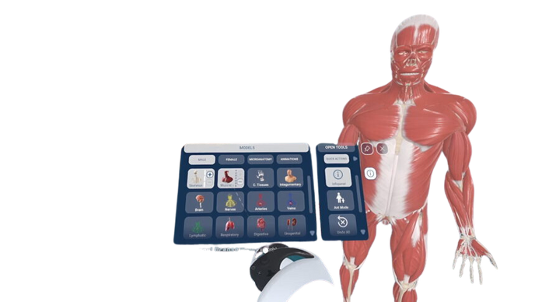

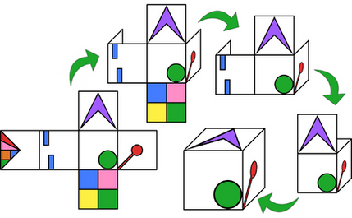
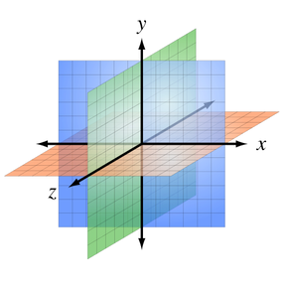
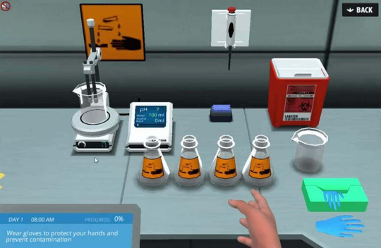
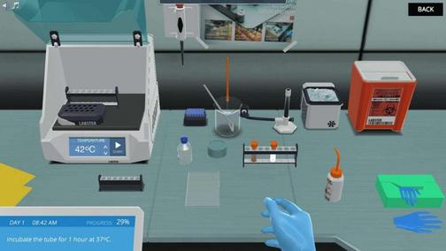
VR in Education: Enhancing Spatial Understanding
Visualizing Complex Concepts
VR allows students to visualize complex concepts and structures in three dimensions.
Developing Spatial Reasoning
VR provides opportunities for students to develop spatial reasoning skills
Improving Memory and Recall
Foster Deeper Understanding & Better Retention

Slide 16








Pedagogical Benefits of Extended Reality
Increased Engagement
Immersive experiences make learning more exciting and interactive, boosting student motivation and interest.
Improved Retention
Hands-on experiences in virtual environments lead to deeper understanding and improved knowledge retention.
Personalized Learning
Students can learn at their own pace and adapt the simulation to their individual needs and learning styles.
Enhanced Collaboration
Virtual environments facilitate collaborative learning, allowing students to work together and learn from each other.

Slide 17

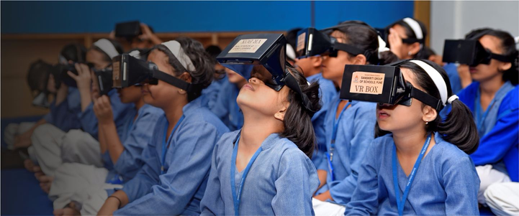
A virtual laboratory is a computer-based activity where students interact with an experimental apparatus or other activity via a computer interface.
Key Features of Virtual Labs
Collaboration Tools: Collaboration tools in virtual labs can enhance the learning experience by promoting
teamwork, communication, and problem-solving skills.
Simple and Responsive Interface:
Accessibility: Virtual environments, or hands-on labs, are accessible from a computer with a primary web browser.
Real-time Guidance: This type of guidance is delivered in real-time, allowing students to receive feedback immediately.
Instructor control authorizes teachers to electronically monitor their students' progress, as happens in physical classrooms

Slide 18




Pedagogical Integration of Virtual Lab
Pre-Lab Session
Performance Session
Post-Lab Session
Understanding theoretical background.
Objectives of the lab activity.
Reviewing of instructional materials & demonstration video to familiarize students with the procedures and equipments.
Utilization of Virtual Lab platform to conduct experiment.
Interacting with computer generated environment which simulate real world.
Analyzing the learning outcomes.
Students analyze the data they collected, draw conclusions, and compare their results with theoretical expectations.

Slide 19


Virtual Labs on DIKSHA
Activity
Step 1: Search https://diksha.gov.in/
Step 2: Scroll banners to find Virtual Labs vertical and click on its “Explore”
icon.
Step 3: Scroll down on the landing page of Virtual labs to reach eContent of
classes 11.
Step 4: Click on the “Explore” icon of the class 11, select the english medium,
then choose a physics as subject.
Step 5: Click on the Explanation resource to reach the link for related resources

Slide 20
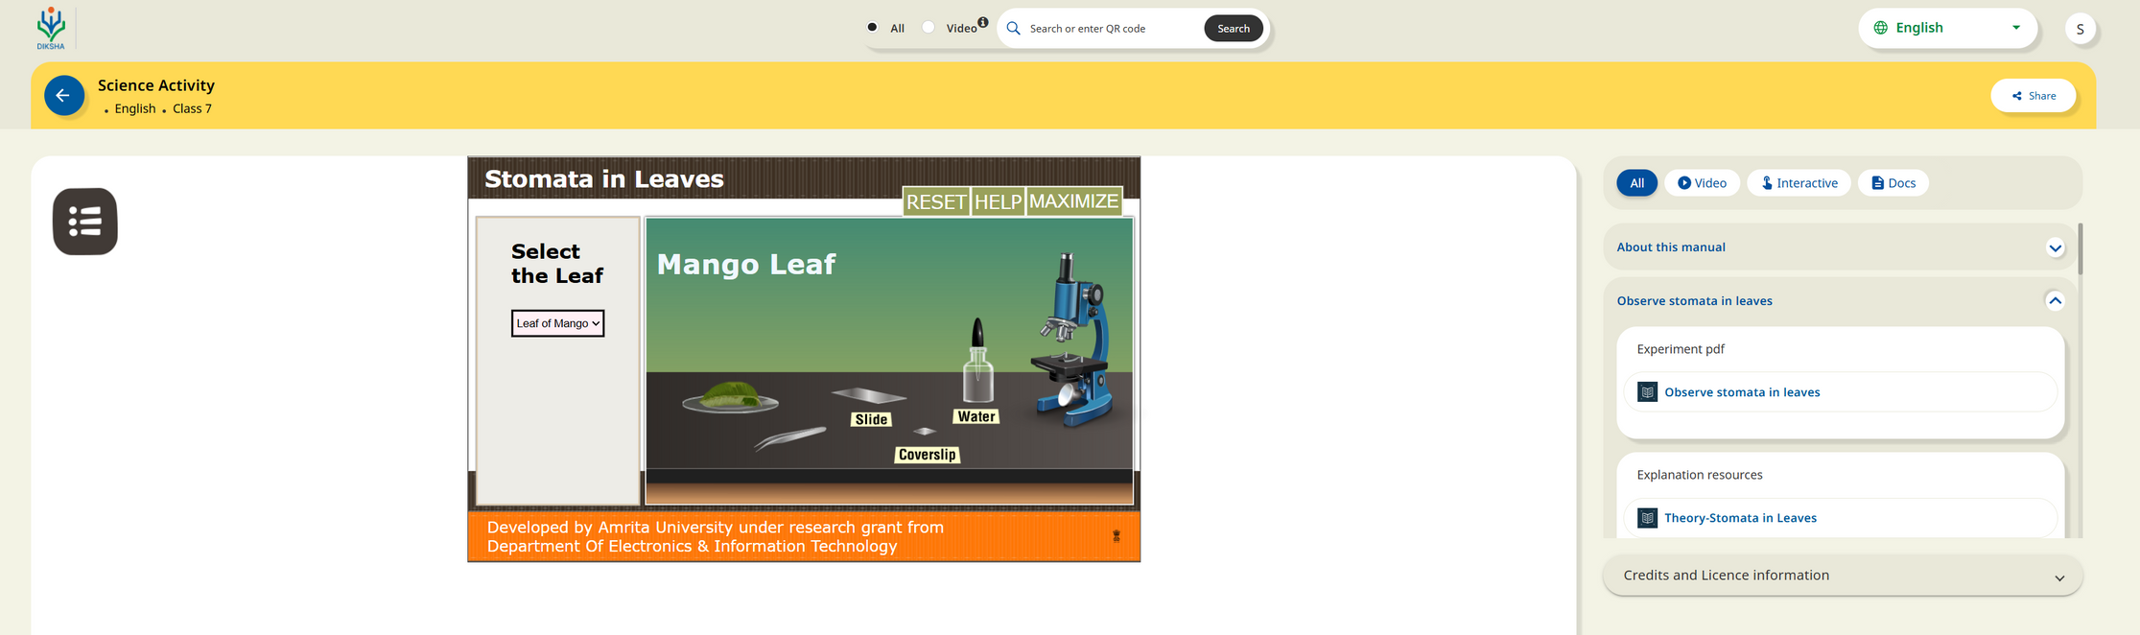


Virtual Labs on DIKSHA
Documentation
Additional Support Materials
Simulations
Feedback & Assessments
Theory of Experiments
Procedure/Videos

Slide 21
Immersive Technologies and Assessments
Simulation-Based Assessments: Assess students' ability to apply knowledge in real-world scenarios through VR simulations, such as virtual labs or problem-solving tasks in simulated environments
Immersive Problem-Solving Tasks: Use AR to create interactive tasks where students manipulate digital elements to solve problems, providing insight into their understanding and critical thinking.
Formative Feedback: Provide continuous feedback in real-time as students engage with VR/AR tasks, allowing for ongoing assessment of their progress and areas for improvement.
Gamified Assessments: Turn assessments into engaging, gamified experiences in immersive environments
Collaboration and Teamwork: Use immersive technologies to assess collaboration skills by having students work together in virtual spaces to complete group projects or challenges. where students earn rewards or achieve goals based on their performance.

Slide 22

Orientation of State Resource Groups (SRGs) on Development of eContent for DIKSHA
Script Writing and Storyboarding
By: Shweta Bhardwaj
Technical Consultant (AR/VR)
CIET,NCERT

Slide 23
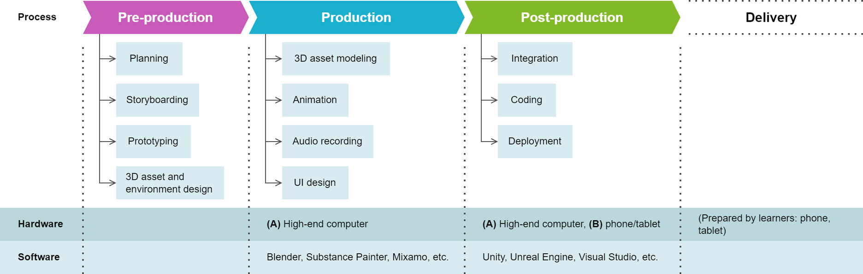
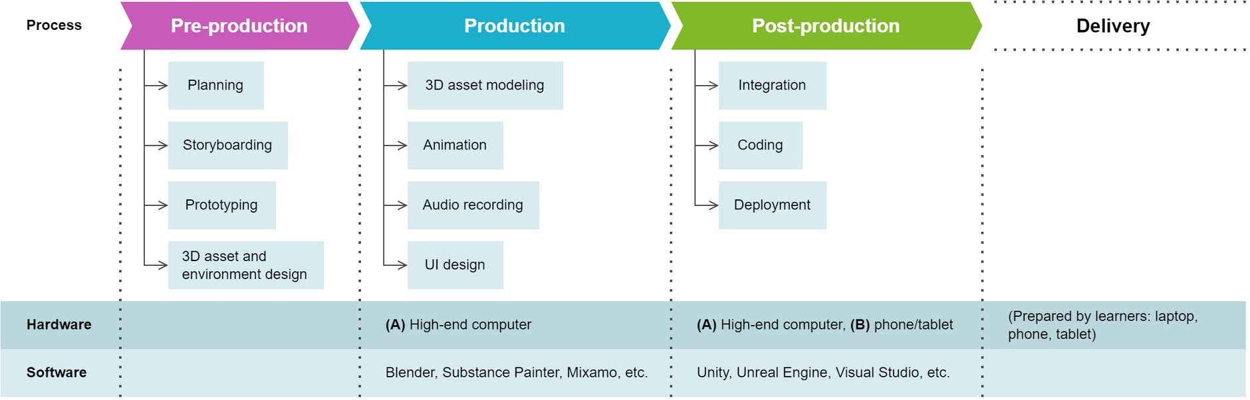
Pre-Production and Production Cycle

Slide 24
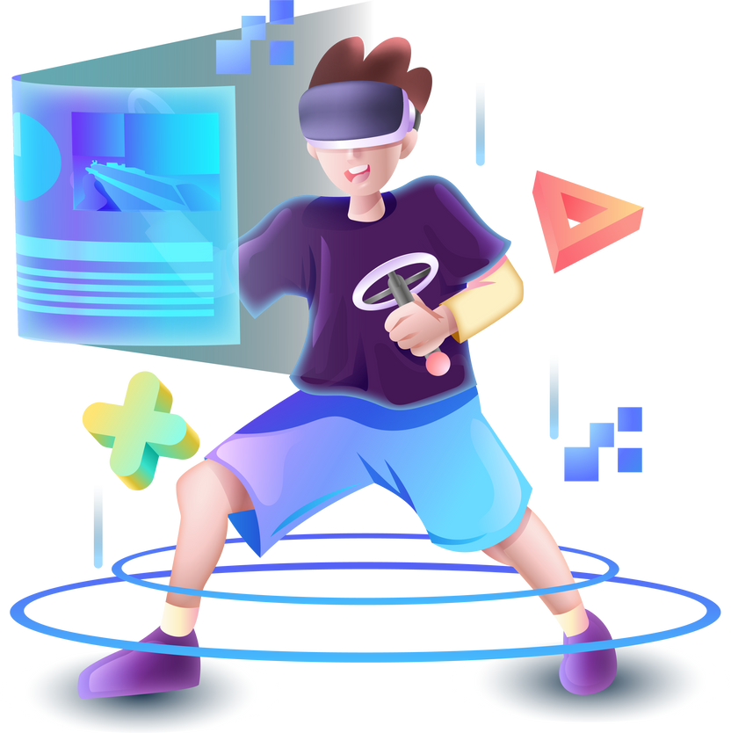
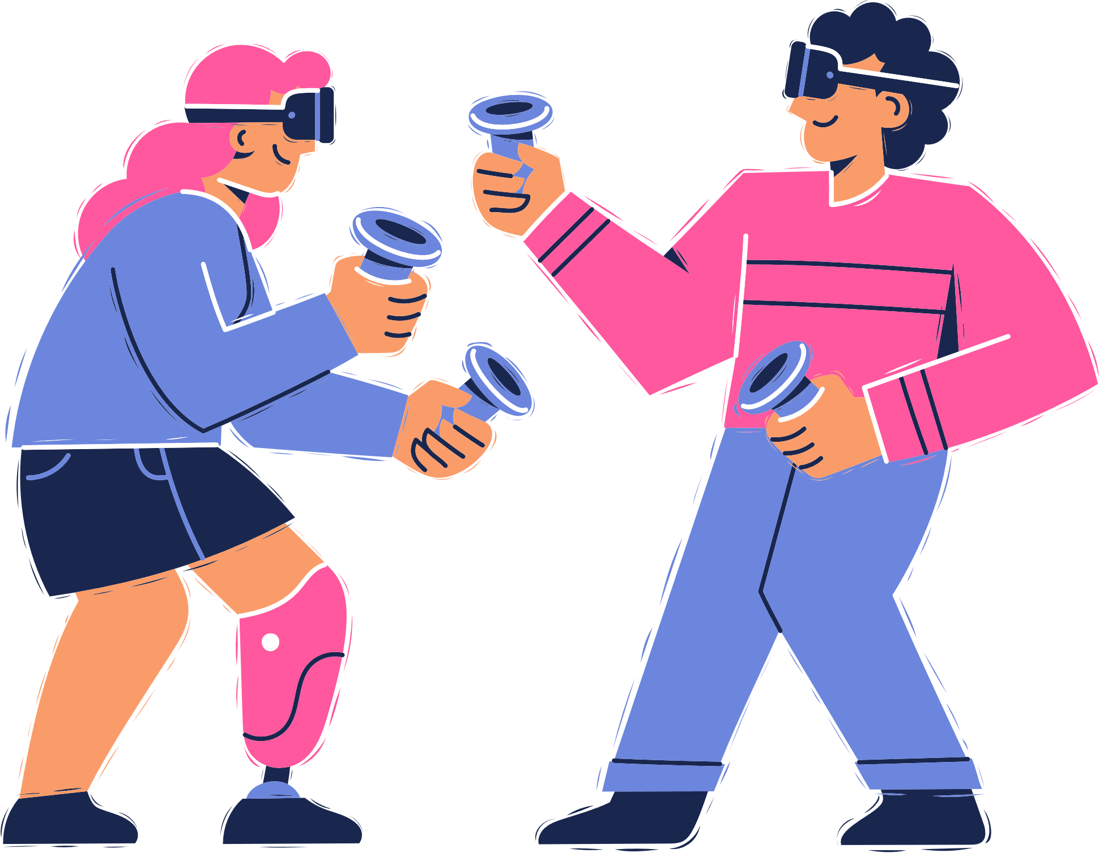

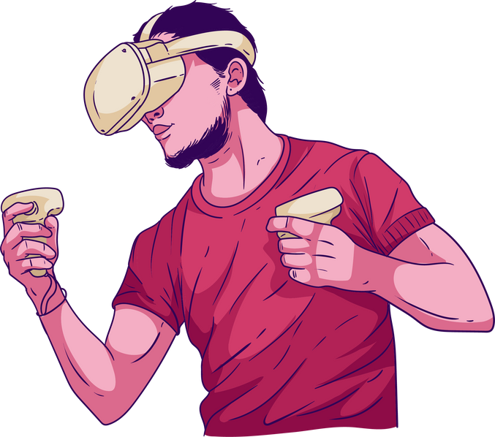


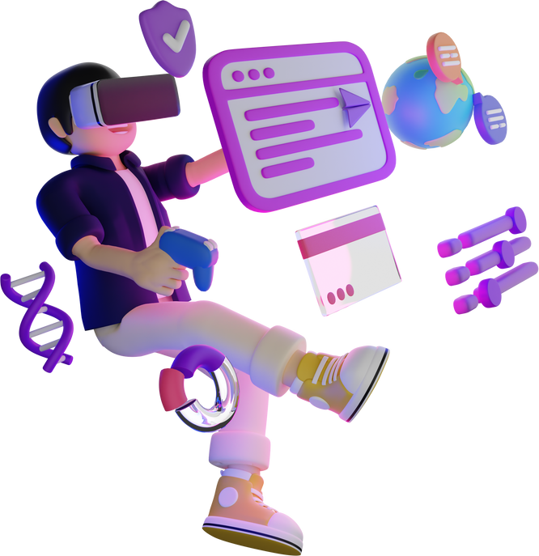


Principles of Script Writing for AR and VR
Interactivity
Immersion and Presence
First-Person Perspective
Spatial Storytelling
Contextual Instructions
Cohesion & Consistency
Emotional Engagement
Replay ability
Narrative Pacing

Slide 25
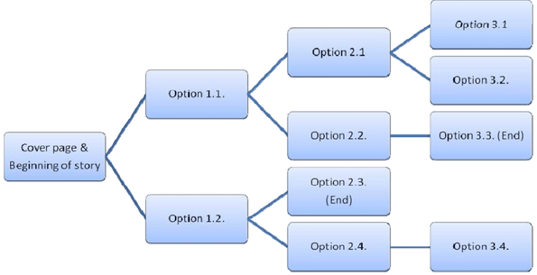
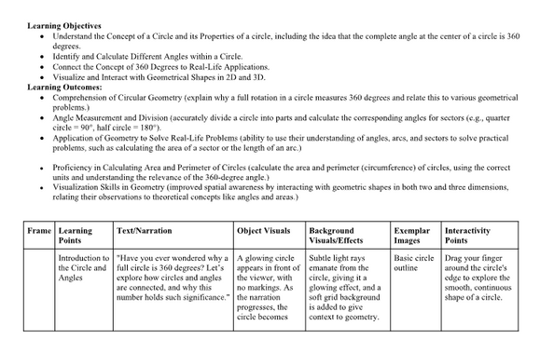

Methods of Script Writing for AR and VR
Branching Narrative Structures:
Scripts often utilize branching storylines to accommodate different user interactions. These multiple narrative pathways ensure that users experience unique outcomes based on their decisions within the virtual environment.
Modular Writing:
The script should be broken down into modular scenes or segments that can be rearranged or triggered based on the user’s actions. This allows for flexibility in how the story unfolds.
Dialogue and Environmental Cues:
Dialogue and environmental sounds should not overwhelm the user but should blend with the setting, creating a coherent narrative flow that supports the user’s choices and actions.

Slide 26
Principles of Storyboarding for AR and VR
360-Degree Spatial Awareness and Visualization
User-Centric Design
Interactive Elements
Layered Storytelling
Spatial Transitions
Immersive Environment Details
Multiple Viewpoints
Pacing and Timing
User Flow and Experience
Narrative Cues and Prompts

Slide 27
Methods of Storyboarding for AR and VR
3D Visualization Tools and storyboards
Top-Down Scene Maps
Interactive Prototypes
Flowcharts for Branching Paths and Diagrams
Sequential Animatics
Environmental Interaction Diagrams
Virtual Camera Placement
Mood and Lighting Boards
Iterative Testing and Refinement
Collaborative Storyboarding Sessions

Slide 28

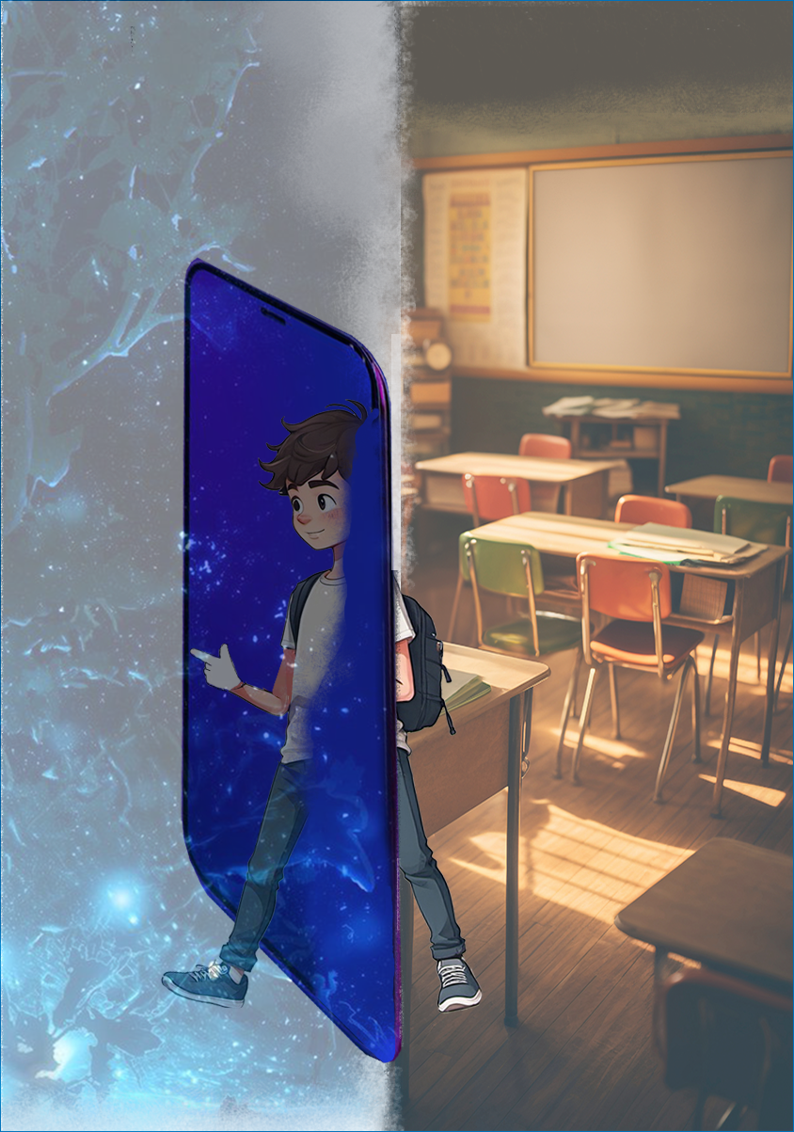


Challenges and Considerations
High Costs and Accessibility
The initial investment in virtual reality and augmented reality technology can be significant.
Lack of Skilled Professionals
Teachers require training to effectively integrate immersive technologies into their curriculum and leverage their potential.
Curriculum Integration
Most immersive content is created for western contexts, and there’s a need for localized content relevant to Indian history, culture, and languages.
Technical Support
Maintaining and troubleshooting virtual reality and augmented reality equipment can be challenging.

Slide 29

"Learning is an endless journey, where every step forward opens a new horizon of discovery."

