Slide 1


Phishing , Vishing & Smishing
Concept & Safety Concern
Chandni Agarwal

Slide 2
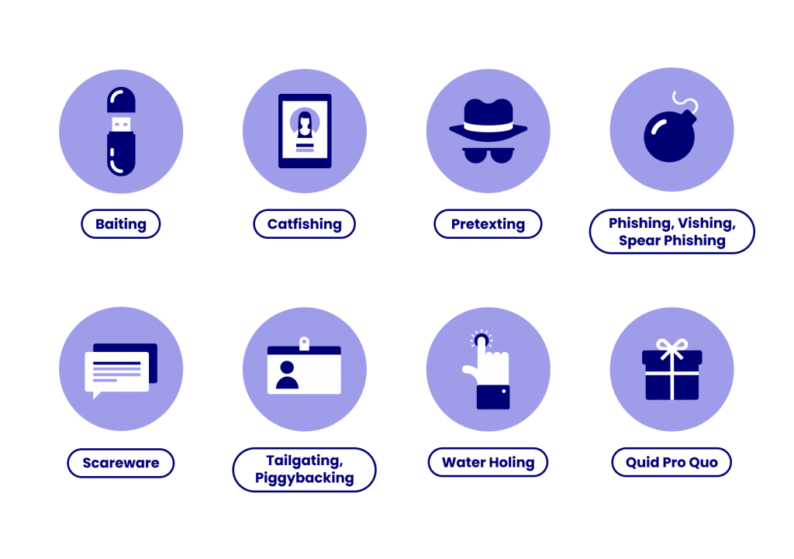
Social Engineering Attacks
A social engineering attack takes place in three steps. First, the attacker targets a victim. Second, they earn their trust. Third, they gain what they were after, usually breaking security practices or stealing information.
These attacks tend to work based on six principles:
Authority and trust: where the attacker poses as an authority figure.
Consensus and social proof: where peer pressure forces someone to commit an action.
Scarcity: the idea that a victim will miss out if they don’t act.
Urgency: the idea that the victim will miss out if they don’t act fast.
Familiarity and liking: convincing victims to perform certain actions by earning their trust / faking attraction.
Notes:
Baiting: The victim usually see the promises for reward in return for sensitive information or knowledge of its whereabouts.
2. catfishing - catfishing is when someone uses images and information (often taken from other people’s social media accounts) to create a new identity online – sometimes using an individual’s entire identity as their own. Newly created social media accounts can then be used to damage the reputation of the true owner of the identity, or alternatively any fictional identities that are created using other people’s images and information can be used to form dishonest relationships online.
3. Pretexting: This type of attack involves the perpetrator assuming a false identity to trick victims into giving up information. Pretexting is often leveraged against organizations with an abundance of client data, like banks, credit card providers, and utility companies.
4. Phishing: The most pervasive way of leveraging social engineering tactics, hackers will use deceptive emails, websites, and text messages to steal sensitive personal or organizational information from unsuspecting victims.
4. Spear Phishing: This type of email scam is used to carry out targeted attacks against individuals or businesses. Spear phishing is more intricate than your average mass phishing email, as it requires in-depth research on potential targets and their organizations
4. Vishing: In this scenario, cyber criminals will leave urgent voicemails to convince victims they need to act quickly to protect themselves from arrest or another risk. Banks, government agencies, and law enforcement agencies are commonly impersonated personas in vishing scams.
5. Scareware A common scareware definition is a cyberattack tactic that scares people into visiting spoofed or infected websites or downloading malicious software (malware). Scareware can come in the form of pop-up ads that appear on a user’s computer or spread through spam email attacks. 6. Tailgating: This attack targets individuals who can give the criminal physical access to a secure building or area. These scams are often successful due to a victim’s misguided courtesy, such as if they hold the door open for an unfamiliar “employee.”
7. Water-Holing: This attack uses advanced social engineering techniques to infect both a website and its visitors with malware. The infection is usually spread through a site specific to the industry the victims operate in, like a popular website that’s visited regularly.
8. Quid Pro Quo: This attack centers around an exchange of information or service to convince the victim to act. Normally, cyber criminals who carry out these schemes don’t do advanced target research and offer to provide “assistance,” assuming identities like tech support professionals.

Slide 3
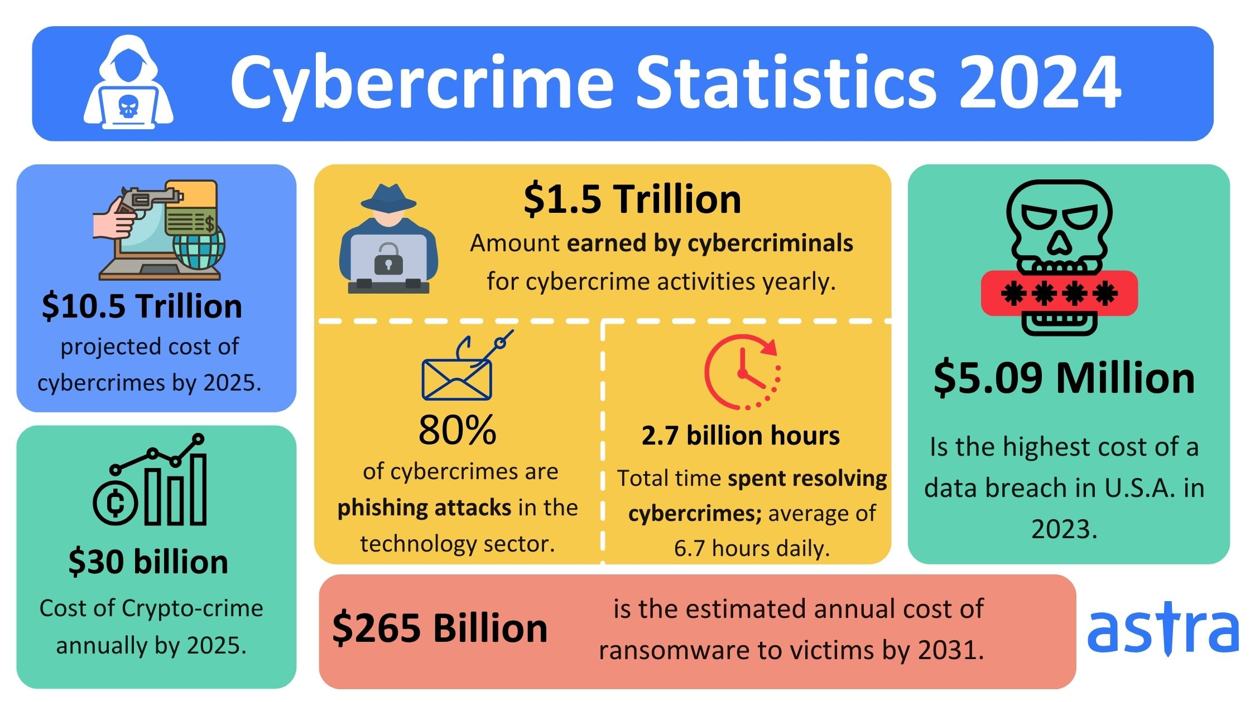

Slide 4
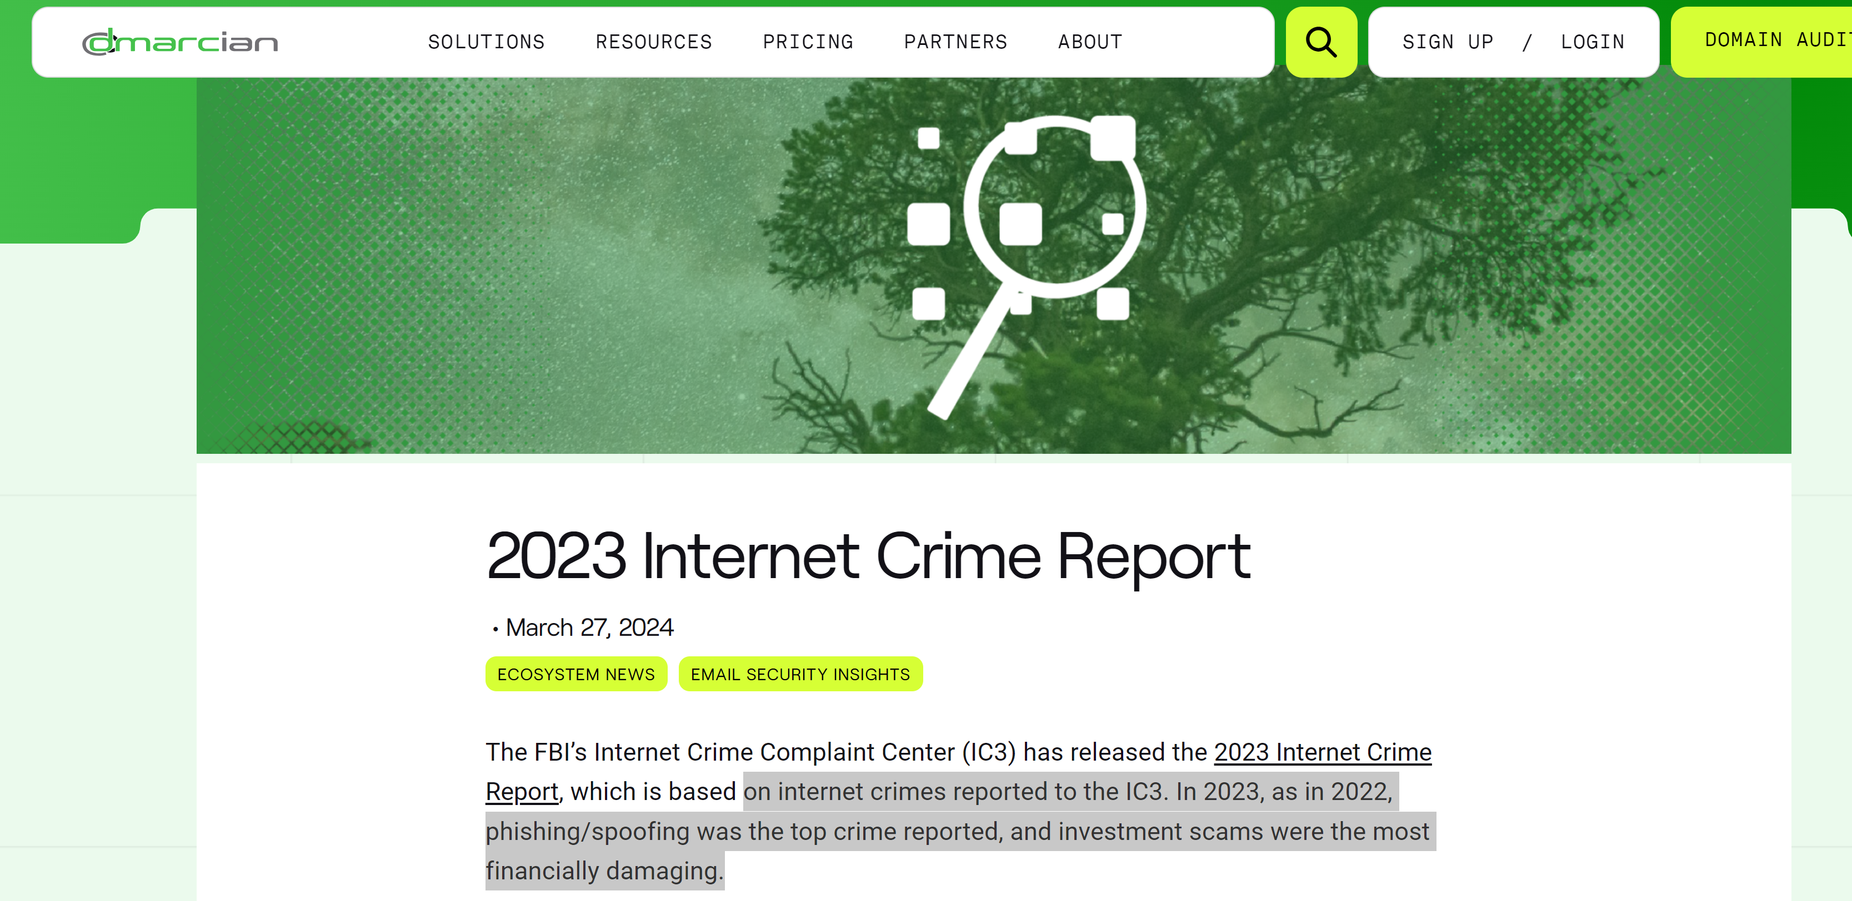

Slide 5
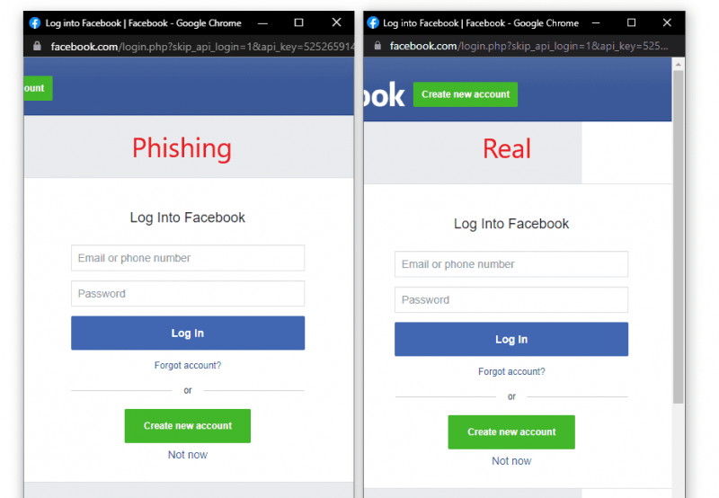

Slide 6
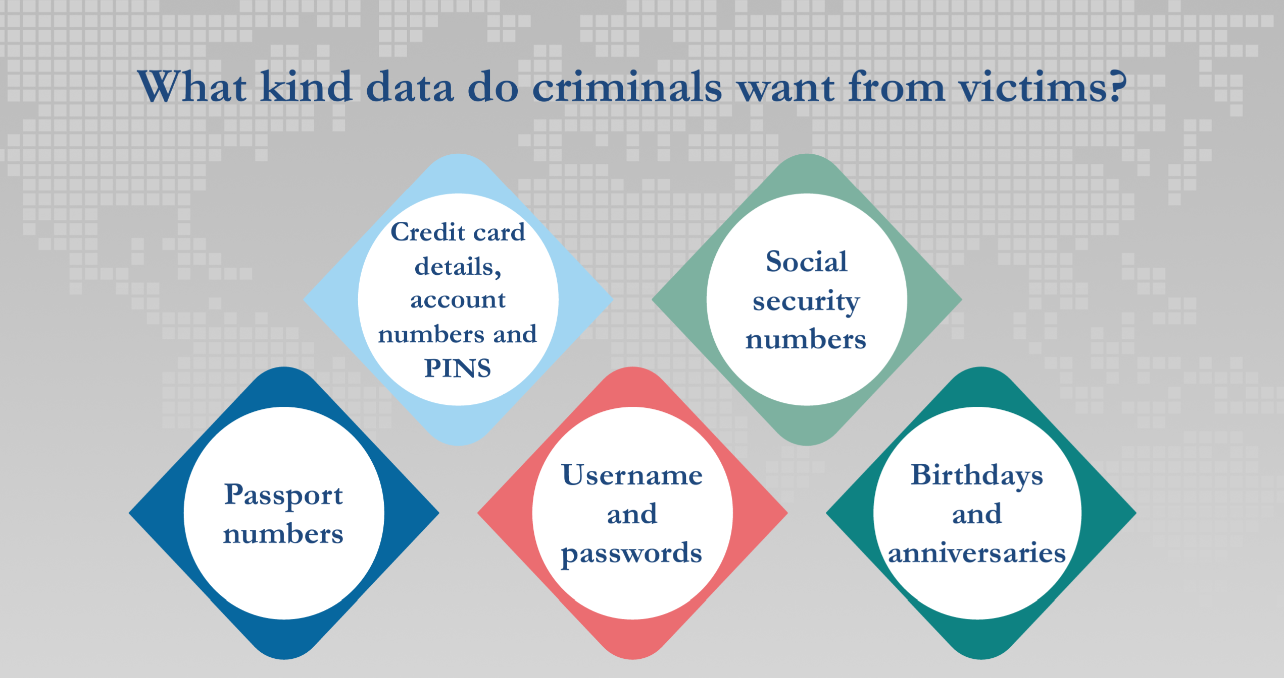

Slide 7
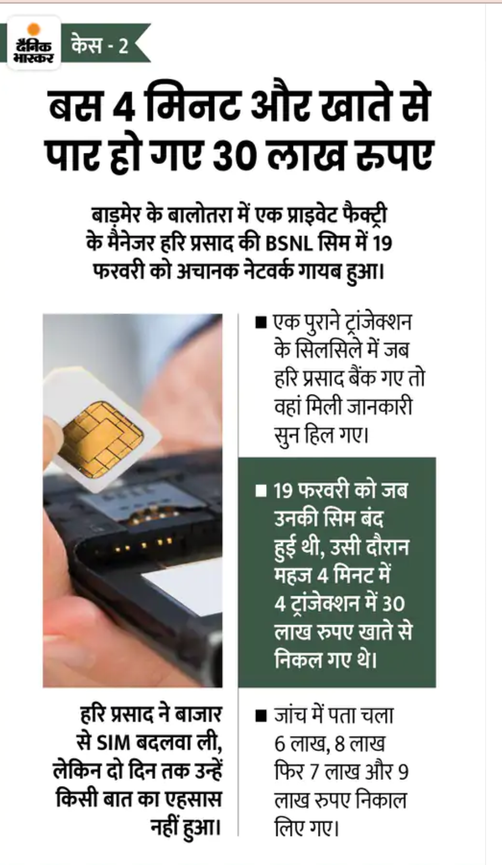
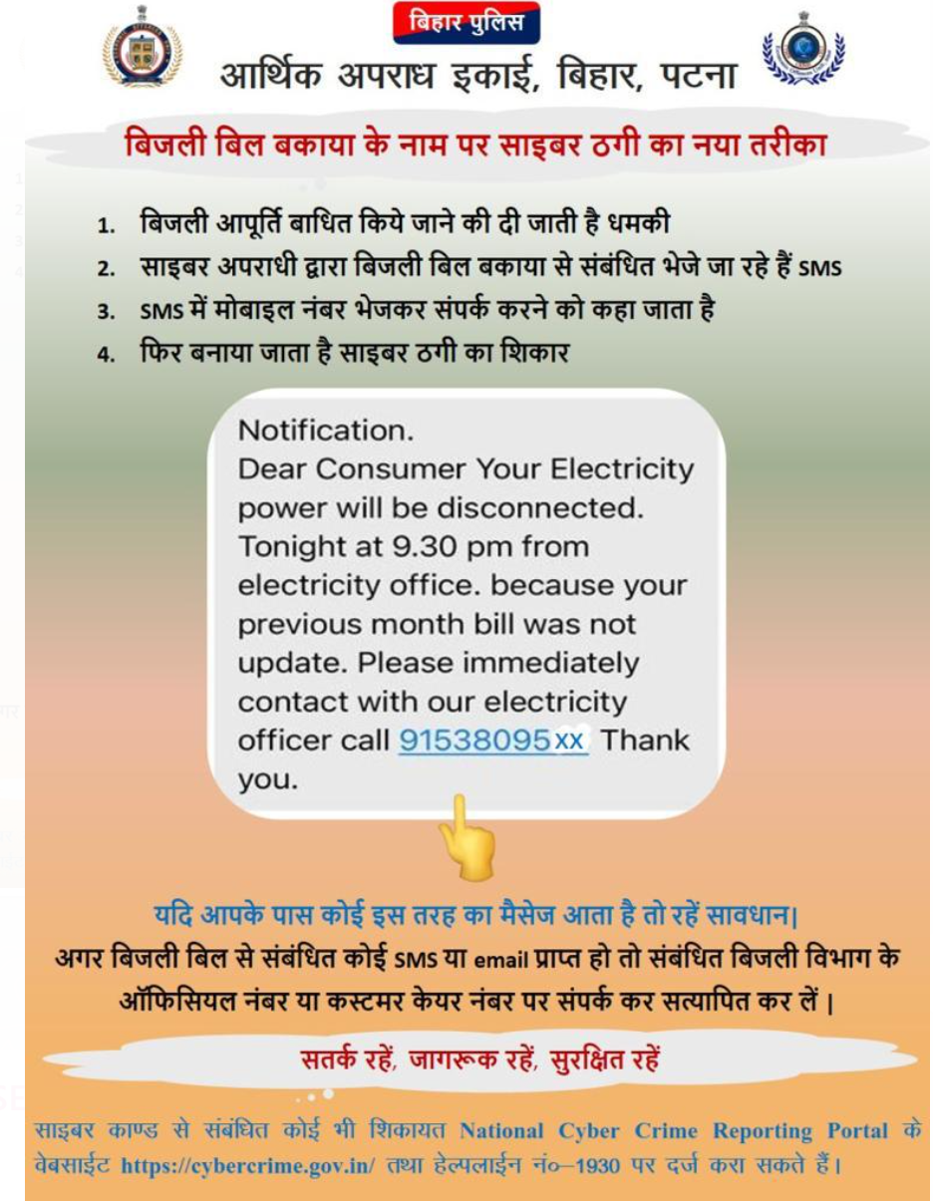
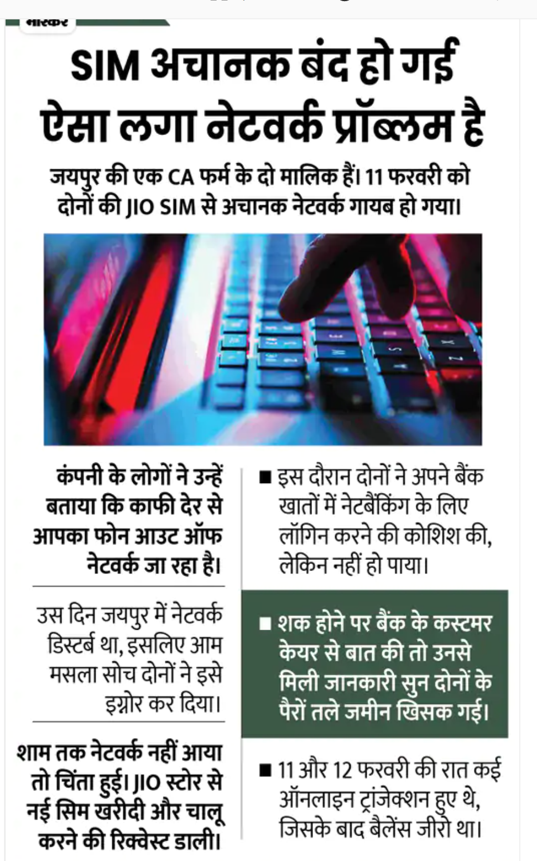

Slide 8
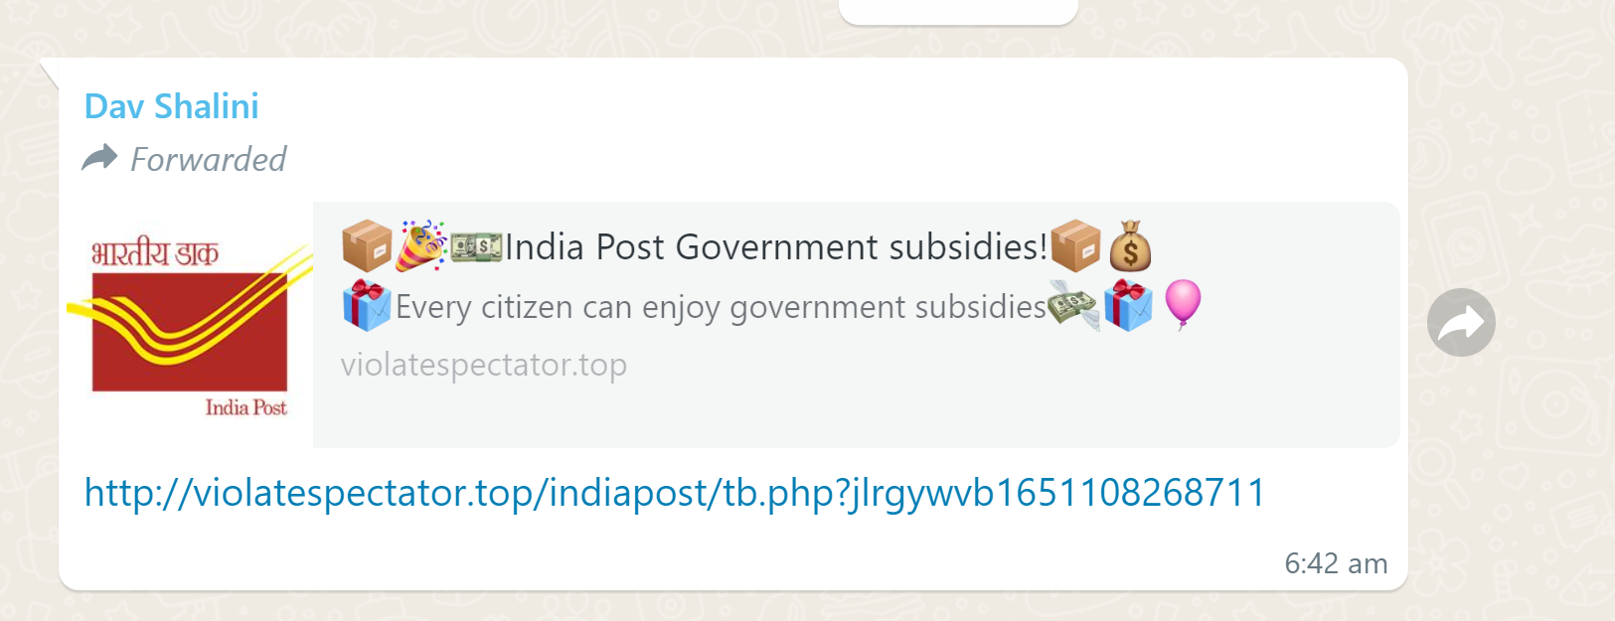

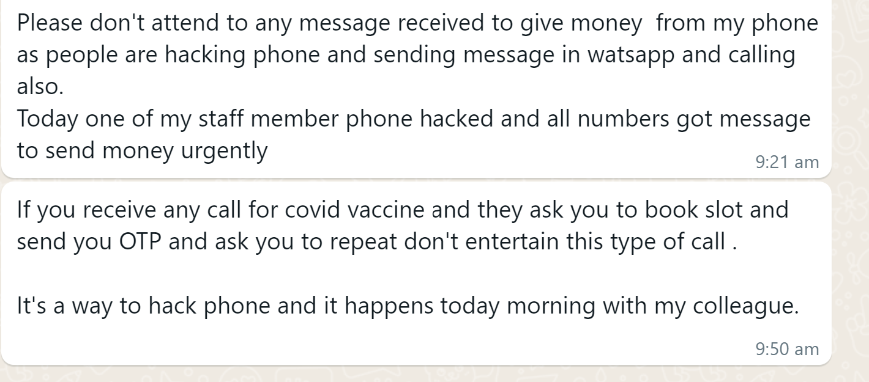
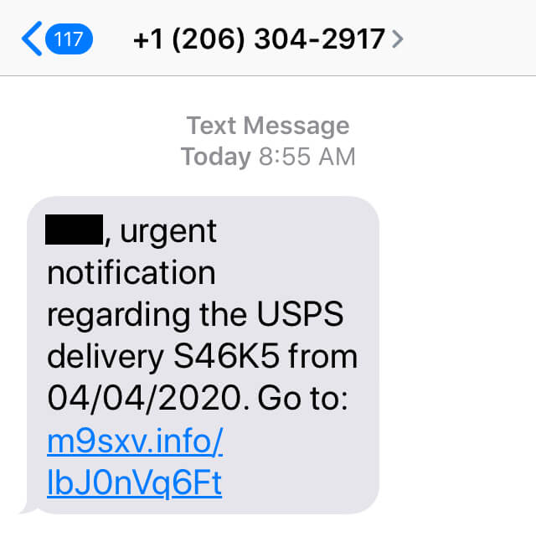
Real life cases

Slide 9
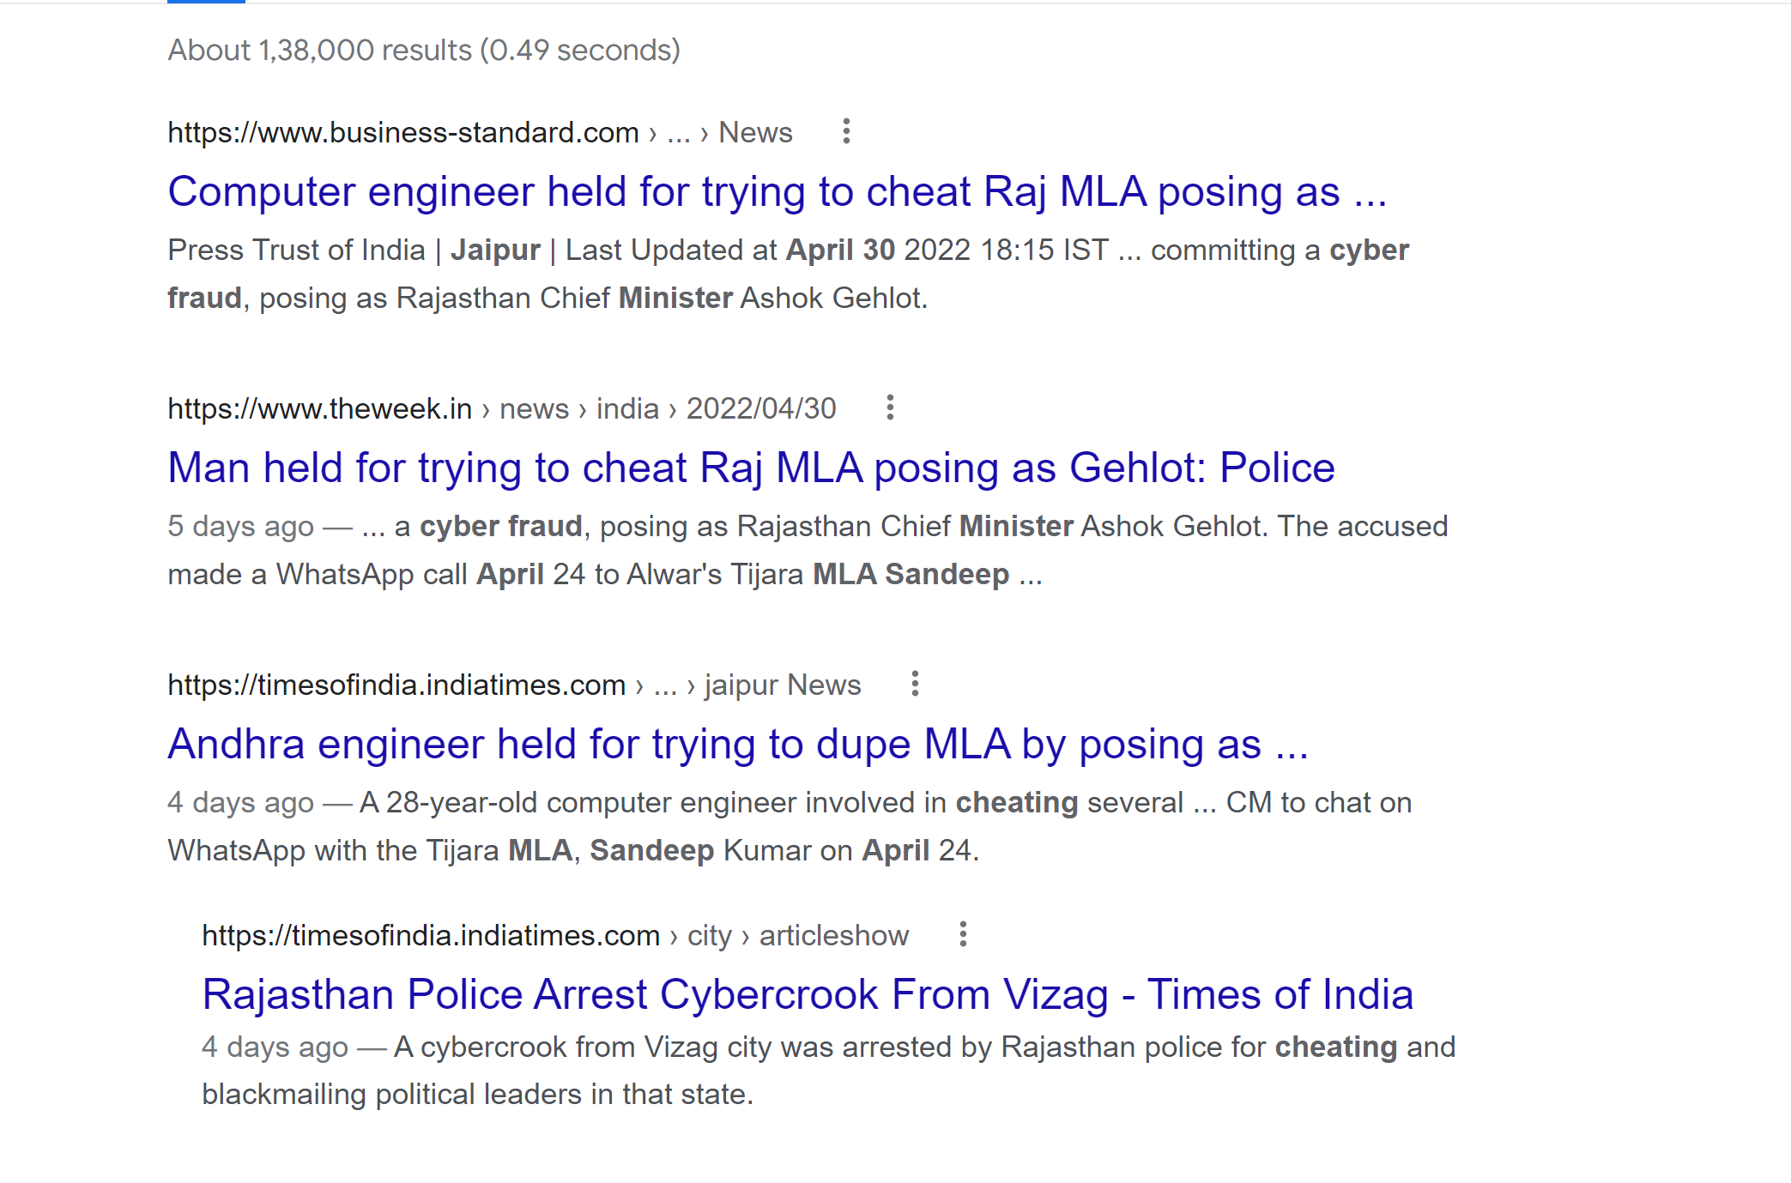
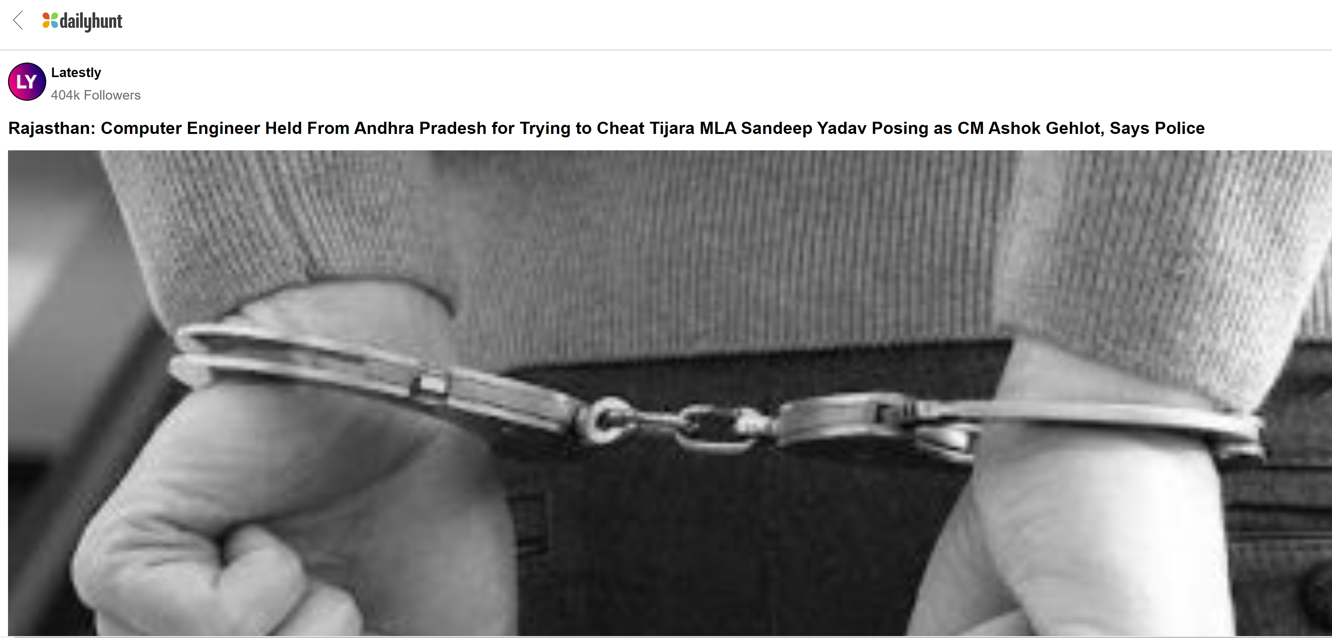
On April 30 in Jaipur A 28 year old computer engineer caught for the vishing fraud. He asked for money transfer from Tijara MLA posing as Rajasthan Chief Minister Ashok Gehlot through virtual number.
With a profile picture of Gehlot family on the whatsapp account he had a brief chat with the MLA and asked 30000 rupees to transfer thru Google Pay.
On suspicion MLA asked Chief Minister and enquired about the number.
Once it is clear case of cheating , bhiwadi police traced the number and arrested the accused after investigartion process from Vishakhapatnam.

Slide 10
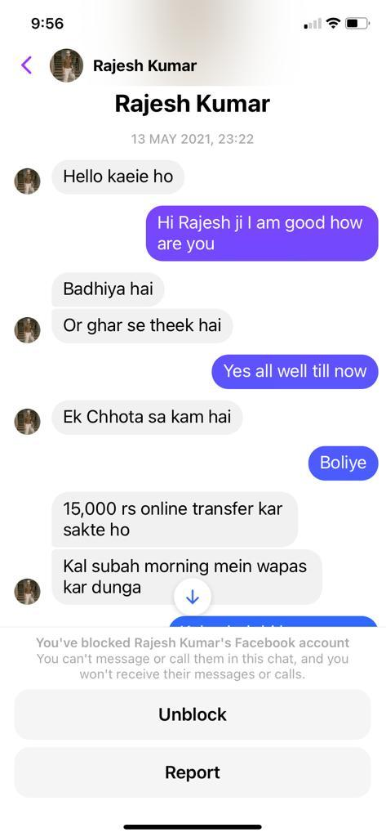
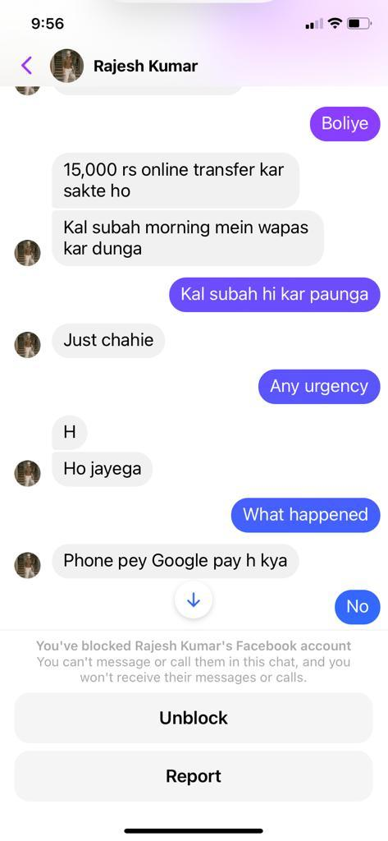
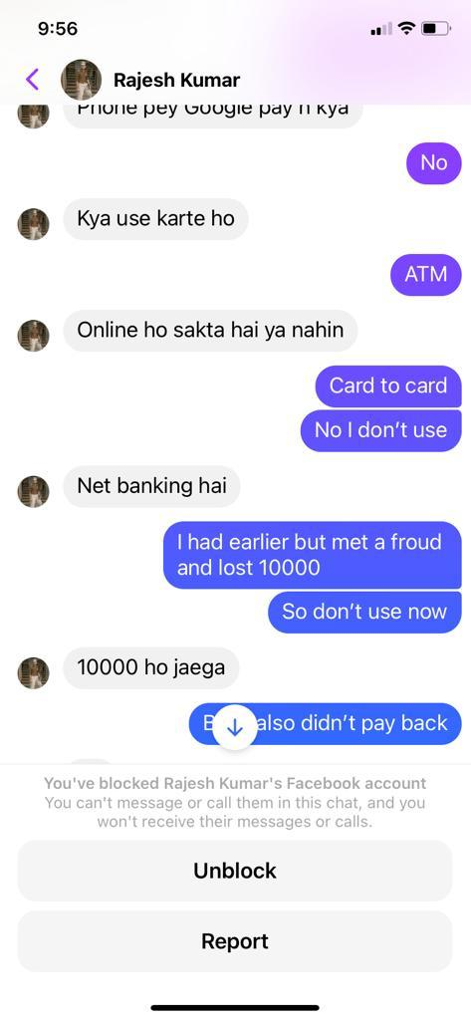
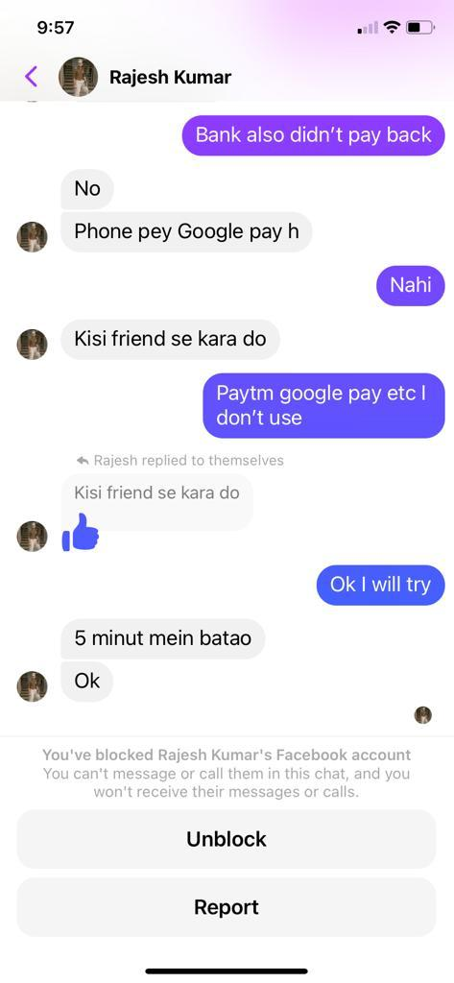

Slide 11
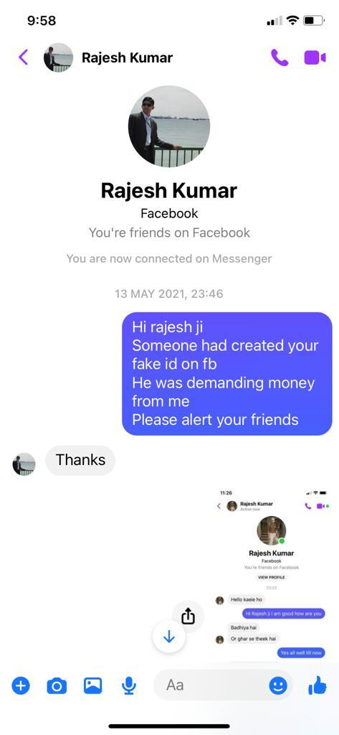
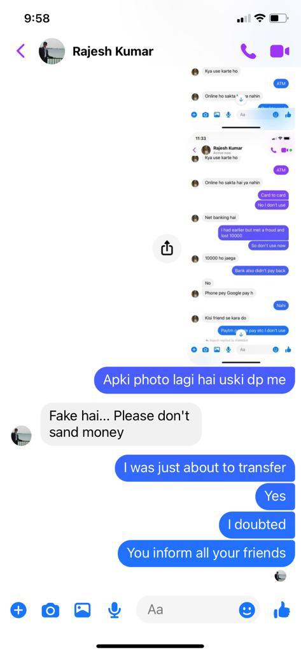
Conversation with Actual
person saved the victim

Slide 12
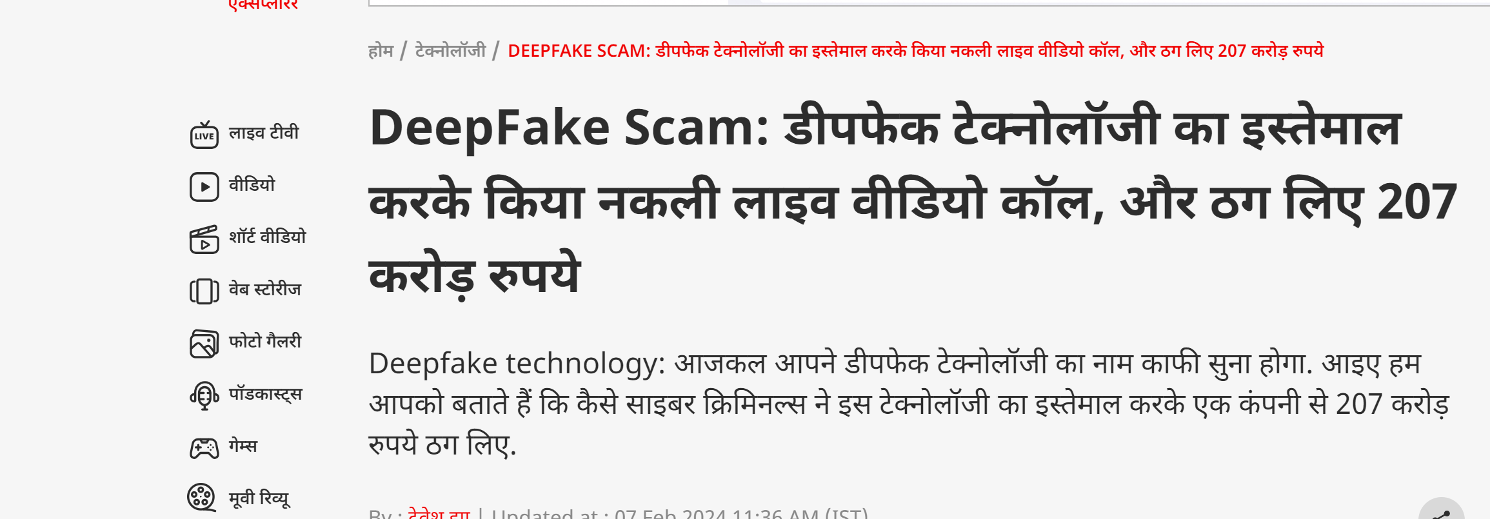

Slide 13

Even a two-second voice clip or one image is enough to create deepfakes

Slide 14

Phishing
Notes:
As per Wikipedia : Phishing is a type of social engineering where an attacker sends a fraudulent message designed to trick a person into revealing sensitive information to the attacker or to deploy malicious software on the victim's infrastructure like ransomware.

Slide 15
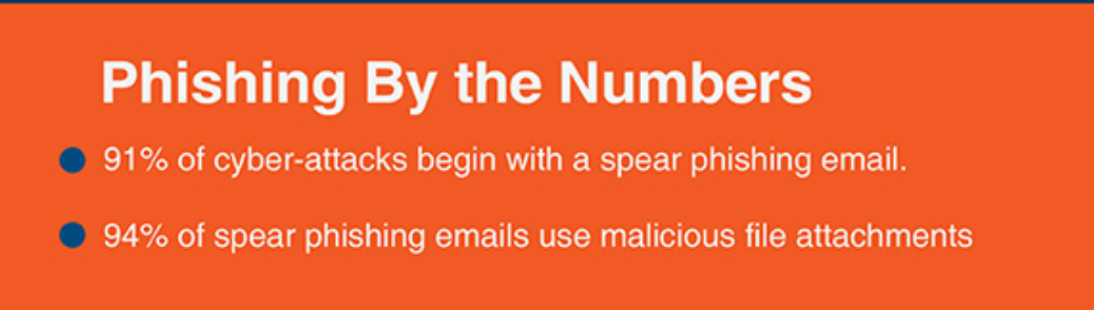
Phishing
Phishing is an attack that attempts to steal your money, or your identity, by getting you to reveal personal information -- such as credit card numbers, bank information, or passwords -- on websites that pretend to be legitimate.
Cybercriminals typically pretend to be reputable companies, friends, or acquaintances in a fake message, which contains a link to a phishing website.

Slide 16
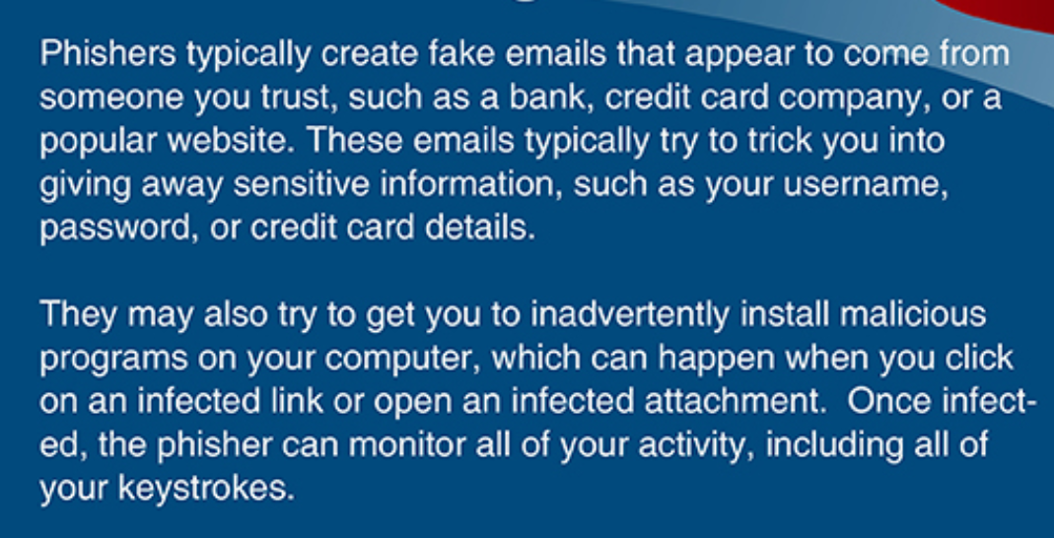

Slide 17
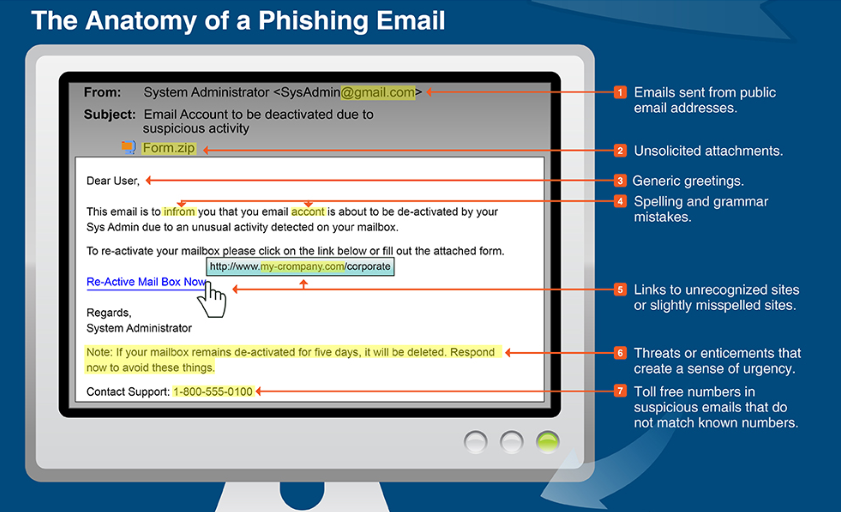
https://inspiredelearning.com/blog/phishing-infographic-how-to-detect-a-phishing-email/

Slide 18
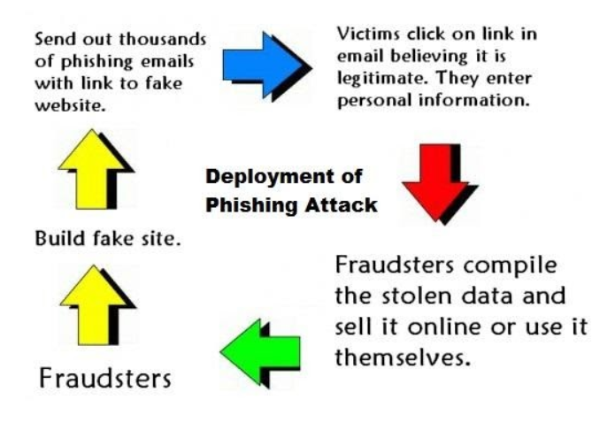
https://www.kratikal.com/blog/understanding-the-difference-between-spear-phishing-and-phishing/

Slide 19
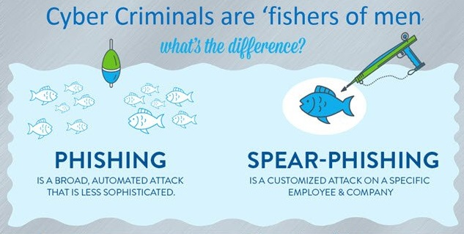
https://images.app.goo.gl/ujC7865pYEd2mMbA8
Notes:
Along with the evolution in technology, a rapid and dramatic shift has been experienced in the occurrence of cyber attacks. The new targeted email-based phishing attacks have replaced the old extensive spam attacks. These phishing campaigns are causing major financial, brand, and operational harm to organizations across the world. The most notorious crime that is affecting major banks, corporates, media companies, and even security firms is a spear phishing email attack.
Spear phishing is an email scam that is targeted towards a particular individual, an organization, or a business. Attackers install malware on the targeted user’s computer system besides stealing user’s data.

Slide 20
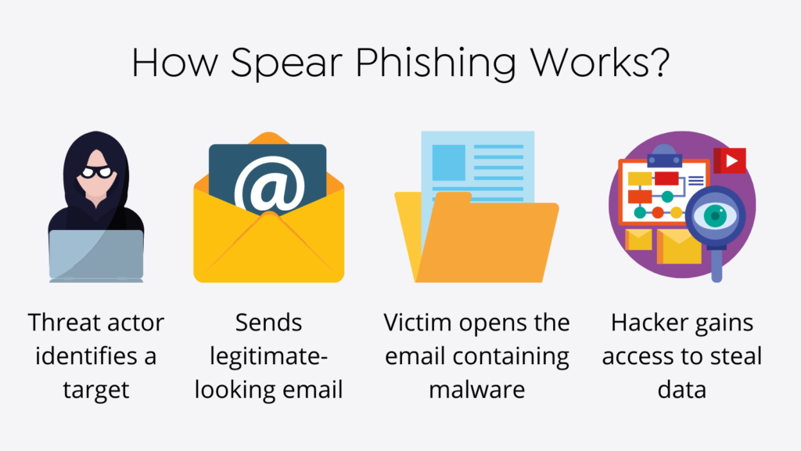
https://socradar.io/how-to-identify-spear-phishing/

Slide 21
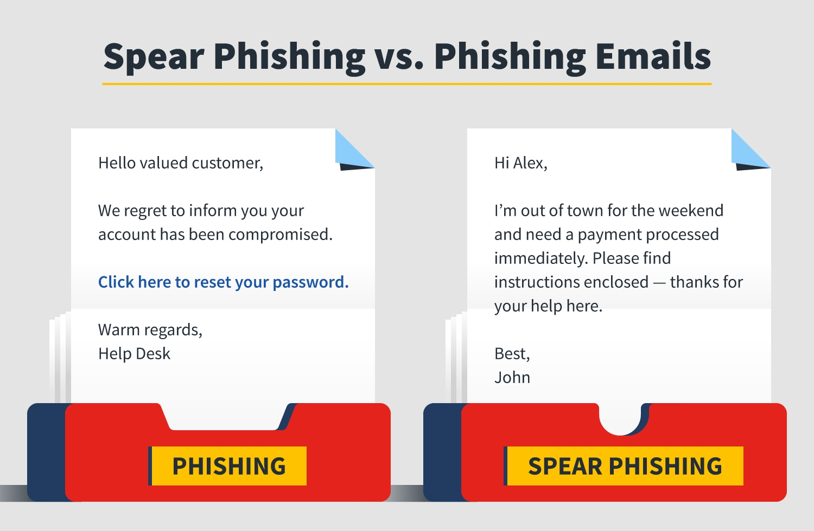

Slide 22
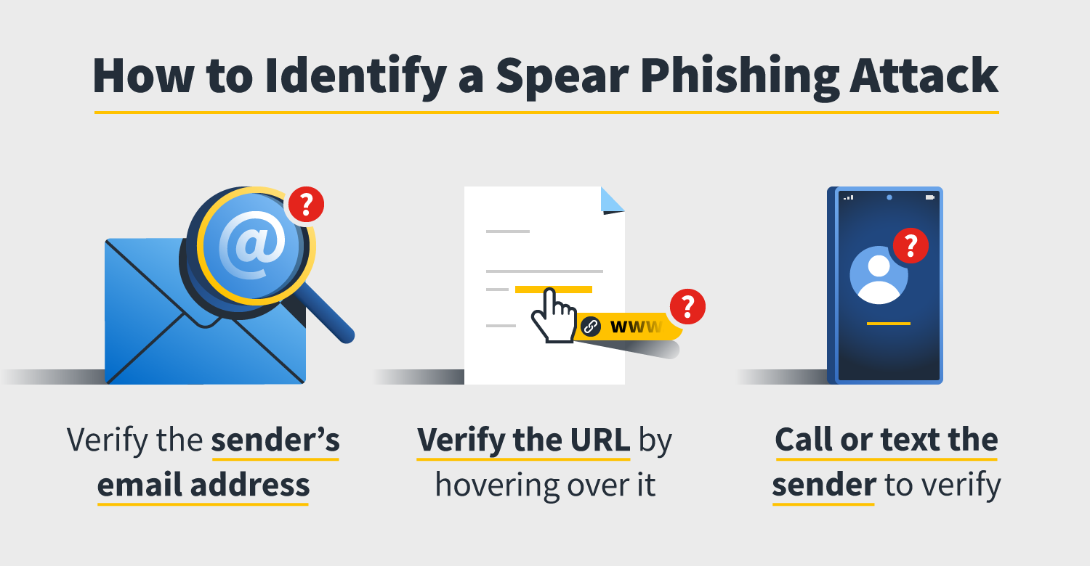
https://in.norton.com/internetsecurity-malware-what-spear-phishing.html

Slide 23
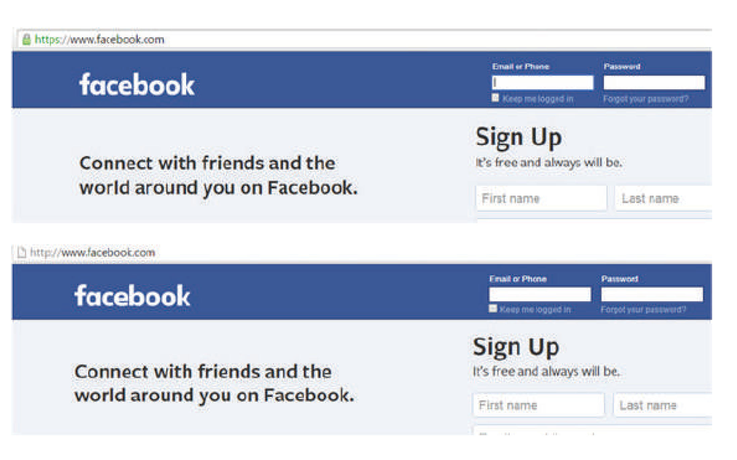

Slide 24
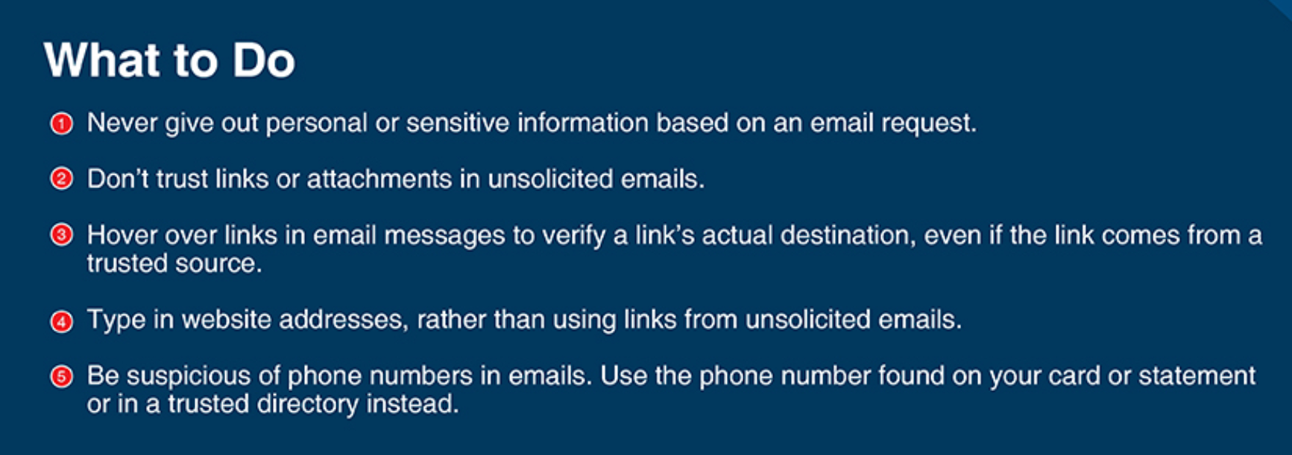
Prevention from Phishing

Slide 25
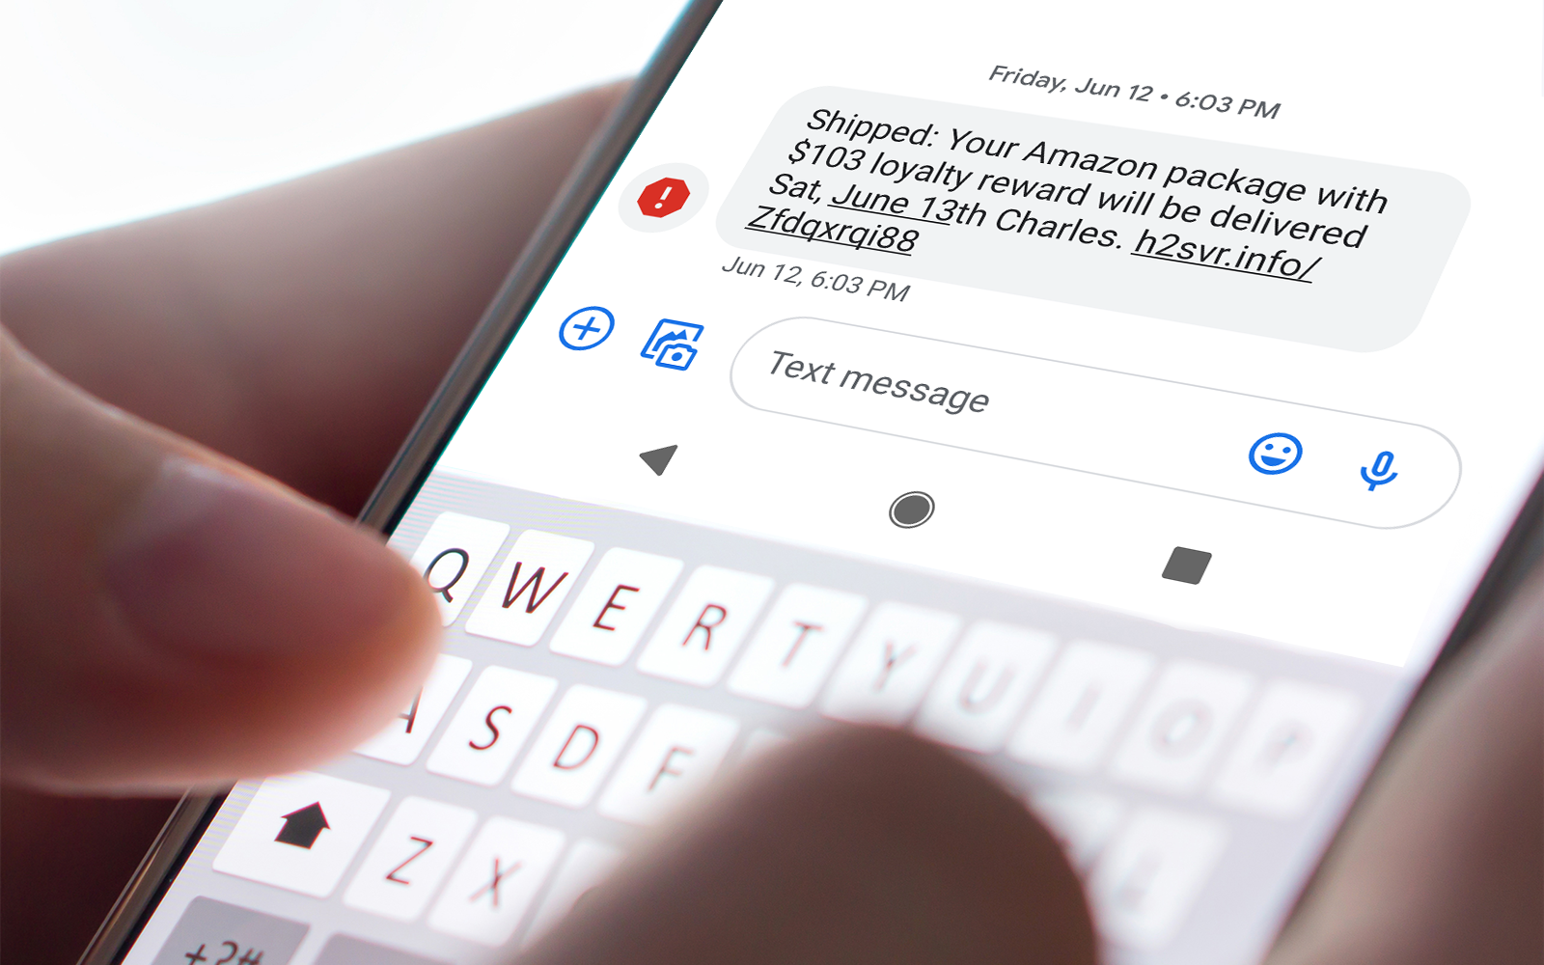
SMISHING
Smishing is a cyber attack that uses SMS text messages to mislead its victims into providing sensitive information to a cybercriminal.
Notes:
Smishing is a cyber attack that uses SMS text messages to mislead its victims into providing sensitive information to a cybercriminal.
Sensitive information includes your account name and password, name, banking account or credit card numbers. The cybercriminal may also embed a short url link into the text message, inviting the user to click on the link which in most cases is a redirect to a malicious site.

Slide 26
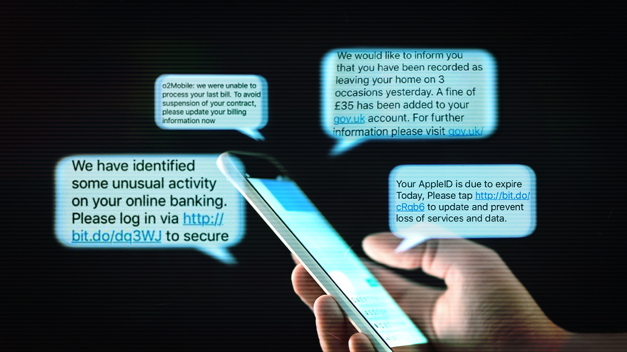
Smishing Attacks

Slide 27
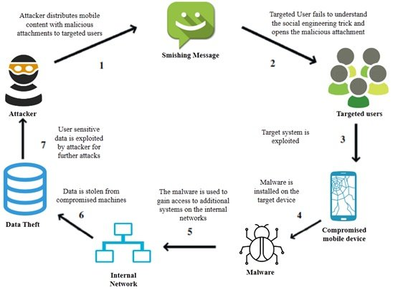
The Schematic sequence of Smishing attack
Priyadarshini, Ishaani. (2019). Introduction to Blockchain Technology. 10.1002/9781119488330.ch6.

Slide 28
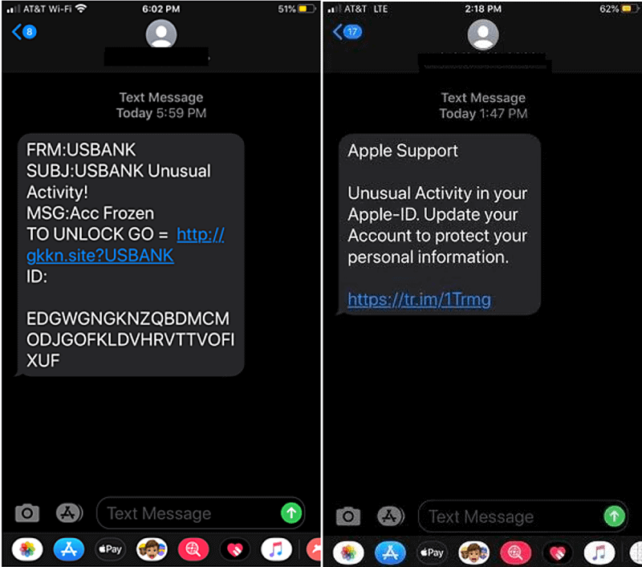
https://purplesec.us/smishing-attacks/

Slide 29
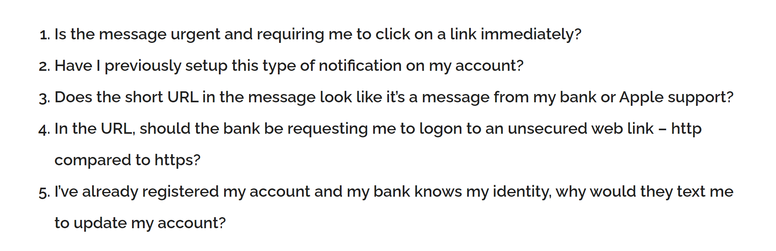
How to spot SMISHING attack?

Slide 30
Preventive tips - SMISHING attack
Don’t respond to text messages that request private or financial information from you.
If you get a message that appears to be from your bank, financial institution, or other entity that you do business with, contact that business directly to determine if they sent you a legitimate request. Review this entity’s policy on sending text messages to customers.
Beware of messages that have a suspicious number in beginning or some other number that is not a cell number. Scammers often mask their identity by using email-to-text services to avoid revealing their actual phone number.
If a text message is urging you to act or respond quickly, stop and think about it. Remember that criminals use this as a tactic to get you to do what they want.
Never reply to a suspicious text message without doing your research and verifying the source. If your bank is really going to cancel your credit card, you should be able to call the number on the back of your card to discuss this matter with them.
Never call a phone number from an unknown texter.

Slide 31
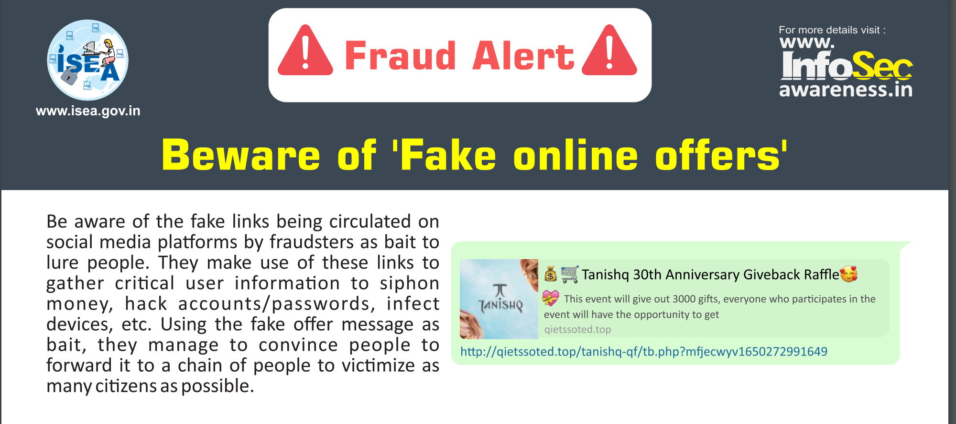

Slide 32

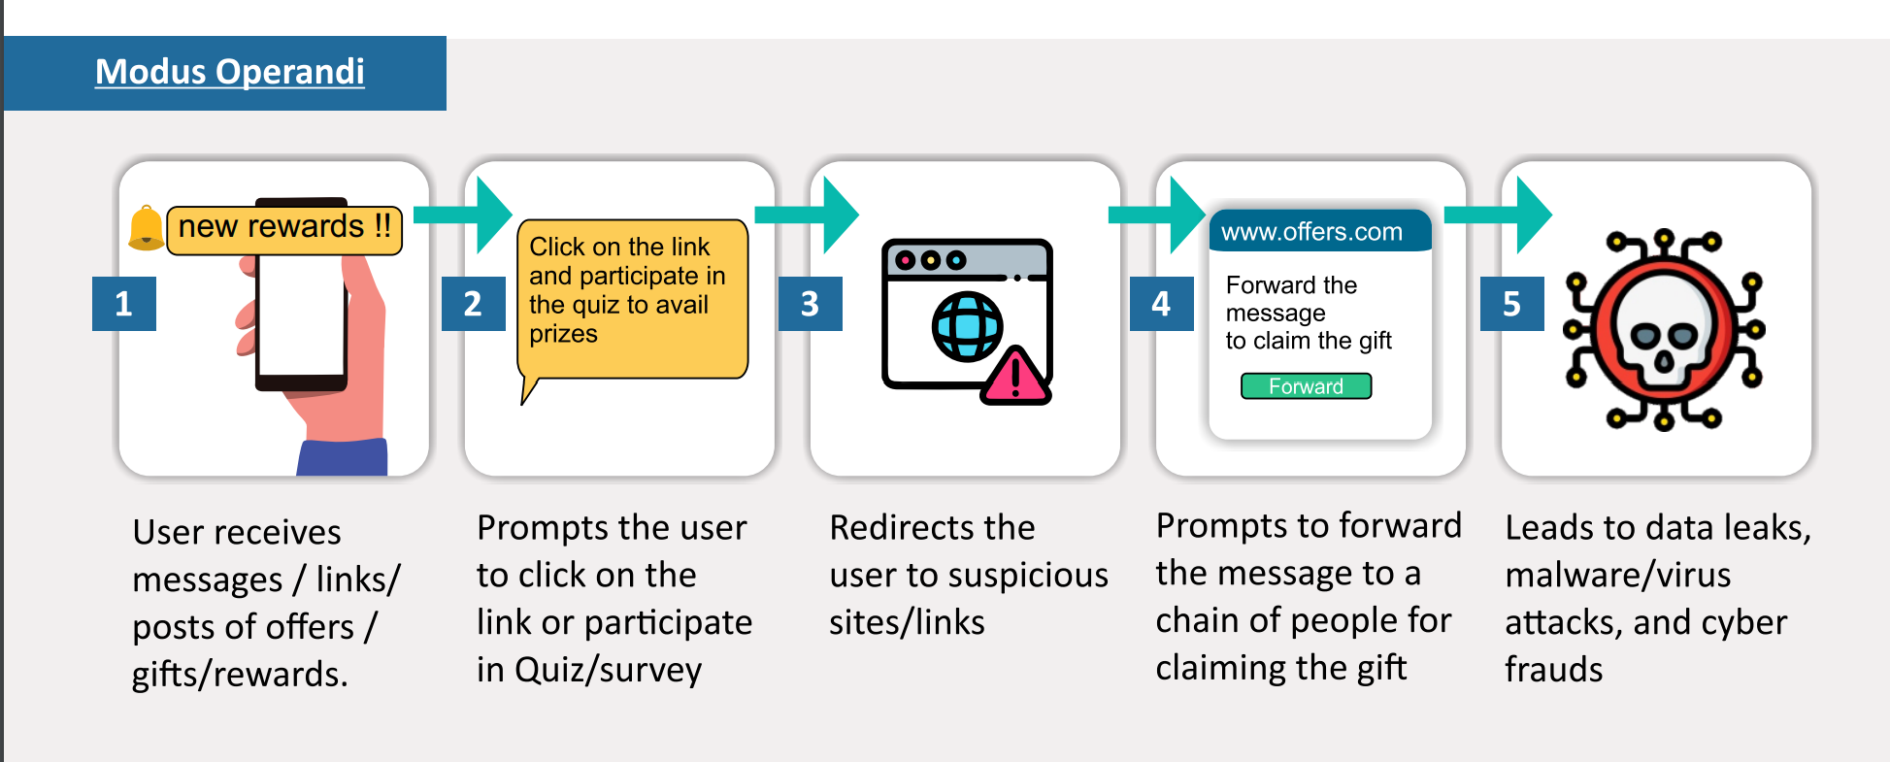

Slide 33
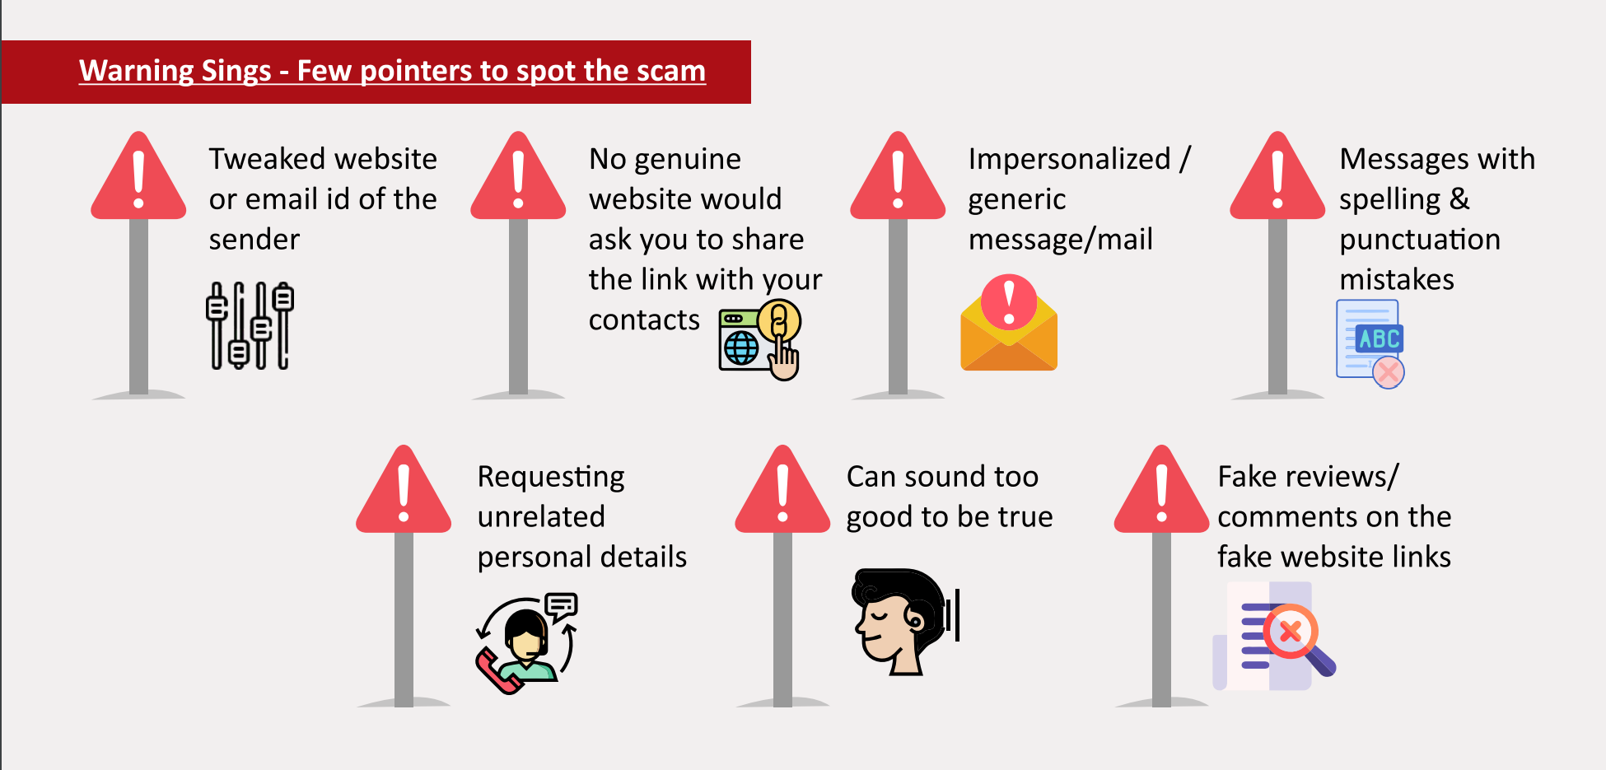

Slide 34
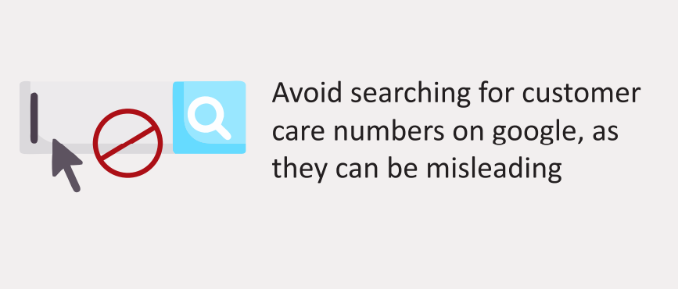
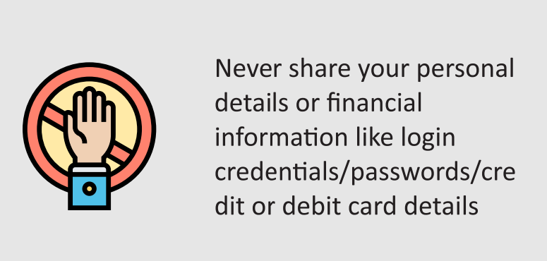
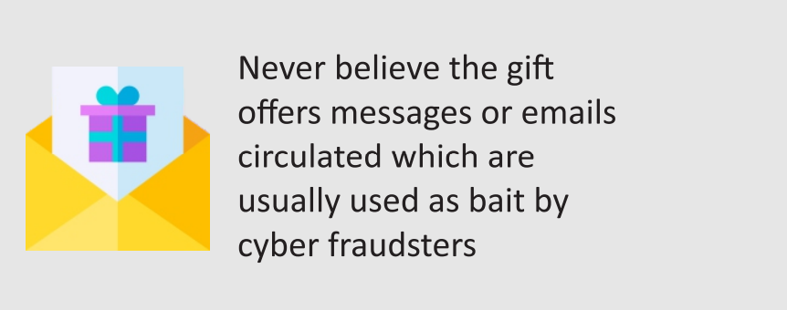
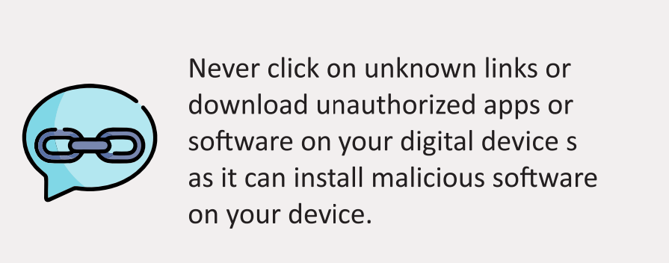
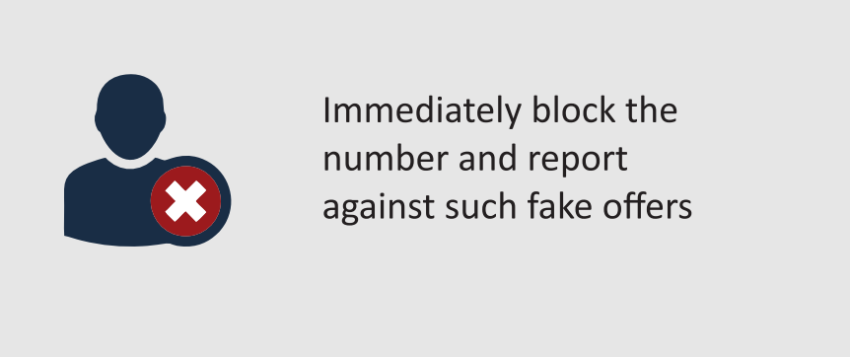
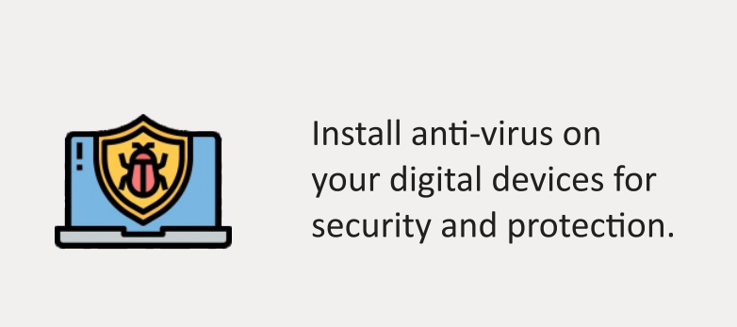
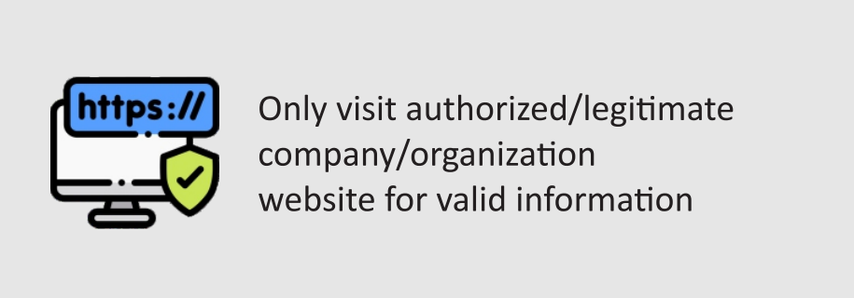
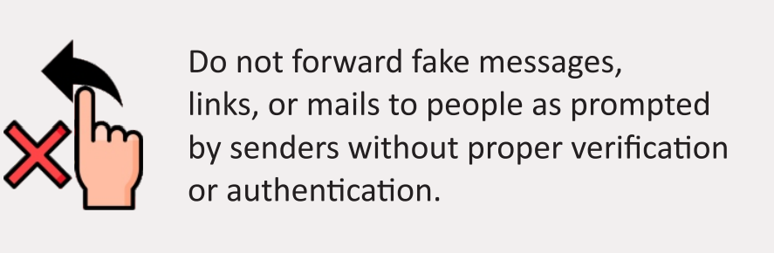

Slide 35
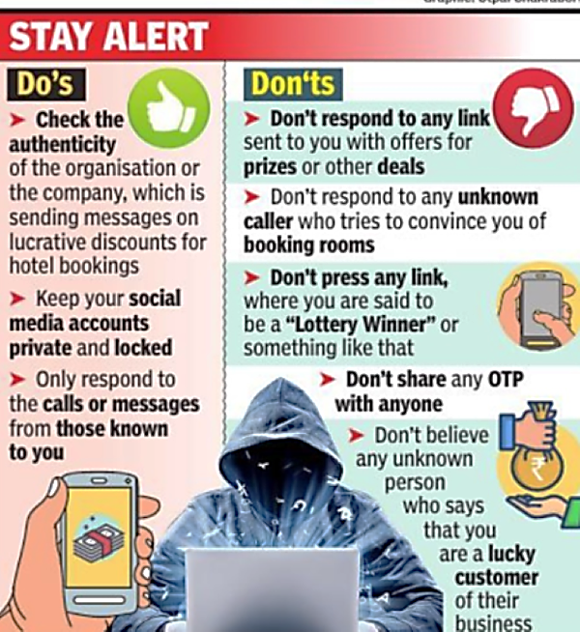

Slide 36
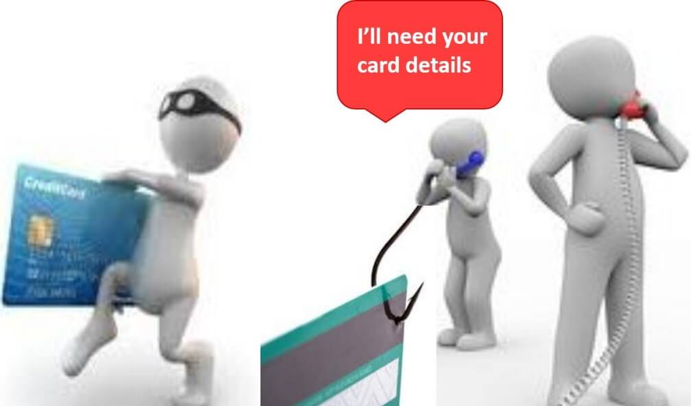
Vishing Attacks
Notes:
Vishing attacks are a type of social engineering fraud where a fraudster convinces the user to provide critical information over the phone.
These types of attacks are ever prevalent and have been causing serious damage around the world. They’re particularly dangerous as they successfully bypass the usual second authentication methods (SMS, email codes and so on).
Vishing attack prevention comes from both the user and the company side.

Slide 37
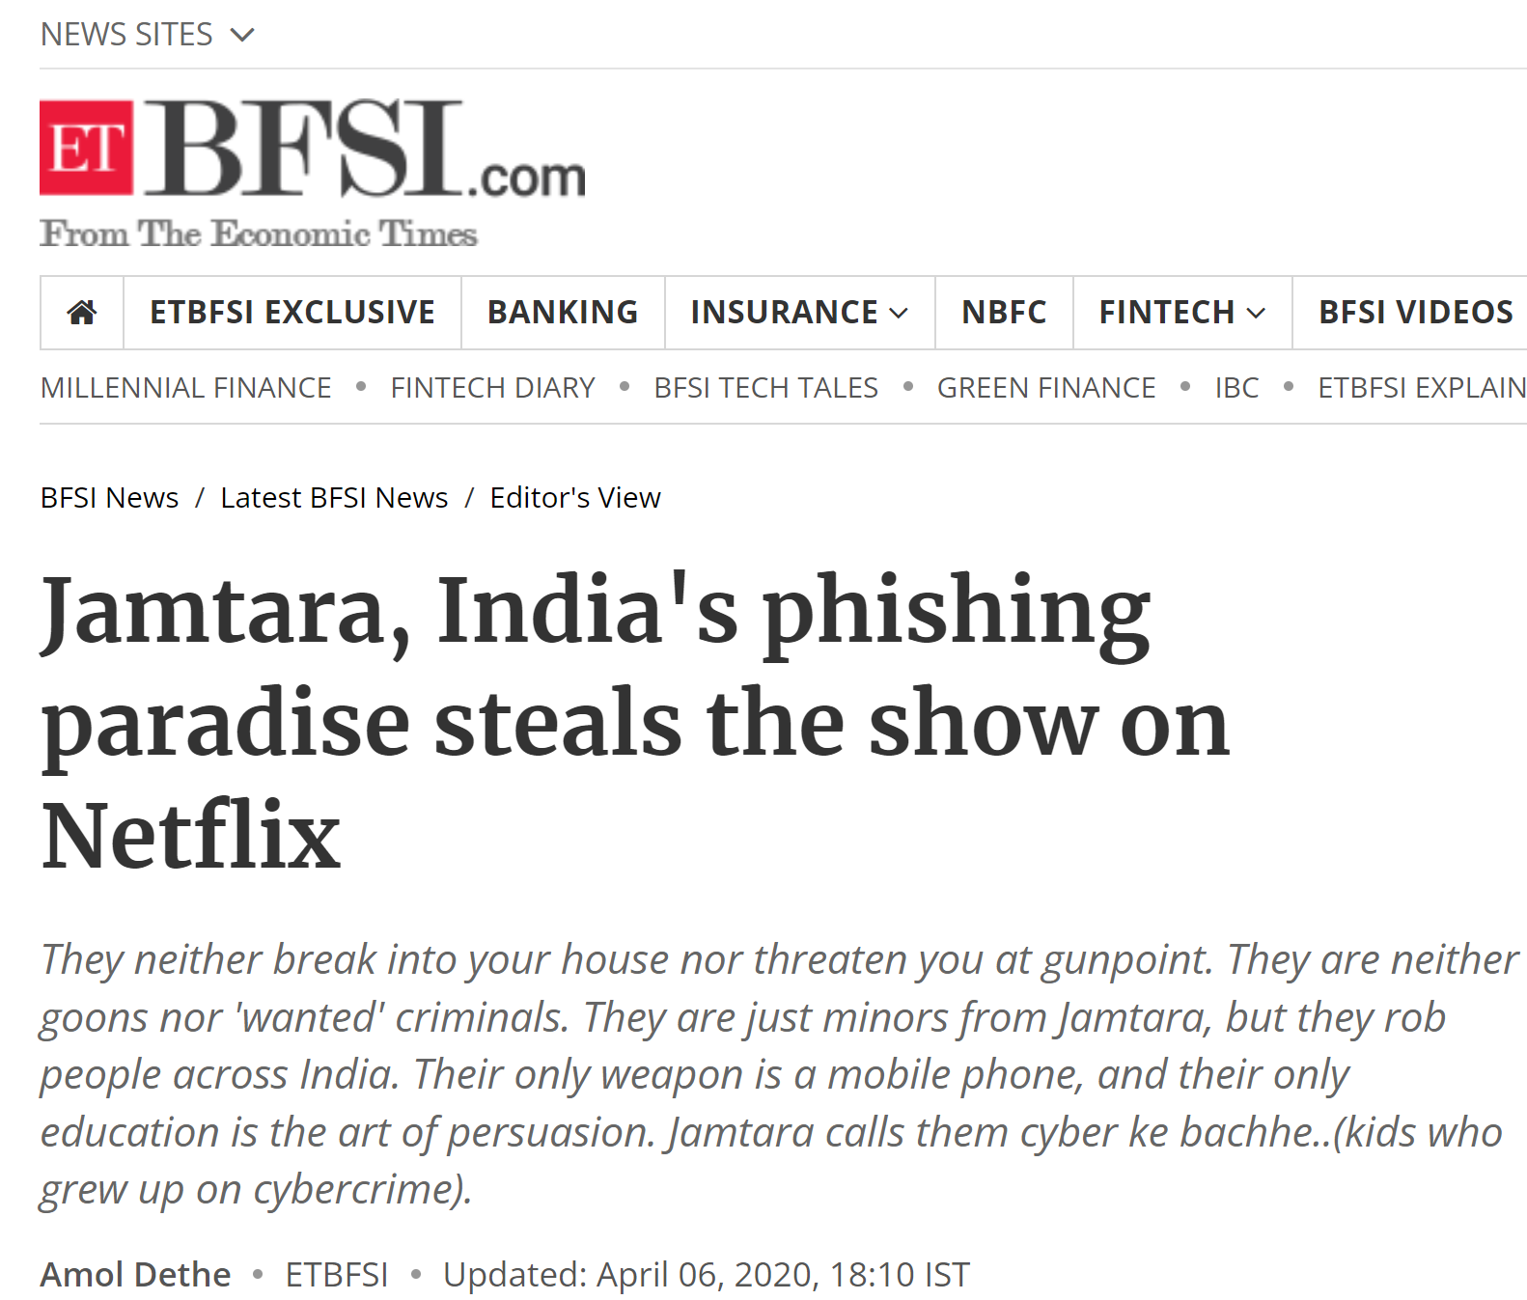
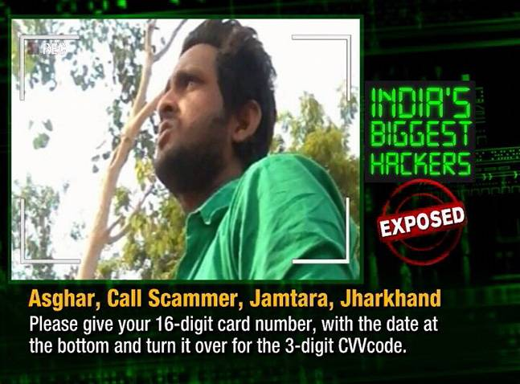

Slide 38
Vishing follows the familiar social engineering setup:
An attacker creates a scenario to prey on human emotions, commonly greed or fear, and convinces the victim to disclose sensitive information, like credit card numbers or passwords.
In that sense, vishing techniques mirror the phishing scams that have been around since the 1990s. But vishing calls exploit the fact that we’re more likely to trust a human voice — and may target the elderly and technophobic who are naive and have no experience with these types of scams.

Slide 39

In plain vishing type, the fraudster calls the victim pretending to be the bank and by implying urgency and authority sways the user to share the credentials and/or any other incoming second form of authentication. In this type, the fraud is completed on the fraudster’s computer.

Slide 40

In this sophisticated vishing type of an attack the fraudster persuades the user to install a remote access tool (such as TeamViewer), share the credentials, second authentication factors, and any other information if needed. Once the software is installed by the user, the fraudster assumes control of their computer and continues to use the banking systems as they wish.

Slide 41


Four Common Vishing Techniques
1. Wardialing
The cyber criminal uses software to call specific area codes, using a message that involves a local bank, business, police department, or other local organization. When the call is answered, the automated message begins, urging the person to provide their full name, credit card details, bank account information, mailing address, and even social security details. The recorded message may suggest that this information is needed to confirm that the victim’s account has not been compromised or confirm valid account details.
2. VoIP
VoIP makes it very easy for cyber criminals to create fake numbers and hide behind them. These numbers are tough to track and be used to create phone numbers that appear local or use a 1-800 prefix. Some cyber criminals will create VoIP numbers that appear to come from a government department, local hospital, or police department.

Slide 42


Four Common Vishing Techniques
3. Caller ID Spoofing
Like VoIP vishing, the cyber criminal hides behind a fake phone number by spoofing the caller ID. They may list their name as Unknown or pretend to represent a legitimate caller, using an ID such as Government, Tax Department, Police, etc.
4. Dumpster Diving
A simple and popular method of collecting valid phone numbers is to dig through dumpsters behind banks, office buildings, and random organizations. Often criminals will find enough information to deliver a targeted spear vishing attack against the victim.

Slide 43

Prevention from Vishing Attacks

Slide 44

Notes:
Be vigilant
Knowing that criminals and hackers use a range of different methods to scam individuals and employees means you can be on your guard to potential attacks. According to research, 75% of victims reported that the attacker already had some personal information on them when they made the call.
Be helpful but defensive
Assist the caller where you can, but remember you don’t know this person or what their motive is. Keep a level of healthy scepticism.
Don’t Panic
like all forms of social engineering vishing frequently uses fear and urgency to “bump” the listener into doing something they wouldn’t do if they thought about it more calmly. Stay calm, if you feel you are being emotionally overloaded put the caller on hold or use an excuse to remove yourself from the situation.
Call them back!
If you get a feeling that something isn’t wrong, act on it and ask to call them back. Then call them back on a publicly listed number – not the one they might give you.
Don’t give out valuable information over the phone
Don’t feel obliged to give out credentials or confidential information over the phone just because someone asks for it.
Treat urgency as a red flag
The fact that someone claims to need something urgently should be a small red flag that something could be amiss, not that you should automatically comply with the callers’ request.
Don’t be afraid to say NO
If a request is not justified, don’t be afraid to reject the request. You can do this by deferring authority, tell them you need to check this with your manager or politely decline and cite your company’s policy on information disclosure.
Don’t log in to a phishing site.
Don’t navigate to an unknown website that the caller asks you to log in to. Remember that the caller will be prepared for this, it is no good saying no to the first request if you give in on the second attempt- stand your ground!
Don’t trust caller ID
It is simple for attackers to change or spoof the number that is displayed on your handset. OFCOM advises that caller ID should not be used as a means of verifying a caller’s identification.

Slide 45
Vishing Prevention Techniques
Remain Vigilant and Pay Attention During Phone calls.
Verify the identity of those who ask for information in person or over the phone, before you release any information.
Be Cautious When Giving Out Your Information.
Be Suspicious of Unrecognized Phone Numbers.
check your bank statement regularly.

Slide 46


www.virustotal.com
https://haveibeenpwned.com/

Slide 47




Slide 48


Cybersecurity Threats faced by Students

Slide 49




Slide 50

https://cybercrime.gov.in
Chandni Agarwal

