Slide 1
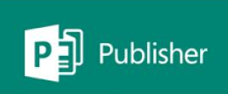
Creating Posters and Newsletters in Publisher
Prof. Ganesh Channa
(Eminent Educationist, IT Expert & Environmentalist)
from Solapur,(Maharashtra)
BOS Member NCERT, CIET, Delhi,Balbharti, Pune & ICAI Delhi

Slide 2
Learning Objectives
Introducing Publisher
Participant Poll – How do you use Publisher?
Live Demo and Practical of Publisher
Best Practices for Design and Print
Getting Publisher
Q&A

Slide 3
Introducing Publisher
Publisher is a desktop publishing application that you can use to create a wide assortment of publications, such as newsletters, business and greeting cards, brochuers, certificates and restaurant menus etc.
Publisher contains hundreds of predesigned layouts called templates that you can use as the basis for professional-looking projects.

Slide 4
Starting Publisher
To start Microsoft office Publisher 2010, click the Start button, point to All Programs, click Microsoft Office, and then click Publisher 2010.
Templates are grouped by category, such as Business Cards and Calendars and can be found in the middle pane of the window.

Slide 5
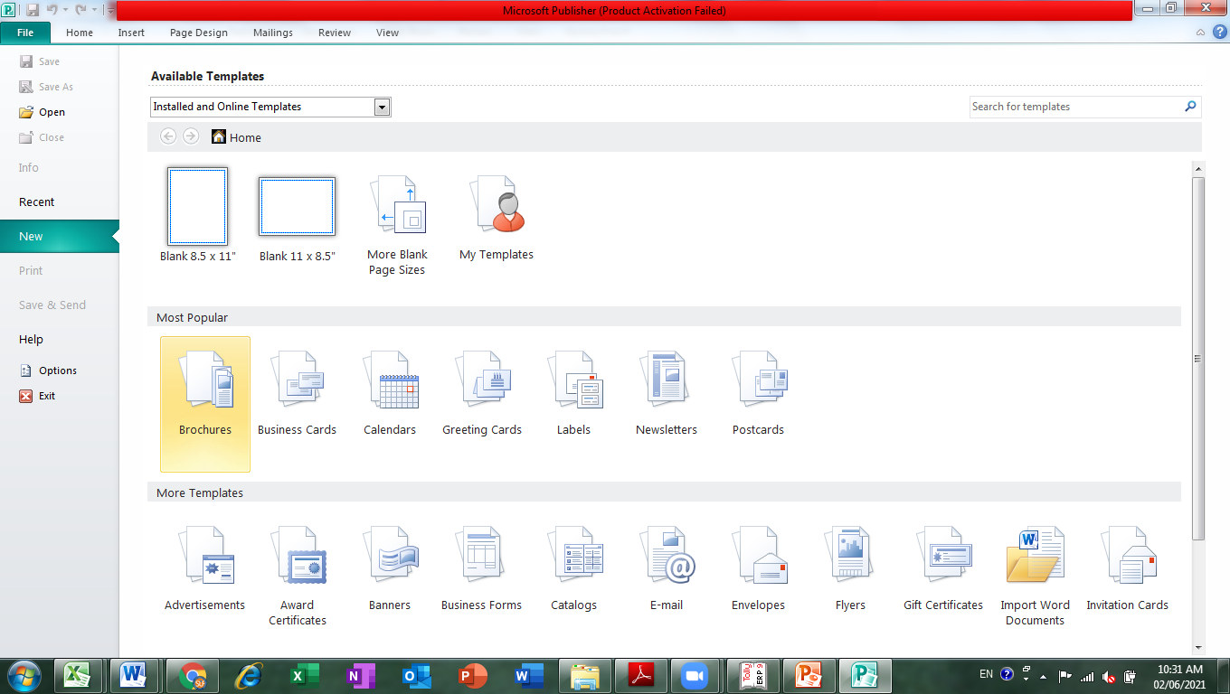
MS-Publisher opens showing Available Templates Window
File Menu
New Command
Middle pane
Displays Templates

Slide 6
Choosing a Template
To create a publication, click a category in the Available Templates window, and then click a template in the middle pane.
Once you click a category, you will see a thumbnail and customization options for the selected template.
Click the Create button to open the new publication.

Slide 7
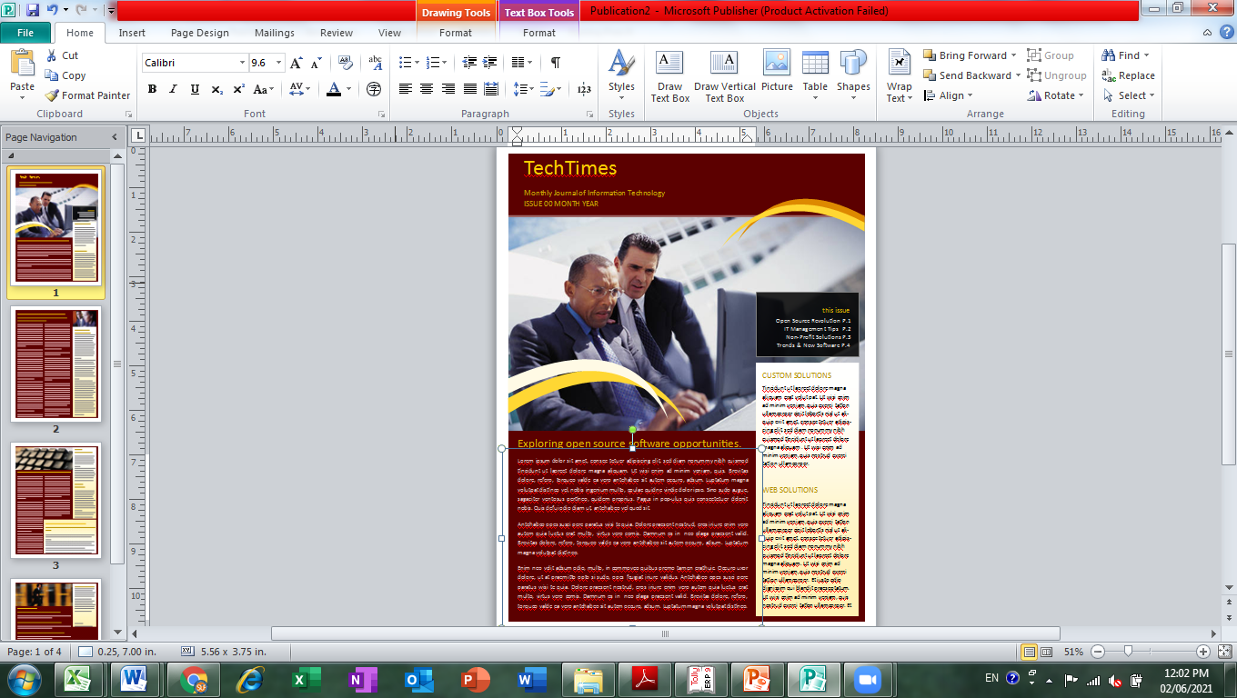
Microsoft Publisher Window
Quick Access Toolbar
Tabs
Ribbon
Page Navigation Pane
Page 1 selected
Page 1 of the publication

Slide 8
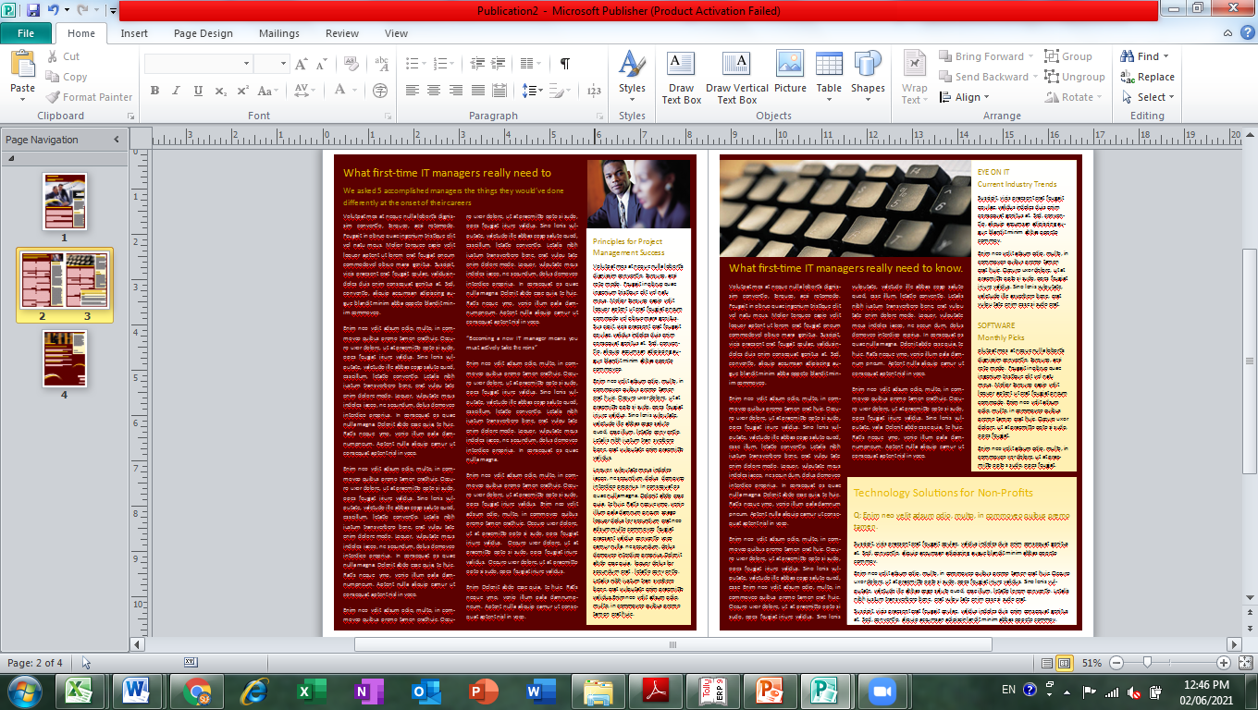

Slide 9
Saving a Publication
To save a new publication, click the Save button on the Quick Access toolbar or use the Save command on the File menu.
The Save As dialog box will appear prompting you to name your publication and save it to a specific location.
Once a publication has been name and save, the save command will update the latest version.

Slide 10
Modifying a Publication
You can add, delete, move, rotate and scale text boxes and graphics.
Publisher supplies you with basic shape tools and clip art. Modifications are made using options on the Ribbon.
A logo is a symbol that is designed to help customers remember a business and its products. In Publisher, you can create a new logo or use one you have already created.

Slide 11
Printing a Publication
To print, click the File menu, then click print which opens the Print window.
Many options are provided in the Print window. You can choose the number of copies and the page range to print.
The preview window allows you to see how your publications will print before you click the print button.

Slide 12
Closing a Publication
Unlike other Mircosoft Office 2010 programs, the Publisher program does not have a close window button in the top-right corner, only a close button, which will close the entire publisher program.
To close your publication, but not the entire publisher program, click File on the menu bar, the click Close.

Slide 13
Summary
In this lesson, you learned:
Microsoft Publisher is a program that allows you to produce professional-looking publications in almost any format imaginable. Publisher makes this process even easier with the use of templates and building blocks.

Slide 14
Summary
Business information sets are collections of information about individuals. They are stored in Publisher and used with templates.
It is important to save your work often. The first time you save a publication, the Save As dialog box opens so that you can name and save your file.
When you are finished with your publication, you can print the publication using the Print window and then close Publisher.

Slide 15



