Slide 1
Mind Map using Edraw
Dr. Rekha Kaushal
Assistant Professor
Department of Education, School of Liberal Arts
GD Goenka University

Slide 2
1
How Technology has changed the Teaching and Learning Scenario
2
Introduction to Mind Map
Uses/Benefits/advantages of Mind Mapping for Teachers and Students
3
Introduction to Edraw as a tool of mind mapping
A demonstration of Edraw as a mind mapping Tool
How different tools and software's have merged for Making T-L process more Engaging

Slide 3

शिक्षा - ई-लर्निंग
डिजिटल शिक्षा "पंख" बन सकती है जो शैक्षिक दुनिया को पहले से कहीं अधिक दूर और तेजी से उड़ने की अनुमति देगी - जेनी अर्लेज
ई-लर्निंग सिर्फ एक चरण नहीं है, यह भविष्य की शिक्षा का मुख्य आधार है

Slide 4
Technology Enhanced Teaching and Learning
Technology touches virtually every area of our lives including how we learn.
Many Students find that technology enhanced learning help them to learn the information more quickly, understand better and retain it for longer
Technology Enhanced Learning (TEL) is the implementation of technology into teaching methods to enhance the learning process.
The teaching activity has changed with the internet or devices such as computers, smartphones, and tablets

Slide 5
Benefits of Digital Learning Environment
Allow expanding the scope of teaching beyond the traditional classroom.
Increase access to education and foster interactivity.
Better way of sharing educational materials or information, both for teachers and students
continue learning and developing knowledge
Ubiquitous Learning
Increased opportunities for their participation
Offers A Wider Choice Of Materials That Can Be Accessed Easily
It Provides A Fun And Engaging Learning Experience For Students

Slide 6
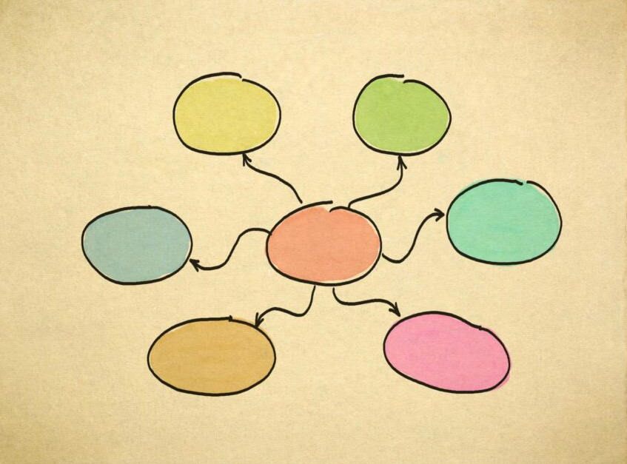
Mind Map
Mind maps have the power to turn monochrome text into a kaleidoscope of understanding.
Initially, mind mapping might appear chaotic and disorganized.
One of the most efficient methods for organizing and structuring information systematically.
Mind mapping is a favored learning tool that assists both students and educators in enhancing and optimizing the learning process
A central idea acts as a keystone, anchoring the flow of brainstorming and ensuring that students can effectively convey and comprehend complex information.

Slide 7
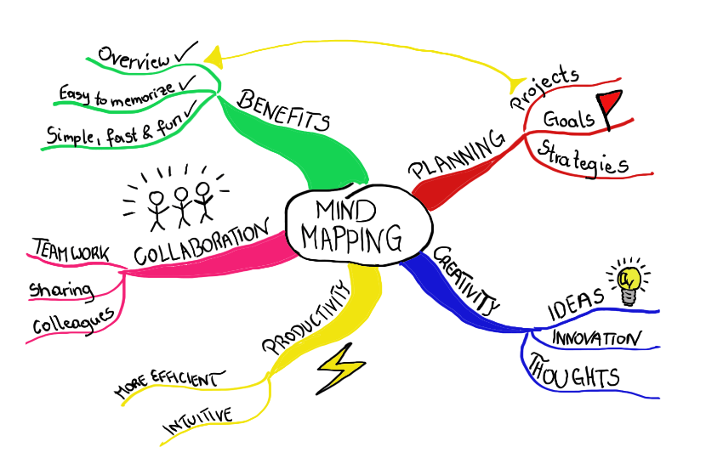
Mind Map
Mind maps are visual diagrams that structure information around a central idea, with linked ideas branching out
Mind maps give a clear structure and hierarchy of thoughts and make complex concepts easier to understand. They include a central idea, topics and subtopics showing as nodes, and branches connecting these nodes.

Slide 8
Students Collaborate to Create Mind Map
Students Visualize their Thinking
Strategic Approach to Problem Solving
Innovative Thinking
Better Organization of Though
Mental Decluttering

Slide 9
Mind Map
Effective tool for students and educators
Teachers can significantly improve their lectures
Students can better understand
Retain knowledge
Help student grasp complex topics
Multi-sensory engagement
Associations between various pieces of information

Slide 10
Benefits of Creating Mind Maps
Enhanced Information Organization
Improved Problem-Solving and Creativity
Clear Communication and Collaboration
Enhanced User Understanding

Slide 11
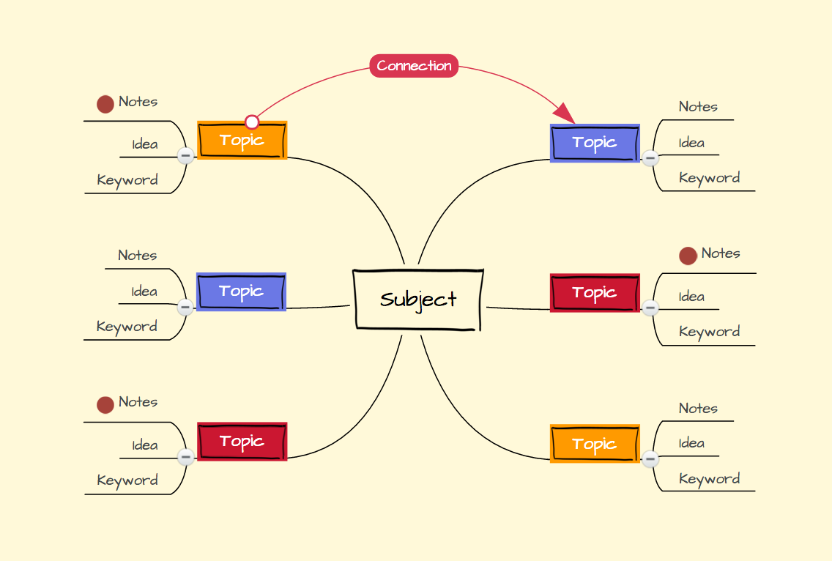
Mind Map Basics

Slide 12
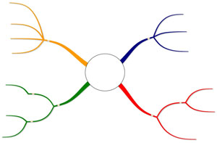
Sub-Theme 1
Sub-Theme 2
Sub-idea/ relationship
Sub-Theme 3
Main Theme/Key Idea
Sub-idea/ relationship
Sub-Theme 1
Sub-Theme 2
Sub-Theme 1

Slide 13
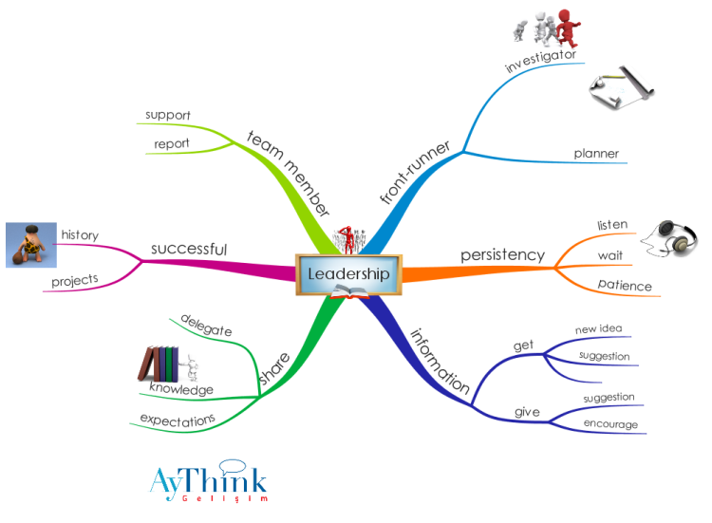

Slide 14
ClickUp | XMind
Concept draw | MindManager
Miro | MindMeister
Coogle | LucidChart
Mindly | EdrawMax

Slide 15
Mind Map Using Edraw
Mind Map can be created using Mind Map Maker-Edraw
Step 1 Start on a Blank Page
  Enable (EdrawMax Online) on your browser, and there are 2 different methods for you to get started with it.
Step 2 Add Topics and Subtopics
  When the blank mind map template is open in EdrawMax Online, the mind map shapes will show up on the Library pane. Select one of the main topics, click Subtopic on the pane and then press Enter to add more subtopics.

Slide 16
Mind Map Using Edraw
Mind Map can be created using Mind Map Maker-Edraw
Step 1 Start on a Blank Page
  Enable (EdrawMax Online) on your browser, and there are 2 different methods for you to get started with it.
Step 2 Add Topics and Subtopics
  When the blank mind map template is open in EdrawMax Online, the mind map shapes will show up on the Library pane. Select one of the main topics, click Subtopic on the pane and then press Enter to add more subtopics.
Step 3 Repeat the Same Process
  Repeat the same process of adding topics and subtopics until the number of topic boxes is enough for you

