Slide 1

Transforming Assessment with Plickers: A Comprehensive Introduction
Presentation by:
Alok Kumar
Academic Consultant
CIET- NCERT
05 April 2024, Friday

Slide 2






Introduction to Plickers
A Powerful and user-friendly tool for smooth classroom interaction.
With its seamless and user-friendly interface, helps educators/teachers to conduct real-time polls, and quizzes, contributing to active participation and overall enhancement in student learning outcomes.
Highlights
A Rapid-Response Classroom Assessment Tool/ Polling App
Foster active student engagement
Real time feedback
Organize Data Effortlessly/Easy data collection

Slide 3




Key Features
Support different formats: teachers can put polls or questions in different formats including MCQs, true/false
(educators can get a sense of student’s understanding across different formats)
Real time assessment: allows teachers/educators to collect instant feedback from students through polling during class.
Offline/Online mode: this works in both the modes; offline mode is useful for areas with limited internet connectivity where teachers can collect responses even without internet.
Data representation: the app can generate detailed reports and analytics based on the responses, so that teacher can observe trends, assess performance of the class, and can also track individual progress over time.

Slide 4
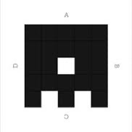


Key Features (contd.)
      Plickers Cards: unique ids are assigned to each student ( for ex. 1 to 40 for a class of 40 students), for this-printable Plickers cards are assigned to each student with unique pattern of dots that student can rotate to indicate their responses (for MCQs)
Scanning Technology: Plickers card can be scanned easily and quickly, ensuring efficient data collection without the need for individual devices of students
Instant Feedback: Once plickers cards are scanned, app will be able to provide immediate feedback to both teachers and students; so that immediate suggestions/instructions can be made and learning strategies can be improved.

Slide 5
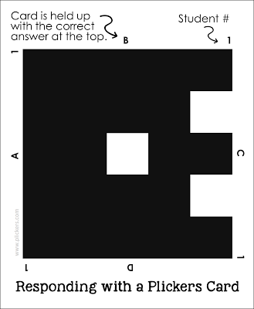
More about Plickers Card
  Each student is given a card with a unique visual code.
  Each side of the card represents an answer choice.
  Students hold the card so that the letter they choose to answer is at the top

Slide 6
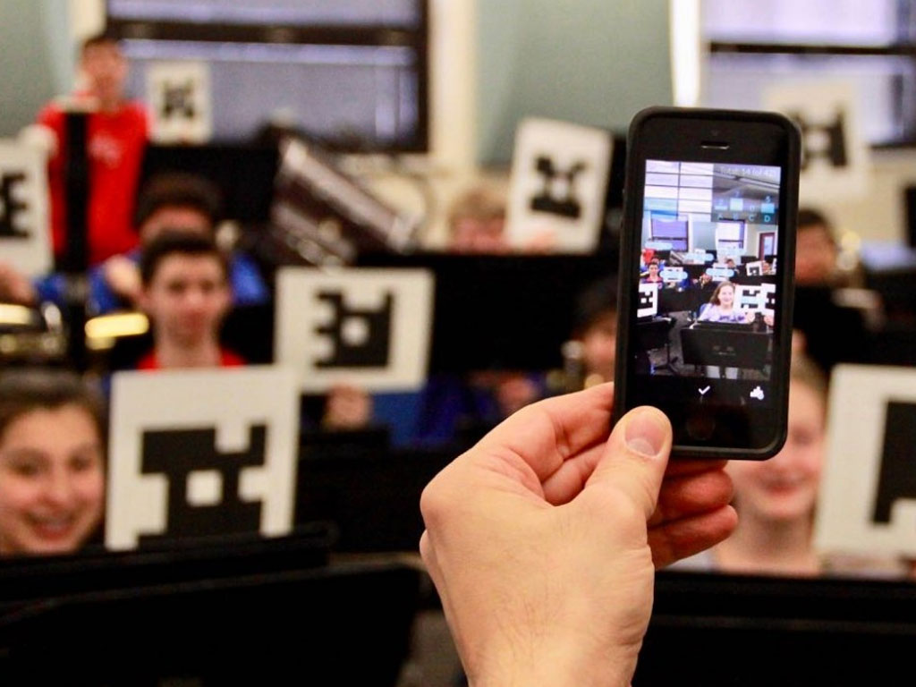
Plickers App
  The teacher uses the app on a smartphone or tablet to scan the card.
  The app recognizes the cards, records, and captures the student's answer.

Slide 7
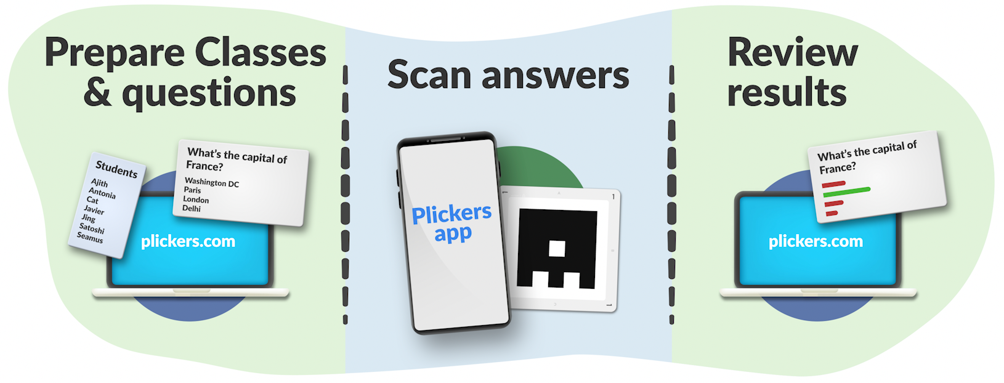
Only the teacher needs the Plickers App; students don't need to download it.
The letters on the cards are small to maintain privacy.
The app records each student's answer once.
Requires a Wi-Fi/mobile data connection to project real-time data.

Slide 8

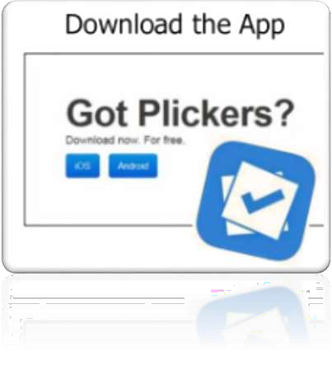
Getting Started with Plickers
https://get.plickers.com/
Sign up for an account

Slide 9
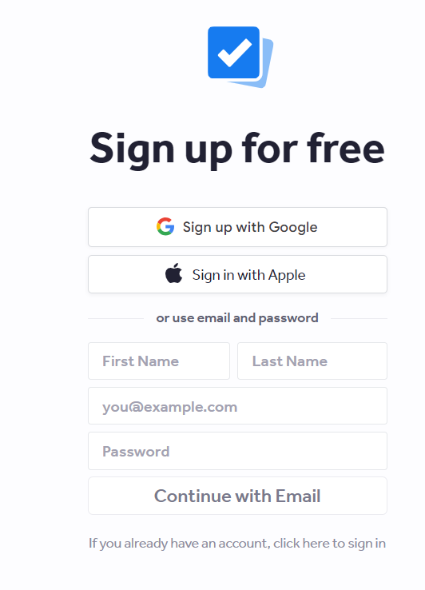
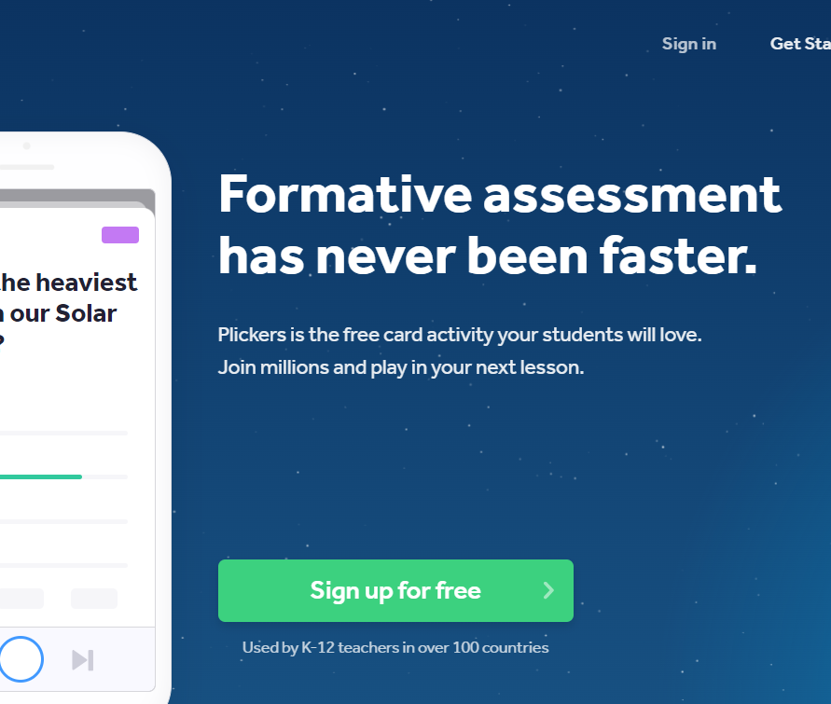

Slide 10
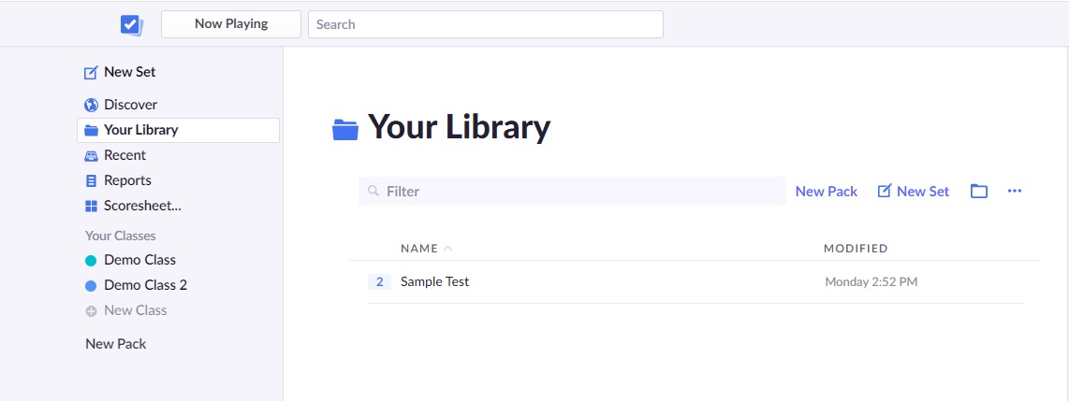
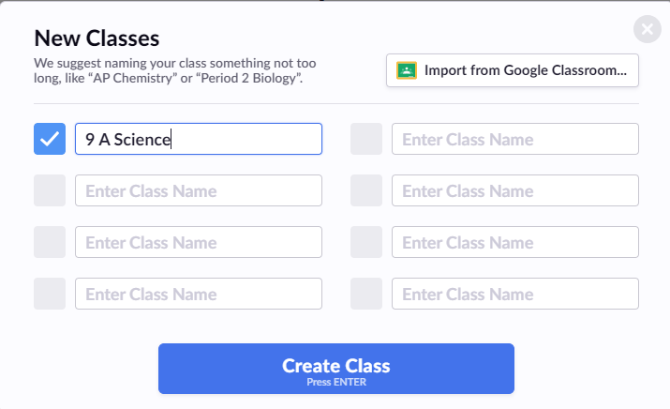

Create a class

Slide 11
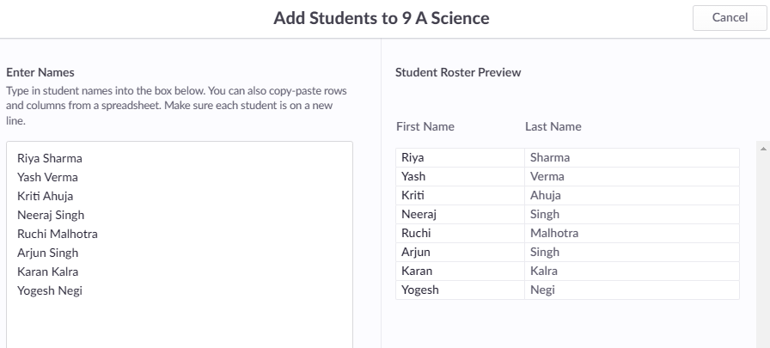
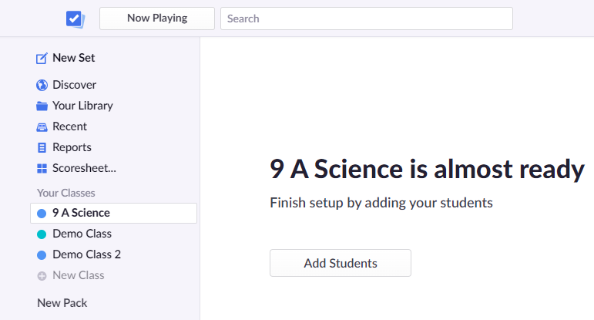
Add Students

Slide 12
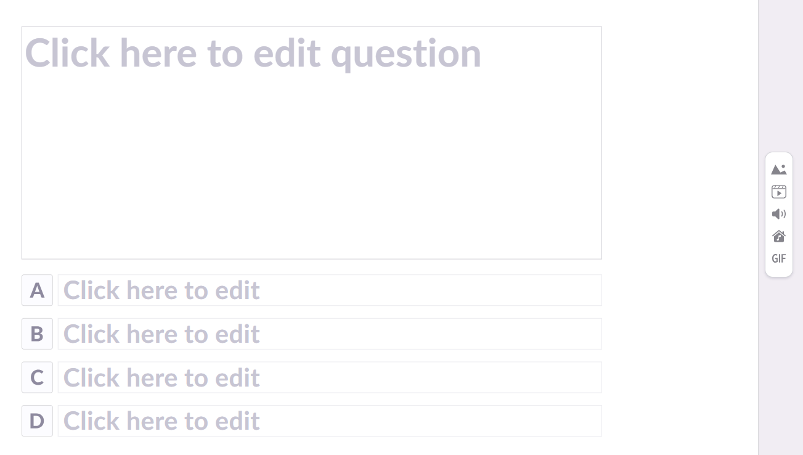
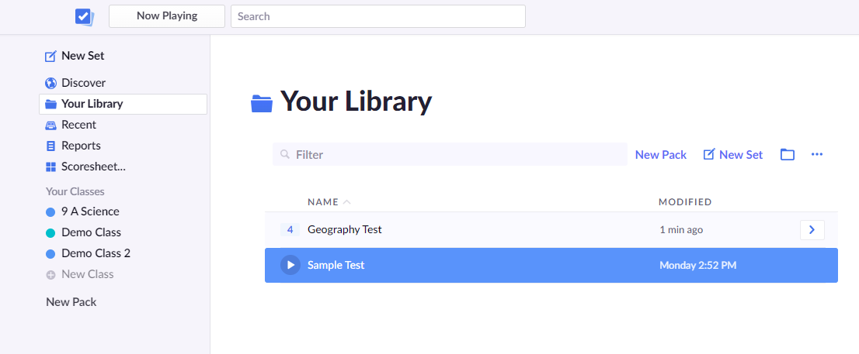
Adding Questions

Slide 13
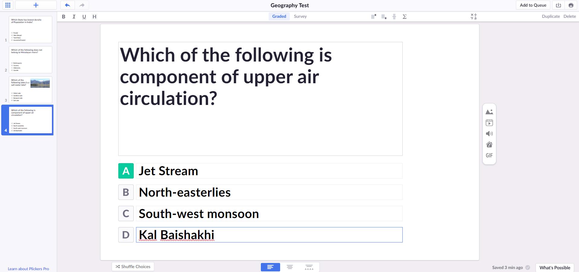
Use Graded if the question has a correct answer, for example formative assessment or test
Use survey if there is no right or wrong answer, for example student feedback or discussion topic
New Question
Import Questions
Print Set
Insert Options
Questions Layout

Slide 14
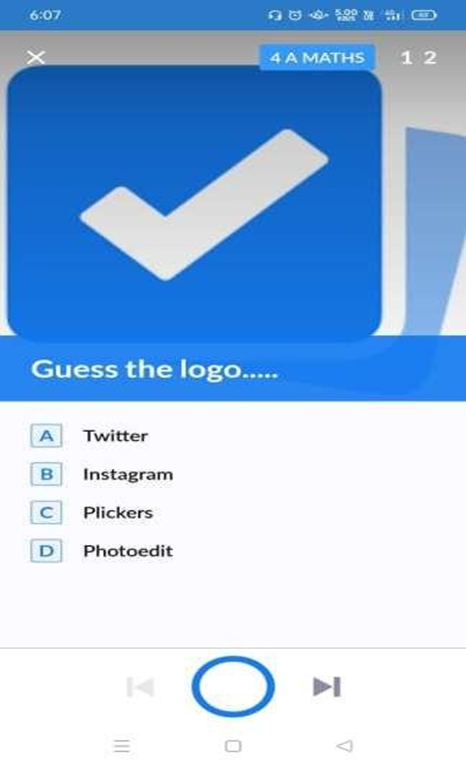
Scan the responses
Select the questions
Tap the camera icon to scan student’s responses.
Use the live view tab to display results
CAMERA

Slide 15

www.plickers.com
LET’S DO HANDS ON PRACTICE ….

Slide 16

Thank you all for participating!

