Slide 1

Mrs. Sona O.K
National ICT Awardee

Slide 2
Contents
Introduction to biteable
Video viewing statitics
Advantages of biteable
How to create an account in biteable
Step by step explanation on creating a video
Video recording
Screeen recording
Creating video using AI

Slide 3
Biteable is an online video editing platform that allows users to create professional-looking videos quickly and easily. It provides a user-friendly interface and a wide range of customizable templates, making it accessible even to those without extensive video editing experience.

Slide 4
Videos are one of the most versatile formats for efficiently transferring information without cognitive extra-efforts. There is no need to read lengthy tutorials or listen to explanations. People can understand a concept much more effectively by just watching animated explainer videos . You shouldn’t also think of the most engaging way to tell about the concept as animated promotional videos can help you do it creatively.

Slide 5
Key features of Biteable include
Templates
Customization:
Drag-and-Drop Interface
Media Library
Preview and Editing:
Exporting and Sharing:
Collaboration

Slide 6
More features….
Create Amazing Animated videos
Convert images to videos
Choose from 4 million pics, clips, and animations
Access to millions of premium video clips from Shutterstock
HD 1080p resolution
Upload your own images and video with full audio support
Voiceover audio layer

Slide 7
How to create an account
in

Slide 8
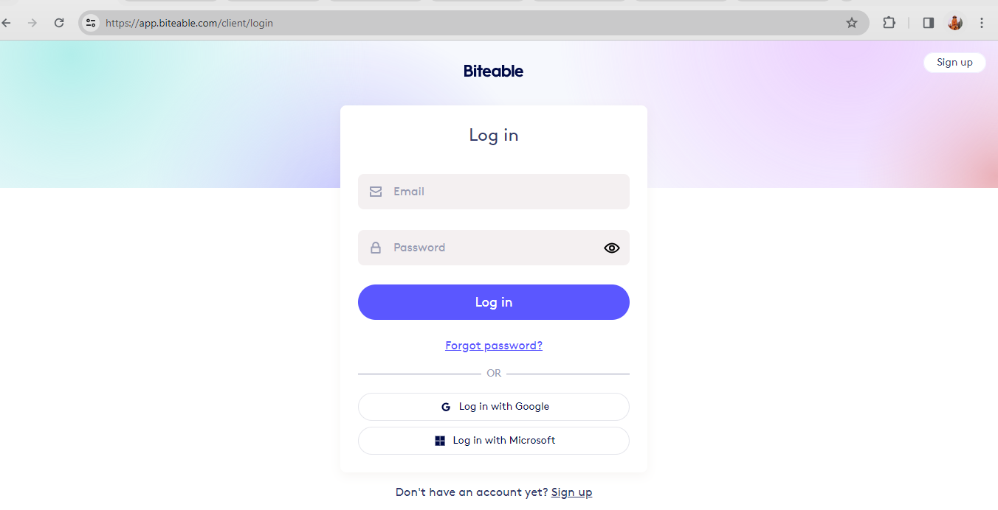

Slide 9
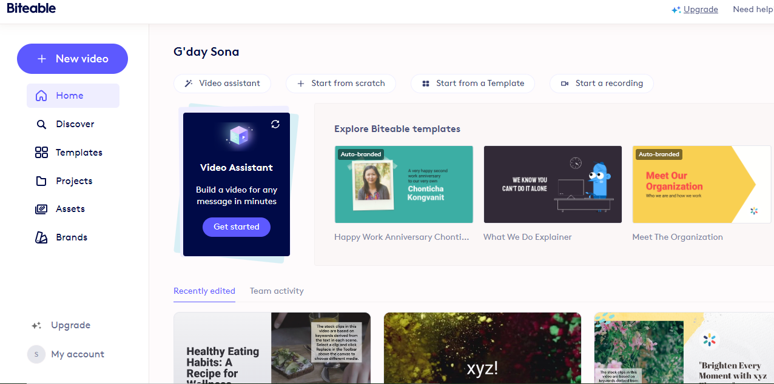

Slide 10
Steps to create a video
in

Slide 11
Step 1 | Choose Your Video Settings
Step 2 | Select Animations
Step 3 | Edit Scenes and Captions
Step 4 | Add New Captions and Logo Captions
Step 5 | Add Text and Logo Animations
Step 6 | Add Scene Transitions
Step 7 | Add Audio and Music
🌟 🌟 🌟 | Add Video with Audio
Step 8 | Build and Share Your video

Slide 12
Step 1
Choose Your Video Settings

Slide 13
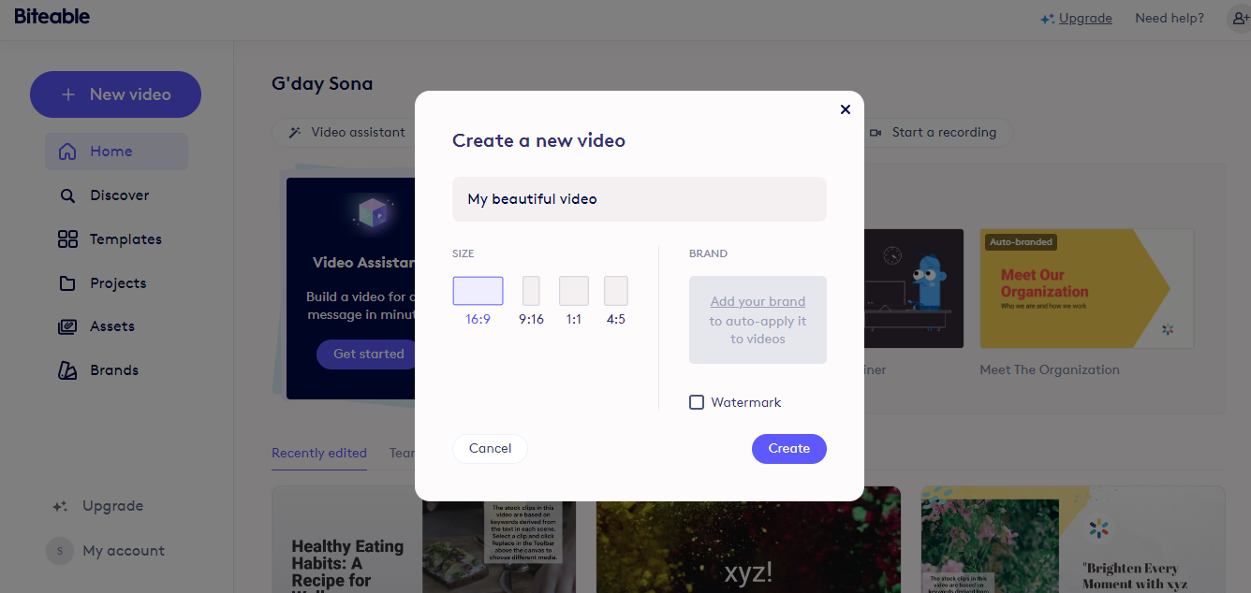

Slide 14
Step 2
Select Animations

Slide 15
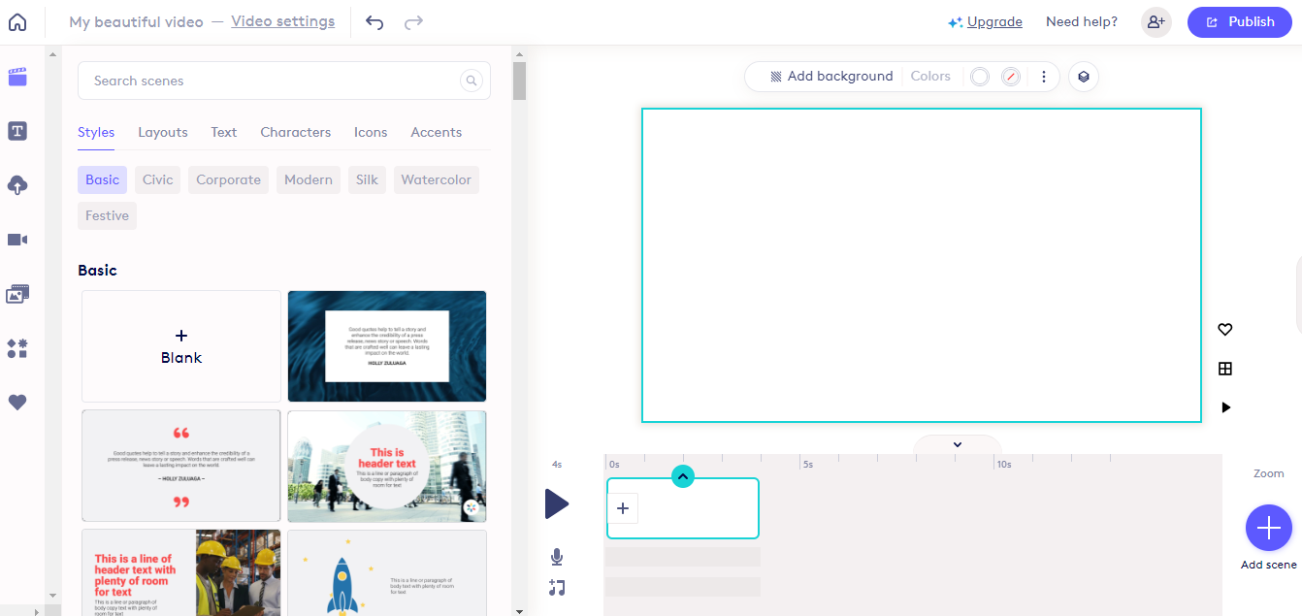

Slide 16
Step 3
Edit Scenes and Captions

Slide 17
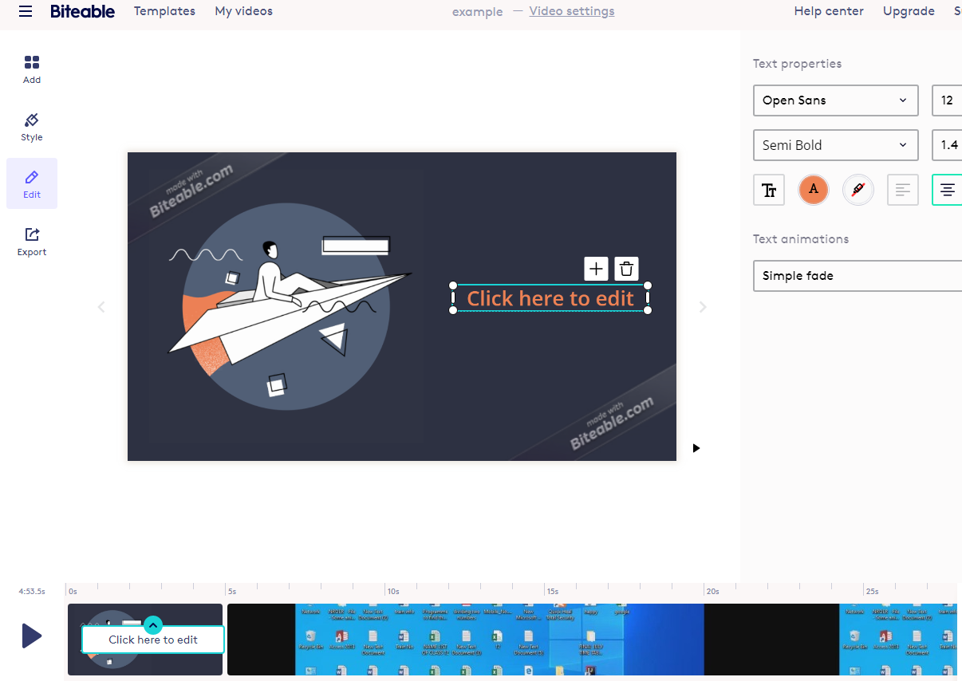

Slide 18
Step 4
Add New Captions and Logo Captions

Slide 19
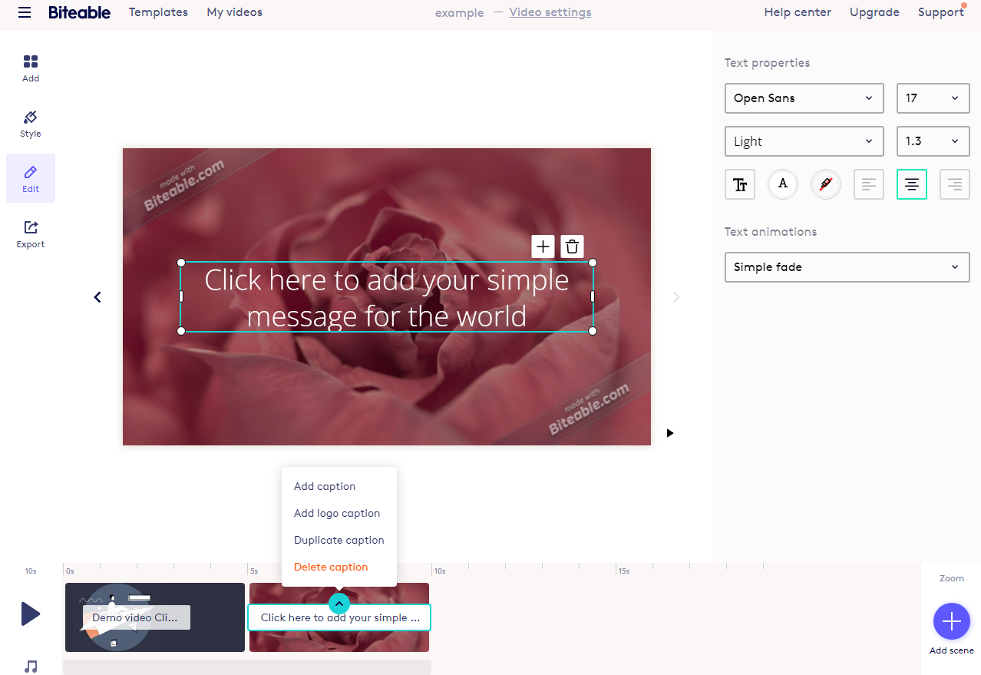

Slide 20
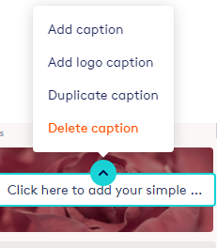

Slide 21
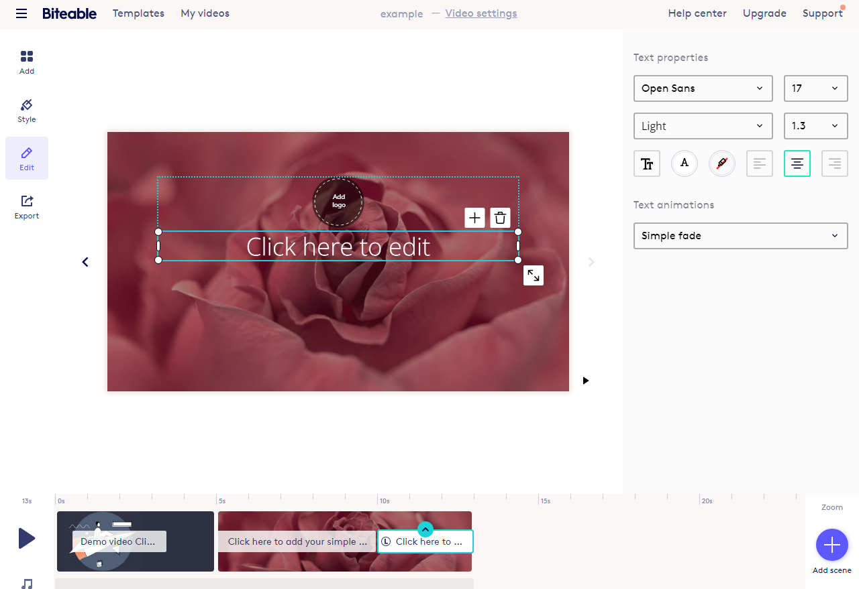

Slide 22
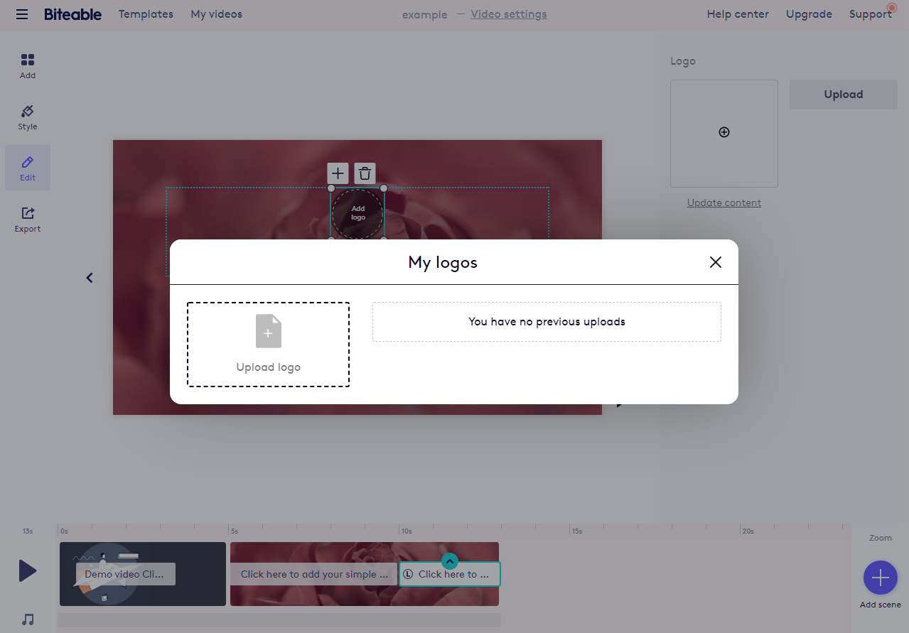

Slide 23
Step 5
Add Text and Logo Animations

Slide 24
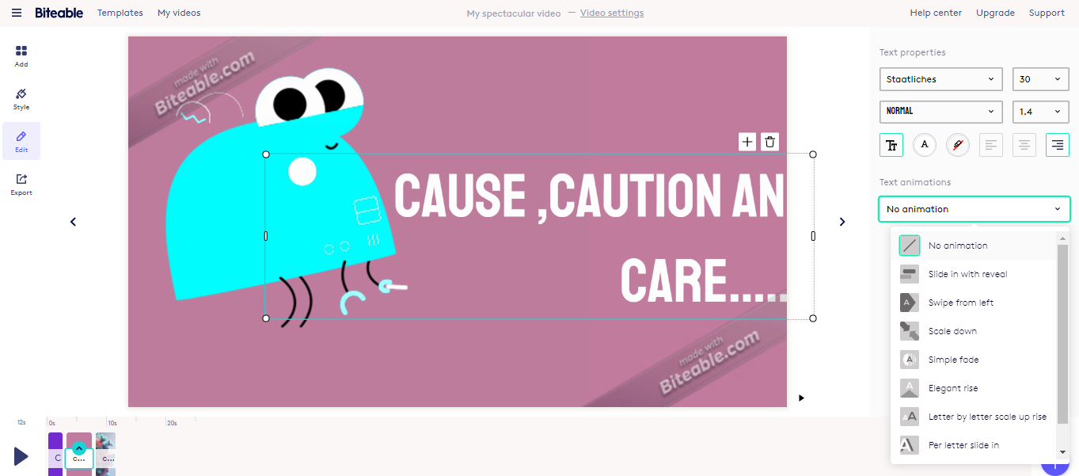

Slide 25
Step 6
Add Scene Transitions

Slide 26
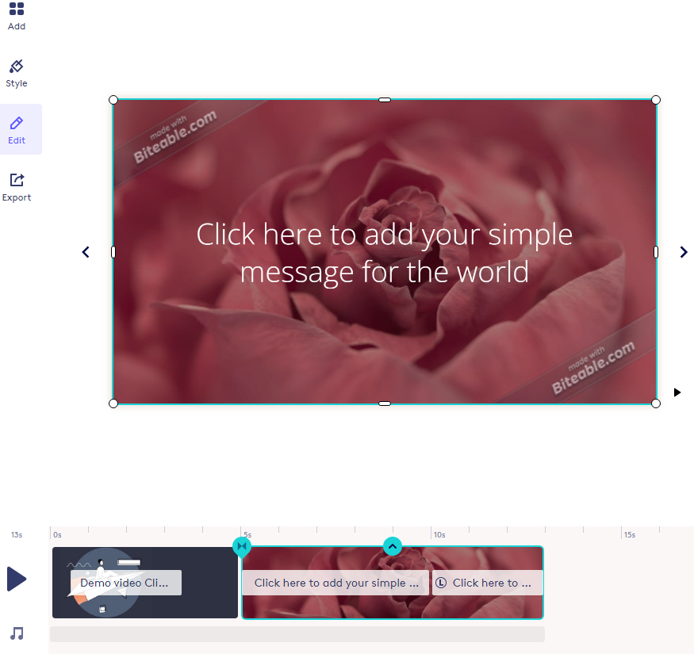

Slide 27
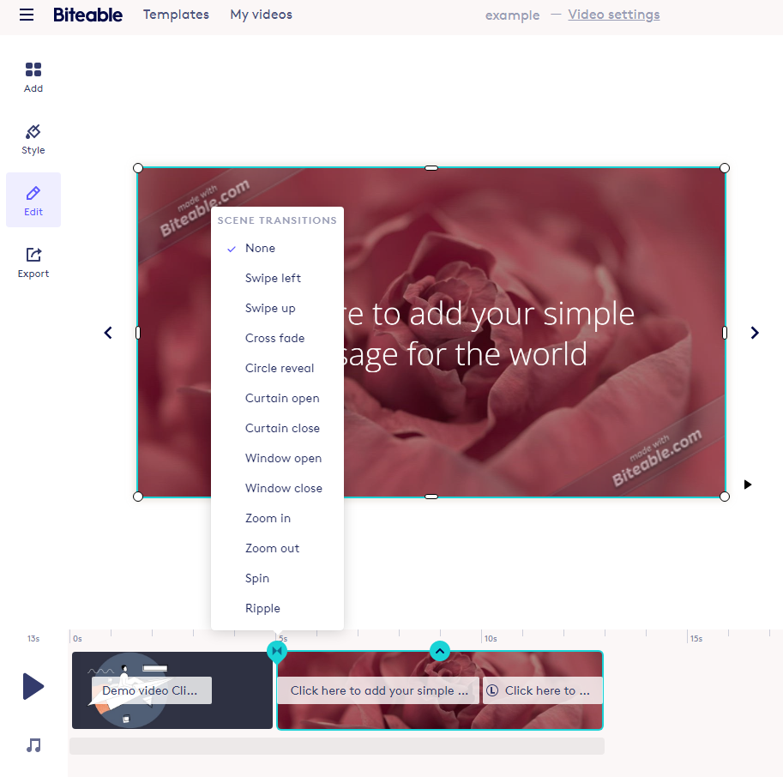

Slide 28
Step 7
Add Audio/Music

Slide 29
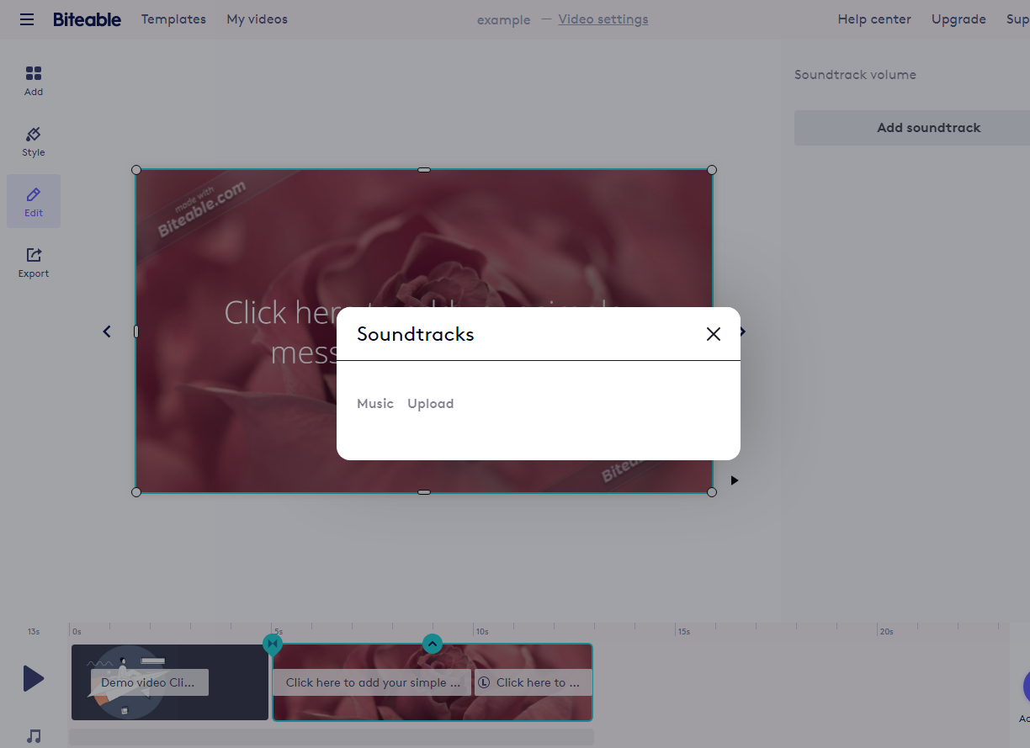

Slide 30
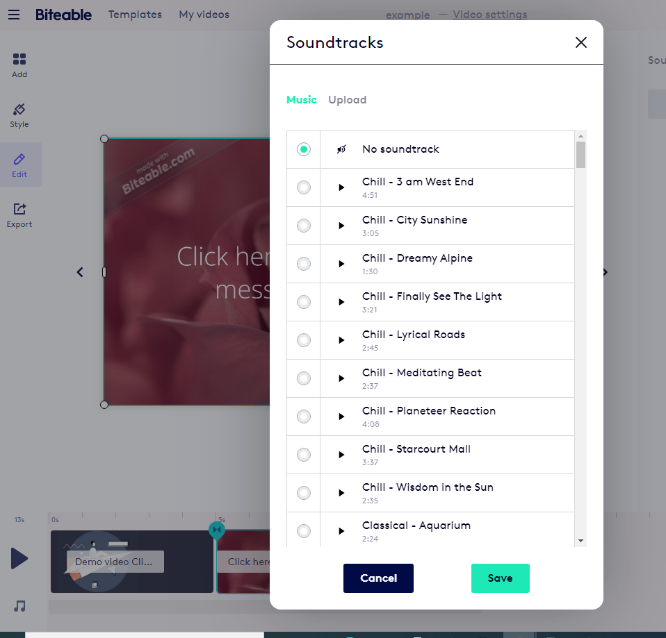

Slide 31
Step 8
Build and share Video

Slide 32
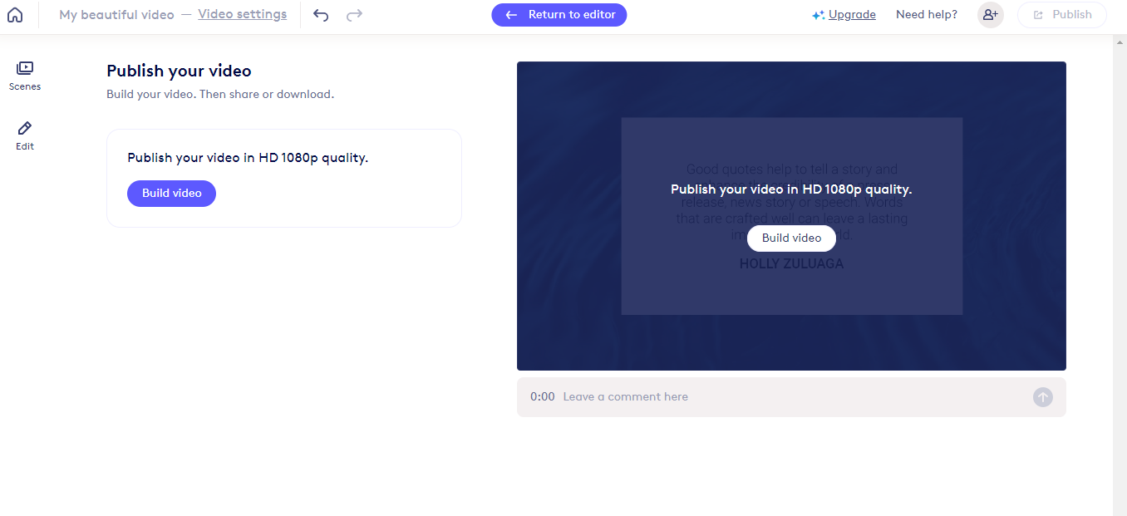

Slide 33
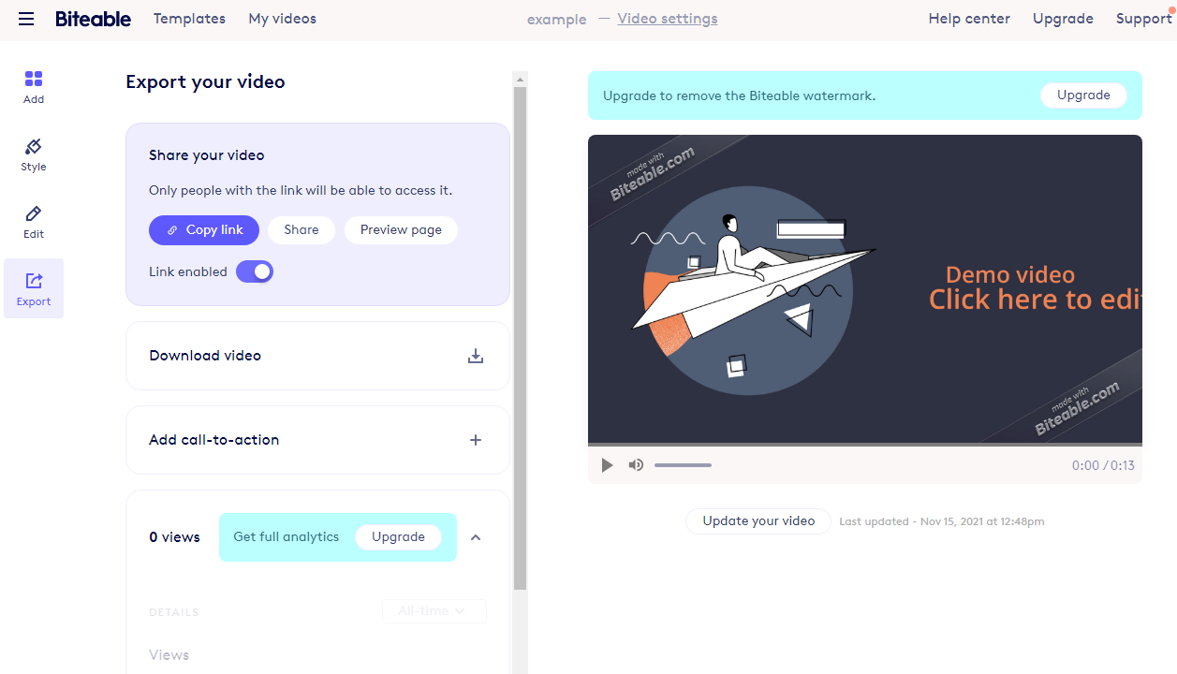

Slide 34
Mrs. Sona O.K
National ICT Awardee

